Slide 1



Perinatal Mental Health September Webinar: Optimizing SUD Care in Perinatal Patients
September 28th, 2026 12:00pm – 1:00pm

Slide 2


Attendance Poll
Please fill out the poll so that we can track hospital team attendance for Perinatal Mental Health Webinars. If unable to complete poll, please email rebecca.ainis@northwestern.edu
4

Slide 3




Staff supporting the Perinatal Mental Health (PMH) initiative!
Rebecca Ainis
ILPQC Project​ Coordinator
Email: rebecca.ainis@northwestern.edu
Kristina Diaz
ILPQC Nurse Quality Manager
Email: kristina.diaz@northwestern.edu
Illinois Perinatal Quality Collaborative

Slide 4
Call Overview
Annual Conference Updates
ILPQC/PMH Announcements
Tracking Progress with PMH Data
Optimizing SUD Care
Presentations / Team Talks
  IL MAR Now; James Kowalsky
  UWNI Swedish American; Courtney Fisk, MSN, RNC-OB, C-EFM
PMH Next Steps

Slide 5
Upcoming ILPQC 14th Annual Conference
The Westin Lombard, IL

Slide 6


Registration is Open!
The Westin Lombard
Hotel Room Block
available on website!
Make sure at least one physician champion, one nurse champion, and a patient partner are there to represent your hospital.

Slide 7


DHS/ILPQC Bedside
Nurse Scholarship Opportunity
Each hospital can send:
1 bedside OB and 1 bedside Neonatal nurse to attend the 14th Annual Conference in Lombard, IL.
Discounted registration available.​
1-night hotel stay provided.​
Scan the QR code to apply! ​
​

Slide 8

ILPQC Patient Partner Opportunity
ILPQC Patient & Parent Partners
working with an ILPQC hospital are invited to
attend the 14th Annual Conference in Lombard, IL.
Reach out to your patient partner to invite them today!
FREE Registration & 1-night Hotel stay will be provided.
Email tochukwu.akujieze@endeavorhealth.org for more information!

Slide 9



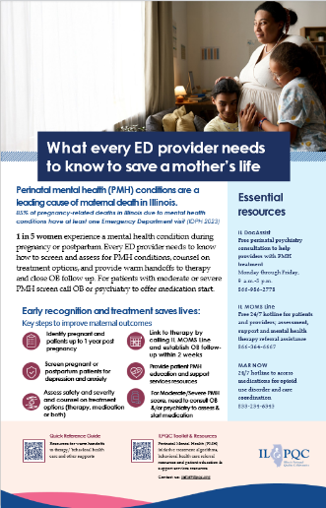
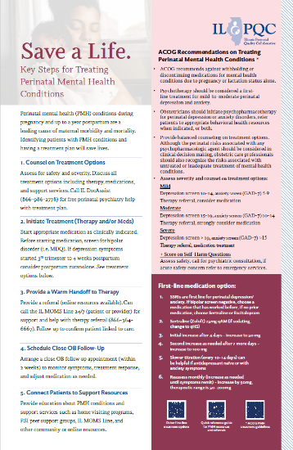
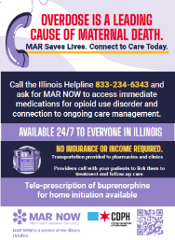

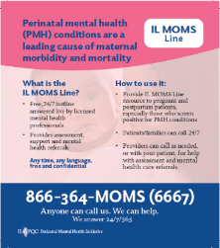
PMH OB/ED Provider Education Campaign
Posters with PMH Workflows
Magnets with state hotlines
Every hospital will receive one campaign kit at Annual Conference.
Please reach out to Rebecca.ainis@northwestern.edu if you’d like to order more copies, ie for outpatient sites, to be picked up at AC!

Slide 10




Safe Sleep Poster Packs are BACK!
Please scan the QR code to place an order for your hospital team!

Slide 11

Upcoming Annual Conference Prep
Submit your Data - due September 15th
Call for QI Abstracts – due October 7th
All hospital teams are asked to submit an abstract on their QI work (can be in progress)! Instructions on ILPQC website.
Submit Birth Quality Designation Application – due September 30th
Highlight your teams incredible work towards achieving Birth Quality Designation!
Apply for the chance to be awarded $10,000-$20,000
All data baseline-August 2026 was due on September 15th, 2026, for award consideration.
Getting ready for Annual Conference: opportunities to share and to celebrate success

Slide 12

14th Annual Conference
QI Abstract Submission
WHO? All hospital teams are encouraged to submit an abstract on complete or in-progress perinatal quality improvement (QI) work.
WHAT? Your abstract briefly describes your QI work and will be the foundation for a poster that your team creates to display and share at the ILPQC 14th Annual Conference Poster Session.
HOW? Submit your written abstract using the submission form below.
  All abstracts are accepted. After you've submitted your abstract, develop a poster (instructions in form)
Deadline: October 7th
Questions? Email info@ilpqc.org

Slide 13





ILPQC Share the Love Donation Drive
Bring donation items for our Share the Love drive supporting families served by the Outreach House. Top-need donations include:
Diapers & wipes (all sizes)
Sleep sacks/swaddles
Infant clothing (0–12 months)
Unopened formula or baby bottles
Toiletries/self-care items for parents & caregivers
Together, we can “Share the Love” and help families meet newborn needs with dignity and care.
Your support helps sustain their incredible impact — distributing over 20,000 diapers each month and providing essentials for families with young children.

Slide 14
PMH QI Excellence Awards
ILPQC is excited to celebrate teams who have achieved QI Excellence by meeting the following criteria:
Schedule a 1:1 with Rebecca to review your team’s progress!
Measure | Goal
Structure measures | 14/14 in place
Depression and anxiety screening during delivery hospitalization* | 80%
Depression and anxiety screening during prenatally | 70%
Clinicians receiving PMH education and training* | 80%
Patients provided PMH education before delivery discharge | 80%
Patients who screened positive for PMH conditions counseled and /or provided PMH treatment (therapy/medication or both) | 80%
Patients who screened positive for PMH conditions with an early OB follow-up visit scheduled | 80%
* These measures are also included in the Birth Quality Designation Award criteria

Slide 15


ILPQC Announcements
23

Slide 16

Complete the Family Care Plan Survey
The State of Illinois wants to hear from you!
This survey is part of a statewide effort to improve the care of pregnant and postpartum individuals with substance use, and substance-exposed infants.
This initiative seeks to increase participation in substance use treatment for pregnant and post-partum individuals, and to reduce families’ involvement in the child welfare system, while maintaining child safety.
Your responses on this survey will contribute to decisions regarding training, resources, and services provided by public and private organizations statewide.
It should take 10 minutes
The survey will be open until 9/31/26
Scan here!
Illinois Perinatal Quality Collaborative

Slide 17

Recognition for OB Providers Engaging in your PMH Initiative
Help them get ABOG credit for QI work
The PMH Initiative is an approved ABOG Continuing Certification Part IV activity
Steps to receive ABOG QI credit: Must be completed by November 15th
Identify providers who meaningfully participate in your PMH initiative QI work (OB QI Lead)
Scan and submit form below in REDCap describing provider participation in PMH initiative
ILPQC approves and sends provider and QI team certificate of completion
Provider applies for Continuing Certification in ABOG portal by November 15th
Provider selects ILPQC PMH initiative as Part IV requirement for QI activity and uploads certificate of completion
Complete the short attestation form for each OB provider by September 30th :
Another opportunity to engage OB provider participation on your PMH QI team
Illinois Perinatal Quality Collaborative

Slide 18
Updated PMH Webinar Schedule!
October Webinar
No October webinar, See you at Annual Conference!
*November 30th, 2026, 12:00-1:00pm
Combined Nov/Dec call, Perinatal Loss and Trauma Informed Care
December Webinar
Happy Holidays!
*Note the updated date!!

Slide 19
Tracking Progress with PMH Data
Reviewing Data through August

Slide 20
Teams are engaged and working hard to improve PMH care across IL!
91% of hospital teams submitted August 2026 data!
We can’t wait to celebrate our QI Excellence Award winners in November!
174 attendees at the July PMH webinar
Illinois Perinatal Quality Collaborative

Slide 21
PMH Structure Measures
Systems changes achieved to provide optimal PMH care
23

Slide 22


Creating PMH Systems Changes
Moving to Green on Screening, Treatment, and Linkage to Follow-up
Hospital has protocol to screen all patients
Hospital has process flow to provide treatment for + PMH screens
Hospital has process flow to link + patients to behavioral health care

Slide 23

Getting to Green for PMH Structure Measures
Structure Measures | How to Get to Green
OB Staff Education | Select education components Have a process in place for providing education Have a process in place for tracking and reporting completion
ER Staff Education | Select education components Have a process in place for providing education Have a process in place for tracking and reporting completion
PMH Access Workgroup | Identify workgroup members Establish aims for workgroup Workgroup has held its first meeting
Patient Education | Select education components for patients and families Include information on hotlines Establish process to share education materials with all postpartum patients before delivery discharge
Sharing Patient Education With Outpatient Settings | Select patient education resources to share Identify contacts at outpatient settings Establish process to share education materials with outpatient settings
Access more detailed document here:

Slide 24
Getting to Green for PMH Structure Measures Cont.
Structure Measures | How to Get to Green
Sharing Screening Tools and Algorithms With Outpatient Settings | Select PMH materials Identify contacts at outpatient settings Establish process to share PMH materials with outpatient settings Encourage clinics to update screening/treatment workflows
Identify a Patient Partner | Identify a patient partner with lived PMH experience. Onboard patient partner to PMH QI team Identify a main contact on your QI team to connect with your patient partner
Screening Workflow | Identify and trial screening tools including depression, anxiety screening, bipolar screen Establish screening process flow based on PDSA cycle(s). Establish process for documenting screening results.
Treatment Workflow | Identify and trial process for OB providers to see patients who screen positive. Establish process to share key PMH treatment resources with OB providers for + screen Establish process to share process flow and steps for optimal PMH care with OB team
Referral to Link Patients to Behavioral Health Care | Map community behavioral health resources available for your patients. Establish process flow to provide warm handoffs to therapy for patients who screen positive. Establish process for utilization of IL MOMS Line to support follow up mental health care.
Identify and Implement Innovative Strategies | Work with PMH multidisciplinary inpatient / outpatient workgroup to identify barriers and innovative strategies for behavioral health care follow up for your patients. Trial and implement an innovative strategy to address barriers to behavioral health care.

Slide 25
PMH Process Measures
23

Slide 26
Clinical Team PMH Education:
OB staff and ER staff
So much amazing progress in clinician education!!
What are your next steps to increase education?
Who can you engage to help increase education rates across OB and ER?
Do you have the ER module C to share with ER teams? Do you have the ACOG e-module for OB? Consider grand rounds for ER staff / OB staff?
90.1%
Goal: 80%
77.0%
66.7%
58.0%

Slide 27
PMH Screening During Delivery Hospitalization
Monthly data from a random sample of all delivered patients
90.4%
Goal: 80%
81.4%
Both screening rates are above 80%! Great work!
Review depression / anxiety response to + screen to confirm clinical teams are responding to both + depression and +anxiety screens, do providers get results identified by score as mild/moderate / severe?

Slide 28
Great opportunity to engage outpatient prenatal care sites – confirm documenting PMH screens and sharing with L&D!
Use random sample data, identify which sites are not documenting prenatal PMH screens & give feedback
PMH Screening Prenatally
Monthly data from a random sample of all delivered patients
Goal: 80%
70.8%
55.1%

Slide 29
Patient PMH Education
Monthly data from a random sample of all delivered patients
87.6%
Goal: 80%
We’ve achieved 80%! Great work!
Can you hit 100% of patients and sustain your efforts?

Slide 30
PMH Outcome Measures
23

Slide 31
% patients + PMH screen with offered/linked to therapy
Monthly data from random sample of patients with positive PMH screen
Great opportunity to use Fall Out Review Form to review +PMH screen cases for optimal PMH care
Steady Progress!
Total:
72.7
Goal: 80%
Total:
69.3
Total:
62.6
Total:
49.7
Total:
53.1
All patients with + PMH screens should be counseled on treatment options (therapy, medication or both) and offered therapy & provided warm handoff
Total:
41.1

Slide 32
% patients + PMH screen offered/provided medication
Monthly data from random sample of patients with positive PMH screen
Use new OB Provider PMH Education Posters in OB spaces, PMH order sets, PMH Purple Folder, Fall Out case review feedback to drive clinical culture change for OB providers, need to assess & counsel treatment options for all patients with + screen
Goal: 80%
Total:
60.9
Total:
57.8
Total:
58.4
Total:
60.8
Total:
60.3
Total:
53.8
100% of patients with + PMH screen should be counseled and offered treatment (therapy, medication or both). How do you help your OB providers do this for every +PMH screen?

Slide 33

% of patients with +PMH screen offered/provided treatment & follow up
Monthly data from random sample of patients with positive PMH screen
Reference the Optimal PMH Care flyer to provide optimal PMH care every time!
Goal: 80%
Percent
Goal is optimal PMH care every patient every time
Incredible work on this!
Review charts and confirm optimal PMH care using Fall Out Review Forms
Confirm counseling includes: therapy, medication or both for all patients and warm hand-offs to therapy & close follow up

Slide 34
% of patients with +PMH screen early OB follow-up visit scheduled
Monthly data from random sample of patients with positive PMH screen
Review fall out cases and provide follow up to OB clinical team where they can improve providing optimal PMH care!
Goal: 80%
Percent
100% of patients with + PMH screen should have close OB follow up scheduled within 2 weeks
Illinois Perinatal Quality Collaborative

Slide 35
Optimizing Substance Use Disorder Care

Slide 36
PMH Key Drivers Diagram
Drivers
Change Ideas / System Changes
Optimize SUD Care
Establish a process flow for treatment/linkage to recovery treatment services for positive perinatal SUD screens in OB/ER settings, including utilization of IL DocAssist and MAR Now.
Improve risk reduction for SUD through participation in DOPP to access and distribute free naloxone/Narcan kits for pregnant/postpartum patients at risk of overdose.

Slide 37
Revisiting Strategies From ILPQC’s Mothers and Newborns (MNO) Affected by Opioids Initiative (2018-2020)
AIM: Optimize the care of mothers with opioid use disorder (OUD) and their infants during the prenatal and postpartum periods by providing screening and comprehensive care.
Early screening for all pregnant women (SBIRT)
Linage to Care: Access to OUD Tx Programs
Optimize Care for Women with OUD: Best practices in clinical care
Provider education
Patient education and engagement
Prevention
MNO 6 Key Strategies

Slide 38
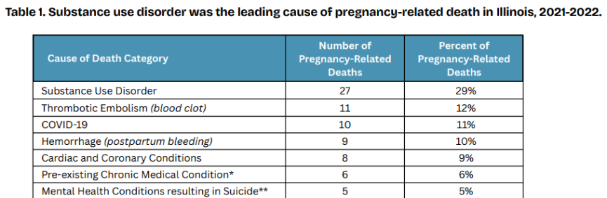

Perinatal SUD: The Problem
5% of pregnant women use one or more addictive substances
Co-occurrence of PMH conditions and perinatal SUD is common
Pregnancy-related deaths due to PMH condition or SUD are preventable

Slide 39
ILPQC Hospitals Are Screening for SUD/OUD and Improving on Linkage to Resources

Slide 40
Creating PMH Systems Changes
Moving to Green on SUD Measures
Hospital has a treatment process flow for SUD in the OB
Hospital has a treatment process flow for SUD in the ED
Participation in DOPP

Slide 41
Getting to Green for PMH Structure Measures Cont.
Structure Measures | How to Get to Green
Process Flow for Linkage to Recovery Treatment Services in OB for Positive SUD Screens | Establish protocol and process flow for utilizing IL DocAssist and MAR Now for positive SUD screens during delivery hospitalization. Share resources for IL DocAssist and MAR Now with OB clinical team members. Post flyers, posters, or magnets in OB clinical team spaces.
Process Flow for Linkage to Recovery Treatment Services in ER for Positive SUD Screens | Establish protocol and process flow for utilizing IL DocAssist and MAR Now for positive perinatal SUD screens (pregnancy and up to a year postpartum) for ED visits. Share resources for IL DocAssist and MAR Now with ED clinical team members. Post flyers, posters, or magnets in ED clinical team spaces.
Participation in DOPP | Register your hospital with DOPP and order Narcan kits for distribution. Establish a protocol and process flow for distributing free Naloxone.
Access more detailed document here:

Slide 42
Providing Optimal SUD/OUD Care
23

Slide 43




What do we need every
OB Provider to know about OUD?
Opioid Use Disorder is an urgent obstetric issue
Opioid Use Disorder is a life-threating chronic disease with lifesaving treatment available, reducing stigma improves outcomes
There are key steps OB providers need to take prenatally and on L&D to care for women with Opioid Use Disorder
Linking moms to MOUD / Recovery Services
Reduces overdose deaths for moms
Improves pregnancy outcomes
Increases # women who can parent their baby

Slide 44

What Does Optimal SUD/OUD Care Look Like?
  Screen every patient for SUD/OUD
  Assess all SUD/OUD+ patients’ readiness for treatment
  Start MOUD/link to Recovery Treatment Program
  Complete OUD Clinical Care Checklist
  Counsel for Narcan if OUD+
  Schedule close OB follow-up within 2 weeks

Slide 45

OUD SBIRT/Clinical Algorithm
Provide Universal SUD/OUD screening with validated tool
OB provider to see patient, provide brief intervention to assess diagnosis, counsel risks, assess readiness for treatment
(SBIRT Counseling)
+ Risk factors: provide brief intervention discuss risk reduction
Screen positive
SUD/OUD
Start OUD Clinical Care Checklist
Access the algorithm here:
Withdrawal symptoms &/or ready to start MOUD
Unclear if MOUD indicated, Not ready to start MOUD or
Outpatient MOUD available
Document OUD in problem list :
099.320
Admit to hospital for Fast-Track MOUD start
Hep C screen
Narcan Counseling
Serial Tox screen w/ consent
Neo/Peds consult
Social Work Consult
Anesthesia consult
MFM consult
Contraception counseling
Initiate outpatient stabilization with Social Work support
Bill for SBIRT:
< 30 min G0396
> 30 min G0397
Stabilize MOUD and discharge to Recovery Treatment Program
Warm Handoff to Behavioral Health/ Recovery Treatment Program
Close OB follow up every 1-2 weeks (pregnancy and postpartum)
Provide standardized patient education: OUD/NAS, mom’s important role in care of opioid exposed newborn (breastfeeding, rooming in, eat-sleep-console)
Inpatient Treatment Program
Intensive Outpatient Treatment
Behavioral Health Treatment Support
Peer Support Program
IL OUD Hotline (MAR Now)
MOUD/Recovery Treatment help:
1-833-2-FINDHELP
IL Doc Assist for free Perinatal OUD Addiction Med Consult:
1-866-986-ASST (2778)

Slide 46

OUD Clinical Checklist
OB providers should use OUD checklist prenatally and during delivery admission
Consider systems that include checklist in EMR as a dot phrase or order set
Link the checklist to the screening tool
How can the OUD checklist be implemented outpatient / inpatient for every OUD patient?

Slide 47
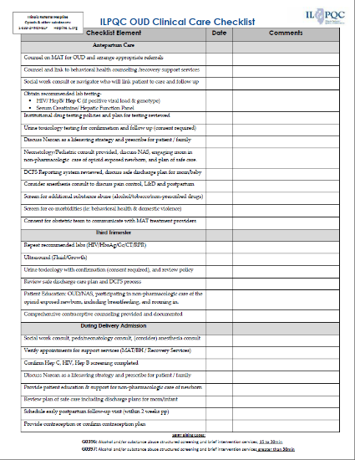

ILPQC OUD Clinical Care Checklist
Engaging providers to utilize this tool for every OUD screen+ will help move your data forward!
Access the checklist here:
Examples of checklist items:
Narcan counseling and prescription
Contraception counseling and plan
Hep C screening
Pediatric/neo consult completed
Social work consult completed
Standardized education provided on NAS and the mom’s important role in newborn non-pharmacologic care

Slide 48
Resources to Optimize SUD/OUD Care
23

Slide 49


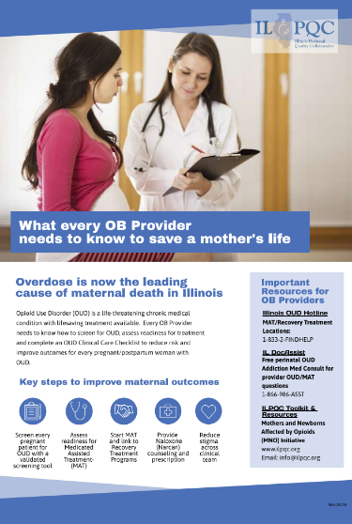
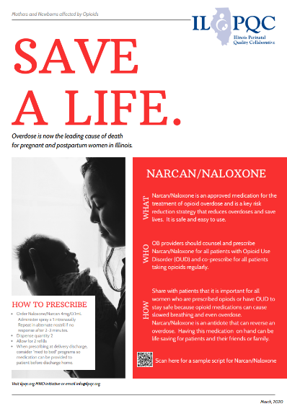
ILPQC Mothers and Newborns Affected by Opioids Education Campaign Posters
Access materials here:

Slide 50
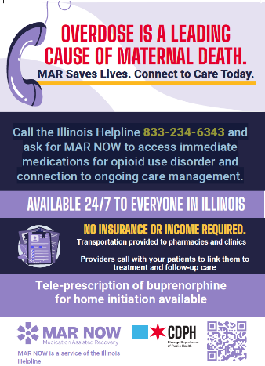

Call the Illinois Helpline 833-234-6343 and
ask for MAR NOW to access immediate
medications for opioid use disorder and
connection to ongoing care management.
MAR Now
What is MAR Now?
Free, 24/7 hotline answered live by a healthcare professional for patients with OUD/AUD to call
MAR Now offers medication on demand to Illinois residents seeking treatment for OUD and AUD
MAR Now also provides in-person or telehealth appointments, transportation assistance to pharmacy or clinic, and coordinated follow-up
833-234-6343
Magnets and flyers available!

Slide 51


Call Illinois DocAssist M-F 9AM – 5pm with ANY questions around diagnosis, treatment, or follow up for patients with mental health or substance use conditions
Illinois DocAssist
What is Illinois DocAssist?
Consult line for free perinatal mental health technical/clinical support for all Illinois clinicians (not a patient line)
Psychiatric consultants can quickly assist you with addressing the mental health and substance use of perinatal women over the phone.
Available to all clinicians Monday through Friday, 9–5pm. During non-business hours, messages can be left and will be answered the next business day.
866-986-2778

Slide 52
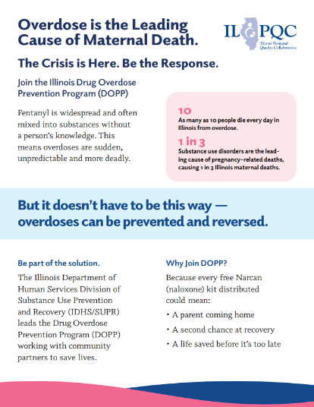
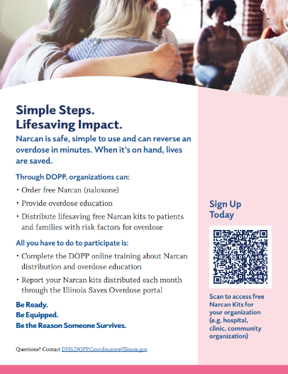


Providing Free Narcan to Patients Through the DOPP Program
Access the flyer here:
Share Angel’s Story

Slide 53
Presentation
MAR Now
James Kowalsky
23

Slide 54
Medication Assisted Recovery
(MAR) NOW
Illinois Perinatal Quality Collaborative (ILPQC)
September 28, 2026
Notes:
Outpatient care providers, OB unit hospital care teams, Emergency Department care teams, and community organizations serving pregnant and postpartum individuals
Taking Action to Improve Linkage of Pregnant and Postpartum Patients to Perinatal Mental Health Care Across OB Care Settings
This webinar will provide practical strategies and resources to help link pregnant and postpartum patients experiencing perinatal mental health conditions to follow up treatment and behavioral health care, including utilization of innovative strategies and statewide supports. We were hoping to highlight key PMH state resources and wanted to see if someone from MAR Now could speak about MAR Now on the webinar.

Slide 55
James Kowalsky, MSW
Integrated Recovery Support Services Administrator
Illinois Department of Human Services, Division of Behavioral Health & Recovery (IDHS-DBHR)
Email: James.Kowalsky@illinois.gov
Cell: 312-858-0360

Slide 56
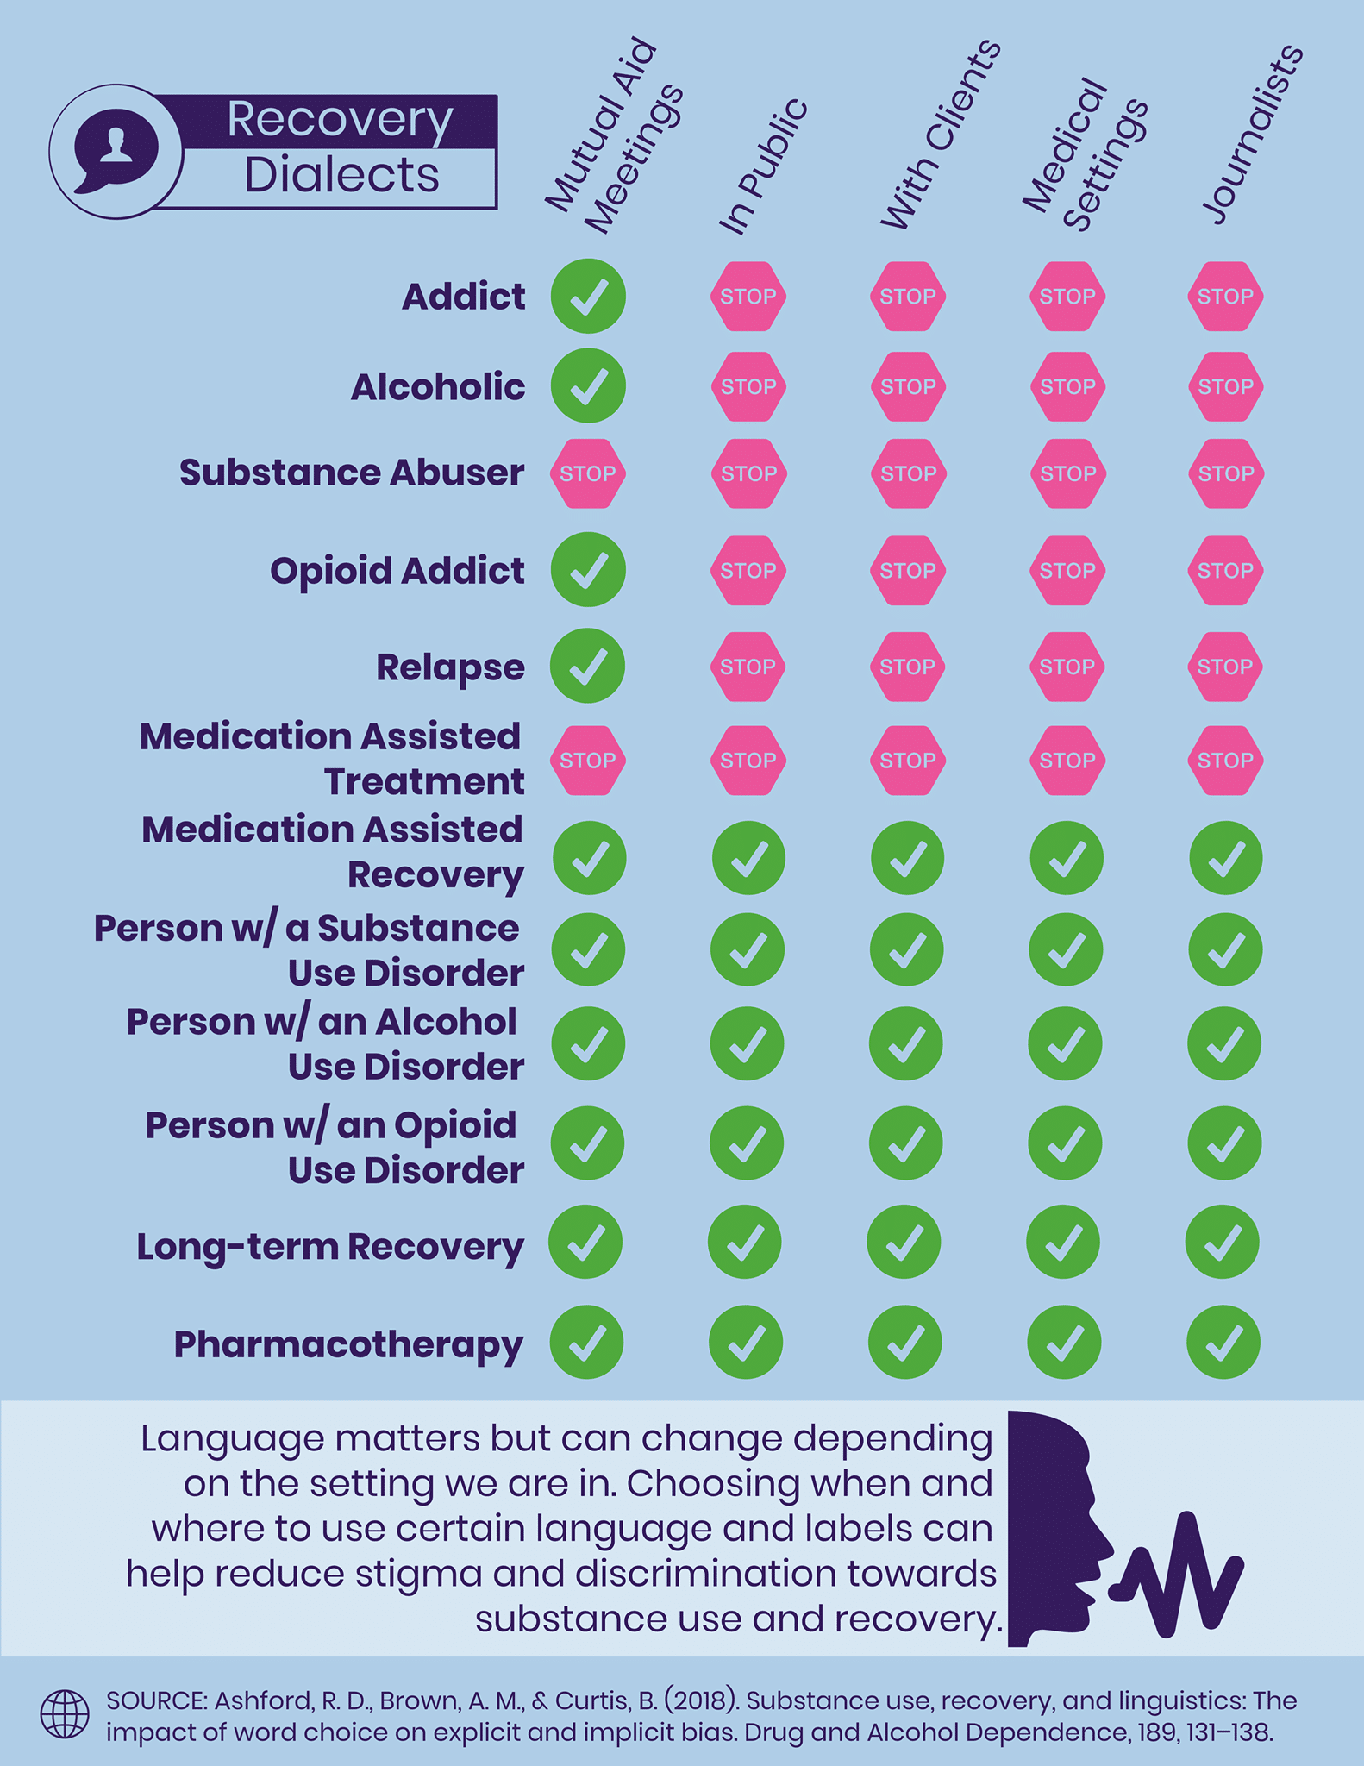
Language Influences Attitudes
Notes:
Other language: pharmacotherapy, Medication for Addiction Treatment, Medications for Opioid Use Disorder

Slide 57
Maternal Mortality and Substance Use
The leading cause of pregnancy-related death in Illinois is substance use disorder
Roughly 1 in 3 pregnancy-related deaths are caused by substance use disorder and overdose
Most pregnancy-related deaths due to substance use disorder involved opioids
There are ways to reduce risk of overdose
IDPH, 2023; IDPH, 2025
Notes:
https://dph.illinois.gov/content/dam/soi/en/web/idph/publications/idph/topics-and-services/life-stages-populations/maternal-child-family-health-services/maternal-health/maternal-mortality-data-report-2025.pdf
Pregnancy-Associated Death: The death of a woman during pregnancy or within one year of the end of a pregnancy from any cause.
Pregnancy-Related Death: The death of a woman during pregnancy or within one year of the end of a pregnancy from a pregnancy complication, a chain of events initiated by pregnancy, or the aggravation of an unrelated condition by the physiologic effects of pregnancy. These deaths are a subset of pregnancy-associated deaths

Slide 58
Medication Assisted Recovery (MAR)
MAR is the use of FDA-approved medications to
treat substance use disorders.
As compared to behavioral therapy with placebo or no medication, MAR for an opioid use disorder (OUD)
  Reduces illicit opioid use
  Retains people in treatment
  Reduces risk of opioid overdose death and all-cause mortality (methadone and buprenorphine)
“Discussing medications that can treat OUD with patients who have this disorder is the clinical standard of care.”
SAMHSA, TIP 63, 2021
Notes:
Push it in hospitals for inpatient discharge, jails and corrections to help with coordinating follow up services. It supports anyone who needs help 24/7.

Slide 59
Medication Assisted Recovery (MAR) Now
MAR NOW provides low-barrier access to medications to treat alcohol or opioid use disorders within 48 hours of calling the Illinois Helpline
Patient Options:
Home induction (buprenorphine)
Same or next-day MAR appointment (methadone, buprenorphine, naltrexone)
Connection to other services in the community (withdrawal management, residential treatment)
Individual calls IL Helpline for treatment or withdrawal support
IL Helpline transfers caller to MAR NOW Care Manager
24/7 Access
Connected to Care Manager & Provider
833-234-6343​
Care Managers provide free transportation, insurance enrollment, assistance with pharmacy access, and follow up to ensure patient is connected to long-term care
Notes:
Alcohol and opioids
Includes both Methadone (requires in person) and buprenorphine (telehealth only)
Spokes for MAR – FGC in Northern Illinois, Carle Hospital in Central Region, SIU Hospital in Southern Region
Pioneering program with national implications
Funded by CDPH and DBHR
Used by ER docs, private practice, callers can also request for themselves or others
>90% of patients receive medication and attend follow-up appointments

Slide 60



Call, Text, or Visit the Illinois Helpline
  Order Free
  Helpline Materials
Notes:
Helpline staff are trained to help identify appropriate services and level of care. Healthcare providers (doctors, nurses) can call the Helpline as well. If you’re not sure about MAR, Helpline staff can counsel on the options.

Slide 61
MAR NOW: Annual Data
Year | Calls Transferred to MAR Now | Monthly Average Calls Transferred | Number of People Seeking Medication | Monthly Average Seeking Medication | % of Callers Seeking Medication | Number of People Started on MAR | Monthly Average Started on MAR | % of People Seeking Started on MAR
SFY23 | 823 | 91 | 534 | 59 | 65% | 512 | 57 | 96%
SFY24 | 2,604 | 217 | 1,787 | 149 | 69% | 1,660 | 138 | 93%
SFY25 | 4,280 | 357 | 2,612 | 218 | 61% | 2,330 | 194 | 89%
SFY26 | 4,536 | 378 | 2,740 | 228 | 60% | 2,609 | 217 | 95%
Total | 12,243 | 272 | 7,673 | 171 | 63% | 7,111 | 158 | 93%
Note: State Fiscal Year (SFY) is July 1 – June 30. MAR NOW launched during SFY23, only includes 9 months—October 2022 – June 2023
Notes:
In State Fiscal Year 2026, the Helpline:
• Answered 22,587 calls
• Provided 11,327 referrals through calls, chats, and texts
• Responded to around 2,000 texts and chats
• Had 578,765 unique web visitors

Slide 62
MAR NOW: Pregnant Caller Data
MAR NOW Effectively Links Pregnant Patients to Treatment
May 9, 2022 – August 31, 2026 | Number​ | Percent of Total​ | Linked to Care | Percent Linked
Total calls from pregnant patients​ | 62​ | ​ | 55
Methadone​ | 7​ | 11%​ | 6 | 86%
Buprenorphine​ | 48 | 77%​ | 46 | 96%
Withdrawal management with medical stabilization on MAR​ | 1​ | 2%​ | 1 | 100%
Residential treatment​ | 2​ | 3%​ | 2 | 100%
Other callers | 4 | 6%​ | NA | NA
Notes:
Since its launch, MAR NOW has recorded a total of 62 pregnant callers.
From 2022 through August 2026, there were 2 pregnant callers in 2022, 8 in 2023, 22 in 2024, 15 in 2025, and 15 in 2026.
Across all years combined, 56 callers were outside of Chicago and 6 were in Chicago.
For pregnancy data, the word “seeking” means “referred to treatment for.”
*‘Other’ callers are individuals who refused services, are solely inquiring about MAR services, or are calling back to speak to a care manager.

Slide 63
Start the Conversation
Ask about knowledge and experience
What do you know about medications like methadone and buprenorphine?
How have you tried to address your substance use in the past?
Provide information
Methadone and buprenorphine reduce people’s risk of overdose.
When pregnant patients with an opioid use disorder are treated with MAR, they and their baby have better health outcomes. It’s safer than quitting cold turkey.
Ask for feedback
What do you think about that?
Would you be interested in learning more about your options?
For more information, read:
Pregnancy and Substance Use: A Harm Reduction Toolkit
Notes:
NOWS/NAS has a higher incidence in untreated OUD than with treated OUD--neonatal abstinence syndrome and neonatal opioid withdrawal syndrome (NOWS)
COMMON QUESTION FROM PATIENTS
• ISN’T TAKING METHADONE OR BUPRENORPHINE FOR OPIOID USE DISORDER JUST
TRADING ONE ADDICTION FOR ANOTHER?
• METHADONE AND BUPRENORPHINE ARE MEDICATIONS, NOT RECREATIONAL SUBSTANCES
• TAKING METHADONE/BUPRENORPHINE UNDER MEDICAL SUPERVISION TO GET WELL
• NOT USING METHADONE/BUPRENORPHINE TO GET HIGH, SO NOT THE SAME AS ILLICIT
OPIOIDS USED RECREATIONALLY
• NOT ADDICTED TO METHADONE/BUPRENORPHINE

Slide 64
Screening for Opioid Use During Pregnancy
Engaging Patients in Care Improves Maternal and Infant Outcomes
Give positive reinforcement in response to self disclosure
Maintain a supportive, caring, and nonjudgmental stance
SBIRT Model
Screening should be universal
Validated screening tools are preferred method for screening—e.g., 4Ps (Parents, Partner, Past, Present) and NIDA Quick Screen
Routine urine drug screening is controversial
Screening creates opportunities for information sharing and referrals to treatment when appropriate
ACOG, 2017
Notes:
UDS tells you about use not use disorder
Responding to disclosure:
“Thank you so much for telling me”
“I can tell how much you care about your pregnancy”
“Would it be ok if I ask you more questions about your use?”
“What are your goals related to your use?"
“Would it be ok if I reviewed treatment options and/or offer my recommendation?

Slide 65
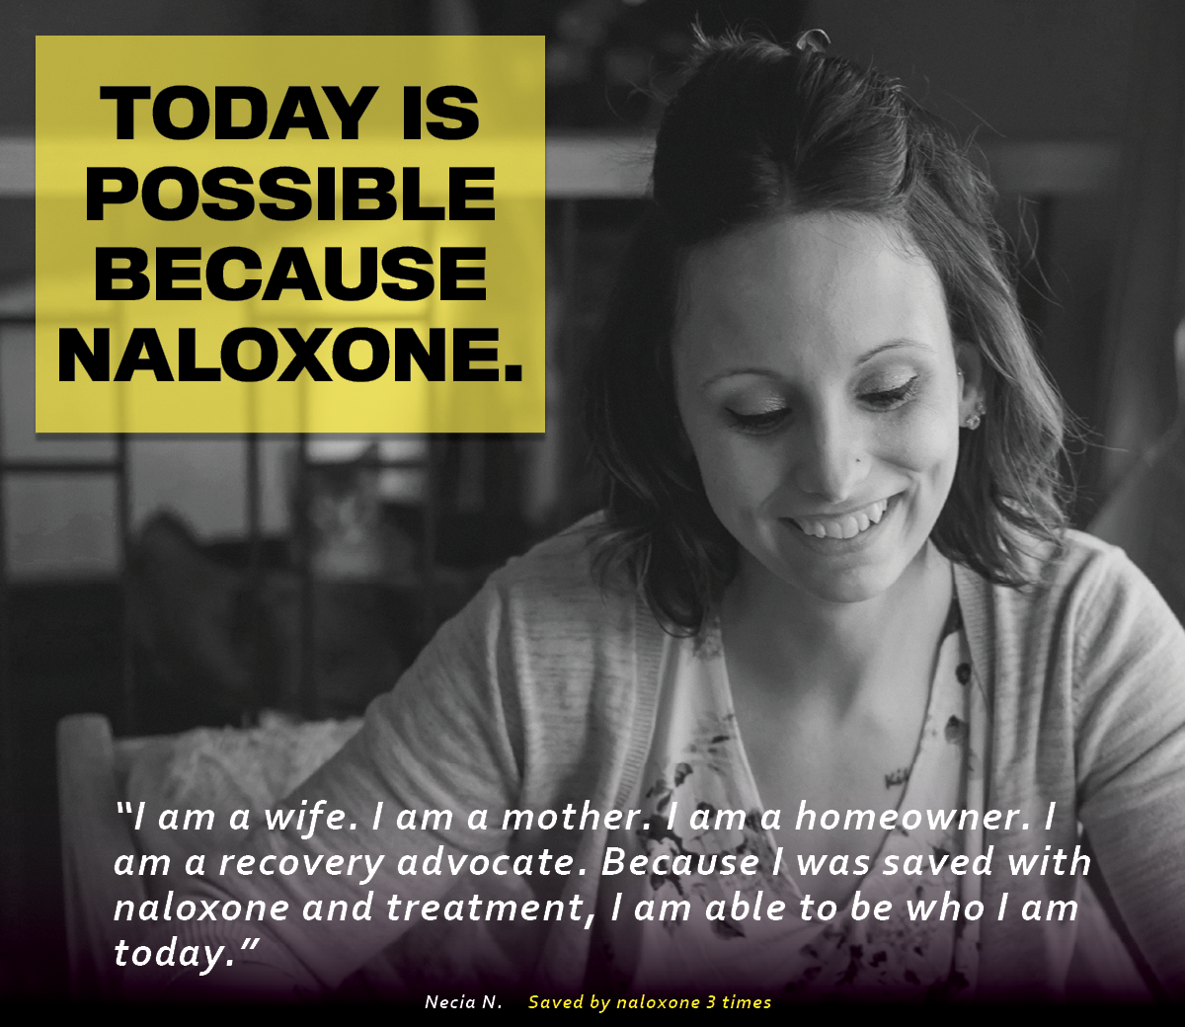


IDHS/DBHR Drug Overdose Prevention Program
Two options to access free naloxone supplies
  1. Contact your local, funded DOPP
  2. Enroll in DOPP to order free naloxone directly
(Photo: Prevention First, 2020)
Notes:
Enroll here: https://www.dhs.state.il.us/page.aspx?item=58142
Basics of naloxone: 2-3 min to start working, can use multiple doses but wait a few minutes in between; difference between generic dose and Narcan 4mg Nasal Spray; 30-90 minutes and then falls off receptors and withdrawal symptoms; often people do not know that you cannot give naloxone to yourself and that if someone has overdosed they are unresponsive4
IDSH/DBHR is charged with administering the Drug Overdose Prevention Program (DOPP)
Organizations and hospitals enroll in the DOPP
DOPP enrollment must be tied to distribution of naloxone
Once enrolled, you receive credentials to order Narcan
Data on naloxone trainings and distribution is shared with DBHR through the portal

Slide 66
Recovery Resources
MAR Now Call the Illinois Helpline at 833-234-6343
IDHS Help is Here
  833-234-6343 Illinois Helpline
  988 Suicide & Crisis Lifeline
  988+1 Veteran’s Crisis Line
  866-359-7953 Illinois Warm Line
IDHS MAR Overview webpage: https://www.dhs.state.il.us/page.aspx?item=93859
Drug Overdose Prevention Program To get naloxone or register to distribute in your community

Slide 67
Recovery Residence Resources
For Recovery Homes, contact the Illinois Helpline at 833-234-6343 or text "HELP" to 833234
Cook County Recovery Home Navigators: 312-508-3819 (call or text, text preferred). Available Monday – Friday 6 am – 5 pm and Saturday 7:30 am – 10 pm RHCC@fgcinc.org
Oxford House: For current availability, go to oxfordvacancies.com

Slide 68

Questions and Comments

Slide 69

Illinois Helpline: MAR NOW Campaign
Health Resources in Action (HRiA) MAR NOW Marketing Videos
https://www.youtube.com/watch?v=aURCan97boM&list=PLjSociu8cP5BORsO-PchexFaKWiwLEOft&index=24
Notes:
Health Resources in Action (HRiA) MAR NOW Marketing Videos
Helpline operator (Health Resources in Action) marketing materials for promotion of Helpline and MAR NOW. Run time 2:35.
Full list of marketing videos available at: https://youtube.com/playlist?list=PLjSociu8cP5BORsO-PchexFaKWiwLEOft&si=MSzZsrsG6O71WLLo

Slide 70
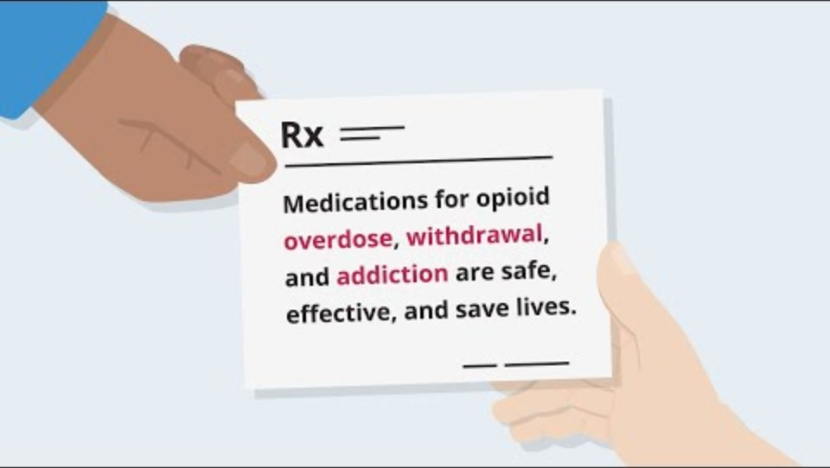
NIH Video: Medications for Opioid Use Disorder
https://nida.nih.gov/videos/medications-opioid-use-disorder-video
Notes:
https://nida.nih.gov/videos/medications-opioid-use-disorder-video

Slide 71
Team Talk
UWNI SwedishAmerican Hospital
Courtney Fisk, MSN, RNC-OB, C-EFM
23

Slide 72
UW Health
SwedishAmerican
Optimizing SUD Care Through Narcan Distribution
Presented by: Courtney Fisk, MSN, RNC-OB, C-EFM

Slide 73

UW Health Women & Children’s Hospital
2850 deliveries per year
Level III- 32 bed NICU
L&D:
  14 delivery rooms
  3 triage/ante rooms
  2 OR & 3 PACU
Postpartum:
  20 rooms
OBED:
  4 beds
  4400 patients seen in 2025
Provide Maternal/Neonatal transport services

Slide 74
Service Area
Located in downtown Rockford, IL
  Serving the greater Rockford region, including twelve counties across northern IL and southern WI
  Demographic composition:
    White (non-Hispanic)- 48.6%
    Black or African American (non-Hispanic)- 19.2%
    Hispanic- 8.8%
    Asian (non-Hispanic)- 3.6%
    Other- 19.8%
  Public aid is primary payor source

Slide 75
WINNEBAGO COUNTY
2023
2024
2025
#1 in IL:
Fatal opioid overdose
#2/#3 in IL:
Fatal opioid overdose
#3 in IL:
Fatal opioid overdose
Re-education:
To postpartum staff on importance of Narcan distribution
Narcan kits:
Stocked in med room on PP unit
DOPP facility:
July 25-Dec. 25
625 kits provided
2023 workflow:
Patient meets criteria?
If yes, main ED to bring Narcan kit and do admin. education
2024 workflow:
Patient meets criteria?
If yes, PP RN will provide kit and admin. education
2025 workflow:
Every delivered patient receives Narcan kit(s). Preselected in PP order sets.
Notes:
***2023: 4 maternal deaths attributed to overdose (adverse effects of fentanyl) 2 of which were 4 days a part
2024: 0 maternal deaths related to overdose of any kind
Comparison data: August 2023 to August 2024: fatal overdose rates for women decreased by 40% in Winnebago county
2025: WCH was 1 of 2 areas that piloted Narcan distribution after becoming a DOPP facility

Slide 76
Take-home Narcan kit discharge workflow:
Narcan kits are currently stocked in Omnicells on both the postpartum unit and in OBED
Each postpartum admission order set has take-home Narcan as a preselected order
At time of discharge:
  EVERY patient offered Narcan
  Can have as many kits as they would like
  Provided with administration instructions
Any discharged patient has the option to go home with Narcan (undelivered, triage, demise, etc.)

Slide 77
Becoming a DOPP facility at UWNI:
2018: started a collaborative initiative (ED, EMS and local health dept.) supplying Narcan in hospital
2025: Applied and enrolled as an IL DOPP utilizing one of our ED pharmacists (now our official DOPP pharmacist)
“Simply treating the overdose in the moment was not enough”
“The DOPP program became more than a hospital initiative—it became an opportunity to make a meaningful difference beyond the walls of the Emergency Department.”
Notes:
2018: partnered with EMS and the WCHD to provide community access to Narcan kits to those in need. WCHD supplied Narcan kits
2025: noted limitations for sustaining Narcan supply and the need continued to increase. What began in 2018 as an ED/EMS partnership with WCHD developed into an effort to create a sustainable, hospital-based overdose prevention program capable of maintaining its own naloxone supply, providing overdose education, tracking distribution and use, and expanding access to naloxone for patients and community members at risk for witnessing an opioid overdose.

Slide 78
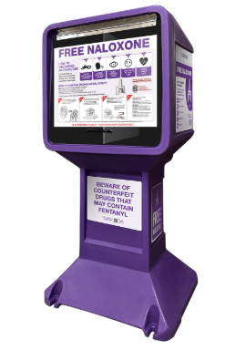
Looking ahead at future state:
Narcan stocked hospital-wide for all discharged patients
Have “Barney” stands in outpatient pharmacies and outside of hospital entrances
Narcan kit availability at outpatient facilities

Slide 79

Thank you for having us!
Contact info:
Courtney Fisk
cfisk@uwhealth.org

Slide 80
PMH Next Steps
23

Slide 81

PMH Next Steps
September PMH monthly data is due October 15th
October webinar canceled!
See you at Annual Conference!
Next Stop!

Slide 82
Updated PMH Webinar Schedule!
October Webinar
No October webinar, See you at Annual Conference!
*November 30th, 2026, 12:00-1:00pm
Combined Nov/Dec call, Perinatal Loss and Trauma Informed Care
December Webinar
Happy Holidays!
*Note the updated date!!

Slide 83



ILPQC FALL OFFICE HOURS ARE HERE
Every Thursday
at 1 p.m. CST
Register here or go to ILPQC Website under “All Events”

Slide 84


Continuing the Momentum Through QI Support
ILPQC continues to offer QI support to teams at all stages of PMH implementation!
Reach out to Rebecca (rebecca.ainis@northwestern.edu) to schedule a 1:1 call to go over progress, resources & strategies
Rebecca is currently reaching out to hospitals missing certain measures (if she reaches out, please respond and schedule a meeting time).
Attend weekly office hours, Thursdays 1-2pm, connect with ILPQC for help & other hospitals teams
  Register for office hours here:

Slide 85

Interested in having a PMH Grand Rounds or OB or ED Provider Meeting PMH update at your hospital? We’ve got you!
Reach out to rebecca.ainis@northwestern.edu to be connected with a speaker from our Perinatal Mental Health Grand Rounds Speakers Bureau

Slide 86


Thank you for everything you do to make change happen for Illinois moms and babies!
TOGETHER we can improve Perinatal Mental Health care across Illinois!
Notes:
86

Slide 87

If you are watching this webinar as a recording, please complete the attestation form here to receive ILPQC participation credit:
Note: you will have 2 weeks to watch the webinar and complete the attestation to receive credit
Notes:
87

Slide 88







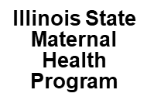














Thank you to our Funders:
Supporters:

Slide 89
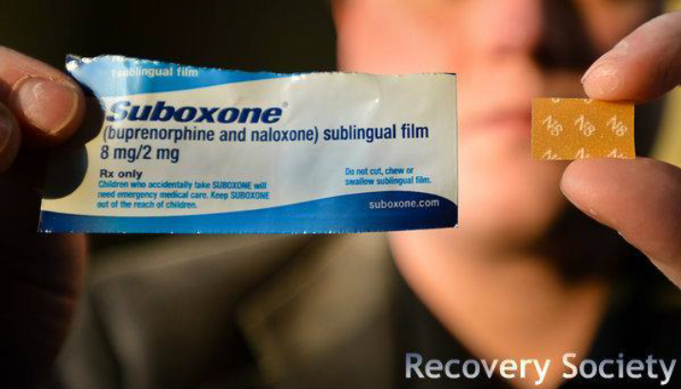
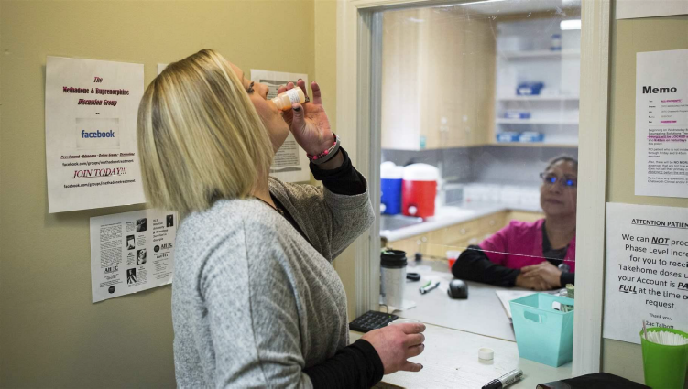
Medications Used to Treat OUD and AUD in Pregnancy
Methadone and Buprenorphine (Subutex, also Suboxone, Brixadi)
  Recommended during pregnancy for patients with OUD (ACOG, 2017)
  Improves adherence to prenatal care
Naltrexone: not recommended for pregnant patients with OUD
Naltrexone and Acamprosate
  Recommended for alcohol use disorder (AUD) in some situations
  Evidence for medications for AUD during pregnancy is more limited
Disulfiram (Antabuse) is used to treat AUD, but is not used with pregnant patients with AUD
Notes:
American College of Obstetricians and Gynecologists’ “For pregnant women with an opioid use disorder, opioid agonist pharmacotherapy is the recommended therapy and is preferable to medically supervised withdrawal because withdrawal is associated with high relapse rates, which lead to worse outcomes.” -ACOG
Any OAT is recommended over untreated OUD during pregnancy, because untreated persons have greater incidence of adverse outcomes owing to withdrawal, return to opioid use, overdose, intravenous drug use, and inadequacy of prenatal care
recommendation: Subutex is a sublingual tab, suboxone is a film that dissolves orally, and methadone is a liquid
Naltrexone reduces alcohol slips, used for opioids, reduces cravings, reduces pleasurable effects of alcohol
Acamprosate reduces symptoms of abstinence (insomnia, anxiety, restlessness)
Disulfiram (Antabuse): reacts with alcohol, causing nausea, headache, palpitations
Opioid agonist pharmacotherapy prevents opioid withdrawal symptoms and is shown to prevent complications of nonmedical opioid use by reducing relapse risk and its associated consequences. It also improves adherence to prenatal care and addiction treatment programs.
Neonatal abstinence syndrome is an expected and treatable condition that can follow prenatal exposure to opioid agonists and requires collaboration with the pediatric care team for care of the infant.

Slide 90
MAR NOW: History and Overview
Launched May 2022 in Chicago, Expanded Sept. 2022 Statewide
Funded by Chicago Department of Public Health (CDPH) and Illinois Department of Human Services Division of Behavioral Health and Recovery (IDHS/DBHR)​
Operated by Family Guidance Centers, Inc. (FGC). FGC provides methadone, buprenorphine, and naltrexone at their Chicago and statewide clinics.​
Operates through the existing 24/7 IL Helpline for Opioids and Other Substances: 833-234-6343​
Provides low-barrier, rapid access to medications for opioid use disorder and alcohol use disorder to all callers regardless of insurance status, income, ability to pay, or documentation status.​

Slide 91
Creating PMH Systems Changes
Moving to Green on Education Measures
OB clinical staff education on PMH conditions
ER clinical staff education on PMH conditions
Postpartum patients provided education on PMH conditions

Slide 92
Creating PMH Systems Changes
Moving to Green on Engaging Outpatient Sites
Sharing PMH patient education resources with outpatient settings
Sharing PMH screening tools with outpatient settings
Hospital has created a PMH access workgroup

