Slide 1

Optimal Perinatal Mental Health (PMH) Care
responding to a positive screen for perinatal depression or anxiety
✔ Assess safety / severity (mild, moderate, severe)
✔ Counsel on treatment options (therapy, medication or both)
✔ Provide treatment, with warm handoff for therapy
✔ Schedule close OB follow-up within 2 weeks
✔ Provide patient with PMH educational resources and support services (ie. IL MOMS Line, PSI support groups, Home Visiting)
*Call IL DocAssist for clinical consultation help with treatment/ follow up plan
*Engage with IL MOMS Line for help with therapy referral
MILD
Depression screen 10-14 Anxiety screen 5-9
Therapy Referral
Consider medication treatment
MODERATE
Depression screen 15-19
Anxiety screen 10-14
Therapy referral
Strongly consider medication treatment
If onset of depression symptoms occurs in 3rd trimester to 4 weeks postpartum and if the patient is <6 months postpartum at screening, consider postpartum zuranolone (administered orally for 14 days)
SEVERE
Depression screen > 19 Anxiety screen > 15
Therapy referral
Medication treatment
If onset of depression symptoms occurs in 3rd trimester to 4 weeks postpartum and if the patient is <6 months postpartum at screening, consider postpartum zuranolone (administered orally for 14 days)

Slide 2
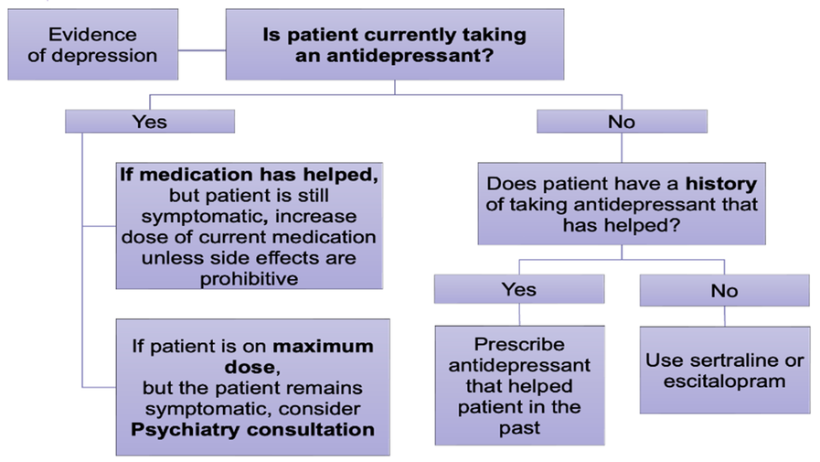
PMH Resources
IL DocAssist
Free perinatal psychiatry consultation to help providers with PMH treatment
Monday through Friday, 9am-5pm
866-986-2778
IL MOMS Line
Free 24/7 hotline for patients & providers; assessment, support and mental health care / therapy referral assistance
866-364-6667
MAR Now
Free 24/7 hotline to access medications for opioid use disorder and care coordination
866-364-6667
Example Order Set
Assess safety and severity. Counsel on treatment options (therapy, medication or both)
Referral with warm handoff to therapy / behavioral healthcare follow-up
  Call IL MOMS Line with patient for support and help with therapy referral (866-364-6667)
  Can submit an online referral from list of resources for scheduling help or use local referral
  Link to PSI peer support groups and/or home visiting program for additional support
  Provide education on perinatal depression/anxiety including self-care and support resources (dot phrase)
Medication orders for depression/anxiety
  Screen for bipolar disorder using the MDQ (link to screen) before starting treatment
  If patient has used med before that worked, can prescribe that
  If treatment naïve, see ACOG resource for first line treatment options, including:
    Sertraline (Zoloft) 25mg qAM (if sedating, change to qHS)
    Initial increase after 4 days – increase to 50 mg
    Second increase after 7 more days – increase to 100 mg
    Slower titration (every 10-14 days) can be helpful if antidepressant naïve or with anxiety symptoms
    Reassess monthly (increase as needed until symptoms remit) – increase by 50mg
    Therapeutic range = 50-200 mg
  Call IL DocAssist for clinical consultation (866-986-2778) help with treatment plans
  Consider postpartum Zuranolone within 12 months of delivery if moderate/severe symptoms started 3rd trimester through 4 wks postpartum, check insurance coverage; it is administered orally for 14 days

