Slide 1
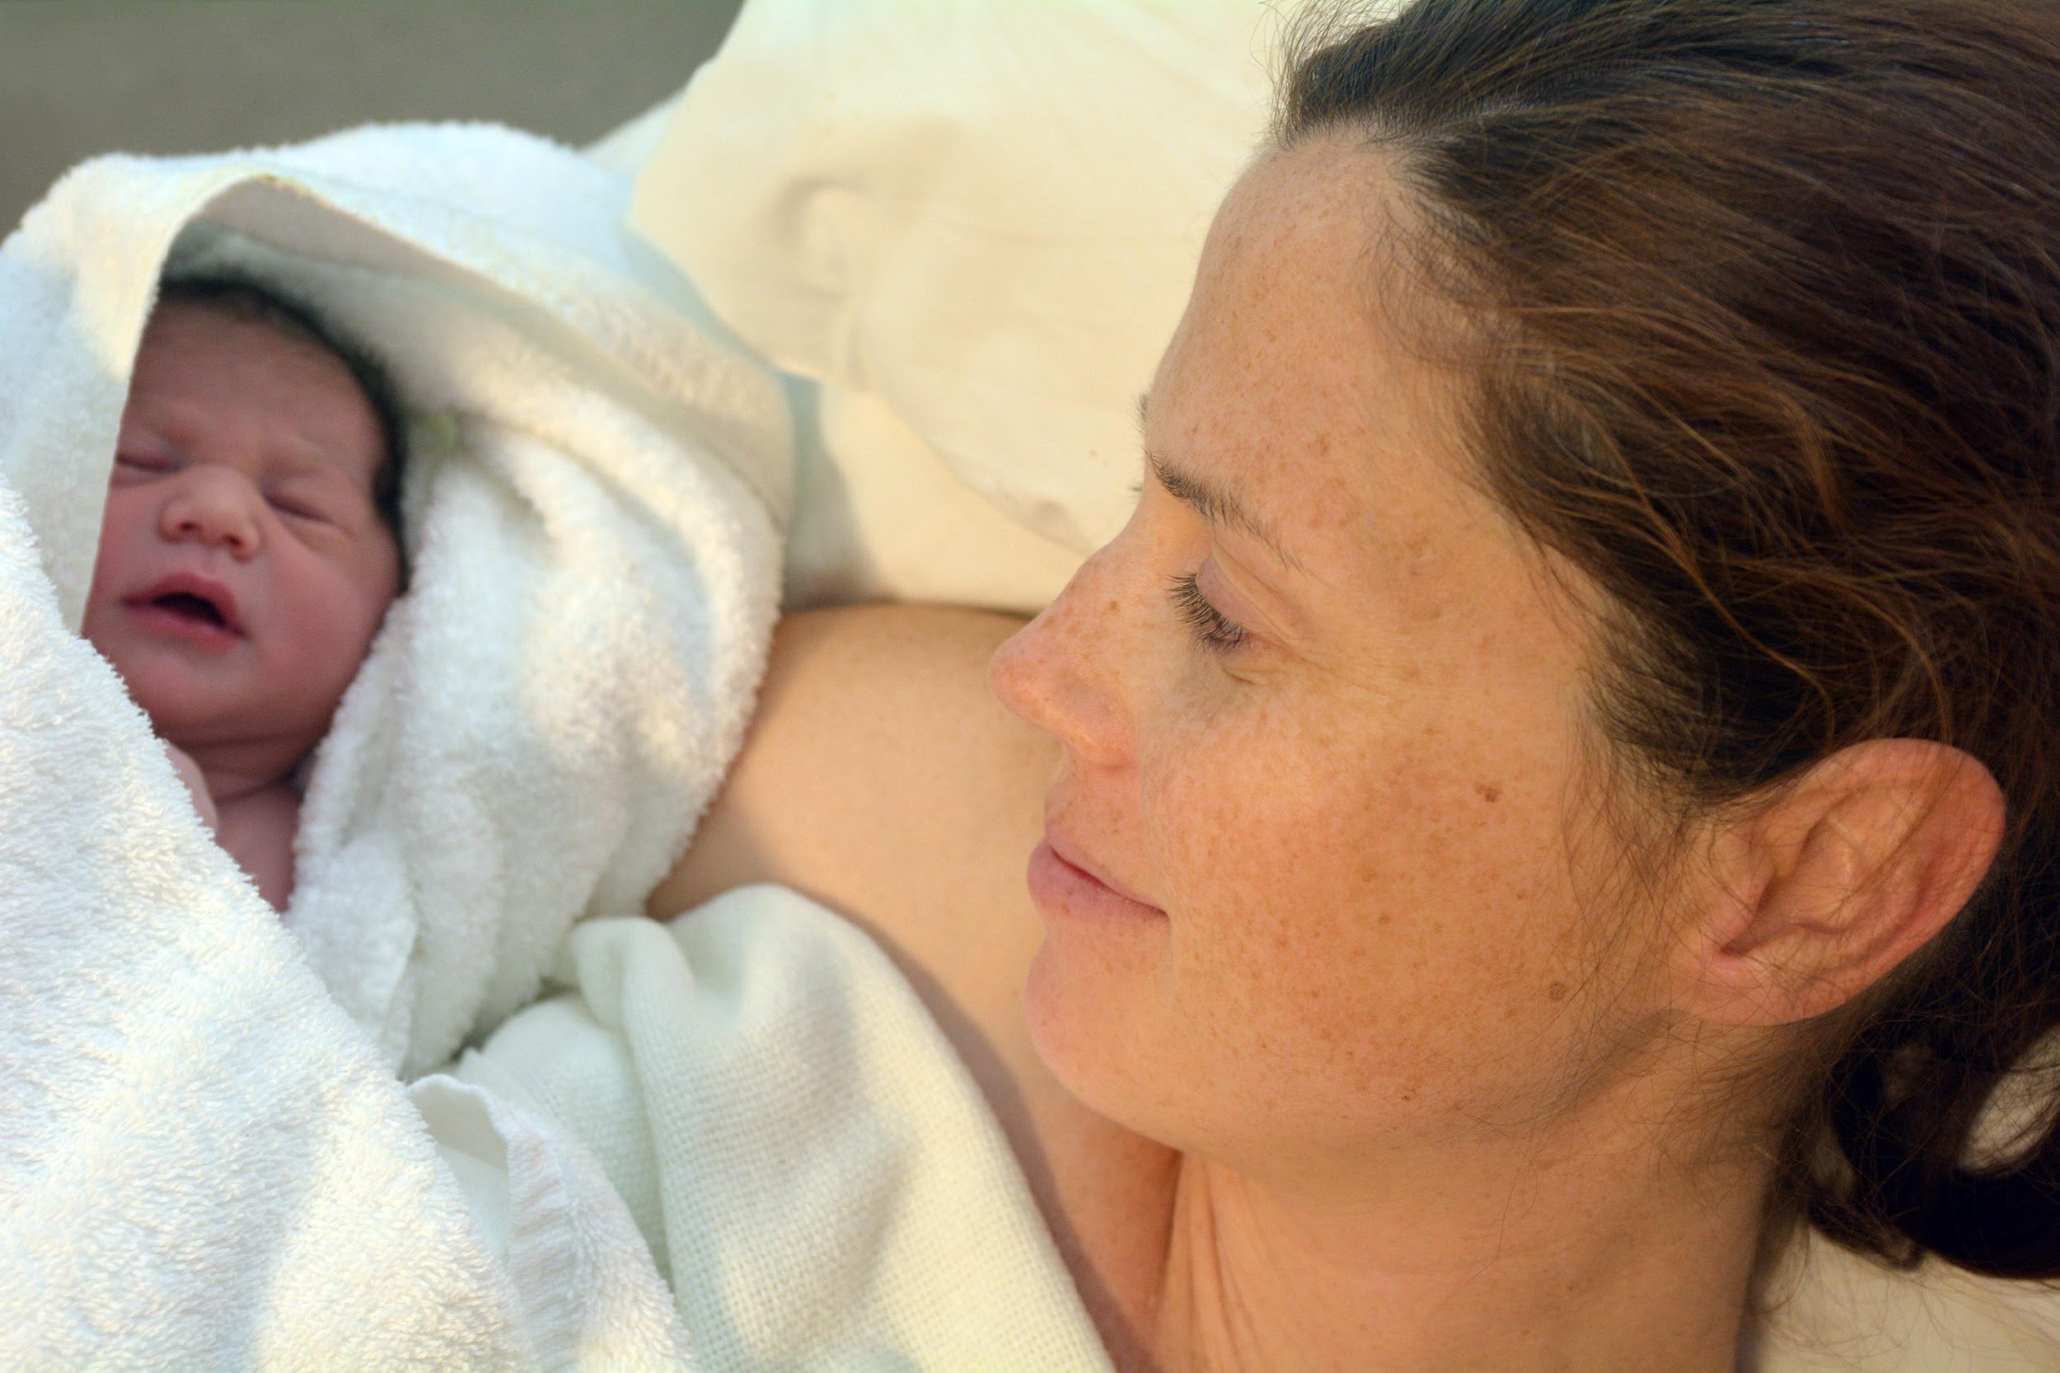
Closing Reflections & Celebration: Advancing Perinatal Care Together

Slide 2

Upcoming Neonatal Calls
Topic | Date
ESSI Sustainability Launch Call | June 15, 2026
ESSI Sustainability Call #1 | September 2026
ESSI Sustainability Call #2 | December 2026

Slide 3
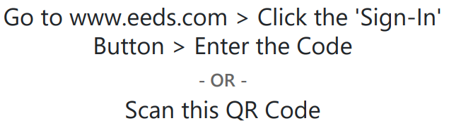
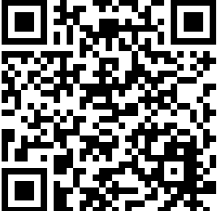
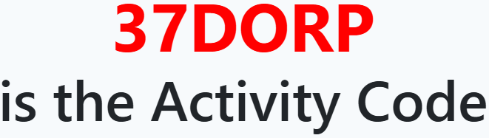
Get your CE Credits!
ILPQC 2026 Neonatal Face-to-Face Day 2
Please sign-in (required for CE credit):
The Activity Code will Expire on Saturday, June 20, 2026 at 9:00 AM

Slide 4

Thank You to our Amazing Speakers!
Lily Lou, MD, FAAP
Ann Downey, MD, MSc
Maia Birchmoon-Gordon, BSN, RN, IBCLC
Kristina Dakis, MD
Malika D. Shah, MD
Notes:
Make fonts bigger

Slide 5
Thank You Breakout Facilitators!
Lily Lou
Bailey Johnson
Malika D. Shah
Mary Jarvis
Donna Lemmenes
Keri Schubert
Jenny Garst
Rebecca Ainis
Mathura Ananthuran
Danielle Wittig
Keri Benbrook
Wally Hussein
Notes:
Make fonts bigger

Slide 6
Thank You to the Planning Committee!
Amanda Schaefer
Sharon Green-Hughes
Daniell Ashford
Deb Miller
Yah-Yah Greene
Keri Schubert
Donna Lemmenes
Mary Jarvis
Sherry Jones
Karen Kasinger
Mathura Ananthan
Joanne Sorce
Kim Vuckovich
Notes:
Make fonts bigger

Slide 7


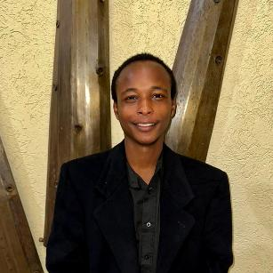
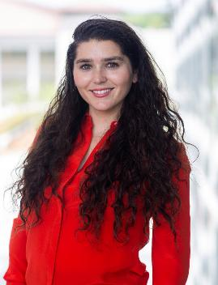
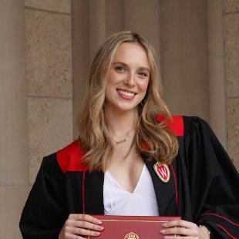
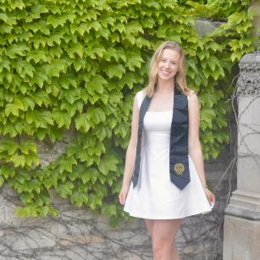
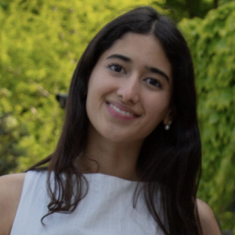
Thank you to our Learners!
PMH, Birth Quality Designation, and ESSI data and website
PMH evaluation and dissemination
VINCENT MAMBO
NORTHWESTERN UNIVERSITY
UNDERGRADUATE STUDENT
BLAIRE PINGETON
POSTDOCTORAL SCHOLAR
Birth Quality Designation Evaluation
Review of options for next OB initiative
Evaluation of ESSI key strategies for equity
GILLIAN BROWN
NORTHWESTERN UNIVERSITY
MPH STUDENT
JULIA LEHR
NORTHWESTERN UNIVERSITY
MPH STUDENT
LAIQA MAZHAR
NORTHWESTERN UNIVERSITY
MPH STUDENT

Slide 8



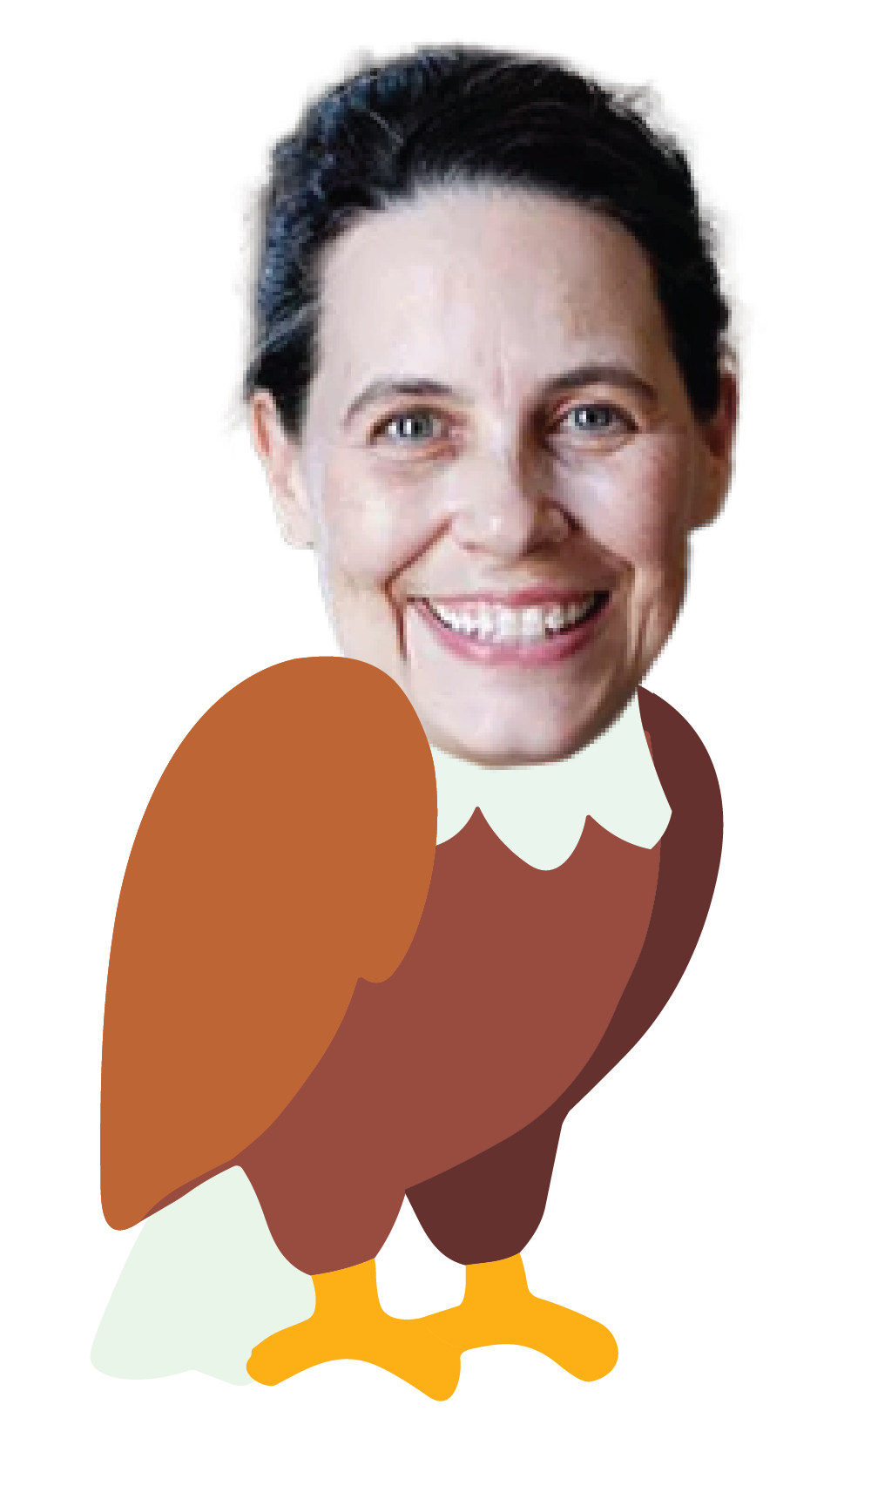


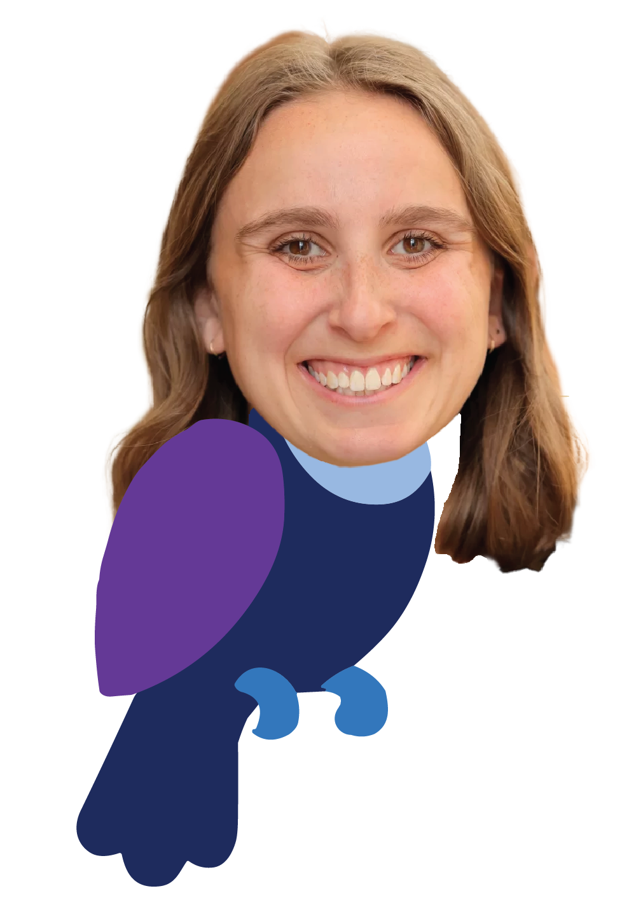
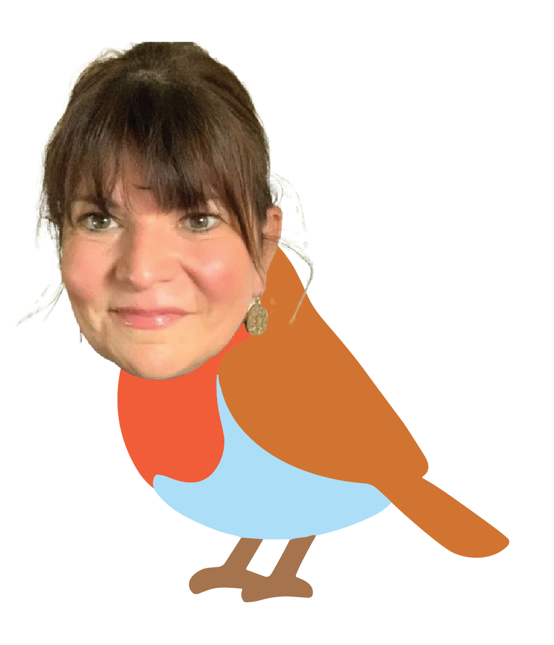

Thank You ILPQC Central!

Slide 9

Us!

Slide 10
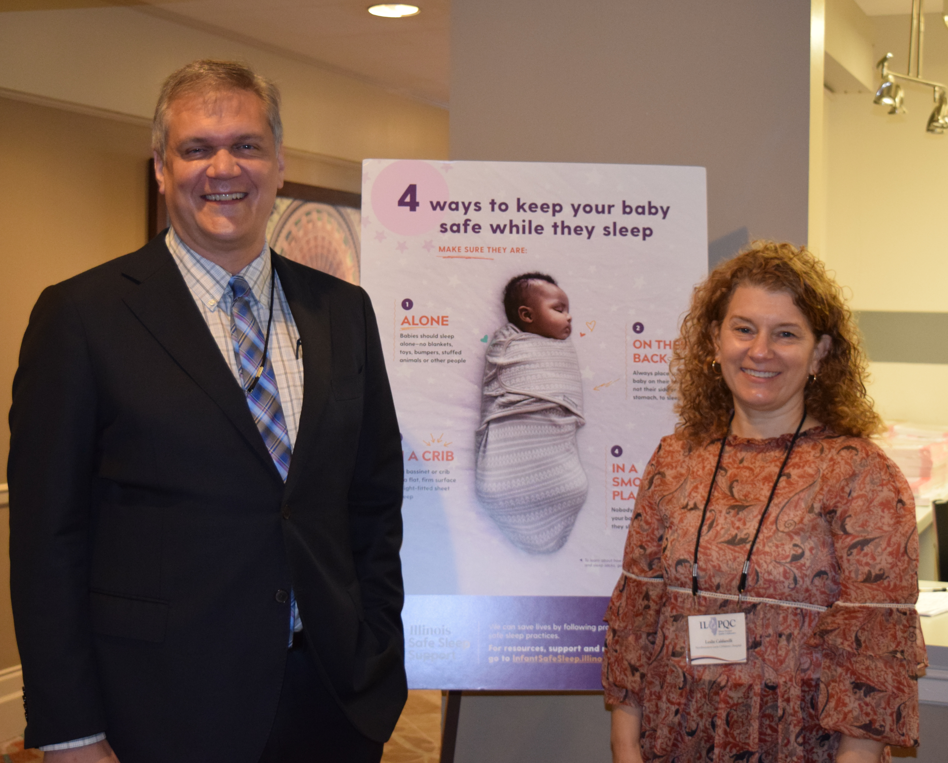
Because I Care?

Slide 11
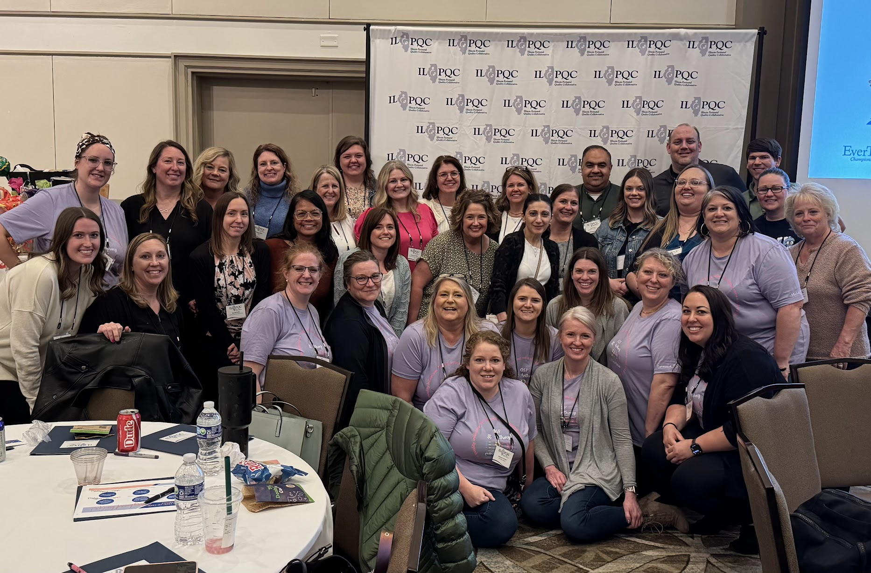
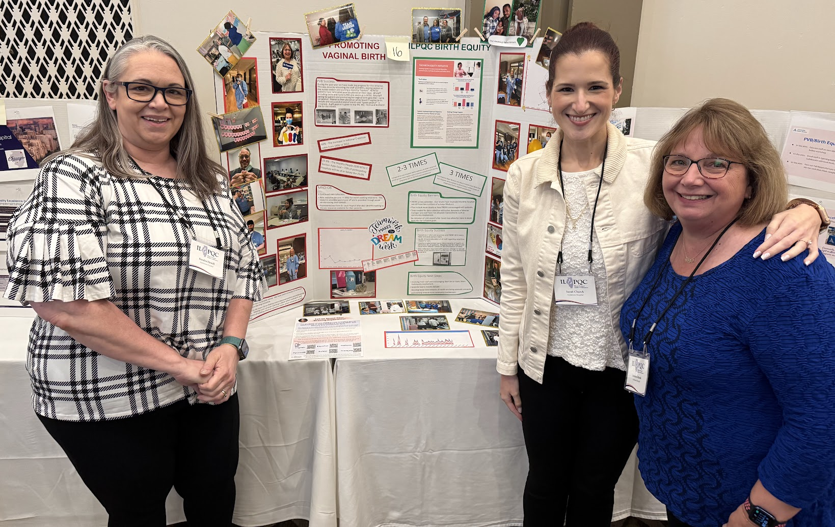
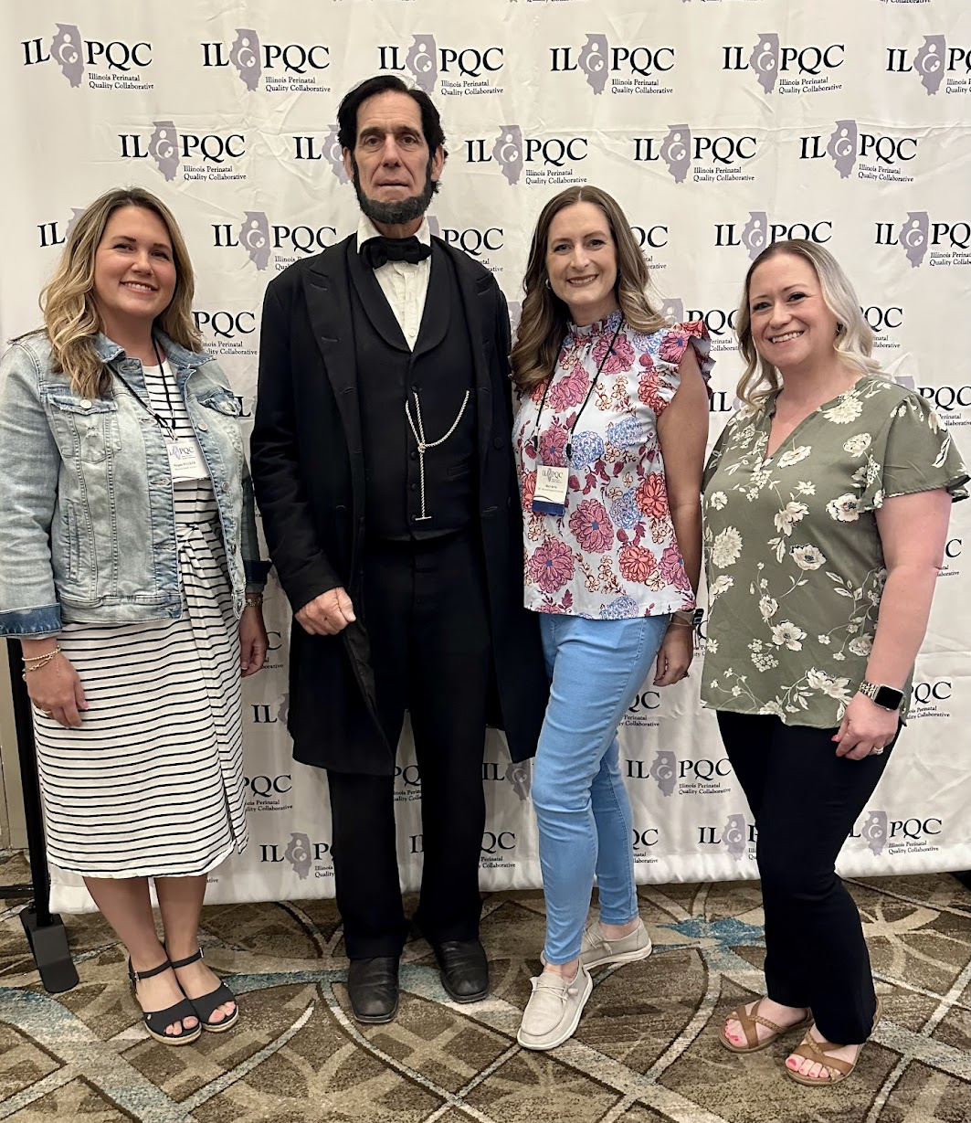
Because You Care?

Slide 12

We Care Together!
Turning Caring into Impact through Collaboration.

Slide 13

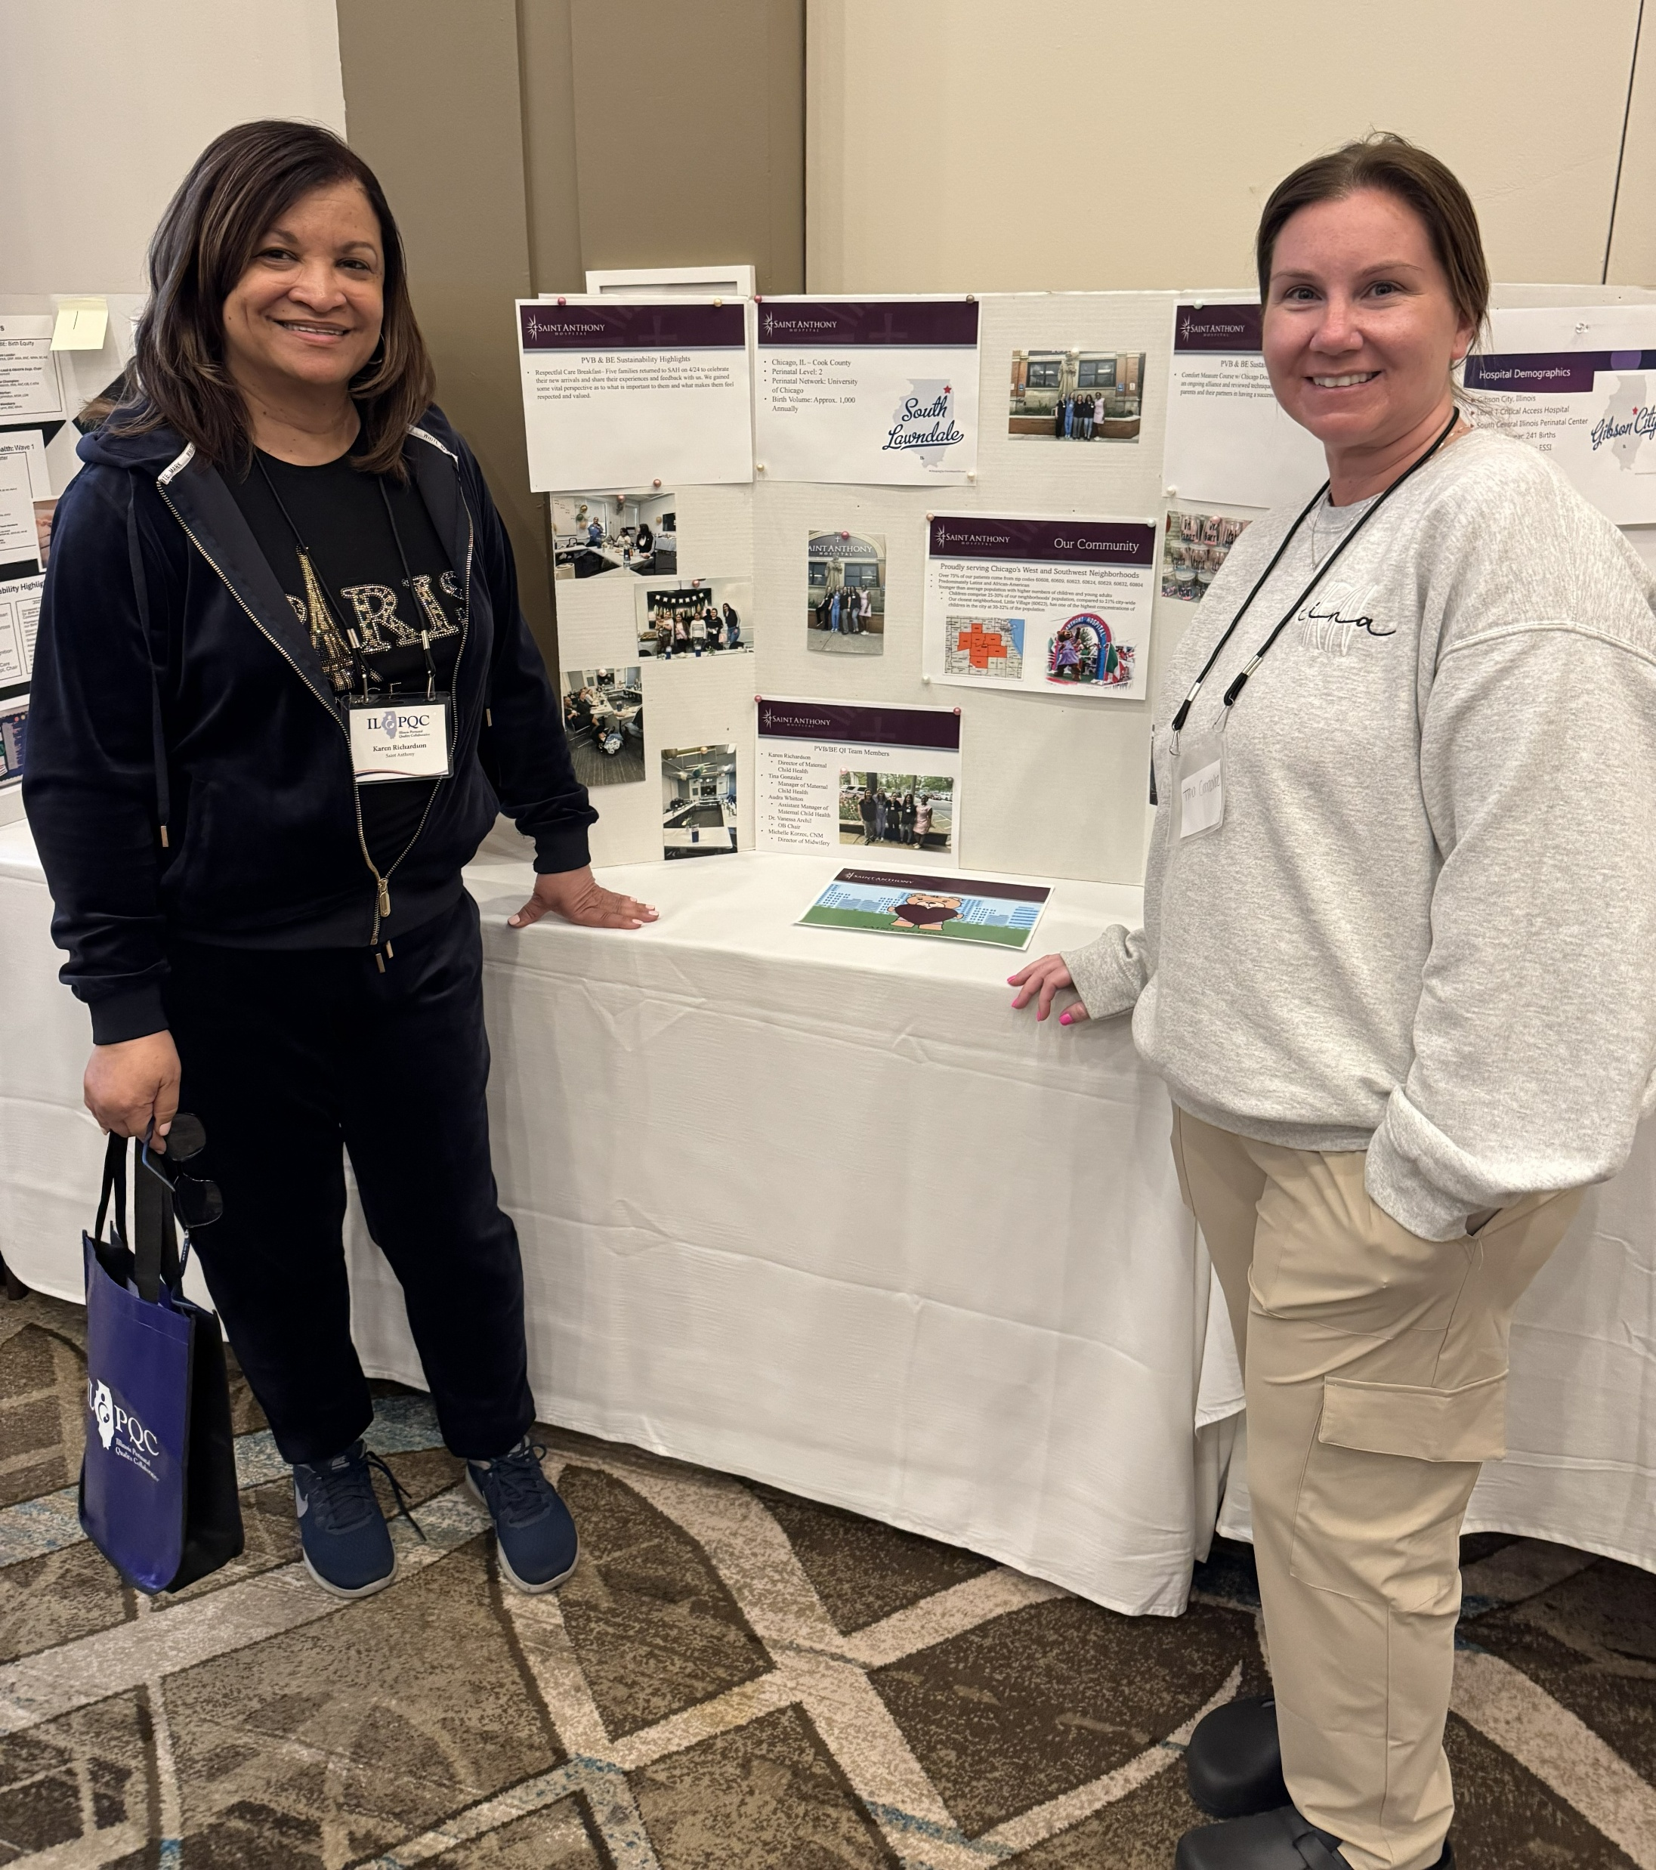
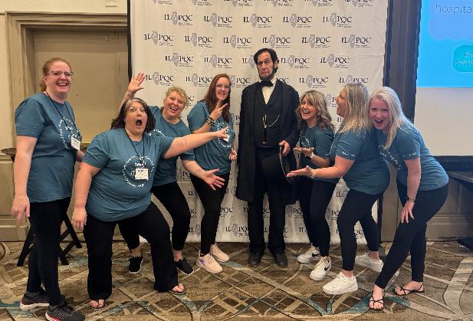

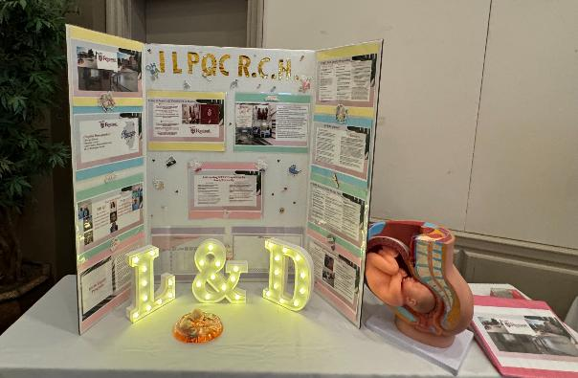
Announcing the Winners of the Team Spirit Awards!
Let’s celebrate you and your teams for the energy you have brought to F2F today!

Slide 14


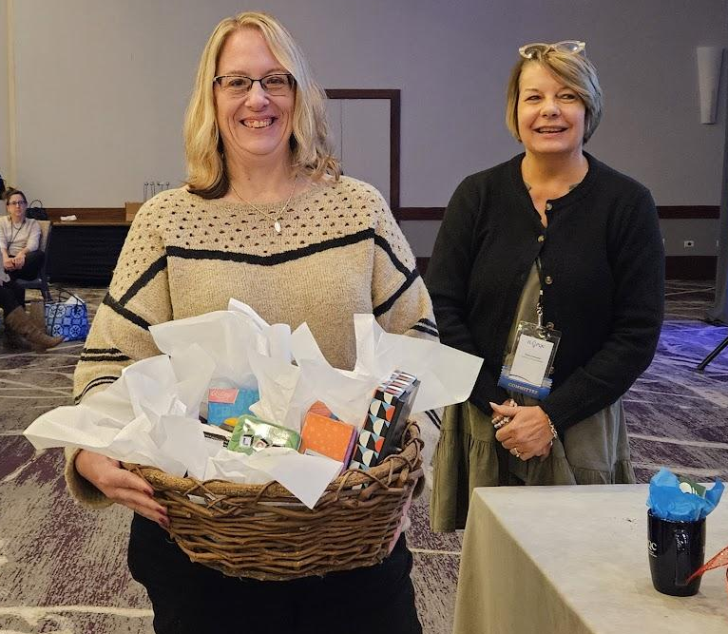
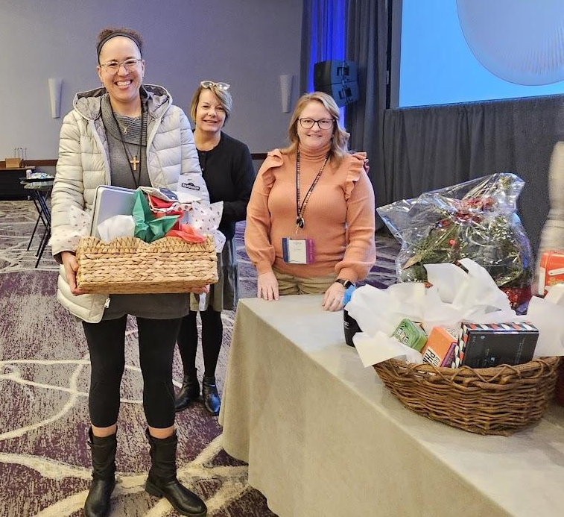
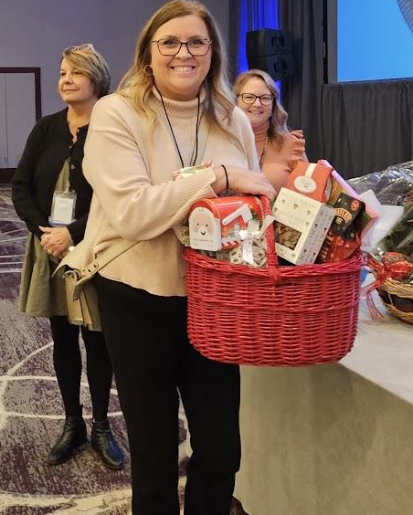
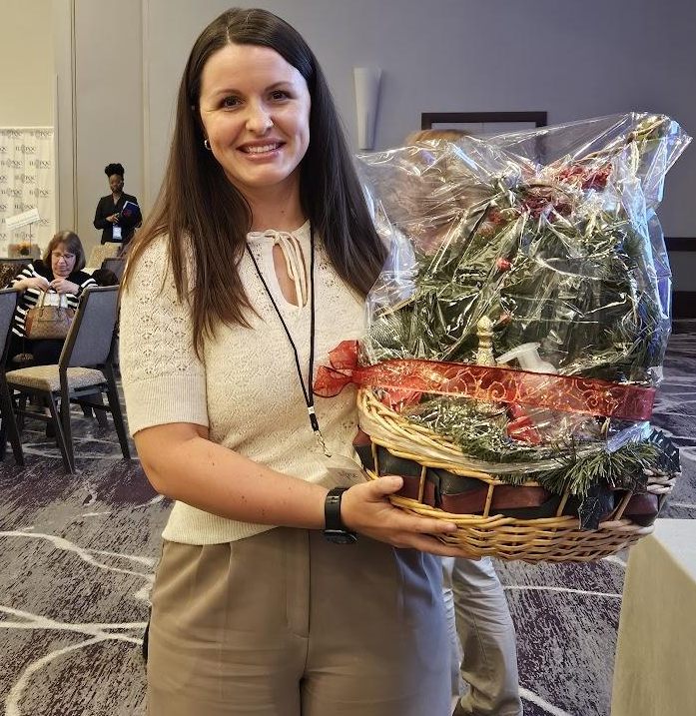
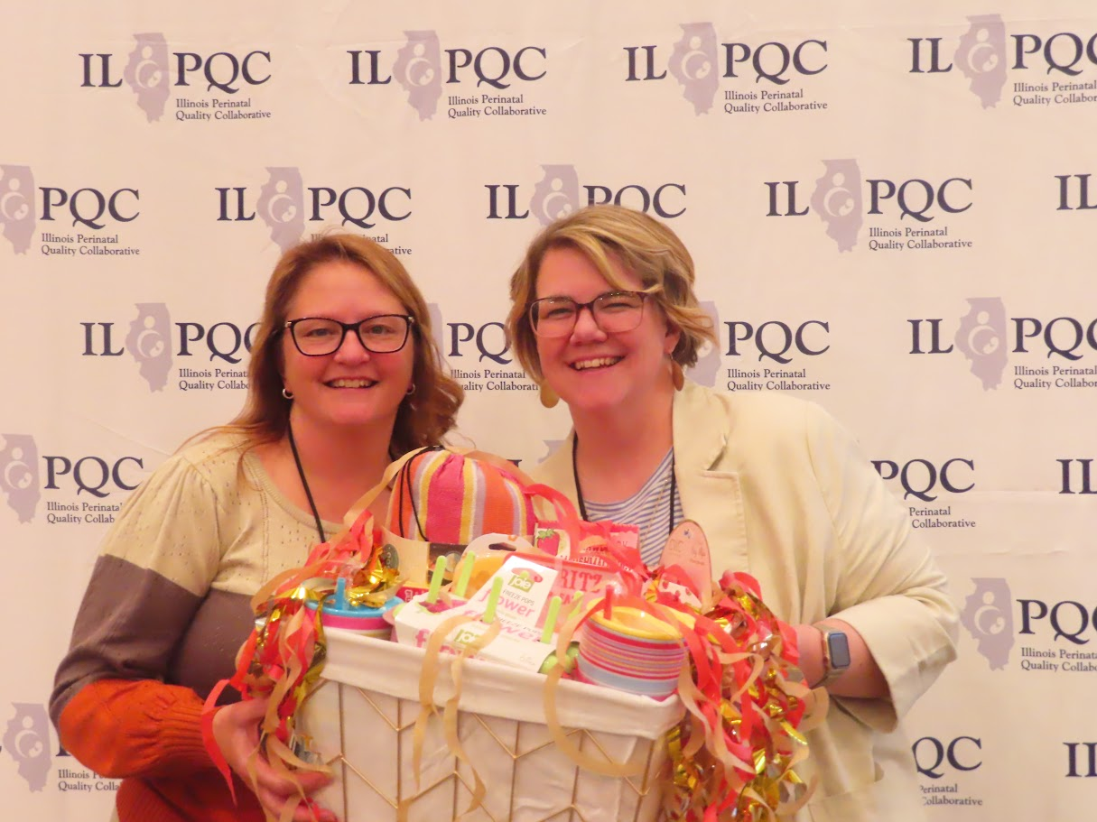
And the winners of the raffle are…

Slide 15
ILPQC
14TH ANNUAL CONFERENCE
NOVEMBER 10TH, 2026
THE WESTIN LOMBARD YORKTOWN CENTER

Slide 16
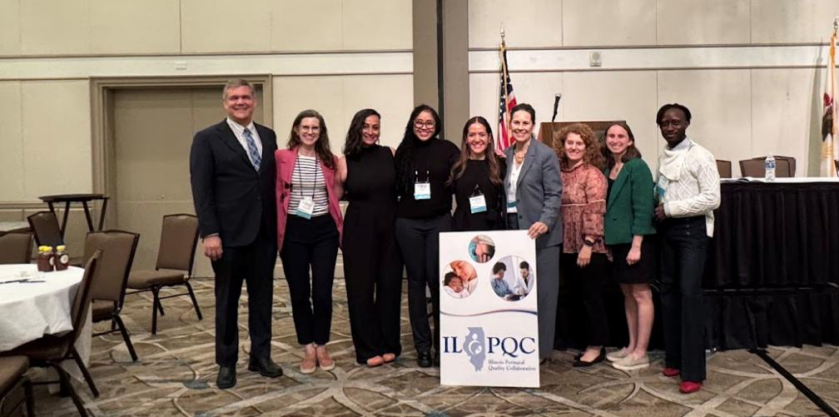
Thank you all for a great conference!

Slide 17






















Thank you to our Funders:
CME Provider
Supporters:
17
Notes:
18

Slide 18
Get your CE Credits!
ILPQC 2026 Neonatal Face-to-Face Day 2
Please sign-in (required for CE credit):
The Activity Code will Expire on Saturday, June 20, 2026 at 9:00 AM

