Slide 1
Inclusive care: building mental health support for NICU families
Ann Downey, MD, MSc
May 21, 2026
ILPQC
Notes:
Good morning. It’s an honor to be here. I spent the first years of my career as a neonatologist in Chicago and some of my fondest professional memories were made with ILPQC. It’s great to be back!

Slide 2

Disclosures and Acknowledgements
I have no financial interests or relationships to disclose.
I am not a mental health expert.
Inclusive language remains a problem in the perinatal mental health literature.
The work presented is credited to a huge team of social workers, parents, and clinicians across the Twin Cities.
I am not Dr. Sarah Swenson.
Notes:
I have no financial interests or relationships to disclose. I’d like to disclose that I am a neonatologist, a mother, and a quality improvement specialist, but I am not a mental health expert. And I’d like to acknowledge that inclusive language continues to be challenging in describing perinatal mental health. For our work in the Twin Cities, we originally used the terms gestational parent and nongestational parent. We felt that these were the most inclusive terms for all. When we submitted our work for publication, our team was told that this language was confusing and not representative of the majority of families. So we settled on mother and partner. While this describes some families, there are families that would prefer birthing parent and non-birthing parent, and the traditional mother/father dyad as well.
Finally, I’d like to acknowledge that I stand before you to speak about work that we have done in Minneapolis and Saint Paul, Minnesota, but I wouldn’t be here without the huge team of dedicated social workers, parents, and clinicians that contributed to this work. And my colleague, Dr. Sarah Swenson, was the primary architect and team leader at all of our sites. Sarah just had her third child a few weeks ago and I’m happy to report that both mom and baby are thriving.

Slide 3
Description of content
Describe Perinatal Mental Health Disorders
Describe why parent mental health support is important in the NICU
Describe our experience in the Twin Cities
Provide action items for teams looking to start this work
Notes:
So today I’d like to introduce the topic of perinatal mental health disorders and share some statistics about PMH in general. We’ll explore why PMH support is especially important in the NICU. I’ll share our experience in the Twin Cities. And I’ll be candid about our both our successes and our challenges.
And I hope to impart practical tools to support your NICU programs in providing better support to parents.

Slide 4
What can we do?
Understand the problem
Advocate for upstream interventions
Screen for mental health problems
Know local resources for treatment of PMH disorders
Refer or provide treatment locally
Notes:
So we’re the neonatal team, what can we do about perinatal mental health? Well first, we can take some time to understand the problem.

Slide 5
Perinatal Mental Health in the United States

Slide 6
Prevalence of Maternal Mental Health Conditions
https://www.kimberlygibsoncounseling.com/post/1-in-5-women-will-experience-a-maternal-mental-health-disorder
Notes:
Maternal Mental Health disorders, like postpartum depression, anxiety, obsessive-compulsive disorder (OCD), bipolar disorder, and psychosis are the leading complication of childbirth, impacting 20% of U.S. women.
Over the last decade, the mental health of US mothers has worsened, with mothers reporting a nearly 65 percent increase of “fair to poor mental health.”²
And stigma unfortunately remains a barrier. Many mothers still feel uncertainty or discomfort with seeking mental health support due to the social stigma. In one 2025 study, 62% felt they were judged or treated unfairly during the perinatal period for various issues, including postpartum depression^{3,4}

Slide 7
Timing of Maternal Depression
Postpartum period 40.1%
During pregnancy 33.4%
Before pregnancy: 26.5%
Wisner, et al. Onset Timing, Thoughts of Self-Harm, and Diagnoses in Postpartum Women with Screen-Positive Depression Findings. JAMA Psychiatry. 2013.
Notes:
Maternal depression can happen anytime during the perinatal period. In the largest postpartum depression screening study conducted in the US, the onset of depression occurred most commonly in the postpartum period. Though it can occur during pregnancy as well as before.

Slide 8
Anxiety, Obsessive Compulsive Disorder and Bipolar Disorder
20% of women experience maternal anxiety disorders with the highest rates occurring during early pregnancy.
(Ayers et al, BJPsych Open. 2024)
The prevalence rate of OCD is 8% during the prenatal period and 17% in the postpartum period.
(Fairbrother et al, Oxford University Press. 2021)
In women without a psychiatric condition before the perinatal period, the prevalence rate for bipolar disorder is 2.6%. In women with an existing bipolar disorder diagnosis, 54.9% have at least one bipolar-spectrum mood episode occurrence in the perinatal period.
(Masters et al, The Journal of Clinical Psychiatry. 2022)
Notes:
And while the statistics on depression are striking, maternal anxiety disorders present in 20% of women. There are increased rates of obsessive-compulsive disorder in the perinatal timeframe. And in women with an existing bipolar disorder diagnosis, over 50% of them have at least one bipolar-spectrum mood episode in the perinatal period.

Slide 9
Risk Factors
Prior psychiatric disorder raises a woman’s risk. (Johansen et al. Journal of Clinical Psychiatry. 2020)
Those living in poverty suffer from PPD at double the rate of those who don’t live in poverty. (Chaudron et al. Pediatrics 2010)
With a greater number of women unable to interrupt pregnancy, rates of depression and anxiety are expected to rise significantly.
Notes:
There are several risk factor for perinatal mental health disorders. Having a prior psychiatric disorder raises a woman’s risk. Those living in poverty suffer from PPD at double the rate of those who don’t. And with a greater number of women unable to interrupt pregnancy since the supreme court overturned Roe V. Wade, rates of depression and anxiety are expected to rise significantly.

Slide 10
Disparities in Perinatal Mental Health
Up to 30% of American Indians and Alaskan Natives suffer from post-partum depression (PPD). (Heck. The American Journal of Maternal/Child Nursing. 2021)
Up to 40% of Black and Latina mothers suffer from PPD, twice the rate of their white counterparts. (Howell et al. Obstetrics and Gynecology. 2005)
Latina and Black women are 57% and 41%, respectively, less likely to start treatment for maternal depression than white women. (Kozhimannil et al. Psyciatric Services. 2011)
From 2010-2021, there was a 280% increase in PPD diagnoses for Asian American and Pacific Islanders. (Khadka et al. JAMA Network Open. 2024)
Women living in rural communities are 21% more likely to develop PPD compared to women living in urban communities. (Nidey et al. The Journal of Rural Health. 2020)
Notes:
As you might expect, perinatal mental health problems don’t affect all demographic groups the same way. Up to 30% of American Indians and Alaskan Natives suffer from post-partum depression. Up to 40% of Black and Latina mothers suffer from PPD, twice the rate of their white counterparts. Latina and Black women are 57% and 41%, respectively, less likely to start treatment for maternal depression than white women. From 2010-2021, there was a 280% increase in PPD diagnoses for Asian Americans and Pacific Islanders. And women living in rural communities are 21% more likely to develop PPD compared to women living in urban communities.

Slide 11
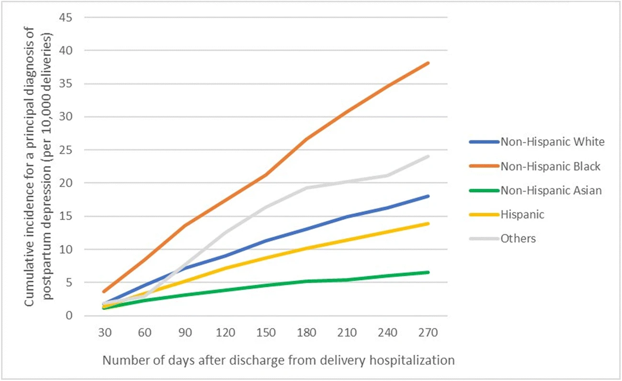
Maternal Mental Health Disparities: the Unseen Struggle of Postpartum Depression
Chan et al, AMWA. 2020. https://link.springer.com/article/10.1007/s40615-020-00774-y
Notes:
This graph shows the cumulative incidence for a principal diagnosis of postpartum depression per 10,000 deliveries on the y-axis over time along the x-axis. As you can see, not all racial and ethnic groups experience postpartum depression in the same way over time.

Slide 12

Perinatal Mental Health Concerns
The leading cause of pregnancy-related death
https://www.cdc.gov/media/releases/2022/p0919-pregnancy-related-deaths.html
Notes:
The US has more than twice the rate of maternal mortality compared to other wealthy nations. (Commonwealth Fund)
And while worldwide, the most common causes of maternal mortality include hemorrhage, hypertension, or infection, in the United States, maternal mental health conditions (suicide and overdose) are the leading cause of pregnancy-related deaths. I’ll pause for a moment to let that sink in.

Slide 13
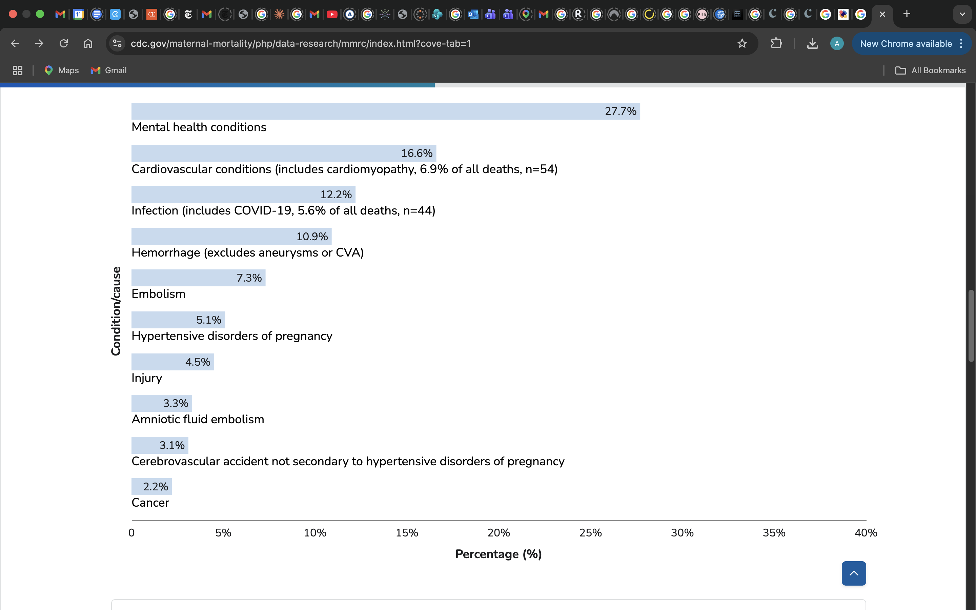
CDC: Underlying Causes of Pregnancy-Related Deaths Overall, 2022
Notes:
The CDC reports the underlying causes of pregnancy-related deaths annually. As you can see, the 2022 data, the most recent reported year on the site, show that almost 28% of pregnancy-related deaths were caused by mental health conditions. The website additionally supports the analysis of pregnancy-related deaths by race and ethnicity and there’s significant variability within the different race and ethnicity groups.

Slide 14
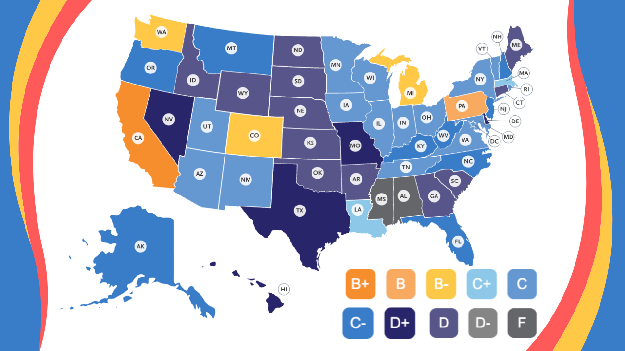
Policy Center for Maternal Mental Health State Report Cards 2025
https://policycentermmh.org/2025-maternal-mental-health-state-report-cards/
Notes:
Moving to looking at how we do in the United States by state, the Policy Center for Maternal Mental Health issues a yearly state report card. As you can see, the highest grade reported is in California at a B+. Both Illinois and my home state or Minnesota are graded at a C. They take into account several factors when grading states, including whether there is a state PQC that prioritizes maternal mental health.

Slide 15
Easy Statistics to Remember
20% of the perinatal population suffer from a mental health disorder
20% of maternal deaths are due to suicide
Less than 20% of birthing-age women live in areas with adequate maternal mental health professionals
Notes:
Before we move into the NICU setting, I want to underscore a few easy-to-remember statistics. 20% of the perinatal population suffer from a mental health disorder
20% of maternal deaths are due to suicide or mental health disorders such as overdose. And less than 20% of birthing-age women live in areas with adequate maternal mental health professionals

Slide 16
Why does parent mental health matter in the NICU?
Notes:
So narrowing our focus a bit, we’re going to look more closely at parent mental health in the NICU setting.

Slide 17
Impact of Maternal Mental Health Concerns on Preterm Birth
Women diagnosed with mental health conditions have a 50% greater risk of giving birth prematurely.
Chronic stress activates the hypothalamic-pituitary-adrenal (HPA) axis, resulting in elevated cortisol levels and systemic inflammation, which can induce early labor.
Poor maternal mental health is associated with a 6.5-7.3% higher risk of having a low birth weight infant.
Bidirectional relationship: Poor MMH leads to higher preterm birth rates, and experiencing a preterm birth increases the risk of developing postpartum anxiety and depression.
Voit et al. PLoS One. 2022.
Notes:
So, women who are diagnosed with mental health conditions have a 50% greater risk of giving birth prematurely.
Chronic stress activates the hypothalamic-pituitary-adrenal (HPA) axis, resulting in elevated cortisol levels and systemic inflammation, which can induce early labor.
Poor maternal mental health is associated with a higher risk of having a low birth weight infant.
And there’s a bidirectional relationship: Poor MMH leads to higher preterm birth rates, and experiencing a preterm birth increases the risk of developing postpartum anxiety and depression.

Slide 18






Unique Stressors of the NICU Experience
The NICU environment compounds typical perinatal stress with chronic uncertainty, loss of role, and exposure to medical trauma.
Traumatic birth
Medical fragility
Disrupted attachment
Emergency delivery, separation from infant, perceived loss of control.
Witnessing resuscitation, alarms, procedures, and clinical deterioration.
Limited holding, feeding barriers, interruption of bonding rituals.
Loss of parental role
Prognostic uncertainty
Environmental strain
Caregiving deferred to staff; feelings of helplessness or inadequacy.
Day-to-day changes, mixed information, fear of long-term outcomes.
Lights, noise, loss of privacy, financial burden, work and family disruption.
5

Slide 19
Problem
Untreated parent mental health disorders are an adverse childhood experience with lasting impact (Earls et al)
NICU parents are at increased risk for PMH concerns but miss screening at AAP-recommended well-child checks
Mothers and partners have similar risk, but partners are less likely to receive mental health support or NICU support (Pace et al)
Notes:
Studies done earlier in this century have shown that untreated parent mental health disorders are an adverse childhood experience with a lasting impact.
NICU parents are at increased risk for PMH concerns, but miss screening at AAP-recommended well-child checks.
Mothers and partners have similar risk, but partners are less likely to receive mental health support or NICU support

Slide 20
Perinatal Mental Health Concerns in NICU Parents
¹Pace et al., Evolution of depression and anxiety symptoms in parents of very preterm infants during the newborn period. JAMA Pediatrics (2016).
²Shaw et al., Screening for Symptoms of Postpartum Traumatic Stress in a Sample of Mothers with Preterm Infants. Issues in Mental Health Nursing (2014).
1
1
2
2
Notes:
In a study of parents of very preterm infants during the newborn period, 45-50% of parents experienced depression or anxiety, over 70% experienced acute stress, and 80% had a mental health concern.

Slide 21
Data on Dads
When dads (n=24) were screened at a postpartum primary care clinic, 30% screened positive for depression on EPDS (threshold 8 or suicidal ideation)
  26% were uninsured
  54% did not have a primary care providers
Wainwright et al. BMC Pregnancy Childbirth, 2023. https://doi.org/10.1186/s12884-023-05966-y
When dads have postpartum depression, children are twice as likely to experience 3+ Adverse Childhood Experiences by age 5
Schmitz. Abstract, AAP NCE, 2023.
Notes:
And though the literature on dads isn’t robust with a small number of studies that have a low number of subjects, one study showed 30% of dads screened at a postpartum primary care clinic screened positive for depression with over a quarter being uninsured and over half without primary care clinicians. We also know that when dads have postpartum depression, children are twice as likely to experience 3 or more adverse childhood experiences by age 5.

Slide 22
Notes:
A 2021 study showed that Black birthing parents of preterm infants are more likely to have a mental health-related ER visits and hospitalizations.
Many of these statistics are interrelated and compound the risk of perinatal mental health problems.

Slide 23
What can we do?
Understand the problem
Advocate for upstream interventions
Screen for mental health problems
Know local resources for treatment of PMH disorders
Refer or provide treatment locally
Notes:
Hopefully, I’ve shared enough information for everyone to understand the scope of the problem. Next, I’ll share some resources for advocacy.

Slide 24





Key Organizations and Resources for Advocacy
Postpartum Support International
Maternal Mental Health Leadership Alliance
Policy Center for Maternal Mental Health
National Maternal Mental Health Hotline
March of Dimes
Notes:
Postpartum Support International, the Maternal Mental Health Leadership Alliance, the Policy Center for Maternal Mental Health, the National Maternal Mental Health Hotline, and the March of Dimes are all organizations that provide resources supporting parent mental health.

Slide 25
Core Advocacy Priorities and Action Items
Advocacy Priorities:
  Universal Screening
  Addressing Disparities
  Systemic Changes: paid family leave, increased funding for mental health resources, including telehealth.
Action Items:
  Utilize the toolkits: March of Dimes or PSI to contact legislators
  Raise awareness about symptoms and resources to reduce stigma
  Support specialized perinatal mental health programs
Notes:
These resources have identified that the priorities for advocacy are universal screening, addressing disparities, and creating systemic changes in society, including paid family leave and increased funding for mental health resources.
In terms of action items, both March of Dimes and Postpartum Support International provide toolkits for contacting local, state-level and national legislators. And all of us can raise awareness about symptoms and share resources to reduce stigma. Everyone who has access to a smartphone has a platform. And healthcare voices are powerful in amplifying the message.

Slide 26
Implementation of perinatal mental health screening in the NICU

Slide 27
Initial goal
Improve local mental health support for families while in the NICU through implementation of routine mental health screening
Notes:
In 2022, like many NICUs across the country, we practiced without standardized perinatal mental health screening for parents. We relied on informal social work mental health assessments to detect PMH problems. For our local NICU mothers, who were able to avail themselves of their 6-week postpartum office visits, they did have some screening at those appointments. But we have a large catchment area across the upper Midwest and consistent postpartum care can be difficult for NICU parents.
So we set a goal to Improve local mental health support for families while in the NICU through implementation of routine mental health screening.
I’ll share our work with lessons learned in the next few slides.

Slide 28
Overview of Initiative
Shared knowledge of teams across the country
Multidisciplinary team was organized
  NICU fellow, neonatologists, former NICU parents, social work lead, OB/Gyn, child psychologist
QI science to implement change
Baseline data: mental health concerns detected through informal assessments (March – September 2022)
Roadshow
Visual Prompts in work spaces
Swenson et al., 2025.
Notes:
Prior to implementing the project, we met with other NICU teams across the country who were performing screening in their units. We then organized a multidisciplinary team inclusive of former NICU parents, created our driver diagram, and determined our aims, measures and screening protocols. Our pre-intervention data was collected over a 6 month period, and included social work tracking of parents whom they referred for further assessment of mental health symptoms based on informal assessments. We used our system’s well child clinic depression screening protocol as a guide when building our NICU screening program, and also reviewed screening protocols from existing NICU screening programs.
Met with SW leadership, nursing leadership, risk management/legal, and presented the initiative to all stakeholders.
Signs posted in break spaces, work rooms, and touch-down spaces to remind the team that screening would be performed as standard of care

Slide 29
Overview of Initiative, Continued
Screening initiation: October 2022 Edinburgh Postnatal Depression Scale (EPDS), anxiety subscale (EPDS-3A)
  Mother thresholds: EPDS 10, EPDS-3A 4
  Partner thresholds: EPDS 8, EPDS-3A 4
    Scores above threshold →referral to mental health or primary care providers
    Peer mentor/support group referrals made per social work discretion
    Parents receiving mental healthcare were not routinely rescreened
Pre/post surveys regarding mental health support were given to parents attending NICU follow-up visits
Swenson et al., 2025; Swenson, unpublished.
Notes:
We chose to implement longitudinal, standardized screening using the Edinburgh Postnatal Depression Scale and its anxiety subscale, as the EPDS was already being used in OB and pediatric visits at our initial institution. The thresholds for referral are shown on the slide – and the EPDS score of 10 was what our outpatient pediatric clinics were using. We lowered the threshold to 8 for fathers/partners based on data specific to that population. We selected an EPDS-3a threshold of 4 to improve sensitivity, as we felt it was better to offer more resources than not enough, but other groups have used 5 or 6. Screening was performed by the social work team per their preference and also to make the referral process as efficient as possible. Referrals were made to mental health providers, PCPs, or both, based on our screening algorithm. Social work team members continued to refer parents based on informal assessments outside of the screening intervals. We aimed to screen all families at least once, even if they were followed for mental health symptoms, but parents who were receiving mental health care were exempt from further screening unless it was felt to be clinically indicated, mirroring the outpatient policy. We also surveyed parents in NICU follow-up visits before, and after initiating screening to understand their perceptions of mental health support

Slide 30
Specific Aim
Implement standardized, longitudinal mental health screening for parents of infants hospitalized in the NICU at the AAP-recommended intervals of 1, 2, 4, and 6 months and increase screen completion rate from a baseline of 0% to 70% within 6 months.
Notes:
Our specific aim was to implement standardized, longitudinal mental health screening for parents of infants hospitalized in the NICU at the AAP-recommended intervals of 1, 2, 4 and 6 months and achieve at least 70% screening rate in 6 months.

Slide 31
Measures
Outcome
Process
Rate of parents screening above thresholds concerning for clinical depression and anxiety
Rate of parents with positive screens who were referred
Rate of parents declining screening or social work involvement
Rate of parents undergoing depression and anxiety screening
Swenson et al., 2025, https://doi.org/10.1038/s41372-025-02315-z
Notes:
Our outcome measure was…
And for our process measures, we tracked…

Slide 32
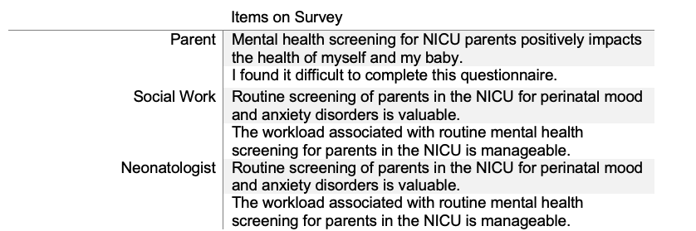
Balancing Measures
Swenson et al., 2025.
Notes:
For our balancing measures, we created a two-question survey to be administered to NICU parents, our Social work team members, and the Neonatologists. The questions were specific to the population surveyed, but essentially asked about the value of mental health screening of NICU parents and the burden of screening on parents and the team.

Slide 33
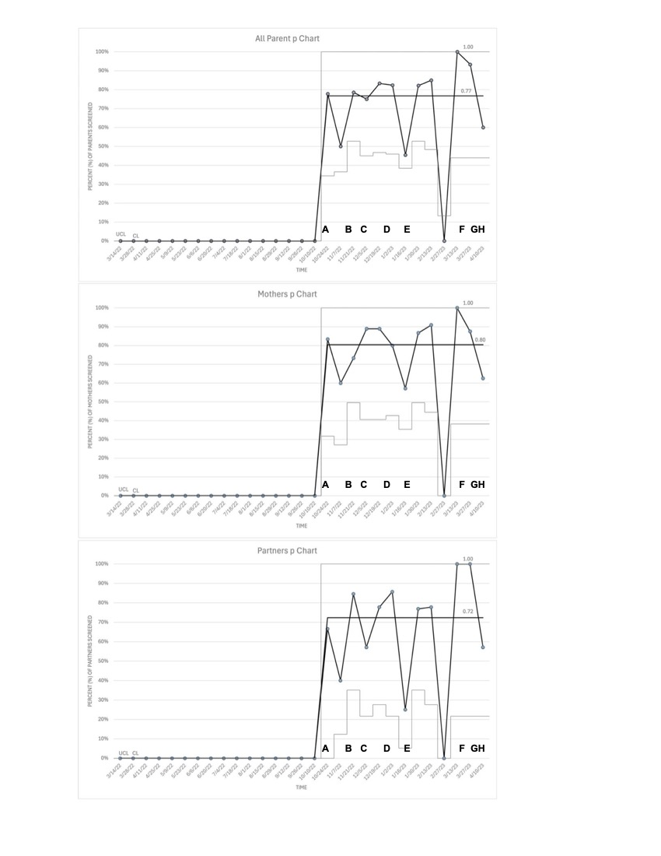
Results
Swenson et al., 2025.
Notes:
This run chart shows the baseline period and the first 6-months of screening. As you can see, there was inconsistency in those first 6 months, though we did achieve a median rate of 77%.
Excel spreadsheets were stored securely in Box
QI team lead checked EMR weekly on Monday to determine patients eligible for screening by DOL (30-36 DOL were eligible for 1 month screening, etc.)
QI team lead shared list of patients eligible that week or the following week with SW team
SW team approached families for screening and post-screening survey
SW scored screens, responded to screens, and documented results and recommendations in either parent chart (if available) or confidential note within infant chart (if no parent chart available)
Screens (with patient sticker) were returned to folders in locked SW workroom
Surveys (without patient sticker for anonymity) were returned to separate folder
QI team lead collected screens, entered completion into Excel document, and entered score results and deidentified demographic information into separate Excel document for parents who were screened or were not screened, reason that parents were not screened was noted if known
Screens were destroyed after data entry
And as I go, I’ll be highlighting some of the major lessons learned. Here you can see that we increased screening rates from a baseline of 0 to 77% when looking at all parents

Slide 34
Screen Completion by Parent Type
Swenson et al., 2025.
Notes:
We also separated our run charts by parent type and found that the screening completion rate for mothers was 80% and 72% for partners. So, although we know that partners are often more difficult to reach for screening, we demonstrated that the majority could be reached for screening.

Slide 35
Screen Completion Rate by Interval
Swenson et al., 2025.
Notes:
This slide shows the screening completion rate by screening interval with all parents in navy blue, mothers in purple and partners in lighter blue. You can see they are fairly stable across time, though higher, especially for mothers at four months and six months, indicating that it wasn’t more difficult to screen parents as time went on, even though that’s a period where more and more parents need to go back to work

Slide 36
Majority of Concerns Detected Through Informal Assessments Occurred within 1st Week After Birth
Informal assessments
(6-month period)
Standardized screening program
(6-month period)
52 parents with mental health concerns
73% detected within 1 week of birth
60/158 parents (38%) with mental health concerns
Informal assessments continued unmeasured
Lesson
Swenson et al., 2025.
Notes:
This is a comparison of the six-month periods - so using clinical interactions in our baseline period alone, we identified 52 parents with mental health concerns in a six-month period, and standardized screening resulted in 60 parents being identified through screening in a six-month period. Although those numbers look similar, that doesn’t include informal assessments, which continued but were not measured through the screening period, so we would estimate that total referrals were higher. One surprising finding was that 73% of the concerns detected through routine clinical interactions were identified within the first week of birth, and we posit that this is because parents may have more interactions with the social work team in the days following admission, than they do later in the NICU stay.

Slide 37
Standardized Screening Detected More Concerns 1 Month or More After Birth
Informal assessments
(6-month period)
Standardized screening program
(6-month period)
12 concerns (23%) detected 1 month or more after birth
60 concerns identified 1 month or more after birth
Lesson
Swenson et al., 2025.
Notes:
When we look at later time points during the NICU stay, we see that informal assessments only identified 12 concerns at or after 1 month, compared to 60 in the standardized screening program. which was lesson 2
--------
NNT uses denominator of 206 (estimated eligible in pre screening v. eligible in screening)
12/206 (6%0 in control v. 60/206 (29%) in experimental
From this, we can estimate a number needed to screen before detecting an additional concern through screening to be 4 (4.30), that is to say that you only need to screen 4 parents using standardized screening at or after 1 month to detect an additional mental health concern, compared to informal assessments alone,

Slide 38
Positive Screens by Screening Interval
Lesson
Swenson et al., 2025.
Notes:
The fact that informal screening didn’t detect many concerns one month or more after birth is especially concerning given our finding that mental health needs increased in parents with prolonged Nicu stays, which was lesson 3. The high proportion of positive screens at 4 and 6 months suggests the need for repeat screening in the inpatient setting.

Slide 39
In parents’ words
“I wish there was more [mental health] support in the last weeks of admission and in follow ups for a few months after discharge. Those first few months on the [high acuity unit] were just a blur. It wasn't until later in the stay and immediately after discharge that I needed support”
“We didn’t feel the social worker helped much at the end of our journey”
“I probably needed mental health support while my baby was in the NICU, but I definitely needed it after they came home”
Swenson, unpublished.
Notes:
In our pre-screening implementation surveys, we also saw a common theme when parents were asked open-ended questions about what was or wasn’t working for Nicu families under our current system related to support after the initial weeks. One parent said
Another said
And a parent on our QI team said

Slide 40
Similar Rate of Parents had Established Mental Health Clinicians
Informal assessments
(6-month period)
Standardized screening program
(6-month period)
21% of referred parents had established mental health providers
26% of referred parents had established mental health providers
Swenson et al., 2025.
Notes:
It’s important to note that a similar rate of parents in both periods who were referred had established mental health clinicians.

Slide 41
Standardized Screening Detected More Parents with Suicidal Ideation
Informal assessments
(6-month period)
Standardized screening program
(6-month period)
No suicidal ideation detected
4% of parents who were screened disclosed passive suicidal ideation
Swenson et al., 2025.
Notes:
We also found that more parents were identified through screening to be experiencing suicidal ideation, which was evaluated to be passive, but we did have an escalation of care policy if parents disclosed active suicidal ideation.

Slide 42
Standardized Screening Detected more Partners with Mental Health Concerns
Informal assessments
(6-month period)
Standardized screening program
(6-month period)
6% were fathers/partners
30% were fathers/partners
Lesson
Swenson et al., 2025.
Notes:
Screening increased the rate of concerns identified in partners 5-fold. So, lesson 4 was that partners' needs are unlikely to be met without systematic attention to their inclusion in the NICU.

Slide 43
Parent Perceptions of Screening
140/206 (68%) returned surveys on parent perceptions of screening
93% agreed screening was valuable
11% agreed screening was difficult
4 parents (2%) explicitly declined screens or social work involvement
1 declined screening, citing privacy concerns, lack of time
2 declined SW involvement
1 returned blank screen
Swenson et al., 2025.
Notes:
Of the parents who returned surveys on perceptions of screening, the majority viewed screening as valuable. Some parents wrote things like ‘thank you for asking’ on the bottom of screens or surveys. And only 11% found screening difficult.
We also looked at the number of parents who explicitly declined screening or social work involvement, which was low at 2 percent.

Slide 44
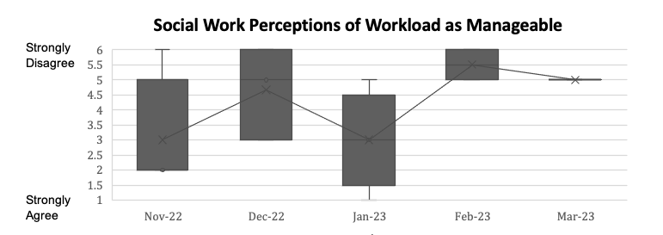
Workload increasingly perceived by SW team as unmanageable over time
Point after which only 2/5 NICU Social workers covering unit
Lesson
Swenson et al., 2025.
Notes:
Physician perceptions of screening were overwhelmingly positive in terms of value. Our social work team agreed that there was great value in screening.
However, the workload was increasingly perceived by the social work team as unmanageable over time, especially after unexpected leaves meant only two NICU social workers were covering a unit that is usually covered by five social workers. So, lesson 5 was that nicus likely need additional psychosocial team members to support effective perinatal mental health screening programs. The local data we were able to provide to our initial health system through screening led to greater institutional interest in this topic and collaboration with both child and adult psychologists as we worked toward embedding more services within the NICU.

Slide 45
Limitations of Screening Program
Did not assess trauma symptoms
Did not screen post-discharge
Did not track whether parents received mental healthcare after referral
Notes:
There are also limitations of our pilot screening program, including that we didn’t assess trauma symptoms. We did not screen post-discharge, and we did not track whether parents received mental healthcare after referral.
Screening rate was not 100%
Some parents may not disclose mental health symptoms through screening
Baseline data relied on a social work team
May underestimate mental health concerns detected through informal assessments
May overestimate concerns detected due to observer bias
Unable to track concerns detected outside of screening during screening period

Slide 46
Expansion to two additional NICUs
Notes:
After a successful rollout at our first site, and the 2023 AAP recommendation to screen parents in NICUs, we were excited to introduce our screening program to a second level IV NICU in Minneapolis and a level 3 NICU in Saint Paul. The two sites care for almost 3,000 neonates per year, compared to the roughly 800 per year at site 1. So the ability to impact more parents was quite appealing.

Slide 47
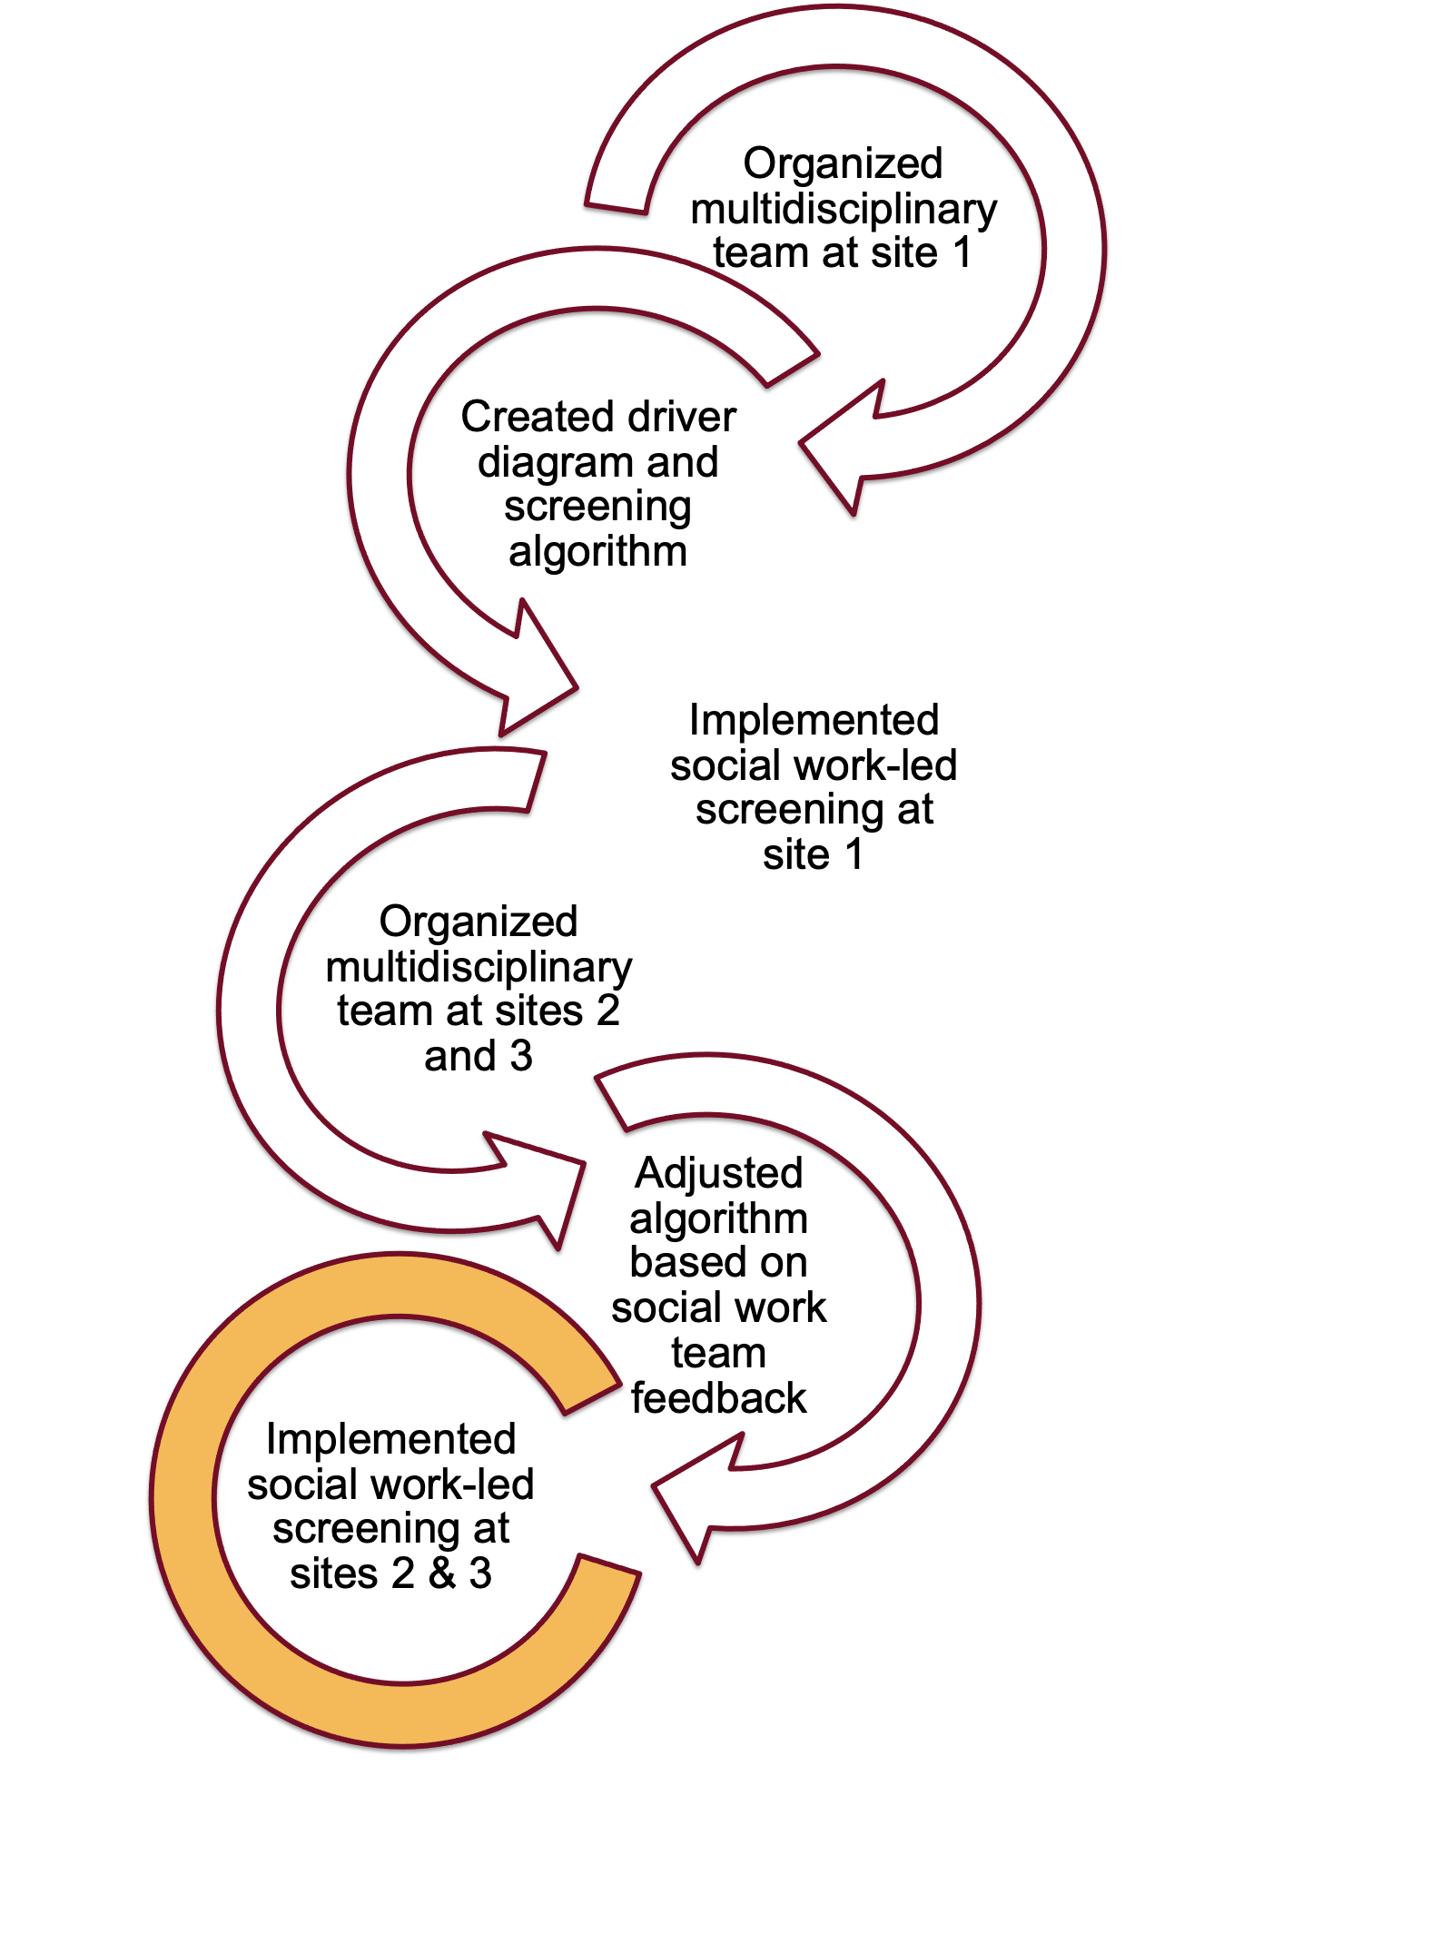
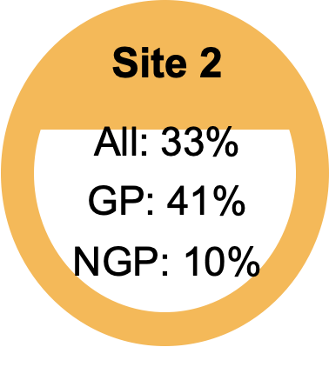

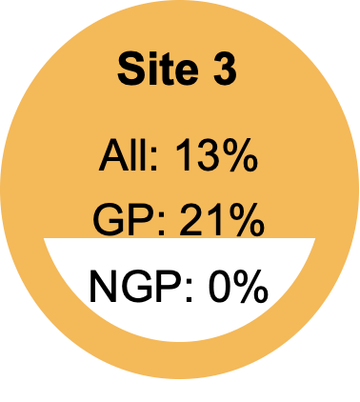
What we did
Measures
Outcome: Screening rate
Process: Rate of screens positive
Balancing: Perceptions of screening among physicians, social workers and parents
Notes:
We organized our multidisciplinary team, made adjustments to our methodology with the use of a different screening tool to match our OB partners at sites 2 & 3, we shared the importance of screening with our teams, and used the same metrics. At site 2, we screened 41% of gestational parents and 10% of nongestational parents in our first 6 months. And at site 3, we screened 21% of gestational parents and NO nongestational parents.

Slide 48

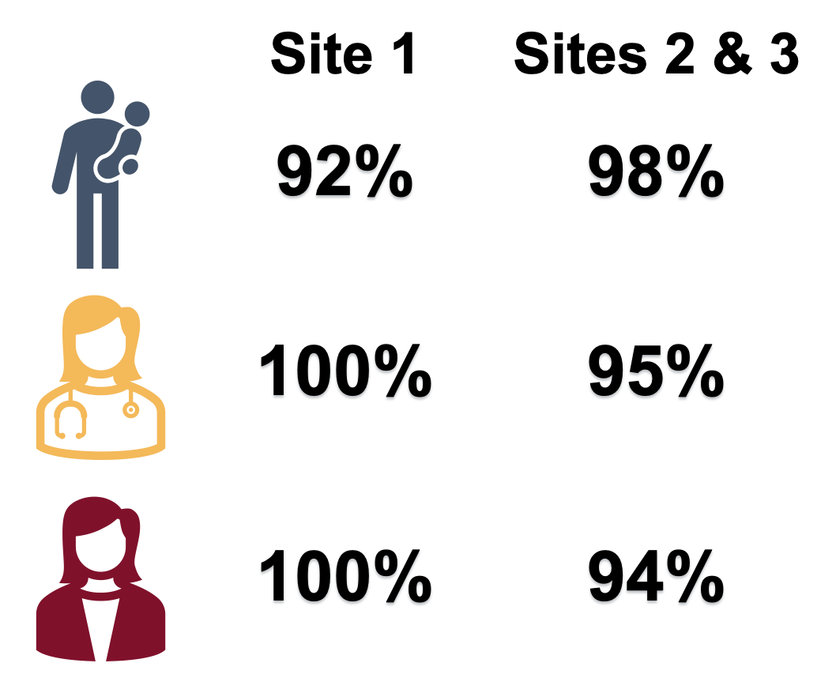
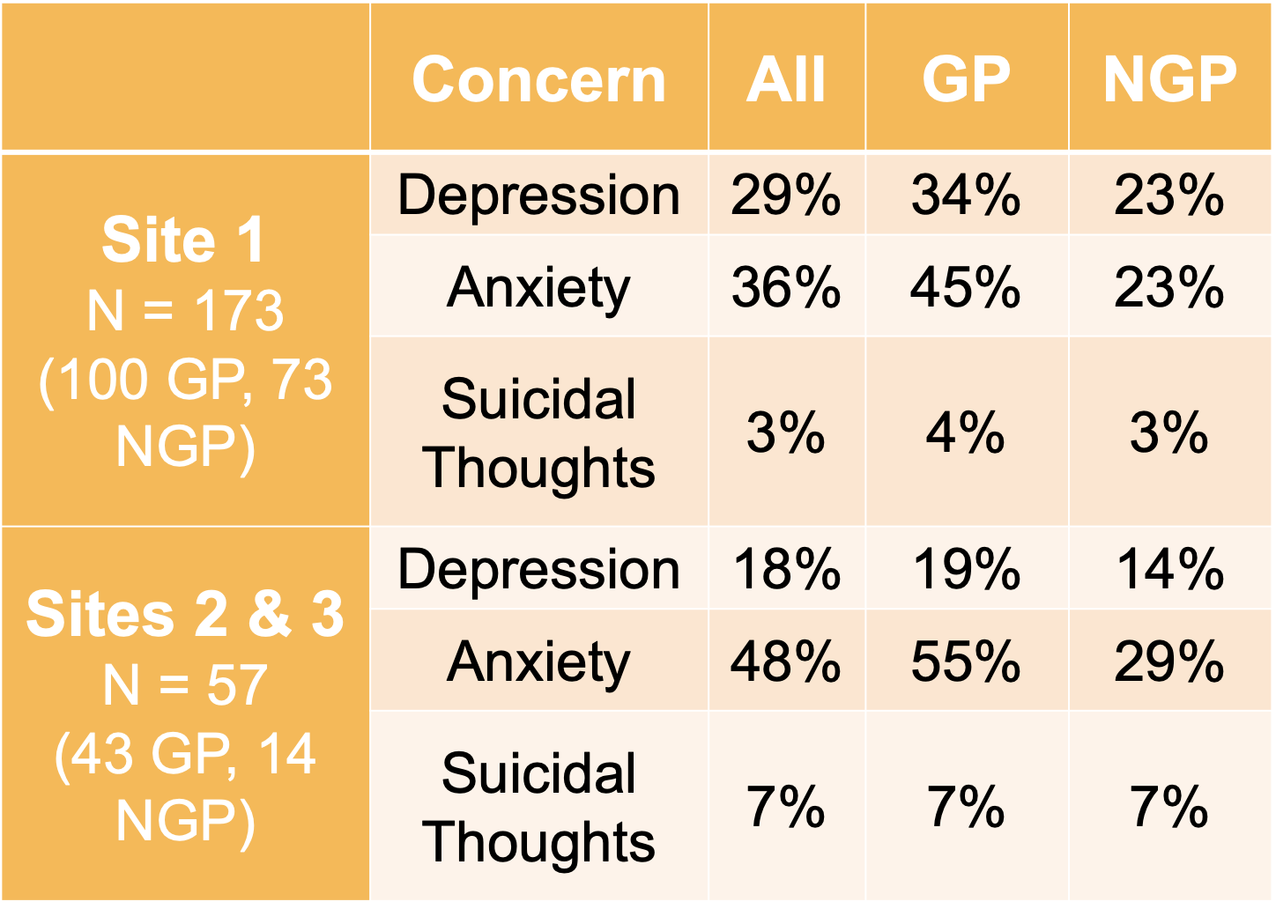
What was similar?
Percent Positive
Perceptions as Valuable
Notes:
So what was similar? Well, the demographics for the units were similar. Rates of depression, anxiety and suicidal ideation were similar. Perceptions of the value of screening from parents, social workers, and neonatologists were very similar and quite positive.

Slide 49
What was different?
Lack of social work QI team lead at sites 2 & 3
Project lead on maternity leave during rollout at sites 2 & 3
Different screening tools
Slightly different algorithms, allowing SW to provide therapy at bedside to families where appropriate
Less system support at sites 2 & 3/not tied to bonuses
Notes:
But, we struggled with ownership of the work at sites 2 and 3. We used different screening tools. We had different algorithms with our social work teams providing therapy at the beside where appropriate. And another difference was that an incentive bonus was tied to screening at site 1. No such bonus was tied to sites 2 and 3.
I’m describing a classic example of what works at one site will not necessarily work at another site. And this is my final lesson of the day: local stakeholders are invaluable to the success of any QI initiative. We can borrow and replicate where it makes sense, but each unit needs to work through their own PDSA cycles in order to establish a screening program that works locally.

Slide 50
Current State and Sites 2 and 3
Weekly “To Be Screened List”
Data are tracked by the SW team, increased ownership of process
EPDS now standard
Expansion to Intensive Care Follow-Up Clinic
Notes:
I’m happy to report that our screening rates have dramatically improved since 2023 at Children’s Minnesota. We have an automated weekly “to be screened” list from our EMR that’s published every Monday morning. Our data are tracked by our social work team and they truly own the process. We switched to the EPDS for screening and we have expanded to our Intensive Care Follow Up clinic.

Slide 51
Key elements of screening
Notes:
I want to highlight some key elements of screening.

Slide 52
Screening Tools
Depression:
  Edinburgh Postnatal Depression Screen (EPDS)
  Patient Health Questionnaire (PHQ-2 or PHQ-9)
Anxiety
  Perinatal Anxiety Screening Scale (PASS)
  EPDS has one question
  Generalized Anxiety Disorder (GAD-2 or GAD-7)
Other tools for: Psychosis, Substance Use Disorder, OCD, PTSD, Bipolar, and others.
Notes:
There is no single best screening tool. We considered what our outpatient clinics were using, what our OB colleagues were using, and we made adjustments over time.
EPDS has 10 questions
PHQ 2 questions or 9 questions
PASS 31 questions
GAD 2 or 7 questions

Slide 53
Timing of Screening
Standardized screening may be especially beneficial beyond first few weeks of admission, when interactions with psychosocial team members may be less frequent
Longitudinal screening appears to be important
More work is needed to understand parent perspectives
  Determine appropriate frequency of screening to detect symptoms that may arise later without becoming overly burdensome
Notes:
Standardized screening appears to be especially beneficial in identifying parents with mental health symptoms beyond the first few weeks of admission, when interactions with the social work team may be less frequent.
Longitudinal screening appears to be important, as the Initial screen may miss symptoms that develop later in NICU stay.
BUT we need to work with parents to understand their perspectives and determine a frequency of screening that maximizes detection of symptoms and early intervention without being so frequent as to become burdensome.
We chose to mirror the well child check intervals, but other NICUs have established different protocols for screening with success.

Slide 54
Inclusion of Partners
Supporting mental health of all parents is important
Mental health concerns in partners are likely to be missed without systematic attention and inclusion
Partners are not routinely included in parent mental health screening that occurs during outpatient well child visits
AAP Resolution
Mental health of partners is less frequently discussed, not explicitly included in many perinatal mental health resources
  Development of specific supports may be beneficial
Notes:
We need to systematically include partners – the mental health of all parents is important.
We found that we were missing partners with mental health concerns when we relied on our clinical interactions with them. The use of validated tools should be considered, with attempts to screen universally.
This is especially important because partners are not routinely screened after nicu discharge during postpartum visits. An aap resolution was passed in 2025, asking the AAP to explicitly include partners in screening recommendations for NICU families, and to include recommendations for partners in the next AAP policy statement on perinatal depression screening at well child visits.
We must also recognize that partner mental health is further stigmatized by less frequent discussion. And resources, such as the maternal mental health hotline, accept calls from partners, but the name alone may discourage them from receiving the support they need.

Slide 55
Workload Associated with Screening Warrants More Attention
Screening takes time to perform well
Dedicated workforce is likely needed for screening programs to be successful
  Designated staff for screening, referring, and auditing program (Perazzo et al)
Others have recommended availability of psychotherapy within units (Hall et al)
We must advocate more psychosocial supports within our units and beyond
Notes:
The workload associated with screening reported by the social work team must also be highlighted. Additional personnel are likely needed for screening programs to be successful in the long term.
Acknowledging that the ultimate goal of screening is to connect parents with mental health symptoms to mental health care, some have recommended the availability of psychotherapy within units. If this doesn’t sound aspirational enough for your unit, I’ll also add that this support should be available at no cost to parents. We have a lot of work to do within our systems to make this a reality.

Slide 56
Consideration of Electronic Screening
Possible benefits
  Improve accuracy of algorithm adherence
    Especially when algorithms are complex due to use of multiple screening tools or different thresholds
  Decrease time between screen completion and parent discussion with psychosocial team member on screening results
  Decrease workload associated with screening
  Improve screen completion rate?
Notes:
Lastly, electronic screening may be beneficial compared to paper screening, although parent perspectives will be important to understand before implementing.

Slide 57
More Work is Needed to Develop Systems that are Effective Across Institutions
Screening is a complex intervention
Unlikely that a one-size-fits-all approach will be effective
There’s much we can learn from one another
Notes:
And, More Work is Needed to Develop Systems that are Effective Across Institutions.
Screening is a complex intervention….

Slide 58
What can we do?
Understand the problem
Advocate for upstream interventions
Screen for mental health problems
Know local resources for treatment of PMH disorders
Refer or provide treatment locally
Notes:
Finally, I’ll share local resources for the treatment of perinatal mental health disorders in order for your teams to connect families to treatment locally.

Slide 59
Local resources

Slide 60
Key Organizations and Resources
Postpartum Support International
Maternal Mental Health Leadership Alliance
Policy Center for Maternal Mental Health
National Maternal Mental Health Hotline
March of Dimes
Notes:
I shared this slide earlier. These are some of the largest and best-known national and international organizations in this space.

Slide 61

Illinois Department of Healthcare and Family Services
Local support groups for perinatal depression by county
Outpatient mental health clinics by county
Notes:
The Illinois Department of Healthcare and Family Services offers local support groups for perinatal depression by county
As well as Outpatient mental health clinics by county

Slide 62


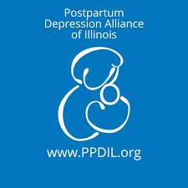

Additional Resources
Local partners: obstetricians, family practice, MFMs, midwives, doulas, social workers, mental health professionals
Postpartum Depression Alliance of Illinois
Illinois Doc Assist
Illinois Chapter of Postpartum Support International
Notes:
Please work with your local partners in the continuum of care. Our local obstetricians, family practice, MFMs, midwives, doulas, social workers, and mental health professionals are great sources of information for local teams. Additionally, Illinois-specific organizations are available. The Postpartum Depression Alliance of Illinois
Illinois Doc Assist
Illinois Chapter of Postpartum Support International are some of your state’s resources.
And while I didn’t discuss trauma-informed care and communication in this talk, it’s important for us to familiarize ourselves with these principles in order to best support our NICU families.

Slide 63
Thank you
Notes:
I thank you for your attention!

