Slide 1
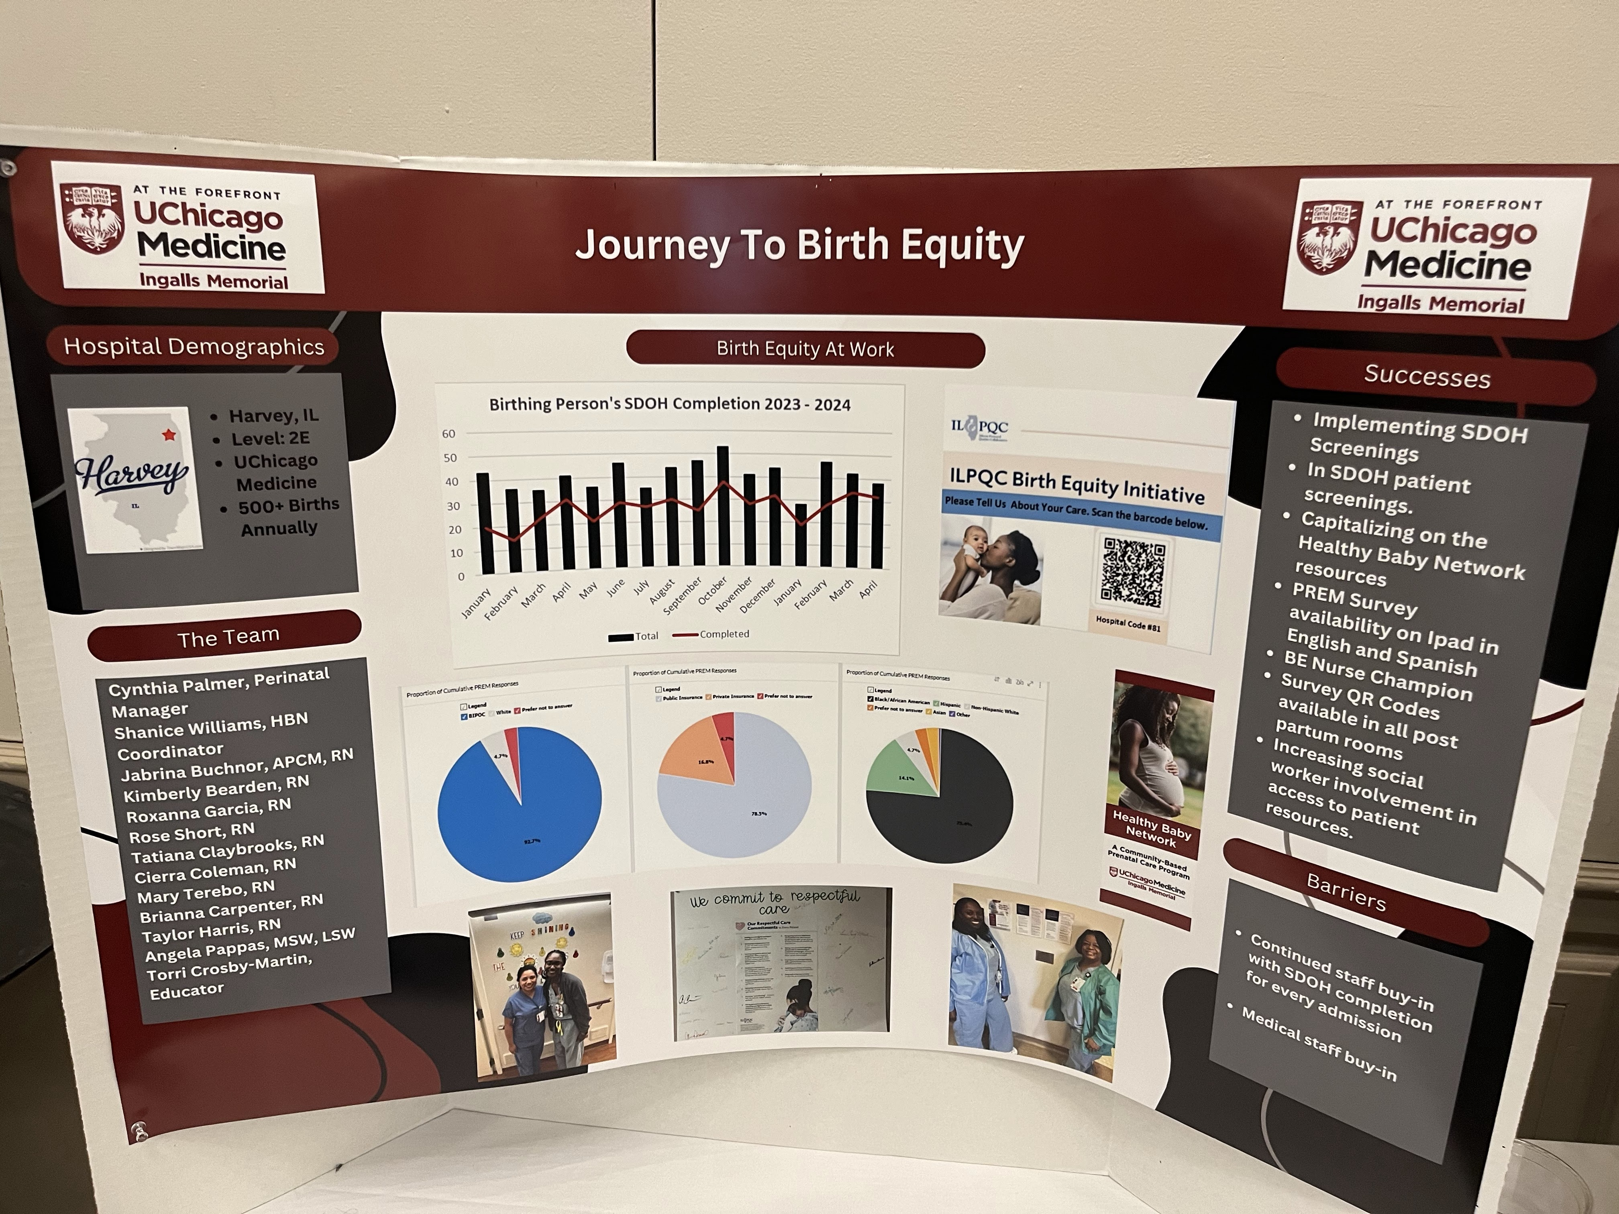
OB F2F Storyboard Template
OB DAY IS MAY 20, 2026

Slide 2
What is a Storyboard?
A storyboard is a visual summary of your team’s quality improvement journey. It tells the story of what changed, how it changed, and why it matters.
At ILPQC Face-to-Face meetings, storyboards allow teams to:
Share successes and challenges
Highlight creative implementation strategies
Show real data and impact
Learn from one another
Celebrate progress!

Slide 3
How to Use This Template
Be creative and have fun!
Focus on where meaningful change has occurred
Use the “Where were you → Where are you now → How did you get there” prompts
Show movement in these areas
Include visuals whenever possible
Data, workflows, tools, photos, quotes
End with reflection and sustainability
What will last? What did you learn?

Slide 4
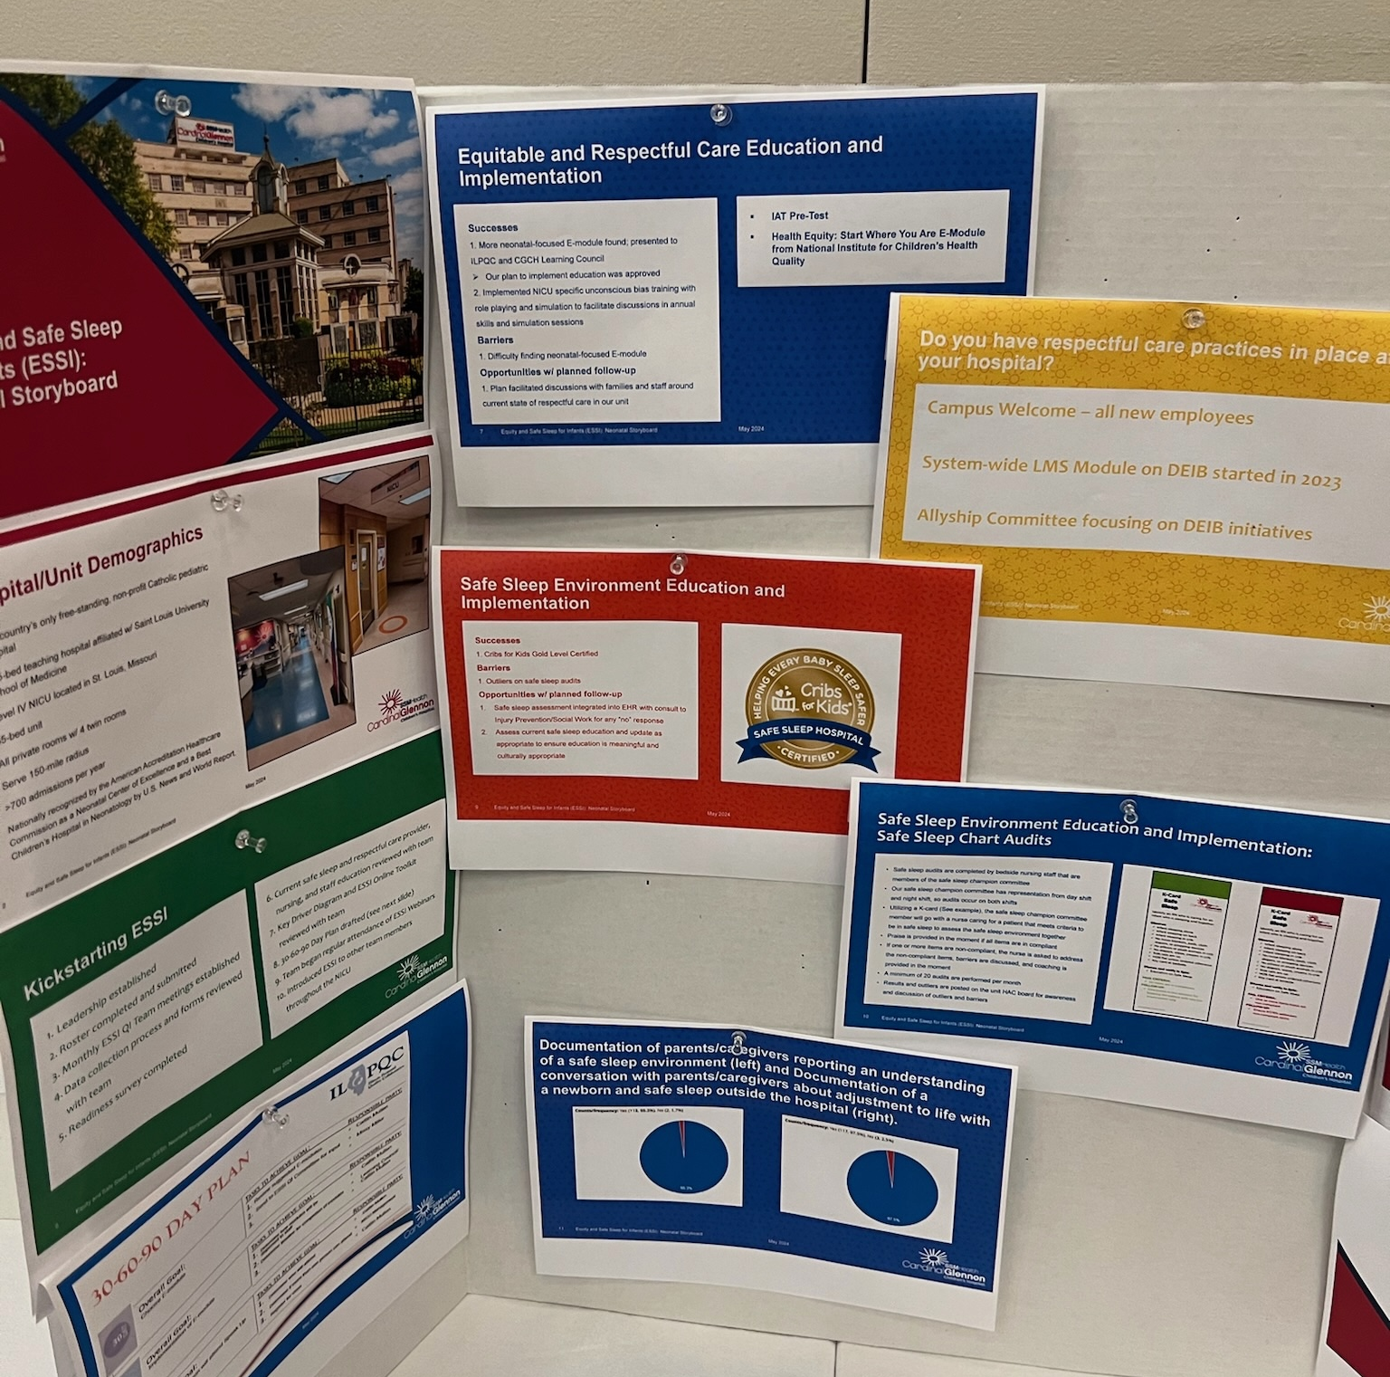
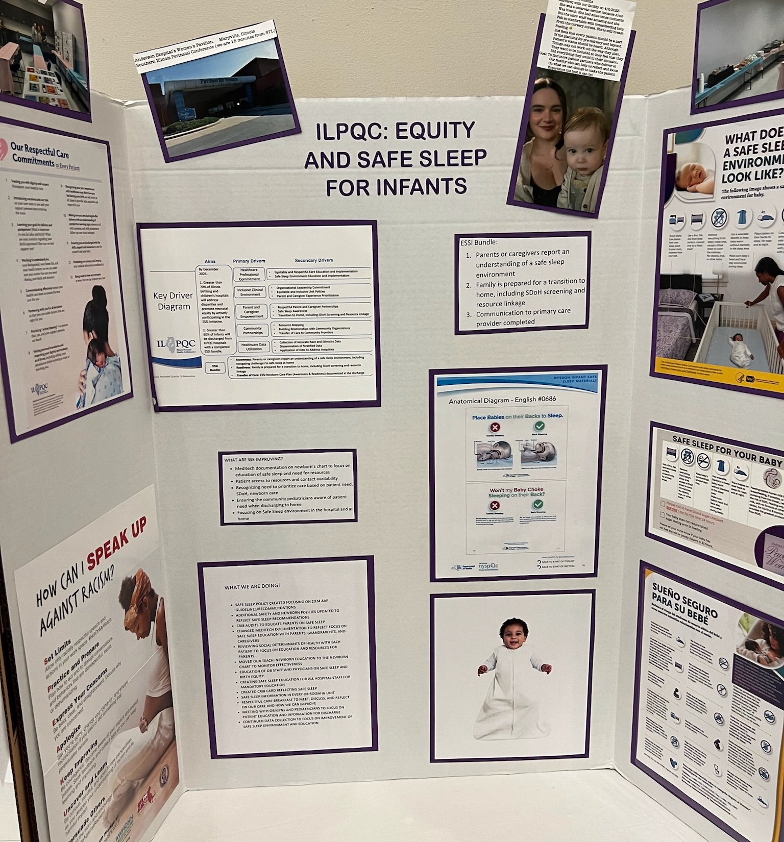
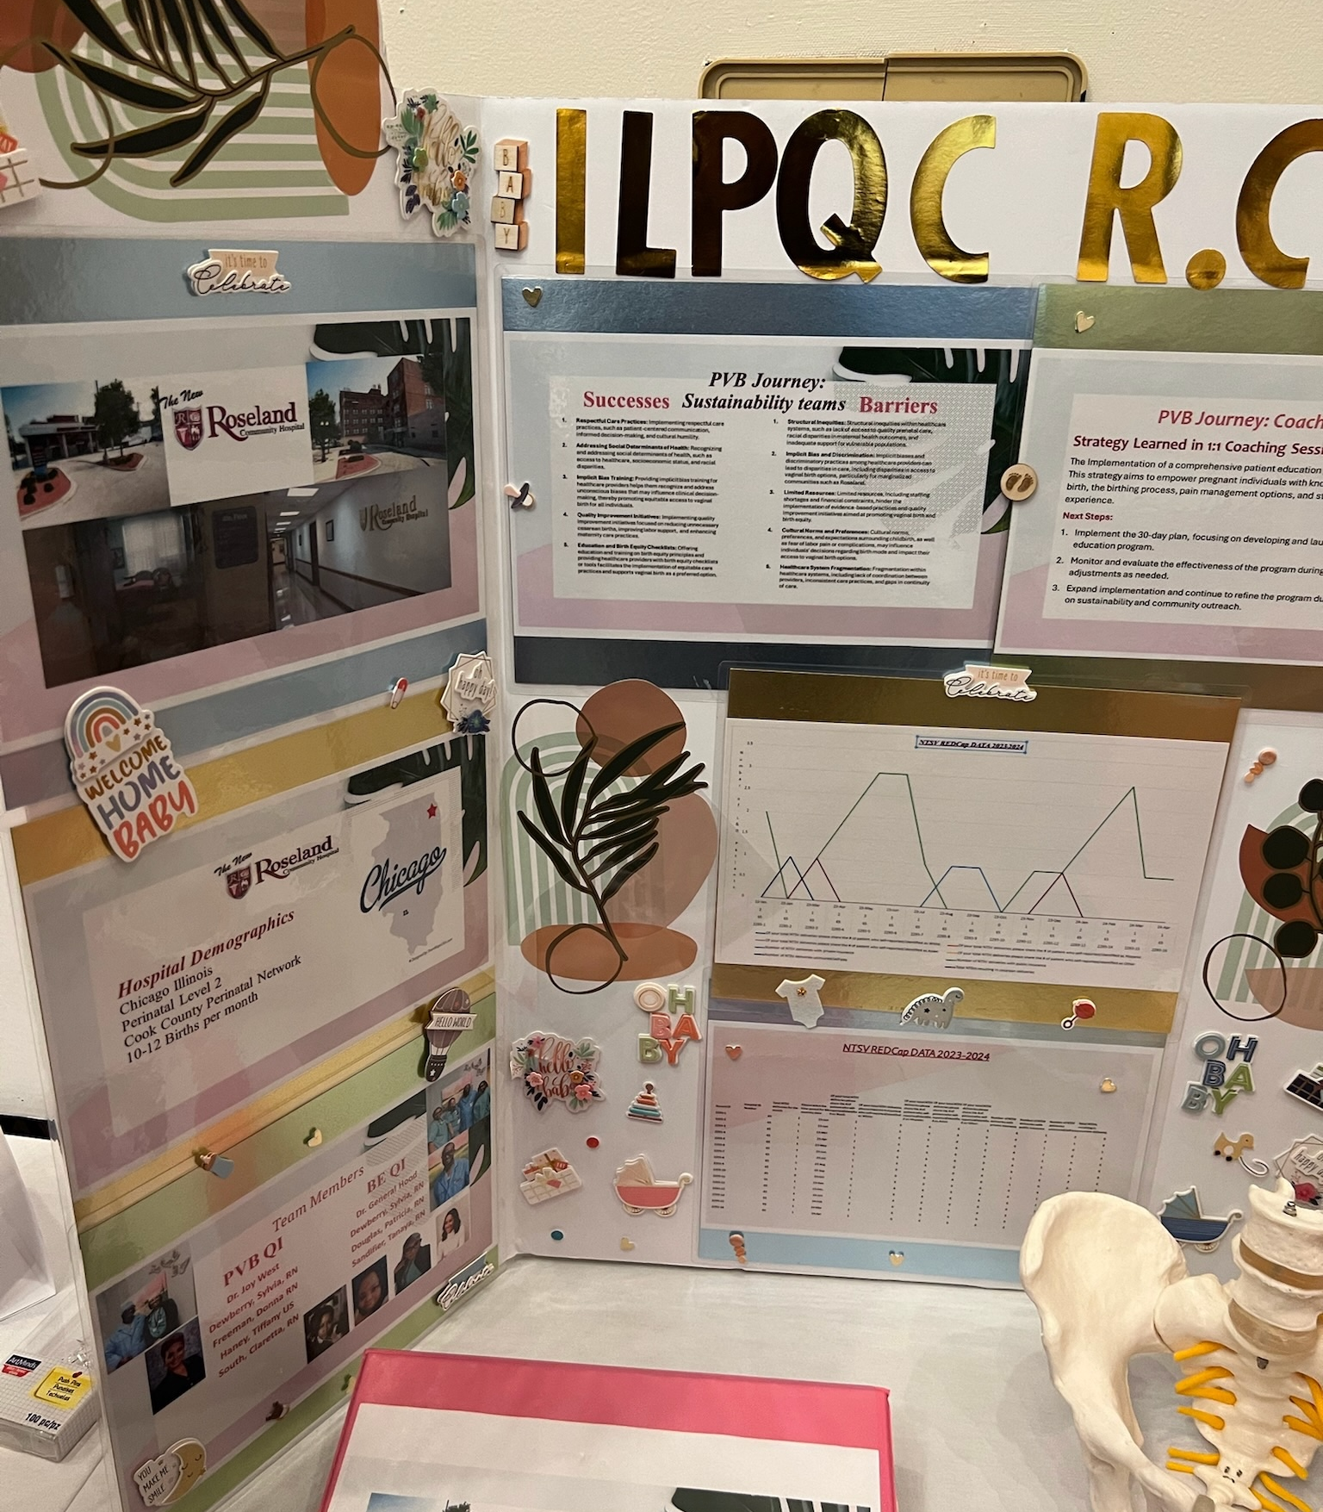
Creativity Tips
Make this your own
Use photos from your unit
Highlight your team members
Share your QI highlights from this year
Include quotes from staff or families
Add before-and-after comparisons
Show what makes your hospital unique

Slide 5
Storyboard Ideas – Pick Your Theme (TeamBirth, BQD, or PMH)
OB Story Board Template
Hospital Name
Pathway to Birth Quality Designation (Sustainability of PVB and BE)
Perinatal Mental Health
Success
Including Data
Hospital Demographics
Birth Quality Designation Team Members
Success
Including Data
Goals for 2026
Example PDSAs
Barriers and plans to address
PMH workflow (diagram) for response to positive screens including improve access to treatment and warm handoffs
Perinatal Mental Health (PMH) Team Members
Helpful resources
TeamBirth Team Members (if participating in Waves 1 or 2)
Engagement of patient partners and Respectful Care Breakfasts
Helpful resources
Introduce your hospital’s Birth Quality Designation, PMH, and TeamBirth teams
Birth Quality Designation Journey
Engaging Patient Partners & Respectful Care Breakfasts
PMH Journey
Successes and Opportunities
Sustaining PMH Workflows

Slide 6

Hospital Name Insert Hospital Logo
Hospital Demographics
Location
Perinatal Level, Perinatal Network
Birth Volume
Names and titles of Birth Quality Designation, Perinatal Mental Health, and QI team members
Pictures of your teams, picture of hospital
*Include map of where your hospital is located: TownMapsUSA.com - Maps of ILLINOIS

Slide 7
Pathway to Birth Quality Designation (Sustainability of PVB and BE)
Discussion Prompts
Successes and Barriers?
What key strategies were used to achieve success? What opportunities is the team currently working on? What is the planned follow-up?
Share your work on building relationships with Doulas and/or Home Visiting Programs to improve care
Share your work on engaging patient partners to improve care
How did they become involved with your hospital?
How are they engaged with your QI team?
Share one success and one barrier
Share pictures from your hospital's Respectful Care Breakfast (RCB)
Any patient or staff quotes from the RCB or lessons learned for your staff?
Where were you → Where are you now → How did you get there

Slide 8
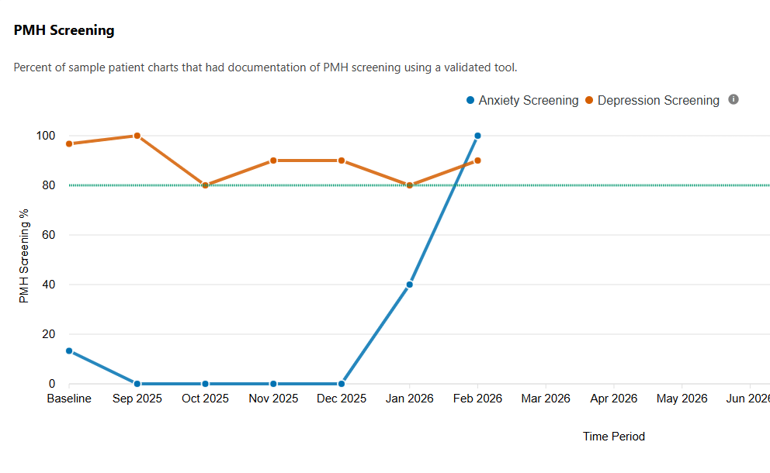
Perinatal Mental Health Journey
Discussion Prompts
Successes and Barriers?
What key strategies have you implemented (e.g., clinical staff PMH training, patient education, access to work groups, screening workflows)?
What opportunities is the team currently working on? What is the planned follow-up? (e.g., educating OB/ED staff, implementing response to a + screen workflows, linking patients to follow-up care upon discharge)
Highlight PMH resources that your team has found helpful/resources that your team developed to achieve success or a new strategy learned in monthly webinars and QI calls
Highlight your PDSA cycles
Describe completed or ongoing cycles related to: screening, treatment initiation, warm handoff, outpatient linkage or ED workflow.
Share your PMH workflows on screening, treatment, & follow-up
How are OB providers engaged in the PMH workflow?
How are you helping OB/ER providers access PMH treatment and warm handoff resources?
What innovative strategies are being utilized for warm handoffs?
Share your data from REDCap. Reach out if you need assistance.
EXAMPLE
Where were you → Where are you now → How did you get there

Slide 9
TeamBirth Wave 1 Teams (Only applicable to Hospitals participating)
Discussion Prompts
Successes and Barriers?
What key strategies were used to achieve success of TeamBirth being launched on the unit? What opportunities is the team currently working on to continue the monitoring TeamBirth progress?
Share your work on engaging providers and clinical staff to prepare staff for TeamBirth
How did you build your TeamBirth implementation team and champions?
What strategies did you use to build momentum prior to launch and help get the team trained and ready?
Share one success and one barrier
Share pictures from your hospital’s TeamBirth Launch Event
Any patient or staff quotes from the launch or lessons learned for your staff?
Where were you → Where are you now → How did you get there

Slide 10
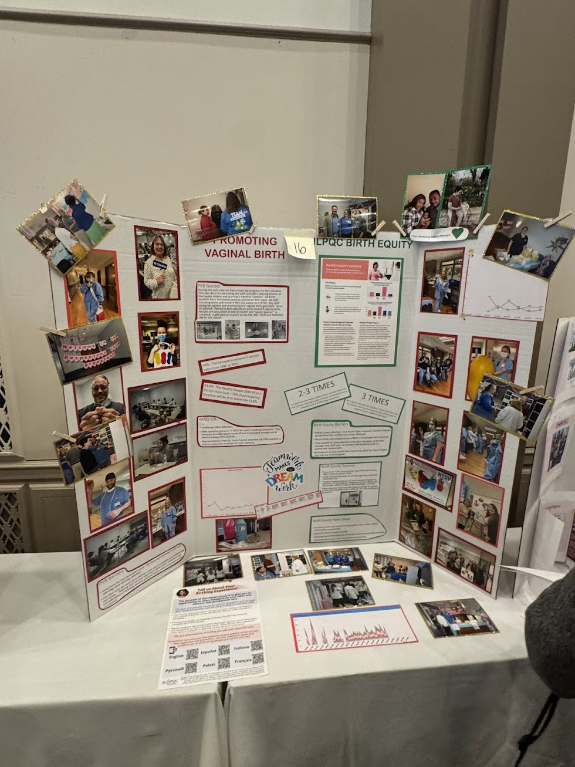
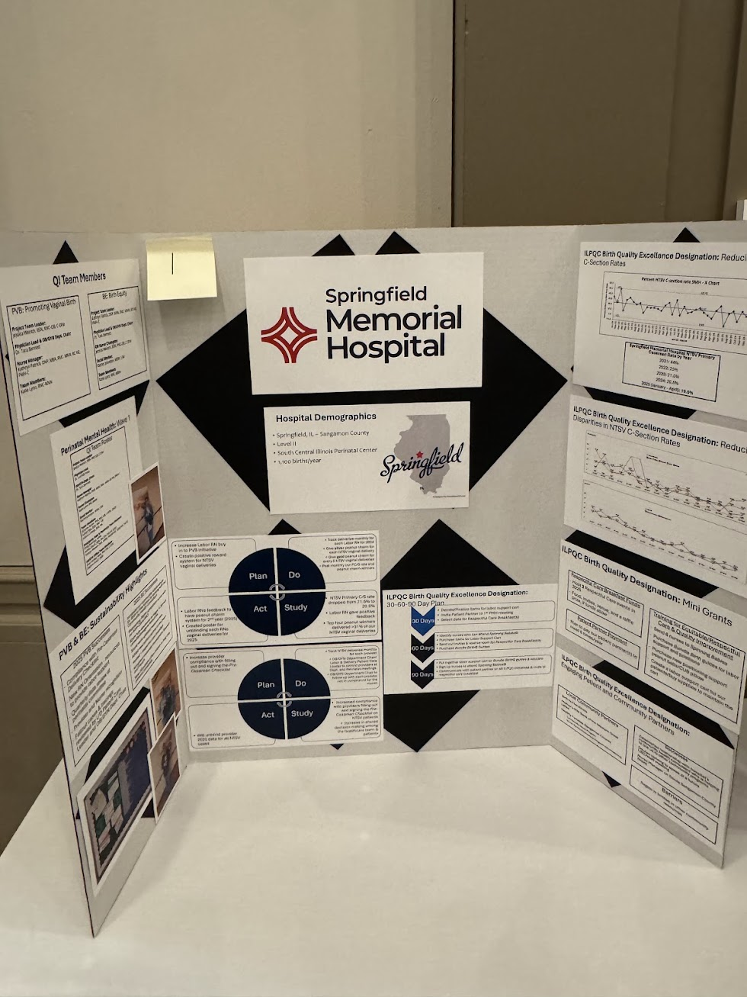
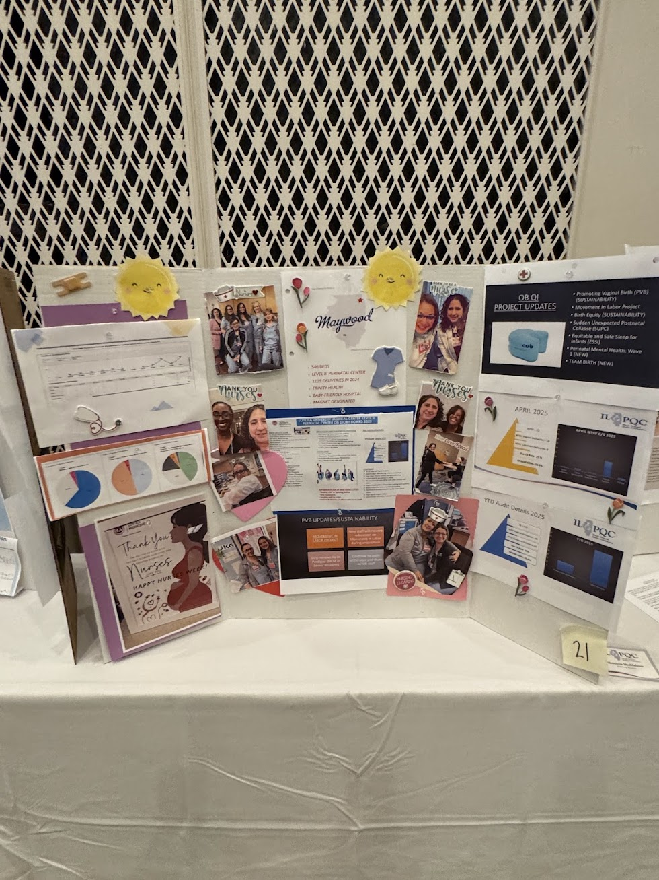
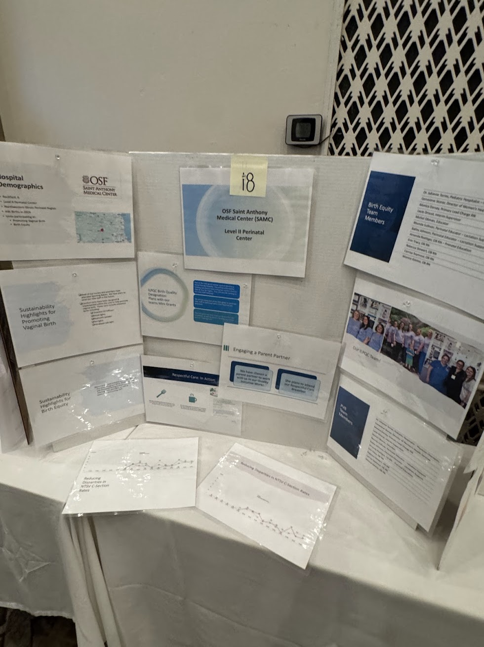
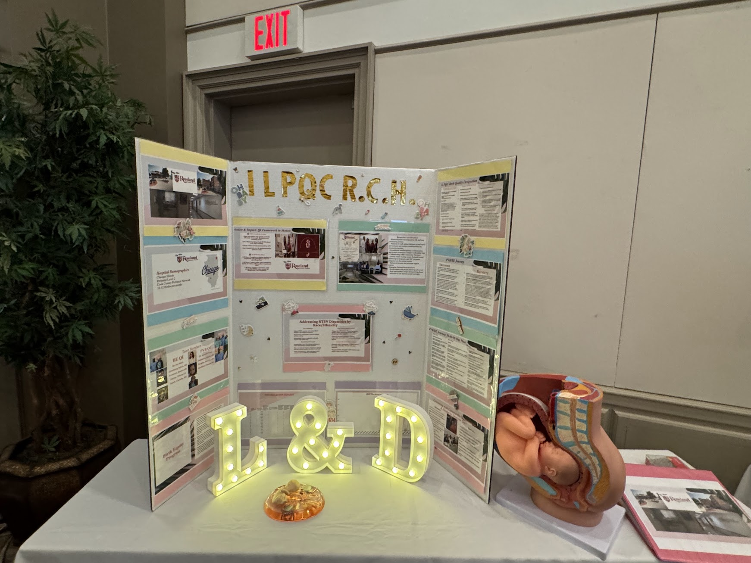
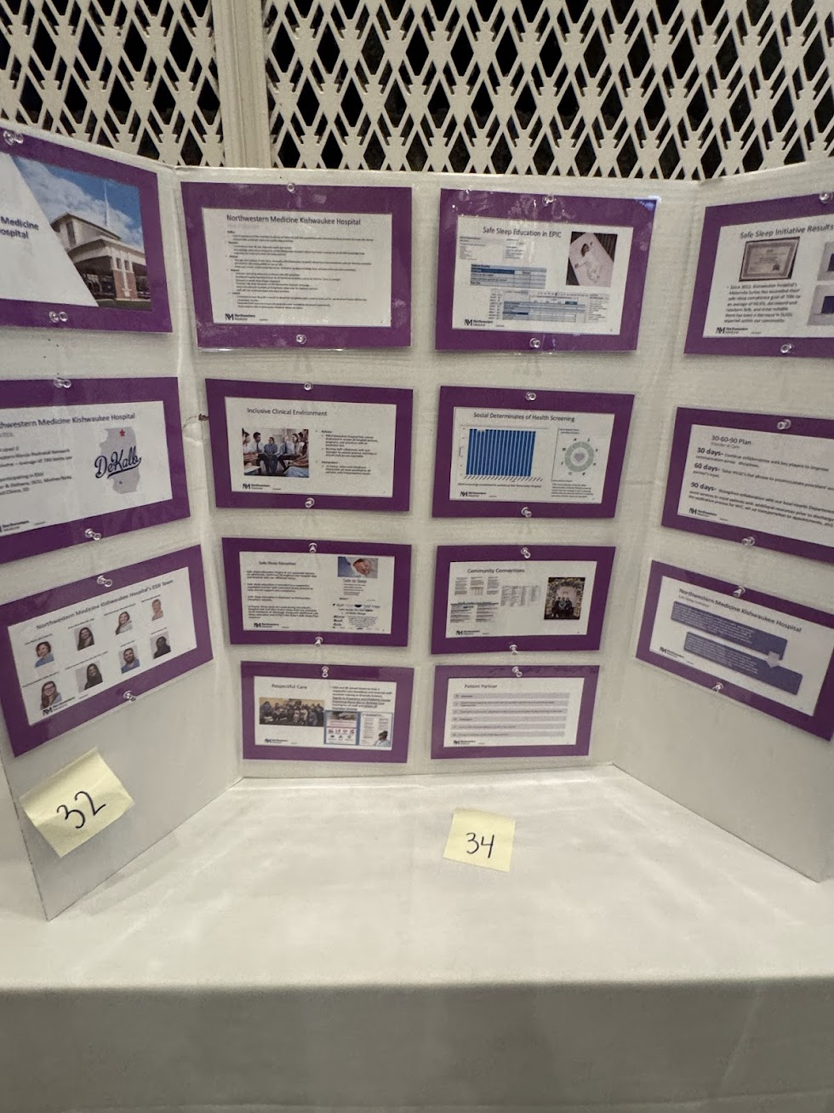
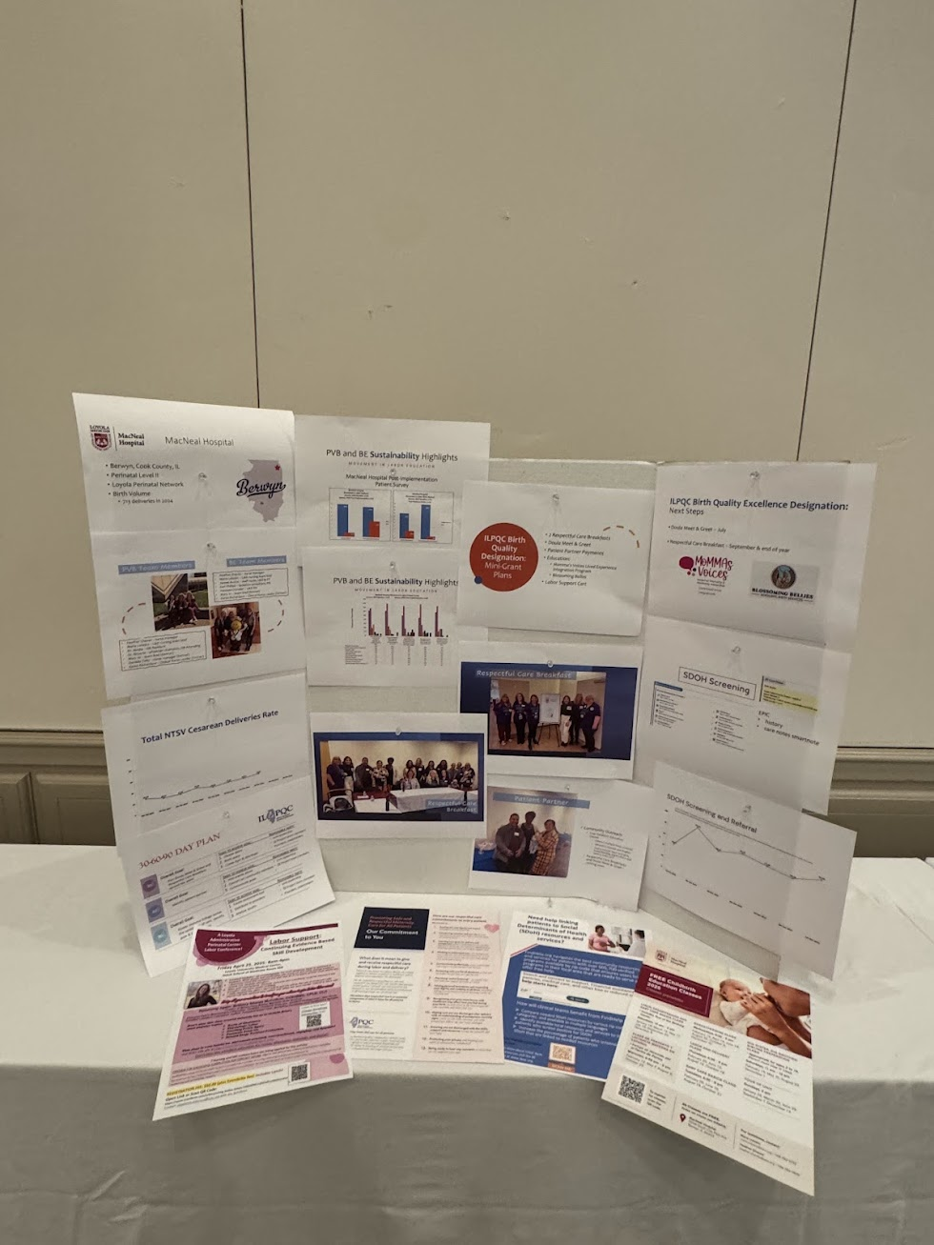
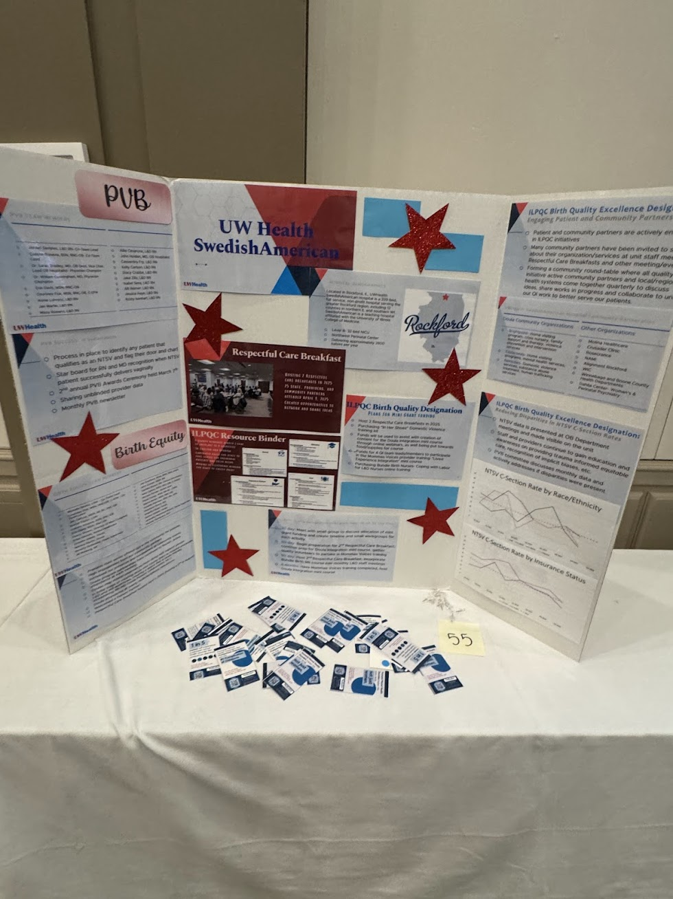
Examples from Past Events
MOST IMPORTANTLY, HAVE FUN!

