Slide 1
What is a Storyboard?
A storyboard is a visual summary of your team’s quality improvement journey. It tells the story of what changed, how it changed, and why it matters.
At ILPQC Face to Face meetings, storyboards allow teams to:
Share successes and challenges
Highlight creative implementation strategies
Show real data and impact
Learn from one another
Celebrate progress

Slide 2
How to Use This Template
You don't need to complete every section.
Choose the sections that best reflect your journey
  Focus on the areas where meaningful change occurred.
Use the “Where were you → Where are you now → How did you get there” prompts
  Show movement in these areas
Include visuals whenever possible
  Data, workflows, tools, photos, quotes.
End with reflection and sustainability
  What will last? What did you learn?

Slide 3
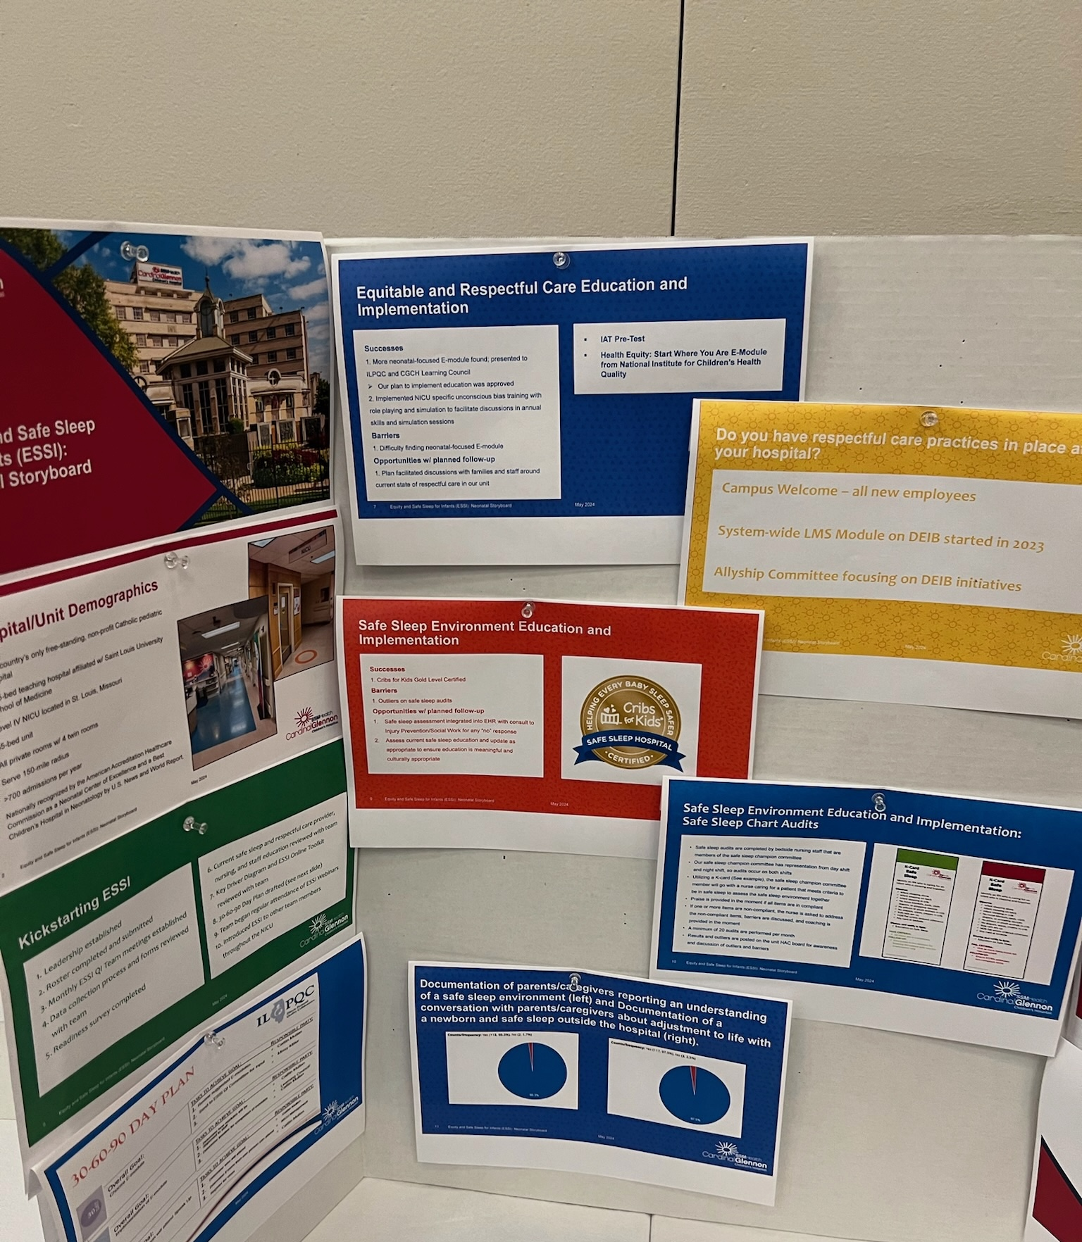
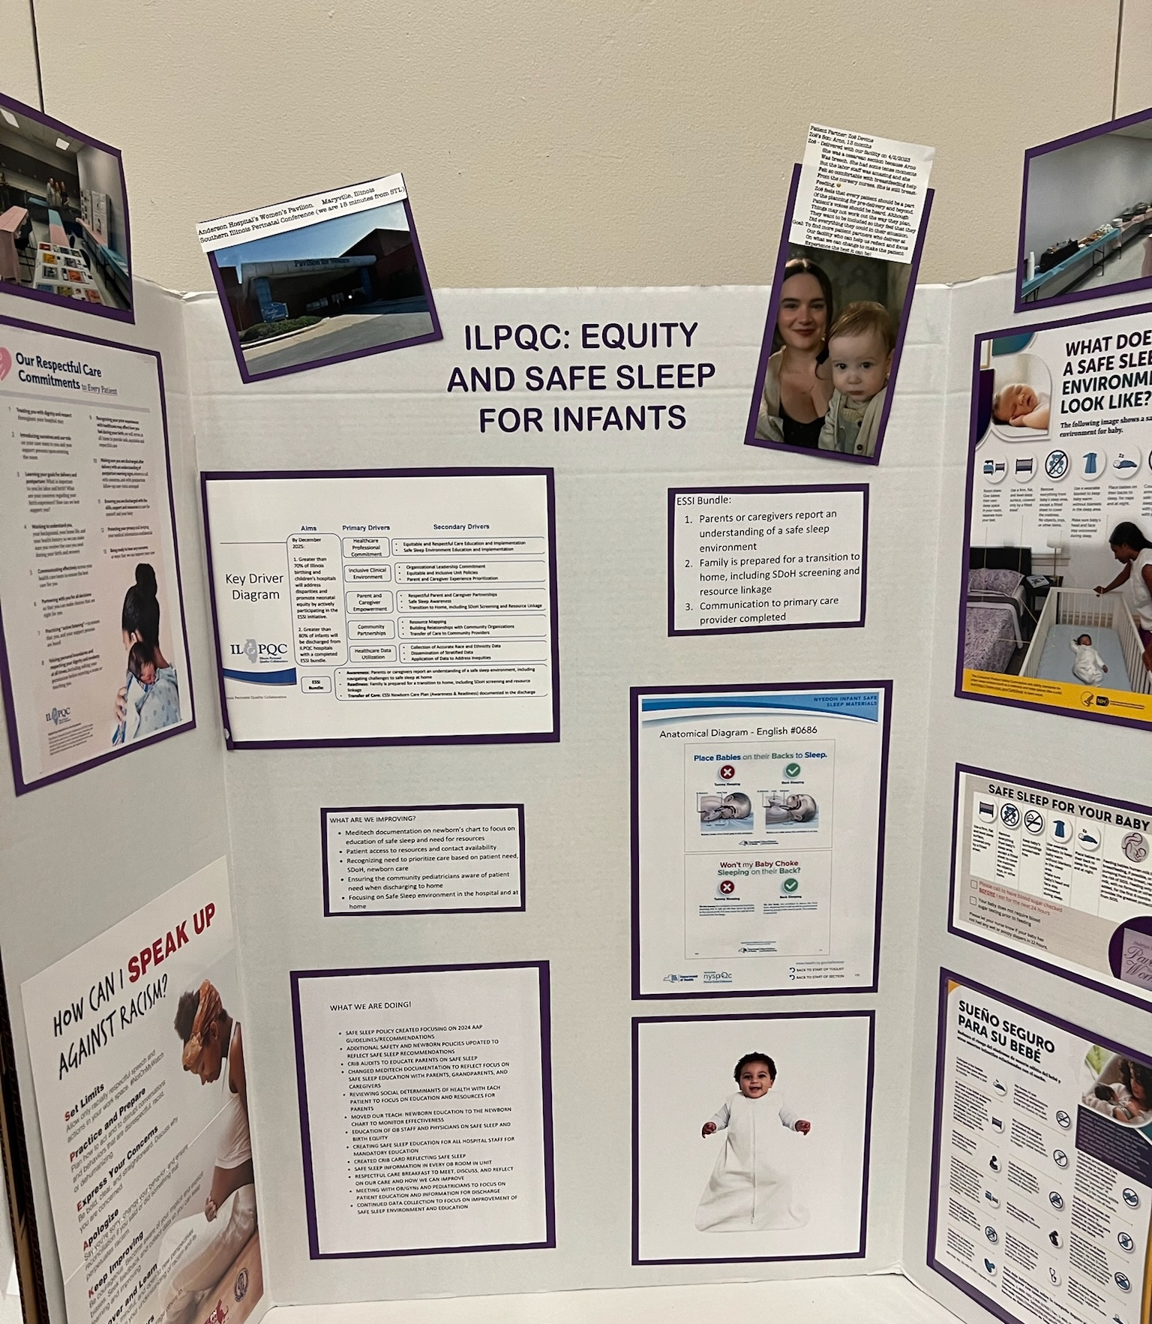
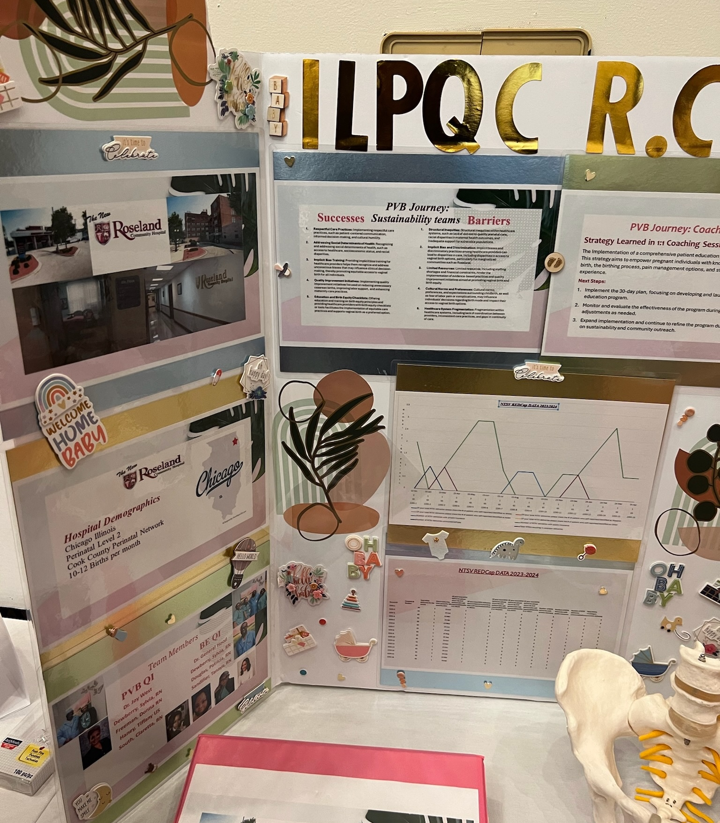
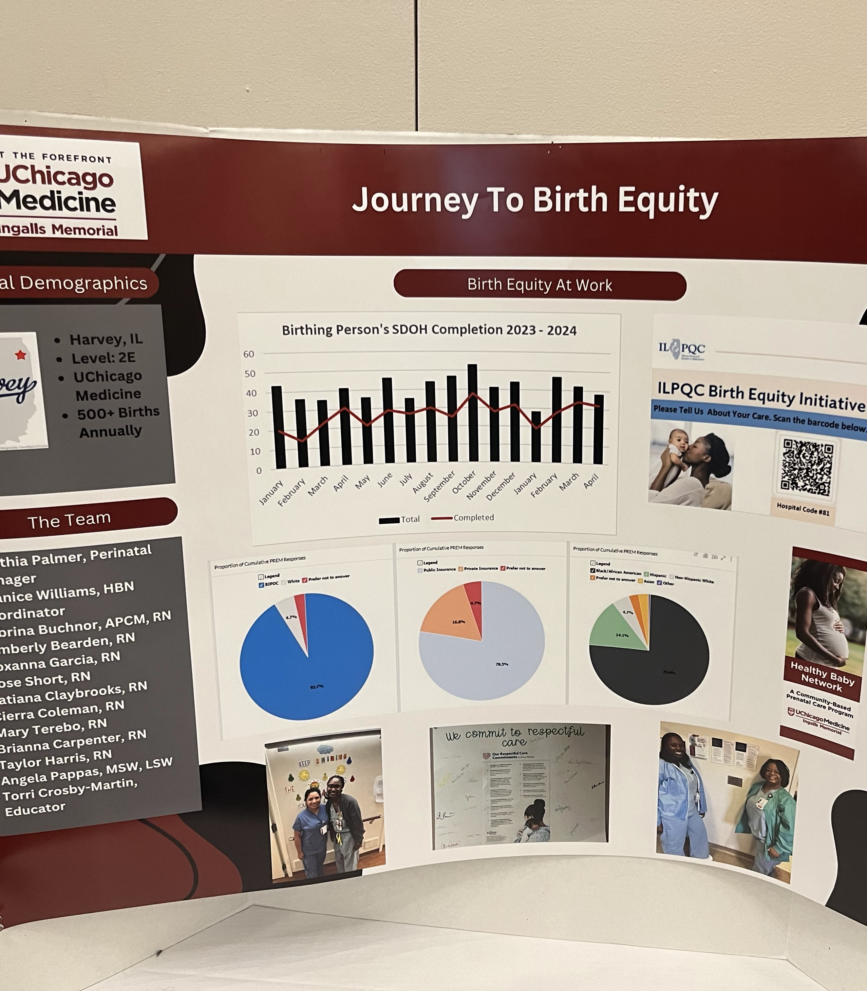
Creativity Tips
Make this your own
Use photos from your unit
Highlight your team members
Include quotes from staff or families
Add before-and-after comparisons
Show what makes your hospital unique

Slide 4
Hospital Name
Insert Hospital Logo

Slide 5

Hospital Demographics
Location
Perinatal Level
Perinatal Network
Birth Volume
Units taking part in ESSI
  SCN, ISCU, NICU, etc.
*Include map of where your hospital is located: TownMapsUSA.com - Maps of ILLINOIS

Slide 6
Pick Your Theme
ESSI Webinar Topics | ESSI Practice Changes | Other Neonatal QI Work
Highlight a topic explored in ESSI webinars (Dec–Apr) and share how your team addressed it. | Share a change your team implemented through ESSI, such as a workflow improvement or new practice. | Highlight another neonatal quality improvement effort your team is working on (does not need to be ESSI or ILPQC-related).
Examples: Organizing and mobilizing local supports through resource mapping Newborn-Inclusive SDOH Screening & Linkage Culturally responsive safe sleep conversations and transition tocommunity providers Stratifying and Sharing Neonatal Data | Examples: New discharge workflow Safe sleep education process Documentation improvements | Examples: Feeding support initiatives Readmission reduction Parent engagement

Slide 7
These sections are intended to help guide your story, but teams are encouraged to present their work creatively.

Slide 8
Stratifying and Sharing Neonatal Data
If you choose Theme 1, here's an example of what your storyboard may look like.
Where were you?
How were you using neonatal data before?
Where are you now?
How is stratified data reviewed and shared today?
How did you get there?
(New dashboards, QI meetings, leadership engagement)

Slide 9
Stratifying and Sharing Neonatal Data
A stratified run chart
A dashboard screenshot
A slide you presented to staff
A meeting agenda with data review included
A visual showing a disparity gap

Slide 10
If You Choose Theme 2 or 3: Practice Change or QI Work
What practice area did your team focus on, and what challenge were you trying to address?
Examples:
Safe sleep modeling
Discharge education
Feeding support
Where Are You Now? (What Changed)
What have you noticed since making the change?
Examples:
Improvements in practice or workflow
Data trends or early results
Staff or patient feedback
Lessons learned
How Did You Get There? (What You Tested or Implemented)
What changes did your team make to address the challenge?
Examples:
Workflow or process changes
Staff education or training
EHR documentation updates
New parent education tools
Where were you → Where are you now → How did you get there

