Slide 1

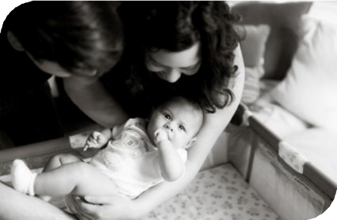


Equity and Safe
Sleep for Infants
  Culturally responsive safe sleep conversations and transitioning to community providers
February 16th, 2026, 2:00 PM

Slide 2


Overview
Quick ESSI Update and Initiative and Data Review
Culturally Responsive Safe Sleep Conversations
Transition to Community Providers
Announcements

Slide 3
Attendance Poll
Please fill out the poll so we can track hospital team attendance for ESSI
Webinars. If unable to complete poll, please email kiela.moreno@endeavorhealth.org
Illinois Perinatal Quality Collaborative
4

Slide 4
ESSI Update
Where are we, what have we done, and what’s left to do?
Illinois Perinatal Quality Collaborative
9

Slide 5
ILPQC Timeline
Face-to-Face 2026:
ESSI enters sustainability
You are here
New Initiative
Equity and Safe Sleep for Infants
85 teams
ESSI Sustainability
2025
2026
2027
Planning for Next Neonatal initiative

Slide 6

Last 5 Months of ESSI
December
  Organizing and mobilizing local supports through resource mapping
January
  Newborn-inclusive SDoH screening & linkage
February
  Culturally responsive safe sleep conversations and transition to community providers
March
  Stratifying and sharing neonatal data
April
  Addressing disparities identified through data

Slide 7





ESSI Initiative Aims
1
2
By May 2026, greater than 70% of Illinois birthing and children’s hospitals will address
disparities and promote neonatal equity by actively participating in the ESSI initiative.
By May 2026, greater than 80% of infants will be discharged from ILPQC hospitals with a completed ESSI Bundle.
AWARENESS
Parents or caregivers report an understanding of a safe sleep environment.
Family is prepared for a transition to home,
including SDoH screening and resource linkage.
Communication to primary care provider completed.
READINESS
TRANSFER OF CARE
Illinois Perinatal Quality Collaborative
10

Slide 8
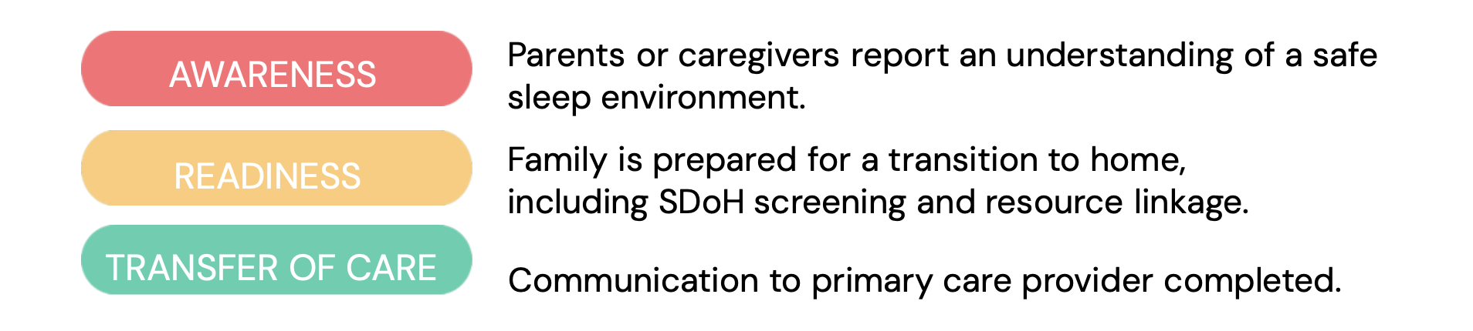
ESSI Data
Illinois Perinatal Quality Collaborative
9

Slide 9
Conversation with parents or caregivers on adjustment to life with a newborn and safe sleep
AWARENESS
Goal = 80%
82%
% of Audited Charts
40%
2.02.2026

Slide 10
Documentation of parents or caregivers reporting an understanding of a safe sleep environment
AWARENESS
93%
Goal = 80%
% of Audited Charts
65%
2.02.2026

Slide 11
READINESS
SDOH Screening and Linkage in Infant’s Chart
94%
Goal = 80%
82%
69%
% of Audited Charts
29%
2.02.2026

Slide 12
ESSI Bundle Documented in Discharge Summary
TRANSFER OF CARE
Goal = 80%
75%
AW
S
% of Audited Charts
18%
2.02.2026

Slide 13
AWARENESS
Standardized process to provide parents or caregivers culturally responsive safe sleep education including awareness of potential challenges, modeling, and teach back opportunities.
2.02.2026

Slide 14
READINESS
Standardized process to screen for newborn-inclusive social determinants of health and to link to needed resources.
2.02.2026

Slide 15
Standardized process for the collection of parent-reported newborn race and ethnicity data.
2.02.2026

Slide 16
Standardized process to stratify and share neonatal data by birthing person's race, ethnicity, and insurance status.
2.02.2026

Slide 17
Standardized process to address disparities based on review of neonatal outcomes stratified by birthing person's race, ethnicity, and insurance status.
2.02.2026

Slide 18

Aims
Primary Drivers
Secondary Drivers
By December 2025:
Healthcare Professional Commitment
Equitable and Respectful Care Education and Implementation
Safe Sleep Environment Education and Implementation
1. Greater than
70% of Illinois birthing and
children’s hospitals will address disparities and promote neonatal equity by actively participating in the ESSI initiative.
Key Driver Diagram
Inclusive Clinical Environment
Equitable and Inclusive Unit Policies
Organizational Leadership Commitment
Parent and Caregiver Experience Prioritization
Parent and Caregiver Empowerment
Respectful Parent and Caregiver Partnerships
Safe Sleep Awareness
Transition to Home, including SDoH Screening and Resource Linkage
Community Partnerships
Resource Mapping
Building Relationships with Community Organizations
Transfer of Care to Community Providers
2. Greater than 80% of infants will be discharged from ILPQC hospitals with a completed ESSI bundle.
Healthcare Data Utilization
Collection of Accurate Race and Ethnicity Data
Dissemination of Stratified Data
Application of Data to Address Inequities
Awareness: Parents or caregivers report an understanding of a safe sleep environment, including navigating challenges to safe sleep at home
ESSI
Bundle:
Readiness: Family is prepared for a transition to home, including SDoH screening and resource linkage
Transfer of Care: ESSI Newborn Care Plan (Awareness & Readiness) documented in the discharge
11
Illinois Perinatal Quality Collaborative

Slide 19
Culturally Responsive Safe Sleep Conversations
Illinois Perinatal Quality Collaborative
9

Slide 20

What is culturally responsive care?
Culturally responsive care incorporates cultural safety, seeks to mitigate culturally unsafe practices, and is practiced with humility, resulting in improved patient relationships and better patient care.
Acknowledges family’s beliefs, traditions, and prior experiences
Recognizes historical mistrust and systemic inequities
Shares evidence-based guidance without judgment, working toward shared solutions

Slide 21



Unsafe Practices: Common Examples We Encounter
Heavy fleece blankets for warmth
Wearing hats while during sleep
Sleeping on belly
Sharing surfaces
Positioning devices designed to reduce reflux
Conflicting guidance from family members or social media
How do you navigate these situations?

Slide 22
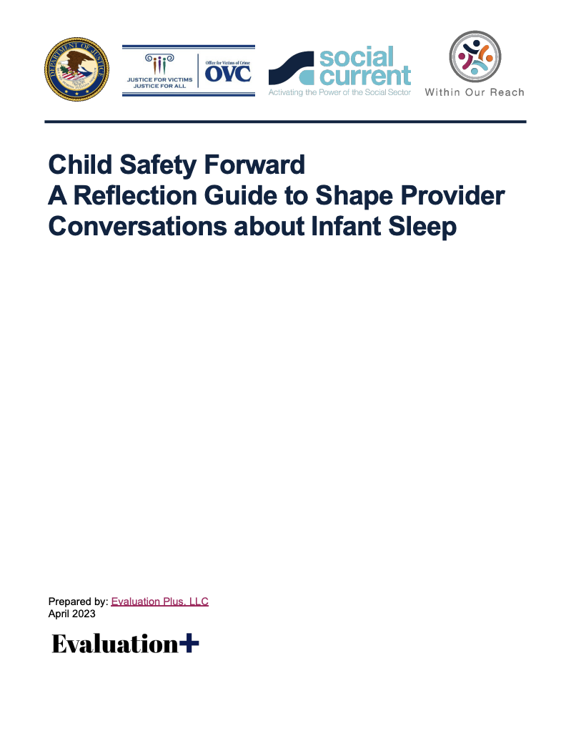
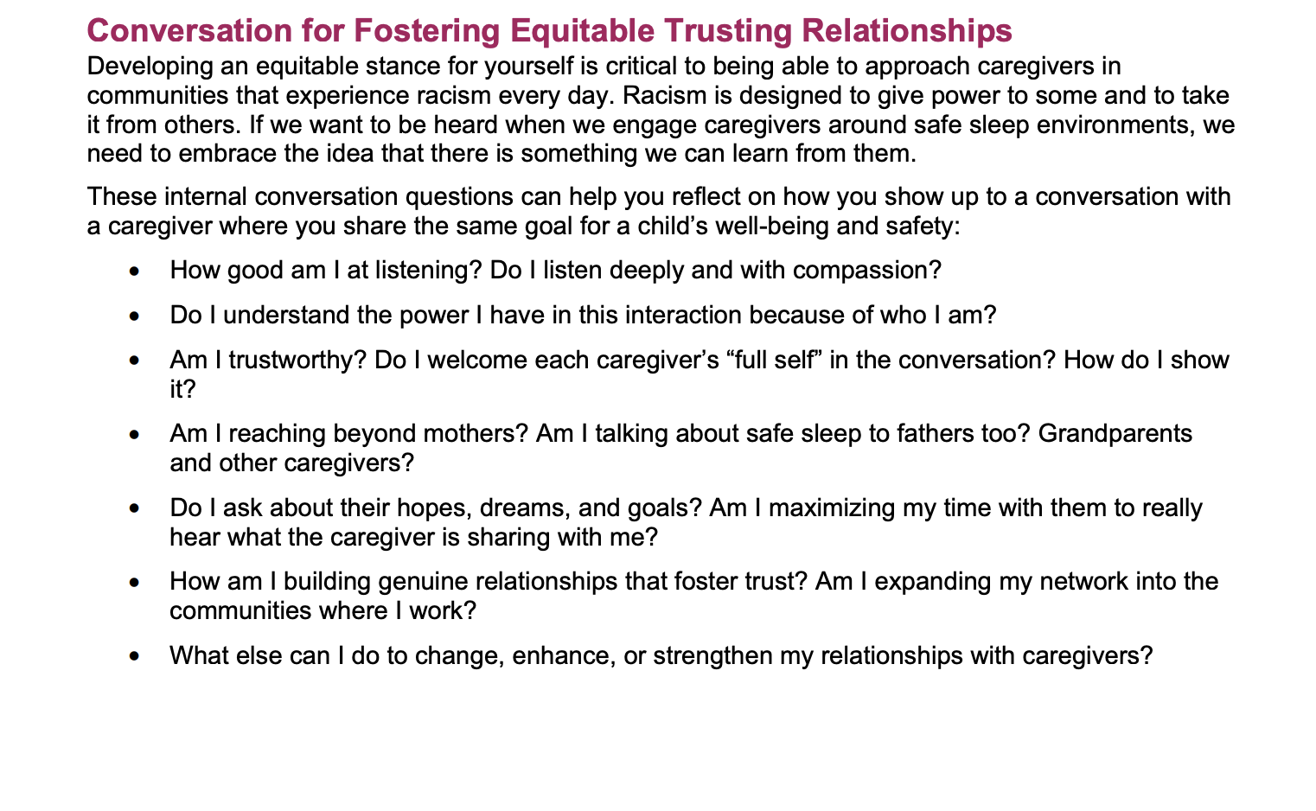
What do culturally responsive safe sleep conversations look like in practice?
Ask open-ended questions
Listen before advising
Validate concerns and constraints
Share guidance clearly and respectfully
HOW WE COMMUNICATE MATTERS AS MUCH AS
WHAT WE COMMUNICATE

Slide 23
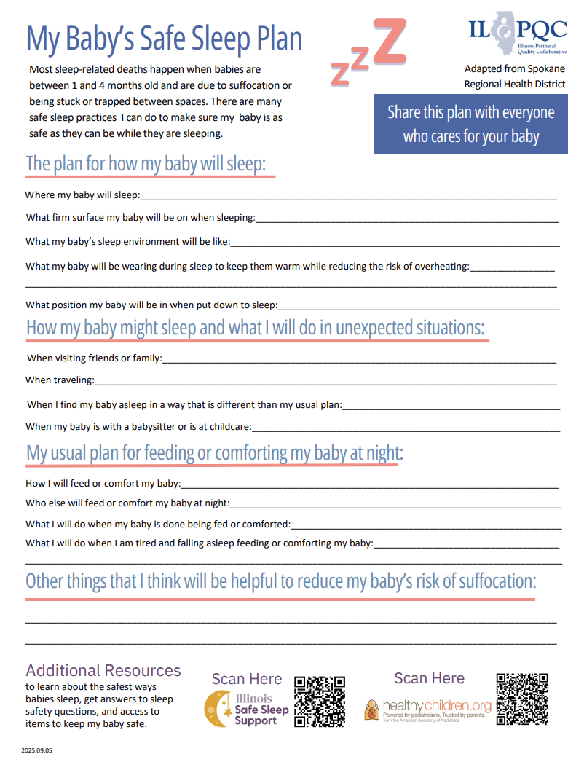
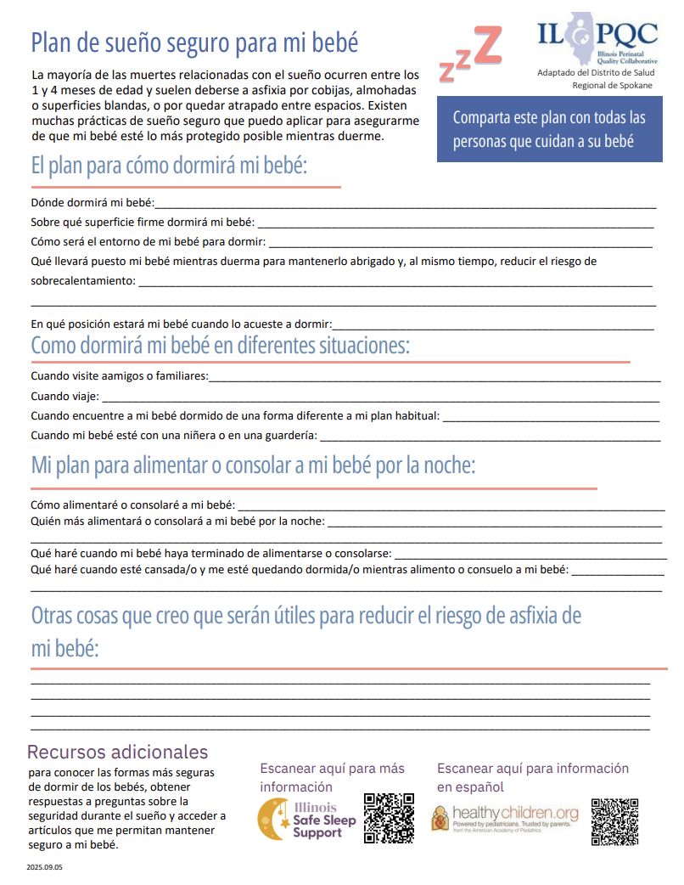
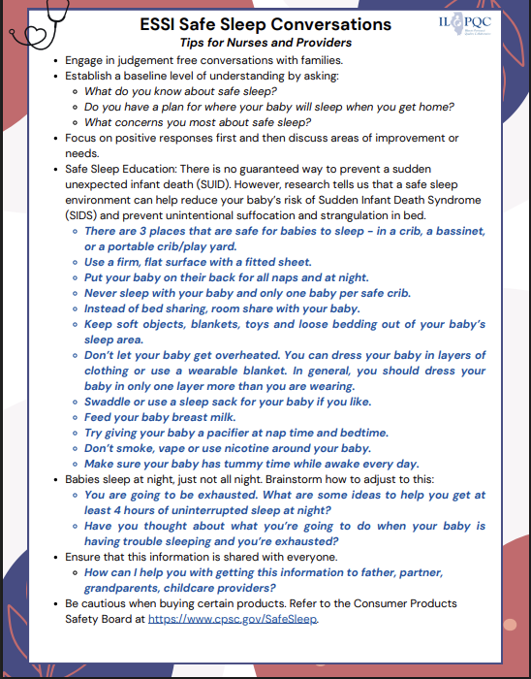
Safe Sleep Conversation Tip Sheet
My Baby’s Safe Sleep Plan
Safe Sleep Guidance for Families
3 ILPQC tools to support consistent, respectful conversations

Slide 24
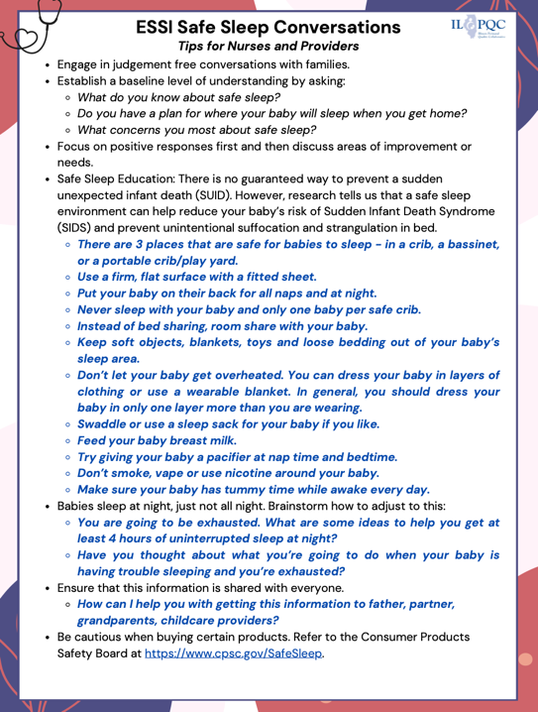
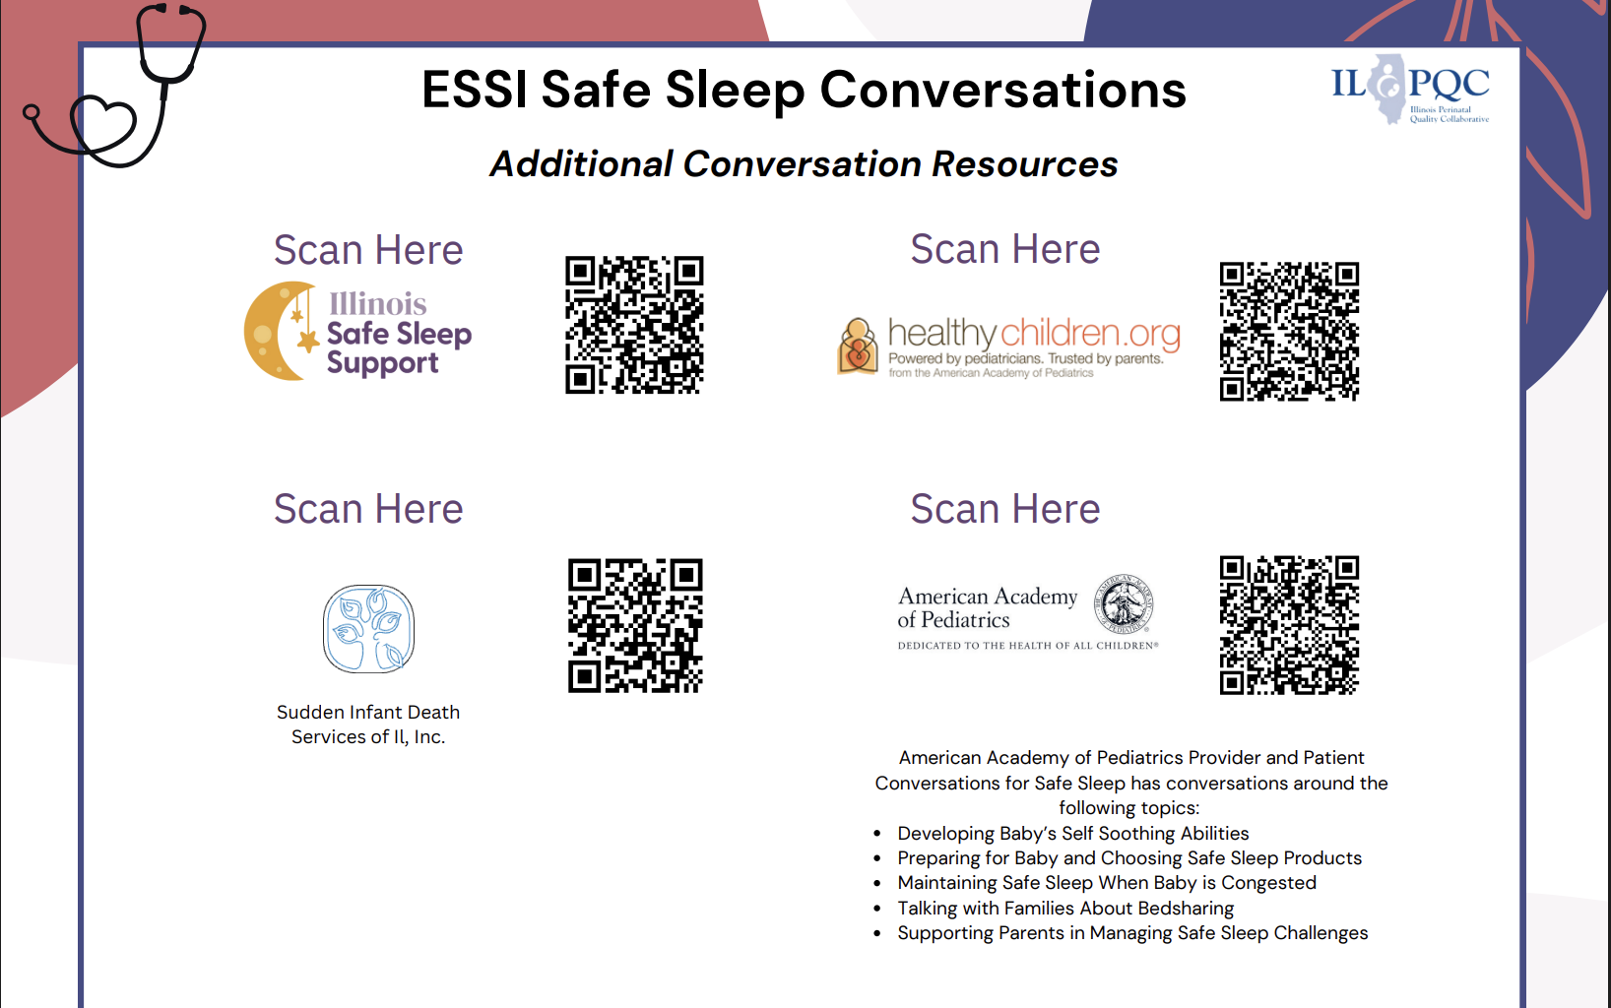
Safe Sleep Conversations Tips Sheet
Notes:
Let’s make sure the graphic is out latest on Monday.

Slide 25
My Baby's Safe Sleep Plan
On ILPQC Website under "Parent and Caregiver Empowerment"
Facilitates conversation between the caregivers and health care provider.
Ideally, safe sleep conversations and plans are started AS EARLY AS POSSIBLE!

Slide 26
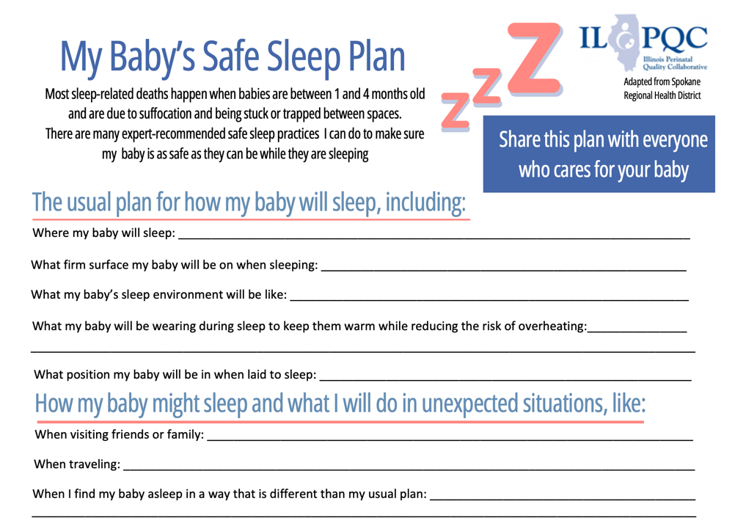
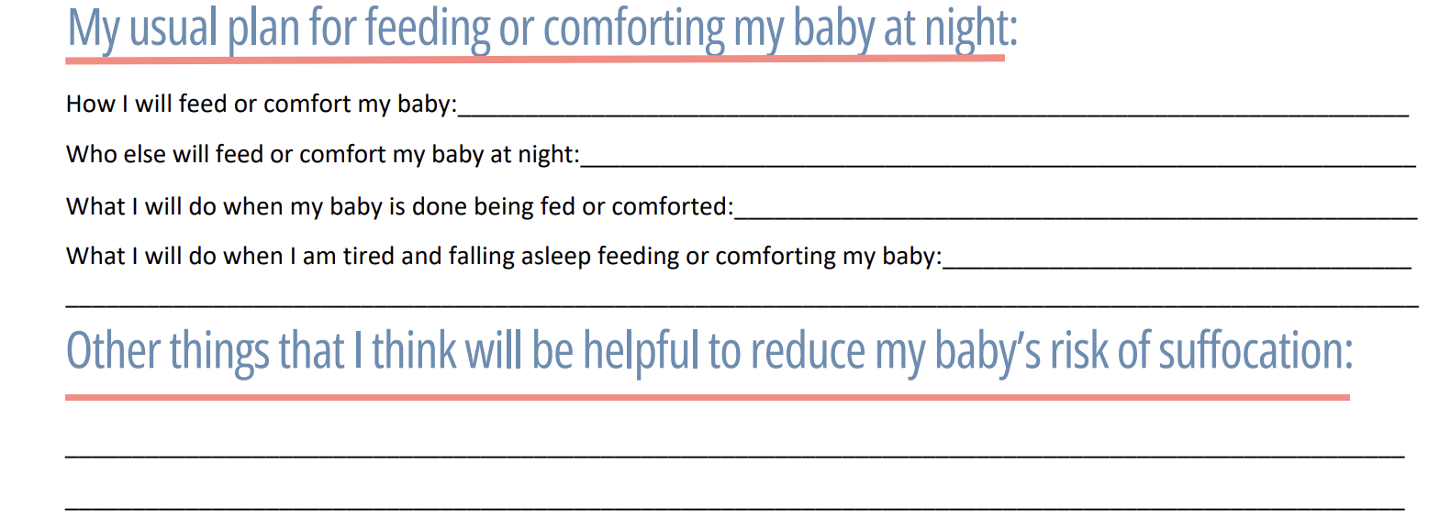
Notes:
Separate out

Slide 27
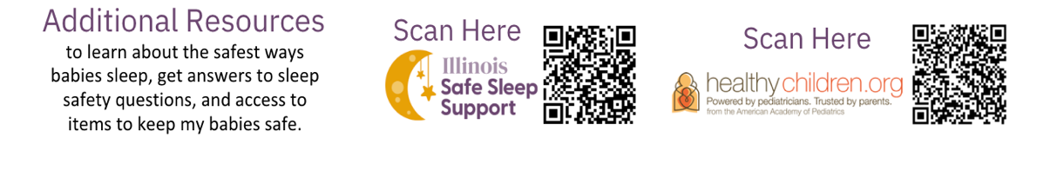
Illinois Safe Sleep Support is a program for families in Illinois. It includes the following resources:
IL data and reporting around safe sleep
Provider and family resources and guidance
AAP Healthy Children
is a website powered by the American Academy of Pediatrics. It includes parenting guidance, evidence-based information, and more around safe sleep Q&A.
This website is also available in Spanish.

Slide 28

Integrating Conversational Resources in Hospital Workflow
What does safe sleep education and messaging actually look like on each unit?
When, and by whom, is safe sleep education introduced? Who starts the conversation?
Who reviews My Baby’s Safe Sleep Plan with families?
Where does the plan go once it’s completed?
Do families fill it out on their own, review it with a nurse, or both?
How do families problem solve obstacles and unexpected situations?

Slide 29
Example Workflow
Normalize and begin conversations
Clarify questions and problem solves barriers
During Hospitalization: Reinforce and Practice
Transfer of Care
Admission: Introducing Safe Sleep
Pre-Discharge: Confirm Understanding
Review My Baby’s Safe Sleep Plan
Model safe sleep environment
Communicate safe sleep plan to PCP

Slide 30
Transfer of Care to Community Providers
TRANSFER OF CARE
Illinois Perinatal Quality Collaborative
9

Slide 31

Why is optimizing transfer of care important?
Care is continuous for newborns and families
Necessary information is communicated
Enhances parental education and confidence
Reduces readmissions and complications
Improves health equity through continued support and early intervention

Slide 32
How do you define an optimal transfer of care?
What does transfer of care look like on your unit?
How do you know families truly understand next steps?
How do you know community providers receive accurate imformation?
Where do gaps most often occur?
Illinois Perinatal Quality Collaborative
9

Slide 33
TRANSFER OF CARE
ESSI Bundle Components and Transfer of Care
.NB_DISCHARGE_HANDOFF
Birth History:
Maternal History / Prenatal Labs:
Hospital Course:
Newborn Screening Results:
Discharge Weight & Feeding:
Immunizations / Prophylaxis:
Safe Sleep Plan & Barriers:
Social Drivers of Health (SDOH):
SDOH Resource Linkage:
Follow-Up Plans:
Home care instructions reviewed with caregivers.
Understanding
  Families can explain safe sleep in their own words
Documentation
  Discharge summary reflects education, concerns, and plan
Continuity
  PCPs and community providers receive clear, aligned messaging

Slide 34
Discharge Dot Phrase
.NB_DISCHARGE_HANDOFF_CORE
Birth History:
Gestational age ___ wks. Birth weight ___ g. Delivery ☐ vaginal ☐ cesarean. Apgars ___ / ___.
Maternal History / Prenatal Labs:
Prenatal care ☐ adequate ☐ limited.
Blood type ___ / Ab screen ☐ neg ☐ pos.
GBS ☐ neg ☐ pos ☐ unknown (treated ☐ yes ☐ no).
Hep B ☐ neg ☐ pos. HIV ☐ neg ☐ pos. RPR ☐ neg ☐ pos.
Substance exposure ☐ none known ☐ yes (________________).
Hospital Course:
☐ Uncomplicated newborn course
☐ NICU admission (reason: ____________________)
Key interventions: ☐ phototherapy ☐ respiratory support ☐ hypoglycemia protocol ☐ feeding support
Feeding plan at discharge: ☐ breast ☐ formula ☐ combination ☐ fortified
Newborn Screening Results:
Metabolic screen sent ☐ yes ☐ pending ☐ repeat needed
Hearing screen ☐ passed ☐ referred
CCHD screen ☐ passed ☐ referred
Discharge Weight & Feeding:
Discharge weight ___ g (___ % change from birth). Feeding well at discharge ☐ yes ☐ no.
Immunizations / Prophylaxis:
Hepatitis B ☐ given ☐ declined
Vitamin K ☐ given ☐ declined
Erythromycin ☐ given ☐ declined
Safe Sleep Plan & Barriers:
Safe sleep education provided using teach-back (supine, separate sleep surface, empty crib).
Family plan for infant sleep reviewed.
Access to safe sleep space ☐ yes ☐ no.
Barriers identified ☐ none ☐ yes (________________).
Resources provided as needed ☐ yes ☐ n/a.
Social Drivers of Health (SDOH):
Caregivers screened for housing, food, utilities, transportation, and infant supplies.
☐ No unmet needs identified
☐ Needs identified (________________).
SDOH Resource Linkage:
☐ WIC ☐ SNAP ☐ safe sleep resources ☐ care coordination ☐ community agency referral
Follow-Up Plans:
Pediatrician follow-up in ___ days.
Subspecialty referrals ☐ none ☐ yes (________________).
Home care instructions reviewed with caregivers.

Slide 35

Discharge Dot Phrase
Community providers rely on discharge documentation to continue safe sleep messaging.
Clear documentation can help with reducing mixed messages and confusion.
Many hospital teams have already started creating and implementing their own EMR dot phrase to:
  Summarize safe sleep education and plans
  Highlight family questions or challenges discussed
  Support consistent follow-up in outpatient settings

Slide 36
Aims
Primary Drivers
Secondary Drivers
By December 2025:
Healthcare Professional Commitment
Equitable and Respectful Care Education and Implementation
Safe Sleep Environment Education and Implementation
1. Greater than
70% of Illinois birthing and
children’s hospitals will address disparities and promote neonatal equity by actively participating in the ESSI initiative.
Key Driver Diagram
Inclusive Clinical Environment
Equitable and Inclusive Unit Policies
Organizational Leadership Commitment
Parent and Caregiver Experience Prioritization
Parent and Caregiver Empowerment
Respectful Parent and Caregiver Partnerships
Safe Sleep Awareness
Transition to Home, including SDoH Screening and Resource Linkage
Community Partnerships
Resource Mapping
Building Relationships with Community Organizations
Transfer of Care to Community Providers
2. Greater than 80% of infants will be discharged from ILPQC hospitals with a completed ESSI bundle.
Healthcare Data Utilization
Collection of Accurate Race and Ethnicity Data
Dissemination of Stratified Data
Application of Data to Address Inequities
Awareness: Parents or caregivers report an understanding of a safe sleep environment, including navigating challenges to safe sleep at home
ESSI
Bundle:
Readiness: Family is prepared for a transition to home, including SDoH screening and resource linkage
Transfer of Care: ESSI Newborn Care Plan (Awareness & Readiness) documented in the discharge
11
Illinois Perinatal Quality Collaborative

Slide 37
Upcoming ESSI Webinars
Date | Topic
March 16th, 2026 | Stratifying and sharing neonatal data
April 20th, 2026 | Addressing disparities identified through data

Slide 38
Face-to-Face
Illinois Perinatal Quality Collaborative
4

Slide 39









May 2026
SUNDAY | MONDAY | TUESDAY | WEDNESDAY | THURSDAY | FRIDAY | SATURDAY
 |  |  |  |  | 1 | 2
3 | 4 | 5 | 6 | 7 | 8 | 9
10 | 11 | 12 | 13 | 14 | 15 | 16
17 | 18 | 19 | 20 | 21 | 22 | 23
24 | 25 | 26 | 27 | 28 | 29 | 30
31
2026 OB and Neonatal Face-to-Face Meetings

Slide 40
ESSI QI Excellence Award Criteria
13 structure measures “In Place”
> 80% implicit bias and safe sleep education for providers and nurses
> 80% components of ESSI Bundle

Slide 41

2026 Face-to-Face
Neo and OB Storyboards
Share the great work that your Neo and OB teams are doing!
Brainstorm ideas. Share your team’s successes, opportunities, and specific strategies implemented.
Templates will be shared with teams soon.
Questions? Email info@ilpqc.org

Slide 42




2026 Face-to-Face
Event Planning Committee Volunteers
Great opportunity to collaborate, contribute ideas, and help shape a meaningful event.
Whether you’ve been involved before or this is your first time, we welcome all voices and perspectives to the committee.
Volunteers must be present at both days of Face-to-Face
Interested? Email info@ilpqc.org

Slide 43

2026 Face-to-Face
ILPQC Partner Tables
Share your organization's resources with ILPQC teams
Engage directly with attendees, foster relationships and collaborate with attendees?
Interested? Email info@ilpqc.org

Slide 44
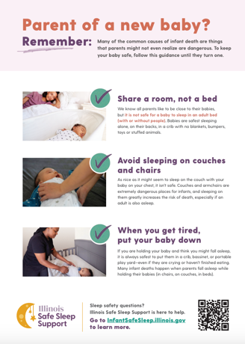
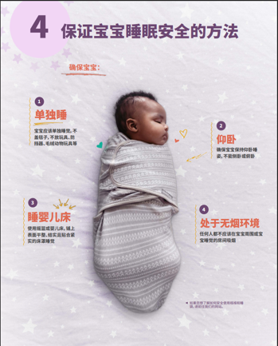

Safe Sleep Poster Packs are BACK!

Slide 45

What’s Included?
Each ESSI team has the opportunity to order a Safe Sleep Support Starter Kit.
Based on your birth volume:
  5 posters + 200 handouts (4 tear pads of 50) in English for hospitals with a birth volume up to 800
  10 posters + 400 handouts (8 tear pads of 50) in English for hospitals with a birth volume over 800
Based on your patient demographics you can order additional handouts in the following languages:
  Spanish
  Chinese
  Arabic
  Polish
Each additional language packet comes with 50 handouts (1 tear pad of 50).
Each team will also receive 1 poster per language
Order Here!

Slide 46





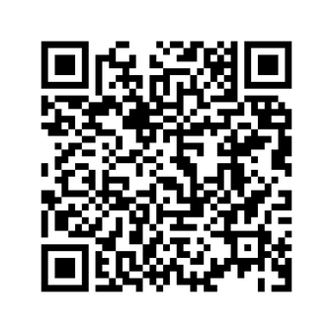

ILPQC WINTER OFFICE HOURS ARE HERE
Every Thursday
at 1 p.m. CST
Register here or go to ILPQC Website under “All Events”

Slide 47



ILPQC
14TH ANNUAL CONFERENCE
NOVEMBER 10TH, 2026
THE WESTIN LOMBARD YORKTOWN CENTER

Slide 48
Upcoming ESSI Webinars
Date | Topic
March 16th, 2026 | Stratifying and sharing neonatal data
April 20th, 2026 | Addressing disparities identified through data

