Slide 1

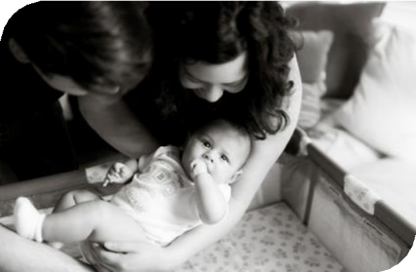


Equity and Safe
Sleep for Infants
  Newborn-inclusive SDoH screening & linkage
January 12th, 2026, 2:00 PM

Slide 2


Overview
Initiative and Data Review
Implementing Perinatal-Specific SDOH Screening – Shawn O'Connor, MD
Team Talk: Mount Sinai

Slide 3
Attendance Poll
Please fill out the poll so that we can track hospital team attendance for ESSI
Webinars. If unable to complete poll, please email kiela.moreno@endeavorhealth.org
Illinois Perinatal Quality Collaborative
4

Slide 4
Quick ESSI Update
Where are we, what have we done, and what’s left to do?
Illinois Perinatal Quality Collaborative
9

Slide 5





ESSI Initiative Aims
1
2
By December 2025, greater than 70% of Illinois birthing and children’s hospitals will address
disparities and promote neonatal equity by actively participating in the ESSI initiative.
By December 2025, greater than 80% of infants will be discharged from ILPQC hospitals with a completed ESSI Bundle.
AWARENESS
Parents or caregivers report an understanding of a safe sleep environment.
Family is prepared for a transition to home,
including SDoH screening and resource linkage.
Communication to primary care provider completed.
READINESS
TRANSFER OF CARE
Illinois Perinatal Quality Collaborative
10

Slide 6
Timeline for Future Initiative
Face-to-Face 2026:
ESSI enters sustainability
You are here
New Initiative
Equity and Safe Sleep for Infants
85 teams
ESSI Sustainability
2025
2026
2027
Planning for Next Neonatal initiative

Slide 7

Next 5 Months of ESSI
January
February
Culturally responsive safe sleep education and messaging with community providers
March
Stratifying and sharing neonatal data
April
Addressing disparities identified through data
December
Organizing and mobilizing local supports through resource mapping
Newborn-inclusive SDoH screening & linkage

Slide 8
ESSI Initiative Data
Illinois Perinatal Quality Collaborative
9

Slide 9
Documentation of parents or caregivers reporting an understanding of a safe sleep environment
AWARENESS
92%
Goal = 80%
% of Audited Charts
65%
1.06.2026

Slide 10
Conversation with parents/caregivers on adjustment to life with a newborn and safe sleep, and resources shared
AWARENESS
87%
Goal = 80%
% of Audited Charts
40%
1.06.2026

Slide 11
READINESS
SDOH Screening and Linkage in Infant’s Chart
90%
Goal = 80%
83%
69%
% of Audited Charts
29%
1.06.2026

Slide 12
READINESS
Screening Across English and Non-English Speaking Preference Populations
% of Audited Charts with Needs Identified
1/06/2026

Slide 13
ESSI Bundle Documented in Discharge Summary
TRANSFER OF CARE
Goal = 80%
73%
AW
S
% of Audited Charts
18%
1.06.2026

Slide 14
Standardized newborn-inclusive SDOH process
Hospital has a standardized process to screen for newborn-inclusive Social Determinants of Health and to link to needed resources.
1.06.2026

Slide 15
Standardized process to provide culturally responsive safe sleep education
Hospital has a standardized process to provide parents or caregivers culturally responsive safe sleep education including awareness of potential challenges, modeling, and teach back opportunities during hospitalization.
1.06.2026

Slide 16
Standardized process for collection of infant race / ethnicity
Hospital has a standardized process for the collection of parent-reported newborn race and ethnicity data.
1.06.2026

Slide 17
Standardized process to stratify and share infant data
Hospital has a standardized process to stratify and share neonatal data by birthing person's race, ethnicity, and insurance status.
1.06.2026

Slide 18
Standardized process to address neonatal disparities
Hospital has a standardized process to address disparities based on review of neonatal outcomes stratified by birthing person's race, ethnicity, and insurance status.
1.06.2026

Slide 19

Aims
Primary Drivers
Secondary Drivers
By December 2025:
Healthcare Professional Commitment
Equitable and Respectful Care Education and Implementation
Safe Sleep Environment Education and Implementation
1. Greater than
70% of Illinois birthing and
children’s hospitals will address disparities and promote neonatal equity by actively participating in the ESSI initiative.
Key Driver Diagram
Inclusive Clinical Environment
Equitable and Inclusive Unit Policies
Organizational Leadership Commitment
Parent and Caregiver Experience Prioritization
Parent and Caregiver Empowerment
Respectful Parent and Caregiver Partnerships
Safe Sleep Awareness
Transition to Home, including SDoH Screening and Resource Linkage
Community Partnerships
Resource Mapping
Building Relationships with Community Organizations
Transfer of Care to Community Providers
2. Greater than 80% of infants will be discharged from ILPQC hospitals with a completed ESSI bundle.
Healthcare Data Utilization
Collection of Accurate Race and Ethnicity Data
Dissemination of Stratified Data
Application of Data to Address Inequities
Awareness: Parents or caregivers report an understanding of a safe sleep environment, including navigating challenges to safe sleep at home
ESSI
Bundle:
Readiness: Family is prepared for a transition to home, including SDoH screening and resource linkage
Transfer of Care: ESSI Newborn Care Plan (Awareness & Readiness) documented in the discharge
11
Illinois Perinatal Quality Collaborative

Slide 20

Perinatal-Specific SDOH Screening
Shawn O'Connor, MD
BJC Memorial Hospital System and Washington University
Illinois Perinatal Quality Collaborative
9

Slide 21
Team Talk
Mount Sinai
Mathura Ananthan, MD
Illinois Perinatal Quality Collaborative
9

Slide 22
Team Talk :
Social Determinants of Health Screening & Linkage to Resources
Mount Sinai Hospital
Mathura Ananthan
Department of Women’s and Children’s

Slide 23


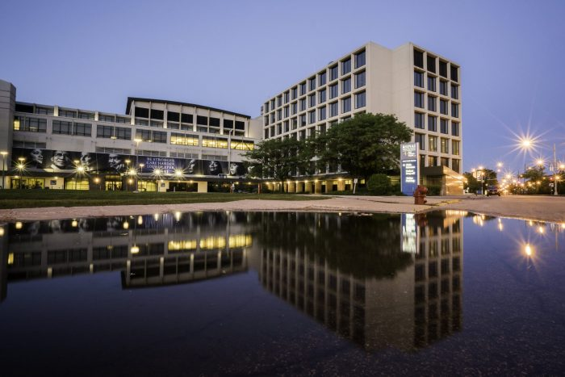
Address: 1500 S Fairfield Ave. Chicago, IL, 60608
Perinatal Level: 3
Perinatal Network:
Rush/AIMMC Perinatal
The largest private healthcare
Safety-Net systems in Illinois
Birth Volume: 1560 deliveries per year
14 Labor Delivery Rooms
2 C-section rooms
4 Triage Rooms
2 OR Suites
3 PACU Beds
19 Postpartum Room

Slide 24

SDoH Screening & Linkage to Resources
Equity and Safe Sleep for Infants Initiative (ESSI)
Sinai’s Slogan “The cutest thing in the crib should ONLY be your baby”

Slide 25
Our Approach at Mount Sinai
Build on existing SDOH screening efforts
Standardize workflows across teams
Strengthen connections to community and internal resources

Slide 26
What This Looks Like at Mount Sinai:
Admission Screening - Epic
Commonly Asked Questions:
Housing Stability
Do you have a steady place to live?
Transportation
Do you have reliable transportation for medical visits after discharge?
Utilities / Basic Needs
Do you have working heat, electricity, and running water at home?

Slide 27
What This Looks Like at Mount Sinai:
Discharge Screening – Social Worker
100% of patients are seen by a Social Worker prior to discharge
Standard part of discharge planning
Ensures early identification of social needs
Supports safe transitions from hospital to home
Creates a reliable opportunity for screening and resource linkage

Slide 28
From Screening to Support: The Social Work Workflow
Standardized social work assessment
Identification of key SDOH domains (housing, food, transportation, insurance, safety)
Connection to internal and community-based resources
Documentation and communication with the care team

Slide 29
How We Link Families to Resources at Mount Sinai
A Structured, Multidisciplinary Approach:
Social Worker completes needs-based assessment
Resources identified based on immediate vs long-term needs
Referrals made to:
  Internal hospital-based programs
  Community-based organizations
  State and county services (as applicable)
Resource plan discussed with families prior to discharge

Slide 30
Best Practices
Ask only what you can act on (resources available)
Normalize the questions:
“We ask all patients these questions because social factors can affect health.”
Have a clear referral pathway (social work, care coordination, community orgs)

Slide 31
NICU Multidisciplinary Rounds:
Neonatologists
Nurses
Residents
Pharmacy
Dietary
Therapists
Social Workers

Slide 32
Housing
Resources
Sinai Social Worker Referral to in-house community partner Renaissance
Renaissance Social Services Chicago | Ending Homelessness & Building Community
https://www.rssichicago.org/
Food
Sinai Social Worker Referral to Sinai Urban Health Institute (SUHI)
  Help locate specific community resources based on zip codes
Community Health Care Workers (CHWs) also help screen for SDoH.
  NECTAR is a food distribution program for food insecurities

Slide 33
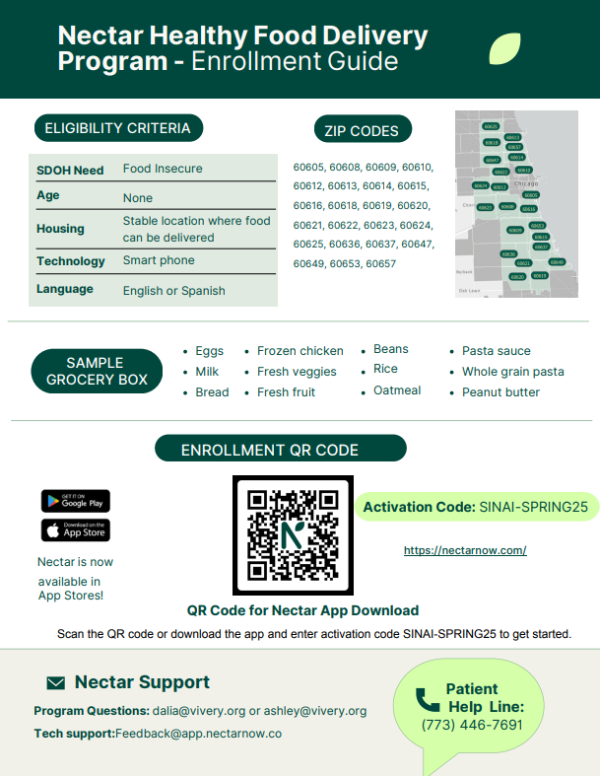

  Home Visiting Nurses

Slide 34
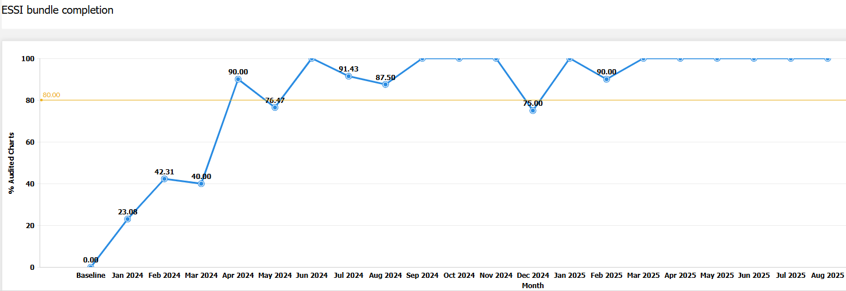
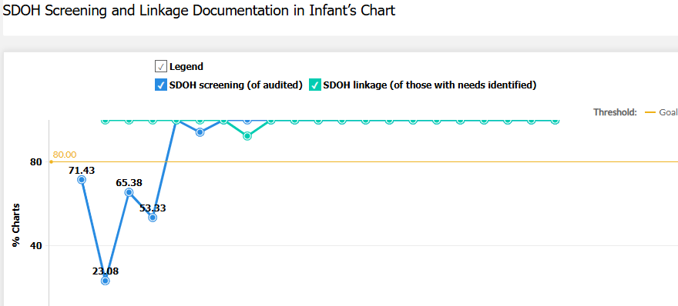

Slide 35

ESSI QI Team members
Dr. Hari Srinivasan
Dr. Victoria Geraldo
Laura Griffith-Gilbert
Irene Cisneros
Connie Hernandez
Mathura Ananthan
Jerilynn Dixon-Sams
Cintia Alvarado-Soto
Frankie Delgado
Rowena De Leon

Slide 36
To-Do's
Review your current ESSI Bundle implementation with a focus on resource linkage and sustainability.
SDOH Screening
Is your SDOH screening perinatal-specific?
Is the screening robust and consistently completed?
Is screening clearly documented in the EMR in a trackable way?
Resource Mapping
Do you have a local resource map or document that makes it easy for team members to link families to resources?
Who is responsible for maintaining and updating this resource map?
How often is it reviewed or updated?
Communication & Workflow
How is resource information communicated to community providers and care partners?

Slide 37
Announcements
Illinois Perinatal Quality Collaborative
9

Slide 38
Upcoming ESSI Webinars
Date | Topic
February 16th, 2026 | Culturally responsive safe sleep education and messaging with community providers
March 16th, 2026 | Stratifying and sharing neonatal data
April 20th, 2026 | Addressing disparities identified through data

Slide 39
ESSI QI Excellence Award Criteria
13 structure measures “In Place”
> 80% implicit bias and safe sleep education for providers and nurses
> 80% components of ESSI Bundle

Slide 40





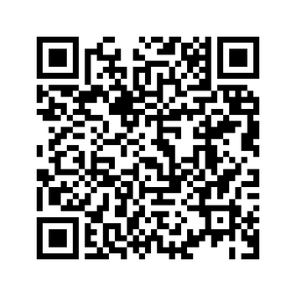

ILPQC WINTER OFFICE HOURS ARE HERE
Every Thursday
at 1 p.m. CST
Register here or go to ILPQC Website under “All Events”

Slide 41









May 2026
SUNDAY | MONDAY | TUESDAY | WEDNESDAY | THURSDAY | FRIDAY | SATURDAY
 |  |  |  |  | 1 | 2
3 | 4 | 5 | 6 | 7 | 8 | 9
10 | 11 | 12 | 13 | 14 | 15 | 16
17 | 18 | 19 | 20 | 21 | 22 | 23
24 | 25 | 26 | 27 | 28 | 29 | 30
31
2026 OB and Neonatal Face-to-Face Meetings

Slide 42



ILPQC
14TH ANNUAL CONFERENCE
NOVEMBER 10TH, 2026
THE WESTIN LOMBARD YORKTOWN CENTER

