Slide 1

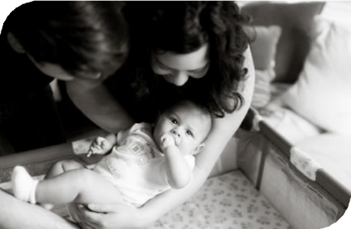


Equity and Safe
Sleep for Infants
Organizing and Mobilizing Local Supports through Resource Mapping
December 15th, 2025, 2:00 PM

Slide 2


Overview
Annual Conference Recap
Initiative and Data Review
Importance of Resource Mapping
Social Workers Panel

Slide 3
Annual Conference
November 12th, 2025
The Westin Lombard Yorktown Center

Slide 4


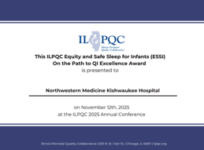
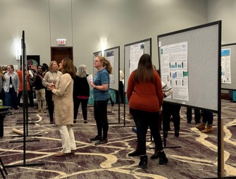



Annual Conference Numbers
Over 600 Attendees
22 Parent / Patient Partners Registered
Over 40 Posters
54 “On the Path to QI Excellence” ESSI Awardees

Slide 5











Nurse Scholarship Recipients
In collaboration with IDHS, ILPQC welcomed bedside nurses from across the state of IL!
63 RNs from
A special Thank You to the PNAs and Hospital Leads for their collaboration in coordinating the registration process.
46 Hospitals

Slide 6
Attendance Poll
Please fill out the poll so that we can track hospital team attendance for ESSI
Webinars. If unable to complete poll, please email kiela.moreno@endeavorhealth.org
Illinois Perinatal Quality Collaborative
4

Slide 7
Quick ESSI Update
Where are we, what have we done, and what’s left to do?
Illinois Perinatal Quality Collaborative
9

Slide 8





ESSI Initiative Aims
1
2
By December 2025, greater than 70% of Illinois birthing and children’s hospitals will address
disparities and promote neonatal equity by actively participating in the ESSI initiative.
By December 2025, greater than 80% of infants will be discharged from ILPQC hospitals with a completed ESSI Bundle.
AWARENESS
Parents or caregivers report an understanding of a safe sleep environment.
Family is prepared for a transition to home,
including SDoH screening and resource linkage.
Communication to primary care provider completed.
READINESS
TRANSFER OF CARE
Illinois Perinatal Quality Collaborative
10

Slide 9
Timeline for Future Initiative
Face-to-Face 2026:
ESSI enters sustainability
You are here
New Initiative
Equity and Safe Sleep for Infants
85 teams
ESSI Sustainability
2025
2026
2027
Planning for Next Neonatal initiative

Slide 10
Next 5 Months of ESSI
January
February
Culturally responsive safe sleep education and messaging with community providers
March
Stratifying and sharing neonatal data
April
Addressing disparities identified through data
December
Organizing and mobilizing local supports through resource mapping
Newborn-inclusive SDoH screening & linkage

Slide 11
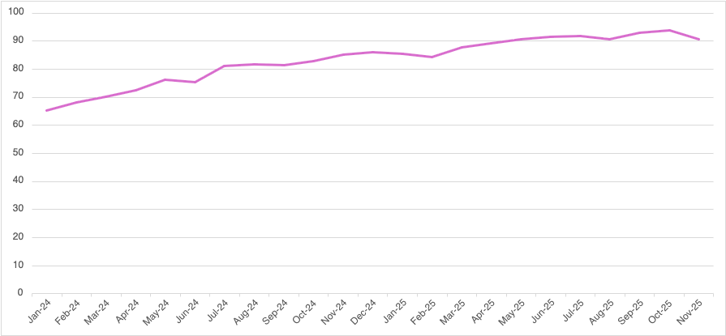
Documentation of parents or caregivers reporting an understanding of a safe sleep environment
AWARENESS
90%
Goal = 80%
% of Audited Charts
65%
12.09.2025

Slide 12
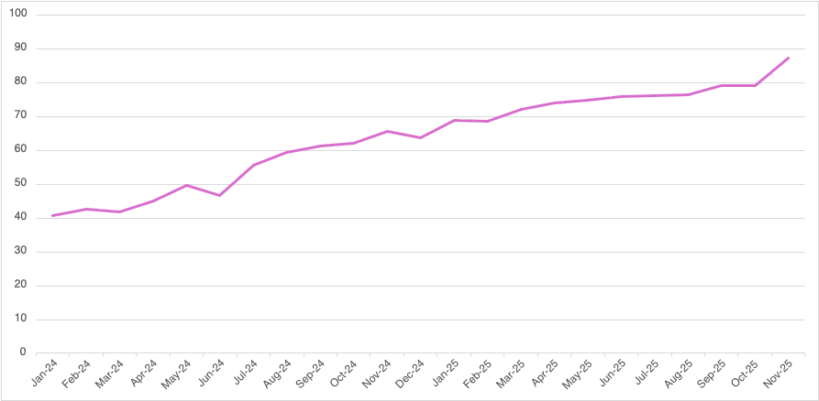
Conversation with parents/caregivers on adjustment to life with a newborn and safe sleep, and resources shared
AWARENESS
87%
Goal = 80%
% of Audited Charts
40%
12.09.2025

Slide 13
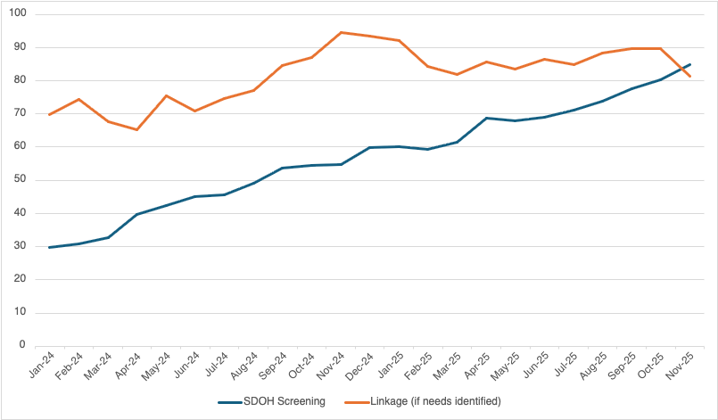
READINESS
SDOH Screening and Linkage in Infant’s Chart
81%
Goal = 80%
83%
69%
% of Audited Charts
29%
12.09.2025

Slide 14
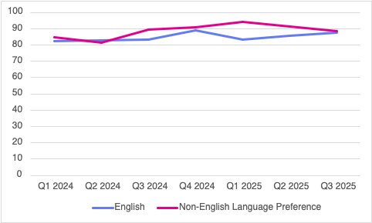
READINESS
Linkage Across English and Non-English Speaking Preference Populations
88%
84%
87%
82%
% of Audited Charts with Needs Identified
12.09.2025

Slide 15
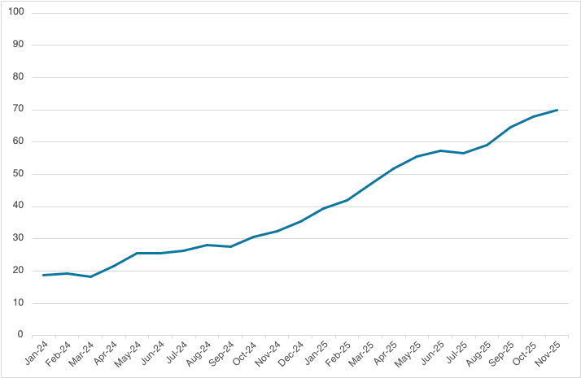
ESSI Bundle Documented in Discharge Summary
TRANSFER OF CARE
Goal = 80%
69%
AW
S
% of Audited Charts
18%
12.09.2025

Slide 16
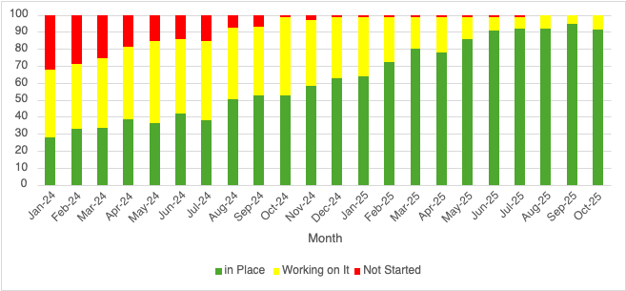
Standardized newborn-inclusive SDOH process
Hospital has a standardized process to screen for newborn-inclusive Social Determinants of Health and to link to needed resources.
12.09.2025

Slide 17
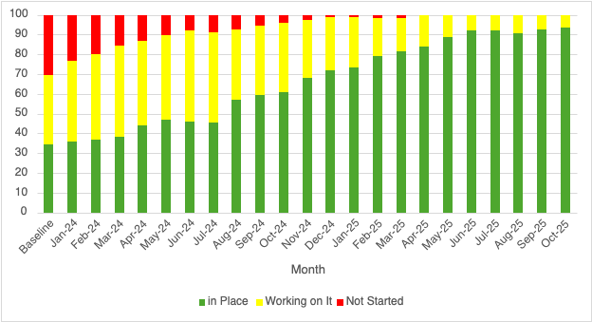
Standardized process to provide culturally responsive safe sleep education
Hospital has a standardized process to provide parents or caregivers culturally responsive safe sleep education including awareness of potential challenges, modeling, and teach back opportunities during hospitalization.
12.09.2025

Slide 18
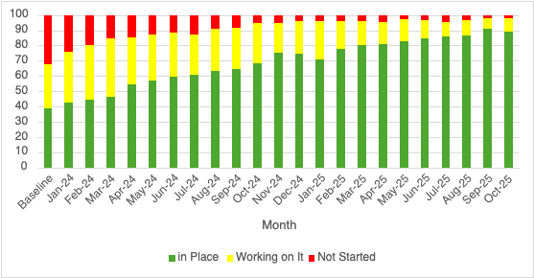
Standardized process for collection of infant race / ethnicity
Hospital has a standardized process for the collection of parent-reported newborn race and ethnicity data.
12.09.2025

Slide 19
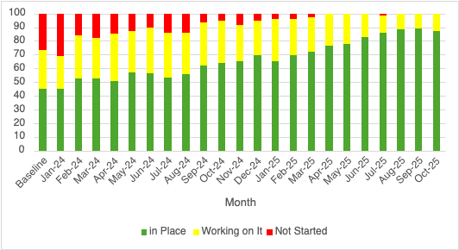
Standardized process to stratify and share infant data
Hospital has a standardized process to stratify and share neonatal data by birthing person's race, ethnicity, and insurance status.
12.09.2025

Slide 20
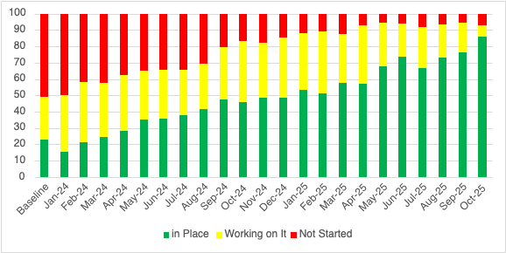
Standardized process to address neonatal disparities
Hospital has a standardized process to address disparities based on review of neonatal outcomes stratified by birthing person's race, ethnicity, and insurance status.
12.09.2025

Slide 21

Aims
Primary Drivers
Secondary Drivers
By December 2025:
Healthcare Professional Commitment
Equitable and Respectful Care Education and Implementation
Safe Sleep Environment Education and Implementation
1. Greater than
70% of Illinois birthing and
children’s hospitals will address disparities and promote neonatal equity by actively participating in the ESSI initiative.
Key Driver Diagram
Inclusive Clinical Environment
Equitable and Inclusive Unit Policies
Organizational Leadership Commitment
Parent and Caregiver Experience Prioritization
Parent and Caregiver Empowerment
Respectful Parent and Caregiver Partnerships
Safe Sleep Awareness
Transition to Home, including SDoH Screening and Resource Linkage
Community Partnerships
Resource Mapping
Building Relationships with Community Organizations
Transfer of Care to Community Providers
2. Greater than 80% of infants will be discharged from ILPQC hospitals with a completed ESSI bundle.
Healthcare Data Utilization
Collection of Accurate Race and Ethnicity Data
Dissemination of Stratified Data
Application of Data to Address Inequities
Awareness: Parents or caregivers report an understanding of a safe sleep environment, including navigating challenges to safe sleep at home
ESSI
Bundle:
Readiness: Family is prepared for a transition to home, including SDoH screening and resource linkage
Transfer of Care: ESSI Newborn Care Plan (Awareness & Readiness) documented in the discharge
11
Illinois Perinatal Quality Collaborative

Slide 22




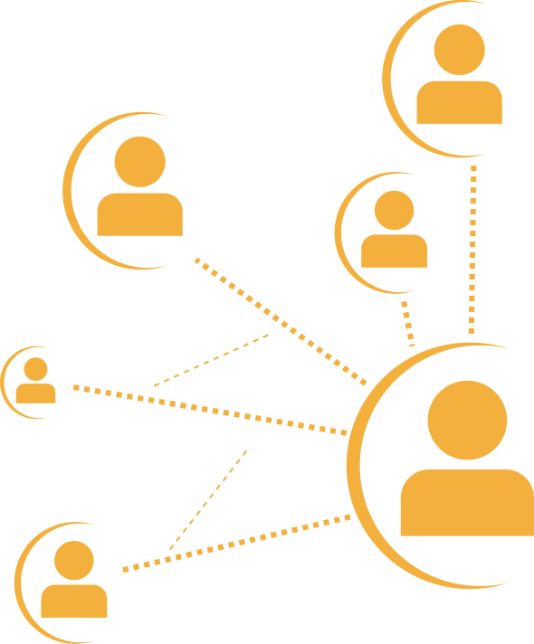





DRIVER 4:
COMMUNITY PARTNERSHIPS
​
Complete local and online resource mapping
Change Ideas
Secondary Driver 1: Resource Mapping
Complete local and online resource mapping
Partner with local community agencies, organizations, and champions to understand challenges/barriers to a safe sleep environment
Secondary Driver 2: Building Relationships with Community Organizations
Endorse consistent safe sleep environment messaging and education
Secondary Driver 3: Transfer of Care
to Community Providers
Coordinate ESSI Newborn Care Plan and initiate warm handoff to community provider

Slide 23
Resource Mapping
Illinois Perinatal Quality Collaborative
9

Slide 24




What is Resource Mapping
Resource mapping is the intentional process of identifying, documenting, and understanding the community resources available to families beyond the hospital.
What resources exist in our community?
Who do they serve?
How and when can families access them?
Community resources may include organizations that support:
Food access
Safe sleep supplies
Transportation
Housing
And more!

Slide 25

Importance of Resource Mapping
Resource mapping ultimately supports equitable care.
It asks us to consider:
Whether families have what they need to act on the education we provide
How social, economic, and structural factors shape family practices
Where gaps exist between guidance and what is feasible for families

Slide 26

Your Role as a Healthcare Professional
As healthcare professions, you are often the first point of contact for families as they prepare to care for their infant at home.
Unique position to:
Recognize barriers families may face
Connect families to resources beyond the hospital
Ensure safe sleep guidance and any other education provided is supported, not just shared

Slide 27
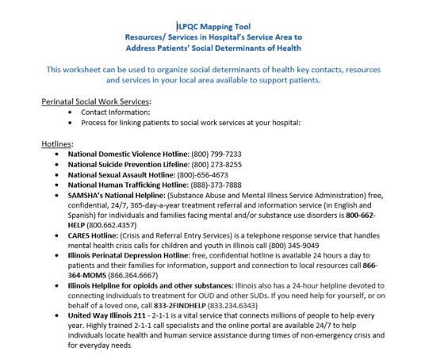
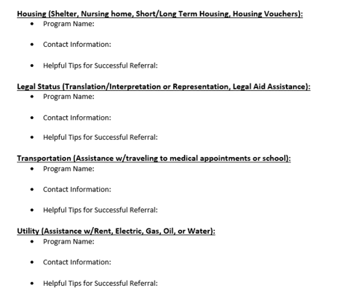
Resource Mapping Support
Use this worksheet to identify resources, understand access, and recognize gaps
You don’t need to have everything figured out to begin this work.
Under “Driver 4: Community Partnerships”

Slide 28

Panel: Organizing and Mobilizing Local Supports through Resource Mapping
Allie Krows, LSW
Decatur Memorial Hospital
Kim Stobbe, LCSW
NM Huntley
Jobi Tabb, MSW LSW
Springfield Memorial Hospital
Skylee Crawford, MSW, LCSW
Gibson Area Hospital
Illinois Perinatal Quality Collaborative
9

Slide 29
Questions:
What makes the biggest difference between giving a list of resources and achieving a true hand-off?
How can social workers and bedside nurses work better in synchrony? How is this a team sport?
How do you work around system limitations or shared coverage to support families well?
What does using resources “well” look like in your day-to-day work, and what makes it easier or harder to do that?
In settings where social workers aren’t always available, how do social workers propose that work gets done?
What are some ways non-social work staff can better use the tools, knowledge, or processes that social workers bring?

Slide 30
Announcements
Illinois Perinatal Quality Collaborative
9

Slide 31
Upcoming ESSI Webinars
Date | Topic
January 12th, 2026 | Newborn-inclusive SDoH screening & linkage
February 16th, 2026 | Culturally responsive safe sleep education and messaging with community providers
March 16th, 2026 | Stratifying and sharing neonatal data
April 20th, 2026 | Addressing disparities identified through data

Slide 32
ESSI QI Excellence Award Criteria
13 structure measures “In Place”
> 80% implicit bias and safe sleep education for providers and nurses
> 80% components of ESSI Bundle
Will be sent in newsletter!

Slide 33







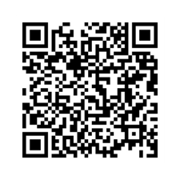


ILPQC WINTER OFFICE HOURS ARE HERE
Every Thursday
at 1 p.m. CST
Register here or go to ILPQC Website under “All Events”

Slide 34
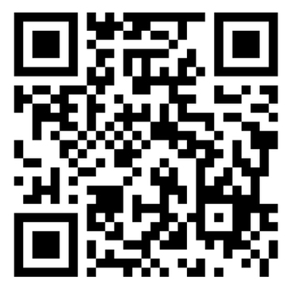

Help Us Improve ILPQC Social Media Outreach!
We are gathering information on which social media platforms you use to access professional health content to better tailor ILPQC’s social media presence.
Please take this short survey (under 5 minutes!) to share your experience and help guide our outreach efforts!

Slide 35









May 2026
SUNDAY | MONDAY | TUESDAY | WEDNESDAY | THURSDAY | FRIDAY | SATURDAY
 |  |  |  |  | 1 | 2
3 | 4 | 5 | 6 | 7 | 8 | 9
10 | 11 | 12 | 13 | 14 | 15 | 16
17 | 18 | 19 | 20 | 21 | 22 | 23
24 | 25 | 26 | 27 | 28 | 29 | 30
31
2026 OB and Neonatal Face-to-Face Meetings

Slide 36



ILPQC
14TH ANNUAL CONFERENCE
NOVEMBER 10TH, 2026
THE WESTIN LOMBARD YORKTOWN CENTER

