Slide 1

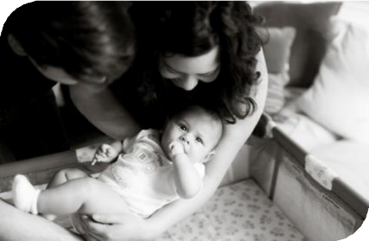


Equity and Safe
Sleep for Infants
Respectful Parent Partnerships
October 20th, 2025, 2:00 PM

Slide 2


Overview
Annual Conference
Initiative and Data Review
Review of Key Strategies for Patient and Community Engagement
Respectful Care Breakfasts
Team Talks
Blessing Hospital
St. Anthony Hospital

Slide 3

ESSI ABP MOC Part IV
Complete an attestation form if you are an ABP-certified
physician seeking
25 credits
under MOC Part IV
Download, complete and submit the attestation form available in the survey to your QI project leader for signature and upload to the survey when complete.
You can start submitting the attestation form in October.
Attestation of Meaningful Participation:
Intellectually engaged in planning and executing the project
Participated in implementing the project’s interventions - the changes designed to improve care
Regularly reviewed data in keeping with the project’s
measurement plan
Collaborated in the activity by attending team meetings
Scan QR Code for attestation submission survey
5

Slide 4
Annual Conference
November 12th, 2025
The Westin Lombard Yorktown Center

Slide 5
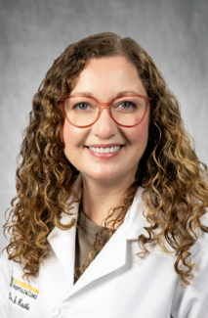





Deirdre J. Lyell, MD
Co-Chair, California Maternal and Perinatal Quality Care Collaboratives (CMQCC/CPQCC)
Julie S. Bosak, DrPH, CNM, MSN
Director, New Hampshire Perinatal Quality Care Collaborative (NHPQC)
Stephanie Radke, MD, MPH, FACOG
Collaborative Director, Iowa Perinatal Quality Care Collaborative (IPQCC)
Kay Matthews, LCHW
Executive Director, Shades of Blue Project
PQC Panel
From Stories to Systems: Advancing Perinatal Mental Health and Health Equity Through Quality Improvement

Slide 6


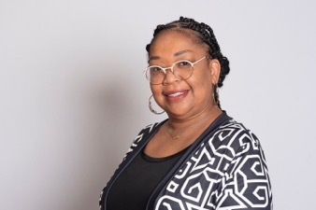

Tamela Milan-Alexander, MPPA
Community Engagement Director, Everthrive IL
ILPQC Obstetric Community Advisory Board member
Charity S. Bean, CMA, CFSD, CLC, CHW, SPM Founder, President & CEO, The Doula Lab
ILPQC Obstetric Community Advisory Board member
Stephanie Radke, MD, MPH, FACOG
Collaborative Director, Iowa Perinatal Quality Care Collaborative (IPQCC)
Using the Model for Improvement to Accelerate Your Work
Patient Partner Breakout Session

Slide 7


Homeward Bound: A Family-Centered Approach to Neonatal Discharge Readiness
Launched in January 2024, the initiative focused on promoting the successful discharge and transition of the NICU baby to home by focusing on three Key Drivers:
Family engagement and preparedness
Health Related Social Needs (HRSN)
Transfer and coordination of care
Patoula Panagos-Billiris
Dr. Patoula Panagos-Billiris is a neonatologist and lead for Homeward Bound. She received her medical degree from University of South Florida Morsani College of Medicine and has been in practice between 11-20 years.

Slide 8
Attendance Poll
Please fill out the poll so that we can track hospital team attendance for ESSI
Webinars. If unable to complete poll, please email kmoreno@northshore.org
Illinois Perinatal Quality Collaborative
4

Slide 9
Quick ESSI Update
Where we are, and what we’ve learned
Illinois Perinatal Quality Collaborative
9

Slide 10





ESSI Initiative Aims
1
2
By December 2025, greater than 70% of Illinois birthing and children’s hospitals will address
disparities and promote neonatal equity by actively participating in the ESSI initiative.
By December 2025, greater than 80% of infants will be discharged from ILPQC hospitals with a completed ESSI Bundle.
AWARENESS
Parents or caregivers report an understanding of a safe sleep environment.
Family is prepared for a transition to home,
including SDoH screening and resource linkage.
Communication to primary care provider completed.
READINESS
TRANSFER OF CARE
Illinois Perinatal Quality Collaborative
10

Slide 11

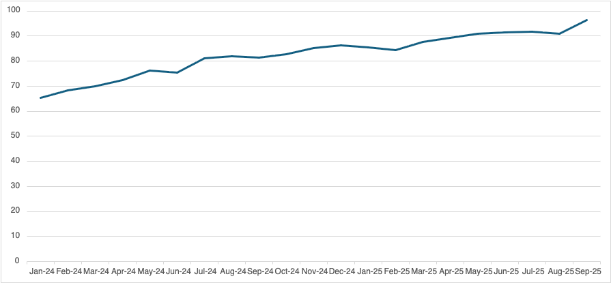
ESSI Bundle: Component 1 - Awareness
Parents or Caregivers Reporting an Understanding of Safe Sleep
96%
Goal = 80%
65.44%
% of Audited Charts
10.12.2025

Slide 12
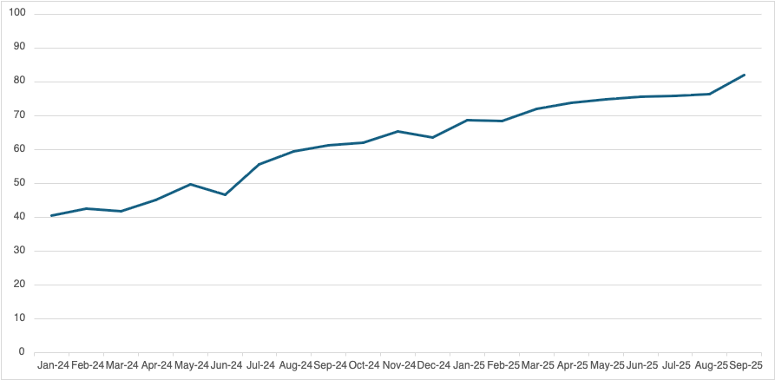
Documentation of a Conversation with Parents/Caregivers on adjustment to life with a newborn and safe sleep, and resources shared
ESSI Bundle: Component 1 - Awareness
Goal = 80%
81%
% of Audited Charts
40.57%

Slide 13

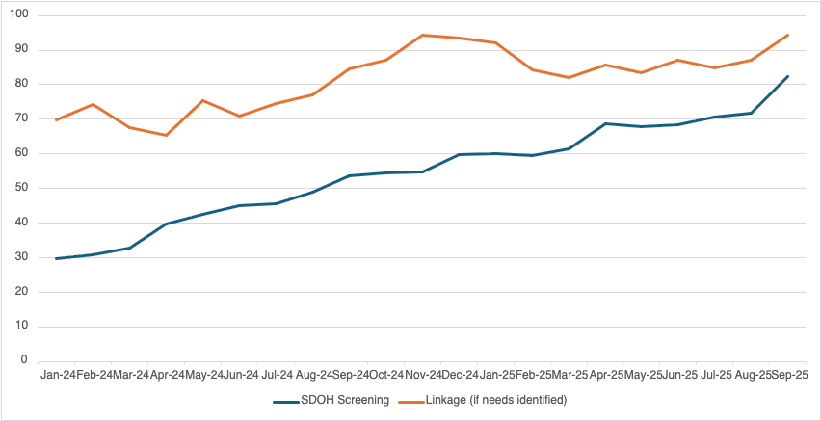
SDOH Screening and Linkage in Infant’s Chart
ESSI Bundle: Component 2 - Readiness
Goal = 80%
96%
69.83%
82%
29.77%
% of Audited Charts
10.12.2025

Slide 14

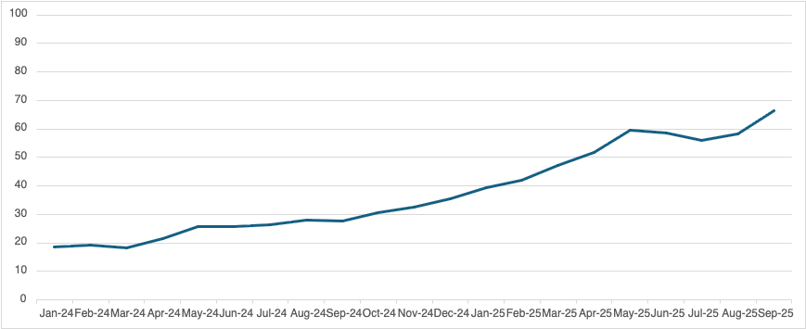
ESSI Bundle: Component 3: Transfer of Care
ESSI Bundle Documented in Discharge Summary
Goal = 80%
% of Audited Charts
AW
S
66%
18.72%
10.12.2025

Slide 15
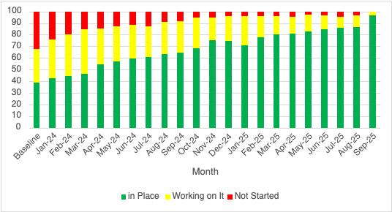
Standardized process for collection of infant race / ethnicity
Hospital has a standardized process for the collection of parent-reported newborn race and ethnicity data.

Slide 16
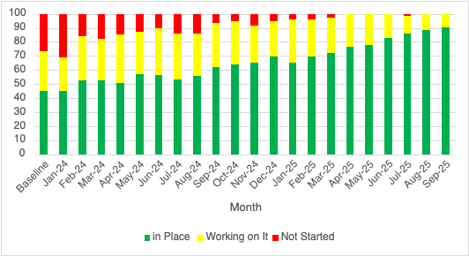
Standardized process to stratify and share infant data
Hospital has a standardized process to stratify and share neonatal data by birthing person's race, ethnicity, and insurance status.

Slide 17
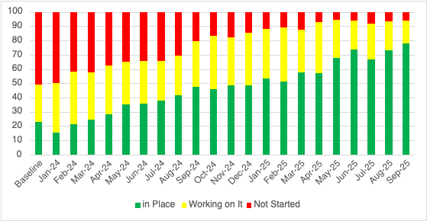
Standardized process to address neonatal disparities
Hospital has a standardized process to address disparities based on review of neonatal outcomes stratified by birthing person's race, ethnicity, and insurance status.

Slide 18
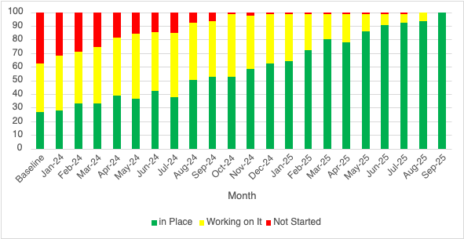
Standardized newborn-inclusive SDOH process
Hospital has a standardized process to screen for newborn-inclusive Social Determinants of Health and to link to needed resources.

Slide 19
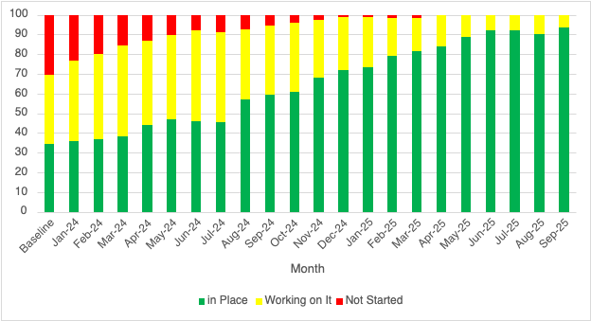
Standardized process to provide culturally responsive safe sleep education
Hospital has a standardized process to provide parents or caregivers culturally responsive safe sleep education including awareness of potential challenges, modeling, and teach back opportunities during hospitalization.

Slide 20

Aims
Primary Drivers
Secondary Drivers
By December 2025:
Healthcare Professional Commitment
Equitable and Respectful Care Education and Implementation
Safe Sleep Environment Education and Implementation
1. Greater than
70% of Illinois birthing and
children’s hospitals will address disparities and promote neonatal equity by actively participating in the ESSI initiative.
Key Driver Diagram
Inclusive Clinical Environment
Equitable and Inclusive Unit Policies
Organizational Leadership Commitment
Parent and Caregiver Experience Prioritization
Parent and Caregiver Empowerment
Respectful Parent and Caregiver Partnerships
Safe Sleep Awareness
Transition to Home, including SDoH Screening and Resource Linkage
Community Partnerships
Resource Mapping
Building Relationships with Community Organizations
Transfer of Care to Community Providers
2. Greater than 80% of infants will be discharged from ILPQC hospitals with a completed ESSI bundle.
Healthcare Data Utilization
Collection of Accurate Race and Ethnicity Data
Dissemination of Stratified Data
Application of Data to Address Inequities
Awareness: Parents or caregivers report an understanding of a safe sleep environment, including navigating challenges to safe sleep at home
ESSI
Bundle:
Readiness: Family is prepared for a transition to home, including SDoH screening and resource linkage
Transfer of Care: ESSI Newborn Care Plan (Awareness & Readiness) documented in the discharge
11
Illinois Perinatal Quality Collaborative

Slide 21




DRIVER 3: PARENT AND CAREGIVER EMPOWERMENT
Change Ideas
Partner with parents and caregivers in quality improvement work and unit culture
Secondary Driver 1: Respectful Parent and Caregiver Partnerships
Develop and promote respectful relationships
between parents and caregivers and healthcare team
Prepare and empower parents and caregivers to
implement a safe sleep environment for every sleep during hospitalization
Secondary Driver 2:
Safe Sleep Awareness
Engage with parents and caregivers to understand
barriers to a safe sleep environment to implement a
safe sleep environment for every sleep outside of the hospital
Empower parents and caregivers to have
conversations about safe sleep environment with additional caregivers
Secondary Driver 3:
Transition to Home, including SDoH Screening & Resource Linkage
Screen for SDoH and connect parents and caregivers to needed resources

Slide 22
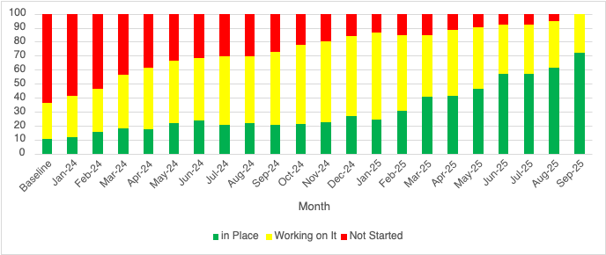
Parent on QI Team
Hospital has parent(s) and/or caregiver(s) on the newborn quality improvement team.

Slide 23
Goals
Describe Patient Partners and Respectful Care Breakfasts
Share what has worked across hospitals for engaging patient partners and implementing RCBs
Highlight tools and resources available to support teams in hosting respectful care breakfasts
Notes:
Justin starts with goals and hands over to Patti on this slide.

Slide 24
Patient Partners
Illinois Perinatal Quality Collaborative
27

Slide 25

Who is a patient /parent partner?
Patient Partners are individuals with lived experience who collaborate with healthcare teams to inform, co-design, and evaluate care improvement efforts.
Started with Birth Equity Initiative, has since expanded to the Equity and Safe Sleep for Infants (ESSI), Perinatal Mental Health (PMH) and Birth Quality Designation Program.
Where we are now:
Across all ILPQC hospital teams, there are 88 active Patient and Parent Partners.

Slide 26

Respectful Care Breakfasts
Illinois Perinatal Quality Collaborative
27

Slide 27
Poll: Has your hospital hosted a Respectful Care Breakfast?
Yes, for Birth Equity only
Yes, for ESSI only
Yes, for both Birth Equity and ESSI
Planning or adapting one
Not yet

Slide 28

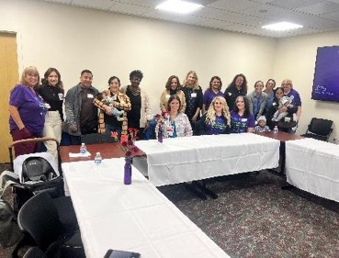
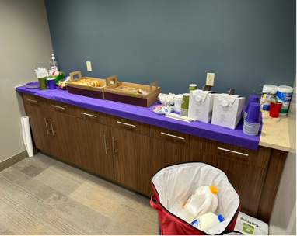


Respectful Care Breakfast
Introduced in January 2023 to foster open discussion between families and staff.
Designed to build trust, highlight lived experiences, and identify care improvements.
Hosted in formats like breakfasts, luncheons, or teas.

Slide 29
The Impact of Respectful Care Breakfasts
“I was invited to the Respectful Care Breakfast at Memorial Hospital of Carbondale by their Perinatal Outreach & Lactation Coordinator. I have been attending now for years and I have seen real change in the Labor & Delivery unit of the hospital because of these meetings. As a doula I have developed relationships with nurses, nurse supervisors, lactation consultants and other staff on the floor. The feedback from birth workers and the community is actually taken and implemented and that is so important for families in our region. It has been years of working together to create this change and the hard work has paid off and it all started by attending the Respectful Care Breakfast.”
Chastity Mays, M.S.ED., CD (DONA)
Carbondale Administrator
The Little Resource Center Carbondale, Illinois https://littleresourcecarbondale.org/

Slide 30

From Conversations to Culture Change
ILPQC conducted an analysis of the success and sustainability of Respectful Care Breakfasts (RCBs) through both the Birth Equity and Birth Quality Designation initiatives.
The following results highlight how hospitals are using Respectful Care Breakfasts to:
Strengthen trust and communication between staff, families, and community birth workers
Promote respectful and equitable care practices
Translate family feedback into tangible quality-improvement actions
Findings from this review will be presented at the 2026 Society for Maternal-Fetal Medicine Conference!

Slide 31
Respectful Care Breakfast – What Works
Key themes of participant feedback on the most valued components of Respectful Care Breakfasts in the post-event survey (n=149)
Hearing patient stories and feedback
47
Occurrences
Staff valued listening directly to families to better understand their experiences.
“I really love seeing patients that have delivered with us and how they are doing now. I think giving patients the opportunity to speak about their experiences is so valuable.” — Nurse “Hearing directly from the patient what they appreciated from their experience and what they need more from us as providers.” — Physician

Slide 32
Respectful Care Breakfast – What Works
Key themes of participant feedback on the most valued components of Respectful Care Breakfasts in the post-event survey (n=149)
25
Occurrences
Facilitating open and honest communication
Participants appreciated open spaces for candid feedback and shared learning.
It was an open discussion, and I felt free to share anything I needed to.” — Community Member “It was so nice to hear an open communication and see all the learning.” — Doula

Slide 33
Respectful Care Breakfast – What Works
Key themes of participant feedback on the most valued components of Respectful Care Breakfasts in the post-event survey (n=149)
Sharing patient experiences
21
Occurrences
Sharing personal birth stories felt empowering and helped improve care.
Getting to share my amazing birthing experience at this hospital and getting to hear about the experiences of others.” — Patient Partner “Everyone was very receptive to the things I shared and they were actively working to make changes as we went through everything.” — Patient Partner

Slide 34
Respectful Care Breakfast – Transforming Care in Illinois
Metric | Result
Hospitals hosting at least one RCB | 46 out of 77
Increase since launch | 5% to 58%
Participant enjoyment (4–5 rating) “I enjoyed participating in the respectful care breakfast.” | 96%
Learning about respectful care (4–5 rating) “I learned more about respectful care practices.” | 90%

Slide 35
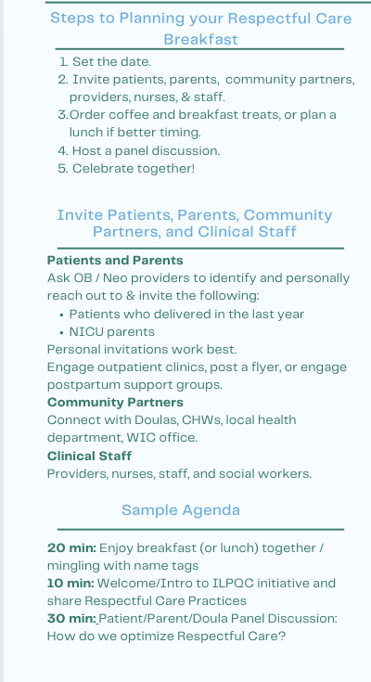
Supporting Your Team’s Implementation of Respectful Care Breakfasts and Gatherings
”A Celebration of Respectful Care” ILPQC Respectful Care Breakfast
This resource was created to help hospitals plan and host a Respectful Care.
Includes:
Step-by-step guide for planning the event
Overview of general steps included in planning your event
Invitation guidance for identifying and involving patients, parents, partners, and staff.
Sample agenda to structure the Respectful Care Breakfast

Slide 36
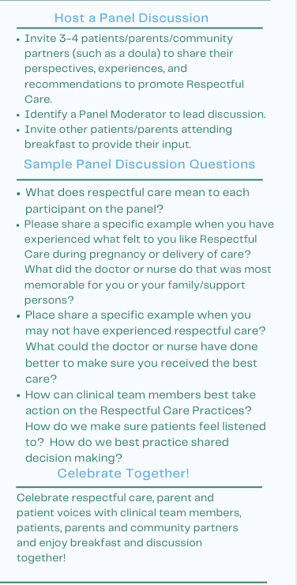

Supporting Your Team’s Implementation of Respectful Care Breakfasts and Gatherings
”A Celebration of Respectful Care” ILPQC Respectful Care Breakfast
Panel discussion section with sample questions to spark conversation about respectful care experiences.
Celebration and follow-up section, including QR codes for participant feedback and ongoing engagement with QI teams.

Slide 37
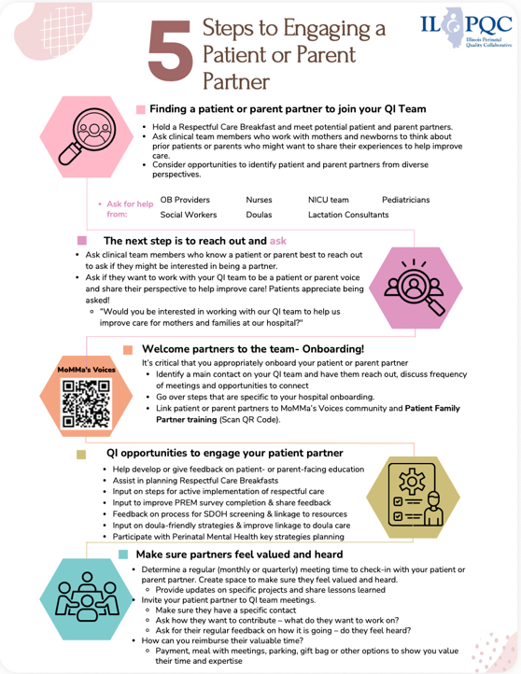
Supporting Your Team’s Parent Partner Engagement
5 Steps to Engaging a Patient or Parent Partner
Find a partner: Ideas for identifying potential parents or patients through events like Respectful Care Breakfasts or staff referrals.
Reach out and ask: Approaching families personally and invite them to participate.
Welcome and onboard: Provide orientation to partner, assign a point of contact, and connect them to MoMMA’s Voices training.
Create QI opportunities! Involve partners in education, respectful care planning, and SDOH or doula linkage work.
Ensure partners feel valued and heard . You can do this through regular check-ins or consider other ways to acknowledge their time/contributions.

Slide 38
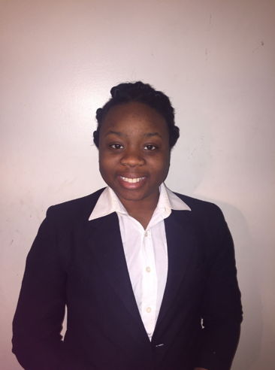

Welcome our new Community Engagement Coordinator!
Provides support and resources to hospital teams to identify, support and strengthen
patient/parent partnerships
community partnerships to support patient/parent health and SDOH needs
Facilitates strategies with hospital teams to engage
community-based/outpatient provider
community-based organizations
doulas
Tochukwu Akujieze, MPH
Notes:
Community Engagement Coordinator, is available to support hospital teams with engaging and supporting patient, family and community partners and community-based providers. She is the contact for the OB and Neonatal Community Advisory Boards.

Slide 39

Integrating Documentation of Respectful Care Breakfast in ESSI
For the month of November, the following questions will be added to the ESSI Hospital Level Data Form.
Have you had a Respectful Care Breakfast?
Y / N
If yes, when?
If yes, was this respectful care breakfast focused on Birth Equity and ESSI (including newborn and/or NICU care)
Starting in January, the following questions will be added to the ESSI Hospital Level Data Form.
Have you had a Respectful Care Breakfast this month?
When was it held?
Focus area (Birth Equity, ESSI, both)

Slide 40
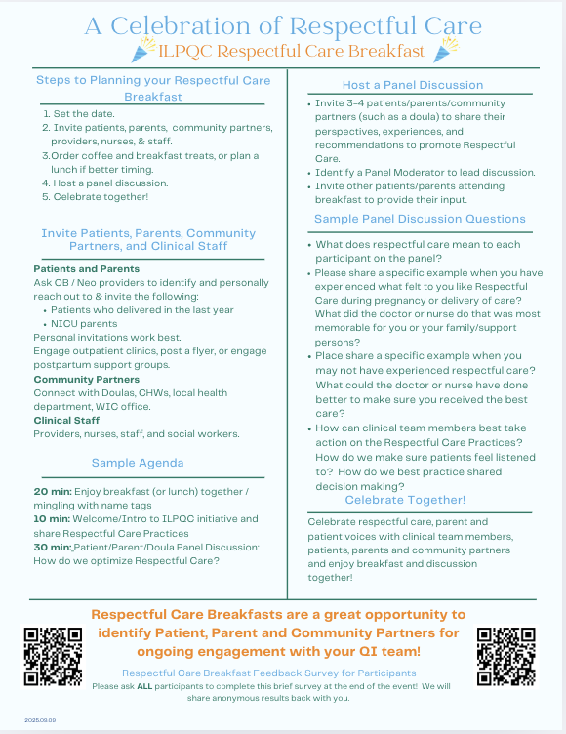
To-Do’s
By Annual Conference, set a date for your Respectful Care event
Review our resource “A Celebration of Respectful Care” and use it as a planning guide to move your event forward.

Slide 41

Team Talk: Blessing Hospital
Patient Partners and Respectful Care in Action!
Quincy, IL
Shannon Zanger, Women’s and Children’s RN Care Coordinator
Illinois Perinatal Quality Collaborative
27
Notes:
I've been an RN for 21 years. All of my experience is in Women's Health as I'm trained as a labor and delivery nurse, but two years ago I was given the opportunity to take a "new to the organization" position as the Women's and Children's RN Care Coordinator.

Slide 42
Team Talk: St. Anthony Hospital
Patient Partners and Respectful Care in Action!
Chicago, IL
Tina Gonzalez, Manager of Maternal/Child services
Audra Whitton, Assistant Manager of Maternal/Child Services
Illinois Perinatal Quality Collaborative
27

Slide 43
Announcements
Illinois Perinatal Quality Collaborative
27

Slide 44









May 2026
SUNDAY | MONDAY | TUESDAY | WEDNESDAY | THURSDAY | FRIDAY | SATURDAY
 |  |  |  |  | 1 | 2
3 | 4 | 5 | 6 | 7 | 8 | 9
10 | 11 | 12 | 13 | 14 | 15 | 16
17 | 18 | 19 | 20 | 21 | 22 | 23
24 | 25 | 26 | 27 | 28 | 29 | 30
31
2026 OB and Neonatal Face-to-Face Meetings

