Slide 1

Bridging Gaps in
Perinatal Mental Health:
Statewide Resources You Can Use

Slide 2

Resource Panel Objectives
Overview of free and accessible statewide mental health resources
How to connect patients and their families to these services during delivery hospitalization, outpatient settings, and emergency departments
Ways to integrate these tools into your clinical team's perinatal mental health workflows
Overall Goal of This Session:
Awareness of statewide resources to strengthen your perinatal mental health support across the patient’s continuum of care.
Notes:
Why this matters: Hospital teams are essential touchpoints for early identification and connection to care.

Slide 3

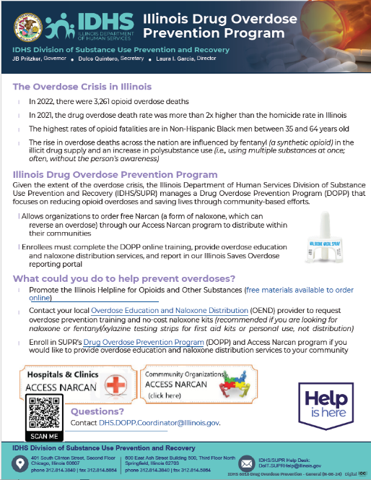
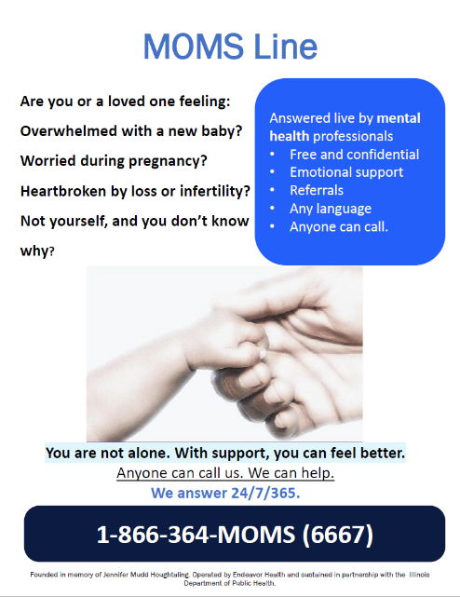
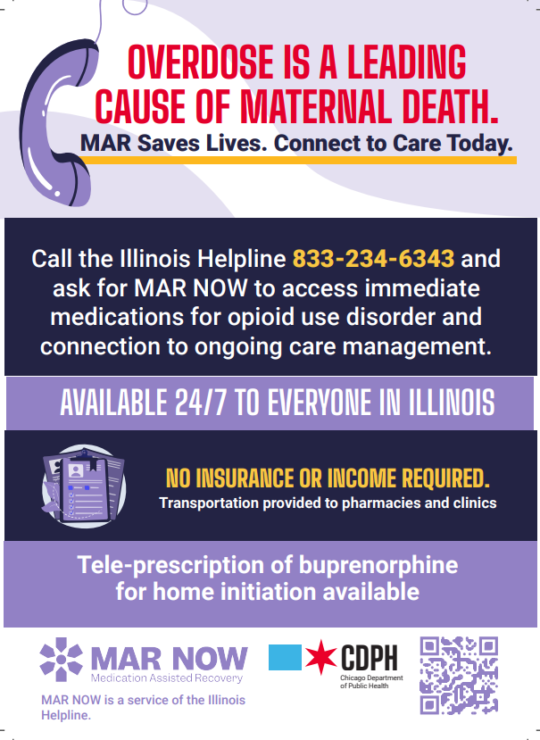
Resources in the F2F Folder
IL DocAssist
DOPP FAQ
IL MOMS Line
MAR Now Flyer

Slide 4
Statewide Resources Panelists
Illinois DocAssist
Diane M. Misch, M.D., F.A.P.A.
Illinois MOMsLine
Laura La Porte, LCSW, PMH-C
MARNOW & DOPP
Nicole Gastala, MD
Medical Director
Clinical Research Manager
Illinois DocAssist, University of Illinois at Chicago
Endeavor Health Perinatal Depression Program
Medical Director
Substance Use Prevention and Recovery Division, IDHS

Slide 5

Diane M. Misch, M.D., F.A.P.A
Medical Director
Illinois DocAssist

Slide 6
Easing access to pediatric and perinatal mental health care with Illinois DocAssist
Diane Misch, MD, FAPA
Medical Director, Illinois DocAssist
Assistant Professor of Clinical Psychiatry
University of Illinois at Chicago

Slide 7
Disclosure Statement
Illinois DocAssist presenters have no relevant conflict of interest
Notes:
Diane slides 2-13
- As Illinois DocAssist presenters, we have no relevant conflict of interest to report.
7

Slide 8
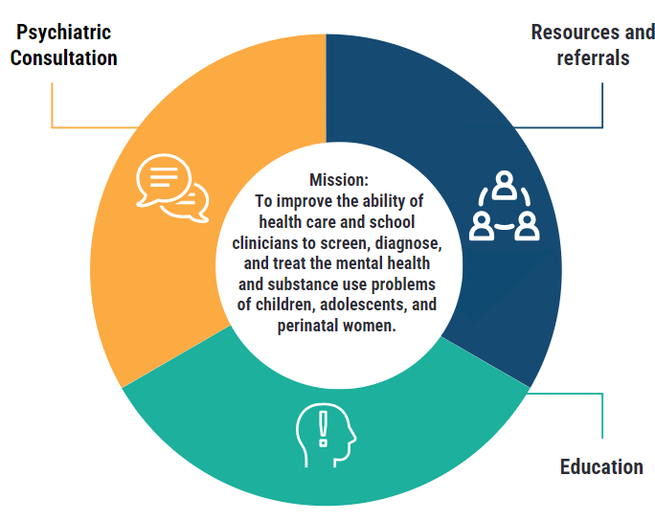
Illinois DocAssist Services
Notes:
Diane
To achieve our mission we provide psychiatric case based telephone consultation focused on….
We also provide researched and vetted community referral resources such as psychotherapy, support groups and psychiatric treatment options. We include wait times and eligibility criteria with consideration to insurance so that as the healthcare provider you can make an informed decision with your patient for the best possible treatment plan.
We offer educational events such as workshops and case consultation rounds to groups of providers
On our website you can find resources and information on pediatric and perinatal mental health topics. We offer medication charts an treatment decision algorithms and this is also where you can find our recorded webinars.
We also offer Monthly educational e -newsletters to providers who sign up for our mailing list and regular informational social media posts.

Slide 9
Consultation
Consultation Can Be:
  Diagnosis and treatment of mental health and substance misuse disorders in general or for a specific patient
  Medication consultation
  Therapeutic interventions for the office
Consultants
  Double and triple boarded academic Child and Adolescent Psychiatrists and Perinatal Psychiatrists
  Academic licensed clinical social workers specializing in pediatric and perinatal mental health
Consultation Process:
  Clinician to clinician communication
  Scheduled or spontaneous call
  Follow-up calls available and recommended
  Same consultant available to help you throughout the case
Notes:
- Illinois DocAssist provides psychiatric phone consultations directly to health care providers, but does not take over the care or management of patients.
- Callers may ask about behavioral health issues, mental health problems, and substance use issues as a general topic or in regard to a specific patient.
- Medication questions are the most frequent type of consultation for prescribers.
- Consultants have a wealth of information to provide about therapeutic interventions health care providers can do during a short office visit
- Consultations always provide some psychiatric education specific for health care providers to enhance their scope of practice but not turn them into psychiatrists
- The consultation process takes some time so it is recommended that the caller reserves at least 10-15 minutes for the phone call
- Consultations are clinician to clinician communication; it is not effective to have office staff call and ask us to help you if you do not talk to us; we do not talk to patients or families
- Consultations can be generated through a phone call, email, or website consultation form. They can be real time or scheduled to suit your needs.
- Consultants will make a follow-up call with your permission, and will recommend it for complicated cases and long referral wait times. There is no limit to follow up calls.
- Unless the caller indicates otherwise, the same consultant will follow up with you for a particular case.
9

Slide 10
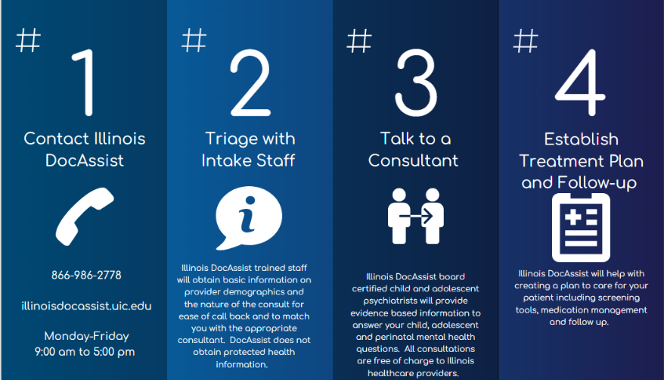
Four Steps to Consulting with Illinois DocAssist
Notes:
- The Consultation Process is 4 Easy Steps.
- The first step is to contact Illinois DocAssist either through the toll-free phone number or website. Consultations can be done in real time or scheduled for your convenience. Illinois DocAssist is available Monday-Friday from 9AM-5PM.
- The second step is Triage with the Intake staff who answer calls, emails, and website consultation requests. The staff are trained to obtain basic information on provider demographics and the nature of the consult. Then an appropriate consultant is matched to the health care provider’s needs.
- The third step involves the health care provider talking to the psychiatric consultant. Illinois DocAssist has academic board certified child and adolescent psychiatrists and social workers who will provide evidence based information to answer your child, adolescent, and perinatal mental health questions. All consultations are free of charge.
- The fourth step involves establishing a treatment plan and follow-up. DocAssist consultants will help with creating a plan of care tailored to the care of your patient including screening tools, medication management, psychotherapy interventions, resources, referrals, and follow-up calls with the health care provider until the patient is stable.

Slide 11
Treatment Referral Assistance
Referrals with Consultation
  Vetted referrals provided for health care providers who receive a consultation
    Therapy
    Perinatal psychiatrist
    Other type of referral resources
  About 3 referrals per referral request
    Insurance
    Languages
    Services
    Wait times
Notes:
Amanda starts 14-20
- DocAssist provides Pediatric and Perinatal Resources to PCPs. This includes but is not limited to screening tools for specific mental health conditions, medication charts, and patient and family resources. A consultation about a patient is not required, but is often how resources are generated. Providers are free to contact DocAssist for resources only and we are happy to provide you with the best ones to fit your situation. Rhapsody will be talking more about resources in a few minutes.
- A consultation with a child psychiatrist is needed for any pediatric and perinatal referrals for mental health services. In this way we maintain PCP involvement and support the PCP’s care of the patient while waiting for the referral to take place.
- Referrals can be to a community mental health agency, child psychiatrist, or other type of service.
- Generally 3 referrals per request are provided and include services provided, wait times, and availability.
- Referrals are only sent to the PCP and not patients or their families. The PCP can then provide all or part of the information to the patient or families.
- Referrals for specialized perinatal providers can be mor elimited
11

Slide 12
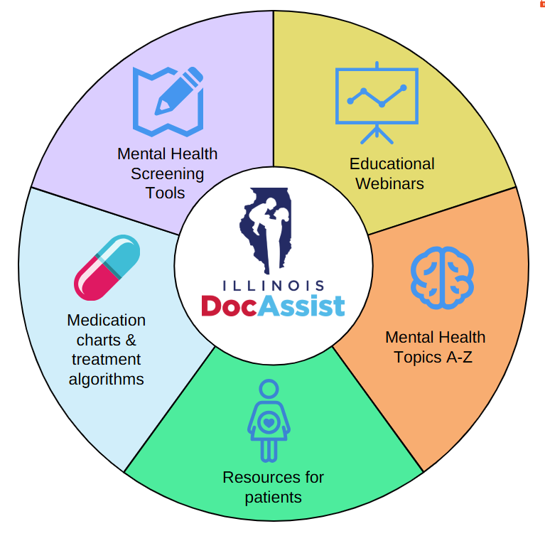

Digital Tools and Resources
Bookmark illinoisdocassist.uic.edu for quick access
Notes:
I would like to take a moment to point you in the direction of some of the curated resources that we offer to help you care for the mental health needs of your patients. We know that it can be overwhelming to comb through the large amount of online information and resources out there to identify quality materials. As mental health professionals we can help you find what you are looking for and ensure that resources and information you are using is evidence based and relevant. We update our website regularly with relevant information for primary care doctors and other healthcare providers. I’ll walk you through some of the highlight son our website we are easy to find in a google search.
Mental health screening tools for general MH and more specific screening ie: for trauma, anxiety and depression) –we look for tools that are evidence based, no cost and easy to use and access in a busy practice.
Medication charts – compiled with evidence based guidance by our psychiatric consultants to guide medication decision making
Workshops and Webinars- Pre recorded educational webinars including trauma informed pediatric care, Adolescent substance misuse, addressing sleep problems and others. Several of our webinars provide CME.
Curated information and resources on many mental health topics with everything you need to start addressing these issues when they come up in your office. There are many topics covered including suicide, eating disorders, vaping and anxiety and phobia’s to name a few.
12

Slide 13
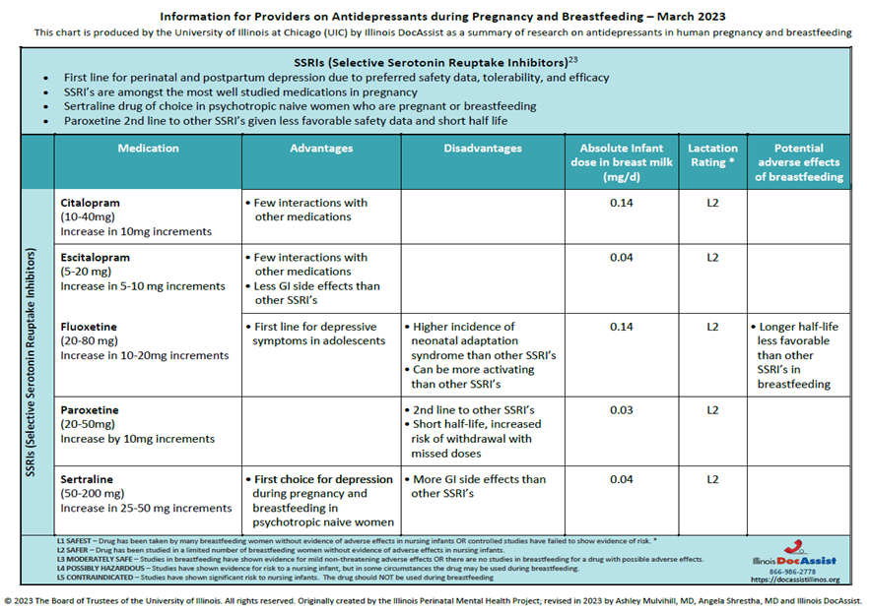
Medication Algorithm associated with Postpartum Depression and Breastfeeding
Notes:
If a woman is pregnant and doing well on a medication consider continuing even if not most preferred medication (from another slide)
If GI issues with sertraline - Discontinue sertraline. GI side effects that do not improve after 2 weeks are unlikely to improve
Start another SSRI (such as escitalopram 10mg qam)
May consider using mirtazapine in women with pregnancy sickness as it can help with nausea/emesis

Slide 14
Continuing Education
Pediatric and Perinatal Education
  Workshops
  Presentations
  Case Consultation Rounds
  Webinars
  Open Office Hours
Educational Format
  In person
  Virtual
Other Educational Sources
  DocAssist Website
  DocAssist Facebook, Twitter, You Tube, Monthly E-Newsletters
Notes:
-In addition to psychoeducation during each consultation, Illinois DocAssist provides pediatric and perinatal education formally through workshops, presentations, case consultation rounds, webinars, and MAT training.
- The educational format can be in person or virtual.
- You can visit our website and You Tube for recorded presentations. Our Facebook, Twitter, and Email blasts provide an additional way to get timely information.
- At live educational events we are available to do consultations and welcome your questions.
14

Slide 15
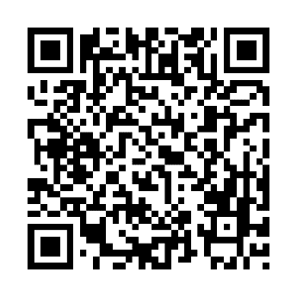
Free continuing education on pediatric & perinatal mental health for primary care providers
Pediatric and Perinatal topics to build knowledge and skills
Recorded webinars available at your convenience
illinoisdocassist.uic.edu/continuing-education/educational-webinars
Notes:
Amanda
Facilitated Peer Support Sessions focused on each topic are also available (see website for details- Muge)

Slide 16

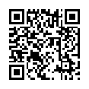
Virtual Open Office Hours for Clinical Pearls, Conversations, and Consultation
  A short presentation focused on a pediatric or perinatal mental health topic
  Discuss your specific questions and cases with a Child and Adolescent Psychiatrist and Psychiatric Social Worker.
  New dates and topics continuously being added
Learn more and register
illinoisdocassist.uic.edu/news-stories/open-office-hours

Slide 17
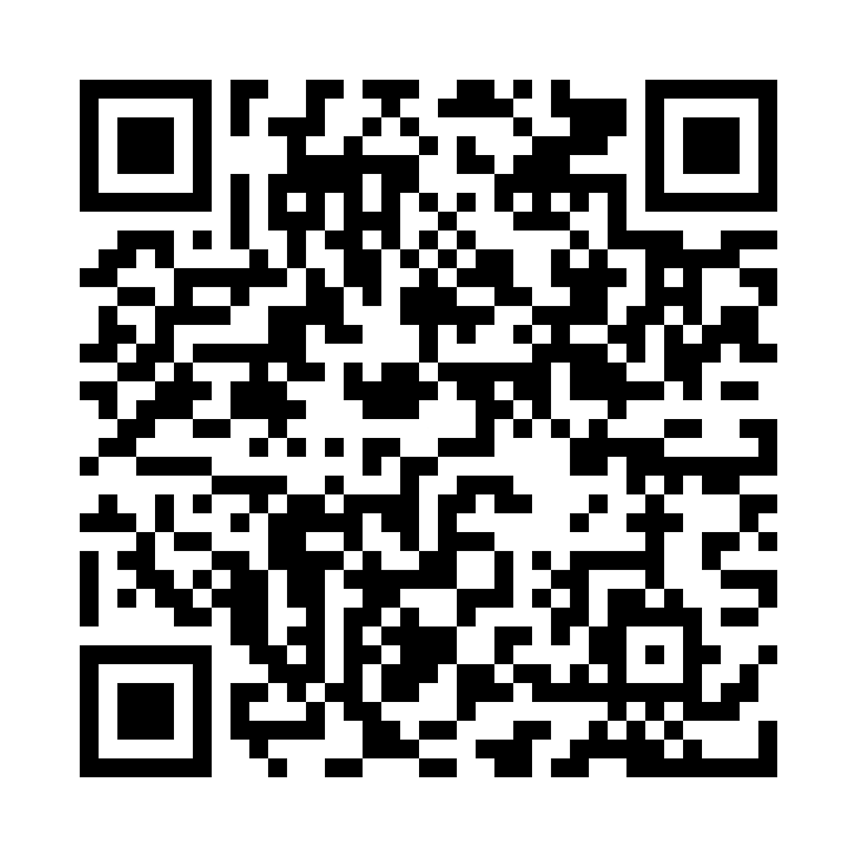
Illinois DocAssist: Essentials
Contact Information
  Consultation Line: 866-986-2778
  Email: docassistil@uic.edu
  Website: illinoisdocassist.uic.edu
Hours of Operation
  Monday through Friday 9AM – 5PM
Notes:
Amanda
- You can contact us for a consultation or presentation through our toll free phone number, email address, or website listed on this slide.
- Our hours of operation are Monday through Friday 9am-5pm.
- The consultants assisting you with consultations or providing education are double and triple boarded academic CAPS, academic licensed clinical social workers specializing in pediatric and perinatal mental health, and certified MAT trainers.
17

Slide 18
DocAssist Common Q&A
Can I refer my patients directly to Illinois DocAssist?
No; Illinois DocAssist is a problem-based consultation and training service to healthcare providers.
Who can use the services?
Health care and school-based clinicians involved in the care and treatment of children, adolescents and perinatal women.
Do the consultation services cost me anything?
No; All services are free of charge
What is the response time for DocAssist consultations?
You can either schedule a consultation for a future date or time or initiate a consultation real time. A staff member will answer the phone live when you call and connect you with a consultant usually within 30 minutes and always within a business day.
Do you collect Protected Health Information (PHI)
We do not ask callers to provide us with any PHI except in the case of a child who is a ward of the state.
Who will provide the consultation services?
Experts in the care and treatment of children, adolescents, and perinatal women with psychiatric and substance use disorders.
Notes:
Amanda
Here are the answers to several questions which we are frequently asked.
Can I refer my patients to Illinois DocAssist
Patients cannot be directly referred to Illinois docAssit for services, rather healthcare providers communicate with our psychiatric consultants directly to aid in addressing the mental health concerns of their patients.
Primary Care and other healthcare providers in the state of Illinois who are involved in the treatment of perinatal women and children can access our consultation services. All Illinois DocAssist services are free.
Consultation requests are responded to within one business day and often real time consulytations are available.
Consultation is provided by board certified psychiatrists and licensed clinical social workers who are experts in the treatment of perinatal and pediatric psychiatric and substance abuse disorders.

Slide 19
References
1. Centers for Disease Control and Prevention, MMWR (Morb. Mortal. Wiley. Rep) 62 (2013) 1-35
2. U.S. Department of Health and Human Services. Mental Health: A Report of the Surgeon General—Executive Summary. Rockville, MD: U.S. Department of Health and Human Services, Substance Abuse and Mental Health Services Administration, Center for Mental Health Services, National Institutes of Health, National Institute of Mental Health,1999.
3. U.S. Department of Health and Human Services. Mental Health: A Report of the Surgeon General—Executive Summary. Rockville, MD: U.S. Department of Health and Human Services, Substance Abuse and Mental Health Services Administration, Center for Mental Health Services, National Institutes of Health, National Institute of Mental Health, 2021.
4. NCHS Data Brief ■ No. 381 ■ September 2020
5. Leeb, R. T., et al., Morbidity and Mortality Weekly Report, Vol. 69, No. 45, 2020
6. JAMA Pediatr. doi:10.1001/jamapediatrics.2022.0056 Published online March 14, 2022. Corrected on April 4, 2022.
Perou, R., Bitsko, R. H., Blumberg, S. J., Pastor, P., Ghandour, R. M., Gfroerer, J. C., Hedden, S. L., Crosby, A. E., Visser, S. N., Schieve, L. A., Parks, S. E., Hall, J. E., Brody, D., Simile, C. M., Thompson, W. W., Baio, J., Avenevoli, S., Kogan, M. D., Huang, L. N., & Centers for Disease Control and Prevention (CDC) (2013).
Mental health surveillance among children--United States, 2005-2011. MMWR. Morbidity and Mortality Weekly Report Supplements, 62(2), 1–35.
Whitney, D.G. & Peterson, M. (2019). US national and state-level prevalence of mental health disorders and disparities of mental health care use in children. JAMA Pediatrics, 173(4), 389-391. doi:10.1001/jamapediatrics.2018.5399
Centers for Disease Control and Prevention. (2020). Youth Risk Behavior Surveillance Data Summary & Trends Report: 2009-2019. Retrieved from https://www.cdc.gov/nchhstp/dear_ colleague/2020/dcl-102320-YRBS-2009-2019-report.html
Kalb, L. G., Stapp, E. K., Ballard, E. D., Holingue, C., Keefer, A., & Riley, A. (2019). Trends in Psychiatric Emergency Department Visits Among Youth and Young Adults in the US. Pediatrics, 143(4), e20182192. https://doi.org/10.1542/ peds.2018-2192
Curtin, S. C. (2020). State suicide rates among adolescents and young adults aged 10–24: United States, 2000–2018. National Vital Statistics Reports; vol 69 no 11. Hyattsville, MD: National Center for Health Statistics. Protecting Youth Mental Health: The U.S. Surgeon General’s Advisory 43
Curtin, S. C., Hedegaard, H., Ahmad, F. B. (2021). Provisional numbers and rates of suicide by month and demographic characteristics: United States, 2020. Vital Statistics Rapid Release; no 16. Hyattsville, MD: National Center for Health Statistics.

Slide 20

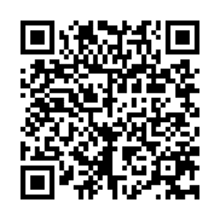
Thank You!
Stay in touch by signing up for our e-newsletter…
Consultation Line: 866-986-2778
Email: docassistil@uic.edu
Website: illinoisdocassist.uic.edu
Notes:
Any questions?

Slide 21


Laura La Porte, LCSW, PMH-C
Clinical Research Manager
Endeavor Health Perinatal Depression Program

Slide 22
Bridging Gaps in Perinatal Mental Health:
IL MOMS Hotline
24/7 Mental Health Referrals, Education and Support for Perinatal Families and their Providers
Laura La Porte, LCSW, PMH-C

Slide 23
Overview of the Illinois 866-364-MOMS Hotline
Who Can Call? Anyone—the hotline is for all pregnant/postpartum patients in IL
Who Answers? Licensed mental health professionals, available 24/7.
What Issues Are Addressed? Perinatal anxiety, depression, stress and more.
Languages Available? Interpretive services are available.
Is it free? Yes.
Live 24/7
No cost to callers
Licensed mental health professionals
Available in any language
Notes:
Available 24 hours a day, 7 days a week
Staffed by licensed mental health professionals
Capacity to serve callers in any language via use of interpretive service line
Free and confidential
Operates via state-of-the-art call routing technology (RACF)

Slide 24

Reach and Impact
16,491 total calls since 2003
62 calls per month
Average call is 26 minutes
Most callers receive referrals
584 callers to ER for life-saving treatment

Slide 25
What We Do
Assessment
Emotional support
Refer to local mental health resources
Safety planning
Psychoeducation

Slide 26
Our Role
Immediate support, assessment and referral for the perinatal population and providers.
Bridge to ongoing mental health care, not a replacement for treatment.
Patients and family can call directly.
Providers can call with the patient.

Slide 27
Who we Serve
Pregnant
Postpartum
BIPOC
LGBTQA+
Providers
Families
Therapists
Anywhere in Illinois
Uninsured
Medicaid
Private Insurance
Loss

Slide 28
Reason for Hotline Call

Slide 29
How You Can Use the IL MOMS Hotline
👩‍⚕️ During pregnancy
Introduce the hotline early – during prenatal visits or OB intakes
Include the hotline flyer in prenatal packets or Centering Pregnancy materials
Post flyers in OB waiting rooms and restrooms
Include the hotline number on mood-screening forms
Add the hotline number to after-visit summaries or discharge note templates
🧭 Example: a patient shares she is overwhelmed with her third pregnancy and has panic attacks. With the patient, the provider calls the hotline from an available room. The hotline worker talks with the patient and emails her therapists who take her insurance, Medicaid.

Slide 30
How You Can Use the IL MOMS Hotline
🏩 During Delivery or Hospital Stay
Post hotline flyers in L&D triage, postpartum recovery rooms, and NICU.
Include the number on whiteboards or bedside education materials.
Train staff to use the hotline when mood concerns arise during hospital stay:
  New mom crying constantly
  Family worried about patient’s mood
  Prior history of mental illness and no outpatient plan
📞 Example: Patient’s loved can call from the bedside or do a three-way call with the patient. We will offer psychoeducation and referrals for support. The hotline worker will encourage the loved one to have the patient speak with us.

Slide 31
How You Can Use the IL MOMS Hotline
🏠 Postpartum
Include hotline flyer in every discharge folder
Scan the hotline flyer into discharge instructions
In postpartum phone follow-ups, staff can remind patients of the hotline
Share with Emergency Room, pediatric offices, lactation consultants or other locations that may provide PMH screens
🧭 Example: A patient has a history of anxiety and is feeling overwhelmed. With the patient, the nurse phones the hotline for assistance with therapy referrals as a part of discharge planning.

Slide 32
IL MOMS Hotline Evaluation Study
Increased satisfaction with obstetric care
High levels of overall satisfaction with hotline
Improved mood, coping and knowledge
"Given the fact that there is this service and that there are these counselors that they can refer you to…it’s incredibly helpful. And I think it’s a basically a necessity for women and children, that there’s programs like this."
Kim, J. J., La Porte, L. M., Corcoran, M., Magasi, S., Batza, J., & Silver, R. K. (2010). Barriers to mental health treatment among obstetric patients at risk for depression. American journal of Obstetrics and Gynecology, 202(3), 312-e1.
Notes:
Qualitative study of 51 women

Slide 33
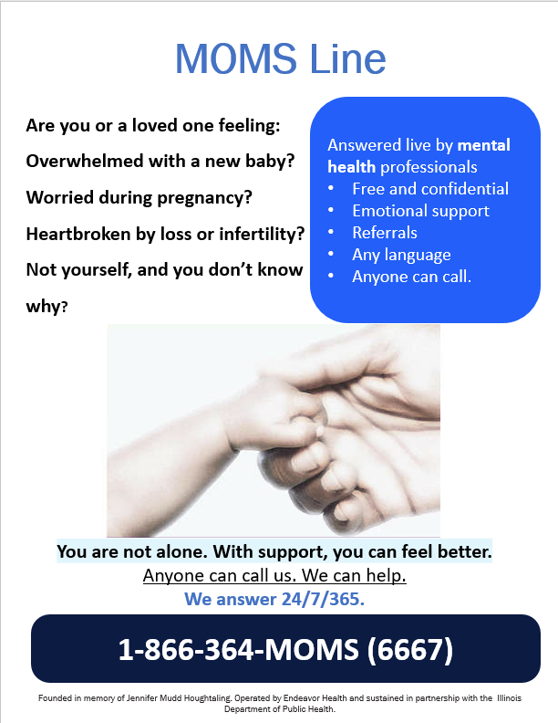
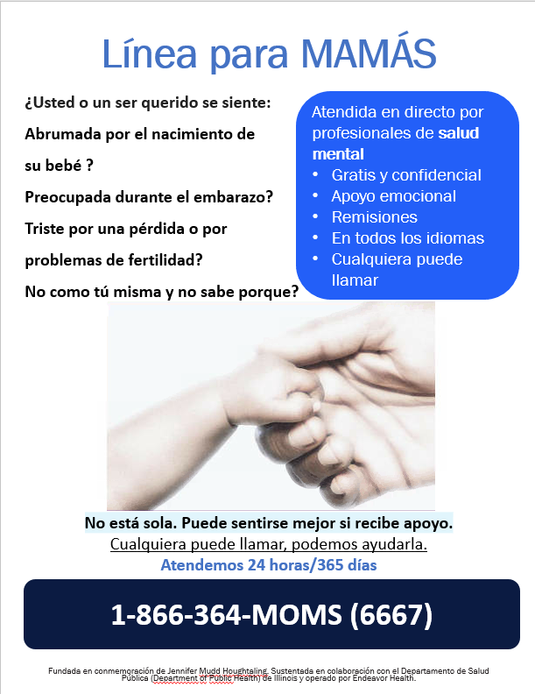

Slide 34


Nicole Gastala, MD
Medical Director
Substance Use Prevention and Recovery Division, IDHS

Slide 35
MAR NOW and DOPP Program Overview

Slide 36
MAR NOW launched May 9, 2022 as a Chicago Pilot
Expanded Sept. 1, 2022 Statewide
Funded by Chicago Department of Public Health (CDPH) and Illinois Department of Human Services Division of Substance Use Prevention and Recovery (IDHS/SUPR)
Operated by Family Guidance Centers, Inc. (FGC). FGC provides methadone, buprenorphine, and naltrexone at their Chicago and statewide clinics.
Operates through the existing 24/7 IL Helpline for Opioids and Other Substances: 833-234-6343
Provides low-barrier, rapid access to buprenorphine, methadone, and naltrexone to all callers regardless of insurance status, income, ability to pay, or documentation status.

Slide 37
Program provides access to medication within 48 hours of first call
Patient Options:
Buprenorphine home induction
Same or next-day MAR appointment at FGC (methadone, buprenorphine, naltrexone)
Connection to other SUD care in the community (withdrawal management, residential treatment)
Individual calls 24/7 IL Helpline for OUD treatment, withdrawal support
24/7 Access
Connected to Care Manager & Provider
IL Helpline directly transfers caller to MAR NOW Care Manager
Care Managers provide free transportation, insurance enrollment, assistance with pharmacy access, and follow up to ensure patient is connected to long-term care

Slide 38
Hub and spoke model to ensures connection to ongoing community care
MAR NOW works closely with pharmacies to ensure that they have medications available and are able to assist patients
Mental health providers
Mental health, primary care, and harm reduction services are key referral points to and from MAR NOW
Pharmacies
Harm reduction providers
MAR NOW
Primary care providers
All patients connected to outpatient MAR for long-term treatment in the community
Cook County Jail
Program is working closely with jail and homeless shelter providers to offer linkage to MAR NOW
Community MAR providers
Homeless shelters and encampment outreach
Patients that leave treatment can come back to MAR NOW and be connected again to treatment in the community. MAR NOW can also serve as a bridge clinic for patients waiting for care.

Slide 39
Where to initiate MAR treatment via MAR NOW? Everywhere!
In the Emergency Department
  Ask patient if they are interested in starting medication, re-started on medication or being connected to services for opioid use disorder
    If yes, have a team member give the patient access to a phone and they can call 833-234-6343
    The MAR team will take it from there including case management
Following Hospital Admission
  Ask patient if they are interested in starting medication, re-started on medication or being connected to services for opioid use disorder
    If yes, have a team member give the patient access to a phone and they can call 833-234-6343
    The MAR team will take it from there including case management
    Inpatient Team can start MAR if medically appropriate and MAR NOW case management team will coordinate follow-up and continuation
In the Urgent Care or Outpatient Setting or Case Management
  Ask patient if they are interested in starting medication, re-started on medication or being connected to services for opioid use disorder
    If yes, have a team member give the patient access to a phone and they can call 833-234-6343
    The MAR team will take it from there including case management

Slide 40
Initial Program Data & Learnings

Slide 41
Initial data indicates program model successfully connects patients to care
May 9, 2022 – February 2, 2025: MAR NOW Call Data | Number | Percent of Total
Calls from patients seeking OUD care | 3804
Patients seeking methadone | 442 | 11.6%
Patients seeking buprenorphine | 3237 | 85%
Patients seeking injectable naltrexone | 11 | .2%
Patients seeking withdrawal management w/ medical stabilization on MAR | 67 | 2%
Patients seeking residential treatment | 47 | 1.2%
Connection to care is high across all treatment options.
Patients connected to withdrawal management and medical stabilization are also connected to FGC's mobile van and MAR.
Patient Connection Data
Methadone patients attended first appointment | 364 | 82%
Buprenorphine patients connected to medication | 2990 | 92%
Injectable Naltrexone patients attended first appointment | 7 | 64%
Withdrawal management & medical stabilization patients who showed at appointment | 65 | 97%
Residential treatment patients who showed at appointment | 43 | 91%

Slide 42
Initial data demonstrates home induction is safe and effective
May 9, 2022 – February 2, 2025: Buprenorphine Patient Data
 | Number | Percent of Total
Calls from patients seeking buprenorphine | 3237
Buprenorphine patients connected to medication | 2990 | 92%
Patients connected to medication that received home induction | 2862 | 96%
Patients connected to medication that received in-person induction | 128 | 94%
Home induction patients connected to a community provider for ongoing care | 2838 | 99%
Home induction patients that experienced adverse events during induction | 2 | 0.06%
Home induction patients terminated from care due to suspicions of misuse or diversion | 0 | 0%
*Note: connection to care pending for recent callers, data current as of February 2, 2025
FGC physicians provide a 14-day prescription for home induction, after which patients are connected to a community provider.

Slide 43
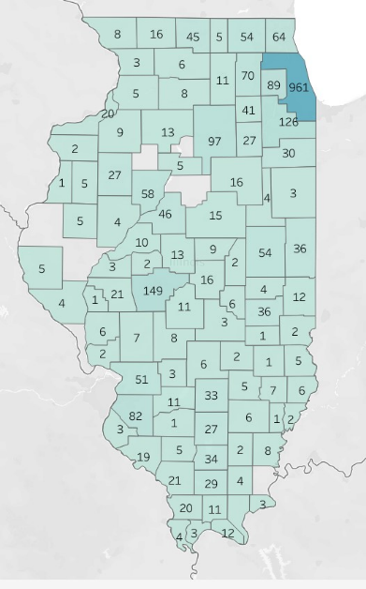
Helpline Calls Transferred to MAR Now
Data is from
May 2022 – September 20th, 2024
County | Transferred Calls
Adams | 5
Alexander | 4
Bond | 3
Boone | 5
Bureau | 13
Carroll | 3
Cass | 3
Champaign | 54
Christian | 11
Clark | 2
Clay | 5
Clinton | 11
Coles | 36
Cook | 961
Crawford | 5
Cumberland | 1
DeKalb | 11
DeWitt | 9
Douglas | 4
DuPage | 89
Edgar | 12
Edwards | 1
Effingham | 2
Fayette | 6
Ford | 4
Franklin | 34
Greene | 6
Grundy | 27
County | Transferred Calls
Hardin | 3
Henderson | 1
Henry | 9
Iroquois | 3
Jackson | 21
Jasper | 1
Jefferson | 27
Jersey | 2
Jo Daviess | 8
Johnson | 11
Kane | 70
Kankakee | 30
Kendall | 41
Knox | 27
Lake | 64
LaSalle | 97
Lawrence | 6
Lee | 8
Livingston | 18
Logan | 13
Macon | 16
Macoupin | 7
Madison | 51
Marion | 33
Marshall | 5
Mason | 10
Massac | 12
McDonough | 5
McHenry | 54
County | Transferred Calls
McLean | 15
Menard | 2
Mercer | 2
Monroe | 3
Montgomery | 8
Morgan | 21
Moultrie | 6
Ogle | 6
Peoria | 58
Perry | 5
Piatt | 2
Pike | 4
Pope | 1
Pulaski | 3
Randolph | 19
Richland | 7
Rock Island | 20
Saline | 4
Sangamon | 149
Scott | 1
Shelby | 3
St. Clair | 82
Stephenson | 16
Tazewell | 46
Union | 20
Vermilion | 36
Wabash | 2
Warren | 5
Wayne | 6
County | Transferred Calls
White | 8
Whiteside | 5
Will | 126
Williamson | 29
Winnebago | 45
Unknown | 1,987

Slide 44
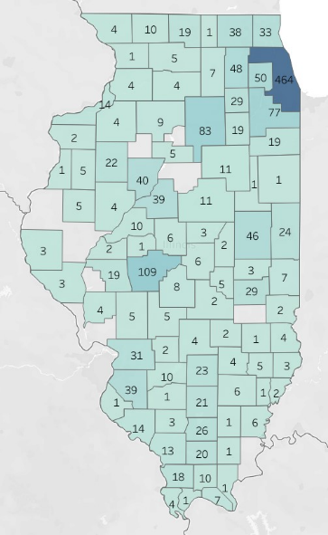
Helpline Calls Transferred to MAR Now for Callers Seeking Buprenorphine Services
Data is from
May 2022 – September 20th, 2024
County | Transferred Calls
Ford | 1
Franklin | 26
Fulton | 4
Greene | 4
Grundy | 19
Hamilton | 1
Henderson | 1
Henry | 4
Iroquois | 1
Jackson | 13
Jasper | 1
Jefferson | 21
Jo Daviess | 4
Johnson | 10
Kane | 48
Kankakee | 19
Kendall | 29
Knox | 22
Lake | 33
LaSalle | 83
Lawrence | 3
Lee | 4
Livingston | 11
County | Transferred Calls
Logan | 6
Macon | 6
Macoupin | 5
Madison | 31
Marion | 23
Marshall | 5
Mason | 10
Massac | 7
McDonough | 5
McHenry | 38
McLean | 11
Mercer | 2
Montgomery | 5
Morgan | 19
Moultrie | 5
Ogle | 5
Peoria | 40
Perry | 3
Piatt | 2
Pike | 3
Pope | 1
County | Transferred Calls
Pulaski | 1
Randolph | 14
Richland | 5
Rock Island | 14
Saline | 1
Sangamon | 109
Shelby | 2
St. Clair | 39
Stephenson | 10
Tazewell | 39
Union | 18
Vermilion | 24
Wabash | 2
Warren | 5
Wayne | 6
White | 6
Whiteside | 4
Will | 77
Williamson | 20
Winnebago | 19
County | Transferred Calls
Adams | 3
Alexander | 4
Bond | 2
Boone | 1
Bureau | 9
Cass | 2
Champaign | 46
Christian | 8
Clark | 2
Clay | 4
Clinton | 10
Coles | 29
Cook | 464
Crawford | 4
DeKalb | 7
DeWitt | 3
Douglas | 3
DuPage | 50
Edgar | 7
Effingham | 2
Fayette | 4

Slide 45
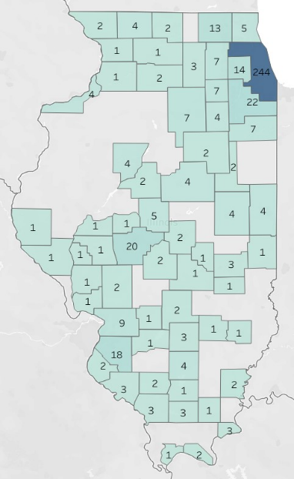
Helpline Calls Transferred to MAR Now for Callers Seeking Methadone Services
Data is from
May 2022 – September 20th, 2024
County | Transferred Calls
Adams | 1
Bond | 1
Carroll | 1
Cass | 1
Champaign | 4
Christian | 2
Clay | 1
Clinton | 1
Coles | 3
Cook | 244
Cumberland | 1
DeKalb | 3
DuPage | 14
Fayette | 2
Ford | 2
Franklin | 1
Grundy | 4
Hardin | 3
Jackson | 3
Jefferson | 4
Jersey | 1
County | Transferred Calls
Kane | 7
Kankakee | 7
Kendall | 7
Lake | 6
LaSalle | 7
Lee | 2
Livingston | 2
Logan | 5
Macon | 2
Macoupin | 2
Madison | 9
Marion | 3
Massac | 2
McHenry | 13
McLean | 4
Menard | 1
Monroe | 2
Moultrie | 1
Ogle | `1
Peoria | 4
Perry | 2
County | Transferred Calls
Pike | 1
Pulaski | 1
Randolph | 3
Rock Island | 4
Saline | 1
Sangamon | 20
Scott | 1
Shelby | 11
St. Clair | 18
Stephenson | 4
Tazewell | 2
Vermilion | 4
White | 2
Whiteside | 1
Will | 22
Williamson | 3
Winnebago | 2

Slide 46

Drug Overdose Prevention Program (DOPP)
Allows organizations to order free Narcan (a form of naloxone, which can reverse an overdose) through our Access Narcan program to distribute within their communities
Enrollees must complete the DOPP online training, provide overdose education and naloxone distribution services, and report in our Illinois Saves Overdose reporting portal
Notes:
DOPP
1.
We manage the Drug Overdose Prevention Program (DOPP) under the Substance Use Disorder Act, providing free Narcan (a form of naloxone) through the Access Narcan program for distribution.
Naloxone is a life-saving medication for opioid overdose reversal.
2.
These programs are essential for ending the overdose crisis in Illinois by ensuring naloxone and overdose prevention knowledge are readily available.
Organizations (except pharmacies) using the Illinois Department of Public Health Naloxone Standing Order must enroll in DOPP.
We encourage all organizations, even those with their own standing orders, to enroll in DOPP for enhanced coordination and support.

Slide 47
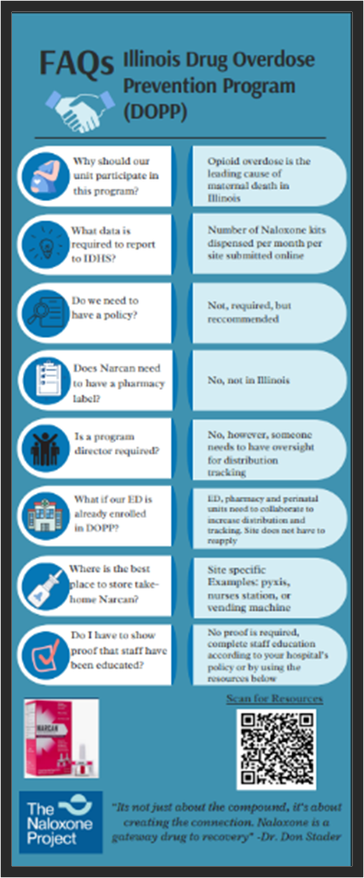
Drug Overdose Prevention Program (DOPP)
DOPP FAQ’s
Data needed? Report # of Naloxone kits distributed per month reported on line
ED, pharmacy and OB units should collaborate to dispense kits
Where to store kits? examples include Pyxis, nursing stations or vending machines
What training is needed? Enrollee completes on line training, for staff see QR code for training resource
Found in the F2F Folder

Slide 48
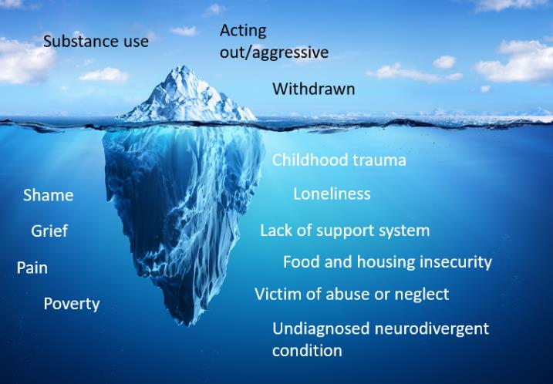
Reflection: Behavioral Health Iceberg
Notes:
Can Slide 21 be in another section (by slide 16) and let slide 19 and 20 be the tips unless the reflection slide is more of an end slide.

Slide 49

Panel Discussion
Q & A

