Slide 1

All Bundled Up: ESSI Summer Plans and What's Next

Slide 2

Thank you for a great day of sharing, learning, connecting, networking, planning…. and making change happen together!

Slide 3






One Minute F2F Day 2 Reflection
What are the two most meaningful things you learned today?
What is one thing you can commit to work towards tomorrow or next week?

Slide 4












ESSI Summer 2025 Webinars
Date | Topic
June 16th, 2025 | Collection of Accurate Data
July 21st, 2025 | Dissemination of Stratified Data
August 18th, 2025 | Application of Data to Address Inequities
Healthcare Professional Commitment
Parent and Caregiver Empowerment
Community Partnerships
Inclusive Clinical Environment
Healthcare Data Utilization

Slide 5



﻿
﻿
ILPQC is Here to Support Your Success:
2025 Quality Improvement Support
Success with ESSI, ILPQC is here to help!
Schedule time with ILPQC staff for tailored coaching and strategy. | Drop in to get answers, share strategies, and focus on the Birthing Hospital Quality Designation Program. Tues/Thurs 1-2pm | This summer: SMARTIE aims, the power of PDSAs, and putting this into action to drive change on your units.
🔍 1-on-1 QI Support Calls | 🤝 QI Office Hours | 🌟 QI Summer Series
📍 Want to learn more?
Visit the ILPQC Table in the lobby and speak with our team!

Slide 6

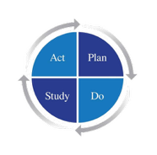


ILPQC QI Summer Series:
From SMARTIE Aims to PDSA Action:
A Hands-On Summer Series to
Drive Change at the Bedside
📅 Date | 🧠 Session Title | 💬 Focus
Tuesday, July 1 at 12 PM | “Aim High with SMARTIE” | Learn how to draft focused, inclusive SMART goals to guide your QI work.
Tuesday, July 29 at 12 PM | “PDSA Like a Pro” | A practical walkthrough of Plan-Do-Study-Act cycles that drive results.
Tuesday, August 12 at 12 PM | “Make It Happen with a PDSA” | Apply PDSA cycles at your unit to create measurable, sustainable change.

Slide 7




Thank You to our Amazing Speakers!
Natalie Bullock, BSN, RN
Kia Ferrer, PhD, MS, CCLS
Kimberly Vuckovich, MSN, CNL, RNC-NIC
Valencia Wilson, PharmD, RPh, MBA
Notes:
Make fonts bigger

Slide 8

Thank You Breakout Facilitators!
Mathura Ananthuran
Jan Southard
Keri Benbrook
Daniell Ashford
Donna Lemmenes
Mary Terry
Jose Ortiz
Danielle Wittig
Mary Jarvis
Keri Schubert
Kia Ferrer

Slide 9










Thank You to the Planning Committee!
  Keri Benbrook
  Keri Schubert
  Mary Jarvis
  Emalee Brink
  Olga Marrero
  Deborah Miller
  Daniell Ashford
  Mathura Ananthan
  Donna Lemmenes
  Joanne Sorce
  Myra Sabini

Slide 10








Thank You ILPQC’s Amazing Interns!
Lillian Pope​
Northwestern University Intern​
Shanti Gallivan​
Northwestern University Intern​​
Maggy Hovden​
University of Chicago Intern​
Notes:
Check on interns
Bigger font
10

Slide 11





Our Gardeners at
ILPQC Central!
Contact Us
ilpqc.org
info@ilpqc.org
illinoispqc
Kiele Moreno, MPH
Project Coordinator
Owusu Bekoe
Sr. Program Coordinator
Patti Lee King, PHD, MSW
State Project Director
Alana Rivera, MSN, RN
Nurse Quality Manager
Rebecca Ainis, MPH
Project Coordinator
Maria Villagomez, MPH, RN
Nurse Quality Coordinator

Slide 12

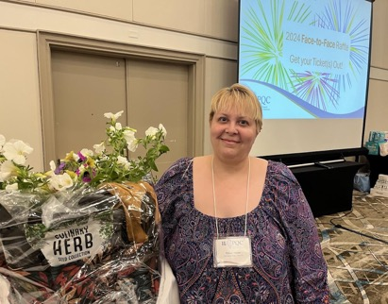

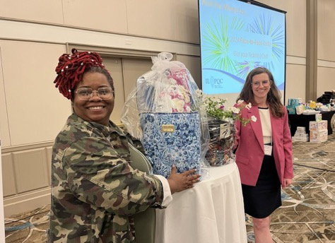

Raffle Time!
Get your raffle tickets out!

Slide 13


🎉 Thank You for an Incredible 2 Days! 🎉
Together, we:
Sparked meaningful conversations
Shared innovative ideas
Reconnected with old friends and made new ones
Strengthened our commitment to improving outcomes for moms and babies across Illinois
💡 You showed up. You collaborated. You inspired change.
Let’s keep the momentum going!
13
Illinois Perinatal Quality Collaborative

Slide 14

14
Illinois Perinatal Quality Collaborative

Slide 15





















Thank you to our Funders:
CME Provider
Supporters:
15
Notes:
15

