Slide 1

Birth Quality Teams Panel:
Sharing Strategies to Advance Equity through Patient Partners,
Respectful Care Breakfasts,
Doula Engagement, &
Reducing NTSV C/S Disparities
﻿

Slide 2
Focusing on Sustainability Efforts
Sustain and spread the progress made through Promoting Vaginal Birth and Birth Equity strategies across IL birthing hospitals
Ensure that improvements in Birth Equity and Respectful care are not one-time changes, but embedded in ongoing practice
Respond to continued feedback from patients and hospital teams, emphasizing the importance of consistency and accountability in QI work together
Maintain energy and connections across teams as we move into 2025 and beyond

Slide 3
Birth Quality Panelists:
Sharing how teams can use key strategies
Patient Partners & Respectful Care Breakfasts
Doula Engagement
Reducing NTSV C/S Disparities
Embed actionable strategies into practice and unit culture
Share success, lessons learned, and future opportunities from sustaining changes over time
Elevate team leadership, frontline champions, patient partners, and doulas to keep this work moving forward
Notes:
How Teams are Using Strategies in 2025:
1) Teams are embedding PVB/BE strategies into:
Staff onboarding and ongoing education
Clinical workflows (e.g., huddles, checklists, debriefs)
Data transparency and regular team review
Community partnerships and patient voice integration
2) OB QI teams are collaborating with postpartum, NICU, emergency departments, and outpatient settings
3) Others are adapting strategies for use in other QI initiatives (i.e. foundation base of upcoming Perinatal Mental Health (PM) and future)

Slide 4
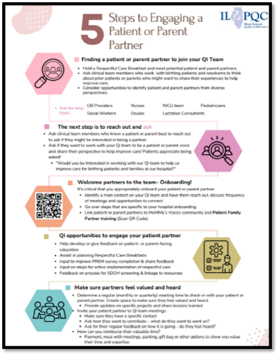
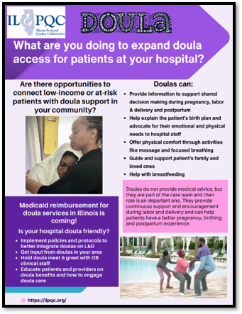
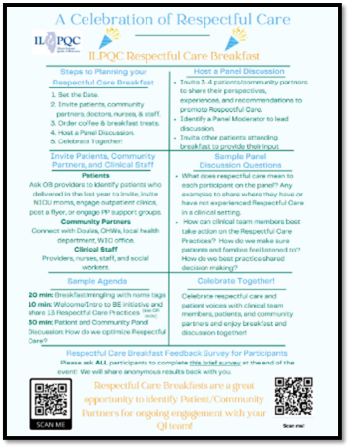
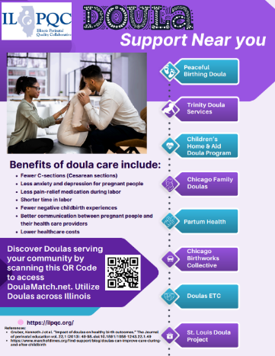
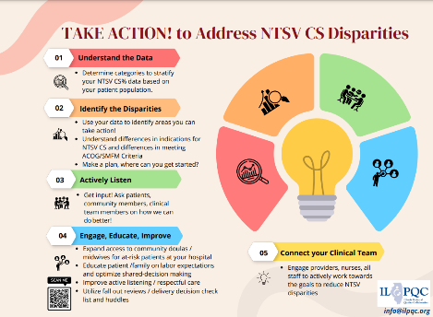
Helping hospitals engage a patient partner
All Handouts in your F2F Folder
Helping hospitals link to community based doulas
Helping hospitals plan a Respectful Care Breakfast
Helping hospitals take action on NTSV disparities

Slide 5

Respectful Care Breakfast recipe for success!
OB/Neo/ social work personal invites for patients, their babies, and partners who delivered at your hospital in the last year
Invite OB doctors, nurses, and staff
Invite community partners like Doulas
Have Breakfast together!
Ask patients to share in small groups or on a panel:
  What Respectful Care means to them?
  Examples when they felt like they received Respectful Care during pregnancy or delivery, what did the doctors/nurses do that was great?
  Examples when they didn’t get the Respectful Care they wanted and what could the doctors/nurses have done better?
Listen and learn! Use what you learn to improve care!
Find in your F2F Folder

Slide 6

Birth Quality Teams Panelists
Patient Partners & Respectful Care Breakfasts
Donna J Freeman, RN, BA & Valencia Yah-Yah Green
Doula Engagement
Jamie Kane, DNP, MBA, RN
Blessing Health System, Quincy, Illinois
Reducing NTSV C/S Disparities
Abbe Kordik, MD
UChicago Medicine, Chicago, Illinois
Roseland Community Hospital, Chicago Illinois

Slide 7


Donna J Freeman, RN, BA & Valencia Greene
Roseland Community Hospital, Chicago, IL

Slide 8

Presents
Sharing Strategies to Advance Equity through
Respectful Care Breakfasts, and Doula Engagement.
May 21, 2025 | Presented by: Donna J Freeman, RN /Sylvia Dewbwerry, BSN, RN Clinical Nurse Navigator

Slide 9
Introduction
Objective: Highlight innovative strategies to promote equitable maternal care.
Topics: Respectful Care Breakfast, and Doula Engagement.

Slide 10
The Case for Equity in Maternity Care
Disparities persist across racial and socioeconomic lines.
Black and Indigenous women face higher risks.
Call to Action: Center patient voices and advance respectful care.

Slide 11
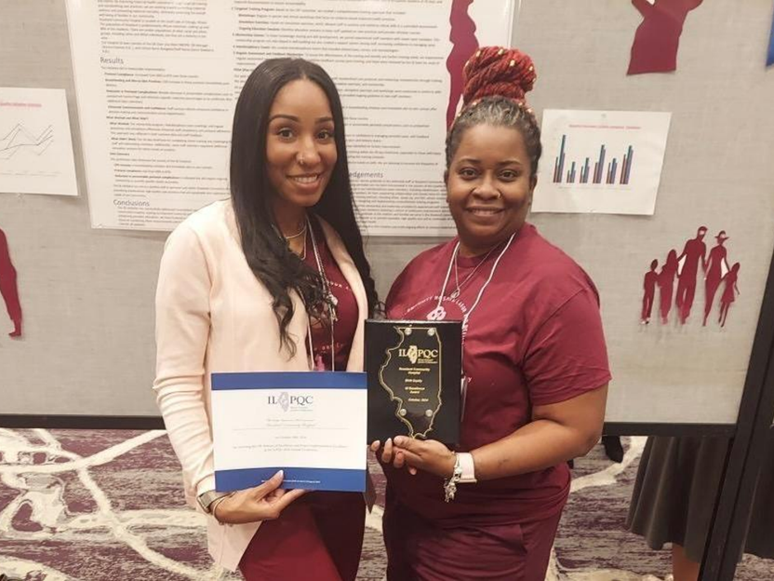
Notes:
We had to submit not only for the present year data, but we had to enter from when the initiative began. Education was done by attending SPEAK Up and doing online education in Relias. Nurses were easy but the doctors. We meet the measure for screening by implementing that all patients will be screened on admission as well as triages. After the addition of Sylvia we were able to add her as a Patient Nurse navigator who along side our doula were able to connect our patients to resources that they needed. To get participation of the PREM survey, I had the clerks when doing the patients birth certificate, have them scan the QR code right then

Slide 12
Respectful Care Breakfasts
Concept: Informal staff-patient gatherings.
Goals: Foster empathy, reduce power dynamics.
Tips: Use prompts, hold monthly meetings.

Slide 13
Our steps for planning a Respectful Care Breakfast at Roseland
In 2023, Roseland hosted it’s first breakfast, with Dr Keisha House as coordinator. We held it at a different location than the hospital.
We did not have a clue in what to do, and we were late getting started, but we took a chance and went to the ILPQC website for information on how to get started.
Notes:
For us to be successful we attended the ILPQC meetings and had support from upper management.

Slide 14
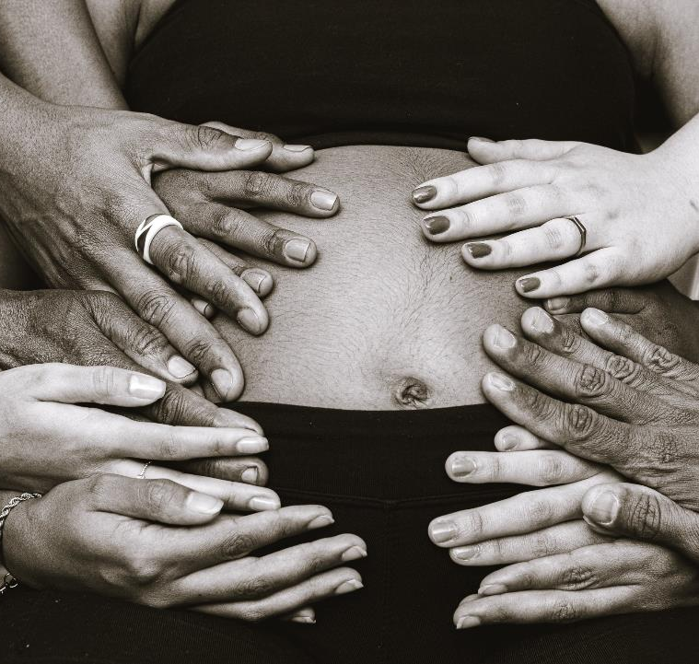
Step 1
We had to define the Purpose and Goals
We wanted to present to our ROSELAND community that every birthing family deserves: RESPECT, QUALITY CARE, AND SUPPORT.

Slide 15

Step 2
Set the Date, Time, Venue, and Menu
When we did the first one, we decided to hold it off-site, down the street from the hospital. We chose a date in the spring and decided to go with breakfast.
So, when we did the next one, we decided to keep it simple and have it at the hospital. Changed the time and offered brunch instead.
Notes:
which meant we would have to travel, not far, but being the springtime in Chicago, the snow decided to come on this wonderful day. Food had to be brought in and it was for breakfast which meant getting up a little earlier for some. (I ‘m the some)

Slide 16
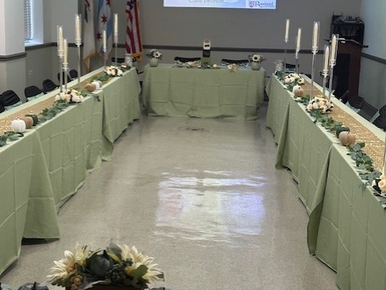
Roseland’s Respectful Care Breakfast
Located on the far south side of Chicago, we decided to do our second breakfast at the hospital, to get more participation from OB staff and the panelists

Slide 17

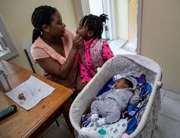
Step 3.
Create a Guest List
Include key stakeholders: OB nurses, doctors, patient advocates, administrative staff, and community partners.
Invite patients and families who have delivered with us in the last year
Ask patients to join OB staff for breakfast to share examples of positive and negative care experiences (what did your OB team do well and what could they have done better) and what does respectful care mean to the patients and their families?
Notes:
Our audience consisted of Roseland and the surrounding communities. We choose moms who were willing to talk about their experience that delivered at Roseland, good or bad. For the first one we invited previous moms and dads who had delivered with us.
Senior leadership,
Doctors and nurses
This I believe is the hardest part for people to open about their experience, good or bad. For us to be successful we attended the ILPQC meetings and had support from upper management.

Slide 18
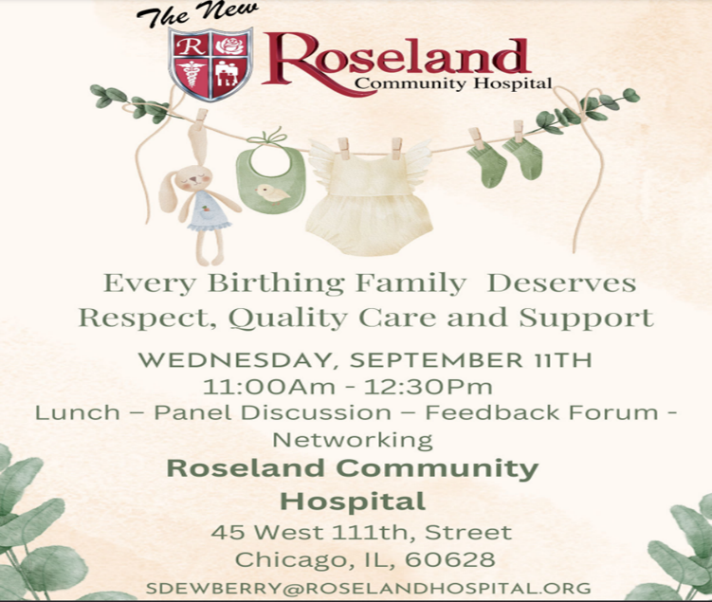

Slide 19

Step 4
Develop the Program Agenda and Promote the Event
Eat together and mingle
Welcome Remarks (by organizer or healthcare leader)
Testimonial/ Panel (Talk about respectful care and patients share about care experiences)
Recognition or Awards Segment (optional)
Interactive Activity (e.g., gratitude wall, pledge to respectful care)
Closing (call to action or group photo)
Notes:
We explained how important this was to let our community know that we hear you and your opinions matter.

Slide 20

Step 5
Incorporate Respectful Care Themes
Decorate with posters or quotes about dignity, empathy, and compassion.
Provide handouts or takeaway materials on respectful care practices.
Notes:
In 2024 Ms Sylvia Dewberry, came in the door running and continued to lead in this initiative. She created our logo and theme, every birthing family deserves: RESPECT, QUALITY CARE, AND SUPPORT.

Slide 21
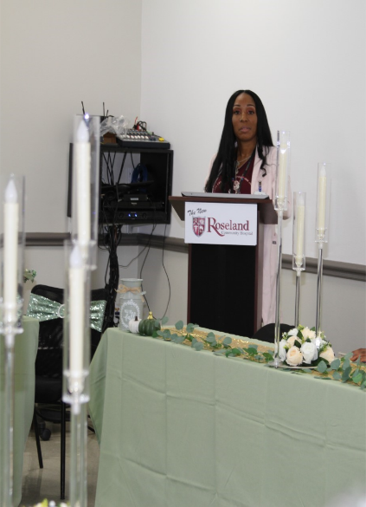

Slide 22
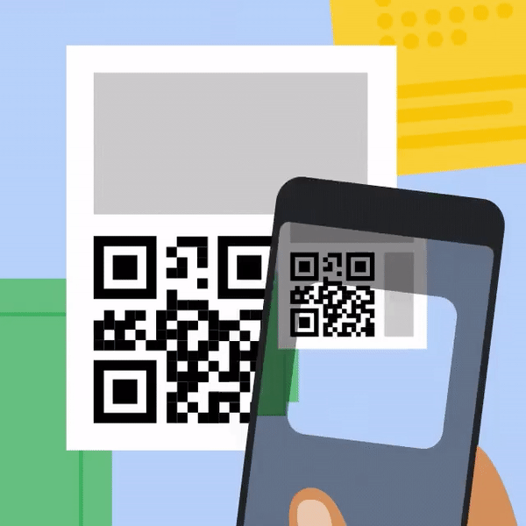
Step 6
Document the event and provide Q & A session.
Take photos/videos (with consent).
Collect feedback form with quotes from participants. (use ILPQC QR code)
Identify possible patient partners / doula partners to work on QI team!
Notes:
This I believe is the hardest part for people to open about their experience, good or bad. We also took this time to reintroduce ourselves to the community and ask questions of those who delivered at our hospital. During our Q & A session, there was a wonderful person that asked a lot of questions concerning care and treatment of our patients.
After we introduced ourselves to one another, she became just what I needed, My Own Doula.
This period was right before legislation had agreed that doulas were needed. So, she offered to be my doula for free.
In 2024 she became official, as our first employed doula at Roseland Community Hospital.
She now works with our clinics and ED to help mothers who are newly pregnant, pregnancy loss or social determinants issue.

Slide 23
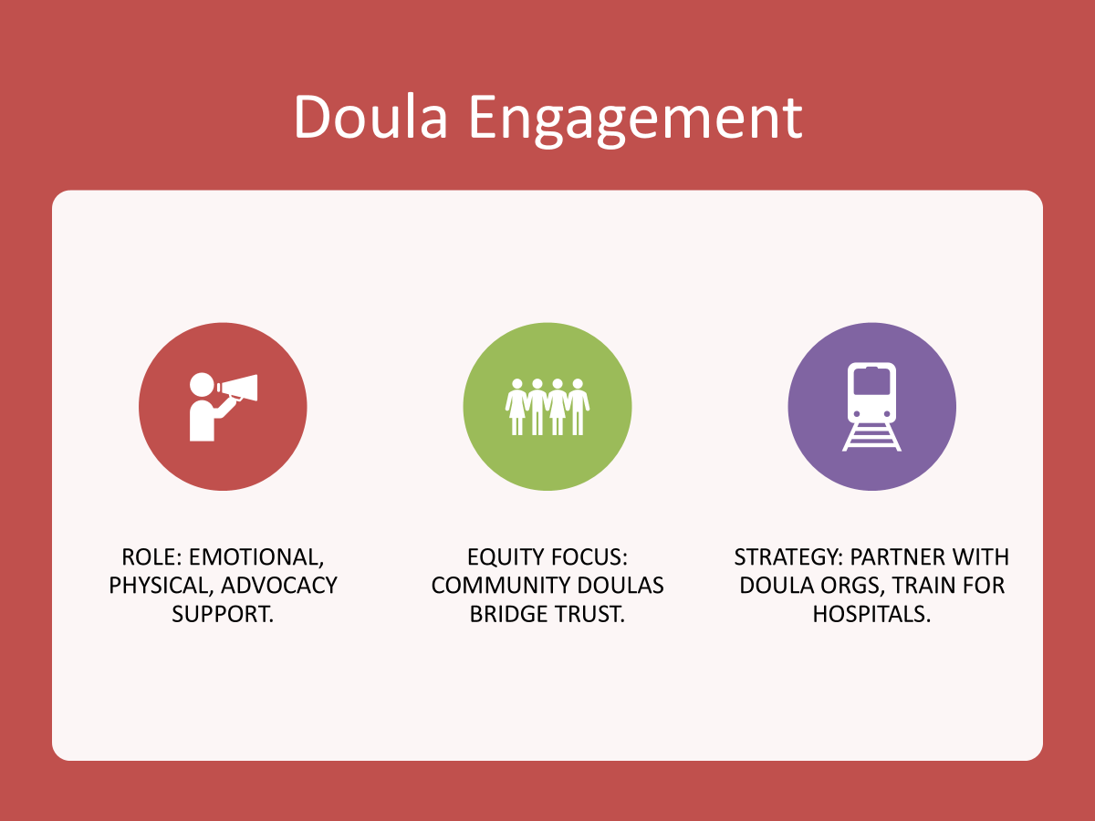

Slide 24
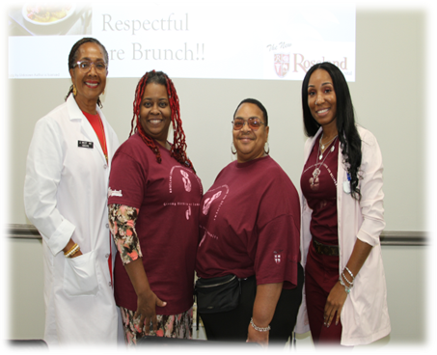
Roseland’s OB Birth Equity Leaders
Dr, Joy West, MD, Chairman of Obstetrics,
Donna J Freeman, RN, OB Nurse Manager,
Yah-Yah, Hospital Doula (Donna’s Doula), and
Sylvia Dewberry, Clinical Nurse Navigator

Slide 25

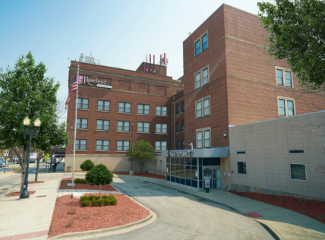
Last Step
Step 7
Follow-Up
Send thank-you notes to speakers and attendees.
Share highlights or outcomes with OB staff.
Consider how to sustain the respectful care conversation moving forward.

Slide 26
Lessons Learned
Equity work takes time, and commitment.
Success starts with grassroots efforts.

Slide 27
Call to Action
Engage
Include patient voices, collaborate with doulas.
Prioritize
Prioritize respectful care daily.
Quote
'Equity is not an initiative—it’s a value system.'

Slide 28
References & Acknowledgments
Sources: ILPQC, ACOG, Bohren et al. (2017).
Thanks to community partners and team members.
Sylvia Dewbery, BSN, RN, Clinical Nurse Navigator
Valencia Greene, Doula

Slide 29


Jamie Kane, DNP, MBA, RN
Blessing Health System
Quincy, Illinois

Slide 30
Building Better Community: a Journey to Doula Collaboration
Jamie Kane, DNP, MBA, RN
Ambulatory Associate Chief Nursing Officer
Blessing Health System. Quincy, IL

Slide 31
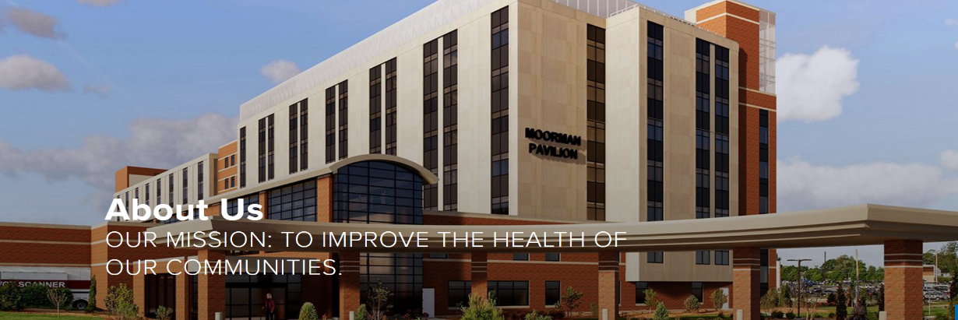
Blessing Health System
Integrated Health System based in Quincy, IL - 2 hospitals, 2 Physician Groups, College of Nursing & Health Sciences, charitable foundation.
Level II perinatal designation
1150 births annually
OBED, Hospitalist Program, NNP
Located in Quincy, IL

Slide 32
Blessing's Journey to Doula Support
Birth Equity Initiative
Implementation of Women’s Health Navigator
Birth Equity Grant Award
Started journey in 2021 with ILPQC Birth Equity initiatve
Rapid identification of oppourtunities
SDOH screening implementation
Bias training
Respectful Care Practices
Engaging staff and providers
Evolution of clear need for navigator to meet the needs of patients
Implemented new role- Women’s Health Navigator
  Health system wide, serving patients in both inpatient and outpatient settings
Streamlining resource referrals
Building community partnerships
Identification of outstanding care gaps and opportunities
Host free Doula training
Awarded Birth Equity Seed grant funds from IDPH to reduce health inequities in black and brown women, focusing on expanding doula access, enhancing care coordination, and education.
  Doula certification coverage
  Reimbursement for Doula services for patients
  Community Health worker- including home visits
  Support group growth and inclusion
  Bilingual support

Slide 33
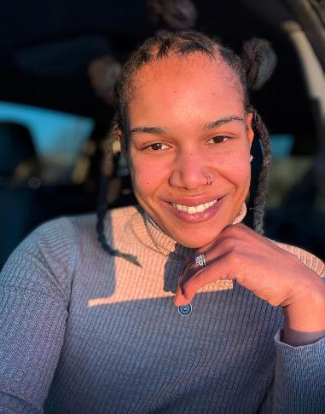

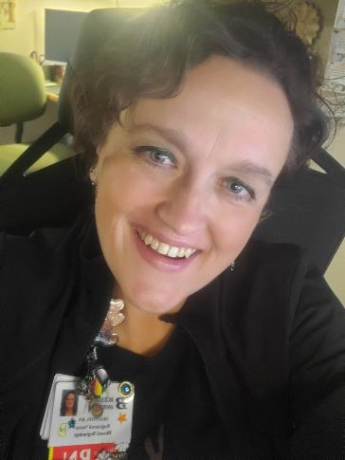
Hello!
Meet
The
Team
Leaders
Chloe Gay,
Community Health Worker/ Doula
Shannon Zanger, RN
Women’s Health Navigator

Slide 34
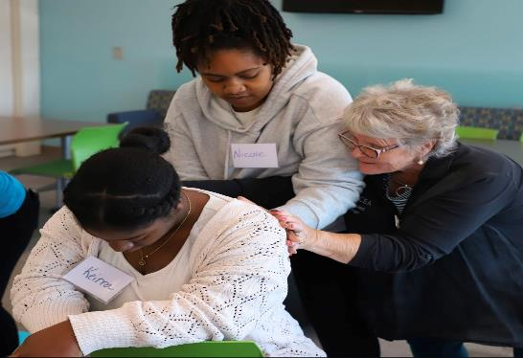

Doula Training-
October 2024
Partnered with ICEA for Professional Birth Doula Workshop
14 future doula’s participated in training
Bilingual
Racial mirrors
Community members

Slide 35
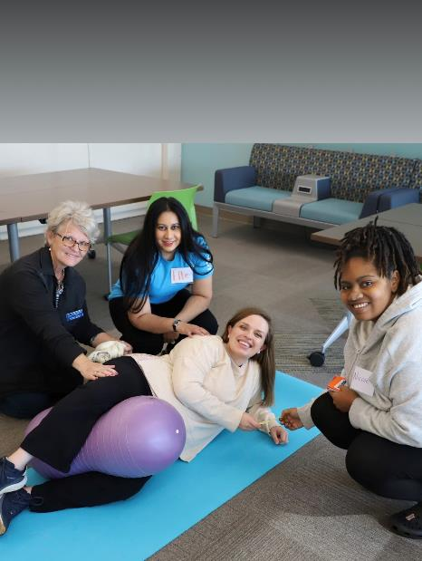
Result
14 Future Doulas
+ 2 established Doulas
16 Partners and advocates for birthing people in SouthCentral IL
All 16 Doulas are certified or
in process of certification
(including Childbirth education
and Postpartum support)

Slide 36
Where we are today
Streamlined SDOH screening and referrals
Personalized
Care Navigation
Strong Community Partners
Referrals and Access to Doula support at no expense to patient
BABY STEPS support group-all inclusive family support
All education materials in English & Spanish
Kermit translation device at every support group
In home support
Building Trust-Improving Outcomes- Building Better Community

Slide 37
615
SDOH screenings since January 1, 2025

Slide 38
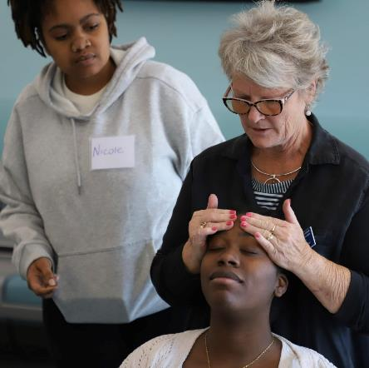
Collaboration
Shannon Zanger, RN- Women’s Health Navigator
Shannon.Zanger@blessinghealth.org
Chloe Gay, Community Health Worker/Doula
Chloe.Gay@blessinghealth.org
Jamie Kane, DNP, RN
Jamie.Kane@blessinghealth.org

Slide 39


Abbe Kordik, MD
UChicago Medicine
Chicago, Illinois

Slide 40
Reducing Disparities
Through QI Work
Promoting Vaginal Birth
*This project was formally determined to be quality improvement, not human subjects research, and was therefore not overseen by the Institutional Review Board, per institutional policy.

Slide 41
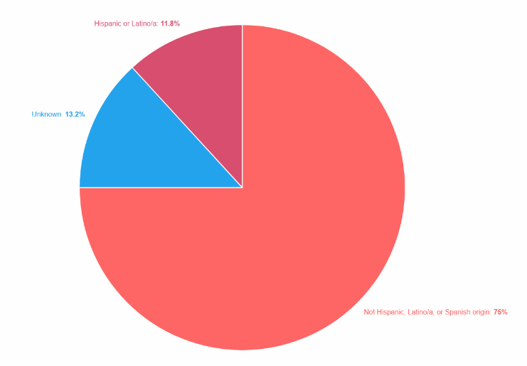
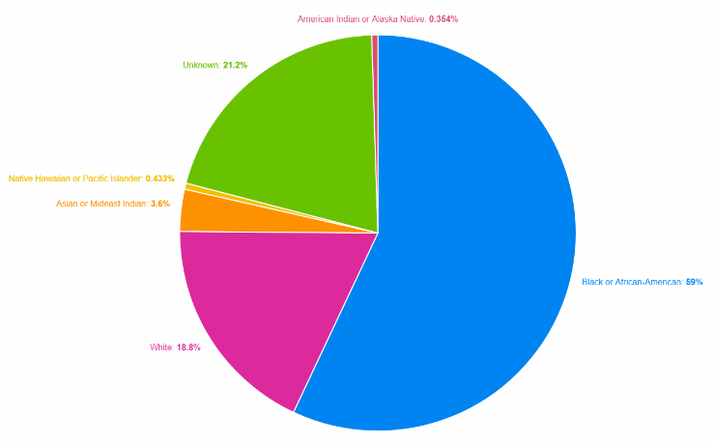
Hospital Background
Chicago, IL – Hyde Park
Perinatal Level III
Birth Volume: ~2,500 deliveries/year
  10 labor beds
  OB ED with 5 rooms
  2 ORs
Hospitalist coverage model
  24/7 in-house coverage with two obstetric attendings
Payor Mix (2024)
  Public insurance: 58%
  Private insurance: 42%
Patient Demographics
  Black or African-American 59%
*This project was formally determined to be quality improvement, not human subjects research, and was therefore not overseen by the Institutional Review Board, per institutional policy.

Slide 42
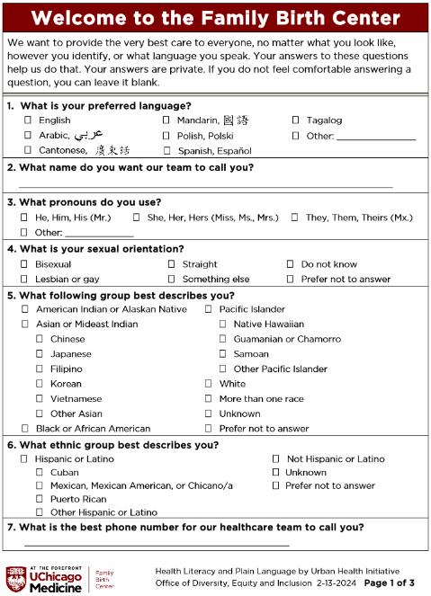
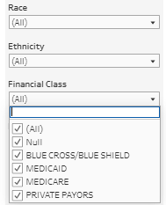
The Basics
Self-reported demographic and SDOH data
  Current workflow
    All patients complete demographic form on admission
    Nurse enters data into EMR
  Future state
    Patients enter data on an iPad upon registration, flows directly into EMR
Data stratification
Equity lens
*This project was formally determined to be quality improvement, not human subjects research, and was therefore not overseen by the Institutional Review Board, per institutional policy.
Notes:
This presentation is using the promoting vaginal birth initiative as a QI project example; however, we think it’s important to call out that we won’t fix systemic racism in healthcare and our institutions through one QI project. Rather you need culture change and widespread incorporation of data sharing and programs designed to improve equity. At UCM we are doing that through systems and policy adjustments to affect lasting culture change.
You need people at the table who are thoughtful of how things look and are perceived by patients. For instance, the top paragraph on this form was developed through multiple revisions to get the “right” message at the top of the form. Things like this are a great area to engage your patient partners.

Slide 43
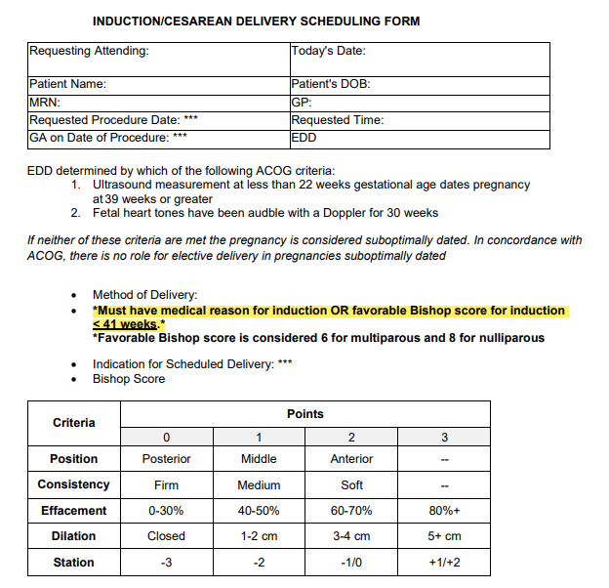
Standardization at the Core of all QI
Difficult to have equitable care without first establishing your institute’s standard of care
  Hospitalist coverage model
    One model for all patients
      Removed idea of “resident patients”
    Twice daily team rounding
    Quarterly meetings
  Policies
    Early elective induction scheduling (medical reason or favorable cervix)
    Order sets with induction/augmentation protocols
*This project was formally determined to be quality improvement, not human subjects research, and was therefore not overseen by the Institutional Review Board, per institutional policy.

Slide 44
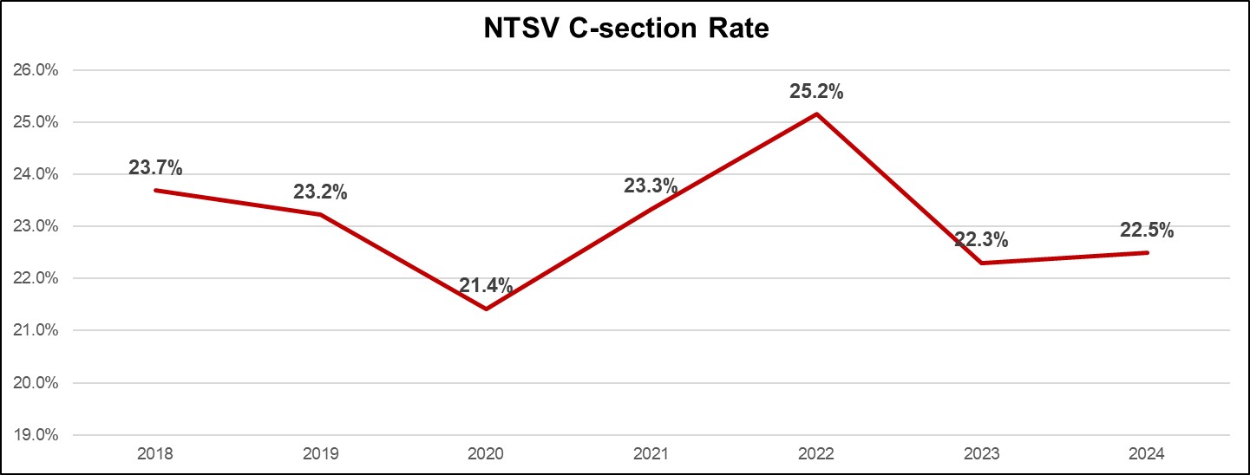
Year over Year PVB NTSV C-section Data
*This project was formally determined to be quality improvement, not human subjects research, and was therefore not overseen by the Institutional Review Board, per institutional policy.

Slide 45
A first look through an equity lens
2022: Began looking via race, ethnicity and insurance status
  Patients who self reported as Non-Hispanic White and patients with private insurance had higher NTSV C-section rates
    What could be causing inverse rates at UCM compared to national trends?
    Are the lower cesarean delivery rates at the detriment to the birthing person/infant dyad?
*This project was formally determined to be quality improvement, not human subjects research, and was therefore not overseen by the Institutional Review Board, per institutional policy.
Notes:
What we found at UCM was the opposite of what is typically found when looking at cs rates by race. But this actually wasn’t new information to us that our patients had similar outcomes regardless of race. We knew this from a large review of data done from 2015-2018 where we found that there were similar rates for all interventions evaluated at UCM between black and white birthing persons. However, part of QI work is continuing to checking to make sure you are still on track. So we decided to look and make sure our lower cs rates in these populations wasn’t negatively impacting other outcomes.

Slide 46
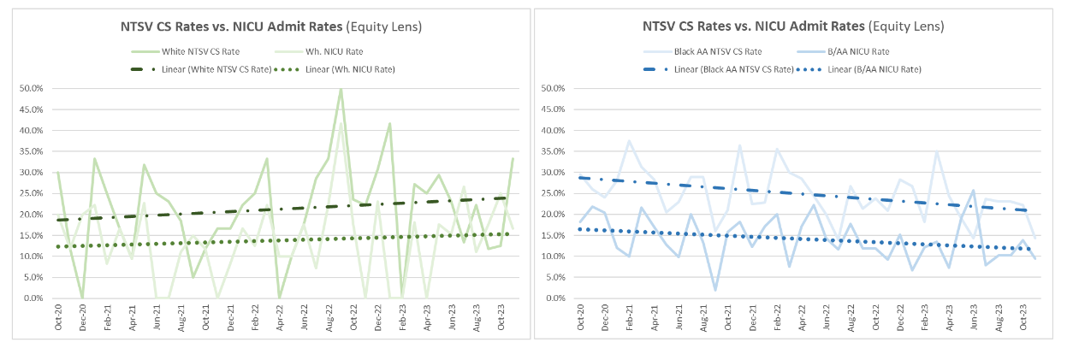
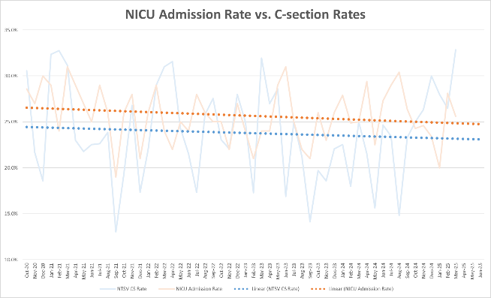
Deeper Dive into the Data
UCM data consistent with published data showing decreasing C-section rates don’t increase poor neonatal outcomes
*This project was formally determined to be quality improvement, not human subjects research, and was therefore not overseen by the Institutional Review Board, per institutional policy.

Slide 47
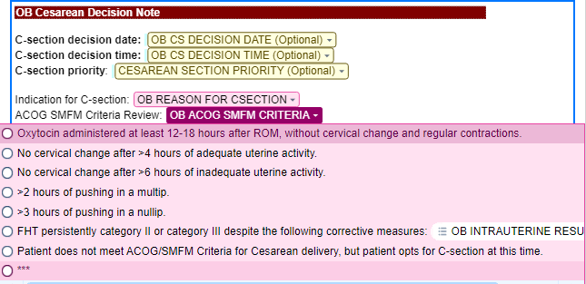
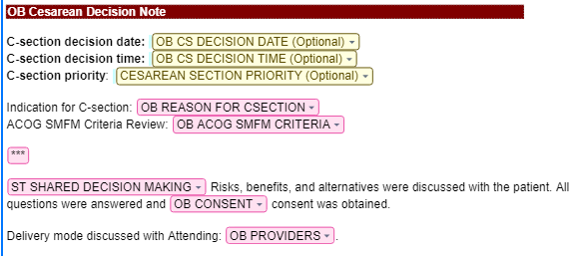
Reducing NTSV C-Section Rates with Education and Standardization
Education
  Shared data with nurses and physicians
EMR standardization
  Order set updates (Pitocin rate 1-30 mu/min)
  Provider note templates (C-section decision notes)
  Nursing flowsheets (position changes, pushing documentation)
Policies and pathways
  Medication titration (start at 2 mu/min)
  Labor management pathway and labor management huddles
*This project was formally determined to be quality improvement, not human subjects research, and was therefore not overseen by the Institutional Review Board, per institutional policy.

Slide 48
Post-Intervention Data:
By the end of 2024, racial disparity gap had lessened
*This project was formally determined to be quality improvement, not human subjects research, and was therefore not overseen by the Institutional Review Board, per institutional policy.

Slide 49
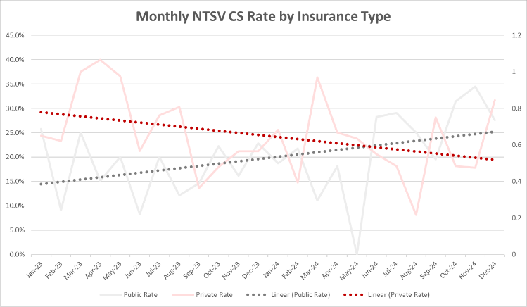
Post-Intervention Data: Payor Status
NTSV C-section rates switched – higher for patients with public insurance
*This project was formally determined to be quality improvement, not human subjects research, and was therefore not overseen by the Institutional Review Board, per institutional policy.

Slide 50

Continuing the Quest for Equity
  Finalizing partnership with inpatient doula services for patients with Medicaid
  Increasing CNM team members who help with management of Low Risk unregistered patient population, 90% of which have public insurance
Individualized Care
+
Standardized Care
Standardized Care
Equality
Equity
*This project was formally determined to be quality improvement, not human subjects research, and was therefore not overseen by the Institutional Review Board, per institutional policy.

Slide 51
Sustaining NTSV C-section rates below goal for all groups
Compliance monitoring stratified data by race/ethnicity, insurance status
Share stratified data with nurses and physicians
Transparent provider level data – meet to discuss as needed
Increase access to doula and midwife care
Labor management standardization and support
Participating in TeamBirth with a goal to improve shared decision making
Engage patient / community partners for input
*This project was formally determined to be quality improvement, not human subjects research, and was therefore not overseen by the Institutional Review Board, per institutional policy.

Slide 52

Panel Discussion
Q & A

