Slide 1
Partnering with Parents: Elevating ESSI through Parent Relationships
ILPQC 2025 OB and Neonatal Face-to-Face Meetings

Slide 2



Advocate Lutheran General Hospital ESSI Team
Kimberly Vuckovich, MSN, CNL, RNC-NIC
Neonatal Outreach Coordinator, Advocate Children’s Hospital- Park Ridge
Valencia Wilson, PharmD, RPh, MBA
Parent Partner at Advocate Children’s Hospital

Slide 3
Partnering with Parents: Elevating Equity in Safe Sleep
Moving from designing safe sleep interventions for families to designing with them
1
This shift in approach is transforming how we implement ESSI initiatives
2

Slide 4
Journey Through Pregnancy and Postpartum Experience
JAN
FEB
MAR
APR
MAY
JUN
JUL
AUG
SEP
OCT
NOV
DEC
Early Pregnancy
Beginning of the maternal journey with varying levels of support
Pregnancy Progress
Experiencing moments where messaging and support were clear or unclear
Postpartum Period
Navigating the challenges of new parenthood and safe sleep practices
Birth Equity Involvement
Personal connection to equity issues led to involvement in Birth Equity/ESSI

Slide 5
Why Parent Partnership Matters in Safe Sleep Education
Equity Focus
Beyond Clinical Approach
Real-world Translation
01
02
03
Emphasizing equity and humility in safe sleep messaging translation
ESSI isn't just clinical—it's personal, emotional, and community-based
Parent partnership ensures practical application of safe sleep messaging

Slide 6
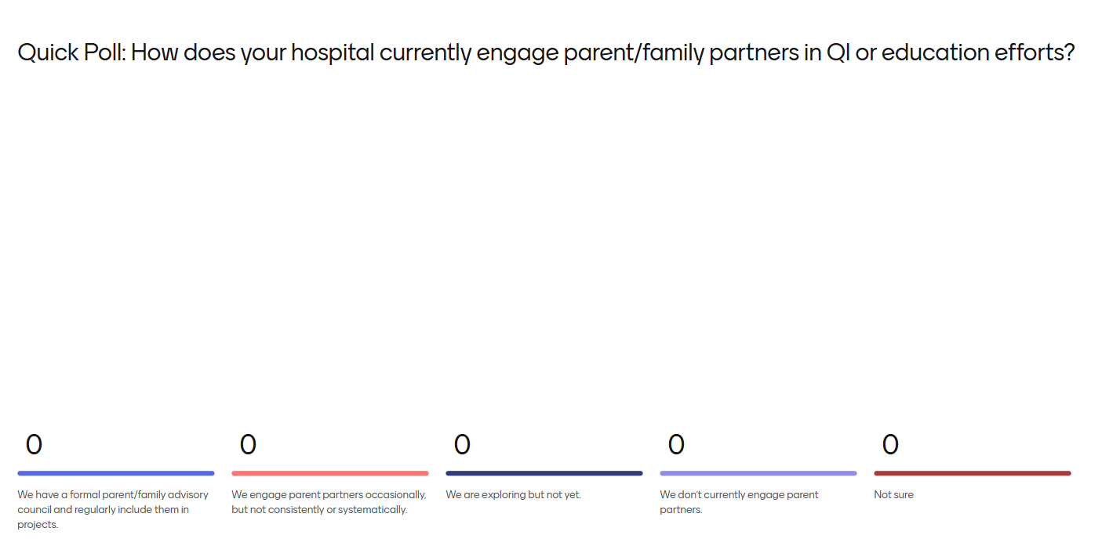

Slide 7



Family Advisory Council and Family Partners: Amplifying Family Voices
Diverse Representation
Monthly meetings with diverse caregivers to advise on hospital policies
Inclusive Feedback
FAC & FP provides broader family perspectives to shape ESSI tools
Policy Influence
Regular input helps shape hospital programs with inclusivity and empathy

Slide 8
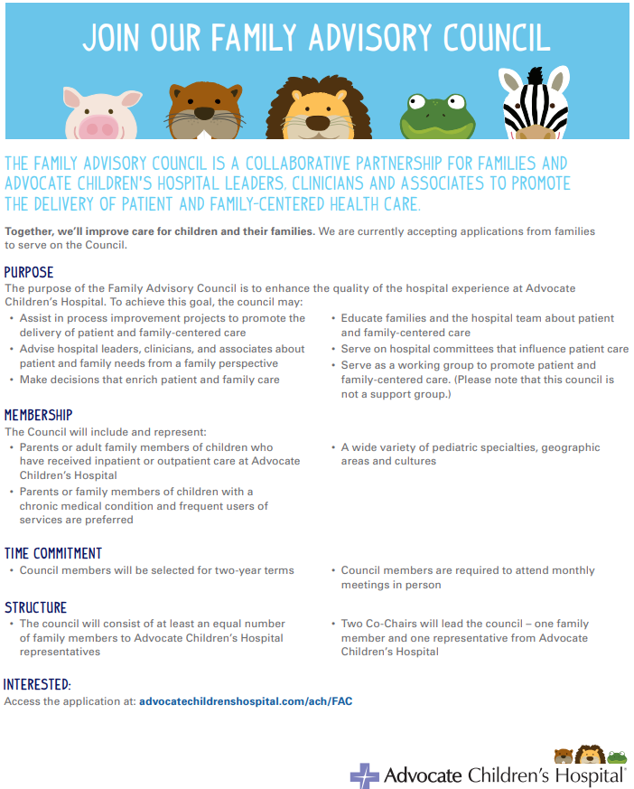

Slide 9
Common Pitfalls in Safe Sleep Communication
Top-down Education
Traditional approaches often rely too heavily on one-way communication
Inconsistent Modeling
Lack of consistent demonstration of safe sleep practices across healthcare settings
Cultural Mismatch
Failure to align messaging with diverse cultural perspectives and practices

Slide 10
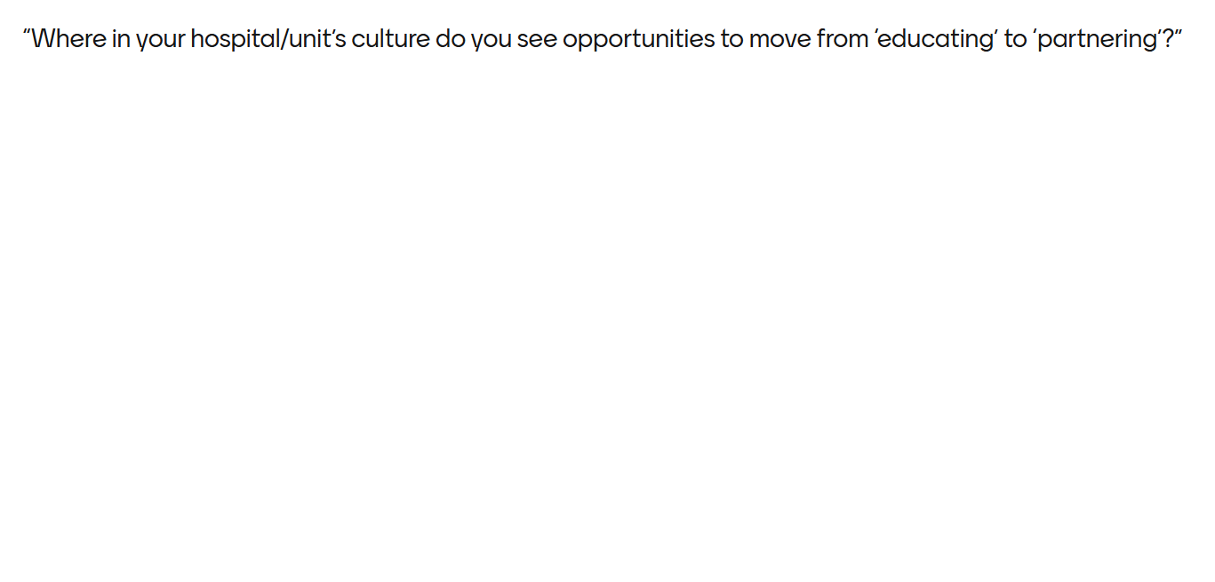

Slide 11
Transforming ESSI Through Parent Input
Parents provide feedback on how safe sleep information is communicated
Adjusting messaging to reflect multigenerational and bilingual household needs
01
Education Script Review
02
Language Adaptation
04
Visual Material Enhancement
03
Implementation Refinement
Incorporating family feedback to create more inclusive and representative imagery
Parents help shape how initiatives are delivered in clinical settings

Slide 12
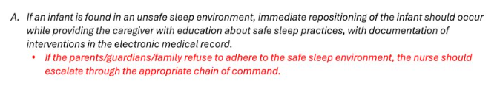

Influences on policy
Smart Note
Infant found in a position that could be unsafe for the sleep environment (list how infant was found). To keep infant as safe as possible, infant was repositioned to lie flat on their back in a bassinet with no loose objects nearby. Reviewed safe sleep practices with (caregiver present). Writer has informed the healthcare team to ensure consistent care. Health Care team will continue to check in, reinforce safe sleep environment concepts, assess for barriers, and provide resources when needed.

Slide 13
Impact of Parent Partnership on Safe Sleep
01
Clinical Impact
Visible changes in clinical spaces based on parent feedback
02
Qualitative Outcomes
Early data shows positive impact of parent-informed approaches
03
Staff Engagement
Increased requests for parent input in program development
04
Partnership Benefits
Surprising positive outcomes from collaborative approach to safe sleep

Slide 14


Slide 15



Staff Evolution: Embracing Parent Input
01
02
03
Staff began actively seeking parent input more frequently
ESSI equity becomes stronger with lived experience at the table
Teams recognize the value of parent perspectives in program development
Flexible Role Definition
Active Listening Practice
Avoiding Token Inclusion
Moving beyond superficial involvement to meaningful partnership and shared purpose
Implementing intentional listening processes to understand parent needs
Creating adaptable roles that respect parent partners' unique perspectives

Slide 16
Keys to Sustainable Parent Partnership Programs
Intentional Selection
01
Choose parent partners with intention, not convenience
02
Professional Integration
Treat parent partners as equal team members
Feedback Scaling
03
Use councils like FAC to validate ideas and scale family feedback

Slide 17
Call to Action: Making Equity Real
Relationship Focus
Critical Question
Continuous Engagement
Equity and safe sleep aren't checklist goals—they're relationships
Every QI team should ask: 'Whose voice is missing?'
Maintain ongoing dialogue with parent partners for sustained impact

Slide 18



Slide 19
Questions and Discussion
01
02
Open Dialogue
Shared Learning
Encourage interactive discussion about parent partnership experiences
Exchange insights and best practices for implementing parent partnerships

Slide 20
