Slide 1




DRAWING THE CURTAIN
AN INTEGRATIVE MODEL FOR ENGAGING FAMILIES IN
CULTURALLY CONCIOUS DISCUSSIONS ABOUT
SOCIAL DETERMINANTS OF HEALTH
KIA L. FERRER, PHD, CCLS, GC-C
NORTHWESTERN MEDICINE PRENTICE WOMEN’S HOSPITAL

Slide 2

OBJECTIVES
  Understand Social Determinants of Health (WHO, 2005-2008) in the Newborn Nursery and Neonatal Intensive Care Unit
  Identify key elements of cultural-relational skills (Garcia Coll & Ferrer, 2021; Ferrer, 2019; Jordan, 2018) for discussing adjustment to life with a newborn
  Implement culturally responsive approaches to support families in creating care plans

Slide 3




CONCEPTUAL FRAMEWORK
  Child Life Theory
(ACLP, 2024)
  Social Determinants of Health (WHO, 2008)
  Integrative Model of Child Development
(Garcia Coll, 1996)
  Cultural-Relational Theory (Jordan, 2018)
Association of
Child Life Professionals (ACLP)
World Health Organization (WHO)
Cynthia Garcia Coll, PhD
Judith Jordan, PhD

Slide 4




CHILD LIFE SPECIALISTS
“Child life programs are an important component of pediatric hospital-based care; they address the psychosocial concerns that accompany hospitalization and other health care experiences. Child life specialists focus on the optimal development and well-being of infants, children, adolescents, and young adults while promoting coping skills and minimizing the adverse effects of hospitalization, health care encounters, and/or other potentially stressful experiences.”
American Academy of Pediatrics (2021)

Slide 5

CHILD LIFE SPECIALISTS
  Understand the role of communication, particularly active listening and empathic responding, in building relationships with families undergoing stress
  Identify types of stressful events affecting children and families, including healthcare experiences, traumatic life events, loss, end of life, and grief work.
  Assess knowledge level, misconceptions, previous experience, and unique sociocultural and learning needs.
  Determine realistic goals and objectives for learning in collaboration with family members and professionals and identify an action plan to achieve these goals.

Slide 6
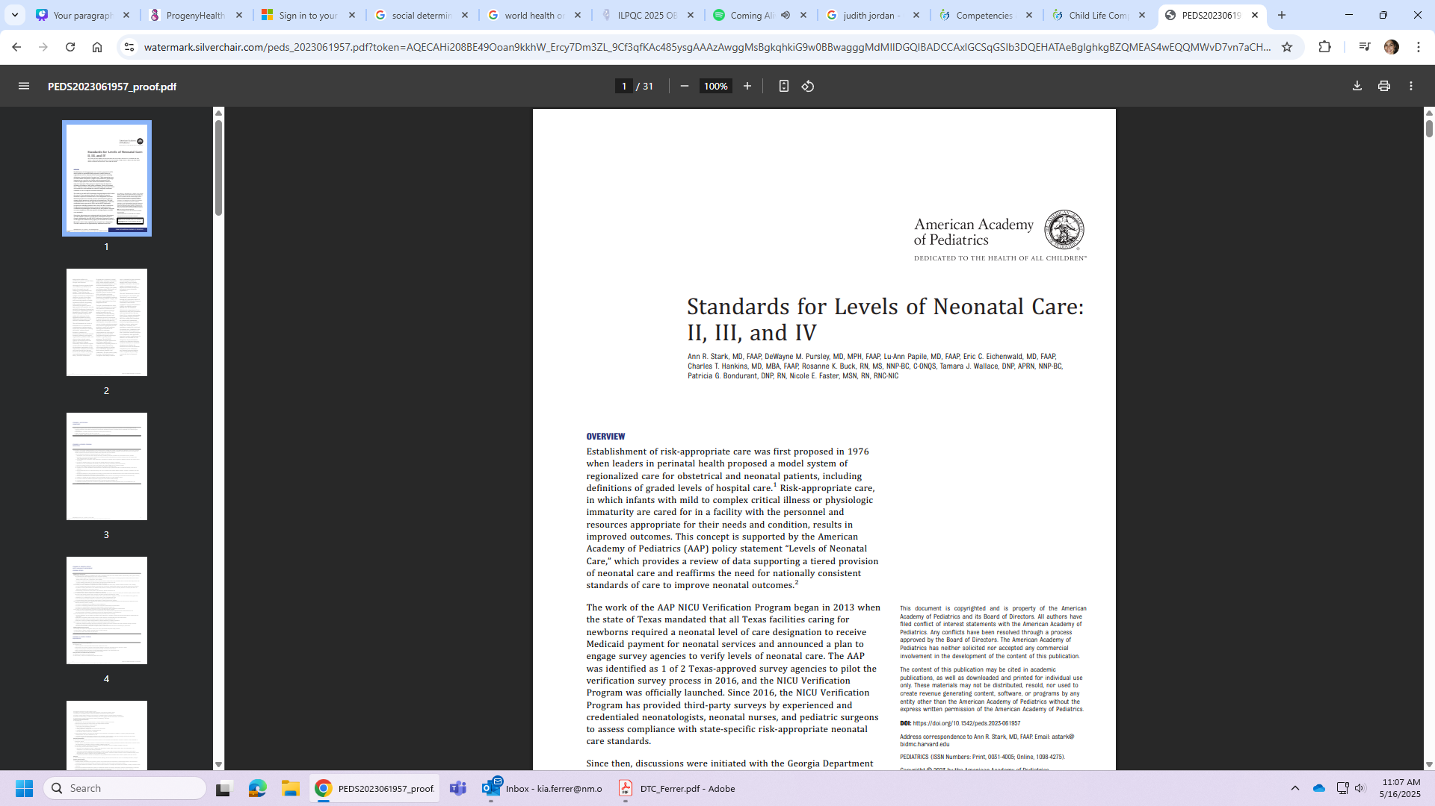


CHILD LIFE SPECIALISTS
in Neonatal Care: II, III, and IV
Child life services, or the equivalent, will be available for on-site consultation to support patient- and family-centered care by establishing and maintaining therapeutic relationships between patients, family members, multidisciplinary team members, and community resources.

Slide 7
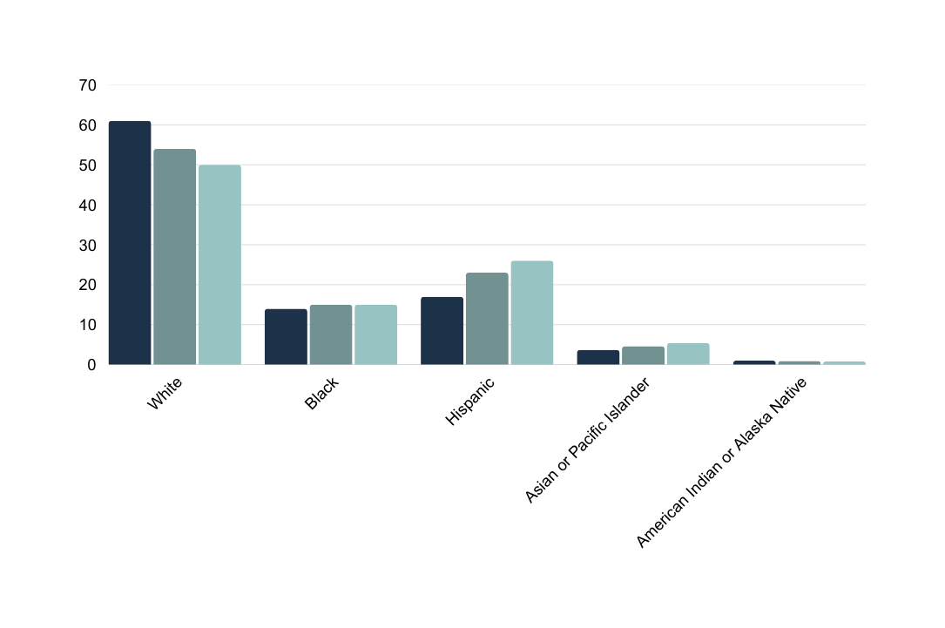
DEMOGRAPHIC SHIFTS
Percentage Distribution of Children Under Age 18 by Race* in 2000, 2010, and 2020
Percentage of Child Population
2000
2010
2020
*Note: The data in this chart reflects the racial composition of Children under 18 living in the United States. Race categories are based on the 1997 standards outlined by the Office of Management and Budget (OMB) and are consistent with the latest HHS (2017) guidelines on data collection standards released in October 2011. Source: ChildStats.gov., Forum on Child and Family Statistics, adapted from the Federal Interagency Forum on Child and Family Statistics. (2017). America's children: Key national indicators of well-being, 2017. Retrieved from https://www.childtrends.org/indicators/racial-and-ethnic-composition-of-the-child-population.

Slide 8
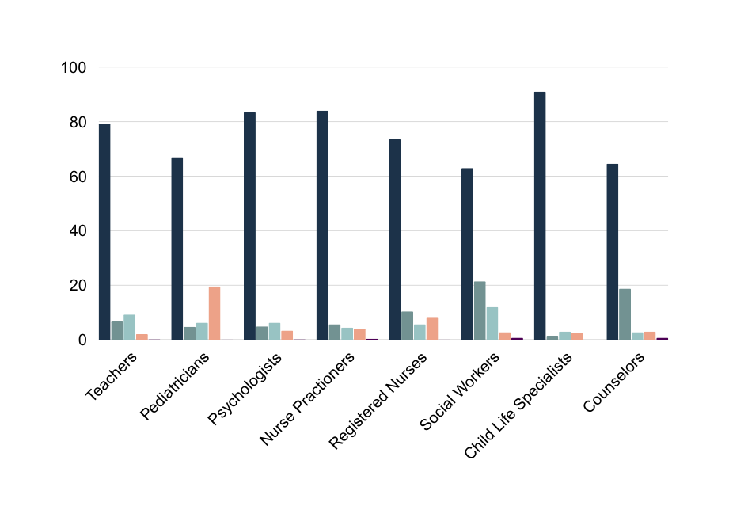
DEMOGRAPHIC SHIFTS
U.S. Early Childhood Professions by Race in 2018
Percentage of Workforce
White
Black
Hispanic
Asian
American Indian/
Alaska Native
Native Hawaiian and Other Pacific Islander
Note: The data in this chart reflects labor workforce characteristics by race in 2018. Source: United States Census Bureau’s (www.census.gov); Bureau of Labor Statistics, Health Care Occupations (www.bls.gov/ooh/health); US Health Resources and Services Administration (hrsa.gov); American Academy of Pediatrics (aap.org); American Psychological Association (www.apa.org); and Association of Child Life Professionals (www.childlife.org); U.S. Department of Education, National Center for Education Statistics, National Teacher and Principal Survey (NTPS), “Public School Teacher Data File,” 2017–18.

Slide 9





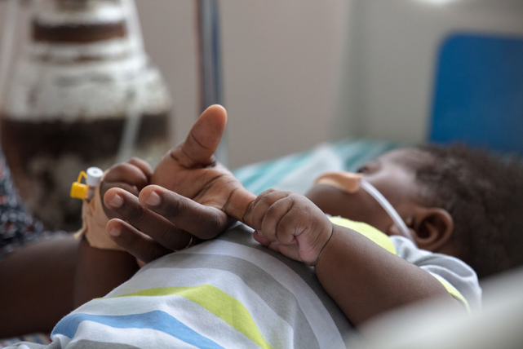

SOCIAL DETERMINANTS OF HEALTH (SDOH)
  Broadly defined as the conditions in which people are born, grow, live, work and age, and people’s access to power, money and resources – have a powerful influence on health inequities.
  These are the unfair and avoidable differences in health status seen within and between countries.
World Health Organization (WHO)

Slide 10








DEVELOPING QUALITY CLINICAL CARE IS ONLY THE TIP OF THE ICEBERG FOR HELPING FAMILIES THRIVE*
INFANT & CAREGIVER
SAFETY
TRANSPORTATION
2X
3.6 MILLION
Domestic violence doubled the risk of preterm birth and low birth weight
Individuals do not access medical care because they do not have transportation- the third leading cause of missed appointments
HEALTH LITERACY
FOOD INSECURITY
90 MILLION
6.5 MILLION
Americans have difficulty understanding and acting upon health information, which can negative effect their health and well-being
Children live in low income neighborhoods that are more than a mile from a supermarket. 1 in 8 families is food insecure
EMOTIONAL AND MENTAL HEALTH
SHELTER
10X
Birthing persons delivering pre-term babies are 10 times more likely to exhibit symptoms of PTSD than birthing persons of full-term babies
55 PERCENT
Reduction in medicaid claims for individuals
1 year after finding housing
  Adapted from Progeny Health and Reno R, Hyder A. The Evidence Base for Social Determinants of Health as Risk Factors for Infant Mortality: A Systematic Scoping Review. J Health Care Poor Underserved. 2018;29(4):1188-1208. doi: 10.1353/hpu.2018.0091. PMID: 30449742.Adapted from

Slide 11




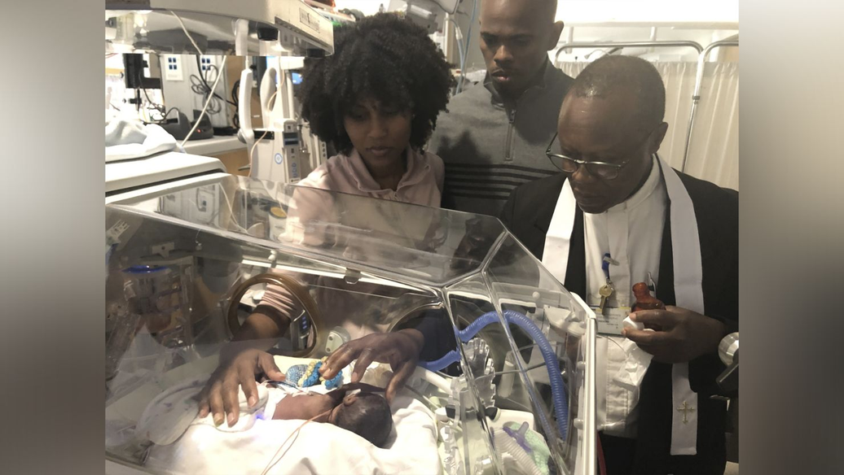




NEWBORN HEALTH
  The high rates of preventable death and poor health and well-being of newborns and children under the age of five are indicators of the uneven coverage of life-saving interventions and, more broadly, of inadequate social and economic development.
  Poverty, poor nutrition and insufficient access to clean water and sanitation are all harmful factors, as is insufficient access to quality health services such as essential care for newborns.

Slide 12





NEWBORN HEALTH CARE DISCREPANCIES
  Racial/ethnic disparities in newborn health have persisted for decades.
  Preterm infants requiring care in the neonatal intensive care unit (NICU) are a particularly vulnerable population. Compared to white infants, Black infants are twice as likely to be born preterm,1 and more likely to experience serious complications when delivered preterm.
  Preterm infants with very low-birth-weight (VLBW) account for 70% of neonatal deaths and are predominantly Black
  Disparities in neonatal outcomes are also elevated among other racial/ethnic groups including Hispanic, American Indian, and Puerto Ricans
  The potential long-term consequences of these disparities are profound: elevated risks of morbidity, adverse neurodevelopmental outcomes and behavioral deficits that influence health and quality of life over the life course, disadvantage preterm infants from birth, and place enormous stresses on their families
Ravi, D., Iacob, A., & Profit, J. (2021). Unequal care: Racial/ethnic disparities in neonatal intensive care delivery.
Seminars in perinatology, 45(4), 151411. https://doi.org/10.1016/j.semperi.2021.151411

Slide 13








THE STATE OF PERINATAL HEALTH
Illinois Department of Public Health (IDPH)
  Illinois has consistent disparities in infant mortality rates based on race. From 2012 to 2021, non-Hispanic Black infants consistently experienced infant mortality rates two to four times higher than non-Hispanic White, Hispanic, and Asian/Pacific Islander infants.
  Additionally, among all the leading causes of deaths (birth defects (20%), prematurity/fetal malnutrition (20%), Sudden Unexpected Infant Death (SUID) cause of infant death (18%), and pregnancy/delivery complications (9%)) non-Hispanic Blacks top the chart for all causes.
  According to the Perinatal Periods of Risk analysis (PPOR), if the fetal and infant mortality rates for infants born to non-Hispanic Black women were reduced to match those of infants born to low-risk White women, it would prevent 204 fetal and infant deaths among Black babies each year.
  Additionally, Infant deaths from SUID is dis-proportionately higher in non-Hispanic black infants than other races. Research indicates many of the SUID deaths are linked to things like not having a separate sleep environment for the infant, co-sleeping, putting baby to sleep on their tummies.
  Many systemic and social factors like health insurance access, and structural issues that impact respectful care amongst others play a role in contributing to these disparities.

Slide 14
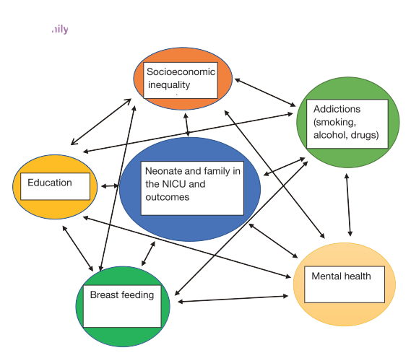
THE INTERPLAY OF VARIOUS SOCIAL DETERMINANTS AFFECTING THE NEONATE & FAMILY

Slide 15





EQUITY SAFE SLEEP INITIATIVES (ESSI)
The ESSI Bundle consists of three components:
  Awareness: Parents or caregivers report an understanding of a safe sleep environment
  Readiness: Parents or caregivers are prepared for a transition to home, including SDOH screening and resource linkage
  Transfer of Care: ESSI Newborn Care Plan (Awareness and Readiness) is documented in the discharge summary.

Slide 16
ILPQC ESSI TOOLKIT
Parent and Caregiver Empowerment
  Secondary Driver 1: Respectful Parent and Caregiver Partnerships
“By supporting patient and family voices and encouraging space for collaboration, health care professionals can help ensure shared vision and values are at the forefront of determining solutions to improve a community’s health outcomes.”
National Institute for Children’s Health Quality (2023) – 4 Tips for Including & Engaging Family Partners in Your Work

Slide 17

CONVERSATIONAL APPROACH
  It’s important to find the time to have an interactive conversation with parents, families and caregivers.
  During these conversations, we ask open ended questions about their plans and circumstances and acknowledge where families are in terms of their beliefs and plans. This provides an opportunity to share the evidence that we know, then discuss risk reduction for behaviors families are willing to adopt.
  When we do this, we can support their understanding, provide an opportunity to discuss the advice or expectations coming from their family, and uncover questions they have around practices they may not be familiar with or are uncomfortable with. Using a strength based approach, we can identify the caregivers’ practices and behaviors that will reduce the greatest risks.

Slide 18




SDOH DISCUSSION STRATEGIES
  Traditional patient education focuses on one-way information sharing, leaving gaps in implementation at home.
  Traditionally, patient education programs have been created from the perspective of the providers and neglected patients’ perspectives which potentially hinders patient engagement and adherence with these programs

Slide 19


SDOH DISCUSSION STRATEGIES
1) MITIGATE DEFICIT-PERSPECTIVES (GARCIA COLL & FERRER, 2021)
  Although studies are addressing the contributions of stress, poverty, and lack of social support (rather than assuming genetic differences or cultural deficits) the emphasis still remains on negative developmental outcomes.
  Communication strategies include focusing on sleeping soundly (emphasis on sleeping deeper because you know your baby is safe) versus sleeping better (emphasis on getting unbroken sleep). (AAP, 2021)
THERE IS A COMMUNICATION BARRIER AND WE NEED AN INTERPRETER TO UNDERSTAND WHAT SHE KNOWS BEFORE MAKING THAT ASSUMPTION
SHE DON’T SPEAK ENGLISH, SHE PROBABLY DOESN’T KNOW ABOUT SAFE SLEEP

Slide 20

SDOH DISCUSSION STRATEGIES
1) MITIGATE DEFICIT-PERSPECTIVES (GARCIA COLL & FERRER, 2021)
  Key unsafe sleep behaviors (bed-sharing and tummy-sleep) are driven by a desire to help the baby sleep deeper and longer so the parent can also sleep or get time to themselves. Strategies that offer moms the “solution to sleep” must not promise something that moms have rarely experienced (e.g., 8-straight hours of sleep).

Slide 21

SDOH DISCUSSION STRATEGIES
2) EMPHASIZE INFANT DEVELOPMENT
  Emphasize that baby will choose how he wants to sleep once he starts turning himself over — until then, stick with what’s safest.
  Instead of addressing all possible scenarios, focus on this simple message: babies sleep safest on their backs.
  Recognize that sleep is a vulnerable place. It is about recognizing the need to help our children to develop positive sleep associations that will be there for a lifetime.

Slide 22

SDOH DISCUSSION STRATEGIES
3) INSTEAD OF ADDRESSING ALL POSSIBLE SCENARIOS, FOCUS ON THIS SIMPLE MESSAGE: BABIES SLEEP SAFEST ON THEIR BACKS.
  Many parents who put their babies to sleep on their stomachs do so out of worry about spitting up and choking.
  The key is to reinforce the simple message that parents can remember in materials, and pediatricians can provide specifics about why choking is not a concern for back sleeping.

Slide 23

SDOH DISCUSSION STRATEGIES
4) USE EMPATHY
  We found that parents are extremely sensitive to messaging that sounds condescending or not based in the reality they are currently experiencing.
  They specifically want to hear real advice from real parents. While that may not always be possible depending on the messenger, focusing on empathetic tone and direction is key.

Slide 24


SDOH DISCUSSION STRATEGIES
5) ACKNOWLEDGE, THEN TEACH
I want to co-sleep with my baby. My mom co-slept with me and my siblings and we turned out fine!
I understand you want to co-sleep, and that is important to your family and culture. I’d like to tell you about the risks, and then teach you how to reduce them.
  Acknowledge the risks, and the riskiest variables (age less than 3 months, soft bedding, loose blankets and pillows, bed up against a wall, tobacco, alcohol, bedsharing with a non-parent, and bedsharing in non-breastfeeding).They specifically want to hear real advice from real parents. While that may not always be possible depending on the messenger, focusing on empathetic tone and direction is key.
  Then, counsel the birthing person on how to reduce all other risks, and support exclusive breastfeeding

Slide 25


So, tell me where do you plan to put your baby to sleep? Does your baby normally sleep with you? Is that what many of your family members do?

Slide 26
My baby can’t sleep by herself in her crib/bassinet but sleeps when she is with me in bed.

Slide 27
TIP: ACKNOWLEDGE, AS ALWAYS, THE FRUSTRATION WITH NOT GETTING A GOOD NIGHT’S SLEEP.
what baby would not like to sleep close to their mother? I am sure you are right about her sleeping better with you, but the concern I have is for her safety. You may not know it, but an adult bed is not the safest place for a baby to be. Here’s why… Trust me if you start putting her back in a safe sleep environment, she may be a little fussy at first but she will get used to it. And you won’t have to fight with her when she gets older when you want her to sleep in her own bed

Slide 28
I Understand. I should improve her safety, while also taking care of myself. Putting her in a bassinet close to me still gives me the comfort i need AND keeps in her a safe space

Slide 29



CULTURALLY CONCIOUS CONVERSATIONS

Slide 30
Relational-cultural theory (Jordan, 2018)
START WITH CONNECTION, NOT CORRECTION
  RCT Principle: Mutual empathy and authenticity.
  Application: Begin by affirming the parent’s love and intentions.
  “It’s clear how much you care about your baby. Every family’s situation is unique, and I want to understand what safe sleep might look like at home for you.”
  Avoid leading with rigid instructions. Instead, invite conversation:
  “Can you tell me what you’ve heard or experienced about infant sleep so far?”

Slide 31
Relational-cultural theory (Jordan, 2018)
Honor Context and Cultural Wisdom
  RCT Principle: People grow in connection; disconnection causes suffering.
  Application: Recognize that safe sleep guidelines may conflict with cultural norms, trauma histories, or practical realities (like housing insecurity, co-sleeping traditions, etc.).
  “Some families sleep close together for warmth or comfort—can we talk about how to make that as safe as possible?”
  This shifts the conversation from compliance to collaboration.

Slide 32
Relational-cultural theory (Jordan, 2018)
Share Power and Build Trust
  RCT Principle: Authentic relationships require power-with, not power-over.
  Application: Ask open-ended questions and include parents in problem-solving.
  “What challenges do you think might come up when you transition home? What would help you feel prepared?”
  Give choices and validate expertise:
  “You know your baby best. Let’s think together about a plan that fits your family and keeps baby safe.”

Slide 33
Relational-cultural theory (Jordan, 2018)
Reflect and Repair Disconnection
RCT Principle: Disconnection is inevitable, but repair deepens relationships.
Application: If a parent responds with resistance or fear, don’t shut down. Name the feeling and stay in relationship.
“I get the sense this feels overwhelming or even frustrating—would you be open to talking through some of those feelings together?”

Slide 34
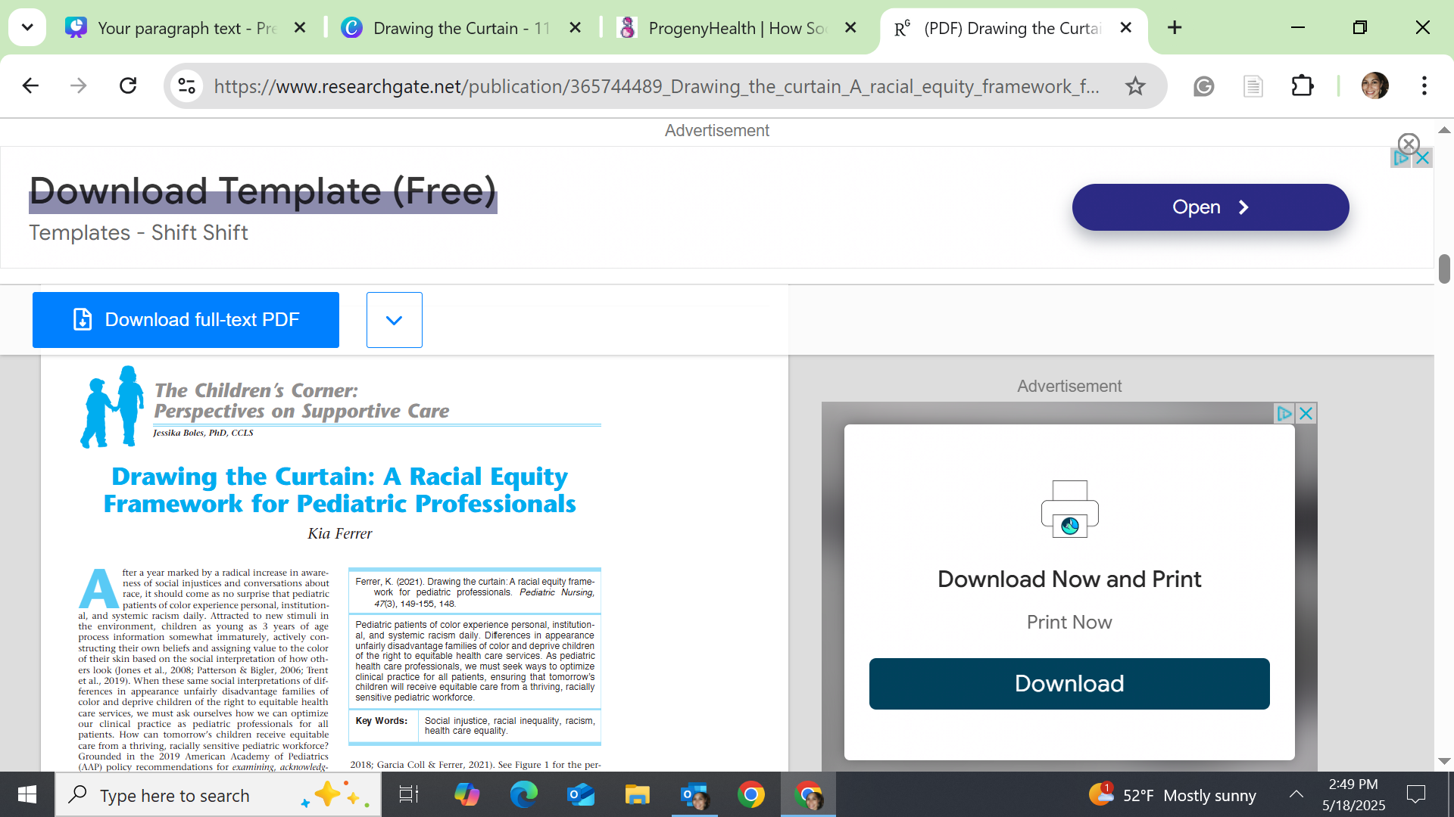
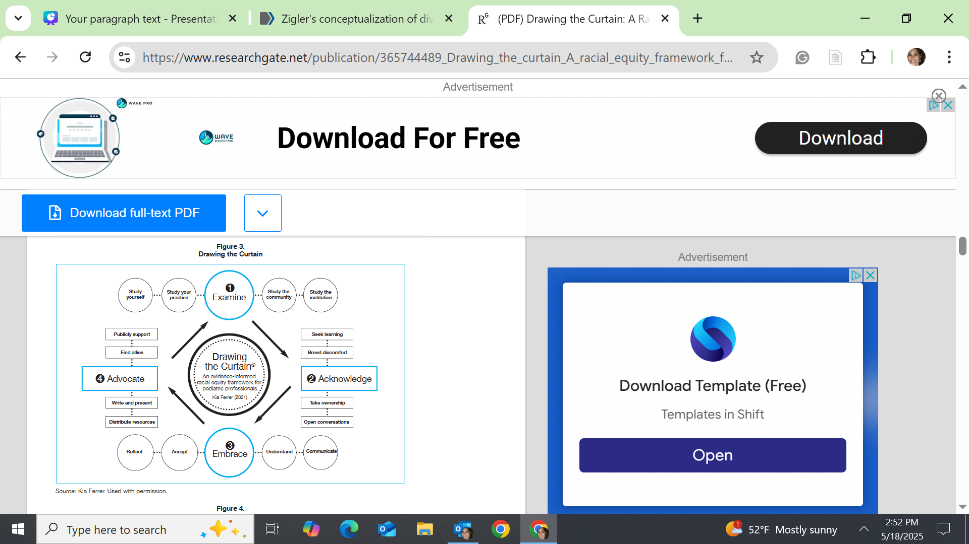
STAFF EDUCATION & TRAINING
Staff education and training about safe sleep in the NICU is essential because it directly supports infant safety, equity in care, and parental trust.

Slide 35
DRAWING THE CURTAIN (FERRER, 2021)

Slide 36
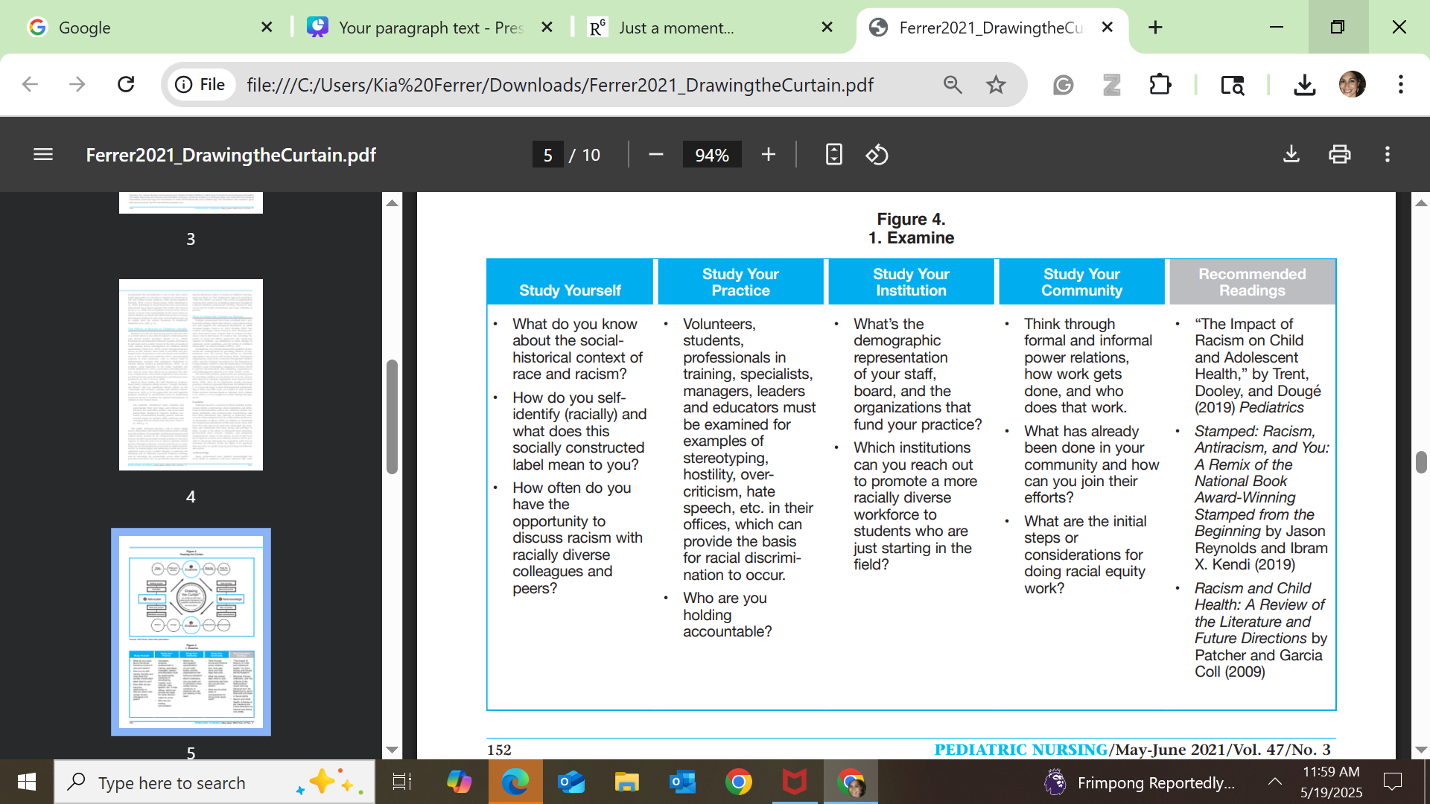

Slide 37
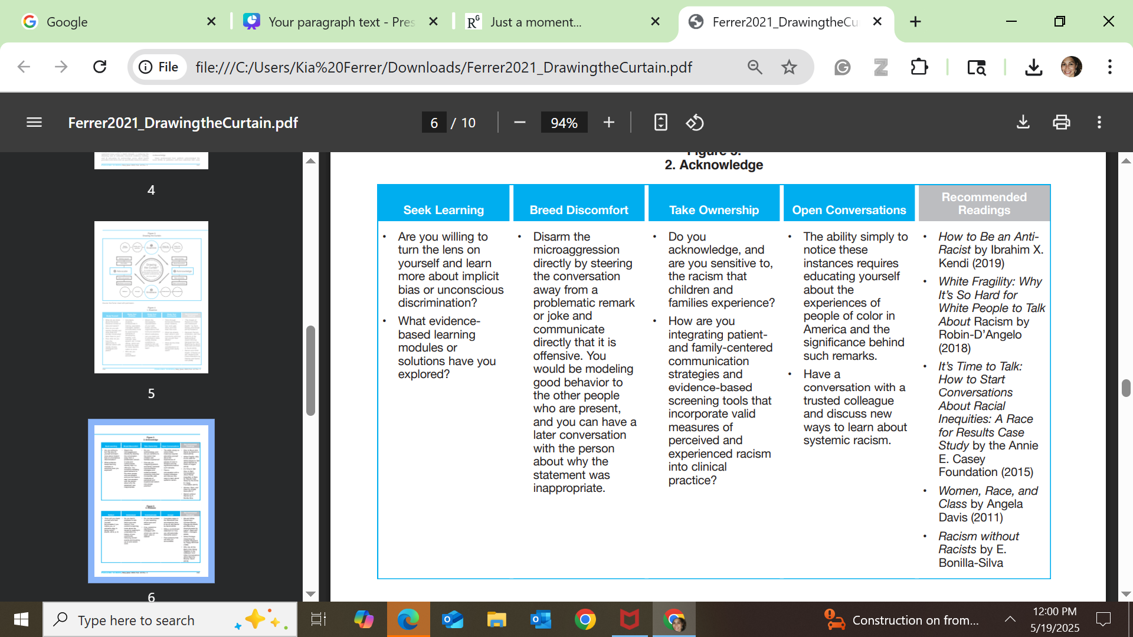

Slide 38
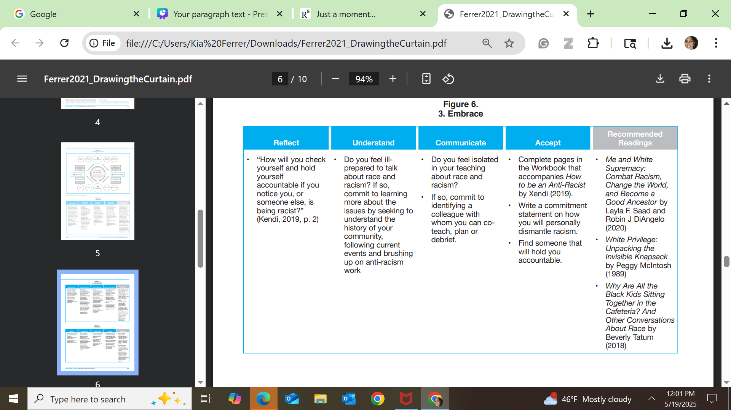

Slide 39
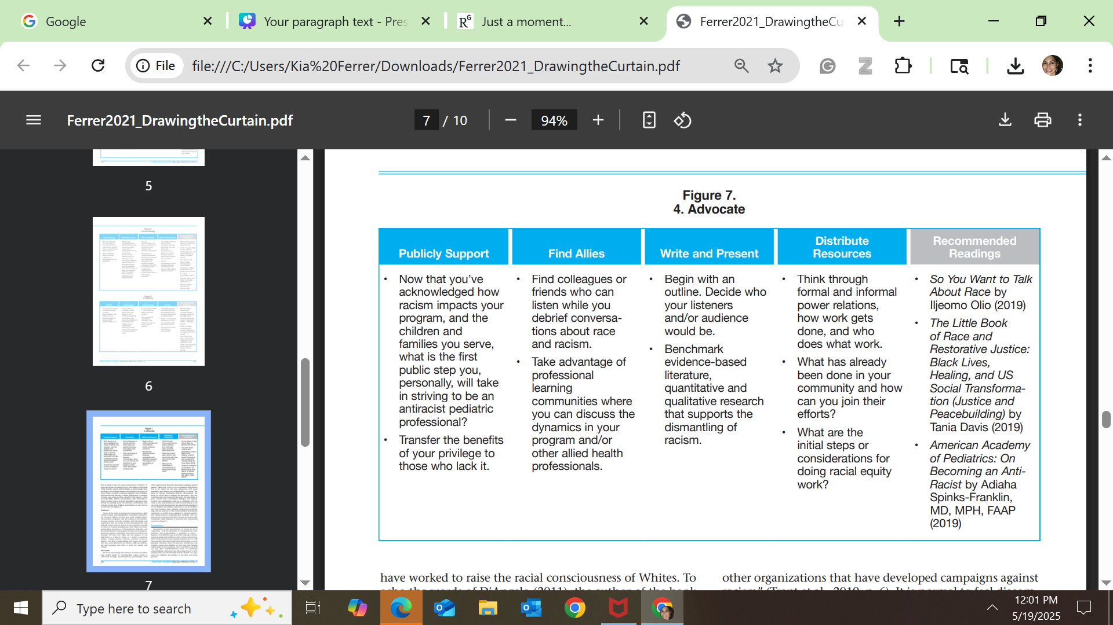

Slide 40

Key Takeaways
Emphasize Cultural Humility Over Cultural Competence
Shift the focus from merely acquiring knowledge about different cultures (cultural competence) to embracing cultural humility—a lifelong commitment to self-evaluation and learning. This approach encourages staff to recognize their own biases and engage in respectful, open dialogues with families about their beliefs and practices. Simulation-based training has been effective in enhancing cultural humility among healthcare providers

Slide 41

Key Takeaways
Integrate Cultural Contexts into Safe Sleep Education
Standard safe sleep guidelines, such as those from the American Academy of Pediatrics, may not align with all cultural practices. For instance, co-sleeping is common in many cultures. Training should equip staff to discuss safe sleep recommendations sensitively, acknowledging cultural norms and working collaboratively with families to find acceptable solutions.

Slide 42
Key Takeaways
Implement Practical Training Strategies like Drawing the Curtain (Ferrer, 2021)
  Simulation Exercises: Develop scenarios that reflect common cultural practices, allowing staff to practice navigating conversations about safe sleep in a controlled environment.
  Role-Playing: Encourage staff to engage in role-playing exercises to build confidence and empathy in discussing sensitive topics.
  Peer Discussions: Facilitate regular meetings where staff can share experiences, challenges, and strategies related to culturally sensitive care.

Slide 43
References
4 Tips for Including & Engaging Family Partners in Your Work. The National Institute for Children’s Health Quality. https://nichq.org/blog/4-tips-for-including-family-partners-in-your-work/
Communication Strategy. (n.d.). Retrieved from https://www.aap.org/en/news-room/campaigns-and-toolkits/safe-sleep/communication-strategy/
Drawing the Curtain: A Racial Equity Framework for Pediatric Professionals - ProQuest. (n.d.). Retrieved December 23, 2022, from https://www.proquest.com/openview/d3ef929db8bc83c12ea9aa73ed9dd2a4/1/advanced
Equity and Safe Sleep for Infants (ESSI) – Illinois Perinatal Quality Collaborative. (n.d.). Retrieved May 19, 2025, from https://ilpqc.org/essi/
Safe Sleep. (n.d.). Retrieved from https://www.aap.org/en/patient-care/safe-sleep/
Trent, M., Dooley, D. G., Dougé, J., Section on Adolescent Health, Council On Community Pediatrics, & Committee On Adolescence. (2019). The Impact of Racism on Child and Adolescent Health. Pediatrics, 144(2), e20191765. https://doi.org/10.1542/peds.2019-1765

