Slide 1






From Awareness to Action: Driving Perinatal Mental Health Systems Change
Andrea N. Clark, JD, MDiv
Deputy CEO &
Director, Alliance for People of Color,
Postpartum Support International

Slide 2

Objectives:
To provide a basic understanding of the scope and prevalence of perinatal mood disorders.
To strengthen understanding of the potential consequences of untreated perinatal mood disorders.
To encourage collaboration between medical providers, mental health providers, allied health professionals and community organizations to improve perinatal mental health outcomes.
To provide examples and best practices for perinatal mental health screenings.
To provide information on perinatal mental health resources for patients and education for perinatal and infant health providers, clinicians and practitioners.

Slide 3

The Facts
Of all women giving birth in the United States in 2021:
  52% were white
  23.8% were Latinx/Hispanic
  14.8% were Black/African-American
  6.6% were Asian
  0.8% were Native/Other Races
  Of all groups of women, black women have the highest rate of maternal mortality (55.3 for each 100,000 live births)
  Njoku, A., Evans, M., Nimo-Sefah, L., & Bailey, J. (2023). Listen to the Whispers before They Become Screams: Addressing Black Maternal Morbidity and Mortality in the United States. Healthcare (Basel, Switzerland), 11(3), 438. https://doi.org/10.3390/healthcare11030438

Slide 4

The Facts
  Perinatal Mood Disorders
  Maternal Depression
  Maternal Anxiety
  Maternal/Perinatal OCD
  Bipolar Disorders
  Postpartum Psychosis
  Traumatic Birth Event and Postpartum PTSD
  Intrusive thoughts
  Perinatal loss and grief
  The Policy Center for Maternal Mental Health. “Maternal Mental Health Conditions.” https://policycentermmh.org/mmh-disorders/
Notes:
Maternal Depression – more than 20% of pregnant and birthing persons, can have onset or increase symptoms during pregnancy or anytime within 12 months of birth
Maternal Anxiety – approximately 20% with one quarter of those experiencing symptoms in early pregnancy
Maternal/Perinatal OCD – 8% during pregnancy, over 17% in postpartum.
Bipolar disorders – approx. 2.6% in women without history of psychotic disorders; 20% in women with pre-existing psychotic disorders . 54.9% of women/birthing people with existing psychotic disorders will experience some symptoms during perinatal period.
Postpartum Psychosis – 1 in 1000, sudden onset usually within first 2 weeks after delivery, most common in women with personal/family history of bipolor or with pervious psychotic episodes
Traumatic birth event – 33% of women state that they have a physically, emotionally overwhelming or distressing event during delivery. Somewhere between 5-20% continue to experience feelings of depression, intrusive thoughts, prolonged grief, etc following the TBE
Substance Use Disorder – not specific to the perinatal period; 2-40% of women. Complications – increased risk for depression, anxiety, perinatal PTSD. 30% screened positive for depression who had identified SUDs prior to pregnancy. That number increased to 40% postpartum.
Intrusive thoughts – 70-100% of women experience during pregnancy and postpartum. Occassional, arising of concern, fatigue. Usually Ego-dystonic – mom knows they are wrong, but they are not constant and don’t necessarily rise to level of psychosis. When the thoughts become constant and/or ego systonic may rise to level of PPP or POCD
Perinatal loss and grief – up to 20% of pregnancies end in still birth or miscarriage. More prevalent in Native and black women. High risk for depression and perinatal PTSD

Slide 5

The Facts
  Johns Hopkins Study on Postpartum Depression
  20% (1 in 5) are diagnosed with PPD
    Cumulatively PPD diagnosis higher for white patients than other groups within 0-7 weeks of giving birth
    PPD diagnosis less likely to occur for BIPOC patients within this timeframe
    Black, Asian, Latinx/Hispanic patients MORE likely to be diagnosed with PPD 8 weeks postpartum than white patients
    Liu, S., Ding, X., Belouali, A., Bai, H., Raja, K., & Kharrazi, H. (2022). Assessing the Racial and Socioeconomic Disparities in Postpartum Depression Using Population-Level Hospital Discharge Data: Longitudinal Retrospective Study. JMIR pediatrics and parenting, 5(4), e38879. https://doi.org/10.2196/38879
Notes:
Reluctance to seek treatment because of cultural stigma
Institutional mistrust
Lack of screening/ ineffective screening tools
Implicit bias and institutional racism

Slide 6
Why This Matters…
Untreated PMDs are associated with pre-term birth, low birth rate (Grate, et. al., 2010)
Negative childhood development outcomes (Koutra, et.al., 2017)
Perinatal Mood Disorders are a leading cause of maternal mortality (Trost, et.al. 2022)
Grote, N. K., Bridge, J. A., Gavin, A. R., Melville, J. L., Iyengar, S., & Katon, W. J. (2010). A Meta-analysis of Depression During Pregnancy and the Risk of Preterm Birth, Low Birth Weight, and Intrauterine Growth Restriction. Archives of General Psychiatry, 67(10), 1012–1024. https://doi.org/10.1001/archgenpsychiatry.2010.111
Koutra, K., Roumeliotaki, T., Kyriklaki, A., Kampouri, M., Sarri, K., Vassilaki, M., Bitsios, P., Kogevinas, M., & Chatzi, L. (2017). Maternal depression and personality traits in association with child neuropsychological and behavioral development in preschool years: Mother-child cohort (Rhea Study) in Crete, Greece. Journal of Affective Disorders, 217, 89–98. https://doi.org/10.1016/j.jad.2017.04.002
Trost, S., Beauregard, J., Chandra, G., Njie, F., Goodman, D., Berry, J., & Harvey, A. (2022, September 26). Pregnancy-Related Deaths: Data from Maternal Mortality Review Committees in 36 US States, 2017–2019 | CDC. https://www.cdc.gov/reproductivehealth/maternal-mortality/erase-mm/data-mmrc.html

Slide 7

In Her Own Words…
Jabina’s Story

Slide 8

Perinatal Mental Health Screening
Where were there opportunities for screening in Jabina’s story?
Why do you believe those providers did not conduct screening?

Slide 9
Existing Screening Tools
Edinburgh Perinatal Depression Scale (EPDS)
Perceived Prenatal Maternal Stress Scale (PPNMSS)
Patient Health Questionnaire – 9 (PHQ-9)
Obsessive Compulsive Inventory 4 or 12 (OCI-4/OCI-12)
PTSD Scale (CAPS-5)

Slide 10
Culturally Responsive Screening
Somatic symptoms
Stigma and verbiage
Dominant cultural narratives
Distrust of the healthcare system

Slide 11

Screening Exercise:
Meet Sasha
You are caring for a pregnant mom by the name of Sasha
Some information about the patient:
  Patient is a 36 year-old bi-racial (African American and Latina) cis-gendered woman
  Patient attends church regularly in her area, but she is the only woman of color and her children are the only children of color in the church
  Patient left her corporate job to stay home with her now 3 year-old twin boys
  Patient is 20 weeks pregnant with her third child
  Patient’s partner is generally supportive, but travels a great deal for work
  Patient moved to your area a year ago for her husband’s job, but her family and most of her friends live in the New York and New Jersey area
  At this visit patient seems to have trouble focusing, is less neatly kempt than usual, and has the twins with her
  She is smiling and the children are well groomed.

Slide 12

Questions and Exercise:
Are there any red flags on concerns you have about Sasha at this point in the pregnancy? Share those concerns at your table.
Will the EPDS help you address those concerns?
With these concerns in mind:
Two people at your table will serve as the medical provider, one will act as Sasha
One provider will administer the EPDS just as written, Sasha will answer based on those questions. Tally and get the resulting score.
After tallying the original score, have the table look at the EPDS questions and assess which ones were helpful, which weren’t and how they may be asked in a way that Sasha feels more comfortable responding. Sasha should NOT participate in this portion.
The second provider will ask Sasha the EPDS using suggested modifications. Tally the scores

Slide 13
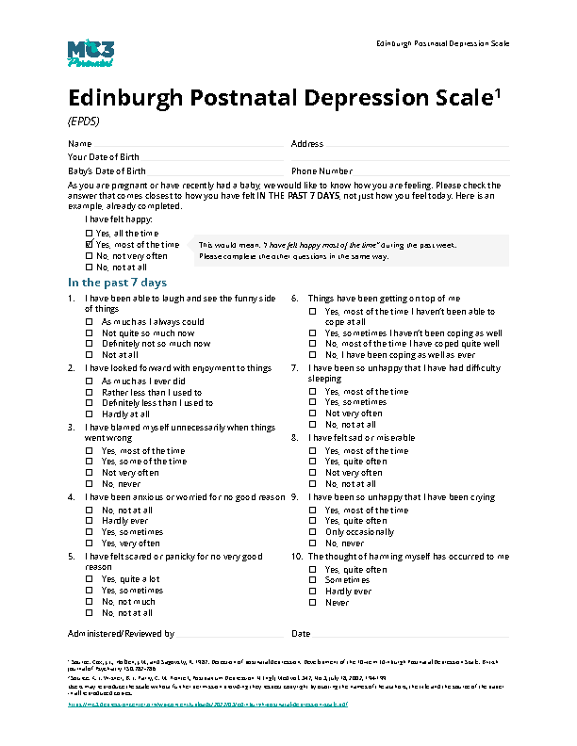
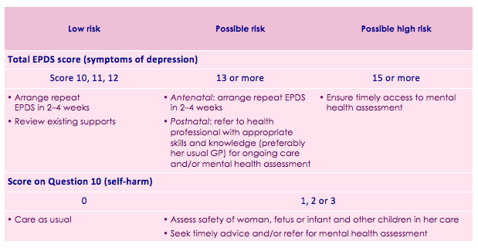

Slide 14

What did you notice?

Slide 15





Better Screening
Improves Systemic Outcomes
Improved symptomology decreases stress on healthcare systems
Promotes inter-team collaboration
Connects healthcare systems with external providers, agencies and organizations equipped to take care of these needs
Improves maternal and infant health outcomes

Slide 16

Postpartum Support International
Our Mission
The mission of Postpartum Support International is to promote awareness, prevention and treatment of mental health issues related to childbearing in every country worldwide.
Our Vision
It is the vision of PSI that every woman and family worldwide will have access to information, social support, and informed professional care to deal with mental health issues related to childbearing. PSI promotes this vision through advocacy and collaboration, and by educating and training the professional community and the public.

Slide 17
Who Can Access PSI’s Resources?
Parents (birthing people and non-birthing partners)
Family members of parents
Providers and Professionals who work with people during the perinatal period

Slide 18

What Resources Does PSI Provide?
Peer and Help-Seeker Support
  Over 50 Virtual Support Groups
  Peer Mentoring
  Support Coordination
  Helpline (warm line)
  Hotline
  Provider Directory
  *All services are free, no diagnosis needed
Advocacy
  Mind the Gap Project

Slide 19
What Resources Does PSI Provide?
Provider Training and Education
  2 Day Components of Care
  Advanced Psychotherapy/ Psychopharmacology
  Continuing Education Webinars
  Psychiatric Consultation Line
  Alliance for People of Color
  Blue Dot Project
Public Education
  Social Media and Live Streams
  Webinars
  Media

Slide 20


Resources
Postpartum Support International:
Postpartum Support International, Illinois:
www.psichapters.com/il/
Maternal Mental Health Hotline: 1-833-TLC MAMA
The Shades of Blue Project:
The Maternal Mental Health Leadership Alliance: www.mmhla.org
The Policy Center for Maternal Mental Health: www.policycentermmh.org
Advocate Illinois Masonic Behavioral Health:
  https://www.advocatehealth.com/locations/advocate-illinois-masonic-behavioral-health-care-chicago

