Slide 1
Hospital Name
Insert Hospital Logo

Slide 2

Hospital Demographics
Location
Perinatal Level
Perinatal Network
Birth Volume
Units participating in ESSI
  SCN, ISCU, NICU, etc.
*Include map of where your hospital is located: TownMapsUSA.com - Maps of ILLINOIS

Slide 3
ESSI QI Team Members
Name, Title, Role
  Title on ESSI team
*Share a picture of your ​
ESSI Team at a QI meeting!

Slide 4
Inclusive Clinical Environment
How have you begun to review your unit policies with an equity lens?
How have you engaged with interpreters on your unit?
Share any tools you’ve used or created:

Slide 5
Let's Talk about Safe Sleep!
Having a conversation with caregivers and providing respectful education isn't one size fits all.
What is your team doing for parental education and conversations around safe sleep with caregivers?
Share successes, barriers, and unique strategies:

Slide 6
Let's Talk about Safe Sleep!
Having a conversation with caregivers and providing respectful education isn't one size fits all.
Share photos of/and resources that your team has used to help facilitate safe sleep conversations

Slide 7
Respectful Care in Action
Share photos of what respectful care practices you may have in place at your hospital, as well as activities that you engaged in to promote respectful care (e.g. Respectful Care Breakfasts, Newborn Respectful Care Practices posters, DHS Safe Sleep posters)
Show clinical team members next to your Respectful Care posters

Slide 8
SDOH Screening
How are you screening for infant needs? Share a photo of what tool you are using.
Throw a graph from Report 4 of your hospital's current screening and linkage percentages! (example on next slide)

Slide 9
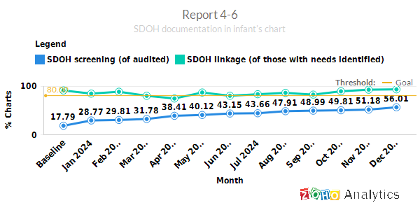
SDOH Screening and Referral

Slide 10
SDOH Linkage and Community Connections
Name 2 resources you have identified around your hospital:
Share a photo of any resources your team has created / distributed or your team at a community event:

Slide 11
Engaging a Parent Partner
How have you engaged a parent partner in QI Work?
Successes:
Challenges:

Slide 12
Pulling it all Together with the ESSI Bundle
Use our 30-60-90-day template, provided here, to create a plan to work on the ESSI bundle.
  What are you going to work on in the next 90 days? Pick a topic from our table below:
  In the next 30 days, what steps are you going to take to move this forward?
Topics
Transfer of Care | SDOH Screening and Integration into the EMR
Building Relationships with Community Organizations | Respectful Care and Listening to Families
Safe Sleep Awareness and Conversations | Interpreters and Language Preferences
Building a Community Resource Guide | Equitable and Inclusive Unit Policies

