Slide 1
Equity and Safe Sleep for Infants Optimizing Transfer of Care from Birth Hospitalization to Community Care Provider - Ensuring Safe Sleep & Addressing Social Determinants of Health
March 17th, 2025, 2:00 PM

Slide 2
Overview
Face-to-Face Conference and ESSI “On the Path to QI Excellence” Award
ESSI Initiative Aims and Progress Overview
Transfer of Care: Optimizing Transfer of Care from Birth Hospitalization to Community Care Provider - Ensuring Safe Sleep & Addressing Social Determinants of Health
Community Corner: Home Visiting with Glendean Burton and Laura Beavers

Slide 3
Attendance Poll
Please fill out the poll so that we can track hospital team attendance for ESSI Webinars. If unable to complete poll, please email kmoreno@northshore.org

Slide 4
Face-to-Face Conference

Slide 5
Registration and Hotel Block NOW OPEN.
Go to “Events” on our website to stay up to date on agendas, storyboards, and registration updates.
Time: 9 am – 4 pm
Time: 9 am – 3:45 pm
Make sure at least one physician champion, one nurse champion, and a patient partner attend to represent your hospital.

Slide 6
ESSI “On the Path to QI Excellence”
Face to Face:
Hospital and individual-level data submission through end of March.

Slide 7
Structure Measure | In Place
Standardized physician, non-physician clinician, and hospital staff education about listening to parents and caregivers, providing respectful care and building trust, addressing implicit bias and engaging in anti-racism
Standardized physician, non-physician clinician, and hospital staff education about the importance of a safe sleep environment and engaging in meaningful, culturally appropriate, respectful, nonjudgmental conversations with parents or caregivers about safe sleep
Hospital has a policy in place for safe sleep practices reflective of the 2022 AAP Recommendations.
Hospital has a standardized process to use qualified language interpreters in parents/caregivers’ preferred language.
Hospital has a standardized process for reviewing all unit policies with an equity lens and making necessary changes.
Hospital has parent(s) and/or caregiver(s) on the newborn quality improvement team
Hospital has a standardized process to provide resources to enable a safe sleep environment outside of the hospital.
Hospital has a standardized process to screen for newborn inclusive Social Determinants of Health and to link to needed resources
6 out of 8 structure measures in place

Slide 8
Sleep Environment Audit | On the Path to QI Excellence
% of infants on Postpartum unit in safe sleep environment | 80%
% of infants on Special Care Nursery or NICU audited in safe sleep environment | 80%
Education Measures | On the Path to QI Excellence
% physicians and nurses completing education about listening to parents and caregivers providing respectful care and building trust addressing implicit bias and engaging in anti-racism | 70%
% physicians and nurses completing education about the importance of safe sleep and how to effectively educate parents or caregivers. | 70%
ESSI Bundle | On the Path to QI Excellence
Percentage of charts audited where there is documentation of SDOH screening and linkage if needed | 70%

Slide 9
2025 F2F Neonatal Storyboards
Share the great work that your ESSI Team is doing!
Introduce your hospital and ESSI QI Team
Share different strategies around safe sleep education and conversations
Make a plan to pull everything together

Slide 10
Connect TODAY with ILPQC for ESSI QI Support
Contact
kmoreno@northshore.org

Slide 11
ESSI Initiative Aims and Progress Overview

Slide 12
ESSI Initiative Aims
1
By December 2025, greater than 70% of Illinois birthing and children’s hospitals will address disparities and promote neonatal equity by actively participating in the ESSI initiative.​
2
By December 2025, greater than 80% of infants will be discharged from ILPQC hospitals with a completed ESSI Bundle.
Parents or caregivers report an understanding of a safe sleep environment.
AWARENESS
READINESS
Family is prepared for a transition to home, including SDoH screening and resource linkage.
TRANSFER OF CARE
Communication to primary care provider completed.

Slide 13
Key Driver Diagram
Aims
Primary Drivers
Secondary Drivers
By December 2025:
1. Greater than 70% of Illinois birthing and children’s hospitals will address disparities and promote neonatal equity by actively participating in the ESSI initiative.
2. Greater than 80% of infants will be discharged from ILPQC hospitals with a completed ESSI bundle.
Healthcare Professional Commitment
Equitable and Respectful Care Education and Implementation
Safe Sleep Environment Education and Implementation
Inclusive Clinical Environment
Organizational Leadership Commitment
Equitable and Inclusive Unit Policies
Parent and Caregiver Experience Prioritization
Parent and Caregiver Empowerment
Respectful Parent and Caregiver Partnerships
Safe Sleep Awareness
Transition to Home, including SDoH Screening and Resource Linkage
4
Community
Partnerships
Resource Mapping
Building Relationships with Community Organizations
Transfer of Care to Community Providers
Healthcare Data Utilization
Collection of Accurate Race and Ethnicity Data
Dissemination of Stratified Data
Application of Data to Address Inequities
Awareness: Parents or caregivers report an understanding of a safe sleep environment, including navigating challenges to safe sleep at home
Readiness: Family is prepared for a transition to home, including SDoH screening and resource linkage
Transfer of Care: ESSI Newborn Care Plan (Awareness & Readiness) documented in the discharge
ESSI Bundle:

Slide 14
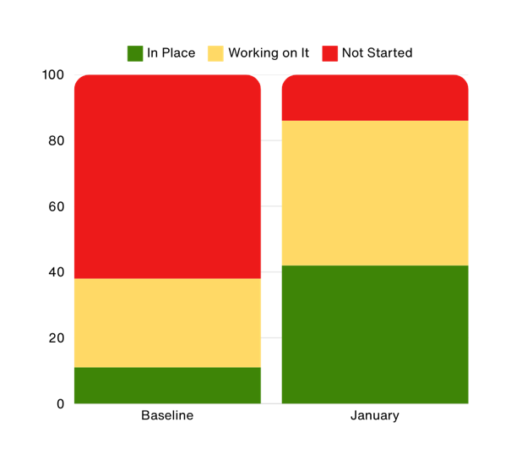
Transfer of Care
Hospital has a standardized process for transfer of care to the newborn's community provider, including documentation of ESSI Newborn Care Plan.
% of hospitals
Oct-Dec 2023
2025

Slide 15
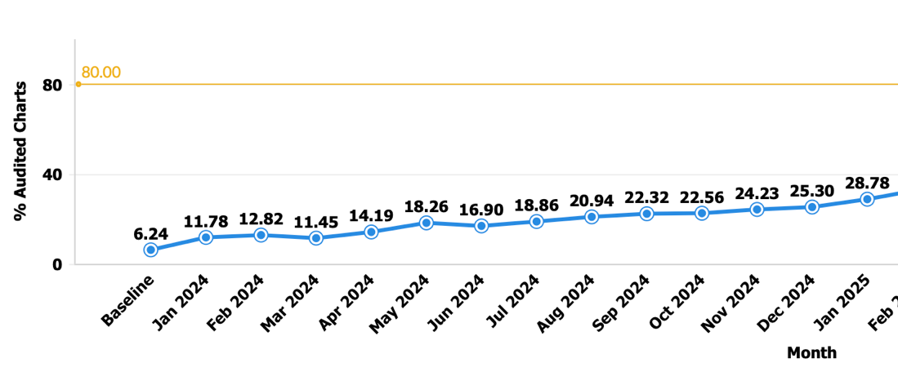
ESSI Bundle Completion
Percent of charts audited that have an ESSI Bundle

Slide 16
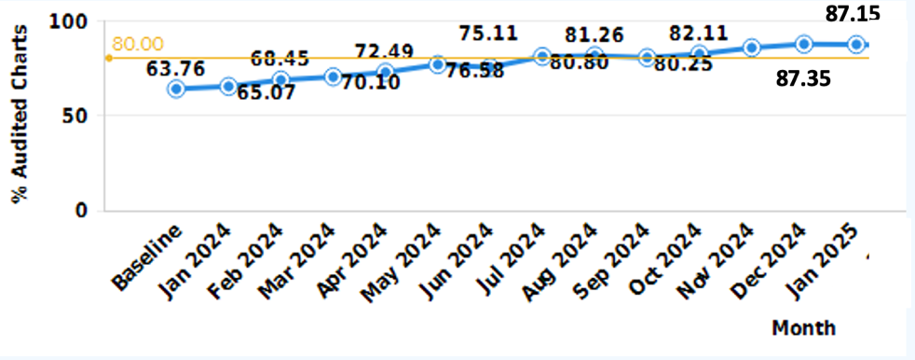
Parents or caregivers reporting an understanding of safe sleep​
Percentage of charts audited where a parent or caregiver reports an understanding of safe sleep​

Slide 17
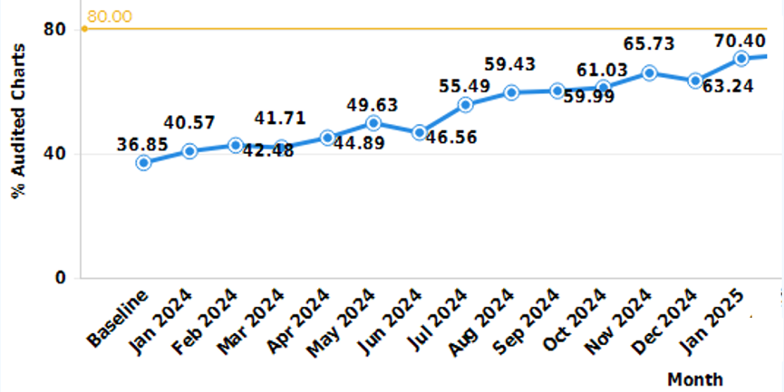
Documentation of a conversation with parents or caregivers about adjustment to life with a newborn and safe sleep, and resources shared
Percentage of charts audited where there is documentation of a conversation about adjustment to life with a newborn and safe sleep​

Slide 18
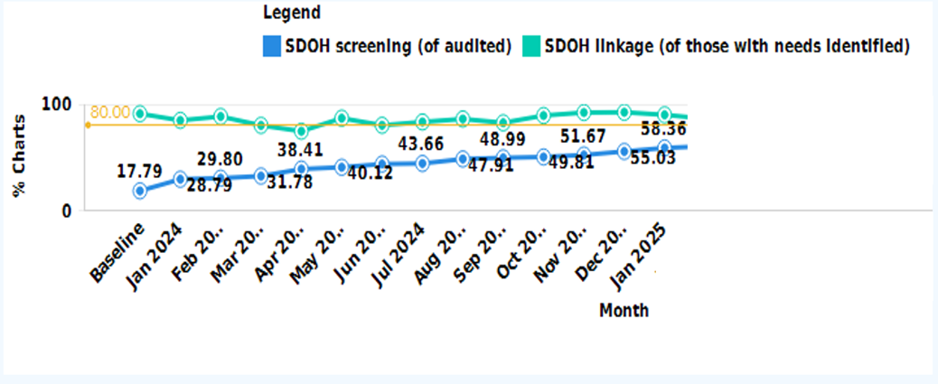
SDOH Screening and Linkage Documentation in Infant’s Chart​
Percentage of charts audited where SDOH screening is documented and subsequent linkage (if needs identified)

Slide 19
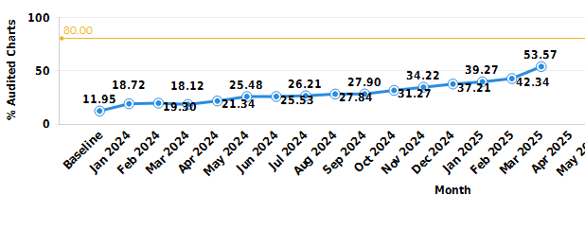
ESSI Bundle documented in discharge summary
Percent of charts audited that have an ESSI Bundle in discharge summary

Slide 20
Optimizing Transfer of Care from Birth Hospitalization to Community Care Provider - Ensuring Safe Sleep & Addressing Social Determinants of Health

Slide 21
What is a Transfer of Care?
A transfer of care is when one medical team turns over responsibility for the comprehensive care of a patient to another medical team.

Slide 22
Case
35 week, 2015g (4lb 6oz), infant born in c/s due to severe preeclampsia. Maternal blood type O positive. Baby blood type A positive, Coombs positive. Initially feeds marginal well, but did not require transfer to NICU and maintained blood sugars. Parents prefer formula to breastmilk. Bilirubin up to 15, but improved with phototherapy and did not demonstrate anemia.
Discharged home on D3 with Neosure 24 calorie, 1850g (92%). WIC form given. Transportation challenges identified on SDOH screening, but team felt that there was adequate transportation plan to PCP office, 1 day after discharge.
Patient sees PCP after discharge as planned. Weight 1835g (91%). “Moderate jaundice” on exam. PCP could not find d/c summary, but parent are “good historians” and reported the birthweight in lbs/oz. They did not remember discharge weight, but “they said it was ok.” Followup planned at 2 weeks of age.
Patient presents to ED at 8 DOL, bilirubin 22, 1755g (88%). Mother reports she could never go to WIC office due to transportation. Using 20 calorie formula from cousin until she can get there. Baby admitted.
Notes:
Justin and I will come up with a case

Slide 23
Case
In Hospital
Discharge and PCP
35 5/7 week, 2015g (4lb 6oz)
C/S severe preeclampisa
Maternal blood type O positive. Baby blood type A positive
Initially feeds marginal well, but did not require transfer to NICU and maintained blood sugars: Parents prefer formula to breastmilk
Bilirubin up to 15, but improved with phototherapy and did not demonstrate anemia.
Discharged home on D3 with Neosure 24 calorie; WIC form given
Discharge Weight: 1850g (92%)
Transportation challenges identified on SDOH screening, but team felt that there was adequate transportation plan to PCP office, 1 day after discharge.

Slide 24
For this case: Key elements of transfer of care?
GA
BW and discharge weight
Bilirubin management and discharge status
Blood type
What SDOH factors should be considered and communicated?

Slide 25
Back to the Case
PCP
Then
Seen day after discharge
Weight 1835g (91%)
Moderate jaundice” on exam
PCP could not find d/c summary, but parents are “good historians” and reported the birthweight in lbs/oz. They did not remember discharge weight, but “the doctor said it was ok.” Followup planned at 2 weeks of age.
Patient presents to ED at 6 DOL
More tired, eating less than yesterday
Bilirubin 22
Weight: 1755g (88%)
Mother reports she has not yet been to WIC office due to transportation. Using 20 calorie formula from cousin until she can get there
Baby admitted for phototherapy, feeding

Slide 26
For this case: Key elements of transfer of care?
GA
BW and discharge weight
Bilirubin management and discharge status
Blood type
How do SDOH influence the outcomes in this case? Could we have avoided admission with additional or more intentional communication with PCP?
What is minimum standard for transfer of care? What can we do in higher risk cases?

Slide 27
Why is structured Transfer of Care important?
Contains all necessary information in a logical and useful format
Ensures continuity of care for newborns and families
Reduces readmissions and complications
Enhances parental education and confidence
Improves health equity through early intervention

Slide 28
What are the key components of a Safe and Effective Transfer?
The discharge summary is often the only form of communication that accompanies the patient to the next setting of care. High-quality discharge summaries are essential for promoting patient safety during transitions between care settings.
Discharge summary with newborn’s medical history
Early pediatric provider follow-up within 48–72 hours
Parental education on newborn care, warning signs, feeding, and safe sleep
Communication of social needs and resource connections

Slide 29
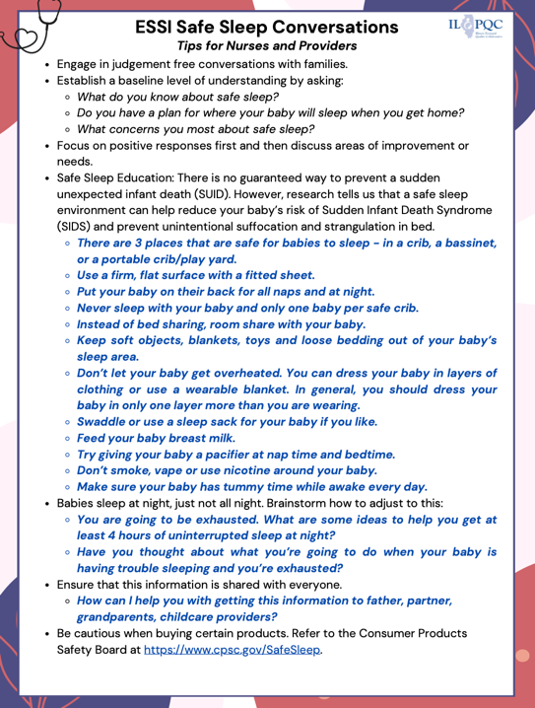
Safe Sleep: A Critical Component in Transfer of Care
2022 AAP Recommendations:
Baby sleeps alone, on back, in a crib
No soft bedding, pillows, or stuffed animal
Room-sharing without bed-sharing
Use of sleep sacks instead of blankets
Trying to figure out tips and how to communicate additional critical safe sleep information? Check out our new resource “Safe Sleep Conversations: Resources for Nurses and Providers”
Notes:
Let’s make sure the graphic is out latest on Monday.

Slide 30
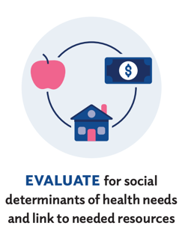
Assessment of Social Needs and Resource Connections: A Critical Component in Transfer of Care
Key SDOH Factors Impacting Newborn Care
Housing insecurity
Food access
Transportation to follow-up care
Parental mental health and substance use
Consider the following:
How can a provider expect to follow-up with a family during well-child visits if that family doesn’t have access of transportation services?
How does one encourage safe sleep practices when a patient is experiencing homelessness or unstable housing?

Slide 31
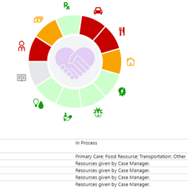
Assessment of Social Needs and Resource Connections: A Critical Component in Transfer of Care
Screening & Connecting Families to Resources
Standardized SDOH screening
Connecting families to resources
Partnerships with community organizations
Notes:
I feel like this slide can be more impactful

Slide 32
Poll Question:
How confident are you that key discharge information is received by the patient's primary care provider?
Likert Scale: (1) Not confident at all – (5) Extremely confident

Slide 33
We all have a role in ensuring an optimal Transfer of Care
ILPQC
Hospital teams
Community providers

Slide 34
ILPQC’s Role
ILPQC’s Focus on Perinatal Quality Improvement
Reducing disparities in maternal & neonatal outcomes
Supporting safe sleep practices statewide
SDOH screening & resource linkage
Standardizing hospital discharge information

Slide 35
ILPQC’s Transfer of Care Tools
Smart and Dot Phrases: These are shorthand tools commonly used in healthcare settings, particularly within electronic health records (EHR) systems. They include commonly used pre-populated information sections and can help standardize processes.
“My Baby’s Safe Sleep Plan”
AWARENESS
READINESS
Check out ILPQC’s ESSI Bundle, SDOH Screening and Safe Sleep Dot Phrases on our website and "My Baby’s Safe Sleep Plan”
TRANSFER OF CARE
Notes:
Can we add slides with the dot phrases and the sleep plan and we need to name the dot prhases

Slide 36
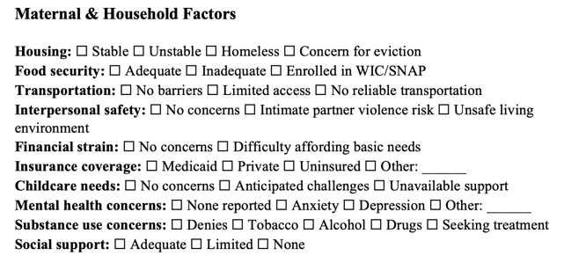
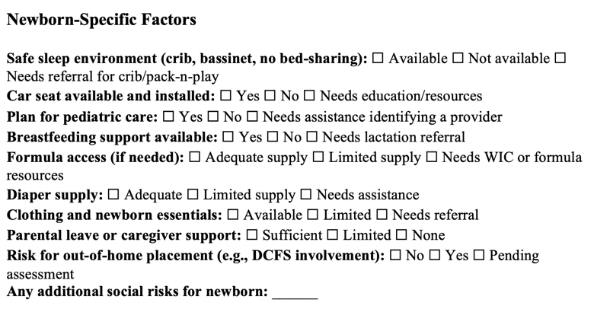
ILPQC’s Transfer of Care Tools
Dot Phrase: ILPQC SDOH Screening
Coming Soon!

Slide 37
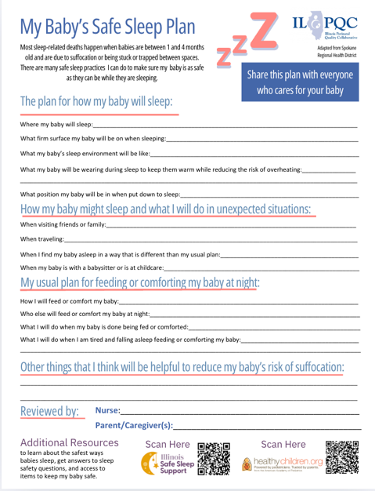
ILPQC “My Baby’s Safe Sleep Plan”
Updated version posted to ILPQC website
AWARENESS
Options: Could be placed into patient discharge folder.
READINESS
TRANSFER OF CARE

Slide 38
Hospital Team’s Transfer of Care Strategies
AWARENESS
Standardized discharge checklist including safe sleep and SDOH screening and resource linkage Parental empowerment with “My Baby’s Safe Sleep Plan”
Leveraging the EMR with ESSI Dot Phrases
Collaboration with community providers for seamless transitions
Telehealth & home visits for high-risk infants
Parental education toolkits with safe sleep and SDOH resources
READINESS
TRANSFER OF CARE
Home visits and collaborating with community providers are a great way to reinforce safe sleep and feeding education, monitor for unmet social needs, and track infants for follow-up care.

Slide 39
Community Provider’s Role
First pediatric visit within 48-72 hours
Reinforce safe sleep & feeding education
Monitor for unmet social needs and connect to resources
Track high-risk infants identified by ESSI for follow-up care
Seamless communication and transition to community providers
Understanding capacity and availability of providers
TRANSFER OF CARE

Slide 40
1
Communication with Primary Care Provider
TRANSFER OF CARE
ILPQC is excited to announce we are collaborating with the Illinois Chapter of American Academy of Pediatrics (ICAAP) to create a survey to distribute to community providers in Illinois.
The goal is to streamline and optimize the Transfer of Care process and information.
2

Slide 41
Community Corner: Home Visiting
Glendean Burton and Laura Beavers
Maternal, Infant, and Early Childhood Home Visiting (MIECHV) Program
Notes:
Glendean Burton:
Glendean Burton is an RN and CLC who has worked in Maternal and Child Health the majority of her career. She retired from Il Dept of Human Services in 2015 as the Bureau Chief for Maternal and Child Health services, and the Acting Director of Family Health Services. Since that retirement, Glendean has continued to work as an MCH Nurse Consultant to the Il MIECHV (Home Visiting program) and in 2021 joined the Il Early Childhood Comprehensive Systems team which is developing a Universal Newborn Screening Supports plan for the State of Il.. Glendean also provides Lactation education and support services for the SIDSIL Special Beginnings clients referred by Blue Cross Blue Shield Il.
Laura Beavers:

Slide 42
Illinois Division of Early Childhood
Home Visiting, Health & Wellbeing
Glendean Burton MPH, BSN, RN, CLC MCH Nurse Consultant- Illinois
Laura Beavers, MSW
Illinois Department of Human Services

Slide 43
Health Care and HV Alignment
Health Care
Home Visiting
Provides health care services
Reinforces healthy developme nt messages
Refers families with risk factors to home visiting
Provides relationship- based support to families with risk factors
Strengthens parent-child attachment
Connects family to health care and other services
Shared goal: healthy children and families

Slide 44
WHAT
What is early childhood home visiting?
WHO
WHERE
WHEN
HOW
Family support and coaching
By a trained professional
Through planned, regular visits to the home
Prenatally through a child’s early years
Using a research- based curriculum
WHY
Improve maternal and child health
Prevent child abuse and neglect
Reduce crime and domestic violence
Increase family education and earning potential
Promote children's development and school readiness
Connect families to community resources
3

Slide 45
Estimated 80-100 hours of training
Home Visitor Training and Supports
Core training
HV model training (curriculum and approach)
Infant and child development and developmental screening
Advanced training may include
Intimate partner violence (Futures Without Violence)
Maternal depression (Mothers and Babies)
Substance use (5P’s)
Supervision
Reflective supervision
Infant/ Early Childhood Mental Health Consultation

Slide 46
HV includes screenings, follow-up, and linkages, in addition to support with child development:
Screenings (maternal depression, substance use, intimate partner violence, child development)
Follow-up to ensure that prenatal, postpartum, and well-child visits and immunizations take place on schedule
Linkages to health care, adult education, housing, and other resources

Slide 47
IDHS-DEC Home Visiting Priority Populations
Families that earn low incomes (below 100% FPL)
Families with teen parents (under age 21)
Families with child welfare involvement
Families with substance use issues
Families in which someone uses tobacco in the home
MIECHV
Priority Populations
Families with an adult or child with low student achievement
Families with a child with a developmental delay or disability
Families with someone in the US armed forces (including veterans)
Families experiencing homelessness
Families in which parents/caregivers are migrant or seasonal workers
Families that face barriers based on culture, language, and religion
Families in which the parent has a disability
Families with refugee or asylee status
Families who face barriers due to immigration status
Children who are Impacted by parental involvement in the criminal justice system
ELC Priority Populations
For more information about the Early Learning Council’s priority populations, visit: https://oecd.illinois.gov/content/dam/soi/en/web/oecd/documents/priority-populations- updated-2021.pdf
6

Slide 48
FY 24 IDHS-DEC
Home Visiting Outcomes
Performance Measures
MIECHV & IDHS
SFY2024 Outcomes
FFY2023 MIECHV
National Threshold
Health Insurance Continuity
95%
83%
Early Language & Literacy
94%
83%
HRSA MIECHV Benchmarks - 19
Maternal, Infant, and Early Childhood Home Visiting Program
Depression Screenings | 86% | 82%
Safe Sleep Practices | 80% | 64%
Parent Child Interaction | 73% | 63%
Developmental Screenings | 79% | 77%
Well-Child Visits | 71% | 70%
Breastfeeding | 41% | 43%
Full description of performance measures- see CRPD website.

Slide 49
Coordinated Intake: A Local Single Point of Entry for Home Visiting
Many Illinois communities have more than one home visiting program, and the programs use different program models and eligibility criteria. This can make it difficult for families and referral partners to find a program that fits what they are looking for.
Home Visiting Coordinated Intake – iGrow

Slide 50
Coordinated Intake Communities
igrow-DHS-Coordinated-Intake-Contact-List-2.5.25.pdf
Chicago
West side-Connect Home Visiting Chicago
South Side-SELN
Kane County Macon County
Peoria County St. Clair County
Stephenson County
Vermillion County Winnebago County

Slide 51
iGrow – Promoting healthy children and families

Slide 52
Questions and Discussion

Slide 53
Thank you!
Glendean Burton, RN, BSN, CLC, MPH BHV MCH Nurse Consultant GlendeanBurton@hotmail.com
Laura Beavers
Coordinated Intake Home Visiting Systems Manager IDHS-DEC-BHV
Laura.beavers2@illinois.gov
www.igrowillinois.org DHS.HomeVisiting@Illinois.gov

Slide 54
Next Steps:

Slide 55
ESSI Action Items for Hospital Teams
Standardize safe sleep education
Implement SDOH screening & referral processes
Adopt a structured transition process including a standardized Discharge Summary
Work to include ESSI safe sleep and SDOH screening and resource linkage in Discharge Summary
Transfer of Care - Complete ESSI Bundle for every baby
Finish your local resource guide!

Slide 56
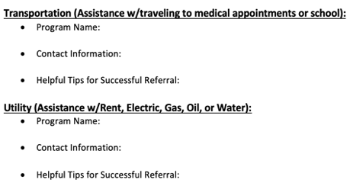
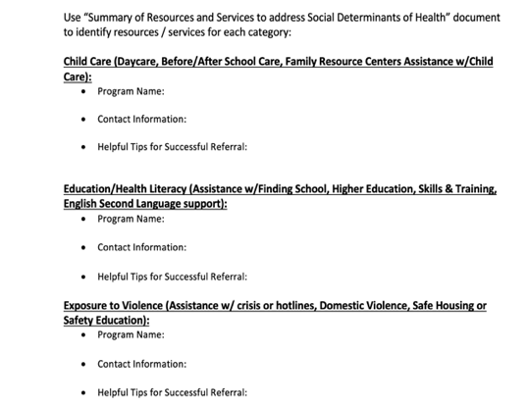
Let’s Make a Resource Guide
Bring your Resource Guide to Face-to-Face!
Is the phone number correct?
Are there limitations / restrictions around accessing resources?
Have you spoken to a representative of this organization?

Slide 57
Upcoming Events and Opportunities

Slide 59
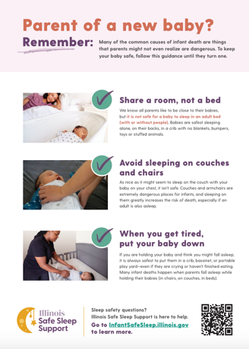
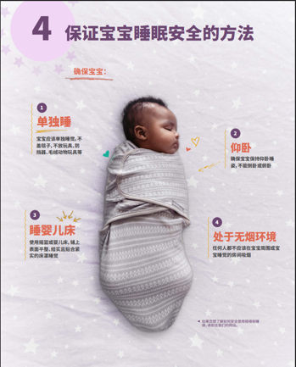
Safe Sleep Poster Packs are BACK!

Slide 60
What’s Included?
Each ESSI team has the opportunity to order a Safe Sleep Support Starter Kit.
Based on your birth volume each team will choose:
5 posters + 200 handouts (4 tear pads of 50) in English for hospitals with a birth volume up to 800
10 posters + 400 handouts (8 tear pads of 50) in English for hospitals with a birth volume over 800
Based on your patient demographics you have the opportunity to order additional handouts in the following languages:
Spanish
Chinese
Arabic
Polish
Each additional language packet comes with 50 handouts (1 tear pad of 50).
Each team will also get a pack of 1 poster per language
Order link will be sent in chat and in March Newsletter!

Slide 61
Registration and Hotel Block NOW OPEN.
Go to “Events” on our website to stay up to date on agendas, storyboards, and registration updates.
Time: 9 am – 4 pm
Time: 9 am – 3:45 pm
Make sure at least one physician champion, one nurse champion, and a patient partner attend to represent your hospital.

Slide 62
2025 F2F Neonatal Storyboards
Share the great work that your ESSI Team is doing!
Introduce your hospital and ESSI QI Team
Share different strategies around safe sleep education and conversations
Make a plan to pull everything together

Slide 63
ESSI DASHBOARD QI TOPIC CALL
Join us as we introducing our ESSI QI Dashboard, a new way to visualize, track and measure your progress towards QI Excellence.
Date: Thursday, March 27th, 2025
1 P.M.
Audience: ESSI QI Team Members
Why you should go: This. dashboard was created to help ESSI Teams visualize recent progress on key structure measures relative to our initiative’s goals and know where you are (or what you need to improve) to address QI Excellence.
Register here.

Slide 64
Upcoming ESSI Calls
Date | Topic
April 21st, 2025 2:00 PM | ESSI Bundle and Pulling it Together

