Slide 1



ILPQC Birth Quality Designation Program with funding from BCBSIL Special Beginnings® and PVB/BE Sustainability Webinar
Monday March 3rd, 2025 12:00 PM

Slide 2




Illinois Birthing Hospital Quality Designation Program
with 2 years of funding from
BCBSIL Special Beginnings® program
Recognizing IL birthing hospitals for sustainability of their PVB/ Birth Equity work and demonstrating a reduction in NTSV Cesarean disparities
3

Slide 3
Webinar Objectives
  Overview of Illinois Birthing Hospital Quality Designation Program
  Birth Quality Designation measures
  Mini Grant Application Process for your hospital
  Next Steps/Pathway for your hospital to achieve Birth Quality Designation
  Birth Equity Sustainability
  Team Talk
Illinois Perinatal Quality Collaborative
2

Slide 4
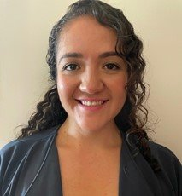

Welcome to our new staff
supporting OB initiative sustainability and the Illinois Birthing Hospital Quality Designation Program!
Maria Villagomez​
ILPQC RN Quality Improvement​ Coordinator
Email: mvillagomez@northshore.org
Owusu Bekoe
ILPQC Senior Program Coordinator
Email: Owusu.Bekoe@northwestern.edu​
Illinois Perinatal Quality Collaborative
2

Slide 5


Key components of birthing
hospitals quality designation program
  Provides support to hospital teams working to achieve PVB and Birth Equity aims, sustain initiative efforts and demonstrate a reduction in disparities
  Hospitals eligible for mini-grants (up to $3750) to support implementation of key strategies
  Hospitals achieving the quality designation award criteria receive recognition and a monetary award ($10,000-20,000)
Illinois Perinatal Quality Collaborative
5

Slide 6
BCBSIL Special Beginnings® program funding
The mini grants and monetary awards are funded by BCBSIL Special Beginnings® program
The mini-grants and monetary awards are time limited with current funding for 2 years (2025 and 2026 awards) to help all hospitals achieve sustainability of PVB and Birth Equity work
ILPQC will continue the Birth Quality Designation Program going forward with ongoing statewide recognition for yearly Birth Quality Awards

Slide 7



Two tiers of Birth Quality designation
Goal Tier 1: Birth Quality Excellence Award
  Top award with state recognition and approximately $20,000 award to your hospital for OB Department QI Work
  Achieve criteria by fall 2025:
        ILPQC participation activities
          Achievement of aims on key BE/PVB measures
          Engage patient and community partners
          Reduction of disparities gap in NTSV cesarean rates
Tier 2: Birth Quality Award
  Achieve Tier 2 criteria by fall 2025
  Approximately $10,000 award to OB Department for QI work

Slide 8
Emails to Hospital Leadership
ILPQC announced the Birthing Hospital Quality Designation with an email to hospital leadership including (if submitted to ILPQC) your stratified NTSV C-Section data to support your efforts
Thanks to all team leads who replied to our emails with leadership contact information!
If your OB leadership / hospital leadership did not receive a letter please reach out to us with contact information
Illinois Perinatal Quality Collaborative
10

Slide 9
Timeline for Birthing hospitals Quality Designation Program
January 2025
ILPQC Designation Launch Webinar
February 2025
Email Sent to hospital leadership
March 2025
Data form Live
Mini grant application opened
Sustainability/quality designation call
Submit your mini grant application by April 1
April-May 2025
September 2025
November 2025
Implementation of strategies
1-1 Support from ILPQC
All 2025 data due
Announce 2025 Birth Hospital Quality Designation recipients at AC
Mini Grant funds distributed to hospitals
Summer 2025
Designation application due
Notes:
7

Slide 10


Mini Grant Application Process
Application due April 1

Slide 11


Application Process
  The mini grant program is designed to provide short term support to all hospital teams to implement sustainability strategies towards achieving Birth Quality designation
  Teams can apply for one or all mini-grant funded activities in one application
  Applications will be reviewed by ILPQC in the order received
  ILPQC will contact applicants to discuss QI implementation, sustainability support and next steps.
18

Slide 12




Activities eligible for a mini-grant
  Respectful Care Breakfast funds (up to $500 total for 2 or more respectful care breakfasts)
  Patient Partner payment for teams with an identified Patient Partner (up to $300 total for up to 6 meetings per year)
  Mommas Voices training for teams with an identified Patient Partner (up to $450 per patient advisor)
  Training to support equitable and respectful care and/or quality improvement implementation for clinical staff, Doula-Friendly Training/ Doula Meet & Greets, or Spinning Babies Training (up to $2,500 total for training)
19

Slide 13

Before you apply
Determine who is the best person to be the primary contact for the mini grant, you'll need
    Applicant primary contact name
    Applicant primary contact email
    Applicant primary contact phone
Decide the amount you are requesting for each activity within the parameters listed
Be prepared to provide a brief description of how you would use the funding for each activity requested.
20

Slide 14

Payment Logistics
  To receive payment, ILPQC will register the hospital as a vendor in the Northwestern University system used by ILPQC
  ILPQC will reach out to the primary contact for the needed information, starting with the hospital W-9 form
  Vendor registration and payment can take a few weeks to process
21
Notes:
Add progress update on how many people have submitted data on new data form, mini grants
Add that they have to subvmiut sustainability plans

Slide 15
Criteria to achieve a 2025 Illinois Birth Quality Designation Award

Slide 16
Components of Birth Quality Designation
Active Participation with ILPQC
New Hire and Ongoing Education to support PVB/BE sustainability
Engage Patients and Community
Achieve Aims and Reduce Disparities: NTSV C-Section Rate and SDOH Screening and Linkage
Illinois Perinatal Quality Collaborative
10
Notes:
delete
10

Slide 17
Actively participate with ILPQC
Criteria | Birth Quality Award
Attend monthly webinars between January and September 2025* (Sustainability, PMH and PVB Coaching when applicable) | Attendance at 5 or more monthly teams webinars
Attend in-person meetings* | Attendance of a physician OR nurse champion at ILPQC face to face meeting and ILPQC annual conference
Submit data between January and September 2025 | 8 months of data with no more than a quarter lag
Share data with your clinical staff | Implementation of a strategy to share quality improvement (QI) data progress with clinical staff (e.g. post data, share QI progress in provider meetings/grand rounds, etc.)
Illinois Perinatal Quality Collaborative
9
*Hospitals should be tracking their own participation and ILPQC will validate
Notes:
-

Slide 18
Actively participate with ILPQC
Criteria | Birth Quality Award
Collect race, ethnicity, and language data | Optimize collection of race, ethnicity, and language data
Stratify data by race, ethnicity, and insurance status | Stratification of designated measures by race, ethnicity and insurance status with plan for data review and action to address identified disparities
Participate in quality improvement support* | Attend 1 or more quality improvement support contact with ILPQC per year
Submit PVB and Birth Equity Sustainability Plans to ILPQC and your PNA
 | Confirm you have submitted both the PVB and the Birth Equity Sustainability Plans before submitting your Birth Quality Designation application
*Hospitals should be tracking their own participation and ILPQC will validate
Illinois Perinatal Quality Collaborative
9

Slide 19

New Hire and Ongoing Education
  Provide clinical team education yearly and for new hires that addresses patient experience of respectful care with a focus on reducing disparities, such as:
  unconscious bias (implicit bias)​
  respectful care ​
  trauma – informed care
  shared decision making​
  reducing stigma ​
  active listening
Illinois Perinatal Quality Collaborative
10

Slide 20

Engage patients and community
  Engagement of a patient partner in the quality improvement team
  Hold 2 or more respectful care breakfasts per year
  Implement patient reported experience measures (“PREM”) Survey for patient survey on respectful care for 10% or more of deliveries per month or at least 15 deliveries per month
Illinois Perinatal Quality Collaborative
11

Slide 21
Engage patients and
community
New Structure Measures for Birth Quality Designation
Coordinate quality improvement efforts to engage outpatient prenatal clinics, federally qualified health centers and other community health clinics affiliated with your hospital
Build relationships with community-based doulas, home visiting programs and other community resources in your hospital catchment to create points of access to improve referral of patients to these community resources
Review labor and delivery policies and procedures to promote doula-friendly unit culture and strategies to support doula participation in the maternity care team.
Illinois Perinatal Quality Collaborative
11

Slide 22
Birth Equity Sustainability: complete BE structure measures
Collection of Patient Reported race and Ethnicity Data
Review of stratified material health data
Sharing stratified QI data with clinical staff
PREM Survey
SDOH Screening and Linkage
Engaging Patients and community in QI efforts
Sharing Respectful Care practices
Existing BE Structure Measures
Illinois Perinatal Quality Collaborative
11

Slide 23

Achieve aims and reduce disparities
3 of 3 criteria achieved for Tier 1 (2 of 3 criteria achieved for Tier 2)
Achieve healthy people nulliparous, term, singleton, vertex ("NTSV") cesarean rate of ≤ 23.6%
Achieve ≤ 25% NTSV cesarean rate for all stratified groups
Documentation in the chart link ≥ 70% of patients who screen positive for social determinant of health needs to community resources
Illinois Perinatal Quality Collaborative
12

Slide 24
Tier 1 Birth Quality Excellence Award (approx. $20,000):
Attendance at 6 or more monthly teams webinars (Tier 2 = 5 or more)
Attendance of a physician AND nurse champion at ILPQC face to face Meeting and ILPQC annual conference (Tier 2 = OB OR nurse)
9 months of data with no more than a quarter lag (Tier 2 = 8 months)
All 3 outcome measures achieved: (Tier 2 = at least 2/3 achieved)
    Achieve NTSV cesarean rate of ≤ 23.6%
    Achieve ≤ 25% NTSV cesarean rate for all stratified groups
    Link ≥ 70% of patients who screen positive SDOH needs to community resources
Illinois Perinatal Quality Collaborative
12

Slide 25
Purpose of the BE/PVB Sustainability data form
  Helps your hospital track your progress towards achieving PVB and BE QI Excellence, sustaining that work and achieving Birthing Hospital Quality Designation
  Combines BE and PVB sustainability questions so that teams are not completing an additional form
    This form REPLACES --> Monthly BE + PVB Hospital Level Data forms
  Allows ILPQC track each team's progress on receiving BCBS Birth Quality Designation status and identify support needs

Slide 26
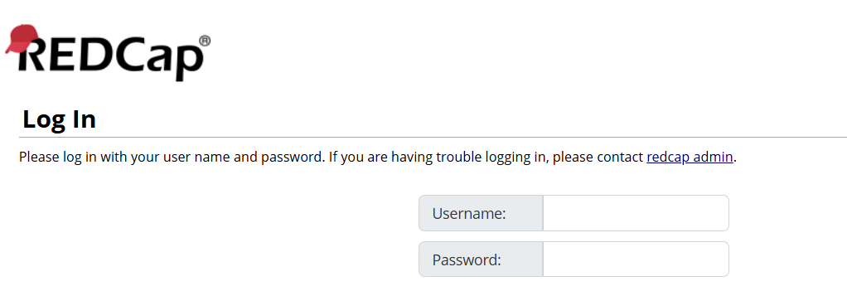
REDCap Access
  Since this is a new data form, we will need to know who from your Hospital QI Team will need access to the Data Form
  Thank you to ALL the teams that have already signed up staff to access form
  See the link in the chat to fill out the survey
24

Slide 27


Data Form Sections
Structure Measures
(new measures to support your work included)
Process Measures
Outcome Measures
Social Determinants of Health
Patient Partners
Respectful Care Breakfasts

Slide 28
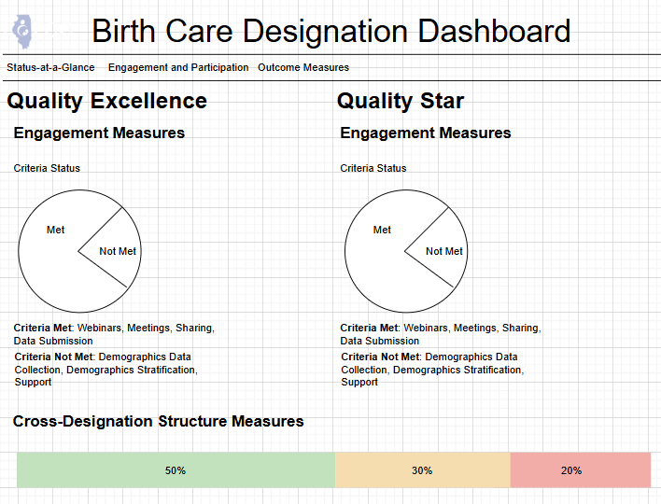
COMING SOON:
Birth Quality Designation Data Dashboard
  ILPQC is in the process of creating a data dashboard to track your hospital’s progress towards designation
  You will be able to track all measures in once place through your RedCap Reports
Birth Quality Designation Dashboard
Birth Quality Excellence
Birth Quality
  Mock-up of Dashboard Status at a glance
Illinois Perinatal Quality Collaborative
11

Slide 29
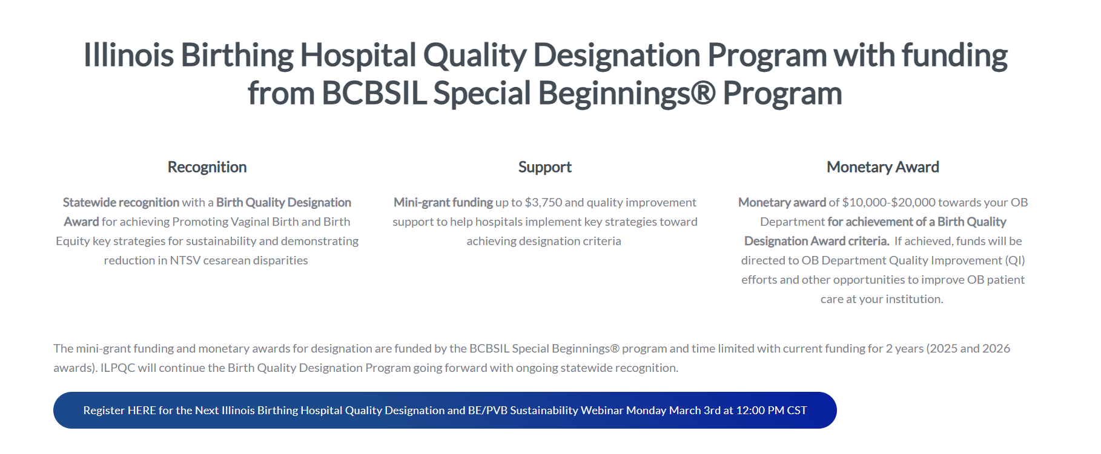
Check out the Birth Quality
Designation Webpage to stay up to date!
https://ilpqc.org/designation/
21

Slide 30
Birth Quality Designation
Status Update
54
26
13
Mini grant applications submitted
January 2025 data forms submitted
Hospitals with access to new data form
40
40
PVB Sustainability Plans
BE Sustainability Plans
21

Slide 31
Next Steps to achieve Birth Quality Designation Awards

Slide 32









PATHWAY TO DESIGNATION
Attend Next Webinar
New Data Form REDCap Survey
Submit Monthly REDCap Data
Submit Mini Grant Application by April 1
Register for and attend the next Designation / BE Sustainability Webinar and ask for any help needed to achieve Quality Designation Awards!
If you have not done so yet, Submit the REDCap Survey to determine who will need access to new REDCap data form to submit sustainability data
Submit the monthly sustainability data form to track progress towards designation and key BE and PVB Sustainability Measures
Submit your mini grant application to receive money toward key QI activities
Sustainability Webinars are planned for
January
March (today!)
June
September
December

Slide 33
BE Sustainability – Sustaining key strategies and eliminating disparities

Slide 34


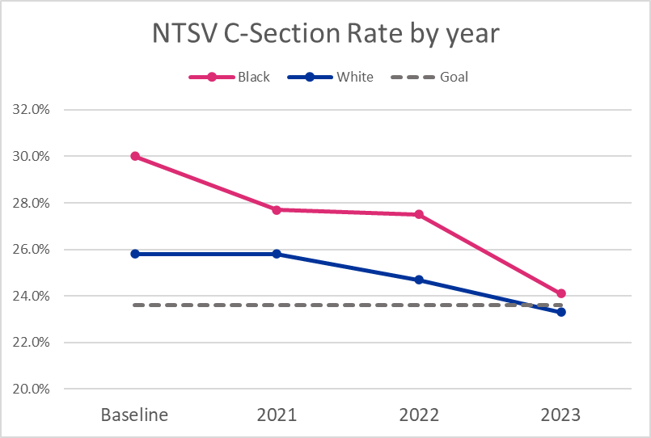




Reducing Disparities in NTSV C-Section Rates
Stratify the Data
Identify the Disparities​
Share stratified data with your clinical team and take action
Engage patient / community partners​ for input
Expand access to doulas and midwives
Improve shared decision making and respectful care
Notes:
Understand the Data
Identify the Disparities
Actively listen
Engage patient/community partners
Expand access to community doulas and improve shared decision making and respectful care
Connect your clinical team

Slide 35
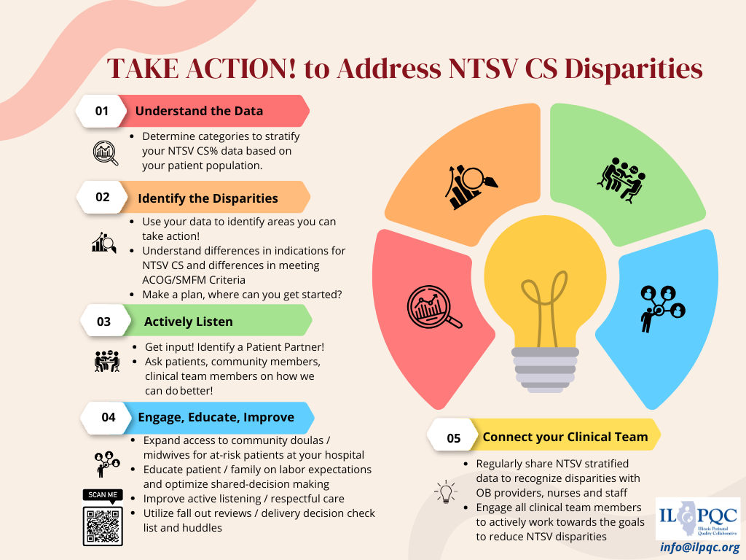

Slide 36
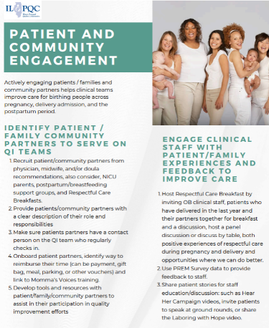
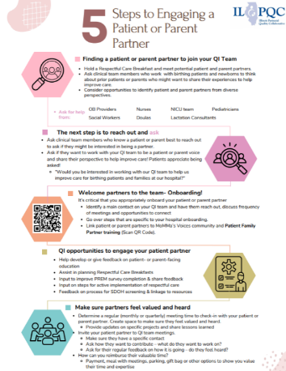
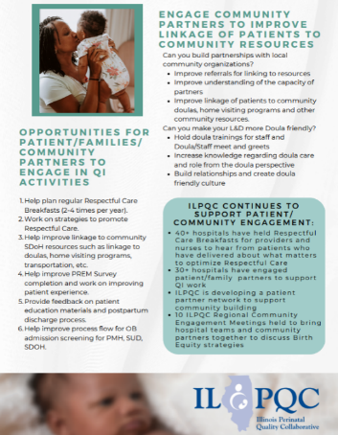

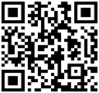
Resources to help identify and onboard a Patient or Parent Partner to work with your QI team
32 birthing hospitals now have patient partners on QI team!
Find more support for patient partner engagement through the MoMMA’s Voices organization
ILPQC Birth Equity Toolkit
Notes:
Can we add a QR code for MoMMa’s Voices:

Slide 37
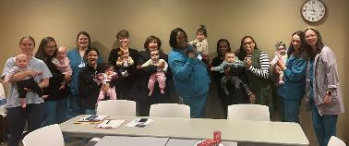





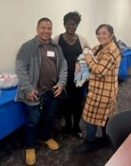
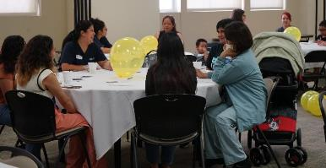
Respectful Care Breakfasts Across IL completed by 41 Hospitals
“Really appreciate the opportunity to discuss my experiences and how open the staff were to patient feedback.”
-Patient
“I felt like caregivers genuinely cared for the feedback and wanted to know how they can improve.”
-Patient

Slide 38
ILPQC Hospital Team Data Submission
Structure Measures​ | Baseline (% In Place)​ | December 2024 (% In Place)​
SDOH Screening (L&D)​ | 17%​ | 100%​
Optimize Accurate Self-Reported ​ Race and Ethnicity Data Collection​ | 7%​ | 96%​
Review Maternal QI Data Stratified by Race, Ethnicity & Insurance | 6% | 95%​
Engage Patients and Community ​ in QI Work​ | 4%​ | 80%​
Sharing Respectful Care Strategies with Healthcare Team and Patients​ | 9%​ | 98%​
PREM Implementation​ | 9%​ | 98%​
Postpartum Safety Patient Education​ | 54%​ | 98%

Slide 39
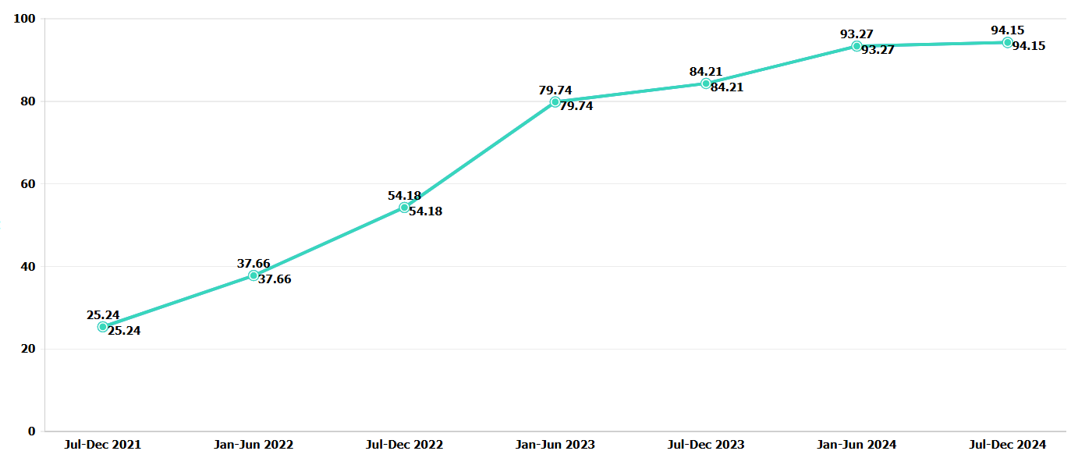
SDOH Screening and Linkage to Resources
SDOH Screening on Delivery Admission

Slide 40
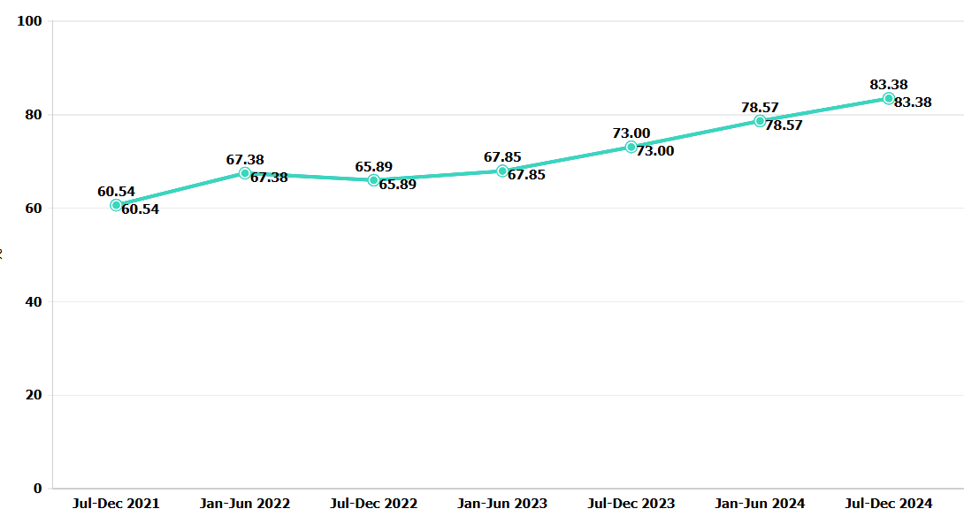
SDOH Screening and Linkage to Resources
SDOH Linkage to Resources on Delivery Admission

Slide 41
Birth Equity Sustainability Team Talk:
Northwestern Medicine Kishwaukee Hospital
Angela Kennedy BSN, RNC-EFM - Clinical Shift Coordinator
Kelly Densberger BSN, RNC-CLC, CBC​ - Outcomes Coordinator

Slide 42
Northwestern Medicine Kishwaukee Hospital
OB Birth Equity
Presented to: ILPQC
Presented on: March 3, 2025, 2024
Presented by: Angela Kennedy BSN, RNC-EFM and
Kelly Densberger BSN, RNC-CLC, CBC

Slide 43
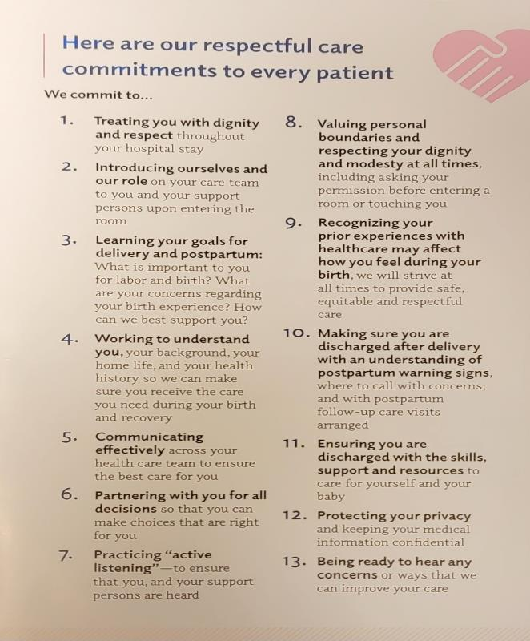
NM KH OB Birth Equity - BE
Respectful Care Commitments / Education
“Our Respectful Care Commitments to Every Patient” will be posted in all patient rooms.
Respectful Care information will be included in patient folders.
All OB staff and physicians have signed a copy of Our Respectful Care Commitments.

Slide 44

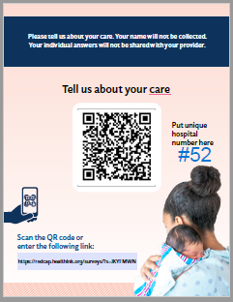
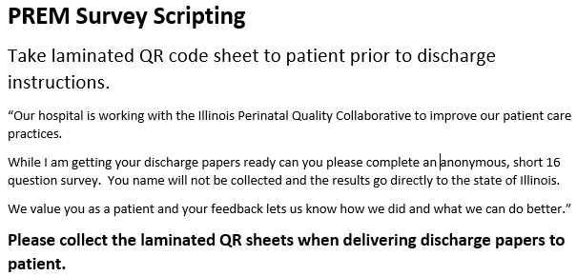
NM KH OB Birth Equity - BE
Patient Reported Experience Measure (PREM) Survey
Tell us about your care
All delivered patients are asked to complete the PREM survey on the day of discharge.
CSC, lactation nurse, or discharge nurse will bring laminated PREM survey to patient prior to patient receiving discharge instruction.
We worked with IT to get 2 iPads access to the link so we can provide the iPad for the survey.
Sample scripting to encourage patients to participate in survey.

Slide 45

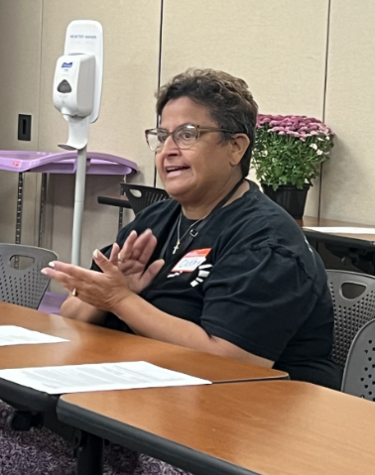
NM KH OB Birth Equity - BE
Birth Equity Team
We identified a Patient Partner who attends our monthly committee meetings.
We identified a Community Partner through our local Doula program for ongoing engagement with our QI team.
Included a Case Management / Social Worker in our Birth Equity Committee.

Slide 46

NM KH OB Birth Equity - BE
Brightpoint Doula Program
Our Community Partner is the Doula Program Supervisor with Brightpoint.
Our Doula partner attends our monthly committee meetings and has had input with our Tower of Power and Comfort Menu.
We are beginning work with our physician offices to get Brightpoint information to the patients early in the prenatal period.
If L&D staff identify a patient that comes in labor without support Brightpoint has an on-call Doula who will assist if they are available.

Slide 47

NM KH OB Birth Equity - BE
NM Kishwaukee Hospital Resource Folder
Social Determinants of Health (SDOH)

Slide 48
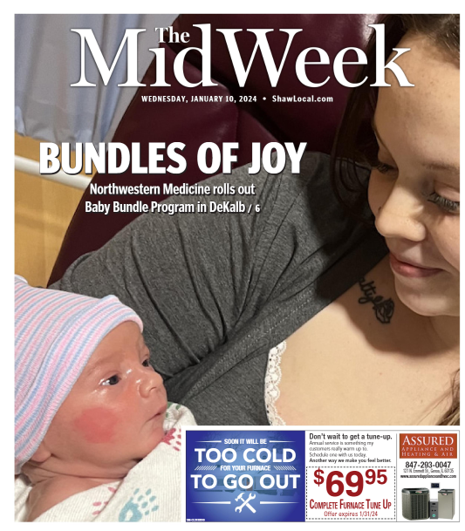
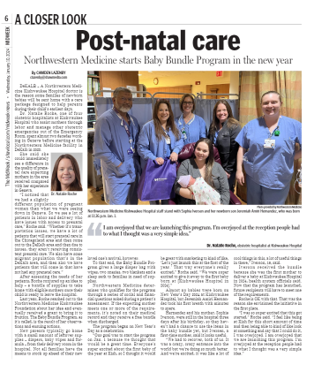
NM KH OB Birth Equity - BE
NM Kishwaukee Hospital Baby Bundle Program
Patients with a positive SDOH screening receive a Baby Bundle

Slide 49

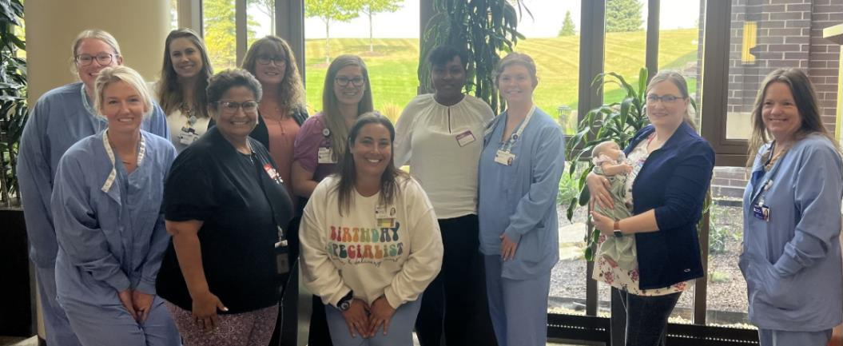
NM KH OB Birth Equity - BE
Hosted our first Respectful Care Breakfast
  Attended by our Patient Partner and our Community Doula Partner.

Slide 50
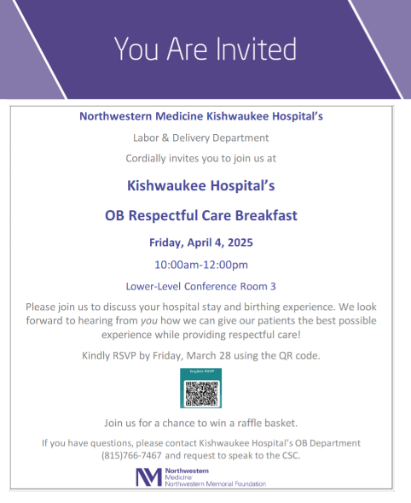

NM KH OB Birth Equity - BE
Next Steps…
Planning our next Respectful Care Breakfast for Friday April 4th

Slide 51
Questions?
Thank You.

Slide 52


Registration is OPEN!
2025 OB & Neonatal
Face-to-Face Meetings
OB TEAMS:
at the President Abraham Lincoln Doubletree Hotel
in Springfield, IL
Calling ALL Perinatal Leaders, Providers, Nurses, Advocates, & Friends!
MAY 21st, 2025
NEONATAL TEAMS:
MAY 22nd, 2025
Join us for an interactive day of collaborative learning with the ILPQC initiative!

Slide 53








ILPQC/DHS Bedside Nurse Scholarship Opportunity Coming Soon!
Each ILPQC hospital can send 1 bedside nurse to each day of event.
Opportunity to introduce NEW nurses to ILPQC and QI.
Discounted registration & 1-night hotel stay provided.
More details to come.

Slide 54


ILPQC Patient Partner Opportunity, in partnership with DHS
Coming Soon!
All ILPQC Patient Partners working with an ILPQC hospital QI team are invited to attend.
FREE Registration and 1-night Hotel stay will be provided.
More details to come.

Slide 55
Face-to-Face Reminders
February 28th- March 31st: Early Bird Registration
April 1st –May 13th: Regular Registration
March 21st: Nurse Scholarship Applications due
April 19th: All data due for Award Consideration
April 29th: Hotel Room Block Closes
May 21st and 22nd: Bring your storyboards to Springfield for our in-person Face-to-Face Meetings (More info and templates to come!)

Slide 56




















Thank you to our Funders:
Supporters:
39
Notes:
35

