Slide 1
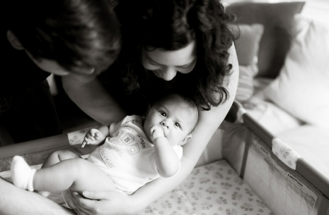
Equity and Safe Sleep for Infants Building Relationships with Community Organizations
February 17th, 2025, 2:00 PM

Slide 2
Overview
Face-to-Face Conference and ESSI “On the Path to QI Excellence” Award
ESSI Initiative Aims and Progress Overview
Building Relationships with Community Organizations
Community Corner: All about WIC
Team Talk: Mount Sinai

Slide 3
Attendance Poll
Please fill out the poll so that we can track hospital team attendance for ESSI Webinars. If unable to complete poll, please email kmoreno@northshore.org

Slide 4
Face-to-Face Conference

Slide 5
Registration and Hotel Block Opening 2/28
Time: 9 am – 4 pm
Time: 9 am – 3:45 pm
Make sure at least one physician champion, one nurse champion, and a patient partner attend to represent your hospital.

Slide 6
ILPQC/DHS Bedside Nurse Scholarship Opportunity Coming Soon!
Each ILPQC hospital can send 1 bedside nurse to each day of event.
Opportunity to introduce NEW nurses to ILPQC and QI.
Discounted registration & 1-night hotel stay provided.
More details to come.

Slide 7
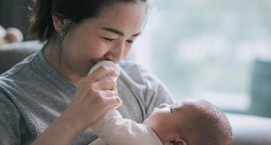
ILPQC Patient Partner Opportunity, in partnership with DHS
Coming Soon!
All ILPQC Patient Partners working with an ILPQC hospital are invited to attend.
FREE Registration and 1-night Hotel stay will be provided.
More details to come.

Slide 8
2025 Face-to-Face Planning Committee Volunteers
Great opportunity to collaborate, contribute ideas, and help shape a meaningful event.
Whether you’ve been involved before or this is your first time, we’d love to welcome new voices and fresh perspectives to the committee.
Interested? Email info@ilpqc.org

Slide 9
2025 Face-to-Face ILPQC Partner Tables
Want to share your organization's resources with the ILPQC teams?
Want to engage directly with attendees, foster relationships and collaborate with attendees?
Interested? Email info@ilpqc.org

Slide 10
ESSI “On the Path to QI Excellence”
Face to Face:
Hospital and individual-level data submission through end of March.

Slide 11
Structure Measure | In Place
Standardized physician, non-physician clinician, and hospital staff education about listening to parents and caregivers, providing respectful care and building trust, addressing implicit bias and engaging in anti-racism
Standardized physician, non-physician clinician, and hospital staff education about the importance of a safe sleep environment and engaging in meaningful, culturally appropriate, respectful, nonjudgmental conversations with parents or caregivers about safe sleep
Hospital has a policy in place for safe sleep practices reflective of the 2022 AAP Recommendations.
Hospital has a standardized process to use qualified language interpreters in parents/caregivers’ preferred language.
Hospital has a standardized process for reviewing all unit policies with an equity lens and making necessary changes.
Hospital has parent(s) and/or caregiver(s) on the newborn quality improvement team
Hospital has a standardized process to provide resources to enable a safe sleep environment outside of the hospital.
Hospital has a standardized process to screen for newborn inclusive Social Determinants of Health and to link to needed resources
6 out of 8 structure measures in place

Slide 12
Sleep Environment Audit | On the Path to QI Excellence
% of infants on Postpartum unit in safe sleep environment | 80%
% of infants on Special Care Nursery or NICU audited in safe sleep environment | 80%
Education Measures | On the Path to QI Excellence
% physicians and nurses completing education about listening to parents and caregivers providing respectful care and building trust addressing implicit bias and engaging in anti-racism | 70%
% physicians and nurses completing education about the importance of safe sleep and how to effectively educate parents or caregivers. | 70%
ESSI Bundle | On the Path to QI Excellence
Percentage of charts audited where there is documentation of SDOH screening and linkage if needed | 70%

Slide 13
Need QI Support for ESSI?
Contact
kmoreno@northshore.org and arivera@northshore.org

Slide 14
ESSI Initiative Aims and Progress Overview

Slide 15
ESSI Initiative Aims
1
By December 2025, greater than 70% of Illinois birthing and children’s hospitals will address disparities and promote neonatal equity by actively participating in the ESSI initiative.​
2
By December 2025, greater than 80% of infants will be discharged from ILPQC hospitals with a completed ESSI Bundle.
Parents or caregivers report an understanding of a safe sleep environment.
AWARENESS
READINESS
Family is prepared for a transition to home, including SDoH screening and resource linkage.
TRANSFER OF CARE
Communication to primary care provider completed.

Slide 16
Key Driver Diagram
Aims
Primary Drivers
Secondary Drivers
By December 2025:
1. Greater than 70% of Illinois birthing and children’s hospitals will address disparities and promote neonatal equity by actively participating in the ESSI initiative.
2. Greater than 80% of infants will be discharged from ILPQC hospitals with a completed ESSI bundle.
Healthcare Professional Commitment
Equitable and Respectful Care Education and Implementation
Safe Sleep Environment Education and Implementation
Inclusive Clinical Environment
Organizational Leadership Commitment
Equitable and Inclusive Unit Policies
Parent and Caregiver Experience Prioritization
Parent and Caregiver Empowerment
Respectful Parent and Caregiver Partnerships
Safe Sleep Awareness
Transition to Home, including SDoH Screening and Resource Linkage
4
Community
Partnerships
Resource Mapping
Building Relationships with Community Organizations
Transfer of Care to Community Providers
Healthcare Data Utilization
Collection of Accurate Race and Ethnicity Data
Dissemination of Stratified Data
Application of Data to Address Inequities
Awareness: Parents or caregivers report an understanding of a safe sleep environment, including navigating challenges to safe sleep at home
Readiness: Family is prepared for a transition to home, including SDoH screening and resource linkage
Transfer of Care: ESSI Newborn Care Plan (Awareness & Readiness) documented in the discharge
ESSI Bundle:

Slide 17
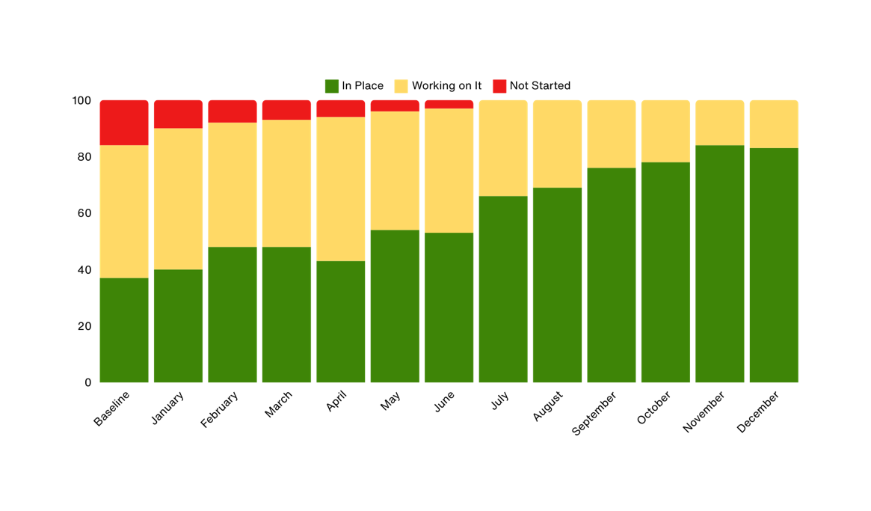
Standardized Provider and Hospital Staff Implicit Bias Education
% of hospitals
Hospital has standardized provider and hospital staff education about listening to parents and caregivers, providing respectful care and building trust, addressing implicit bias and engaging in anti-racism.

Slide 18
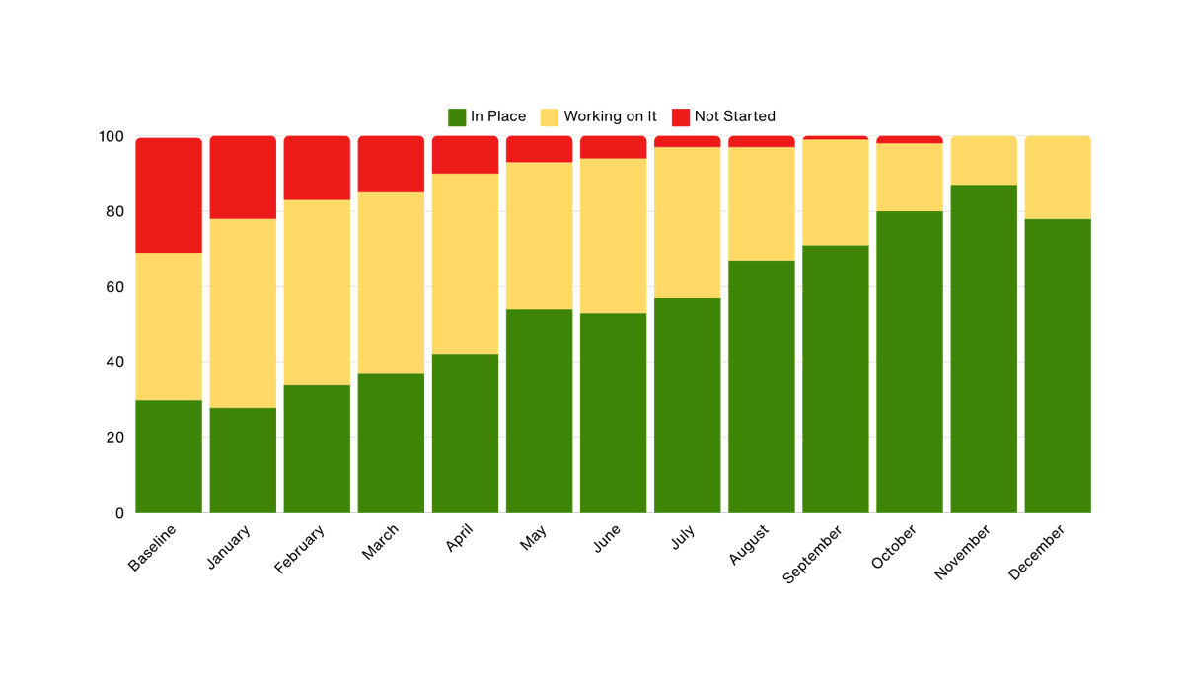
Standardized Safe Sleep Education​
% of hospitals
Hospital has standardized provider and hospital staff education about the importance of a safe sleep environment and engaging in meaningful, culturally appropriate, respectful, nonjudgmental conversations with parents or caregivers about safe sleep.

Slide 19
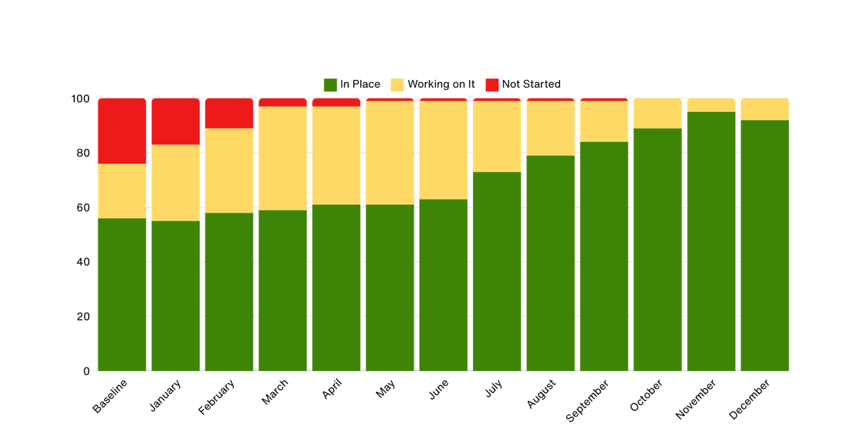
Standardized Practice of Promoting a Safe Sleep Environment​
% of hospitals
Hospital has a standardized practice of promoting a safe sleep environment in the hospital setting in accordance with the 2022 AAP Recommendations.

Slide 20
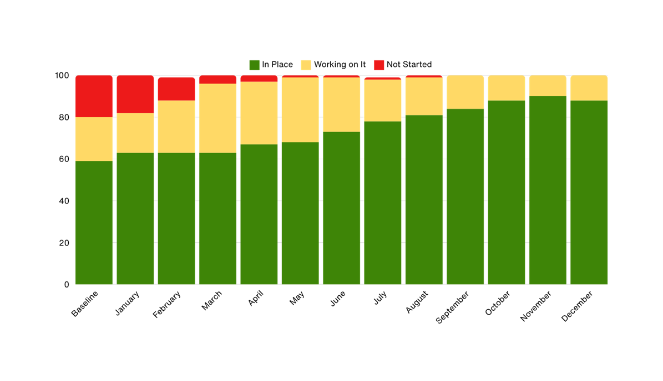
Safe Sleep Policy
% of hospitals
Hospital has a policy in place for safe sleep practices reflective of the 2022 AAP Recommendations.

Slide 21
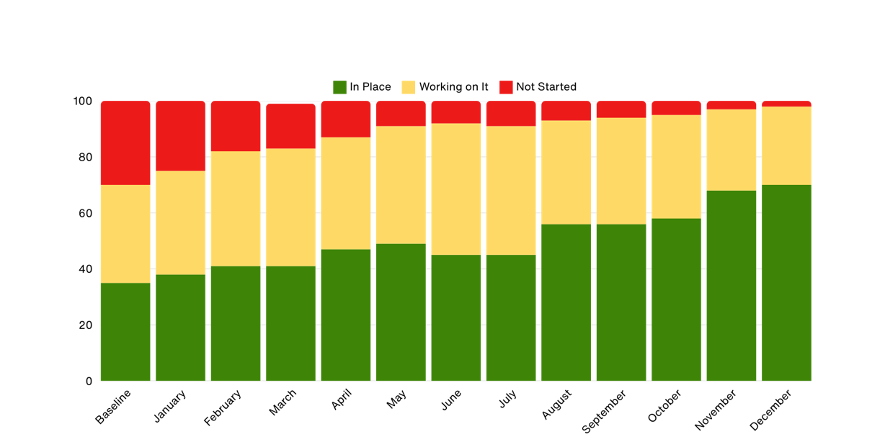
Safe Sleep Education to Parents
% of hospitals
Hospital has a standardized process to provide parents or caregivers culturally responsive safe sleep education including awareness of potential challenges, modeling, and teach back opportunities during hospitalization.

Slide 22
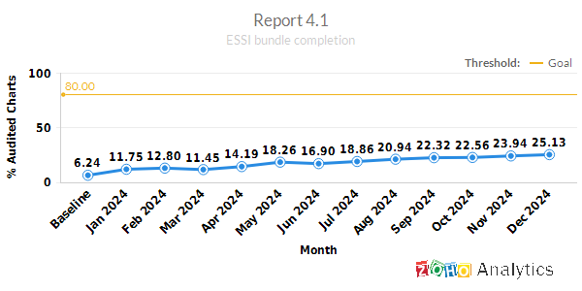
ESSI Bundle Completion Percent of charts audited that have a documented ESSI Bundle

Slide 23
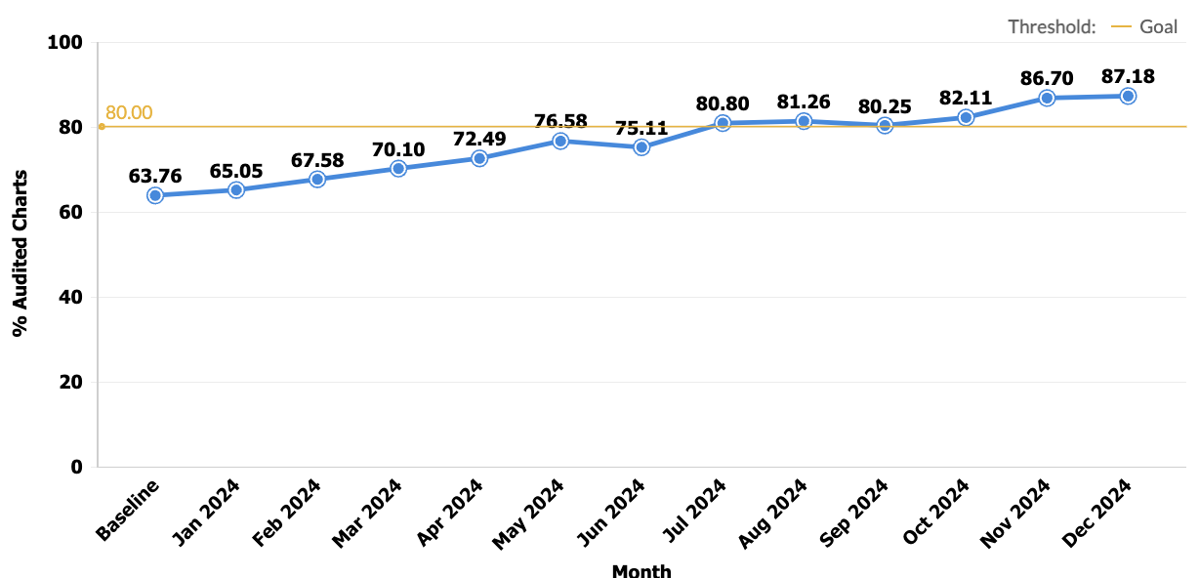
Parents or caregivers reporting an understanding of safe sleep​ Percentage of charts audited where a parent or caregiver reports an understanding of safe sleep​

Slide 24
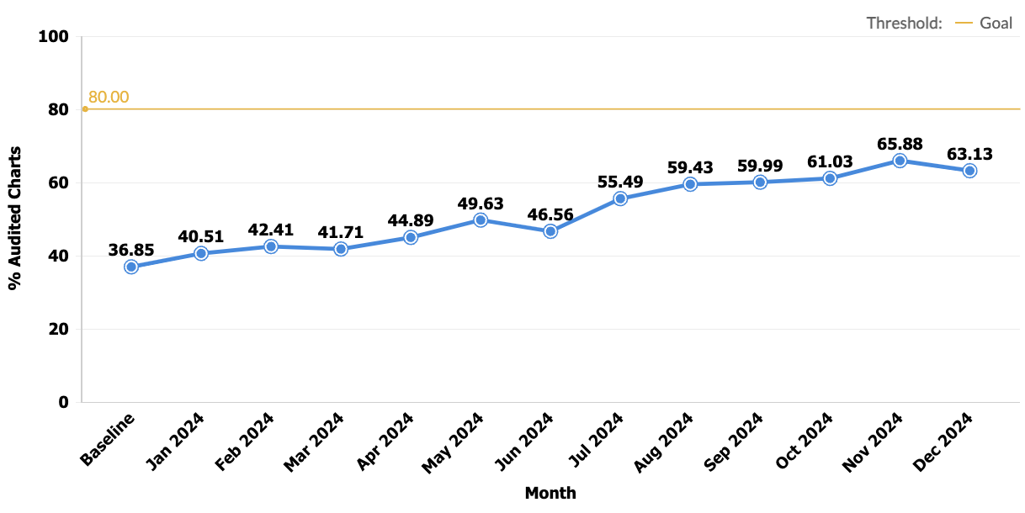
Documentation of a conversation with parents or caregivers about adjustment to life with a newborn and safe sleep, and resources shared Percentage of charts audited where there is documentation of a conversation about adjustment to life with a newborn and safe sleep​

Slide 25
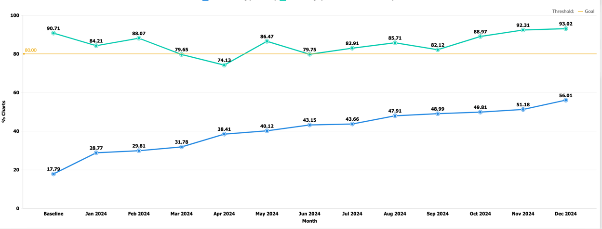
​ SDOH Screening and Linkage Documentation in Infant’s Chart​​ Percentage of charts audited where there is documentation of SDOH screening and linkage (if positive screen)

Slide 26
Building Relationships with Community Organizations

Slide 27
What is a Community-Based Organization (CBO)?
Community-based organizations are oftentimes non-profit organizations that work at the local level to provide services to the communities and specific target audiences which improve a community's health and well-being.
CBOs can include:
Food banks
Childcare centers
Churches
Libraries
Housing assistance organizations
And more!*
*Local Health Departments are often categorized as community-based organizations in that they provide the most basic public health services in a community.
Institute of State and Regional Affairs, Penn State Harrisburg. (2022). Pennsylvania’s Stigma Reduction Opioid Behavior Change Campaign, Data Briefs: Community Based Organizations. Sponsored by the Pennsylvania Department of Drug and Alcohol Programs.

Slide 28
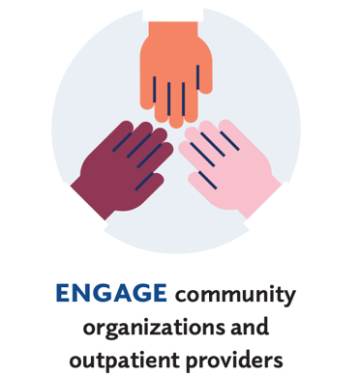
Your Role in the Community
All hospitals, regardless of type (non-teaching, for-profit, religious) play an integral role in delivering care to all people in their community
… but the care should extend beyond the hospital walls
Is your hospital involved in the community it serves, or simply operating within that space?

Slide 29
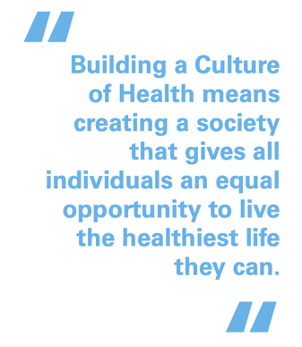
The Importance of Hospital-Community Partnerships
Hospital community partnerships address the health of the individual and the community.
Consider the following:
How can a provider expect to follow-up with a family during well-child visits if that family doesn’t have access of transportation services?
How does one encourage safe sleep practices when a patient is experiencing homelessness or unstable housing?
As a healthcare provider, you have an opportunity to provide linkage to additional resources and supports for the family you are providing care for.
American Hospital Association, “A Playbook for Fostering Hospital-Community Partnerships to Build a Culture of Health”

Slide 30
Benefits of Building Relationships with Community-Based Organizations
Understanding the needs and priorities of the community
Building capacity for both parties to serve the community in the best way possible
Sharing information, data, and resources to help align efforts
You are part of the community!

Slide 31
Building Community Relationships and the ESSI Bundle
Coordinating with organizations to align safe sleep messaging and modeling
Talking to organizations about ESSI to improve knowledge of initiative
AWARENESS
Connecting with organizations before discharge to provide resources for family
Understanding what service gaps are in the area you serve and bridging that gap
READINESS
Seamless communication and transition to community providers
Understanding capacity and availability of providers
TRANSFER OF CARE

Slide 32
Examples of CBO’s:
Federally Qualified Health Centers (FQHCs)
Daycare Centers
Faith-based Organizations
Coordinated Intake Programs
Local Health Departments
WIC
Community Councils

Slide 33
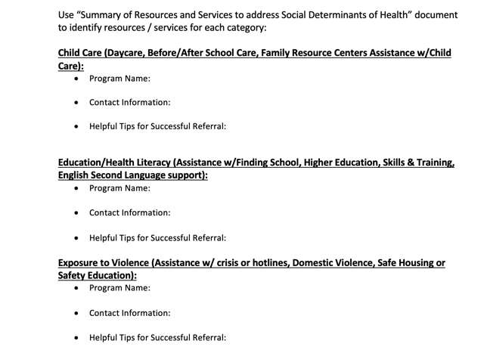
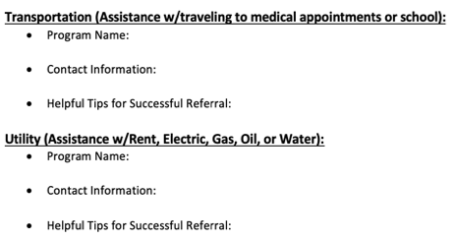
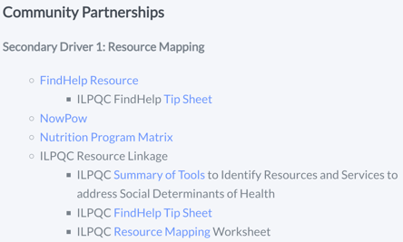
Remember November’s To-Do’s?

Slide 34
To-Do's:
Finish your resource map using the template provided by ILPQC
Identify at least one resource for each of the categories listed (e.g. food, transportation, housing)
Ensure your hospital’s resource list is reliable.
Is the phone number correct?
Are there limitations / restrictions around accessing resources?
Bonus*: Introduce yourself, your ESSI team member, and inquire about opportunities to engage with the organization (councils, advisory meetings, events)
If you’re having trouble resource-mapping or connecting with an organization, please contact kmoreno@northshore.org for additional assistance.

Slide 35
Community Corner: All about WIC
Stephanie Bess
Illinois WIC Director

Slide 36
Team Talk
Mathura Ananthan
Mount Sinai Chicago

Slide 37
Team Talk : Mount Sinai Hospital
Mathura Ananthan

Slide 38
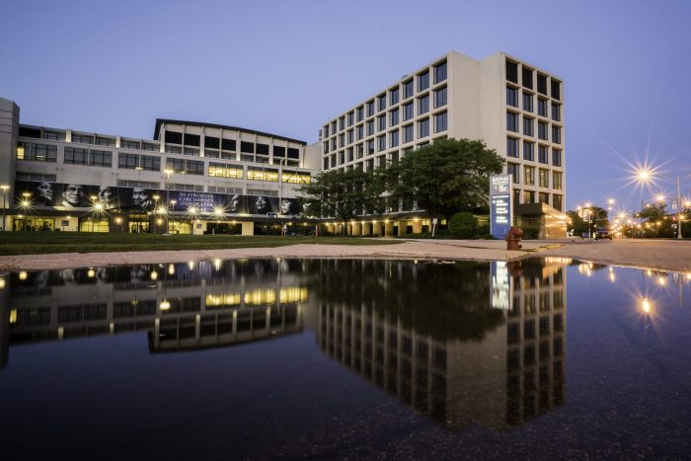
Address: 1500 S Fairfield Ave. Chicago, IL, 60608 Perinatal Level: 3 Perinatal Network: Rush/AIMMC Perinatal
One of the largest private healthcare Safety-Net systems in Illinois
Birth Volume: 1560 deliveries per year
14 Labor Delivery Rooms
2 C-section rooms
4 Triage Rooms
2 OR Suites
3 PACU Beds
19 Postpartum Room

Slide 39
Equity and Safe Sleep for Infants Initiative
Sinai’s Slogan “The cutest thing in the crib should only be your baby”

Slide 40
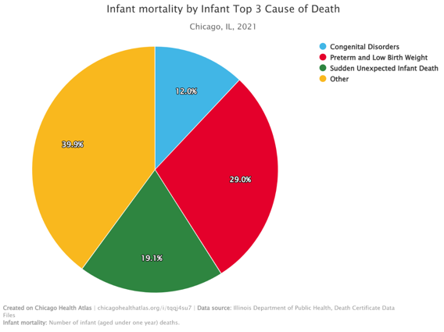
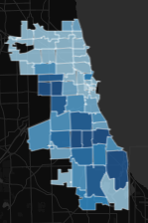
SUIDS are the second most common cause of death among Chicagoans < 1 year of age
60608
SUID
2 count of infants
Sudden Unexpected Infant Death (SUID) (chicagohealthatlas.org)

Slide 41
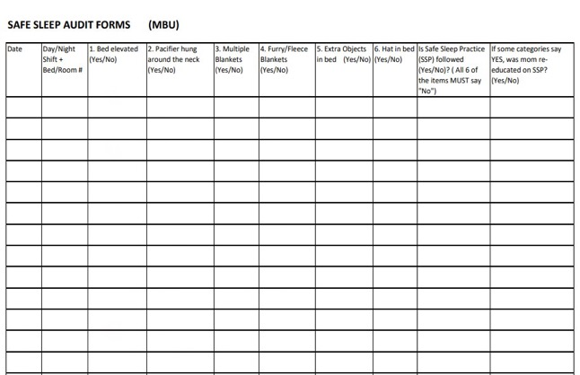
At Mount Sinai Hospital
We practice safe sleep protocols while infants are with us in the hospital ​
For 3 years in a row, we have maintained our National Gold Infant Safe Sleep Certification status through Cribs for Kids​
Every shift our nurses do audits of their patients to ensure safe sleep practices are being followed ​
Patient education
Crib Cards

Slide 42
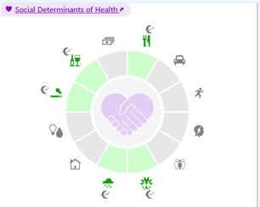
ESSI Launch & 2024 Successes
Provider, Nurse and Staff Education on ESSI and SoDH
- E-modules (May, June 2024)
-Live in-service learning (July 2024) in all 3 departments (MBU, L&D and NICU)
with 90.3% completion rate
Integration into EMR (EPIC)

Slide 43
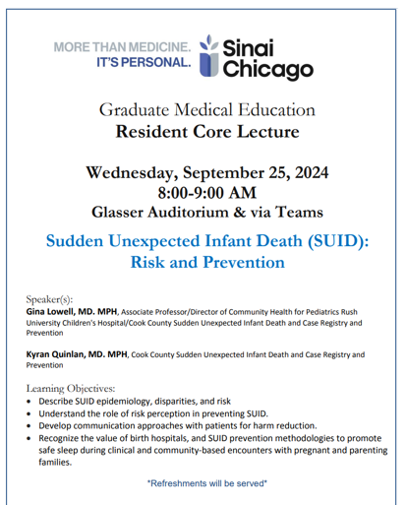
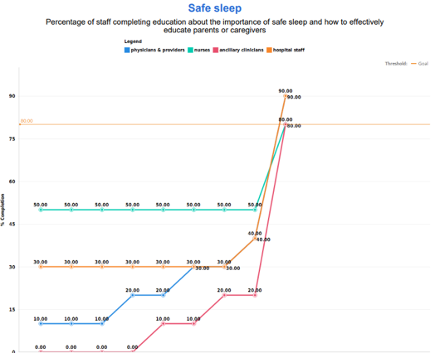
Provider Education

Slide 44
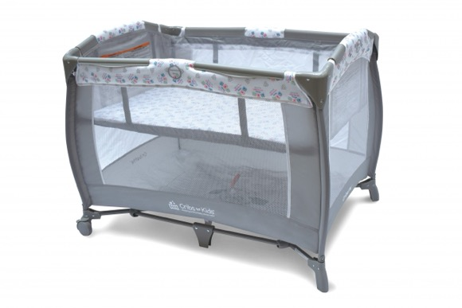
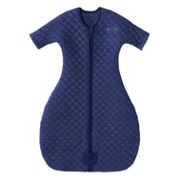
For the Community
IDPH: Baby-ZZZ Grant Safe Sleep Program IL
Resources -case management, cribettes,sleep sacs
Education
Community events

Slide 46
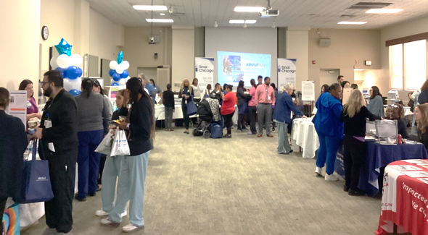
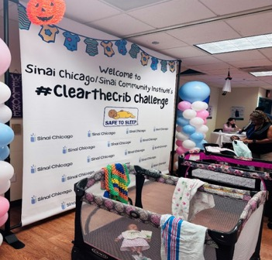
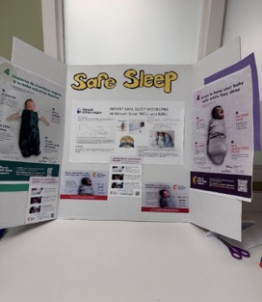
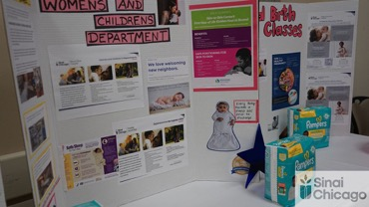
Patient & Community
Respectful Care Breakfast ESSI Focused Aug 8/24
May 2024 Sinai Wellness Fair
2023 Clear the Crib Challenge . Next one in Oct 2024

Slide 47
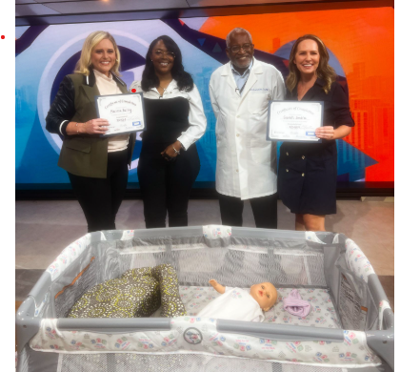
Dr. Charles Lampley (MFM) from Sinai joined WGN (local news) to spread awareness on SUID to community
https://wgntv.com/spotlight-chicago-sponsored-content/sudden-unexpected-infant-death-awareness-month/

Slide 48
ESSI QI Team members
Dr. Hari Srinivasan
Dr. Victoria Geraldo
Laura Griffith-Gilbert
Irene Cisneros
Connie Hernandez
Mathura Ananthan
Jerilynn Dixon-Sams
Cintia Alvarado-Soto
Frankie Delgado
Rowena De Leon
Lauran Skirvin
Yay!!! All of Sinai’s Structure Measures are In Place ☺

Slide 49
Announcements

Slide 50
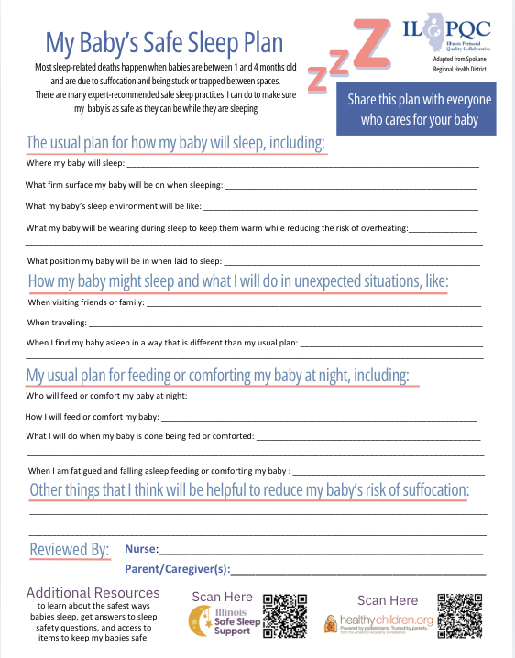
Coming Soon!* Safe Sleep Conversations Tip Sheet
Resource on conversation tips when facilitating safe sleep education and navigating difficult topics, including resources to consult and best practices.

Slide 51
MoMMA’s Voices is an organization dedicated to amplifying the voices of people who have experienced pregnancy or childbirth complications or loss, especially from individuals who have been historically marginalized.
Offers the following trainings and resources:
Patient Family Partner Certification
Lived Experience Integration Mini Course
Matchmaking services for parent voices
QI Community of Learning Webinars

Slide 52
Training Opportunity for You!
Get to green on engaging a parent partner as part of your QI Team.
This unique four-week program, featuring just one hour of live instruction each week, is designed to help healthcare providers better integrate patient family partners into their work to improve maternal care.
Register here .
ILPQC highly recommends that each hospital send a representative to attend to learn how to better engage a parent partner

Slide 53
Upcoming ESSI Calls
Date | Topic
March 17th, 2025 2:00 PM | Transfer of Care to Community Providers
April 21st, 2025 2:00 PM | ESSI Bundle and Pulling it Together

