Slide 1
Promoting Safe Sleep in Illinois Hospitals
Bryanne N Colvin, MD
Assistant Professor of Pediatrics, Division of Newborn Medicine​
Washington University in St. Louis School of Medicine
Christie Lawrence, DNP, RNC-NIC, APN/CNS ​
Cook County Birth Hospital Outreach Coordinator for the Cook County SUID Case Registry
Assistant Professor, Department of Women, Children & Family Nursing
Rush University College of Nursing
Gina Lowell, MD, MPH
Principal Investigator for the Cook County SUID Case Registry
Associate Professor, Department of Pediatrics, RUSH University Children’s Hospital

Slide 2


Cook County Case Registry and Prevention 2019-2022

Slide 3
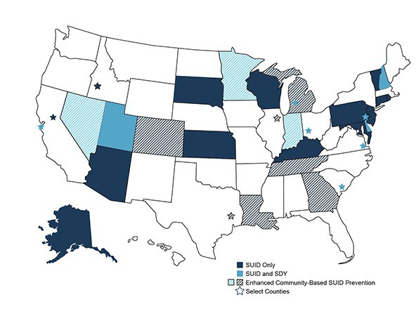
What is the SUID Case Registry?
CDC funds SUID surveillance in 32 states and jurisdictions, covering about 2 in 5 SUID cases in the United States.
SUID CRs build on child death review programs and use the National Center for Fatality Review and Prevention’s Case Reporting System, bringing together multidisciplinary information about the circumstances surrounding SUID cases.
Participating states and jurisdictions use data about SUID trends and circumstances to develop prevention approaches and strategies to reduce future infant deaths.
Cook County’s SUID Case Registry began in 2019
Description and map from: https://www.cdc.gov/sids/case-registry.htm

Slide 4

SUID Cook County Report 2019-2022

Slide 5
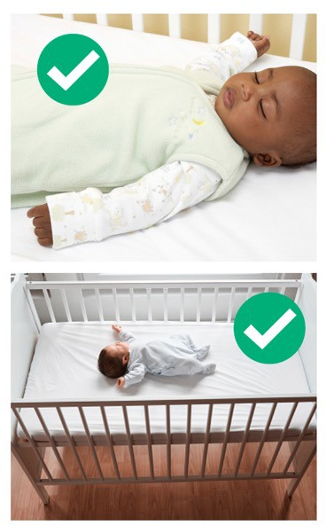
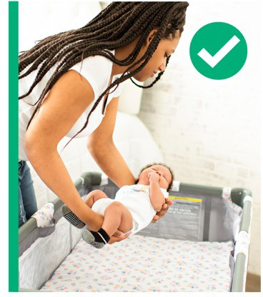
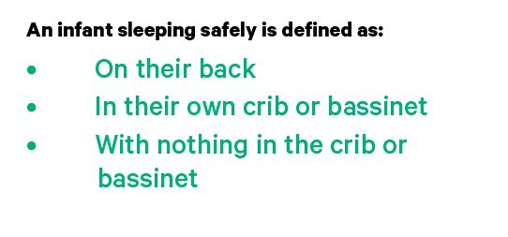
The Sleep Environment
SUID Cook County Report 2019-2022

Slide 6
Total deaths: 181
99%
Nearly all 173 sleep-related SUID occurred in an unsafe sleep environment.
Sleep related deaths: 173
Suffocation: 45
Unexplained: 128
SUID Cook County Case Registry: 2019-2022

Slide 7
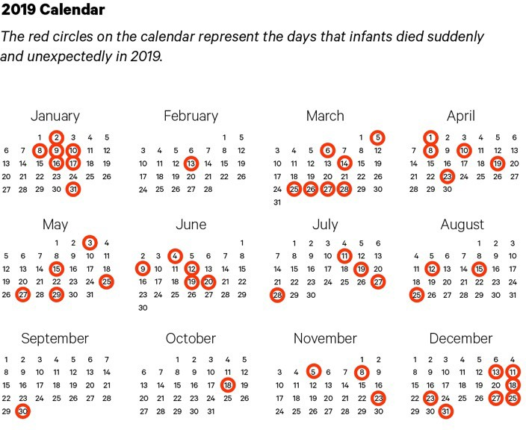
SUID Cook County Report 2019

Slide 8
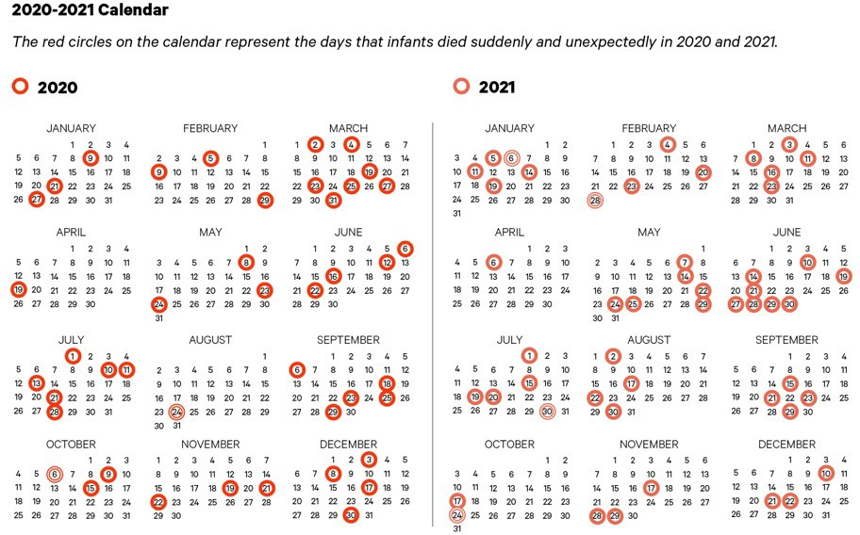
SUID Cook County Report 2020-2021

Slide 9
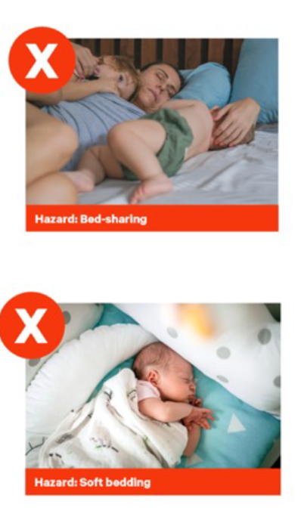
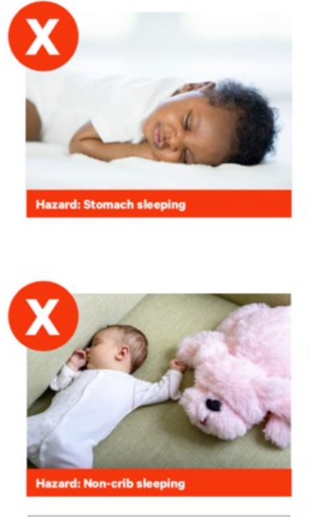
Sleep-related Infant Deaths (173)
42%
Or 72 infants were found on their stomach or side in their sleep space.
68%
Or 117 infants were sleeping with another person, increasing their risk of suffocation.
85%
Or 147 infants were found in places not approved for infant sleep.
91%
Or 158 infants were found with soft bedding in their sleep space.
Number of babies found in each location:
116
16
2
2
1
1
9
Adult beds Couches Inclined sleepers Carseats
Floor Futon Others
10 SUID occurred in ”baby lounger” products, such as Boppy loungers, Dock-a-Tot, Yoocaa and Snuggle Me loungers.
SUID Cook County Case Registry 2019-2022

Slide 10
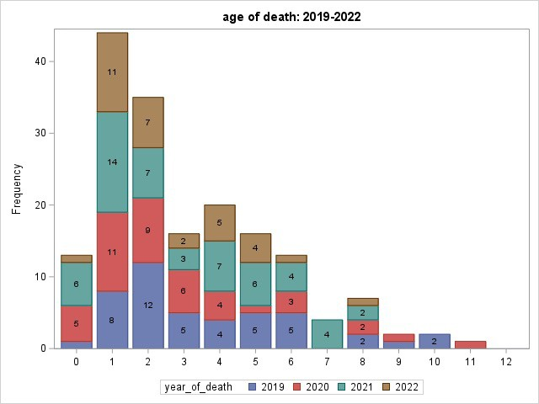
Sleep-related SUID by Age (months)
SUID Cook County Case Registry 2019-2022

Slide 11
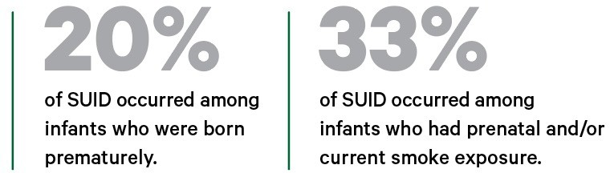
SUID Risk Factors
26%
of SUID occurred among infants who were born prematurely.
16%
of SUID occurred among infants who had prenatal and/or current smoke exposure.
SUID Cook County Case Registry 2019-2022

Slide 12
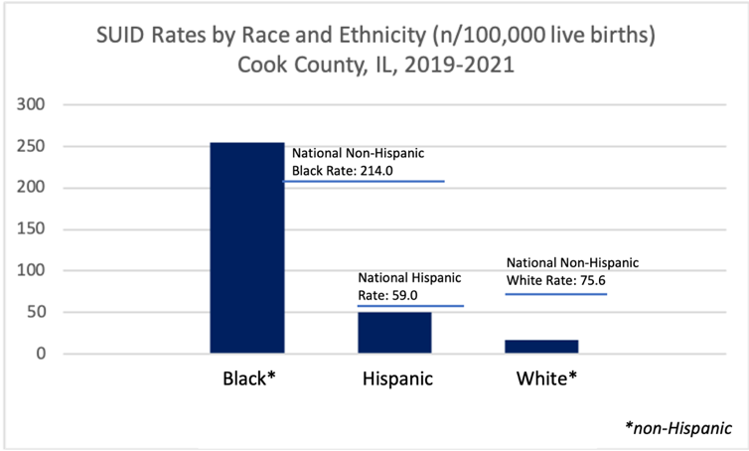
SUID Disparities
255
50
17
In Cook County from 2019-2021, Black infants died of SUID at 15 times the rate of White infants, and Hispanic infants died of SUID at 3 times the rate of White infants.
SUID Cook County Case Registry 2019-2021

Slide 13
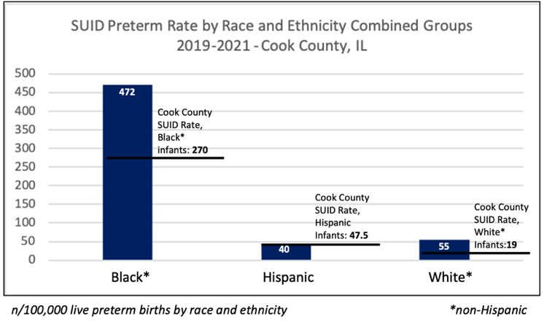
Preterm SUID
The rate of SUID for preterm Black infants in Cook County is
472 per 100,000 preterm births – or 1 in 212 preterm Black births
SUID Cook County Case Registry 2019-2021

Slide 14
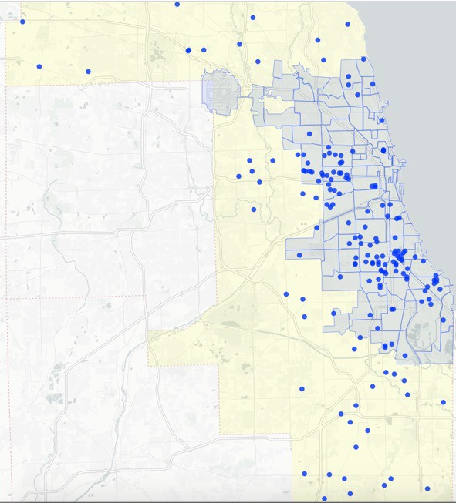
Sleep-related SUIDs of
Cook County, 2019-2021
(141)
Sleep-related SUID of Cook County, 2019-2022
(173)
SUID Cook County Case Registry 2019-2022

Slide 15
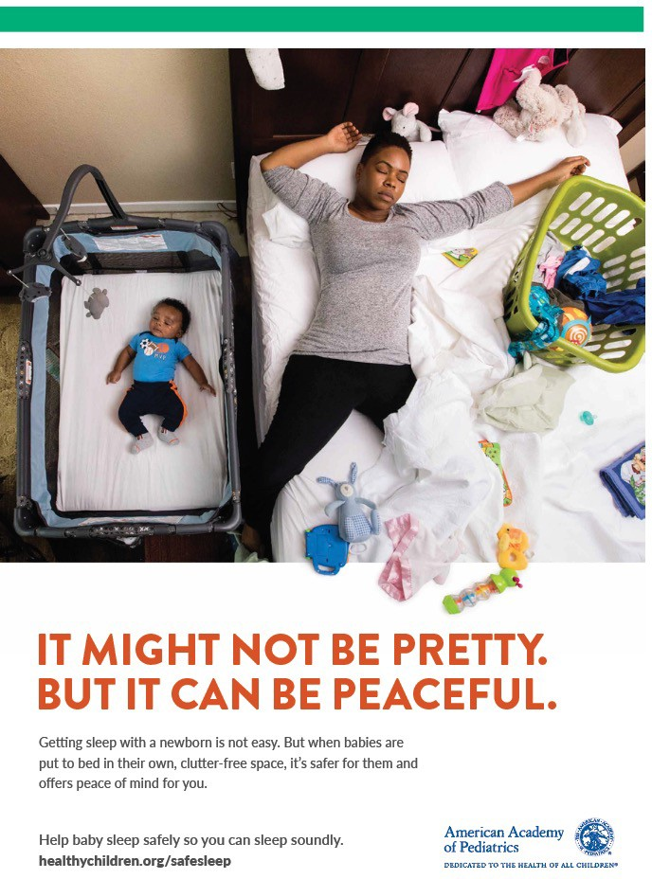
Towards Prevention
The health of a community that is home to an infant is part of the environment that may place an infant at risk for – or protect them from – SUID.
SUID prevention means addressing the root causes of health inequities – alongside promoting safe sleep approaches that work – to protect our infants, families and communities.
SUID Cook County Case Registry 2019-2022

Slide 16


Contributors
Kyran Quinlan MD, MPH Gina Lowell MD, MPH Abbey Mastroianni MPH Rojin Ahadi MPH
Felicia Clark D-ABMDI
Christie Lawrence DNP, RNC-NIC, APN/CNS Sumihiro Suzuki PhD
Eric Eason MD Michael Eckhardt MD
Meredith Reynolds MD
We extend our deepest gratitude to the 181 Cook County families who lost their treasured infants. Without their participation in the multiple investigations into the cause of their infants’ deaths, we would not have the ability to know more fully the circumstances of their deaths in order to better understand how to prevent them.
SUID Cook County Case Registry 2019-2022

Slide 17



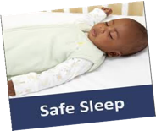



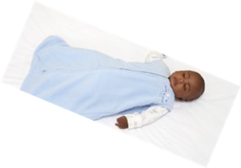
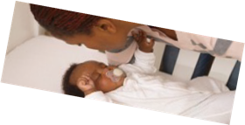






Preventing SUID:
Turning Data to Action with CPASS Chicago
CPASS CHICAGO SLEEPS SAFE!
COMMUNITY PARTNERSHIP APPROACHES FOR SAFE SLEEP
Felicia Clark D-ABMDI
Darren Harris, Center Director, Family Focus
Christie Lawrence DNP, RNC-NIC, APN/CNS
Gina Lowell MD, MPH, FAAP
Kyran Quinlan MD, MPH, FAAP

Slide 18
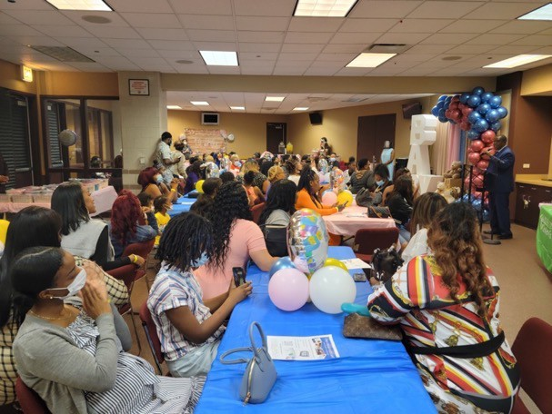



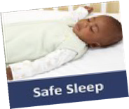

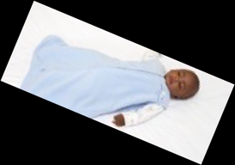
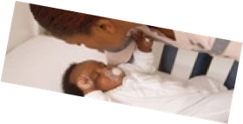











CPASS CHICAGO SLEEPS SAFE!
COMMUNITY PARTNERSHIP APPROACHES FOR SAFE SLEEP
In 2022, Community Partnership Approaches for Safe Sleep (CPASS), an initiative led by the American Academy of Pediatrics, the Injury Free Coalition for Kids, and Amazon, funded 5 children’s hospitals nationwide to partner with CBOs serving pregnant and parenting families to provide safe sleep kits and education in SUID-impacted communities.
CPASS Chicago began as a Family Focus-Rush partnership led by Felicia Clark and the Cook County SUID-CR team.
In 2023, CPASS Chicago expanded partnerships to include Chicago Birthworks Collective, Proviso Township Ministerial Alliance Network and Sinai Community Institute
Salem Baptist Church, Citywide Baby Shower, Roseland community, Chicago
Follow us on Instagram at cpasschicago

Slide 19
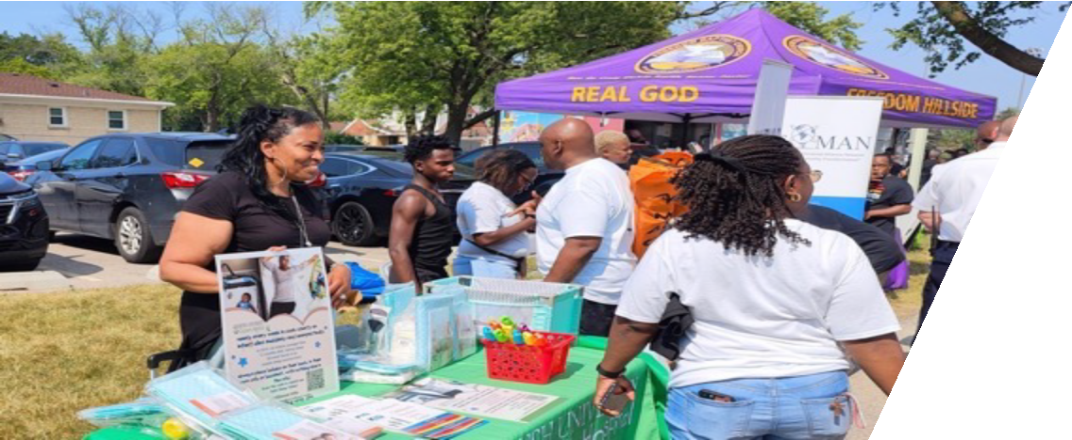
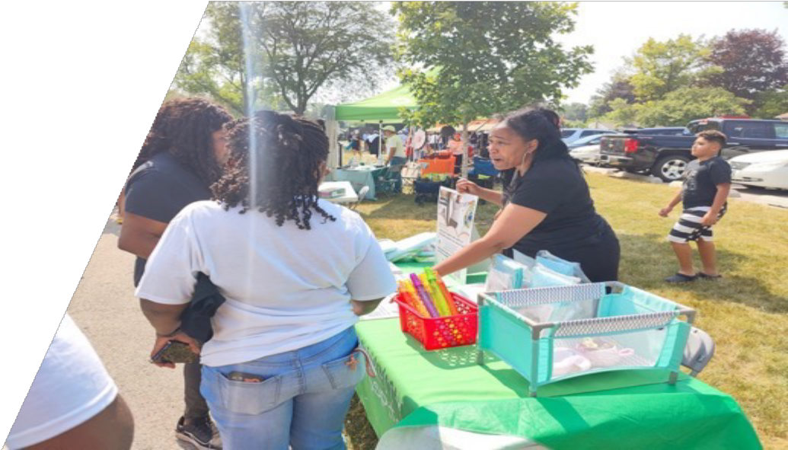

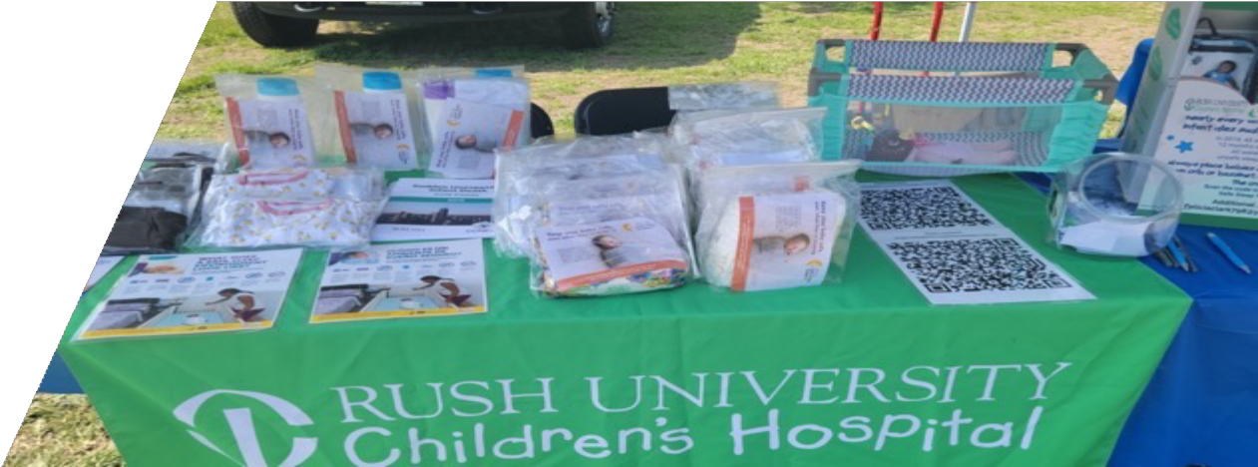

Slide 20
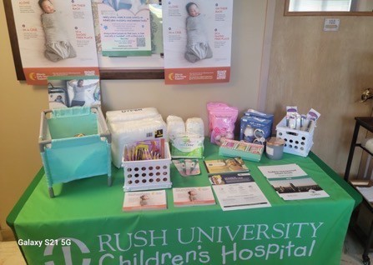
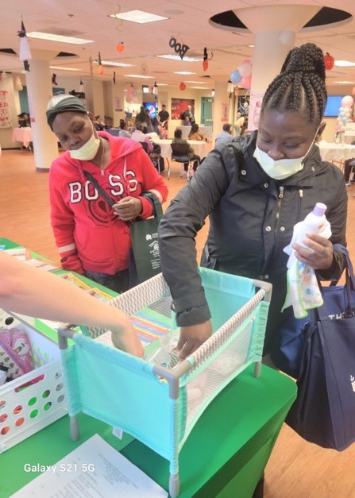
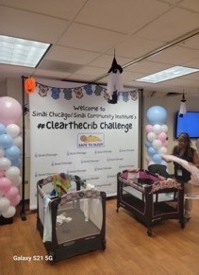
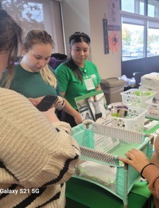

Slide 21
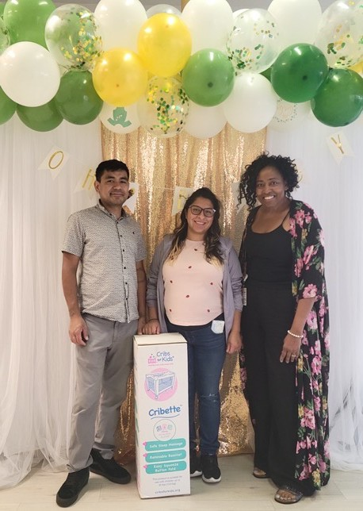
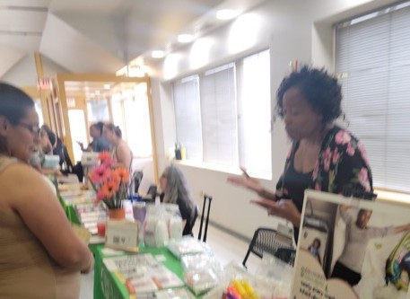
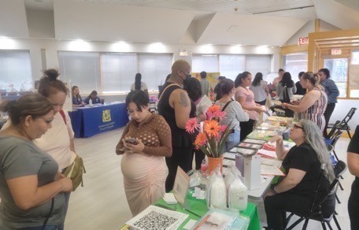

Slide 22
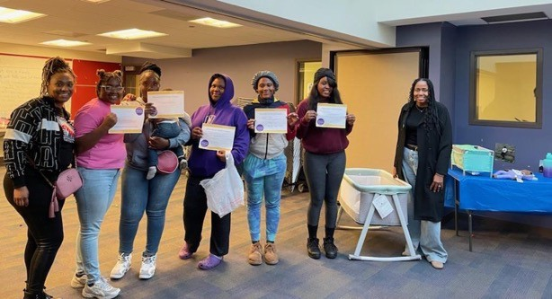
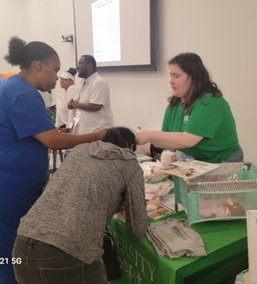
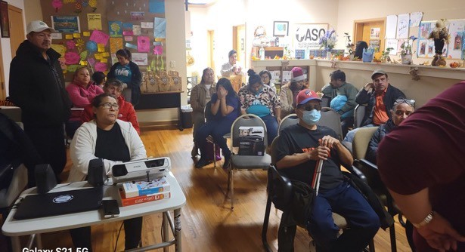
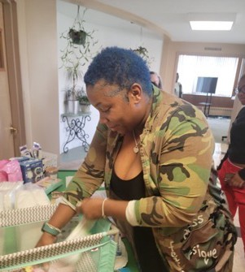

Slide 23
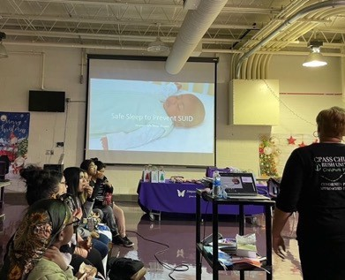
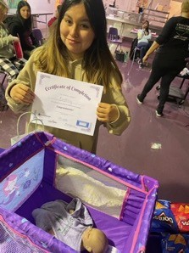

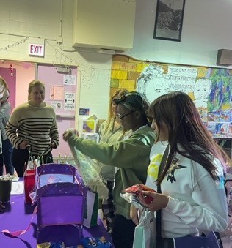

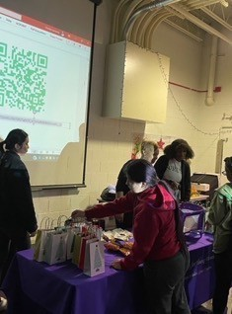

Slide 24
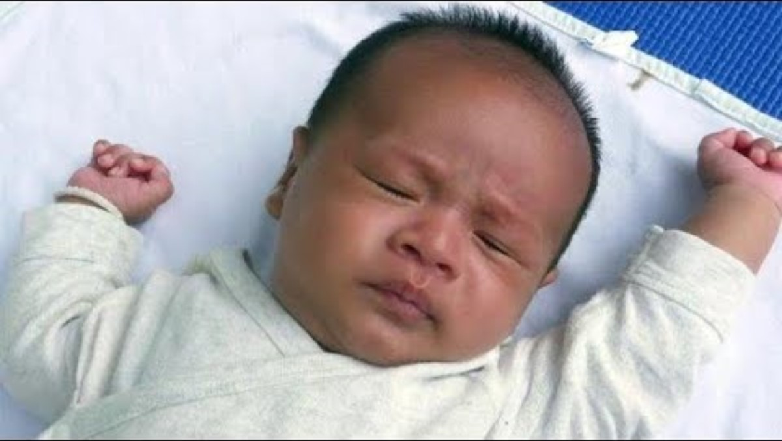
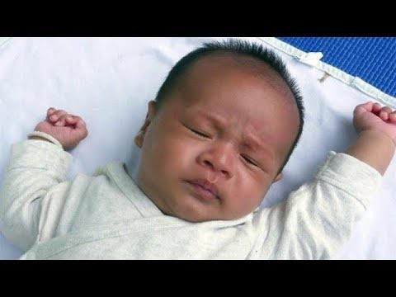

Safe Sleep Video

Slide 25
Scan to watch our safe sleep video
I thought it was very informative. I didn't know this was common within our community amongst my demographic
Being a first time mom when the lady said “you would never think it’ll happen to you until it does” it stuck out to me. Preparation is key! Having a crib for my baby is the safest option
I feel as though the safe sleep video is extremely helpful because I’m able to hear the point of view from a parent who has lost her child due to unsafe sleeping. This video has now alerted me on what not to do with my baby and how I can avoid unsafe sleeping.
I feel that’s good to know I am a new mother and that’s something I needed to understand that baby sleeps in own crib I have lost a nephew due to SIDS
The video was very helpful im a first time mom and actually planned on sleeping with my baby in my bed but now that I see the video I see that its not safe helped me a lot to understand the danger of sleeping with my baby thank you
As a first time mom, I am very concerned with keeping my child safe. To realize that black infants have a higher rate of dying by sleeping with adults is eye opening. This has opened my eyes to how important it is to have my child sleep in her own bed when she arrives.
It kinda made me sad and cry a little bit , mainly because I never knew some of the things they were saying! And unfortunately my daughter sleeps with me! Now it has me a little scared and worried
This video is very informative, growing up babies slept with family members, I wanna break that cycle, I want my baby to have a baby bed for safety most of all
Scan to watch our safe sleep video
Parent reflections*
*selected from 170 responses

Slide 26
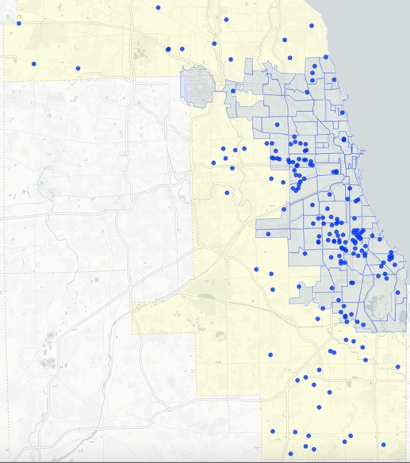
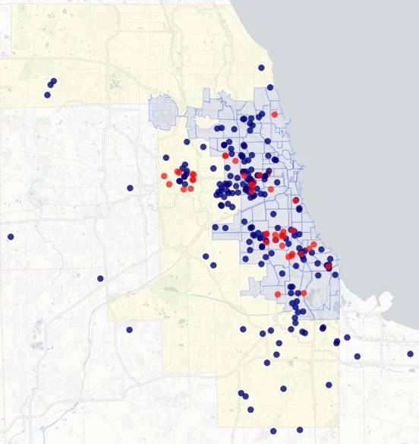
Community baby showers
CPASS 2022
Cribette Distribution
Outreach
Events
Home Visiting and Doula
Senior Living Centers
Community resource fairs
Barbershops and Nail Salons
Churches
Community festivals
Back to school events
Sleep-related SUID of Cook County, 2019-2021
(141)
Community health fairs
CPASS CHICAGO 2022
Reaching Cook County’s Most Impacted Communities

Slide 27
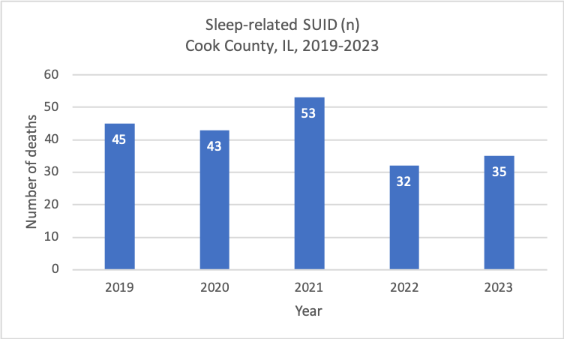

Slide 28



DHS Webinars MIECHV CI-Cicero FHQC Networks
Child Death Review Teams Pediatric Residency Programs
Grand Rounds
CHHRGE
CHW Teams
Building Awareness: Cook County SUID Report Dissemination
CDPH Family Connects Chicago CDPH C3 Conference
Chicago Health Atlas CCDPH APORS
IDPH OWH
ILPQC
Health and Human Services
Public Health
CBP Teams Shelter Staff
Sudden Unexpected Infant Death
Cook County Report 2020-2021
2020-2021
Maternal Child Health Stakeholders
SUID
Prevention Advocates
CDC
FIMR Chicago
Injury Free Coalition for Kids
Prevcon
ISPID
ICAAP
Everthrive IL
March of Dimes Collective Impact Home Visiting/Doula Network Chicago Birthworks Collective Sinai Community Institute OCCN Illinois Action for Children
Erikson Institute/Fussy Baby Network BRIDGES

Slide 29
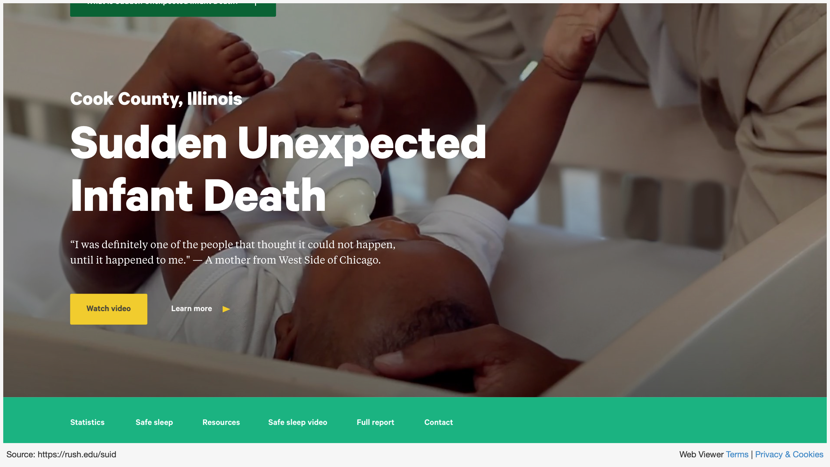

Slide 30
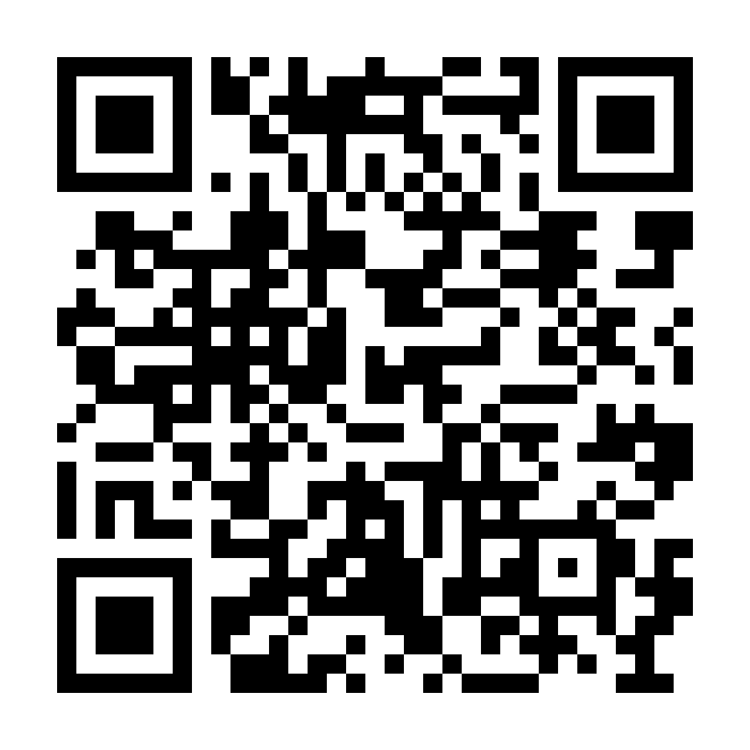







Contact Us!
Find us at rush.edu/suid
CPASS CHICAGO SLEEPS SAFE!
COMMUNITY PARTNERSHIP APPROACHES FOR SAFE SLEEP
Sudden Unexpected Infant Death
Cook County Report 2020-2021
2020-2021
Rojin Ahadi: seyedeh_r_ahadi@rush.edu Felicia Clark: feliciaclark798@yahoo.com Christie Lawrence: christie_lawrence@rush.edu Gina Lowell: gina_lowell@rush.edu
Kyran Quinlan: quinlan.kyran@gmail.com
THANK YOU!
Follow us on Instagram at cpasschicago

Slide 31




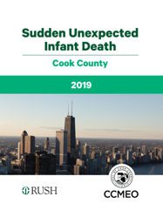







Closing the Loop to Prevent SUID: Birth Hospital Outreach
Christie Lawrence DNP, RNC-NIC, APN/CNS
Gina Lowell MD, MPH
Rojin Ahadi MPH
Cook County SUID Case Registry and Prevention

Slide 32

Cook County IL is the 2nd largest county in the US, birthing ~56,000 infants every year.
From 2019-2021, 141 sleep-related SUIDs occurred in Cook County
  25% of SUIDs are from suffocation; 75% remain undetermined
  Nearly all (99%) SUIDs had one or more unsafe sleep factors
  Black infants died from SUID ~15 times more often than White infants
  Hispanic infants died from SUID ~3 times more often than White infants
  25% of SUIDs occurred in preterm infants
  Peak age of SUID is 1-2 months old
There is no system in place for Cook County birth hospitals to hear about the infants they discharged who subsequently died from SUID.

Slide 33

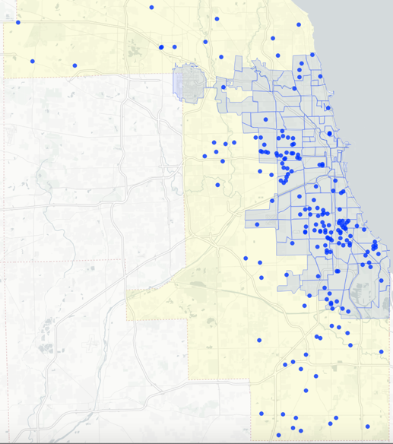
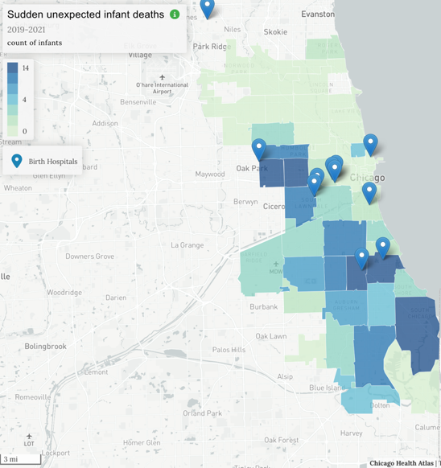

X
X
Sleep-related SUIDs of Cook County, 2019-2021
(141)
Mapping: SUID and Birth Hospitals
Birth Hospital Point Layer: Cook County’s 11 Birth Hospitals with the greatest number of infants discharged who subsequently died of SUID.
(SUID Count by Zip Code, 2019-2021)

Slide 34
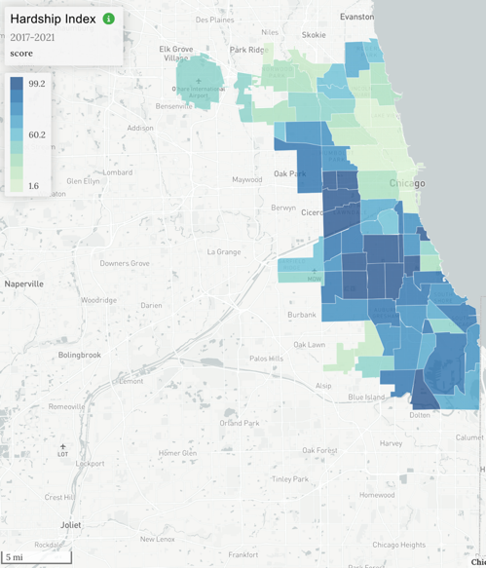
Sleep-related SUIDs of Cook County, 2019-2021
(141)
The Hardship Index is a composite score reflecting hardship in the community (higher values indicate greater hardship). It incorporates unemployment, age dependency, education, per capita income, crowded housing, and poverty into a single score that allows comparison between geographies. It is highly correlated with other measures of economic hardship, such as labor force statistics, and with poor health outcomes.

Slide 35

Closing the Loop: Bringing SUID Case Registry Data back to Birth Hospitals

Slide 36

SUID Rate by Hospital of Birth
Cook County SUID rate: 0.83/1000

Slide 37

Data to Action:
Creating a Birth Hospital Learning Community to Prevent SUID
Identify and Connect
  Identify and establish communication with nurse leadership from each birth hospital’s relevant units.
Share Data
  Meeting #1 (completed with 9/9 hospitals)
    Establish relationships
    SUID background and Cook County SUID-CR data
    Hospital-specific SUID-CR data
    Discuss current hospital practices regarding safe sleep: safe sleep modeling, audits, and education of staff/parents/caregivers of newborns during the newborn’s hospital stay.
  Meeting #2 (completed with 7/9 hospitals)
    Data transparency
    Case-level data regarding the circumstances of each SUID that occurred for families discharged from their hospital
Build a Learning Community
  Sustain relationships
  Regular meetings to share data, practice, success and learning
X
X
❖RELATIONSHIPS ❖TRANSPARENCY ❖CENTERING FAMILIES

Slide 38
Barriers to Safe Sleep:
Family Experiences in Chicago
Physical Environment
Lack of space
Can’t fit crib
Using crib for storage Choosing crib for toddler sleep
Sharing with other families
Having to live by others’ rules Lack of heat
Keep baby close to keep warm Bugs/Rodents
Keep baby close to keep safe Staying with others/Change in environment
No arrangements made for safe sleep Fathers may not have cribs with them when baby stays overnight
We share our experiences with families that inform our lens when holding conversations about SUID and Safe Sleep with parents. Listening and letting families lead centers our approach.
Safety Neighborhood violence/Domestic violence Feels safer if baby is right next to parent If something happens, baby is close Shelter living Fear baby will be taken Cribs unavailable in some shelters | What matters Getting to school in the morning Harder if always up/down with baby overnight Rewarding/satisfying to have baby close Bonding Better sleep (on stomach)
Education Mothers typically “know” the ABCs Fathers/others may not be present during education in hospital/clinic SIDS is something that just happens (cannot prevent) Non-urgency of the problem | Experience/Expectations Nothing happened with other babies (who were in “unsafe” sleep) SIDS – is something that just happens (cannot prevent) Non-urgency of the problem

Slide 39
Cook County SUID Case Registry Workflow
Data From CCMEO to CDC
Rojin Ahadi MPH
Data coordinator
Seeing the process builds trust in the data.

Slide 40
The content of today’s meeting regarding infant deaths can be difficult. The pictures on the next slide are doll scene reenactments with families who have lost their infants to SUID and may evoke strong feelings or other distress.
Please prioritize your own wellbeing, even if you need to step away from the meeting.

Slide 41
The education we are giving is not even the tip of the iceberg of what we should be teaching.
I realize how much larger the conversation needs to be. We have to get way beyond the ABC’s.
We didn’t know about these numbers until these presentations – we know about it but don’t always hear about it.
I can’t get that out of my head now, because that’s on us.
We notice families are not sleeping safely, but that’s because we are not modeling it!
No one brought this information back to us until now.
I think it would hit home if we could share this information.
It is a lot of information, and helpful. It makes me think differently. Some families don’t sleep in the same place all of the time.
I knew that we had some, but that is a lot.
This was really eye opening. Hearing the cases puts the whole thing in perspective. It brings [SUID] from back of mind to top of mind. That’s what needs to happen with providers.
Hearing the cases makes a big difference – it really hits home.
I hope ESSI brings normalcy [to infant safe sleep]. It has to reach beyond the postpartum unit, to OB and other doctors in the hospital. It’s going to take a village.
Those reasons and barriers include us as well.
This has gotten out in front of us, so it needs to be all hands on deck.
Every name I looked at… I kept thinking, do I remember them. Is there something else we could have talked about, something else we could have done…
Hospital stakeholders’ reflections on hearing their hospital-specific SUID Data

Slide 42

Hazardous infant products: Inclined sleepers

Slide 43



Hazardous infant products: Baby Loungers
Boppy Lounger
Snuggle Me lounger
Yoocaa lounger
*10 infant deaths occurred in these products in Cook County from 2019-2022*

Slide 44


Slide 45

BJC Safe Sleep Initiative
A quality improvement project to help babies sleep safely from birth
Bryanne Colvin, MD
Washington University in St. Louis School of Medicine
Department of Pediatrics
Division of Newborn Medicine

Slide 46
Objectives
Background
Project Goals
Project Elements
Safe Sleep Collaborative - Results
Considerations

Slide 47

cdc.gov

Slide 48

Background – SUID rates per 100,000 live births
In St. Louis, Black infants are 4.2x more likely to die than White infants
STL CITY
ASSB
UNK
SIDS
MISSOURI
US
91
110
171
ASSB – Accidental Suffocation & Strangulation in Bed
SIDS – Sudden Infant Death Syndrome
SUID – Sudden Unexpected Infant Death
SUID = ASSB + Unknown + SIDS

Slide 49


Current State
Ideal State

Slide 50
Problem
Our hospitals do not model safe sleep for families during their inpatient stay
Modeling is important to improve compliance with safe sleep guidelines at home
Infant mortality from SUID is above the national average in Missouri and Saint Louis

Slide 51

A face to every story – Preventing Harm

Slide 52
Project Goals
Global aim: Reduce infant mortality in Missouri and the St. Louis Metro East Region
BJC HSO Inpatient:
Greater than 90% of infants less than 12 months of age will be placed in a safe sleep environment as recommended by the AAP by end of 06/30/2021
Community (2021):
75% of parents evaluated who are discharged from a BJC HSO will demonstrate in-home safe sleep practices by end of 12/31/2021

Slide 53


Our Team:
Multidisciplinary,
multi-facility
collaborative to
implement safe sleep
across the system led
by nurse-physician
dyads in each unit

Slide 54
Utilize the IHI Model for Improvement
Develop safe sleep policy
Develop staff education (model the behaviors)
  Training for Safe Sleep Champions
Develop parent education
  Crib cards and parent handouts
  Laminated flip cards
  Parent videos
Develop sleep metrics and track compliance
Multi-facility, interdisciplinary team developed:
Family education
Driver diagram
System-wide Safe Sleep Policy
Online education modules for staff
Champion education

Slide 55


Slide 56
System Policy
Purpose
  Promote and follow safe sleep guidelines as defined by the AAP for infants less than 12 months of age
  Participate in the campaign to reduce SUID
Definitions
Procedures
  Establish infant safe sleep readiness
  Educate parents
  Model the behaviors
    Newborn Nursery
    NICU/SCN/NAC
    Pediatric floor/unit

Slide 57
Staff Education
Two online Saba modules for all staff
  Lesson 1: Adhering to AAP safe sleep recommendations in the hospital
  Lesson 2: How to talk to families about safe sleep
Safe Sleep Champion education
  In-person 3-hour training session
  12 sessions completed located in each of our hospitals
    Over 650 miles of travel!
  Online option

Slide 58

Improvement Handbook
Global Outline:
IHI Model for Improvement
Collaborative Roles/Responsibilities
BJC Pediatric Clinical Program QI Collaborative (following IHI Breakthrough Series Model)
Customizing team’s Aim
Measuring Improvement
QI Resources/Tips/Tools
Psychology of Change White Paper

Slide 59


Family Education

Slide 60


Family Education

Slide 61

Family Education

Slide 62
Safe Sleep Collaborative
The BJC Pediatric Quality Improvement (QI) Collaborative infrastructure used the IHI Breakthrough Series model
Each local HSO used the IHI Model for Improvement to guide frequent plan-do-study-act (PDSA) cycles
Audits performed to monitor SSP compliance using web-based application
System and hospital compliance data distributed weekly
Monthly virtual learning sessions were held to:
  Share data, local SMART Aim, PDSAs, successes and barriers
  Develop family and communication skills
  Learn QI tools essential to implementation

Slide 63

Results

Slide 64

Project Initiation: August 2020
Project Close:
October 2022

Slide 65


Slide 66

Gold Certification:
Alton Memorial Hospital
Barnes-Jewish Hospital
Memorial Hospital Shiloh
Missouri Baptist Medical Center
Parkland Hospital
Progress West Hospital
St. Louis Children’s Hospital
Bronze Certification:
Missouri Baptist Sullivan

Slide 67
Considerations
This is not easy
This requires an interdisciplinary collaborative and supportive approach (not only the responsibility of the bedside nurse)
  Leadership engagement is key!
Partnering with families and having discussions on admission and frequently during their stay is critical

Slide 68
Questions???
Feel free to reach out! – bryannecolvin@wustl.edu

Slide 69

Panel Discussion
Q & A

