Slide 1

PVB Sustainability Webinar
January 29th, 2024, at 12:30 PM

Slide 2
Overview
Upcoming 2024 Face-to-Face Meetings
PVB Data overview
PVB Sustainability Plan
PVB Team Sharing:
  Deb Miller: NM Prentice Women's Hospital
  Dina Kapogiannis: Evanston Hospital
  Becky Miller: Gibson Area Hospital
Sustainability and Coaching Q&A

Slide 3
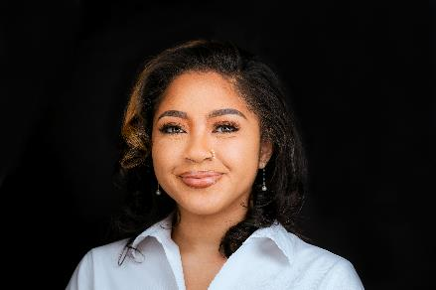
Welcome Kiela!
Please welcome our newest ILPQC team member:
Kiela Moreno, MPH
ILPQC Project Coordinator

Slide 4
2024 Face-to-Face Meeting
May 22nd nd 23rd, 2024
Springfield, IL

Slide 5


save the date
2024 OB & Neonatal
Face-to-Face Meetings
OB TEAMS:
MAY 22ND, 2024
at the President Abraham Lincoln Doubletree Hotel
in Springfield, IL
Calling ALL Perinatal Leaders, Providers, Nurses, Advocates, & Friends!
NEONATAL
TEAMS:
MAY 23RD, 2024
Join us for two interactive days of collaborative learning with the IL Perinatal Quality Collaborative!

Slide 6



Interested in Facilitating an ILPQC Face-to-Face
Breakout Session?
Email info@ilpqc.org
Interested in Volunteering on the Face-to-Face Planning Committee?

Slide 7
PVB Data Progress

Slide 8



PVB Aims and Measures
>70% of Hospitals will be at or below the Health People 2023 Goal of 23.6% NTSV C-section Rate
>70% of NTSV C-sections meet ACOG/SMFM Criteria
>80% of physicians, midwives and nurses educated

Slide 9







PVB Key Strategies:
Putting it all together
Unblinded Provider-level NTSV C-Section Rates ​
Educating patients and shared decision making ​
Clinical Team Education and Buy-in
Cesarean Decision Huddles and Checklist
Fallout Reviews of cases not meeting ACOG/ SMFM Criteria​
Labor Management Support​

Slide 10
NTSV C-Section Rate
At Baseline
38%
Of ILPQC hospitals had a NTSV C-Section Rate of <23.6%
In 2023
77%
Of ILPQC hospitals have achieved an NTSV C-Section rate of <23.6% for at least 1 quarter

Slide 11

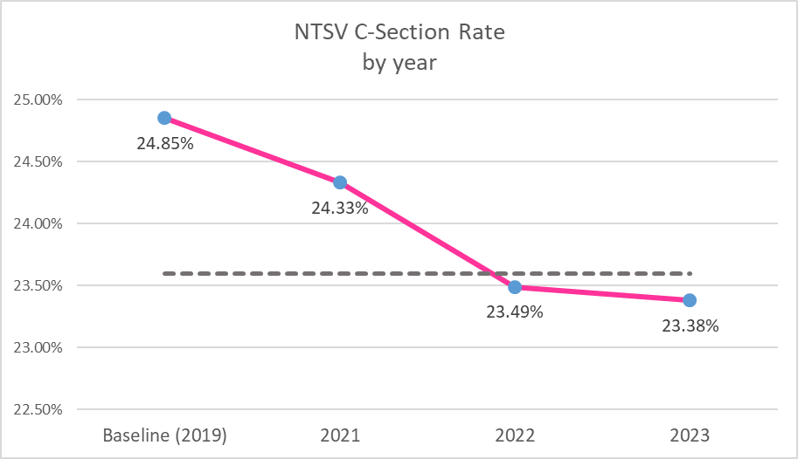

Celebrating our PVB Success
ILPQC NTSV C-Section Rate in 2023
23.38%

Slide 12
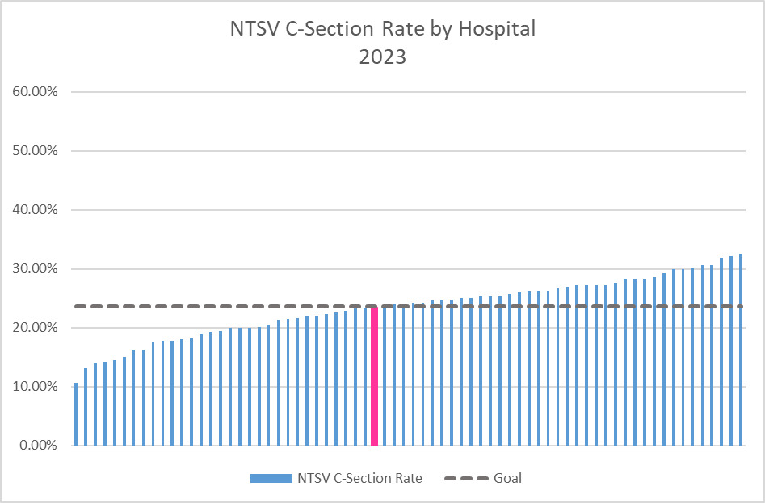
NTSV C-Section Rates for all ILPQC Hospitals

Slide 13
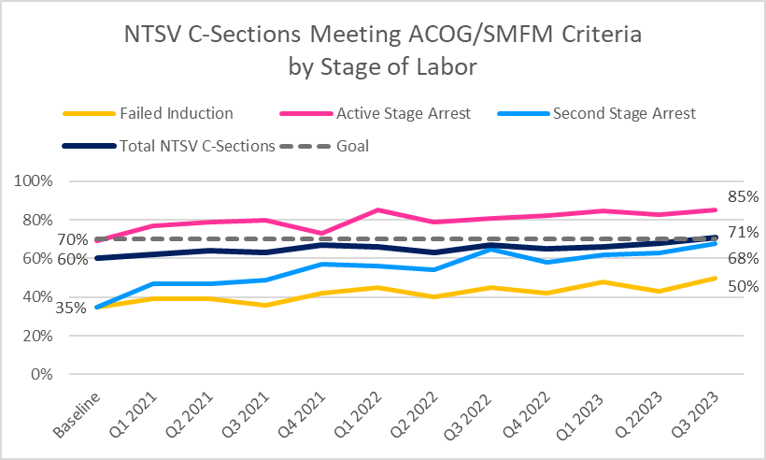
NTSV C-Sections Meeting
ACOG/SMFM Criteria
71%
of NTSV C-Sections Meeting ACOG/SMFM Criteria!

Slide 14
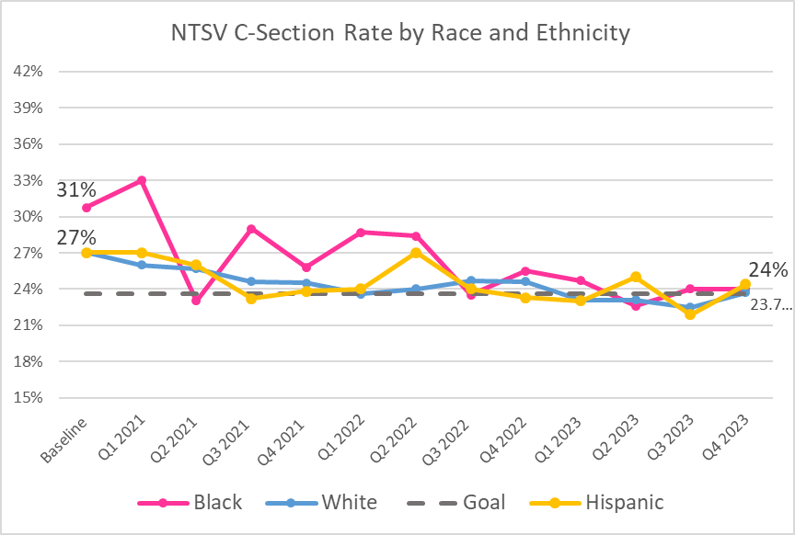
Reducing Disparities in NTSV
C-Section Rates
Notes:
Understand the Data
Identify the Disparities
Actively listen
Engage patient/community partners
Expand access to community doulas and improve shared decision making and respectful care
Connect your clinical team

Slide 15
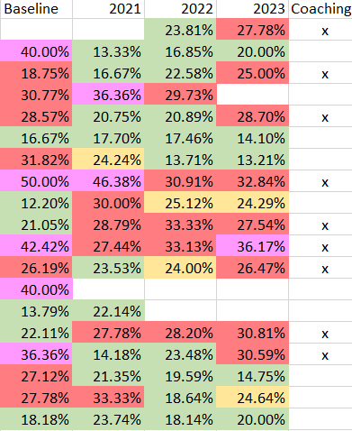
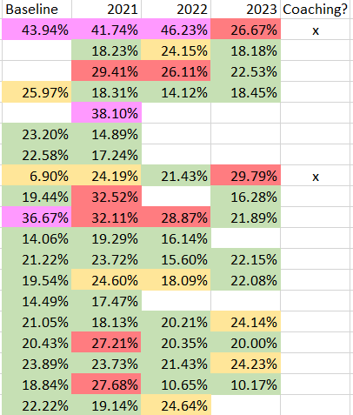
Level I & II Hospitals

Slide 16
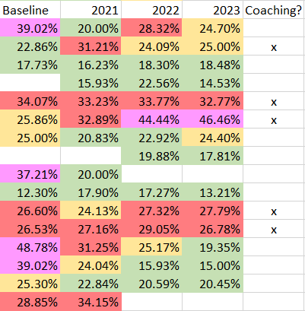
Level II+ Hospitals
x

Slide 17
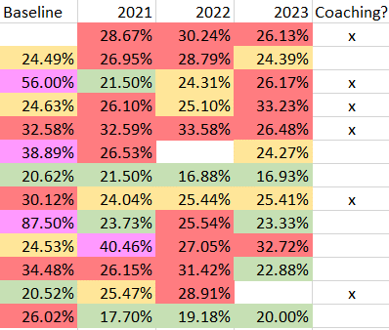
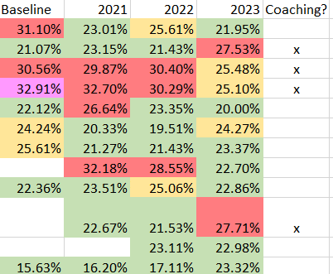
Level III Hospitals

Slide 18
PVB Data Form Updates

Slide 19
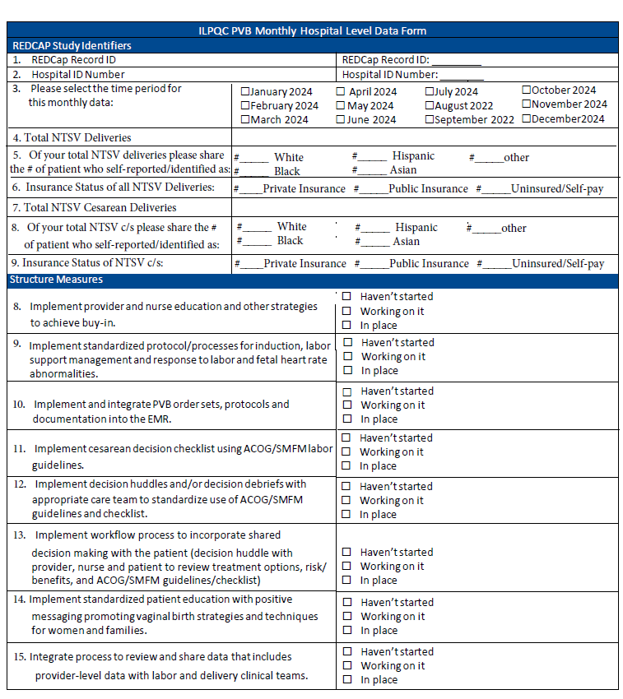
PVB Reduced Data Entry in 2024: Hospital Level Data
Hospital Level Data form will be reduced
  Once key structure measures are green, you will no longer have to enter structure measure
  All teams have met education goals, and that measure will no longer be collected
  You will continue to submit NTSV C-Section Rate data stratified by race, ethnicity and insurance status

Slide 20
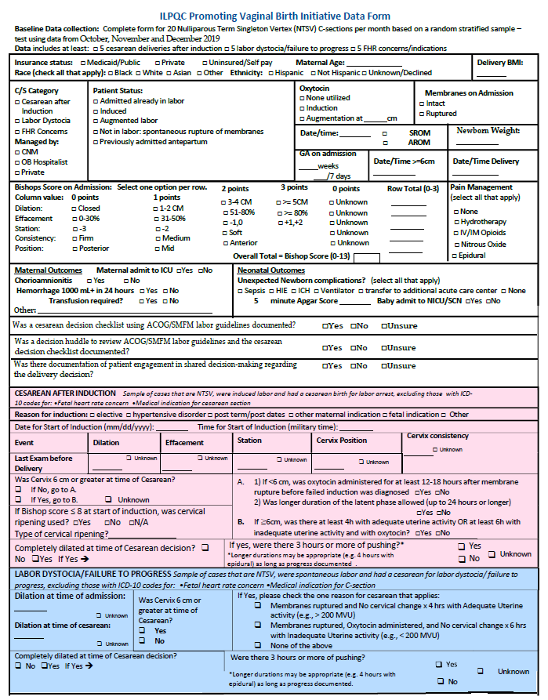
PVB Reduced Data Entry in 2024: Patient Level Data
If your team is in sustainability and NTSV C-Section Rate is staying below goal, you do NOT have to continue to submit 20 NTSV C-Sections
All teams will no longer have to enter NTSV Vaginal Deliveries

Slide 21
PVB Sustainability

Slide 22
PVB Teams moving to sustainability in 2024
  Sustainability Plan
  Stratified Data Review
Meet with your PVB QI team to draft your sustainability plan and submit to ILPQC and your PNA
03
Review your data by race, ethnicity and insurance status and take action on disparities ​
01
  Sustainability Webinars
  Team Sharing
02
Attend Quarterly Sustainability Webinars
04
Share successful strategies for sustaining PVB work on quarterly calls

Slide 23
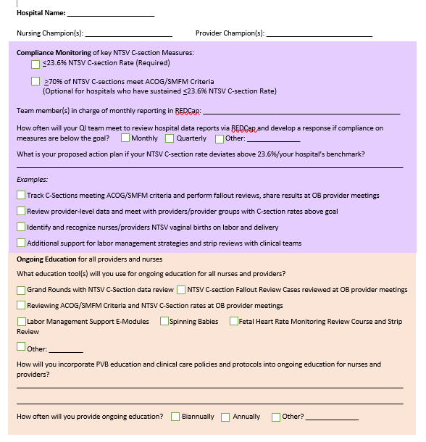
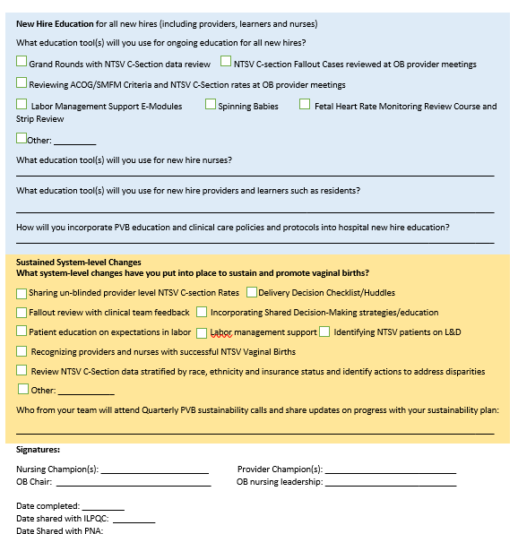
Why do we create a sustainability plan?
PVB teams have spent 3 years working so hard to reduce NTSV C-section Rates and maintain that rate below 23.6%
Your sustainability plan helps to ensure that we maintain the progress made over the last 3 years.

Slide 24



Components of PVB Sustainability
Sustainability planning is vital to maintain all the incredible progress PVB teams have made over the last 3 years
  Ongoing Provider and Nurse Education
  Compliance Monitoring
  New Hire Education

Slide 25
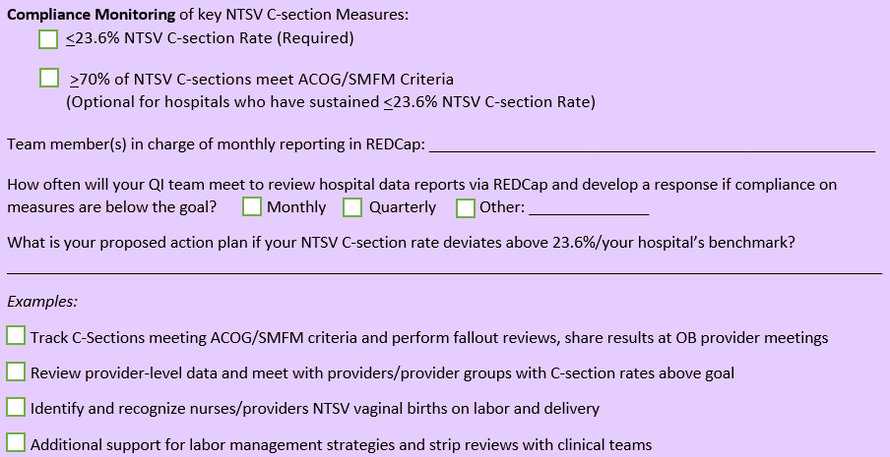
Compliance Monitoring

Slide 26
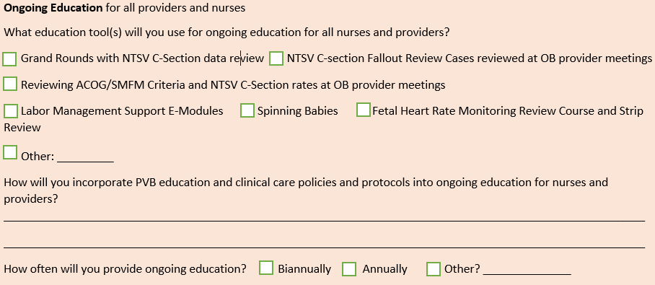
Ongoing Education

Slide 27
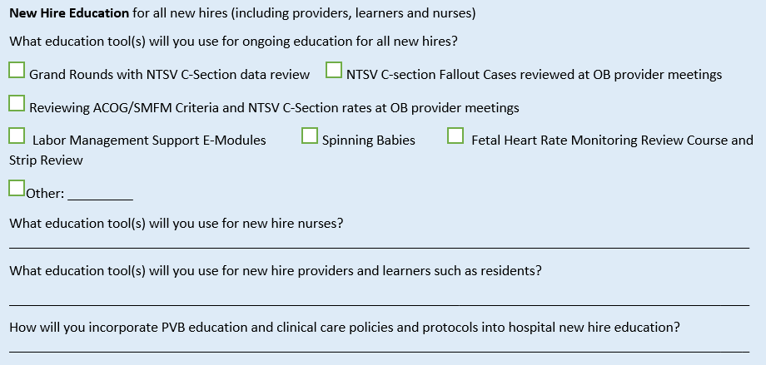
New Hire Education

Slide 28
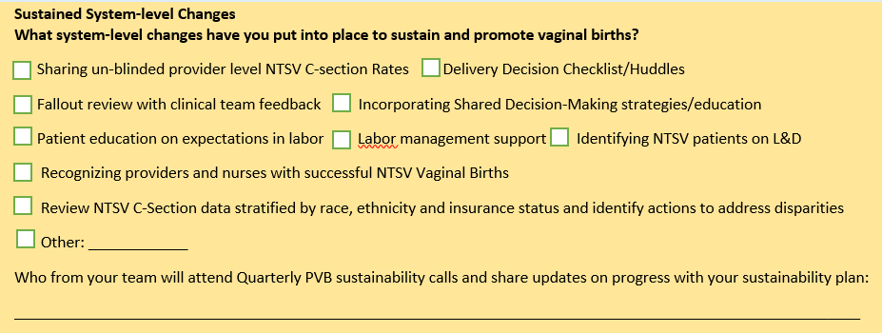
Sustained System Level Changes

Slide 29
PVB Sustainability Teams Next Steps
Meet with your PVB team to complete a PVB sustainability plan for your hospital
Submit PVB Sustainability Plan to info@ilpqc.org and your Perinatal Network Administrator
Continue meeting monthly with your PVB team to review compliance data
If your NTSV C-Section rate increases above goal, conduct fallout reviews for that month to determine NTSV C/S indicated based on meeting ACOG/SMFM criteria, share fall out cases with clinical teams
Implement ongoing and new hire education plans

Slide 30
PVB Small Group Coaching

Slide 31



PVB teams continuing to work towards NTSV C-section goals in 2024
  Quarterly Small Group Coaching Calls
OB and nursing champions will lead coaching calls with 4-5 teams each quarter where teams share their successes, barriers and strategies and learn from one another
  Key Players Meeting for your Hospital
ILPQC will facilitate a meeting for each hospital to bring together hospital, obstetric and nursing leadership to review strategies and establish plan to achieve PVB goals
  Individual Outreach
Quarterly QI Support and 1-1 meetings for teams to discuss specific strategies; ILPQC will provide support and feedback at OB Provider Meeting or Grand Rounds

Slide 32
Quarterly Small Group Coaching Calls
You should have received an email in December regarding your hospitals next steps for 2024 and to alert you if your team has been chosen to a part of the 2024 PVB Coaching Groups
We have reviewed NTSV C-Section Rates for 2023 as well as patterns over the last 3 years to identify which teams can benefit from this exciting opportunity.
We will be reaching out this week to introduce you to your coaches!
Coaching group quarterly calls will start in February and March

Slide 33
Key Players Meetings for Coaching Teams
Key player meetings scheduling for each hospital will start in February
1 ILPQC Team Member present with 1 PVB Coach to help facilitate meeting
Highly Recommended Hospital Team Attendees: Physician and nurse champion, OB Chair and L&D or Women's nursing leader/director, director of OB and director of L&D, nurse educator, L&D charge nurse, PVB team members, representative from quality, may also want to include outpatient clinic representative, etc.
ILPQC will work with PVB team lead to determine the best date for meeting
We will prioritize teams with higher NTSV C-Sections rates for earlier KP Meeting dates
When feasible, we will plan to travel to the hospital to hold the meeting in person
Key Player Meetings will be opportunity to discuss 30/60/90 day plan to achieve PVB goals

Slide 34
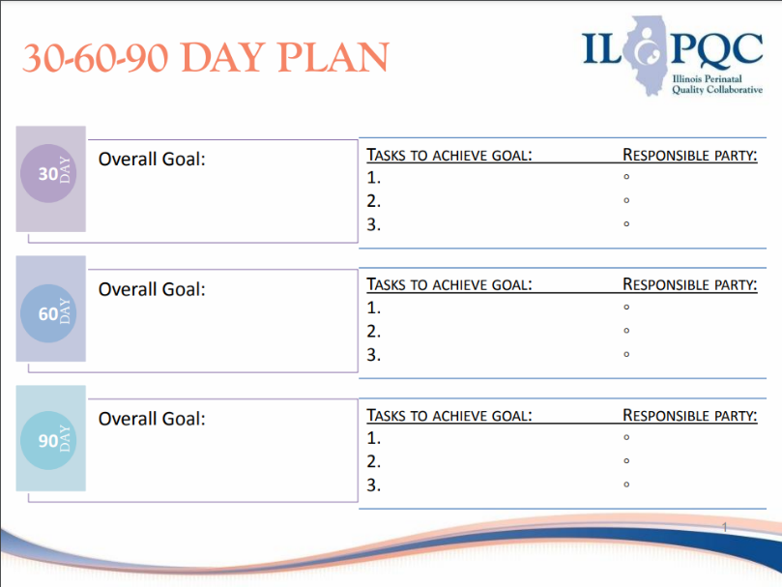

Slide 35
Team Sharing
Gibson: Becky Miller
NM Prentice: Deb Miller
NorthShore Evanston: Dina Kapogiannis

Slide 36
PVB Sustainability Q&A

Slide 37
Breakout Sessions Q&A
PVB Sustainability Teams
PVB Coaching Teams
Choose Breakout Session

Slide 38

Upcoming PVB Calls
Event | Day/Time
February 2024 | PVB Coaching Calls and Key Players Meetings begin
March 2024 | PVB Coaching Calls and Key Players Meetings continue
April 2024 | PVB Sustainability Webinar April 22nd, 2024, 12:30 PM
May 2024 | Face-to-Face Meetings May 22nd, and May 23rd

Slide 39




ILPQC
2024 Events

Slide 40










Thanks to our Funders
In kind support:

