Slide 1

PVB Monthly Webinar:
Key strategies for getting across the finish line
April 25th, 2022 12:30-1:30

Slide 2
Overview:
2022 Face-to-Face Updates
PVB Data Review
Getting to Green on Key PVB Structure Measures
Diane Beck RN, MSN Clinical Director Labor and Delivery Services MCWHLB
Team Talk: St. Alexius Medical Center, Kellie Smith, BSN, RNC-OB, C-EFM Clinical Nurse Educator, Labor and Delivery
PVB Next Steps
PVB Office Hours
  Join us after the call to ask any questions you may have

Slide 3


ILPQC Spring 2022 Face-to-Face

Slide 4

Register now!
Registration link is available at ilpqc.org

Slide 5
PVB QI Excellence Award
All structure & patient-level data entered for Baseline-March 2022 (will provide pass for December and January data given surge) due May 2nd
Key Structure Measures "In Place":
  Implemented provider and nurse education and other strategies to achieve buy-in
  Implemented standardized protocol/processes for induction, labor support management and response to labor and fetal heart rate abnormalities
  Integrated process to review and share data with clinical staff and sharing transparent provider-level data.
  Implemented cesarean decision checklist using ACOG/SMFM labor guidelines
  Implemented decision huddles and/or decision debriefs with appropriate care team to standardize use of ACOG/SMFM guidelines and checklist
  Implemented workflow process to incorporate shared decision making with the patient
Achievement of process and outcome level measures (Based on Jan – March 2022 data)
  80% of Nurses and Providers Educated
  80% of all NTSV C-Sections Meeting ACOG/SMFM Guidelines for January-March 2022
  NTSV C-Section Rate below 23.6% for January-March 2022
Face-to-Face
QI Leader Award Criteria:
Data complete
+
Key structure measures in place
+
1 Process/outcome measure met

Slide 6
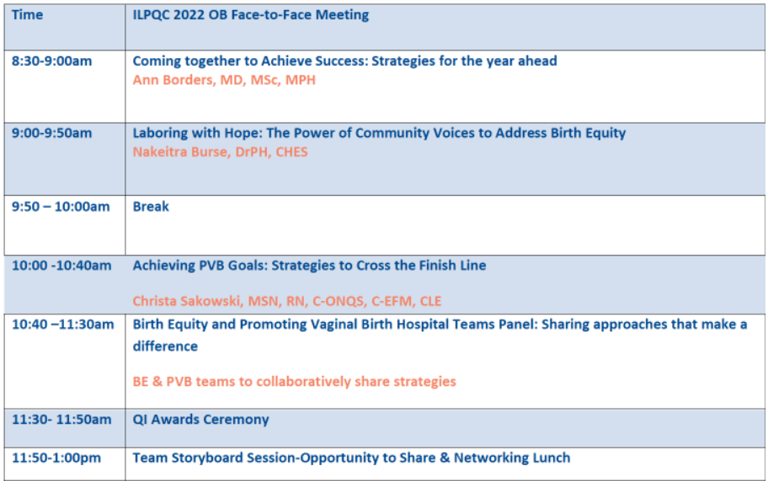
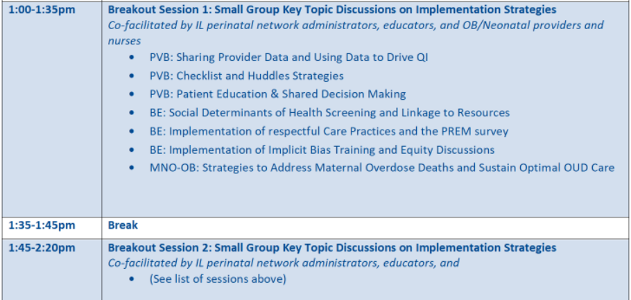
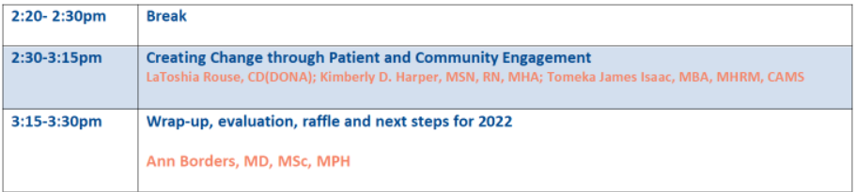
OB Day Face-to-Face Agenda

Slide 7
OB Day Breakout Sessions
PVB: Sharing Provider Data and Using Data to Drive QI
PVB: Checklist and Huddles Strategies
PVB: Patient Education & Shared Decision Making
BE: Social Determinants of Health Screening and Linkage to Resources
BE: Implementation of Respectful Care Practices and the PREM survey
BE: Implementation of Implicit Bias Training and Equity Discussions
MNO-OB: Strategies to Address Maternal Overdose Deaths and Sustain Optimal OUD Care

Slide 8
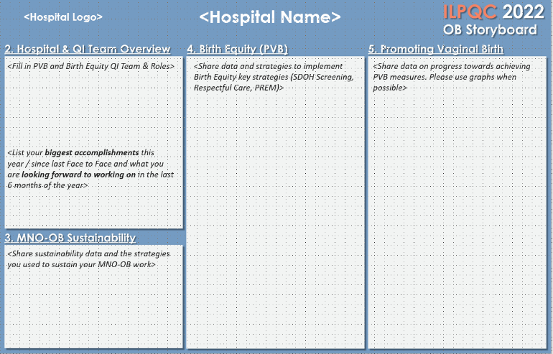

Face-to-Face 2022
OB Storyboard Template

Slide 9
Face to Face Preparation
Register
Now
Get involved
Fill out storyboard and send to info@ilpqc.org by May 11th 2022.
Data and Awards
Storyboards
Email info@ilpqc.org to help facilitate a breakout session
Review PVB award criteria.
Make sure all data is entered in REDCap by May 2nd, 2022.
Registration is OPEN! Share the registration link with your provider and nursing colleages!
QI Team Photo
Submit a photo of your hospital QI team to info@ilpqc.org by May 11th 2022.

Slide 10
PVB Data Review

Slide 11
Supporting vaginal birth and reducing primary Cesareans for optimal maternal and neonatal outcomes
Aim: 70% of participating hospitals will be at or below the Healthy People goal of 23.6% cesarean delivery rate among NTSV births by December 31, 2022
Goal: Increase the percent of cesarean section deliveries among NTSV births that meet ACOG/SMFM criteria for cesarean
Goal: Increase the % of physicians/ midwives/ nurses educated on ACOG/SMFM criteria for cesarean, labor management strategies/response to labor challenges, protocol for facilitating decision huddles and/or decision debriefs
UPDATED GOAL based on Health People 2030

Slide 12
Clinical Culture Change
Identifying NTSVs and recognition for clinical team
Education of ACOG/SMFM criteria for providers and nurses
Implementing cesarean decision checklists and huddles
Labor management support
Un-blinding provider data
Standardized Patient Education and Shared Decision Making

Slide 13
ILPQC Hospital Team Data Submission
(94 Teams Total)
Month | Patient Data | Hospital Data
Baseline | 89 | 85
January 2021 | 86 | 80
February 2021 | 85 | 80
March 2021 | 85 | 78
April 2021 | 81 | 78
May 2021 | 78 | 71
June 2021 | 71 | 70
July 2021 | 76 | 68
Month | Patient Data | Hospital Data
August 2021 | 78 | 66
September 2021 | 75 | 64
October 2021 | 74 | 60
November 2021 | 66 | 60
December 2021 | 66 | 56
January 2022 | 59 | 46
February 2022 | 52 | 44
March 2022 | 40 | 34

Slide 14
ILPQC NTSV C-Section Rates
26%
26%
25%

Slide 15
NTSV C-Section Rates, by hospital
Goal: < 23.6%
All ILPQC Average: 26%

Slide 16
NTSV C-sections meeting
ACOG/SMFM Criteria, across hospitals
Goal: >80%
87%
82%
66%
60%
65%
53%
56%
40%

Slide 17
Where do we need to focus improvements for meeting ACOG/SMFM Guidelines?
ACOG/SMFM Criteria for Failed Induction:
Oxytocin administered for at least 12-18 hours after membrane rupture, without achieving cervical change and regular contractions
Longer duration of the latent phase, 24 hours or longer if <6cm and maternal and fetal status permits
Notes:
?

Slide 18
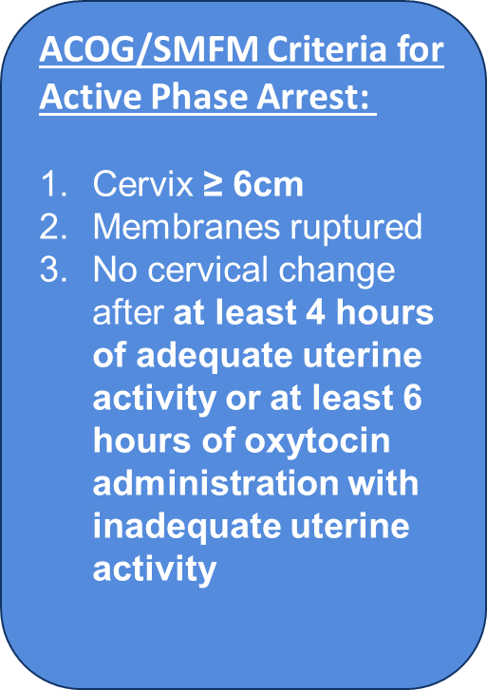
Where do we need to focus improvements for meeting ACOG/SMFM Guidelines?

Slide 19
Where do we need to focus improvements for meeting ACOG/SMFM Guidelines?
ACOG/SMFM Criteria for Second Stage Arrest:
At least 3 hours of pushing in nulliparous patients
Fetal position known and rotated if OP
At least 2 hours of pushing in multiparous patients
Longer durations (e.g. 4 hours with epidural) may be appropriate on an individualized basis

Slide 20
Provider and Nurse Education
Keep it up!

Slide 21

What does it mean to be
GREEN on Provider and Nurse Education?
Do you have a standard process in place to educate providers and nurses on of ACOG/SMFM Guidelines
  Skills days / OB Provider Meeting have leads review guidelines
  Email educational materials
  Education topics during huddles
Have you hosted a PVB Grand Rounds?
Have you displayed Provider Education Posters on your L&D units?
Has your staff attended Labor Management Support training?
  ILPQC Live Virtual Training (August and September 2021)
  Spinning Babies or other in-person courses
  ILPQC Labor Support E-modules (now available!)

Slide 22
Standard protocols and processes

Slide 23
What does it mean to be GREEN on Standard Protocols and Processes?
Has your hospital implemented updated labor protocols for a unit-standard approach for providing labor support, and freedom of movement?
Has your hospital implemented standard criteria for diagnosis and treatment of labor dystocia, arrest disorders and failed induction based on ACOG/SMFM guidelines?
Has your hospital implemented protocols and support tools for women who present in latent (early) labor to safely encourage early labor at home?
Has your hospital developed a policy to implement intermittent monitoring policies for low-risk women?

Slide 24
Sharing Provider Level Data

Slide 25
What does it mean to be GREEN on Sharing Provider-Level Data?
Does your hospital have a process to share un-blinded provider-level NTSV C-section rates?
Tips to get started with sharing un-blinded data:
  Involve your PVB Provider Champion
  Explain the “why” to providers and staff
  Create open space to share provider-level data
    via email, department meetings, unit boards, etc.
  Implement a timeline to review provider-level data
    Provide quarterly provider-level data
    Annual un-blinded sharing of provider-level data

Slide 26
Cesarean Decision Checklists and Decision Huddles/Debriefs

Slide 27
What does it mean to be GREEN?
Do you have a standard process to use the Cesarean Decision Checklist for every potential C-Section?
  Availability of checklist in patient's labor room or in EMR
  Who initiates the huddle and use of checklist? Charge nurse / bedside nurse?
  Documentation of use of checklist or review of ACOG/SMFM Guidelines with every C-Section
Do you have a standard process to perform Delivery Decision Huddles/Debriefs?
  Huddle performed with physician, nurse, any other care team members, and the patient to discuss potential C-Section decision, incorporate ACOG / SMFM guidelines / checklist
  Can also incorporate into 2 hour pushing huddle

Slide 28
Shared Decision Making and Patient Education
Notes:
Focus for today

Slide 29
What does it mean to be GREEN?
Do you incorporate Shared Decision Making into cesarean decisions?
  Implemented workflow process to incorporate shared decision making with the patient
    Decision huddles = patient involvement
Do you have a standard process for education for all patients?
  Implemented standardized patient education with positive messaging see PVB toolkit for materials
    Collaborate with OB offices to incorporate prenatally
Notes:
Patients have the opportunity to obtain personalized information about their treatment options with the goal of improving their ability to make an autonomous decision.
Inclusion of patient in Decision Huddles

Slide 30
Promoting Vaginal Birth
Miller Children’s and Women’s Hospital Long Beach
Diane Beck RN, MSN
Clinical Director Labor and Delivery Services
MCWHLB

Slide 31

Promoting Vaginal Birth
Miller Children’s and Women’s Hospital Long Beach
Report out to the Illinois Perinatal Quality Collaborative
April 25th, 2022
Diane Beck RN, MSN
Clinical Director Labor and Delivery Services
MCWHLB
Dbeck@memorialcare.org

Slide 32
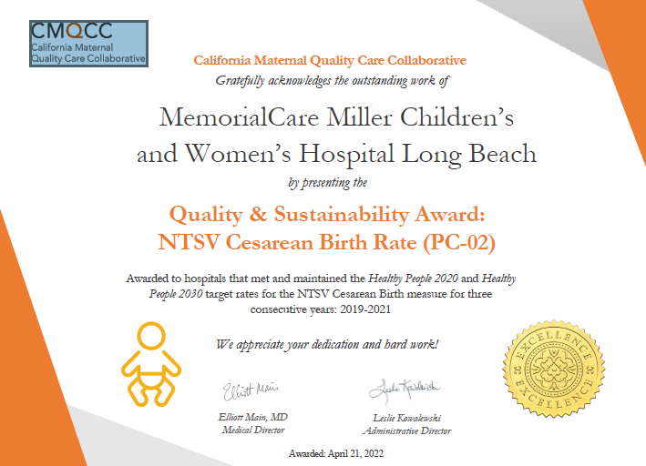


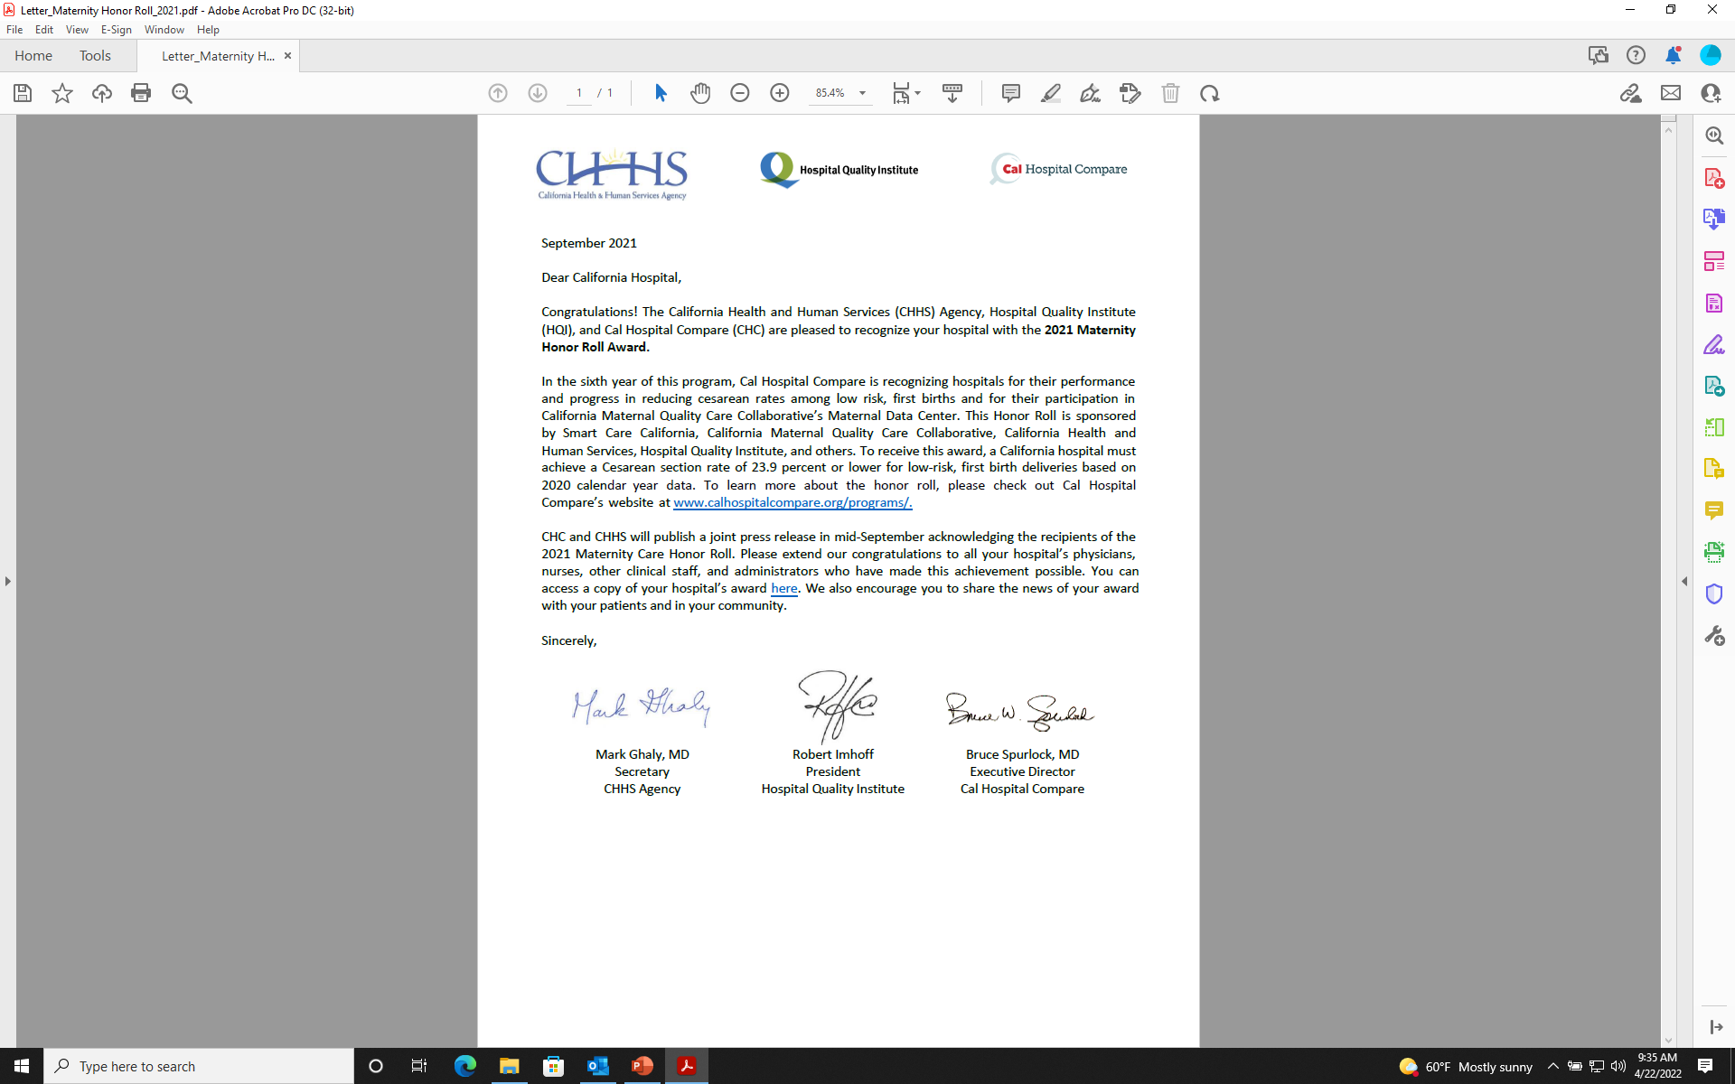
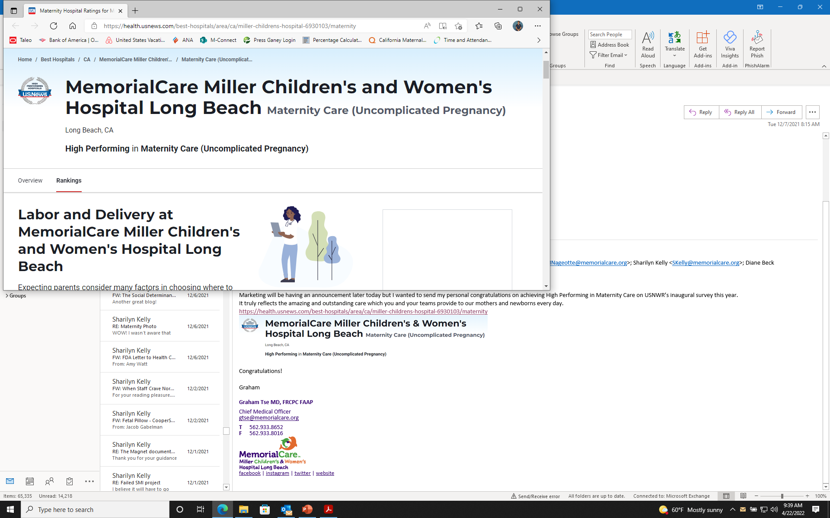
Overview of Miller Children’s & Women’s
BirthCare Center
Magnet Designated
Level IV maternity care with our own Maternal Transport Team
MFM on site 24/7 + in house OB Hospitalist and OBGYN Residents (Yr2-4)
Level IV NICU
101 bed unit (between MBU and Labor), 95 bed NICU
Over 300 nurses, over 200 community Peds, OB’s, Fam. Practice physicians.
Academic center with affiliations with University of California Irvine (UCI) school of medicine and California State University Long Beach (CSULB) school of nursing
Notes:
Data from 2019;
Level IV maternity care, Level III NICU
101 bed unit (between MBU and Labor), 95 bed NICU
5708 total deliveries
NTSV C/S rate of 23.7%
Average a 60% monthly Medi-Cal delivery rate.
Affiliated OB clinic; 590 total deliveries (UCI residents)
Over 300 nurses, over 200 community Peds, OB’s, Fam. Practice physicians.

Slide 33
Delivery Volume by Year
TOTAL DELIVERY EVENTS BY CALENDAR YEAR
MONTH | 2016 | 2017 | 2018 | 2019 | 2020 | 2021
JANUARY | 500 | 471 | 467 | 501 | 414 | 462
FEBRUARY | 494 | 455 | 441 | 400 | 474 | 400
MARCH | 468 | 483 | 460 | 434 | 438 | 503
APRIL | 489 | 454 | 427 | 451 | 431 | 438
MAY | 513 | 482 | 429 | 500 | 459 | 515
JUNE | 449 | 471 | 460 | 440 | 427 | 528
JULY | 513 | 480 | 494 | 474 | 486 | 502
AUGUST | 578 | 539 | 592 | 543 | 478 | 588
SEPTEMBER | 571 | 524 | 569 | 536 | 516 | 497
OCTOBER | 529 | 456 | 450 | 537 | 484 | 547
NOVEMBER | 503 | 485 | 506 | 453 | 454 | 474
DECEMBER | 532 | 473 | 481 | 457 | 480 | 495
YTD Total | 6139 | 5773 | 5776 | 5726 | 5541 | 5949

Slide 34
The 10 Steps for promoting vaginal birth & lowering your NTSV rates by a nurse leader who has lived in the trench's!
Step 1: Take a deep breath- this is going to take a while!
This Photo by Unknown Author is licensed under CC BY-NC-ND

Slide 35
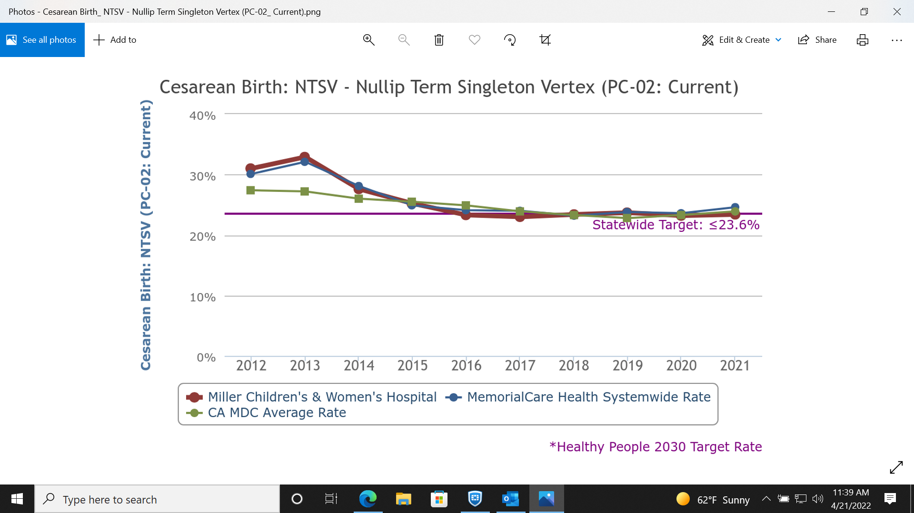
6-year journey
To reduce NTSV rates

Slide 36
Step 2- GET YOUR DATA IN ORDER!
Garbage in =
Garbage out
Moved from manual collection and a home-grown data base to auto upload from EHR to California Maternal Data Center
Process took several years, and we continue to refine our understanding and make improvements
Still requires monthly data clean up - easier said than done!

Slide 37
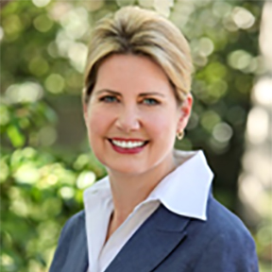
Step 3- Find a physician champion!
Dr. Jennifer McNulty, MD, Maternal Fetal Medicine
Chair of the MHS Women’s Best Practice Team
Made it her personal mission to improve
NTSV rates at MCWHLB- and succeeded!

Slide 38
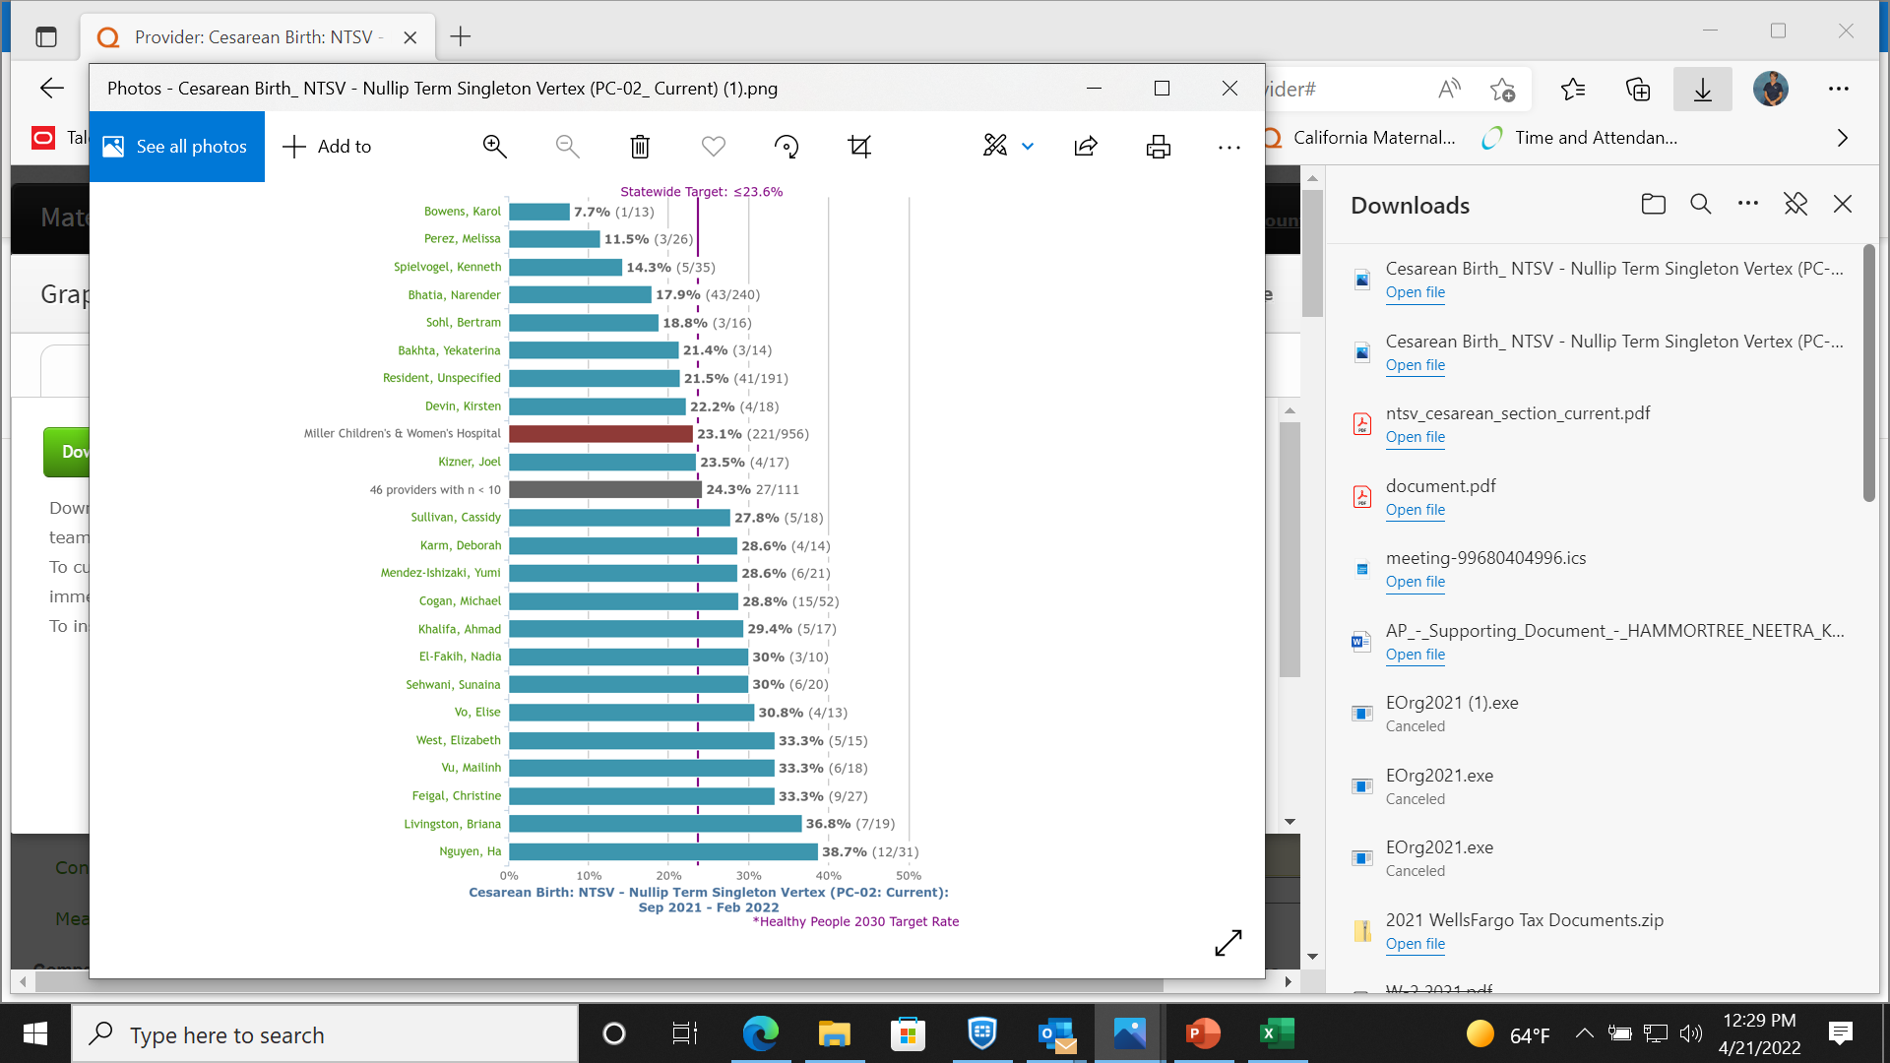
Step 4: Don’t be afraid to hurt feelings & leverage peer pressure!
Unblinded individual
OB’s NTSV rates
Posted in MD lounge
Every 6 months

Slide 39
Step 5: Create tools that work, and put them in every chart.
RN-MD shared decision making tool

Slide 40
Step 6: Don’t work in a silo!
Identify all stakeholders to assist in all aspects of this work
  Senior Executives, Nurse & Physician Leaders
  Quality Department
  Nursing Shared Governance Structures
  Risk Management
  Medical Staff
  Bedside Nurses!!!!
  Patient and Family Advisory Councils
This Photo by Unknown Author is licensed under CC BY-SA

Slide 41
Step 7: Look at your fall-outs and stop making excuses!
Inductions!
Individual providers
Individual nurses

Slide 42
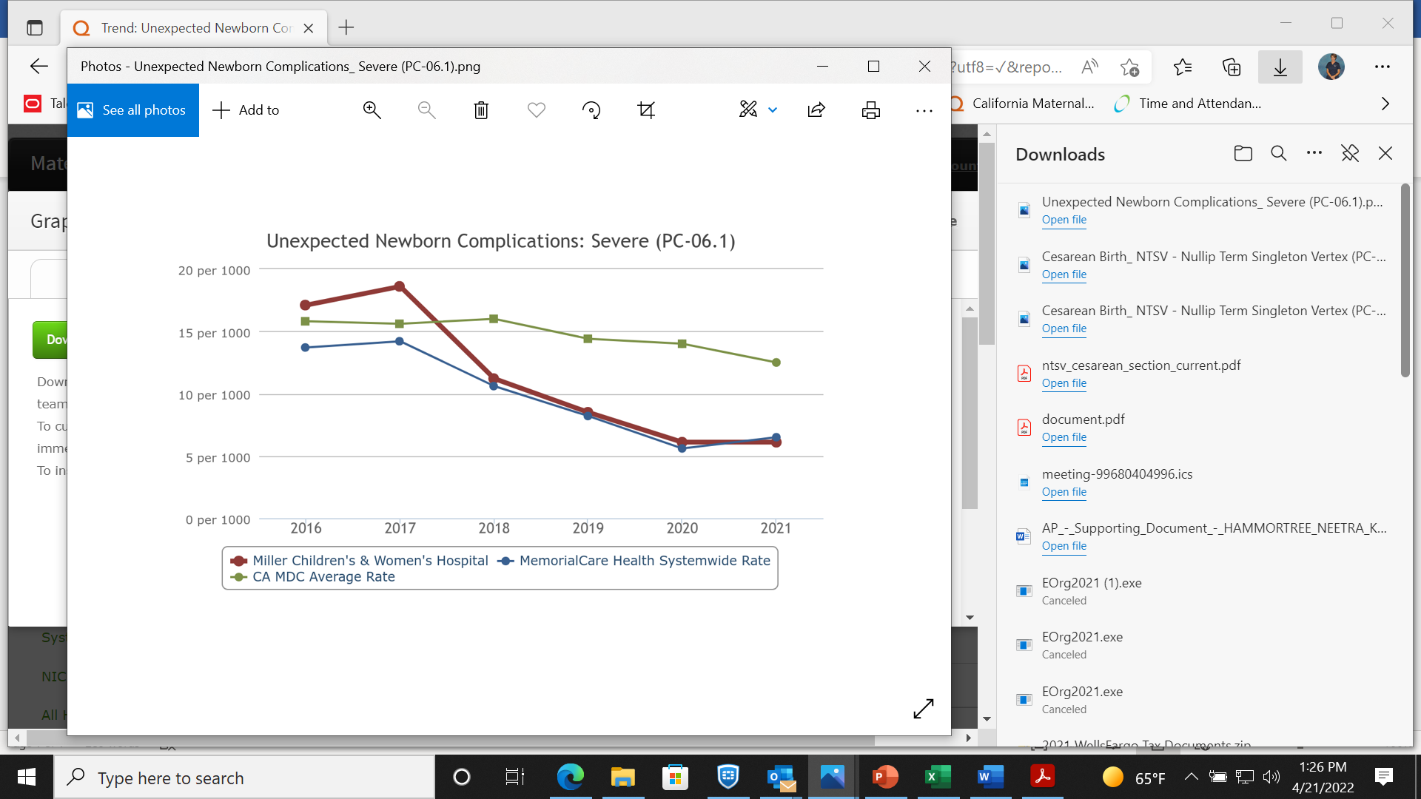
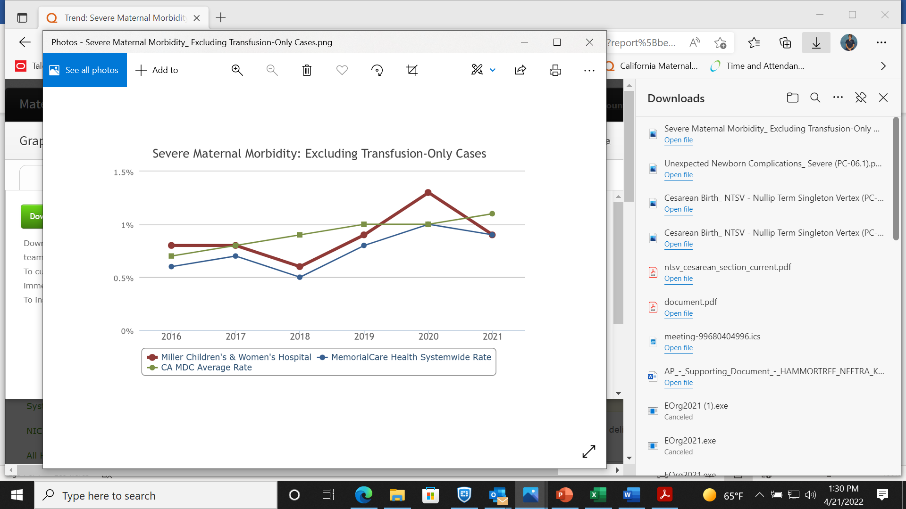
Step 8: Reassure the Nay Sayer’s!
Notes:
UNC denominators: unanticipated transfers to HLOC, birth injury, sepsis, death, etc…
SMM Numerator
Denominator cases with an ICD-10 code indicating a Severe Maternal Morbidity.
Includes those with a diagnosis or procedure code indicating:
AMI
Renal Failure
Respiratory Distress
Amniotic Fluid Embolism
Aneurysm
Cardiac Arrest
DIC
Eclampsia
Heart Failure
Puerperal Cerebrovascular Disorder
Pulmonary Edema
Complications of Anesthesia
Sepsis
Shock
Sickle Cell Crisis
Air and Thrombotic Embolism
Transfusion
Conversion of Cardiac Rhythm
Hysterectomy
Temporary Tracheostomy
Ventilation

Slide 43
Step 9: Pick the lowest hanging fruit and work your way up the tree!

Slide 44
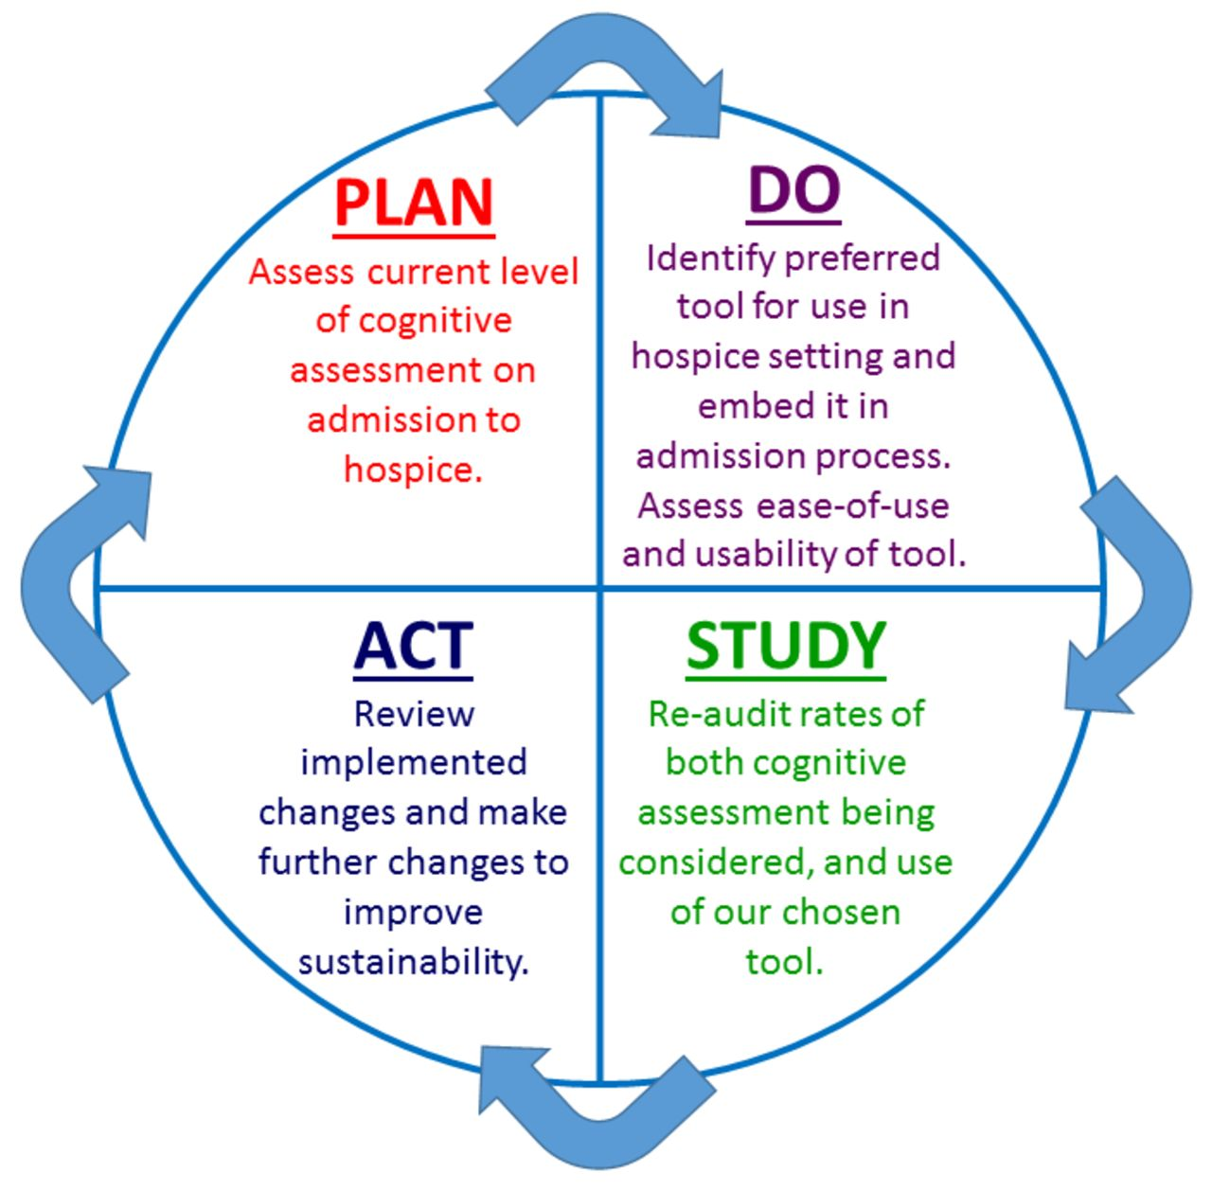
Step 10: Never stop improving, never stop growing, never stop asking questions!
This Photo by Unknown Author is licensed under CC BY-NC

Slide 45
What are we working on now to promote vaginal birth
  Bringing “spinning babies” program to our nursing staff
  Taking a microscope to inductions
  Aggressively promoting/marketing the OB Hospitalist with our community docs
  Midwives???

Slide 46
Thank You.

Slide 47
Team Talk:
Ascension St. Alexius Medical Center
Kellie Smith, BSN, RNC-OB, C-EFM
Clinical Nurse Educator, Labor and Delivery

Slide 48
Ascension Saint Alexius
PVB: Team Shared Decision Making and Multidisciplinary Review

Slide 49

Hospital Statistics
Template Guide
Approved brand icons can be interchanged on the icon slide.
Section Title Here
Our Women & Children’s Hospital has approximately 3,000 deliveries annually
We offer comprehensive care for women experiencing complicated or high-risk pregnancies with access to fetal medicine specialists.
Our hospital has a family-centered, level III Neonatal Intensive Care Unit with single private rooms.
We have a multidisciplinary hospital QI team consisting of maternal fetal medicine physicians, obstetricians, neonatologists, nurses and the leadership team.

Slide 50
Objectives of Team Talk
Section Title Here
Increase the percent of cesarean section deliveries among NTSV births that meet ACOG/SMFM criteria for cesarean
Increase the percent of physicians/midwives/nurses educated on ACOG/SMFM criteria for cesarean, labor management strategies/response to labor challenges, protocol for facilitating decision huddles and/or decision debriefs

Slide 51
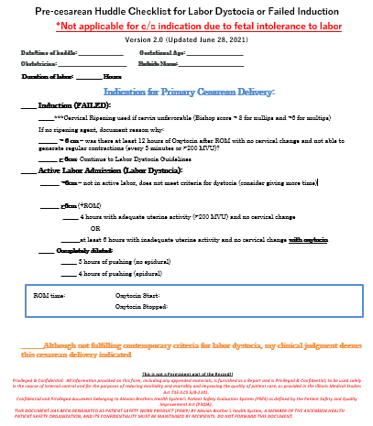
Pre-cesarean Huddle Checklist for Labor Dystocia or Failed Induction
Section Title Here
Placed on patient chart
Huddle shared decision making
Daily compliance on MDI board

Slide 52

Multidisciplinary Cesarean Section Review Process
Section Title Here
Audit all NTSV deliveries
OB representative on quality team review all NTSV cases for ACOG/SMFM criteria
If criteria not met, ERS for physician peer review process

Slide 53
Next Steps
Section Title Here
Education | Schedule CME/Grand Rounds
Huddle Form | Evaluate format into algorithm
Statistics | Deeper analysis of non-reassuring FHTs as indication

Slide 54
Questions?

Slide 55
Next Steps with PVB

Slide 56
PVB Data by Race/Ethnicity and Insurance Status
Goal: Provide data reports to all teams with their NTSV CS rates stratified by race, ethnicity and insurance status to support their QI efforts
  Bridging PVB and BE initiatives to look at key measures stratified by race/ethnicity, insurance status to identify disparities and address them
  Foundation of QI (No quality without equity)
  We already have race/ethnicity and insurance status for NTSV CS, only one additional data point needed:
    race/ethnicity and insurance status for all NTSV births
Notes:
Is this clear enough for teams??

Slide 57
PVB Hospital Data Form Updates
 | Total | White | Black | Hispanic | Asian | Other
NTSV Deliveries
NTSV Cesarean Deliveries
Legend
Question Already Asked
Proposed New Question
 | Private Insurance | Public Insurance | Uninsured/Self-pay
NTSV Deliveries
NTSV Cesarean Deliveries

Slide 58
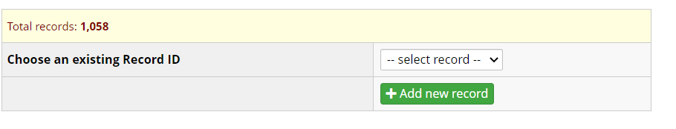
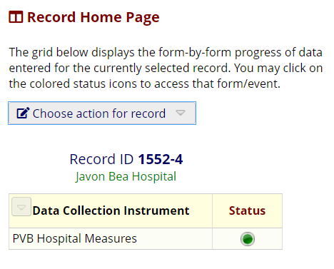
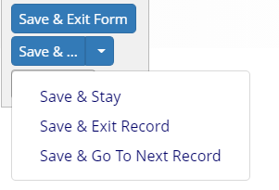
Stratified NTSV C/S data – next steps
Prospective Data (April 2022 – end of Initiative)
  PVB Hospital Level Data form updated in PVB Toolkit and in REDCap
Retrospective Data (Baseline-March 2022)
  Due August 1, 2022
  1. Log-in to REDCap and click the
  select record drop-down menu
  2. Click the green dot under status
  3. The data form will open and you can answer the race and ethnicity questions, then click save and exit

Slide 59

PVB Grand Rounds
PVB Grand Rounds help facilitate buy-in and give your providers the opportunity learn more about the initiative
Hear from an expert on the ILPQC Grand Rounds Speaker’s Bureau
Email ellie.suse@northwestern.edu to schedule your grand rounds or OB provider meeting
14 Grand Rounds already scheduled for PVB

Slide 60

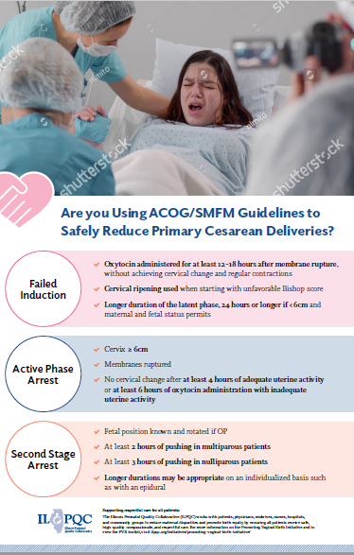

Provider Education Resources:
POSTERS HAVE SHIPPED!
Reach out to ellie.suse@northwestern.edu if you have not received your posters!

Slide 61
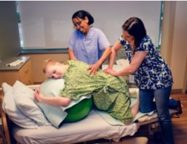
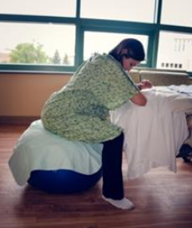
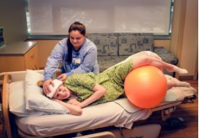
Labor management support
E-Modules: AVAILABLE NOW!
Additional Resource: Supplemental Comprehension guide
ILPQC Labor Management Support E-Modules for physician and nurse education adapted from Labor Management Support Workshops
Notes:
I will insert screenshots once it is on the Webpage

Slide 62
Upcoming Monthly Webinars:
Date | Topic
Wednesday, May 25th | 2022 ILPQC OB Face-to-Face
Monday, June 27th 12:30-1:30 | Dystocia Management Strategies
Monday, July 25th 12:30-1:30 | TBD
Monday, August 22nd 12:30-1:30 | TBD

Slide 63
Next Steps
Prepare for 2022 Face-to-Face Conference
  Registration Open!
  Submit QI Data by May 2nd
  Submit QI Storyboard by May 11th
  Submit team photo by May 11th (to be included in raffle!)
Be on the lookout for PVB Provider posters in the mail and Labor Management support E-modules on the ILPQC Website
Email ellie.suse@northwestern.edu to set up one-on-one QI Support call
Determine if a PVB Grand Rounds/OB Provider Meeting to help achieve nurse and physician buy-in
Submit monthly data for Baseline-March 2022
To allow us to stratify NTSV C/S data request all hospitals submit 2021 Race and Ethnicity / Insurance status data for all NTSV births by August 1

Slide 64
Next Steps
race/ethnicity for all NTSV births by August 1

Slide 65
Questions?
Please put your questions or comments in the chat

Slide 66










Thanks to our Funders
In kind support:

