Slide 1

PVB Monthly Webinar: Individual NTSV C-Section Fallout Case Review
September 26th 2022 at 12:30 PM

Slide 2
Overview:
2022 Annual Conference Information
PVB Data Review
NTSV C-Section Fallout Individual Case Review
Team Talks:
  Riverside Medical Center
  Advocate Good Samaritan
  Advocate Illinois Masonic
PVB Next Steps
PVB Office Hours: Creating your 2022 Annual Conference Abstract/Poster
  Join us after the call to ask any questions you may have

Slide 3


Registration Open!

Slide 4


Slide 5


ILPQC 10th Annual Conference Webpage
Register here // Reserve Hotel Room // AC Teams Survey // Poster Abstract

Slide 6


All structure & patient-level data entered for Baseline-August 2022
  Including Race, ethnicity, and insurance status NTSV delivery data Baseline-August 2022
Key Structure Measures "In Place":
  Provider and Nurse Education
  Standardized Protocol/Processes
  Sharing un-blinded provider level NTSV C-Section rates
  Cesarean Decision Checklist
  Decision Huddles/Debriefs
  Shared Decision-Making

Slide 7
Achievement of PVB aims
  ≥ 80% of Providers and Nurses educated on ACOG/SMFM guidelines
  ≥ 80% of all NTSV C-Sections meeting ACOG/SMFM guidelines
  NTSV C-Section Rate ≤23.6%

Slide 8
Call for Poster Abstracts for AC Poster Session
All hospital teams are asked to submit a brief abstract on QI work from your last year
Abstracts submitted by Oct. 3rd will be reviewed for awards:
  Top abstract(s) in OB, Neonatal, Patient/Family Engagement, First time Level I/II Hospital receive Abstract of Excellence of Wards
  Special recognition for (1) Best Use of Data, (2) Best Project Implementation
Awarded abstracts will be announced at the conference and have a prize designation displayed on their poster
Late breaking abstracts (not eligible for awards) but posters will be shared at the conference are due Oct 10th
All abstracts are accepted- your team should plan to prepare a poster for the AC poster session
Submission link coming soon

Slide 9
We want to hear from you!
ILPQC Annual Conference Survey is open!
This is a great opportunity to share your teams' thoughts & insights reflecting on 2022 and planning for 2023!
Please coordinate with your colleagues working across all ILPQC initiative to have one person from your hospital submit the survey by October 3rd
We typically have almost 100% of teams complete the Annual Survey! Please plan with your team who will complete and submit this important survey to share your important input to make ILPQC the best it can be for every IL birthing hospital

Slide 10
Hospital Team Annual Conference Prep
Register
Data & Awards
Submit your AC Poster Abstract by October 3rd to be considered for an award.
2022 AC Survey
Abstracts
Make sure all data Baseline-August 2022 is entered in REDCap by Sept 19th 2022
Registration open on ILPQC webpage!
Attend Event
Meet together in-person for Annual Conference 8:00am-4:30pm
Book your hotel at the Westin in Lombard, IL
Opportunity to share thoughts & insights reflecting on 2022 & 2023 planning
Submit the survey by October 3rd
Print and bring your poster to display!

Slide 11
PVB Data Review

Slide 12
NTSV C-Section Rate by Race and
Ethnicity
NTSV C-Section Race and Ethnicity Data Collection:
Goal: Provide data reports to all teams with their NTSV CS rates stratified by race, ethnicity and insurance status
Bridging PVB and BE initiatives to stratify key measures to identify disparities and address them
"There is no quality without equity"

Slide 13
PVB Hospital Data that is needed to provide all teams stratified NTSV C/S data
 | Total | White | Black | Hispanic | Asian | Other
NTSV Deliveries
NTSV Cesarean Deliveries
Legend
Data already submitted
Data that must be submitted Baseline through March 2022
 | Private Insurance | Public Insurance | Uninsured/Self-pay
NTSV Deliveries
NTSV Cesarean Deliveries

Slide 14
Receive your NTSV C/S data stratified by race/ethnicity/insurance status: next steps for PVB teams
Who? All PVB Teams
What? # of NTSV Deliveries by Race/ Ethnicity and Insurance status for baseline (Quarter 4 2019) and January 2021 to March 2022
Where? Edit your past submissions for PVB Hospital level data, there is now an entry for # NTSV Deliveries by race/ethnicity and insurance status
34 Teams have submitted all race, ethnicity and insurance data
Notes:
Confirm timeline that NTSV delivery data is needed from

Slide 15
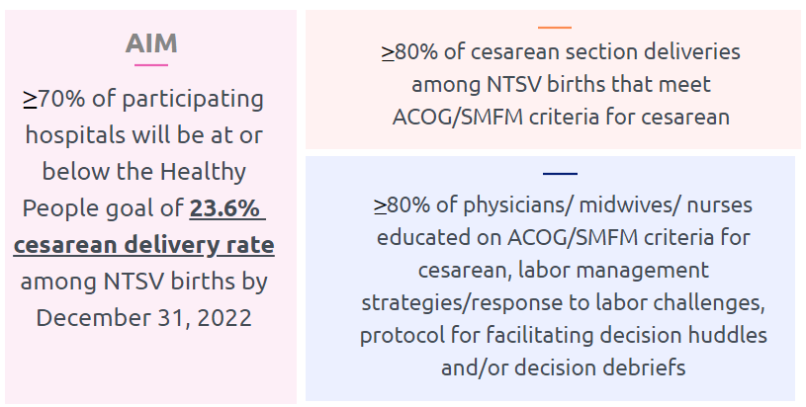
PVB Aims and Measures

Slide 16
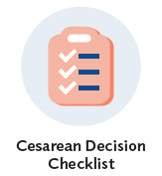






PVB Key Strategies for
Creating Clinical Culture Change
Sharing Unblinded Provider-level NTSV C-Section Rates
Review of NTSV C-Section Cases Not Meeting ACOG/SMFM Guidelines

Slide 17
ILPQC Hospital Team Data Submission
(94 Teams Total)
Month | Patient Data | Hospital Data
Baseline | 89 | 85
January 2021 | 86 | 80
February 2021 | 85 | 80
March 2021 | 85 | 79
April 2021 | 81 | 81
May 2021 | 78 | 71
June 2021 | 71 | 71
July 2021 | 76 | 70
August 2021 | 78 | 68
September 2021 | 75 | 67
October 2021 | 74 | 67
Month | Patient Data | Hospital Data
November 2021 | 70 | 65
December 2021 | 70 | 65
January 2022 | 67 | 66
February 2022 | 66 | 66
March 2022 | 69 | 65
April 2022 | 66 | 62
May 2022 | 68 | 63
June 2022 | 66 | 60
July 2022 | 64 | 56
August 2022 | 54 | 47

Slide 18
PVB Teams Progress on Key Structure Measures

Slide 19
ILPQC teams NTSV C-Section Rate

Slide 20
NTSV C-Section Rates, by hospital
Goal: < 23.6%
All ILPQC Average: 23%
Notes:
Would probably just share June data for this slide and the slide before as July data really hasn’t all been submitted

Slide 21
NTSV C-Sections Meeting
ACOG/SMFM Guidelines (goal > 80%)

Slide 22
Are you reviewing your ACOG / SMFM criteria fall outs? How can you reach your goal > 80% NTSV C/S meeting criteria?
All team members should understand goal > 80% of NTSV C/S achieve ACOG / SMFM criteria.
Every team should review their data for ACOG / SMFM criteria monthly or quarterly (depending on birth volume) and be sharing the data with QI team as well as providers and nurses.
Review fall outs that do not meet ACOG/SMFM criteria:
  Discuss and provide feedback to clinical team
  Opportunity to provide specific education to providers and/nurses
  Huddles / NTSV c/s checklist process should be used to review/discuss criteria and indications for cesarean
  Check how cesarean decisions are documented and why not meeting criteria? Can documentation be improved?

Slide 23
NTSV C-Sections Meeting
ACOG/SMFM Guidelines: Failed Induction
ACOG/SMFM Criteria for Failed Induction:
Oxytocin administered for at least 12-18 hours after membrane rupture, without achieving cervical change and regular contractions
Longer duration of the latent phase, 24 hours or longer if <6cm and maternal and fetal status permits

Slide 24
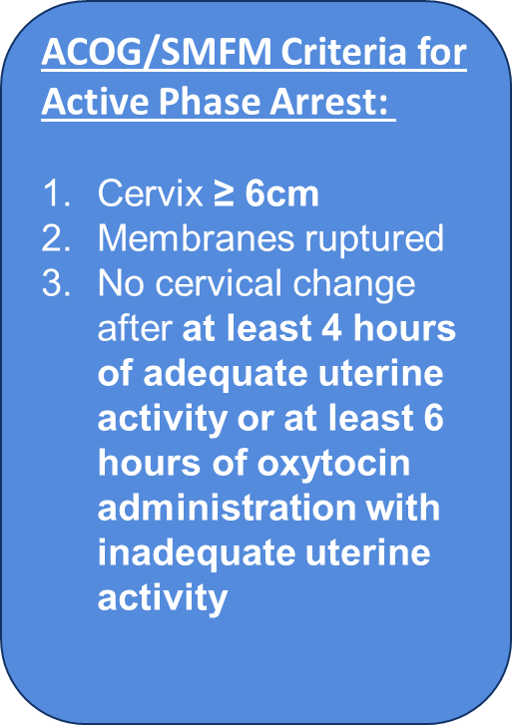
NTSV C-Sections Meeting
ACOG/SMFM Guidelines: Active Phase Arrest

Slide 25
NTSV C-Sections Meeting
ACOG/SMFM Guidelines: Second Stage Arrest
ACOG/SMFM Criteria for Second Stage Arrest:
At least 3 hours* of pushing in nulliparous patients
*Longer durations (e.g. 4 hours with epidural) may be appropriate on an individualized basis

Slide 26
Which ACOG/SMFM Criteria does your team need to focus efforts to achieve your > 80% overall goal?
Failed induction
  Oxytocin administered for at least 12-18 hours after membrane rupture, without achieving cervical change and regular contractions
  Longer duration of the latent phase, 24 hours or longer if <6cm and maternal and fetal status permits
Second stage arrest
  At least 3 hours* of pushing in nulliparous patients
*Longer durations (e.g., 4 hrs with epidural) may be appropriate, individualized basis

Slide 27
Provider and Nurse Education
Keep it up!

Slide 28
Standard Protocols and Processes
Great work!

Slide 29
Sharing Provider Level Data
Wow! Progress!

Slide 30
Cesarean Decision Checklists and Decision Huddles/Debriefs
Keep it up!

Slide 31
Shared Decision Making and Patient Education
Progress with & for Patients!
Notes:
Focus for today

Slide 32
Individual Case review for NTSV C-Sections not meeting ACOG/SMFM Criteria

Slide 33
PVB Fall Outs Review Tools
PVB ACOG/SMFM Guidelines Checklist
ILPQC PVB Dashboard
CMQCC Providence St. Joseph Audit Form

Slide 34
Fall-Outs: Individual Case Reviews
Identify cases not compliant with ACOG / SMFM guidelines: data dashboard
Review chart and identify how NTSV Cesarean Indication documented, identify which component was not compliant with ACOG / SMFM guidelines
Understand additional details of case, was there an additional indication for CS that was indicated? Was documentation appropriate?
Take notes and provide feedback to clinical team.
Identify patterns and areas to work on

Slide 35
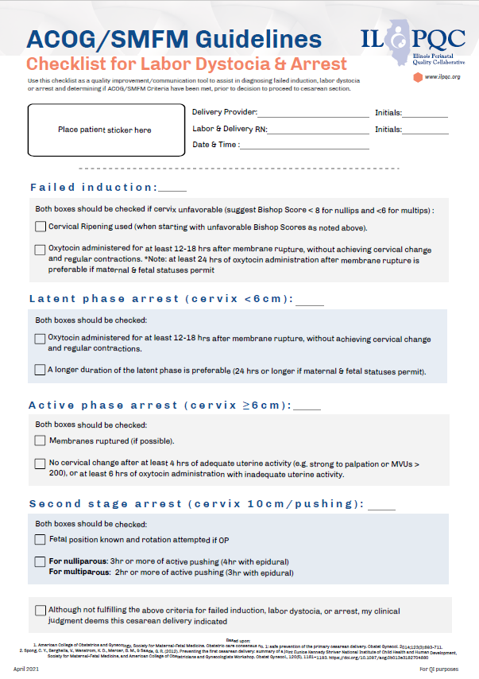
Can use ACOG/SMFM checklist to review and discuss PVB Fall Outs

Slide 36
Create tools that work, and put them in every chart.
RN-MD shared decision making communication tool
Improves discussion of CS indications and if compliant with guidelines, identifies fall outs

Slide 37

Look at your fall-outs and provide feedback
Look for patterns, what can you work on
Inductions!
Can documentation of CS indications and compliance be improved
Feedback to clinical team: providers and nurses
Identify opportunities for PDSA to improve compliance with CS indications

Slide 38
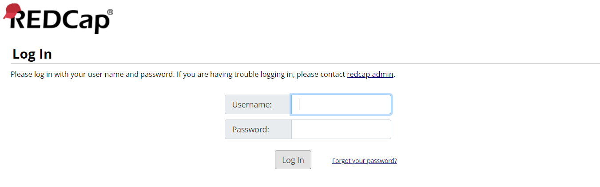
PVB Dashboard: Logging in to RedCap
https://redcap.healthlnk.org

Slide 39
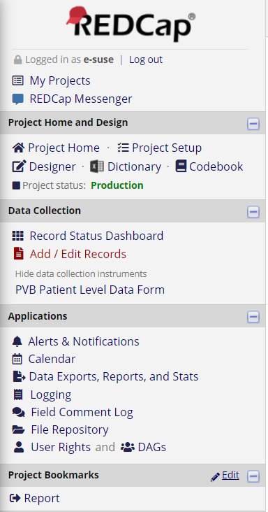
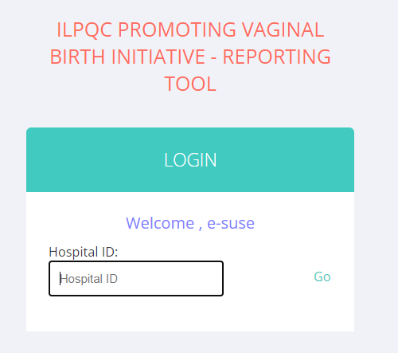
Let’s take a look at our PVB Reports
234

Slide 40
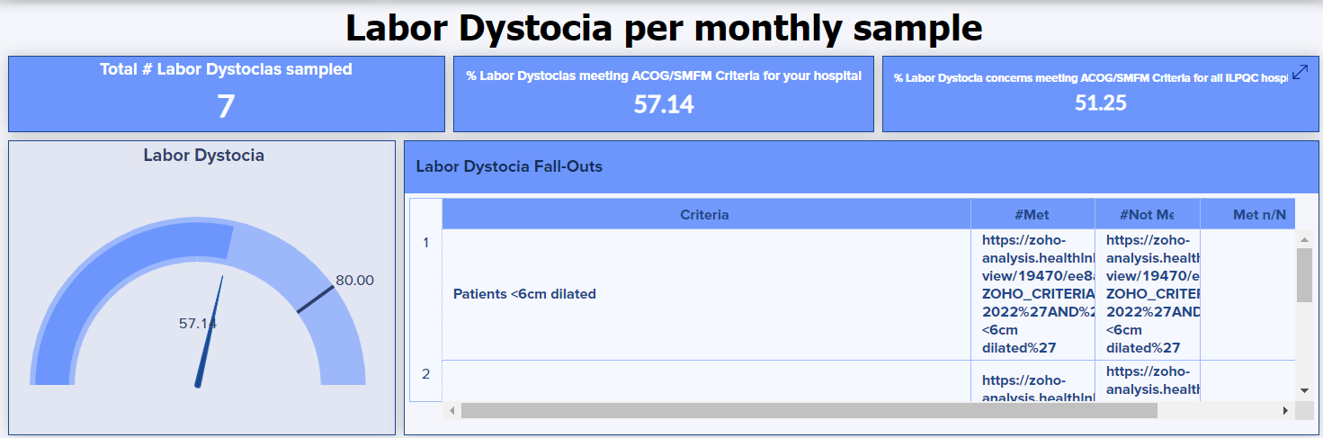
Labor Dystocia

Slide 41
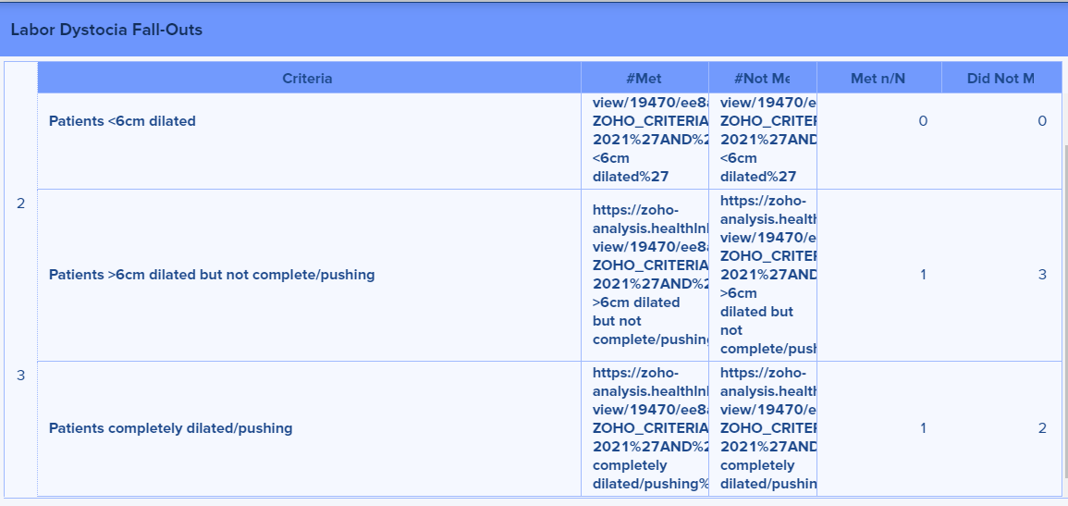
Second Stage Arrest
0
1
2
1
2

Slide 42
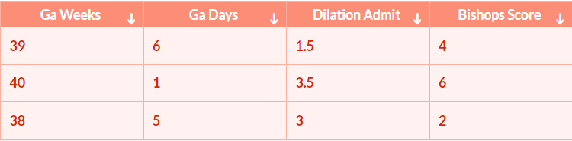
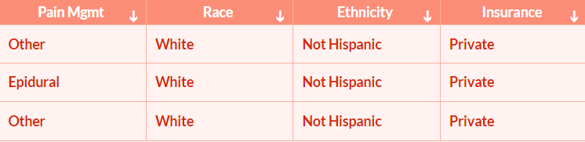
Individual Case Reviews
Record-ID
1234-123
1234-123
1234-126
Public
Black
Hispanic
Public

Slide 43
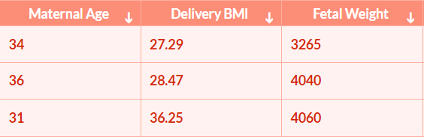
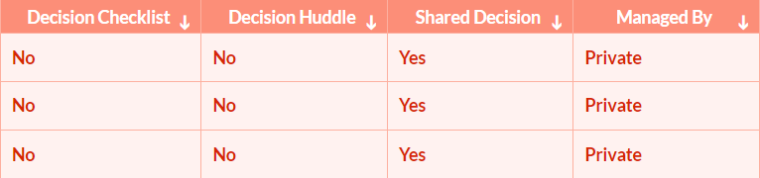
Individual Case Reviews

Slide 44
Other PVB Audit Tools

Slide 45
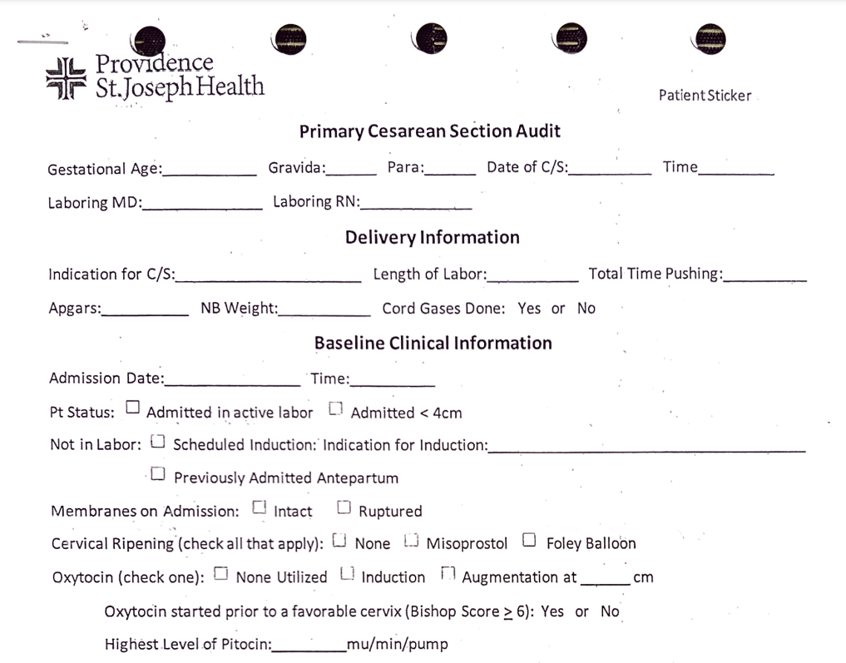
CMQCC Providence St. Joseph Audit Form
Include care team and overall delivery information
Basic admission information for review

Slide 46
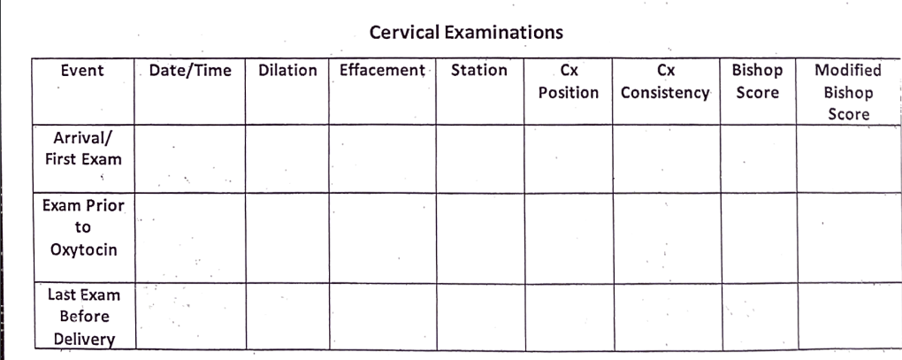
CMQCC Providence St. Joseph Audit Form
Review Cervical Exams during different times of labor

Slide 47
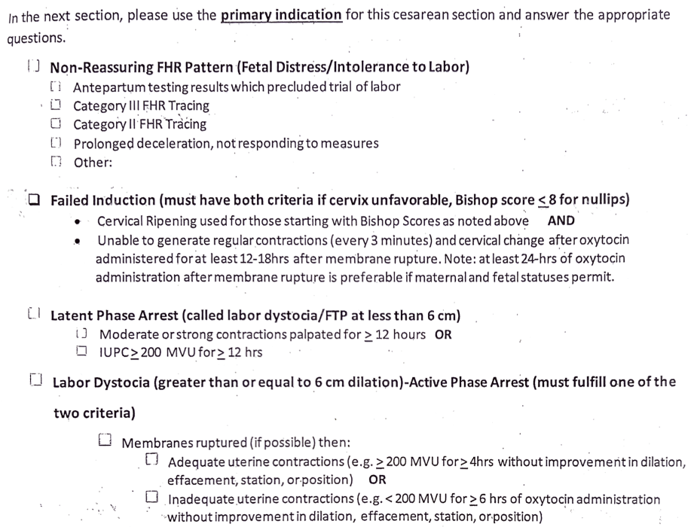
CMQCC Providence St. Joseph Audit Form
Review ACOG/SMFM Criteria for C-section indication

Slide 48
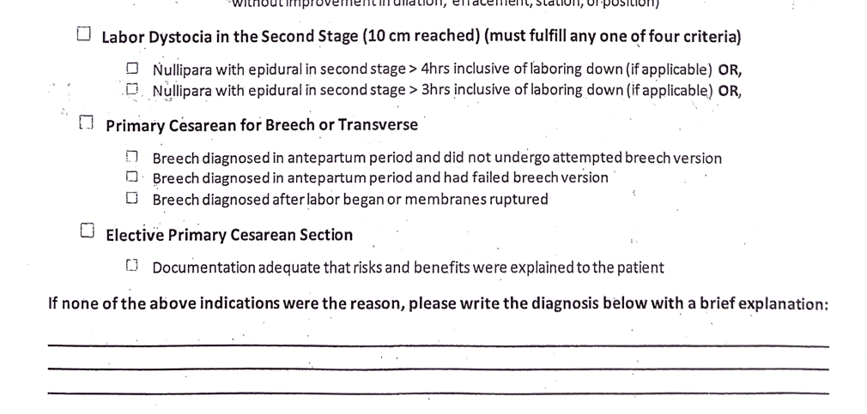
CMQCC Providence St. Joseph Audit Form
Add any additional notes if the indication is not shown above

Slide 49
Team Talk: Advocate Good Samaritan
Rosally V. Starr, M.D., FACOG, CHCQM
Director of Obstetrics

Slide 50
Understanding
NTSV CD trends:
Illinois Masonic Medical Center
Rosally V. Starr, M.D., FACOG, CHCQM
Director of Obstetrics
Sept 26, 2022

Slide 51
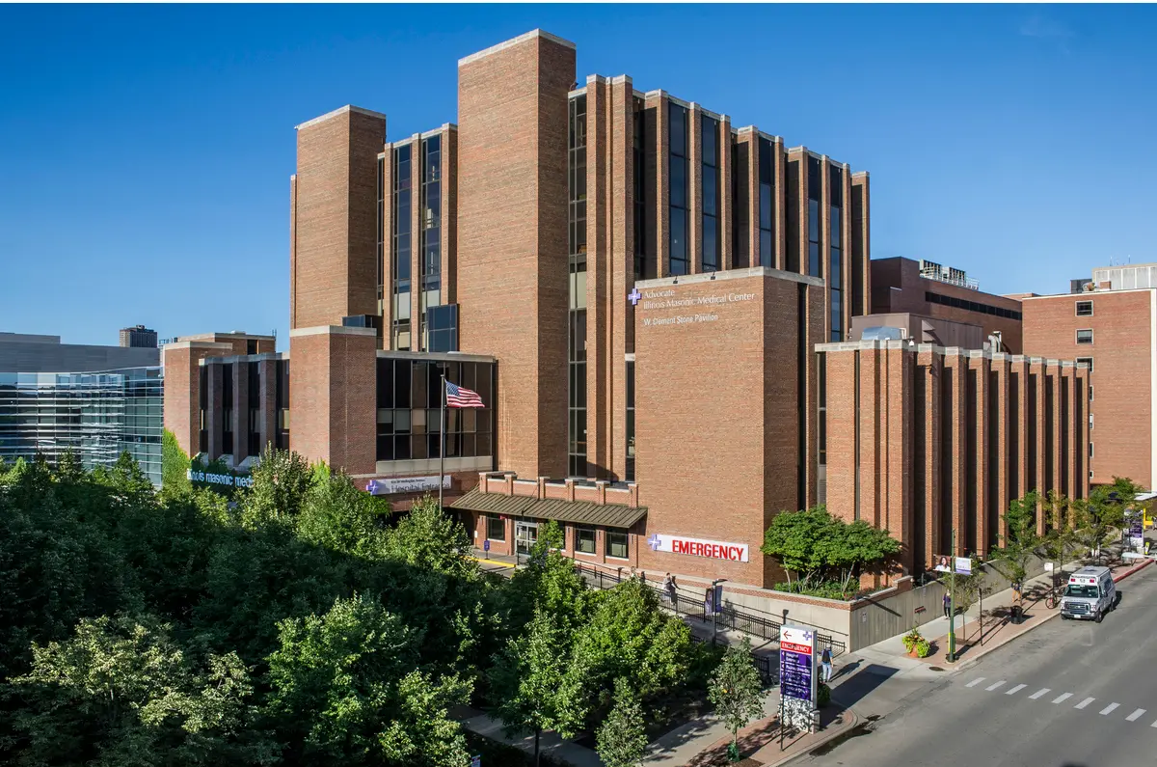
Advocate Illinois Masonic Medical Center
836 W. Wellington Ave
Chicago, IL 60657
Lakeview neighborhood
408 bed teaching hospital
14 OB-GYN residents
~1600 deliveries/yr (4 yr mean)
Level III NICU

Slide 52
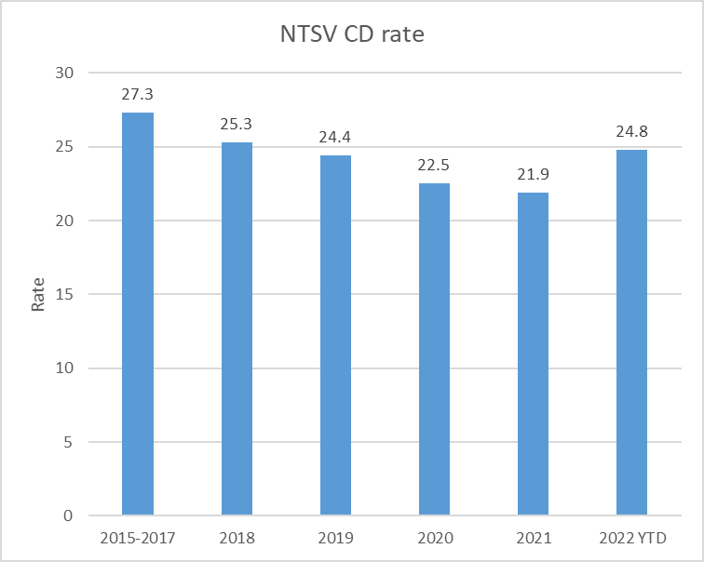
PI project: NTSV CD reduction (2/1/2018)
PI project launch
“Safe Prevention of the Primary Cesarean Delivery”. Obstetric Consensus. ACOG 2014.

Slide 53



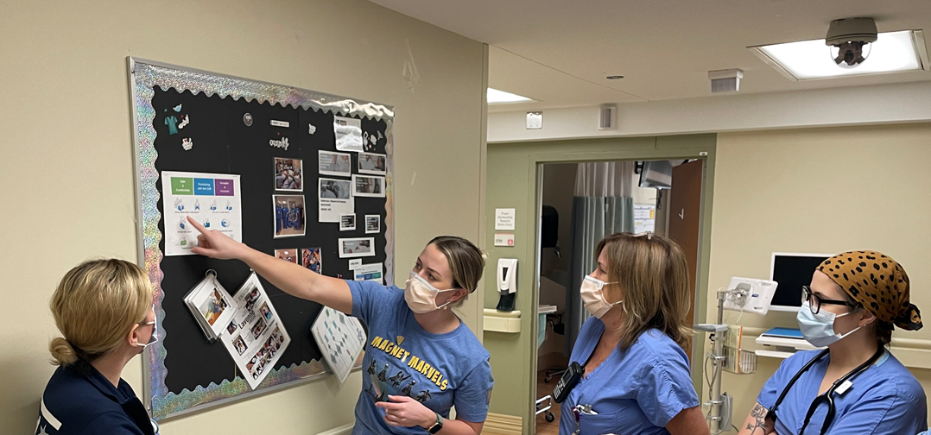
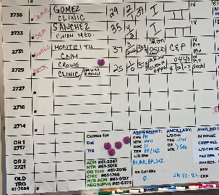

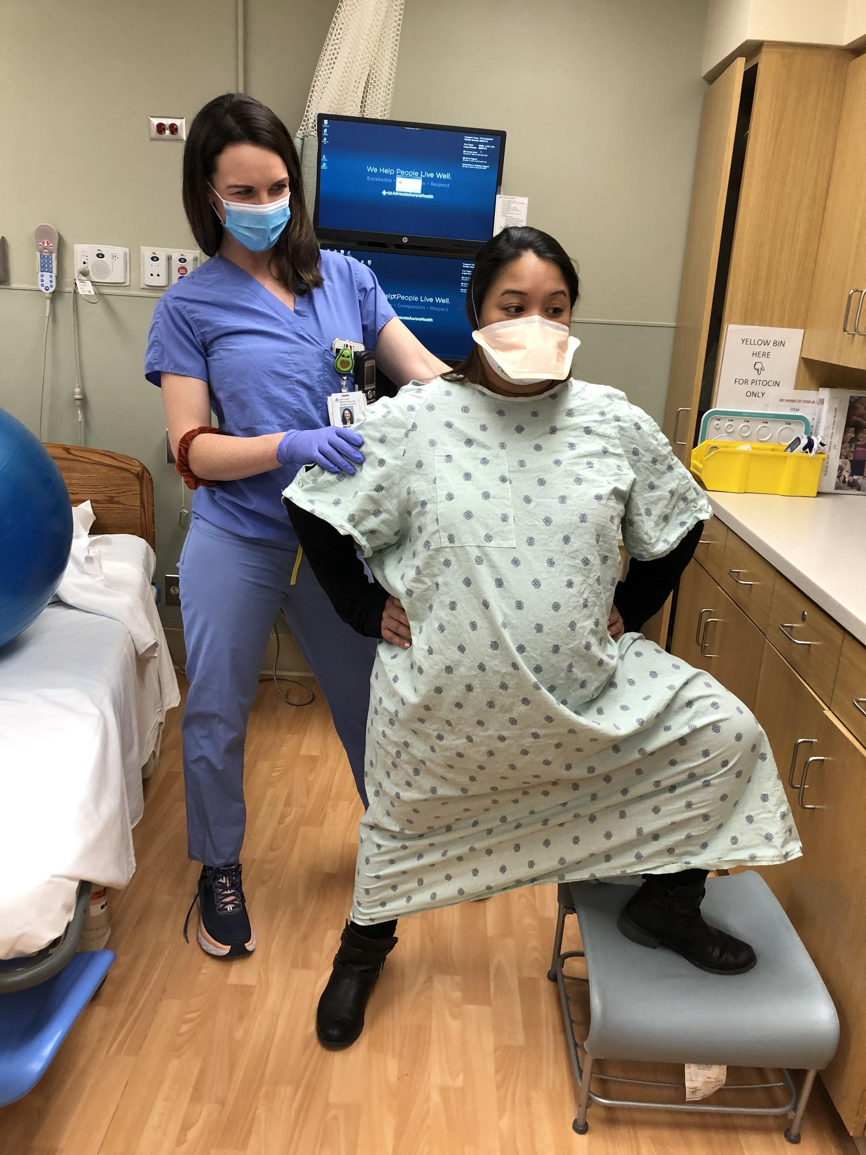
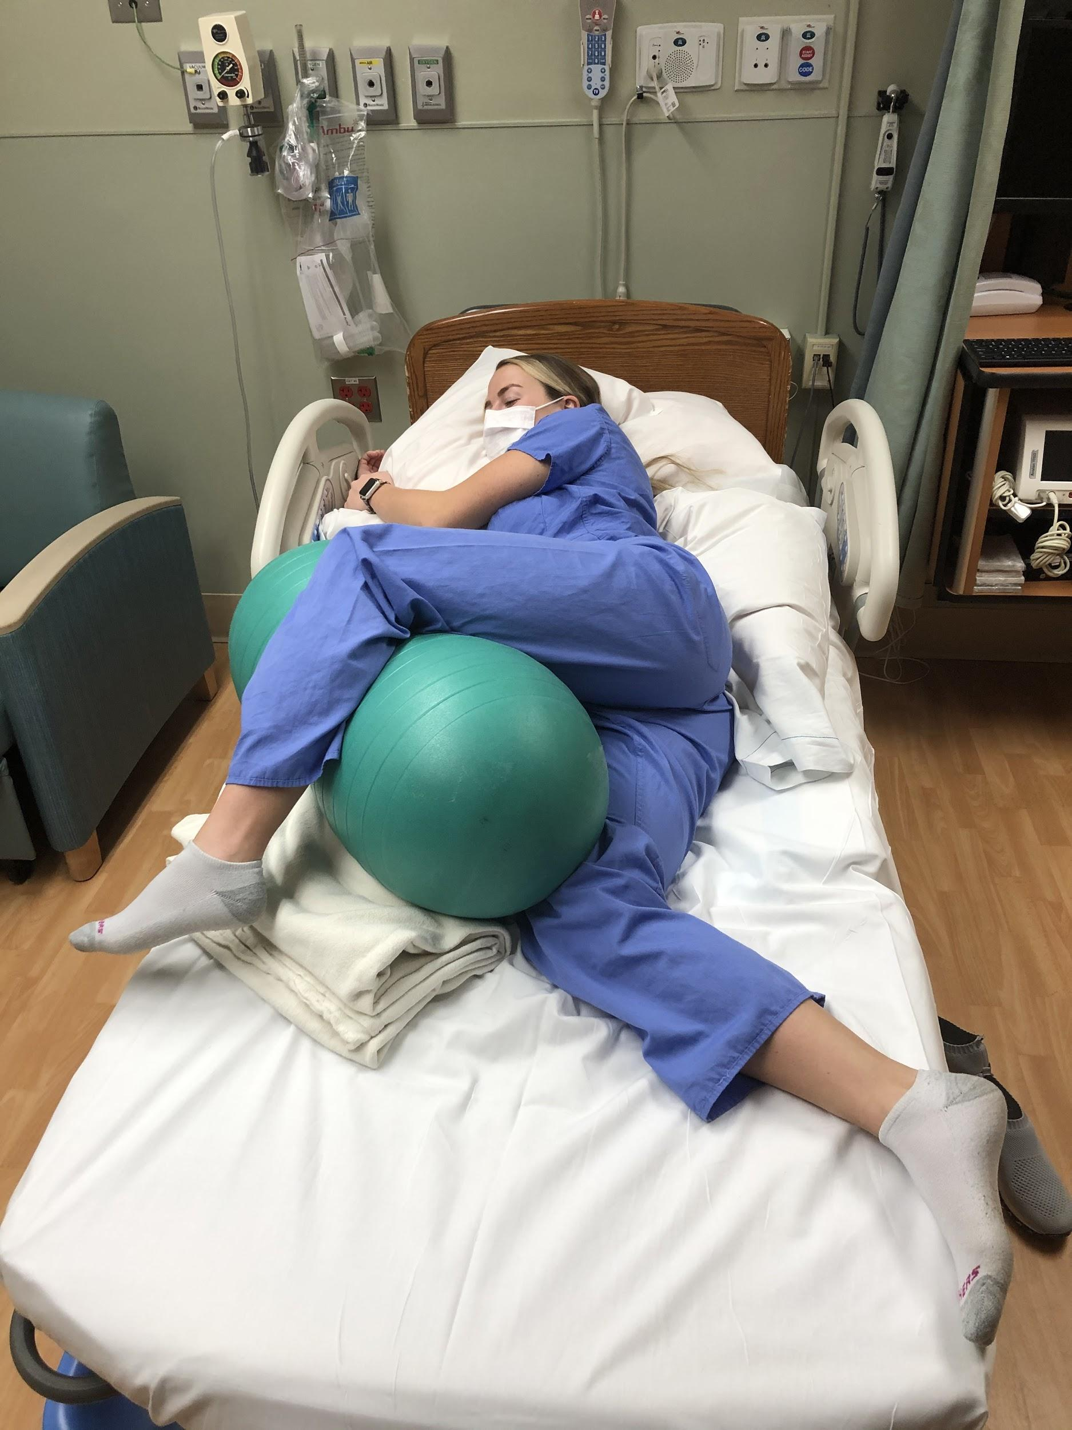
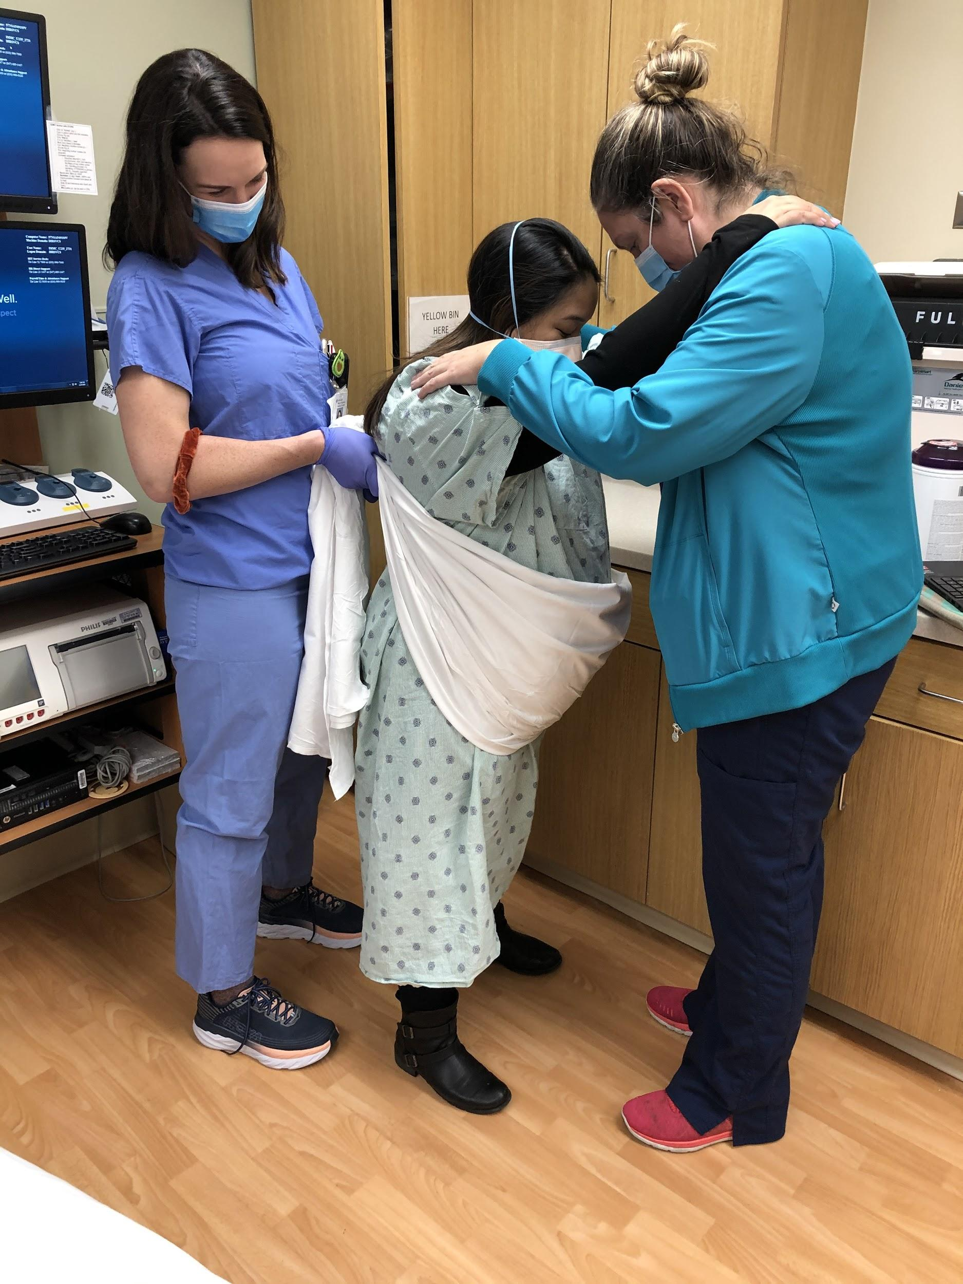
Illinois Masonic Medical Center ILPQC Story Board
Patricia Green, MSN, CNM, WHNP-BC, CLC, Mary Silva, BSN, RNC-NIC, Jessica Burdi, MSN, RNC-MNN
Advocate Illinois Masonic Medical Center is proud to be Magnet® recognized by the American Nurses Credentialing Center.
Hospital & QI Team Overview
PVB
Peggy Hamilton, Karen Wenneberg, Rosally Starr, Molly Kavanaugh, Jude Duval, Kamila Stoksik, Mary Silva, Jessica Burdi, Mary Murphy, Laura Priddy, Zachary Lamaster, Marina Dubovis, Dawn Johnson, Sarah Hoekwater, Humera Asem, Patricia Green
Birth Equity
Jessica Burdi, Thomas Iannucci, Brenda Darrell, David Trotter, Erwin Gumila, Mary Silva, Donna Rice, Sandra Arellano, Susana Sancheztong, Manuel Valdez, Mervin Dino, Toussaint Ward, Shannon Rusch, Laura Priddy, Peggy Hamilton, Patricia Green
PVB magnets for labor board
PVB
Labor positioning formal education with hands on practice for all RNs
RN Team practicing with each other!
New induction of labor guideline that incorporates ILPQC flowsheets and decision huddle documents
RN, CNM and MD team members sent to Spinning Babies workshop & PVB workshop
Labor positioning education for all new team members
Decision huddles/debriefs for NTSV cesarean deliveries
NTSV rate presented at all staff meetings and OB M&Ms
Laborist model and participation in PVB committee allows for smooth implementation
CUB positioners purchased
Telemetry fetal monitor upgraded
Patient education position cards at bedside
Birth Equity
Site- Monthly Meetings
AAH System- Site representatives sit on BE education and data committees
PVB
Site- Quarterly committee meetings- Data reviewed monthly
AAH System- Site representatives on education and policy committees
 | 2019 | 2020 | 2021 | 2022
Annual NTSV CD Rate | 24.4 | 22.5 | 21.9 | 20.9
Review all MNO cases for compliance guidelines put in place.
AAH System MNO committee to determine reeducation as needed
Annual resident education for ILPQC initiatives
ILPQC initiatives reviewed during onboarding of new RNs
Sustainability of Shared-Decision Making Tool on Mother Baby Unit
MNO
 | IMMC
RACE
WHITE | 36%
BLACK/AFRICAN AMER. | 11%
HISPANIC | 44%
ASIAN | 6%
OTHER | 3%
INSURANCE
PRIVATE | 66%
PUBLIC/UNINSURED | 33%
Diversity Science education to be completed by all team members caring for obstetric patients
IMMC is AAH System pilot site for social determinants of health screening tool
Considering creating new roles of outpatient nurse navigator and social worker after determining need from SDOH pilot
Partnering with AAH System DE&I committee to combine efforts on similar projects
BE
Percent of C/S Patients with 0-5 Opioid Pills Prescribed at Discharge
Dec 2021 | 85%
Jan 2022 | 86%
.

Slide 54
A lower
number is
better.
*NTSV C-section Rate: Nulliparous, Term, Singleton, Vertex Cesarean Section Rate
Definition: This measure uses a proxy definition to get as close as possible to the CMS definition. It was developed for the use of OB Leadership and is not abstracted or reported by AAH. Please see attached icon for further information.
Data Source: EDW
Data table:
Please see attached icon for numerator and denominator information.
Target: Per Rosally Starr, MD, Director, Obstetrics, AIMMC, the target is the Illinois 50th percentile; used as goal for the statewide “Promoting Vaginal Birth” Healthy People 2020 initiative of the Illinois Perinatal Quality Collaborative (ILPQC). For information on this initiative, go to https://ilpqc.org/initiatives/promoting-vaginal-birth-initiative.

Slide 55
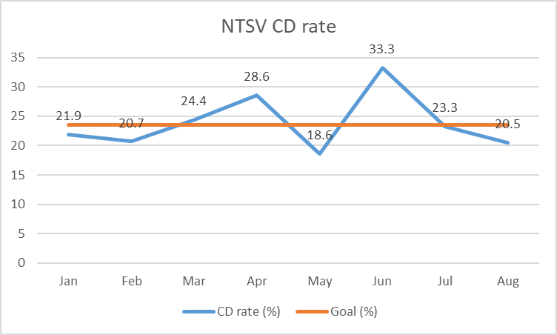

Slide 56
Deep Dive
Manual chart review (n = 77)
Better understand clinical management
Investigate contributing variables to outcomes
Total NTSV
Total IOL
Indicators for cesarean delivery
Personnel (Laborist Model)

Slide 57
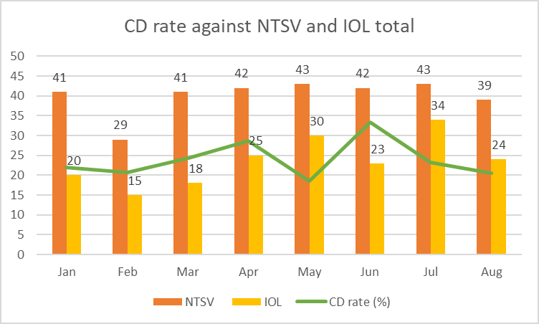

Slide 58
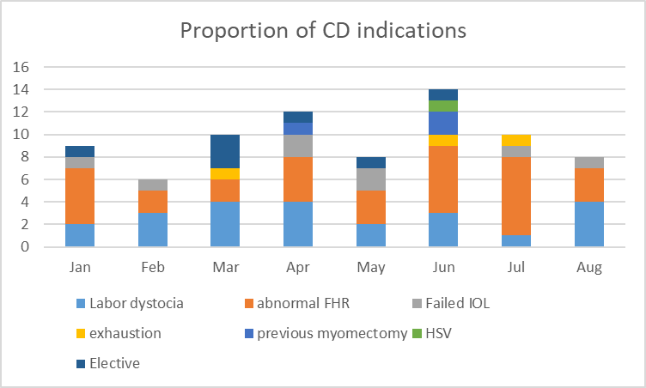

Slide 59
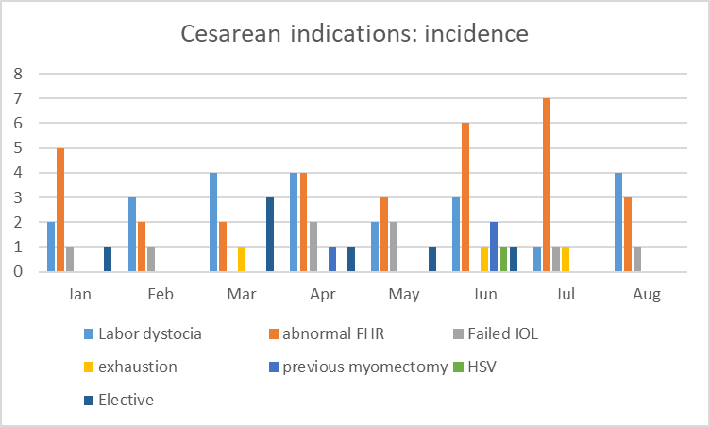

Slide 60
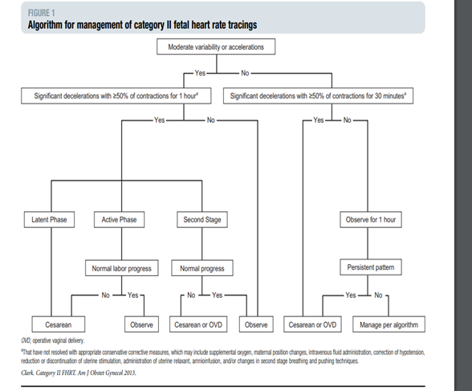
Clark, et al. “Intrapartum management of category II fetal heart tracings: towards standardizations of care”. Am J Obstet Gynecol. Aug 2013.
Exceptions:
TOLAC
Preterm labor < 28wks
Sinusoidal rhythm
Suspected abruption

Slide 61
Moving forward…
“Blip”?
Challenge: Balance parallel goals of PVB vs. supporting fetal well being.
Unintended consequence of ARRIVE trial?
  Discourage elective IOL with unfavorable cervix (maternal exhaustion)
All OB staff current with EFM interpretation competency (standardized terminology for Cat 1-3 tracings).
Continued surveillance of our quality performance.

Slide 62
Team Talk: Riverside
Barbara Schuch, Director of Women & Newborn Services
Mary Ellen Arrington, Perinatal Quality Coordinator

Slide 63

Promoting Vaginal Birth - PVB
Riverside Hospital’s Journey
Barbara Schuch, Director of Women & Newborn Services
Mary Ellen Arrington, Perinatal Quality Coordinator

Slide 64


Riverside Hospital Overview
Riverside Hospital is located in
Kankakee, Illinois
341 bed - Magnet Designated Hospital
Level II Perinatal Center > part of the U of C Regional Network
*24/7 Pediatric U of C Hospitalists
7 LDR, 4 Observation/Testing Rooms
~1000 deliveries per year

Slide 65
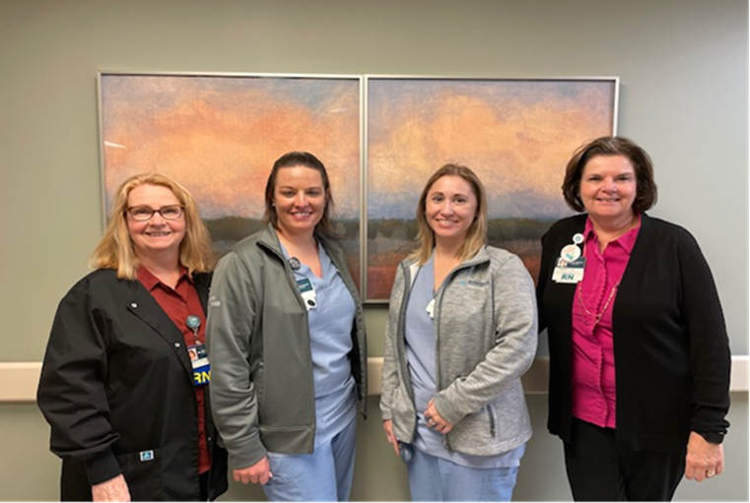
Hospital Quality Team
From left to right…
Mary Ellen Arrington, Perinatal Quality Coordinator
Kaylee Gray, Clinical Team Leader
Laura Brown, Clinical Educator
Barbara Schuch, Director of Women & Newborn Services and Magnet Program

Slide 66
Successes
Provider and RN education √
  OLIE Education rolled out May 2021
  PVB Grand Rounds July 2021 for MD’s
Implemented labor support management-January 2021 in place √
  Standardized protocols for IOL’s
  Response to labor & fetal heart rate abnormalities
Cesarean Section Decision Checklist √
  Worked on May 2021-February of 2022
    (form, education & RN buy-in)
  In place March of 2022
Sharing Unblinded Provider Level Data √
  April 2021 in place & shared at the WCSL Meeting
Decision Huddles & Debriefs √
  May 2021-February 2022
  In place March 20222
Shared Decision Making with the Patient √
  Providers have always done this, but without a checklist

Slide 67
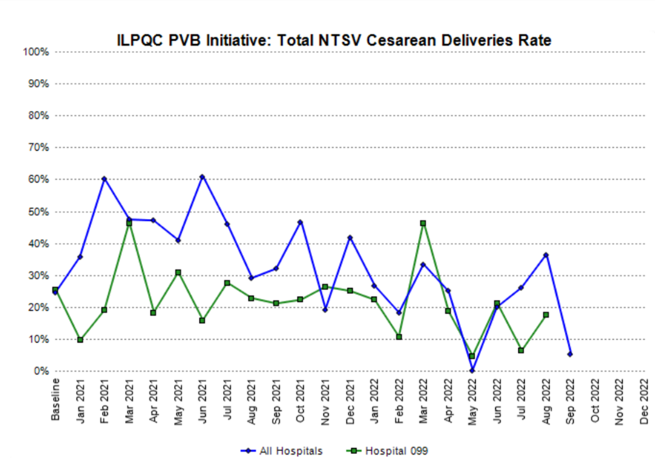
Data Progression – Total NTSV Rate – YTD 16.8%
Redcap

Slide 68
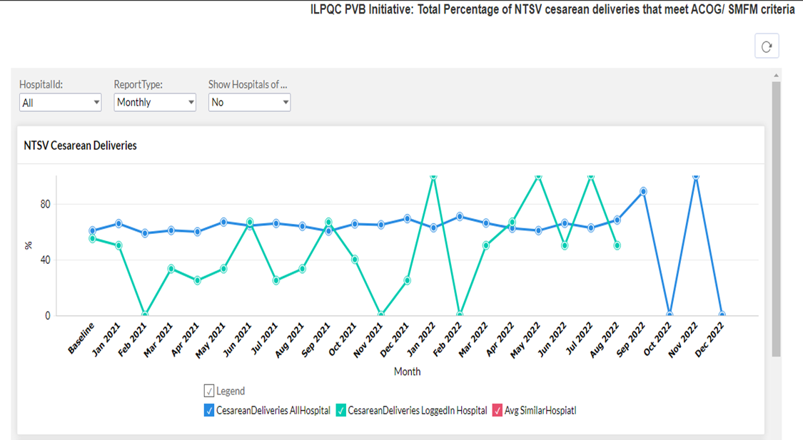
Data Progression – Meeting ACOG/SMFM Criteria
Redcap

Slide 69
Barriers
Remembering to pull the primary cesarean section checklists & completing them
Providers following the ACOG/SMFM guidelines
  Biggest opportunity is allowing patients to push longer &
  allowing for a longer duration of the latent phase

Slide 70

Questions?

Slide 71
Thank You

Slide 72
PVB Next Steps

Slide 73
ILPQC is here to help you get across the finish line!
PVB Finish Line Goals:
QI Excellence Award
6 Key Structure Measures in Place
NTSV C-Section Rate ≤23.6%
80% of Providers and Nurses educated on ACOG/SMFM Guidelines
80% of all NTSV C-Sections Meeting ACOG/SMFM Guidelines
We are here to help!
We are here to support!
Schedule a personalized QI Support Call, email info@ilpqc.org to schedule for additional support!

Slide 74
Upcoming Calls
Date | Topic
October 27th 8:00am-4:30pm | ILPQC 10th Annual Conference Westin in Lombard, IL
November 28th, 2022 12:30 PM | TBD
Continuing PVB into 2023……
Notes:
We plan to continue PVB into 2023 to help teams get across the finish line. We are in the process of working on how that will look and we welcome your feedback!

Slide 75
Questions?
Please put your questions or comments in the chat

Slide 76










Thanks to our Funders
In kind support:

