Slide 1

PVB Monthly Webinar:
2022 Annual Conference Recap & NTSV C-Section Fallouts
November 28th, 2022 at 12:30 PM

Slide 2
Overview:
2022 Annual Conference Recap
PVB Data Review
NTSV C-Section Fallout Individual Case Review
Team Talks:
  NorthShore University Health System Evanston Hospital
PVB Next Steps

Slide 3


2022 Annual Conference Celebrations

Slide 4

Happy 10th Anniversary ILPQC!
Thank you to all who have participated in ILPQC and continue their commitment to equitably improving outcomes and reducing disparities for birthing people and newborns in Illinois.

Slide 5

2022 AC by the Numbers
Our first in-person event since 2019!!
360 in-person attendees
8 national speakers
48 Quality Improvement Posters
  33 OB Abstracts
Over 100 QI Awards for current initiatives
Recordings Available Soon!

Slide 6
PVB QI Awards
12 winners
QI Excellence Award: ​
  6 key structure measures in place​
  Achieved all 3 process and outcome measures​
QI Recognition Award:​
  Have at least 4 key structure measures in place​
  Achieved at least 1 outcome measure​
Data Champion Award:​
  Complete data submitted (if not recognized above)​
24 winners
25 winners

Slide 7


All structure & patient-level data entered for Baseline-August 2022
Key Structure Measures "In Place":
  Provider and Nurse Education
  Standardized Protocol/Processes
  Sharing un-blinded provider level NTSV C-Section rates
  Cesarean Decision Checklist
  Decision Huddles/Debriefs
  Shared Decision-Making

Slide 8
Achievement of PVB aims
  ≥ 80% of Providers and Nurses educated on ACOG/SMFM guidelines
  ≥ 80% of all NTSV C-Sections meeting ACOG/SMFM guidelines
  NTSV C-Section Rate ≤23.6%

Slide 9

Goal is for all PVB teams to achieve a QI Excellence Award by the end of 2023!
ILPQC is committed to supporting all teams to achieve QI Excellence in PVB
ILPQC has been reaching out to teams to set up 1:1 chats to check in on plans/progress to achieve initiative goals

Slide 10
We want to hear from you!
Thoughts on 2022 Annual Conference
What was your favorite experience or moment of the event?
What could we improve on?
Put your comments in the chat!

Slide 11
Promoting Vaginal Birth
Moving from systems change to culture change to achieve success

Slide 12
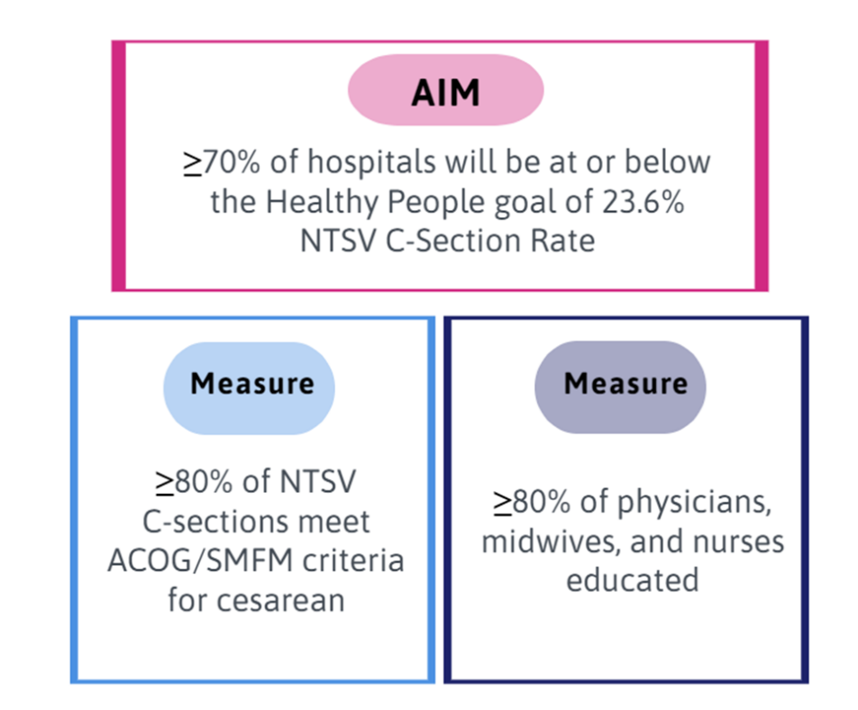
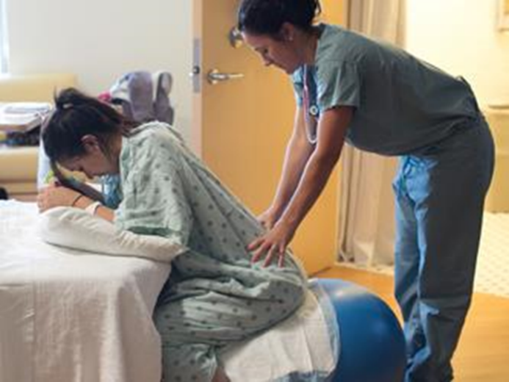
PVB Aims and Measures

Slide 13







PVB Key Strategies for Culture Change
Clinical Team Education and Buy-in
Cesarean Decision Huddles and Checklist
Sharing Unblinded Provider-level NTSV C-Section Rates
Educating patients and shared decision making
Fallout Reviews of cases not meeting ACOG/SMFM Criteria
Labor Management Support

Slide 14
Most Utilized PVB Strategies
2022 Teams Survey

Slide 15
PVB Strategies Reported By Teams
2022 Teams Survey
Acknowledging nurses each month with the most NTSV deliveries
Big focus on nursing education
Labor support cards illustrating positioning and purpose
Sharing unblinded provider group-level C-section rates
Newsletter with position of the month and success stories
Sharing blinded data with the department and providers
All nurses and some physicians have attended Spinning Babies and some are additionally completing the Bundle Birth education
Use of AgileMD Pathways in the EMR for labor management and delivery decision huddles

Slide 16
PVB Teams Progress on Key Structure Measures

Slide 17
Provider and Nurse Education
Keep it up!

Slide 18
Standard Protocols and Processes
Great work!

Slide 19
Sharing Provider Level Data
Wow! Progress!

Slide 20
Cesarean Decision Checklists and Decision Huddles/Debriefs
Keep it up!

Slide 21
Shared Decision Making and Patient Education
Progress with & for Patients!
Notes:
Focus for today

Slide 22
NTSV C-Section Rate PVB Hospitals baseline to Q3 2022
59% of ILPQC Hospitals achieving NTSV C-Section Rate goal of < 23.6%
Goal: 70% of hospitals achieving NTSV C-Section Rate Goal
All ILPQC NTSV C-Section Rate Meeting Goal!!

Slide 23
Addressing disparities:
NTSV C-Section Rate by Race and Ethnicity
71% of teams are tracking NTSV C-section rate by race, ethnicity and insurance status
ILPQC Data System Reports Available
Goal: 23.6%
Making progress to reduce NTSV c/s disparity gap, can we sustain the gains?
Notes:
Making progress this year to reduce NTSV C/S disparity gap, but will need to be sustained!

Slide 24
NTSV C-Sections Meeting
ACOG/SMFM Criteria
68%
of NTSV C-Sections overall are Meeting ACOG/SMFM Criteria

Slide 25
Meeting ACOG/SMFM Criteria by stage of labor
2022 Success
  Second Stage Arrest: increase from 35% → 65%
  Active Stage Arrest: increase from 69% → 81% (Goal >80%)
2023 Opportunities for Improvement :
  Failed Induction: only 45% of C-Sections meeting criteria
Goal: 80%

Slide 26
Which ACOG/SMFM Criteria does your team need to focus efforts to achieve your > 80% overall goal?
Failed induction
  Oxytocin administered for at least 12-18 hours after membrane rupture, without achieving cervical change and regular contractions
  Longer duration of the latent phase, 24 hours or longer if <6cm and maternal and fetal status permits
Second stage arrest
  At least 3 hours* of pushing in nulliparous patients
*Longer durations (e.g., 4 hrs with epidural) may be appropriate, individualized basis

Slide 27
PVB Key Strategies for Culture Change
Clinical Team Education and Buy-in
Cesarean Decision Huddles and Checklist
Sharing Unblinded Provider-level NTSV C-Section Rates
Educating patients and shared decision making
Fallout Reviews of cases not meeting ACOG/SMFM Criteria
Labor Management Support

Slide 28
Improving % of NTSV C-sections meeting ACOG/SMFM Criteria
2022 Teams Survey
Strategies Utilized:
Biggest Challenges:
Standards laminated at desk
Checklist on each patient chart
Sharing data at quality meetings
Labor positioning training
Huddles
Reviewing fallouts
Allowing time
Changing culture regarding longer duration of pushing
Nurse burnout
Provider buy-in
Legal worries for delaying delivery
Notes:
Can we make pink side text bigger

Slide 29
Sharing Un-blinded Provider-Level NTSV C-Section Rates
2022 Teams Survey
What was your process for sharing data?
  Monthly OB provider
  Department meetings
  Email to providers
  Women and Children Service Line Meetings
  Unblinded data posted in provider lounge
  Reviewed at quarterly meetings
  Yearly letter to providers
  Perinatal committee meetings

Slide 30

Sharing Un-blinded Provider
Level NTSV C-Section Rates
Tips to get started with sharing un-blinded data:
Involve your PVB Provider Champion
Explain the “why” to providers and staff
Create a process and space to share provider-level data
Implement and communicate timeline
Notes:
Change text to black

Slide 31
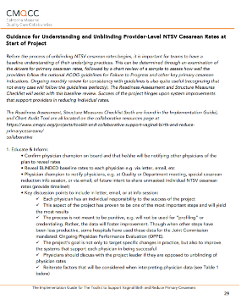
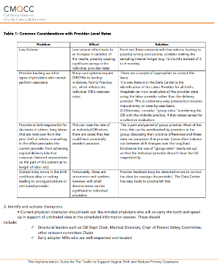
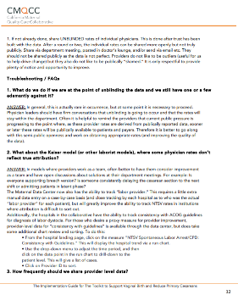
Key Resources and strategies for
Sharing Provider-Level Data
CMQCC Guidance for Understanding and Unblinding Provider-Level NTSV Cesarean Rates
Step by Step Guidance and timeline to
un-blinding data
Common Considerations and barriers to sharing un-blinded data
Troubleshooting and FAQs

Slide 32




Key Resources and Strategies for
Provider and Nurse Education + Buy In
  Review fallouts and debrief cases
  Present successful NTSV vaginal deliveries
Provider Education Posters
Missed Opportunity Review
Labor Management E-modules
PVB Grand Rounds
  Hang education posters
  Email pdf versions to providers and nurses
  Send out an email with a different video each week
  Set up labor management skills day
  Schedule a PVB Grand rounds
  Include learners (Residents, fellows, etc.)

Slide 33
ILPQC Labor Management Support Class
2022 Teams Survey
How have you incorporated skills and key content into your unit?
Attended and incorporated spinning babies
Incorporated into education materials
Labor support cards/handouts in patient rooms and shared in prenatal classes
Comfort measures flowsheet built into EMR
Peanut balls and new labor beds
New position on bulletin board each week
Unit created TikTok videos

Slide 34
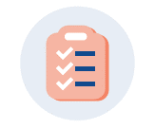

Consistent use of the Cesarean
Decision Checklist and Huddles
Standard process to use the Cesarean Decision Checklist for every potential C-section
Availability of checklist in patient's labor room or in EMR
Standard process to perform Delivery Decision Huddles/Debriefs for every potential C-section
Huddle performed with physician, nurse, any other care team members, and the patient to discuss potential C-section decision
Standardization of who initiates the huddle and use of checklist
Documentation of use of checklist
Use of checklist in huddle initiated by charge or bedside nurse

Slide 35
Cesarean Decision Checklist
2022 Teams Survey
Most Helpful:
Implementation Challenges:
Better interdisciplinary communication between nurses and providers
All staff on same page
Consistent evidence-based decision making
Bringing awareness to newer RNs of the length of labor and keeping providers aware of interventions
Compliance with utilization
Physician Buy-In
Consistent completion
Medical legal concerns
Nurses not wanting to question providers’ decision making

Slide 36

Fallout Review of NTSV C-Section Cases
Not Meeting ACOG/SMFM Criteria
Identify cases not compliant with ACOG/SMFM guidelines in the PVB dashboard
Review chart and identify which ACOG/SMFM guidelines were not met
Utilize new Fallout Review Form to understand additional details of case
Provide feedback to clinical team that performed C-Section
Identify patterns among C-Sections not meeting criteria and areas to work on
Fallout Review

Slide 37
Are you reviewing your ACOG / SMFM criteria fall outs? How can you reach your goal > 80% NTSV C/S meeting criteria?
All team members should understand goal > 80% of NTSV C/S achieve ACOG / SMFM criteria.
Every team should review their data for ACOG / SMFM criteria monthly or quarterly (depending on birth volume) and be sharing the data with QI team as well as providers and nurses.
Review fall outs that do not meet ACOG/SMFM criteria:
  Discuss and provide feedback to clinical team
  Opportunity to provide specific education to providers and/nurses
  Huddles / NTSV c/s checklist process should be used to review/discuss criteria and indications for cesarean
  Check how cesarean decisions are documented and why not meeting criteria? Can documentation be improved?

Slide 38
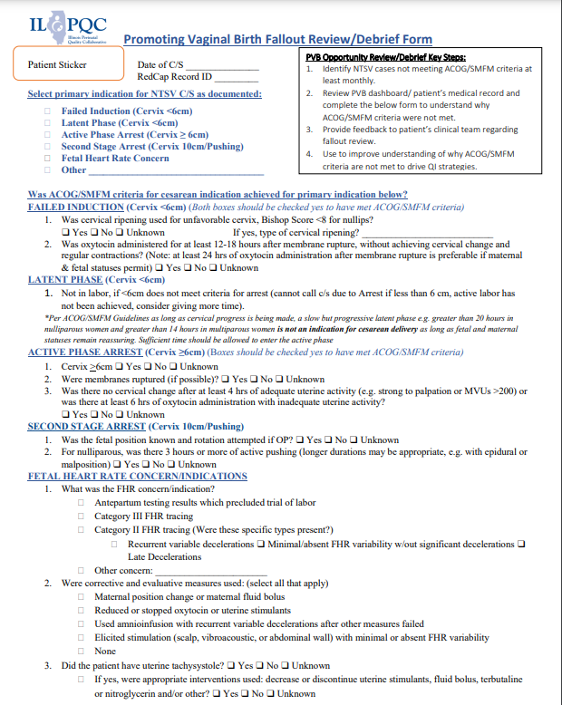
Key ILPQC Resource for Fallout Review NTSV C-Section Cases Not Meeting ACOG/SMFM Criteria
ILPQC has created a Fallout Review form to review NTSV C-Section Cases that do not meet ACOG/SMFM Criteria
Fallout Review

Slide 39
PVB Opportunity Review/Debrief Key Steps
Identify NTSV cases not meeting ACOG/SMFM criteria at least monthly.
Review PVB dashboard/ patient’s medical record and use the PVB Fallout Review Form to understand why ACOG/SMFM criteria were not met.
Provide feedback to patient’s clinical team regarding fallout review.
Use to improve understanding of why ACOG/SMFM criteria are not met to drive QI strategies and focus education for L&D clinical teams.

Slide 40
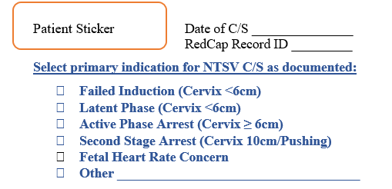
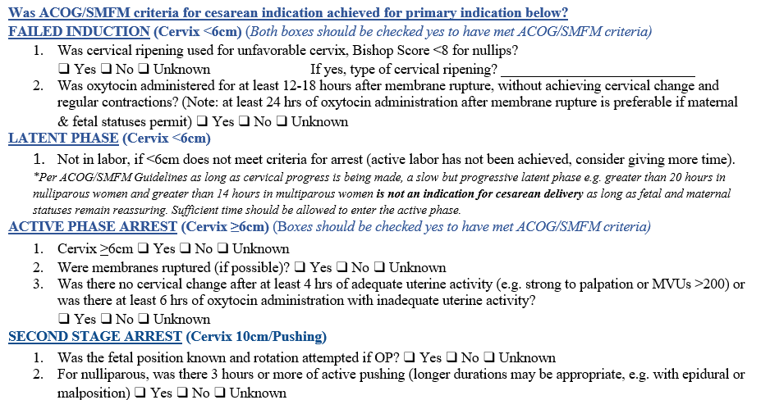
1
Select the primary indication for C/S that is documented
2
Determine whether ACOG/SMFM Criteria for cesarean indication was achieved by answering the questions listed on the indication

Slide 41
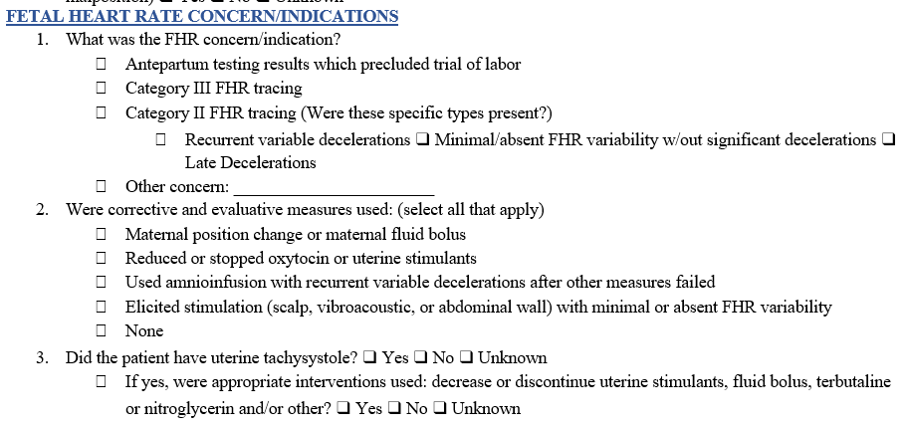
2 Cont…
Determine whether ACOG/SMFM Criteria for cesarean indication was achieved by answering the questions listed on the indication

Slide 42
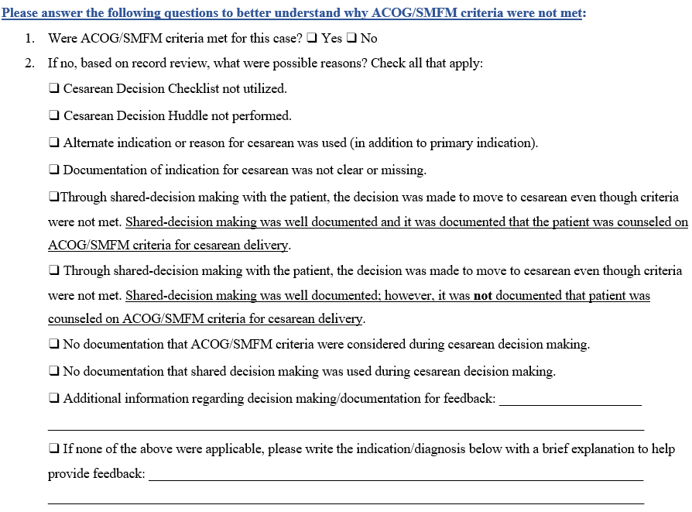
3
Answer this list of questions to better understand why ACOG/SMFM Criteria were not met

Slide 43
Feedback on Fallout Review Form
If you were able to attend the Annual Conference and participated in the OB Breakout session activity, please share your feedback on the activity and how useful you find the form.
Come off mute or put your comments in the chat!
Notes:
Add poll

Slide 44

Fall-Outs: Individual Case Review Steps
Identify cases not compliant with ACOG / SMFM guidelines: data dashboard
Review chart and identify how NTSV Cesarean Indication documented, identify which component was not compliant with ACOG / SMFM guidelines
Understand additional details of case, was there an additional indication for CS that was indicated? Was documentation appropriate?
Take notes and provide feedback to clinical team
Identify patterns and areas to work on

Slide 45
Team Talk: NorthShore University Health System Evanston Hospital

Slide 46
Northshore University HealthSystem
Evanston Hospital
Our PVB Journey

Slide 47
Path to Success
Incredible team members consisting of providers, nursing, data analyst
  Staff buyin was key
  MD and RN champions very committed to the initiative
Comfort measures added to flowsheet in EPIC
ILPQC checklist implementation
  Discussion at change of shift and safety huddles
  Grand Rounds presentations
  Nurses championing the checklist in L&D
Provider Recognition (MD/CNM)
  Emails to providers thanking them for using the checklist
  Care awards sent to provider and their superior
Emails to providers who did not use the checklist

Slide 48
Path to Success
Auditing of every NTSV C/S
  Areas to improve
  Presented fall outs to the Evanston team
Blinded provider data shared initially
Unblinded provider data coming soon!
Data accuracy
  Data Warehouse report created
    Evaluation of every NTSV delivery listed on the report
      Multips were included in error at times
      Incorrect coding of vaginal when actually a C/S or vice versa

Slide 49
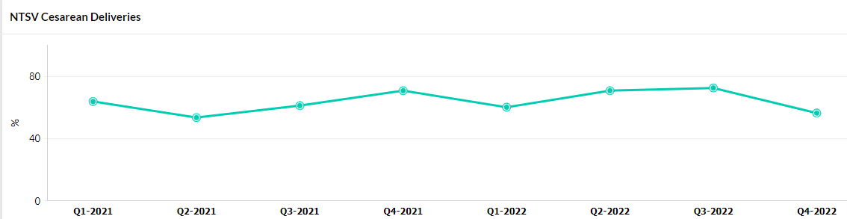
Total NTSV C/S deliveries meeting ACOG/SMFM criteria

Slide 50
Thank you for listening!
Questions??

Slide 51
PVB Next Steps

Slide 52
Ongoing PVB QI Support for Q3 2022
Outreach to teams above 23.6% NTSV C/S rate
Outreach to teams under the 80% of NTSV C/S deliveries meeting ACOG/SMFM criteria
1:1 Support calls with all teams not yet achieving key aims.
*Reply to QI Outreach email sent or email arivera@northshore.org to schedule.
Calls occur every Thursday and Friday of the week until the end of the year.

Slide 53
ILPQC is here to help you get across the finish line!
PVB Finish Line Goals:
QI Excellence Award
6 Key Structure Measures in Place
NTSV C-Section Rate ≤23.6%
80% of Providers and Nurses educated on ACOG/SMFM Guidelines
80% of all NTSV C-Sections Meeting ACOG/SMFM Guidelines
We are here to help!
We are here to support!
Schedule a personalized QI Support Call, email info@ilpqc.org to schedule a check-in call
Check-in calls planned with all teams not yet achieving key aims.

Slide 54
Upcoming Calls
Date | Topic
December | No PVB Webinar
January 23rd, 2022, 12:30 PM | Provider Buy-in for PVB
February 27th, 2022, 12:30 PM | Learning from PVB Teams Achieving QI Excellence
Continuing PVB into 2023……
Notes:
We plan to continue PVB into 2023 to help teams get across the finish line. We are in the process of working on how that will look and we welcome your feedback!

Slide 55
Questions?
Please put your questions or comments in the chat

Slide 56










Thanks to our Funders
In kind support:

