Slide 1
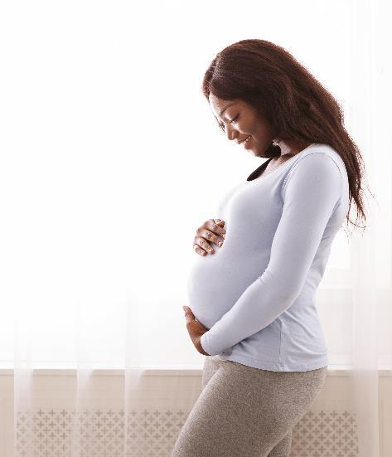
PVB Monthly Webinar:
Reviewing your PVB Data Stratified by Race and Ethnicity
March 27th, 2023, at 12:30 PM

Slide 2
Overview
2023 Face-to-Face Meeting
PVB Data
Reviewing your PVB Data by Race and Ethnicity in REDCap
Things to Consider When Interpreting Stratified Data
  Terri Deeds, MSN, RN, NE-BC, D-ONQS, Clinical Lead, CMQCC
Team Talk: NorthShore Evanston Hospital
  Dr. Emily White VanGompel
PVB Next Steps

Slide 3
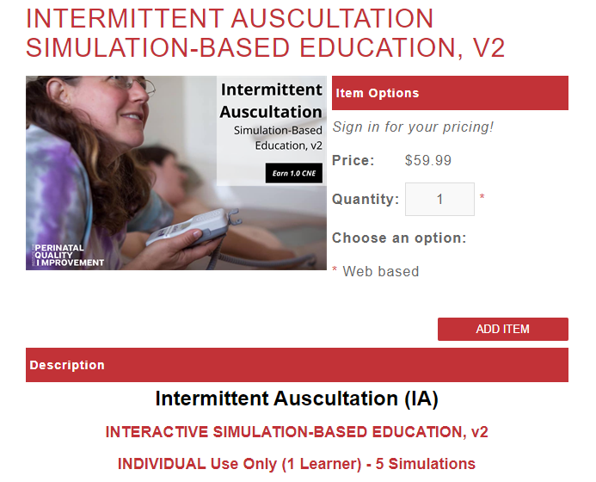
ILPQC Sponsored – FREE
PQI Intermittent Auscultation (IA) Opportunity for Teams
This 45–60-minute online program provides interactive, simulation-based training, and competency assessment designed to improve nurses', midwives', and physicians' IA usage and interpretation skills. This education includes:
evidence related to the use of intermittent auscultation
correct technique to perform IA effectively
IA Practice Guide for interpretation and management of IA findings
simulated IA practice scenarios
Each PVB Team will be provided 1 online train the trainer course ($59.99 value).
*Emails sent to PVB Team Leads*
Email ellie.suse@northwestern.edu
for more information.

Slide 4
2023 ILPQC Face-to-Face Meeting

Slide 5
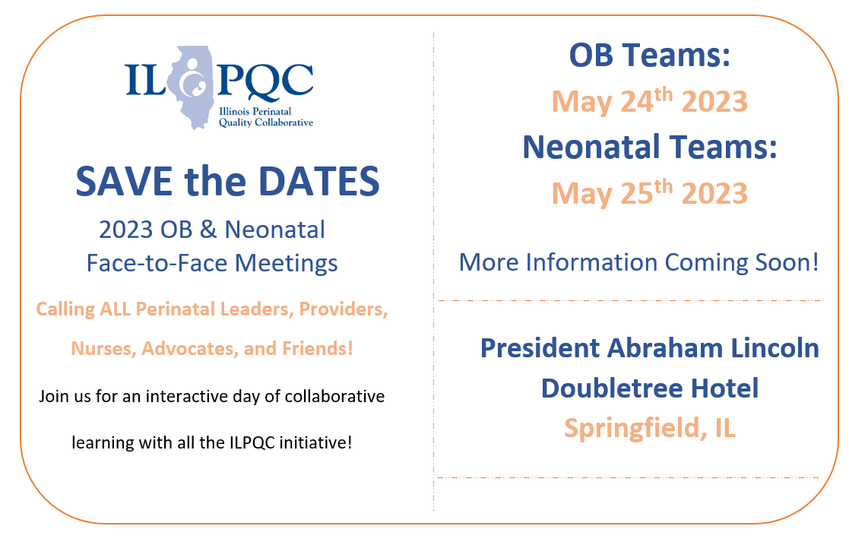
We are back in person in Springfield for Face-to-Face 2023!!!

Slide 6


All structure & patient-level data entered for Baseline-August 2022
Key Structure Measures "In Place":
  Provider and Nurse Education
  Standardized Protocol/Processes
  Sharing un-blinded provider level NTSV C-Section rates
  Cesarean Decision Checklist
  Decision Huddles/Debriefs
  Shared Decision-Making
All Data due
April 21st!

Slide 7
Achievement of PVB aims
  ≥ 80% of Providers and Nurses educated on ACOG/SMFM guidelines
  ≥ 80% of all NTSV C-Sections meeting ACOG/SMFM guidelines
  NTSV C-Section Rate ≤23.6%

Slide 8
2023 Face to Face: Let's Get Ready!
Save the Dates!
Submit your Data!
Submit all your 2022 data plus January, February, March 2023
OB- May 24th, Wednesday
Neonatal- May 25th, Thursday
Storyboard Submissions!
Share your successes, opportunities, and specific strategies implemented!
Share your DATA, graphs, PDSA cycles, process flow or 30/60/90 plans
Submit all data by April 21st
Start brainstorming your storyboard ideas!
ILPQC Room Block opens next week
President Abraham Lincoln Hotel, Springfield, IL
Share your teams past year QI story
Review the award criteria for PVB, BE, and BASIC to achieve QI Excellence!
All Data due
April 21st!
Registration opens next week!
Templates now available

Slide 9
OB Story Board Template
Hospital Name
PVB
Birth Equity
PVB Success
Including Data
BE Success
Including Data
Hospital Demographics
PVB Barriers and plans to address
PVB QI Team Members
BE Barriers and plans to address
BE QI Team Members
PVB Next Steps
BE Next Steps

Slide 10
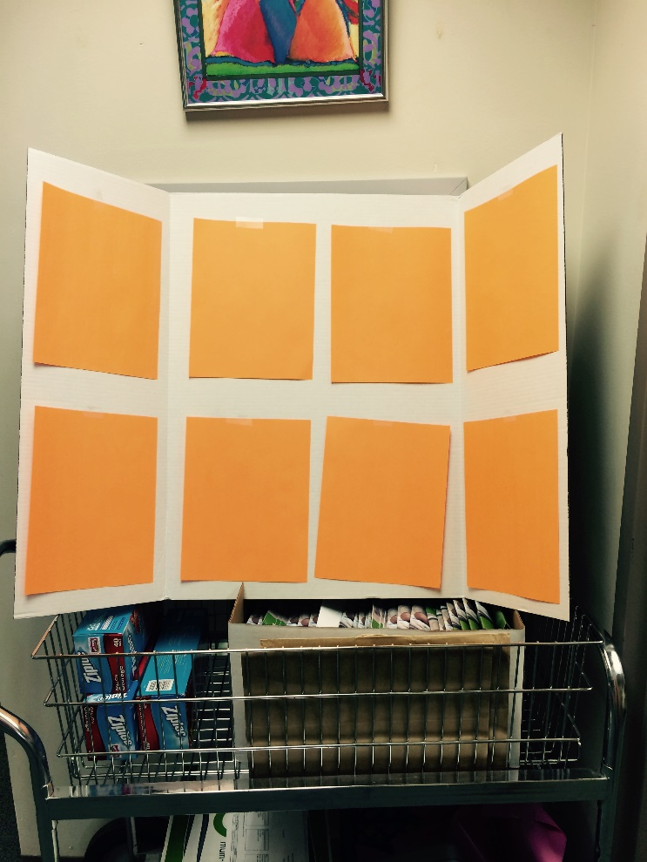
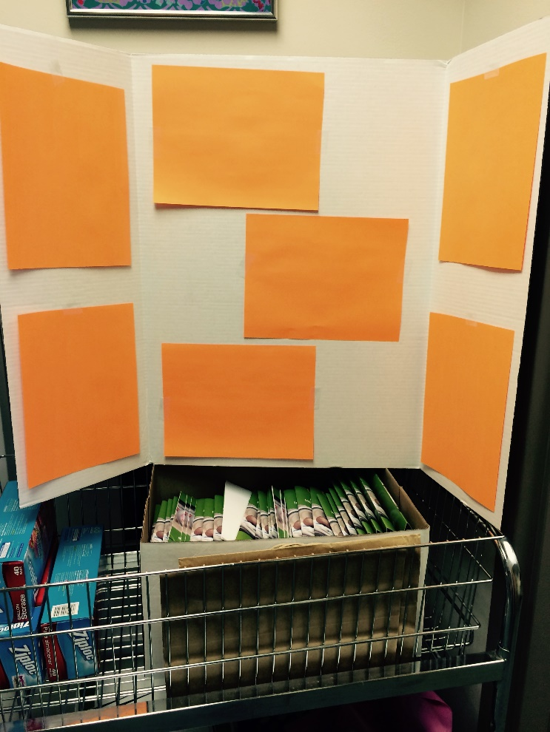
Sample Layout
With 4 portrait oriented sheets in the middle panel
With 3 landscape oriented sheets in the middle panel

Slide 11
Promoting Vaginal Birth
Moving from systems change to culture change to achieve success

Slide 12
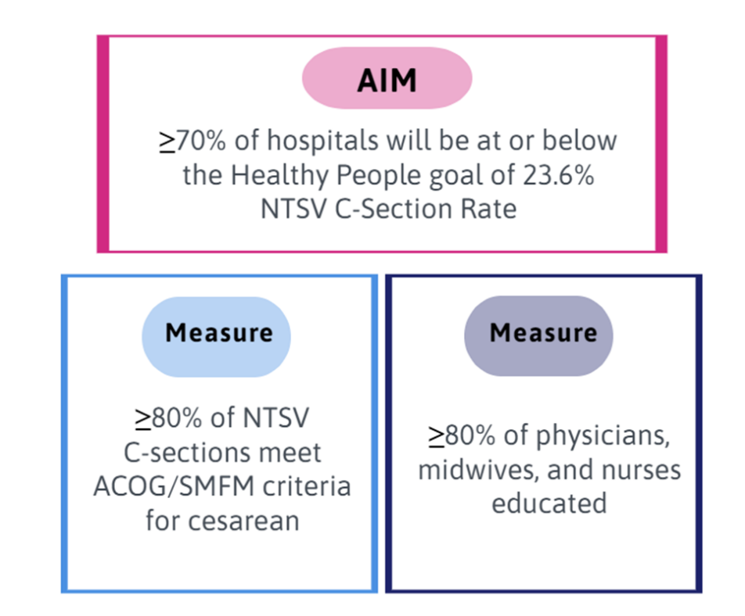
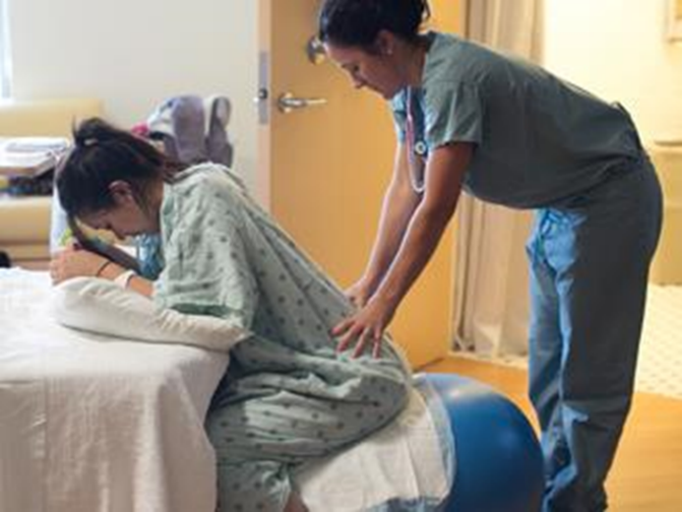
PVB Aims and Measures

Slide 13







PVB Key Strategies for Culture Change
Clinical Team Education and Buy-in
Cesarean Decision Huddles and Checklist
Sharing Unblinded Provider-level NTSV C-Section Rates
Educating patients and shared decision making
Fallout Reviews of cases not meeting ACOG/SMFM Criteria
Labor Management Support

Slide 14
Provider and Nurse Education

Slide 15
Standard Protocols and Processes

Slide 16
Sharing Provider Level Data

Slide 17
Cesarean Decision Checklists and Decision Huddles/Debriefs
Keep it up!

Slide 18
Shared Decision Making and Patient Education
Progress with & for Patients!
Notes:
Focus for today

Slide 19
NTSC C-Section Rate by Hospital
Wow! Progress!
All ILPQC Rate: 21.88
Goal: 23.6%

Slide 20
NTSV C-Section Rate PVB Hospitals baseline to Q1 2023
Goal: 70% of hospitals achieving NTSV C-Section Rate Goal
59% of ILPQC Hospitals achieving NTSV C-Section Rate goal of < 23.6%
Overall ILPQC NTSV C-Section Rate Meeting Goal!!

Slide 21
Meeting ACOG/SMFM Criteria by
Category
Goal: 80%
Notes:
Add percentages in

Slide 22
Addressing disparities:
NTSV C-Section Rate by Race and Ethnicity
ILPQC Data System Reports Available!!!
Goal: 23.6%
Notes:
Making progress this year to reduce NTSV C/S disparity gap, but will need to be sustained!

Slide 23
Indication for NTSV C-Sections:
White vs BOPIC Patients

Slide 24
2022: Percent of NTSV C-Sections Meeting
ACOG/SMFM Criteria by Race/Ethnicity

Slide 25


Summary of BE PREM Survey Completion: Demographic Breakdown
Race / Ethnicity
  18% of survey respondents reported as Hispanic
  19% of survey respondents reported as Black
  52% of survey respondents reported as White
Insurance
  52% of survey respondents have private insurance
  41% of survey respondents have public insurance
Total PREM surveys:
n =2,017
Notes:
Can we add # of PREM completed with these numbers

Slide 26
Summary of BE PREM data: by Race/Ethnicity
93% of patients of color felt they were treated with respect during L&D stay vs 97% of white patients (5% of BIPOC patients felt not treated with respect).
Only 79% of BIPOC patients and 77% of white patients felt that when clinical team couldn’t meet patient's wishes they explained why (over 20% of pts across all racial groups did not feel that decision making was explained to them)
15% of BIPOC patients and 11% of white patients felt they were pressured into care they didn’t want
97% of Black patients, compared to 100% of white patients felt their health care team did a good job of listening to me

Slide 27
Summary of BE PREM data: Insurance status
Only 77% of private patients and 83% of public insurance patients felt that when my clinical team couldn’t meet my wishes they explained why
10% of private insurance patients and 17% of public insurance patients felt pressured into accepting care they didn’t want
GOAL is to improve RESPECTFUL CARE and focus on improved communication with patients!
Shared decision making and active listening
How do we make progress?

Slide 28
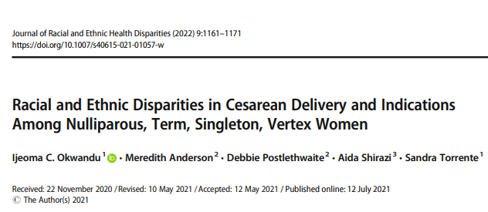
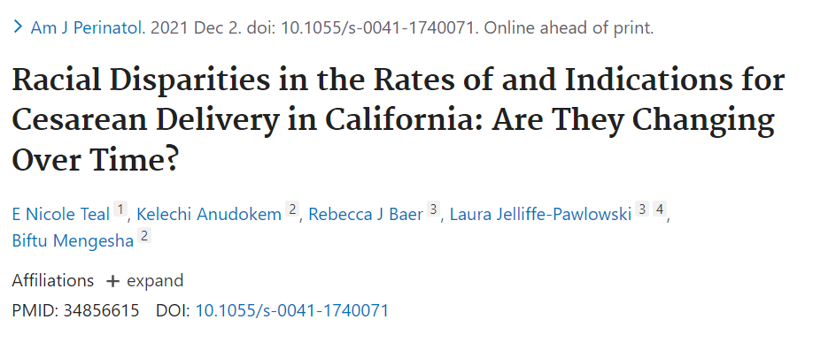
Publications

Slide 29
Viewing your PVB Data by Race and Ethnicity

Slide 30
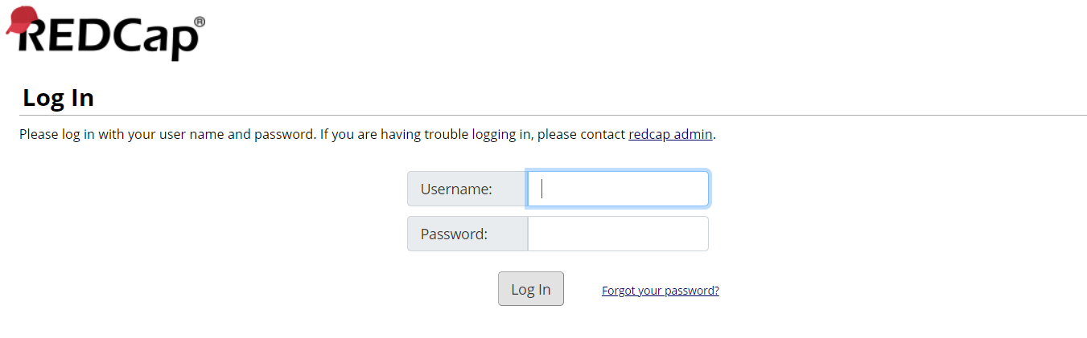
Viewing your NTSV C-Section Rates by race, ethnicity and insurance status in REDCap
https://redcap.healthlnk.org

Slide 31
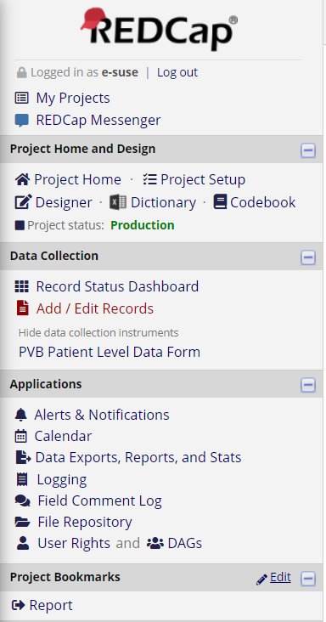
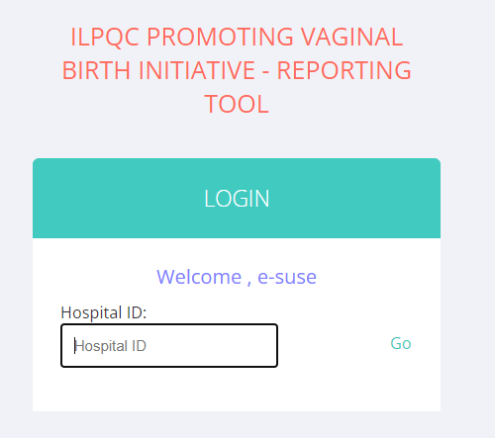
Let’s take a look at our PVB Reports
234

Slide 32
NTSV C-Sections by Race and Ethnicity
RedCap Reports

Slide 33
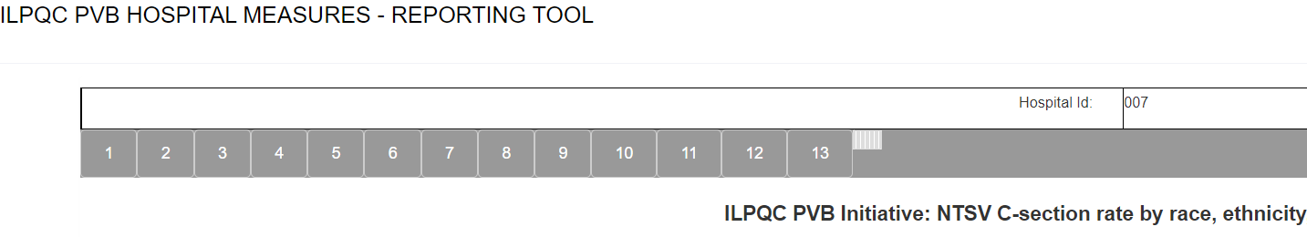
Finding your race and ethnicity report
Go to Report 13

Slide 34
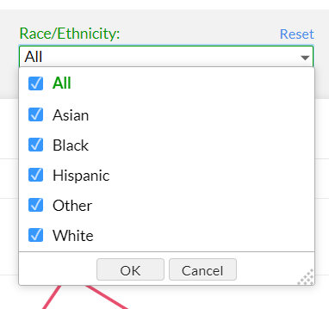
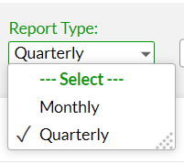
Selecting your report
Select a Quarterly or monthly view
Select which race/ethnicities you would like to compare by checking the boxes

Slide 35
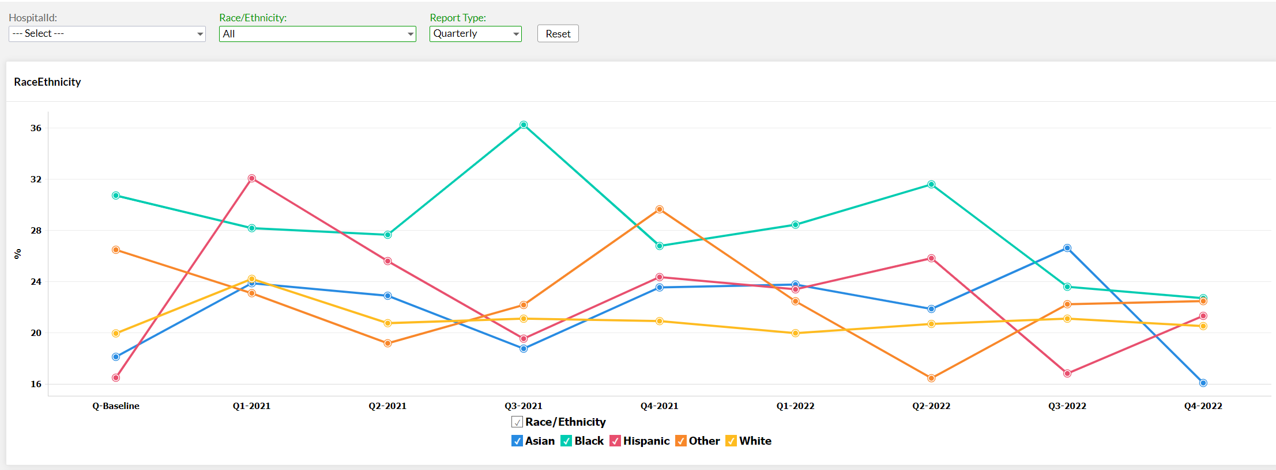
View your report

Slide 36
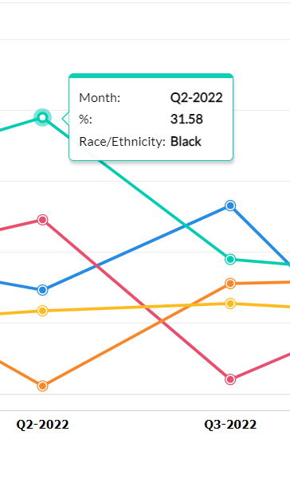
Hover over an individual data point to see the percentage

Slide 37
Addressing NTSV CS Disparities: understand the data, identify disparities
Determine categories to compare NTSV CS% based on your patient population
  look at your data by Black vs White, or BIPOC (Black, Indigenous, Patients of Color) vs White, or Black vs all other groups, or Private vs Public Insurance
Review NTSV CS quarterly data by categories selected
  Use monthly data only if large hospitals if > 10, ideally >30 patients in each group
  If smaller hospital may need to look at disparities data over 6 months or even over a year
Review differences in indications for cesarean by race/ethnicity, insurance
  For your NTSV CS , what is the % NRFHT vs % active stage arrest, vs % 2nd stage arrest vs % failed induction, does it differ by race/ethnicity?
Review differences in meeting ACOG/SMFM criteria for indications for CS by race ethnicity, insurance, what % of your patients meet criteria, does it differ by race/ethnicity

Slide 38
Addressing Disparities in NTSV Cesareans: take action!
Use your data to identify areas you can take action!
Get input! Ask patients, community members, nurses, providers on how we can do better!
Make plan to address issues identified, where can you get started?
Make sure OB Clinical Team aware of goal and strategies you have identified to work on
  Improve patient /family education on expectations in labor and Shared Decision Making
  Improve active listening / respectful care
  Engage Community Doulas / midwives in a program to support patients
  Fall out reviews / Delivery decision check list and huddles
  Engage Clinical Team members to actively work towards goal to reduce NTSV disparities

Slide 39
Things to Consider When Interpreting Stratified Data
Terri Deeds, MSN, RN, NE-BC, D-ONQS
Clinical Lead, CMQCC
Notes:
Title Slide layout

Slide 40
Notice
Considerations for interpreting stratified data are examples of some of the traits used by CMQCC when interpreting patient data.
These considerations are not meant to be all encompassing or representative of other considerations that can be implemented when interpreting stratified data.
Notes:
One column layout

Slide 41
Understanding Data Sources
Is race/ethnicity data self-reported or hospital assigned?
Are there standardized race/ethnicity categories being used for QI?
  CA uses the following categories as defined by CDPH
    Asian
    Black
    Hispanic – US Born
    Hispanic – Non-US Born
    Native American
    Pacific Islander
    White
    Multi-Racial
    Unknown

Slide 42

Focus on Missing Race Trends
Pay attention to missing race trends over time.
Missing race fields can alter stratified data significantly and results may not be reflective of actual practice

Slide 43

How to Handle Small Cell Sizes
As a general rule of thumb, CMQCC suggests results based on >30 cases in the denominator can be interpreted with relatively high confidence.
  Results <30 will be less reliable and may not be attributable to a larger scale
  Results <10 will not provide robust data
Notes:
Two column layout

Slide 44
How to Handle Small Cell Sizes
First line of defense
  Increasing the time periods for your review
  12 months and sometimes 24 months will result in cell sizes >30
  Especially important in small volume hospitals
  Results over time can offer a lens for QI opportunities
Notes:
Two column layout

Slide 45
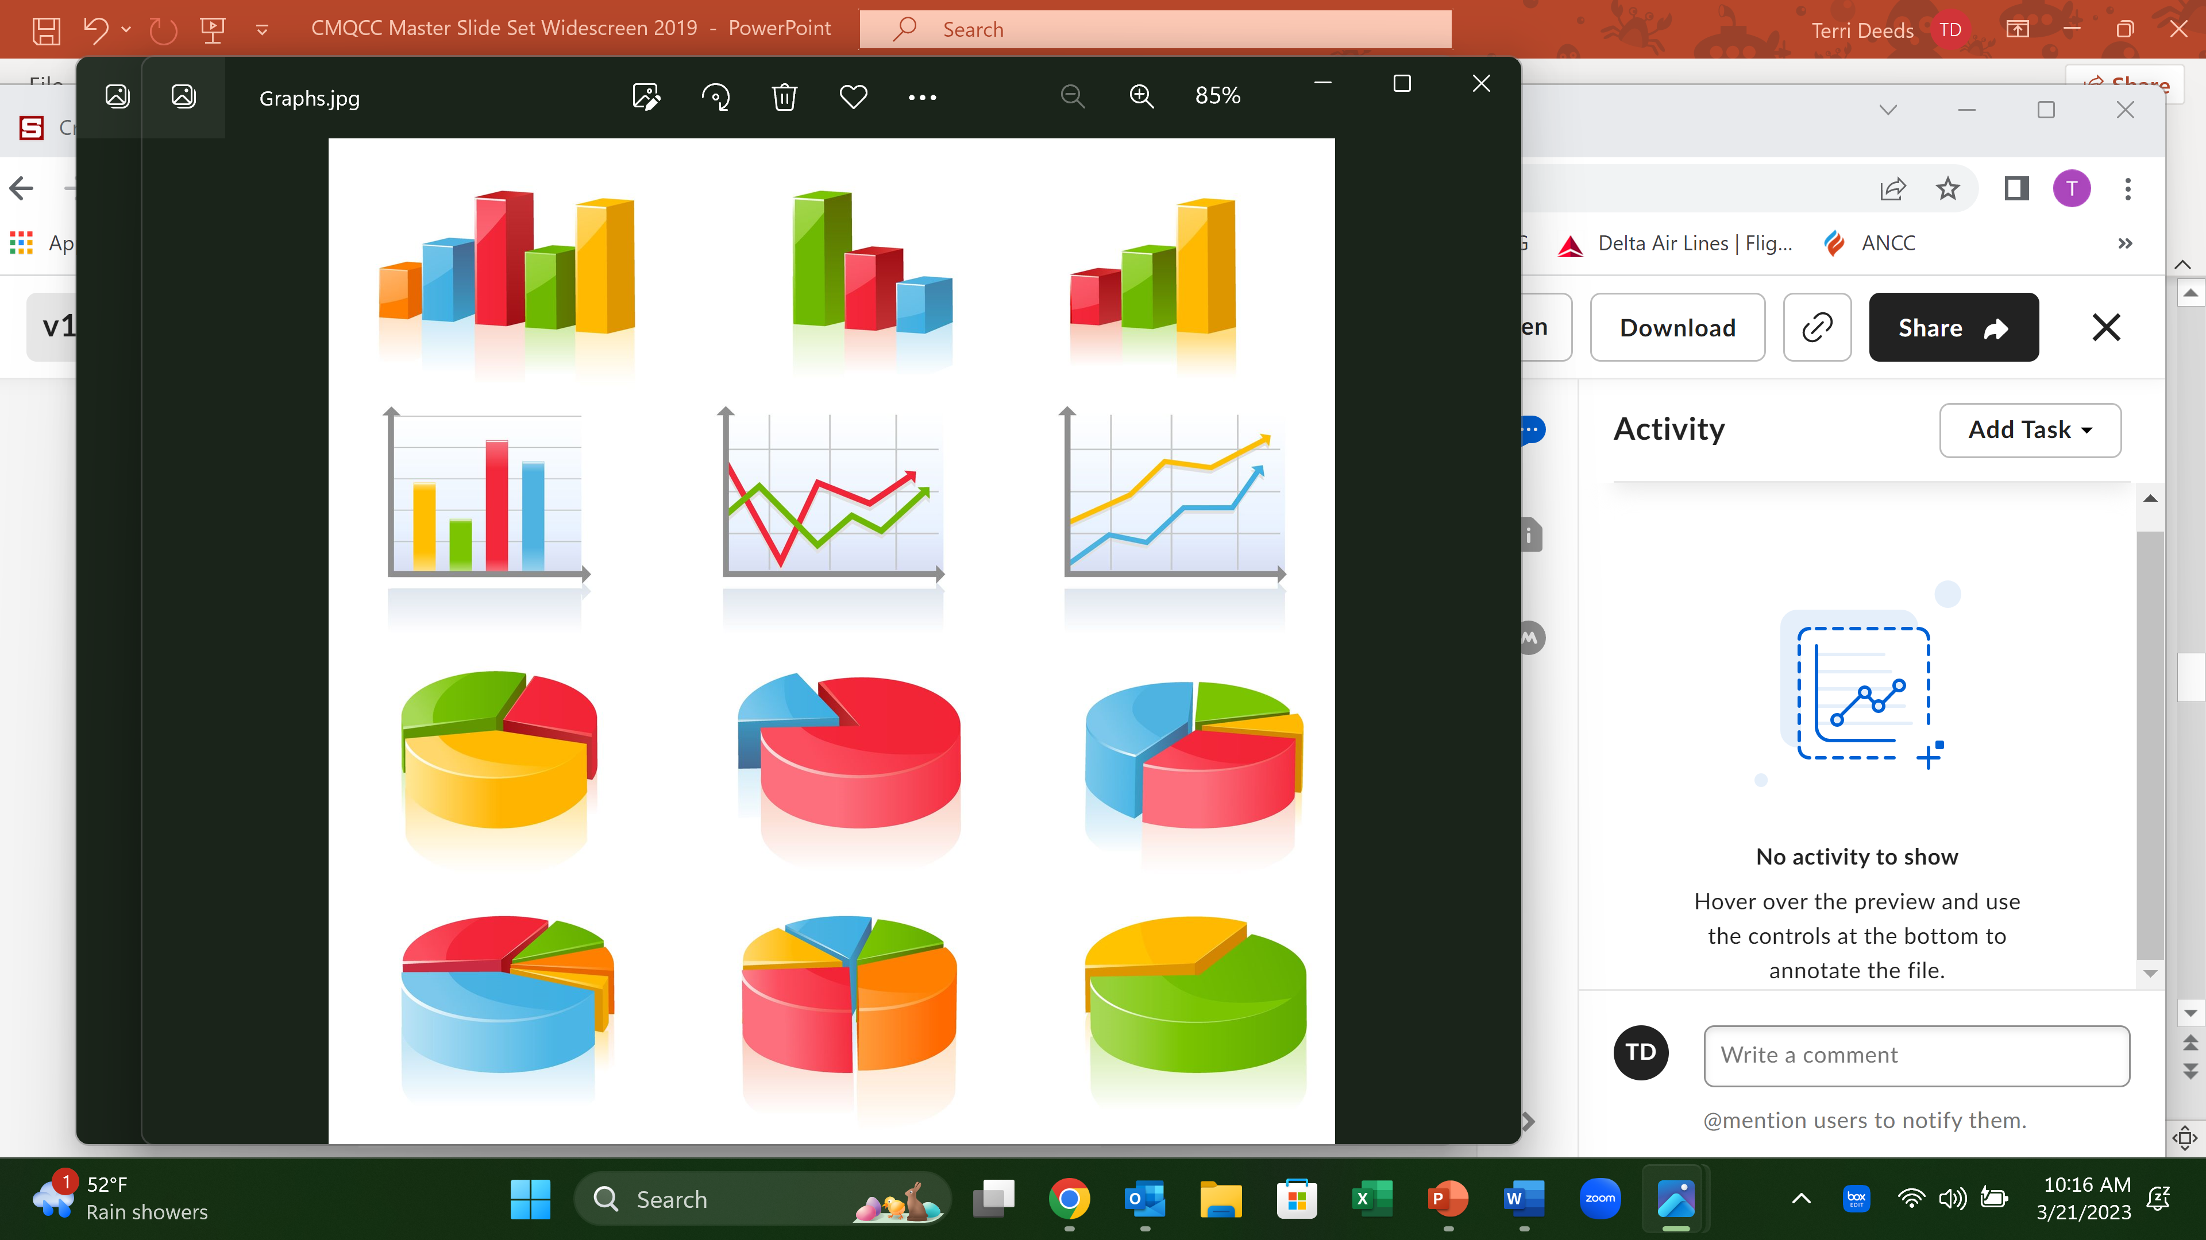
Opportunities with Small Cell Sizes
Review ongoing patterns of concerning outcomes among certain patient groups over time.
  Even with small cell sizes, consistent patterns are worth investigating.
  Consider case reviews for fallout patients to identify QI opportunities

Slide 46
QI Opportunities with Small Cell Sizes
Case Review
  Review the medical record.
  Conduct patient interviews from the identified patient group
    Leadership rounds lends itself nicely to this application

Slide 47
Determine the focus of QI Opportunities
Focus areas
  Significant patient populations
    CA – Majority Hispanic population – pandemic effect
  Most significant identified disparity vs % of delivery volume
    CA – Black population
  Changing disparity trends
    CA- Asian NTSV rates

Slide 48

Location is Important …
In California
  Largely diverse state with multiple racial/ethnic groups
  Often congregating in geographic areas
  What may be important to one community may not be of prime QI focus to others
  Consider regional QI opportunities.
Notes:
One column / long logo layout
*NOTE – if your content is going to be longer than the text box, switch to the standard “one column” layout. There should always be one inch between the long logo and the end of each slide’s content*

Slide 49
QI Improvement Example
CMQCC NTSV Equity Learning Initiative
  Invitations will be offered to all interested hospitals over time
  Select low hanging fruit first to engage the participant pool
  Involve all selected participants in QI opportunities
  Set predetermined data reporting limits
    Cell sizes <30 are not reported in outcome data to avoid the extreme variations in small sample sizes
Notes:
Two column / long logo layout
*NOTE – if your content is going to be longer than the text box, switch to the standard “two column” layout. There should always be one inch between the long logo and the end of each slide’s content*

Slide 50
Suggestions for Equity QI Questions
Are there differences in patient outcomes across racial groups?
For each group, has the rate changed over time?
How do these outcomes compare to the average?
Are we making progress toward our birth equity goal?
Notes:
Image slide

Slide 51

QI Goal
Are we ensuring that all patients are the beneficiaries of improved clinical practice?

Slide 52

Thank you for having me!

Slide 53
Notes:
Backdrop slide. Can also put this as the very first slide (before title slide) to be displayed on screen before you start talking.

Slide 54
Using Disaggregated Race/Ethnicity Data in Promoting Vaginal Birth
ILPQC PVB Meeting, 3/27/2023
NorthShore PVB and BE Teams

Slide 55
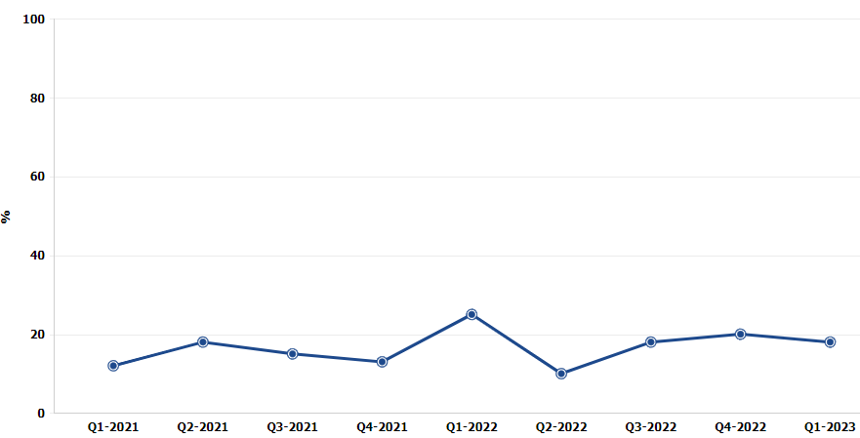
Total NTSV C/S Rate from Beginning of Initiative to Now
25%
15%
18%
18%
12%
18%
20%
13%
10%

Slide 56
A Rude Awakening
Hospital B
Hospital C
Notes:
So the first thing we did was to bring these data back to our PVB team, and we discussed it at a quarterly meeting of all of the hospitals. The data shocked a lot of people, I think. The initial reaction was to question the data, which is expected. There were a lot of questions about prenatal care, risk levels, and which practices were most contributing. After the questions, people started talking about positive changes they had seen that might help in one site or another. Given how productive this was, we decided to bring the issue to a larger audience with a grand rounds.

Slide 57
Promoting Vaginal Birth with a focus on Equity
Barrett Robinson MD, MPH
Lauren Keenan-Devlin, PhD MPH
Emily White VanGompel, MD, MPH

Slide 58
Objectives
To identify racial and ethnic disparities in c-section rates at NorthShore Legacy
To review the role of clinical factors and subjective factors in c-section disparities
To discuss strategies to address c-section disparities at NorthShore

Slide 59
Hospital A and B NTSV C/S 2022
32
66
10
51
308
41

Slide 60
Adjusted for diabetes (all), HTN (all), obesity, smoking
 | Unadjusted OR | 95% CI |  |  | Adjusted OR | 95% CI
Black | 2.28 | 1.43, | 3.62 |  | 1.94 | 1.20, | 3.15
Asian | 1.44 | 0.96, | 2.15 |  | 1.44 | 0.95, | 2.19
Other | 1.51 | 1.08, | 2.14 |  | 1.52 | 1.08, | 2.18
Unknown/Declined | 1.51 | 0.72, | 3.14 |  | 1.38 | 0.65, | 2.95
Hispanic | 1.37 | 0.95, | 1.99 |  | 1.30 | 0.90, | 1.90
Note: Reference group is white non-Hispanic

Slide 61
Clinical factors do not explain racial and ethnic differences in c-section
Used published studies to “myth bust” around clinical differences that lead to disparities in cesarean
Key points:
  Adjusting for known clinical risk factors does not entirely explain the higher odds of cesarean delivery for Black and Latine patients
  These rate disparities have not improved over time
  Indication for cesarean varies by race as well:
    Black patients are more likely to be diagnosed with fetal intolerance of labor
    Asian and Latine patients more likely to be diagnosed with failure to progress
  Qualitative studies suggest biases within our clinical practice that may contribute to these disparities, particularly around shared decision-making

Slide 62
Poll #1
I have seen bias enter into c-section decision-making
  Yes, often
  Yes, Occasionally
  I’m not sure
  No, not at all

Slide 63
% of white patients who agree
% of patients of color who agree
% of patients who neither agree nor disagree
% of patients who disagree

Slide 64


What is the focus of Birth Equity (BE)?
BE AIM: By December 2023,
more than 75% of Illinois birthing hospitals will be participating in the Birth Equity Initiative and
more than 75% of participating hospitals will have the key strategies in place.
86% of Illinois hospitals participating
Promote patient- centered approach to engage patients and communities
Develop respectful care and bias education for providers, nurses, and staff
Addressing Social Determinants of Health
Review race/ethnicity medical record and quality data

Slide 65
Key QI Strategies
Optimize race/ethnicity data collection & review key maternal quality data by race, ethnicity & Medicaid status
Engage patients and community members for input on quality improvement efforts
Universal social determinants of health screening tool (prenatal/L&D) with system for linkage to appropriate resources
Share respectful care practices on L&D and survey patients before discharge on their care experience (using the PREM) for feedback
Standardize postpartum safety education and schedule early postpartum follow up prior to hospital discharge
Implicit Bias / Respectful Care training for providers, nurses and other staff
Notes:
Optimize race/ethnicity data collection and review key maternal quality data by race, ethnicity and Medicaid status
Universal social determinants of health screening tool (prenatal/L&D) with system for linkage to appropriate resources
Share respectful care practices on L&D and survey patients before discharge on their care experience (using the PREM tool) for feedback
Engage patients and community members for input on quality improvement efforts
Standardize postpartum safety education and schedule early postpartum follow up prior to hospital discharge
Implicit Bias / Respectful Care training for providers, nurses and other staff

Slide 66

2. Utilize race/ethnicity medical record & quality data
Need to:
  Collect accurate race and ethnicity data from patients
  Stratify quality data to identify disparities

Slide 67
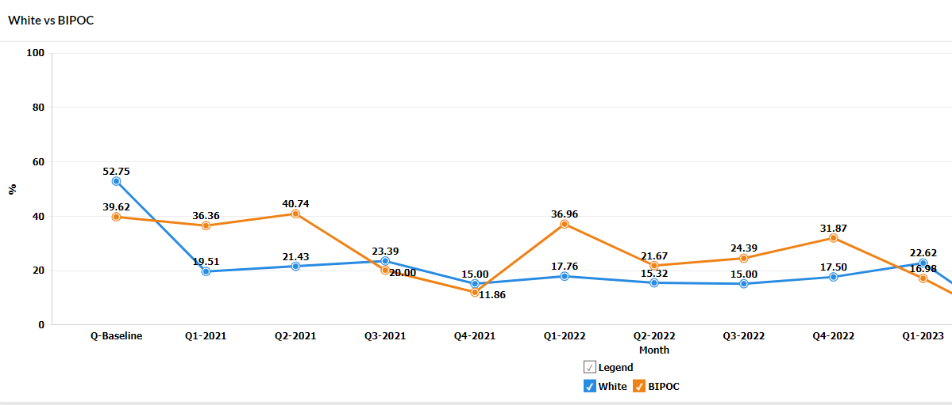
To Review at PVB Team Meetings:
NTSV C/S Rate Over Time
White vs BIPOC
Notes:
One of the things that we discussed at our last PVB meeting was how the PVB team should be working towards equity versus how the birth equity team should be working towards equity. There is certainly a lot of cross-over at our hospital between the groups. One thing the PVB team has already demonstrated is working on interventions at the intrapartum team level with the checklist implementation and outpatient cervical ripening protocol. These are changes to the intrapartum workflow that were crafted and adopted, whereas the birth equity team has worked mainly at the nurse-patient encounter level and the intake level to get SDOH screening, and accurate reporting of race/ethnicity. We haven’t implemented a new workflow for providers yet. So the PVB team can help at that level.

Slide 68
Wrap-Up

Slide 69
ILPQC is here to help you get across the finish line!
PVB Finish Line Goals:
QI Excellence Award
6 Key Structure Measures in Place
NTSV C-Section Rate ≤23.6%
80% of Providers and Nurses educated on ACOG/SMFM Guidelines
80% of all NTSV C-Sections Meeting ACOG/SMFM Guidelines
We are here to help!
We are here to support!
Schedule a personalized QI Support Call, email info@ilpqc.org to schedule a check-in call
Check-in calls planned with all teams not yet achieving key aims.

Slide 70
Upcoming Calls
Date | Topic
April 24th, 2023, 12:30 PM | PVB Small Group Breakouts
May 24th, 2023 | Face-to-Face Meeting

Slide 71










Thanks to our Funders
In kind support:

Slide 72
NTSV C-Sections meeting ACOG/SMFM Criteria by Race, Ethnicity and Insurance Status
RedCap Reports

Slide 73
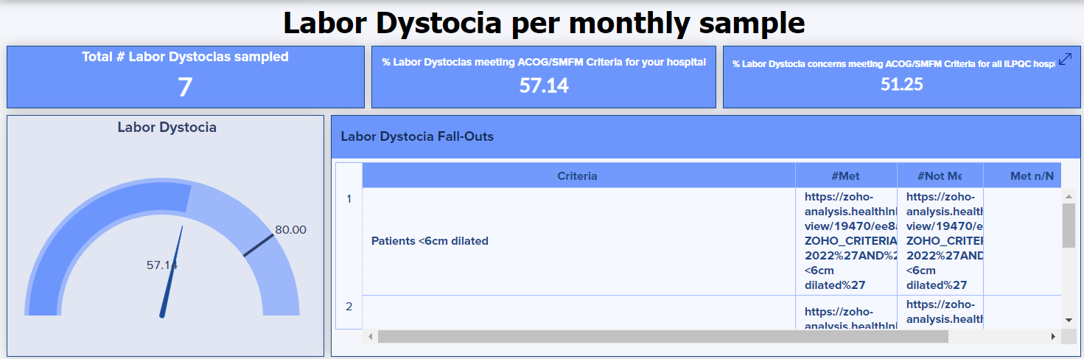
Labor Dystocia

Slide 74
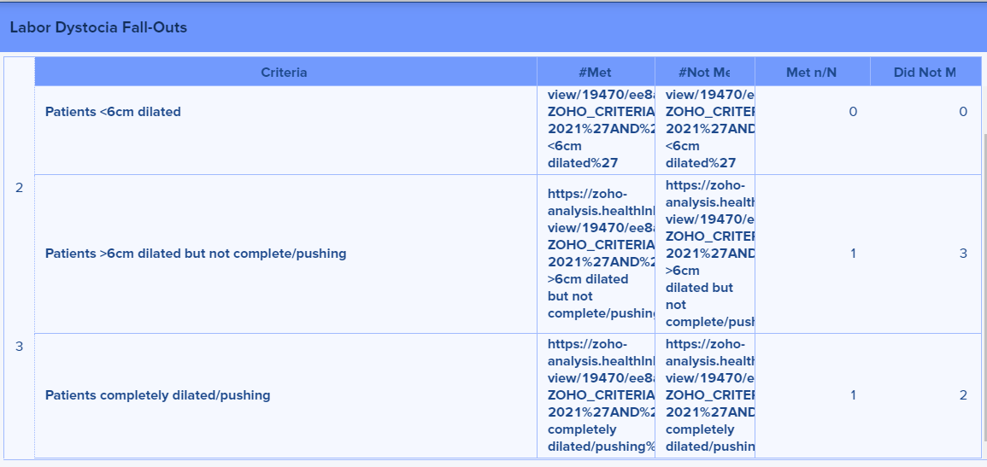
Second Stage Arrest
0
1
2
1
2

Slide 75
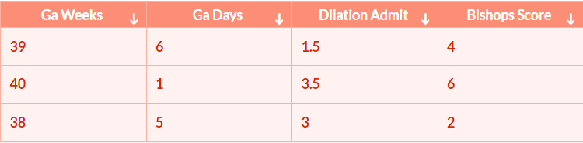
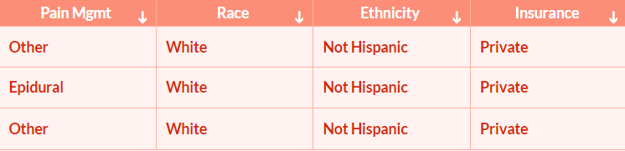
Individual Case Reviews
Record-ID
1234-123
1234-123
1234-126
Use the PVB Dashboard to identify trends in NTSV C-Sections meeting ACOG/SMFM Criteria
Public
Black
Hispanic
Public

