Slide 1
PVB Monthly Webinar: Improving Failed Inductions Meeting ACOG/SMFM Criteria
June 26th, 2023, at 12:30 PM

Slide 2
Overview
2023 Face-to-Face Meeting Recap
PVB Data overview
Failed Inductions
Northwestern Prentice Women’s Hospital: Marissa Wernick, MSN, RN, RNC-OB, Manager
Polling
PVB Next Steps

Slide 4
2023 Face-to-Face Recap
Louisiana Perinatal Quality Collaborative (LaPQC): Achieving Safe, Equitable, and Dignified Births
Veronica Gillispie-Bell, MD, MAS, FACOG
Hospital Teams Panel: Sharing Approaches that make a Difference
BE: Mercyhealth Javon Bea-Riverside, Rockford, IL, Laura Smith, BSN, RNC-OB, C-EFM
BE: SSM Health St. Mary's Hospital, St. Louis, MO, Elena Jenkins, BSN
PVB: University of Chicago Medicine, Chicago IL, Anna Marzano, BSN, CBC, C-EFM & Abbe Kordik, MD, FACOG
PVB: FHN Memorial Hospital, Freeport, IL, Danielle Wittig, BSN, RN & Keri Schubert, BSN, RNC-MNN
Engaging Patient / Community Partners to Optimize Birth Equity
Ebony Carter, MD, MPH , Cheron Philips, Richelle Smith
Attendance:
222 OB Day
176 Neo Day
Approx. 100 across both days

Slide 5
Breakout Session Topics
BE:
BE:
BE:
BE/PVB:
Social Determinants of Health Screening and Linkage to Resources
Active implementation of Respectful Care Practices and PREM survey
Moving Patient and Community Engagement forward at your hospital
Stratify your NTSV C/S Data and Actively Address Disparities
PVB:
PVB:
PVB:
MNO-OB:
Checklist and Huddles Strategies that Promote Shared Decision Making
Sharing Provider Data and Using Data to Drive QI
Implementing Fallout Reviews and Sharing Results with Clinical Team Members
New Resources to Address Maternal Overdose Deaths and Sustain Optimal OUD Care

Slide 6
Don't forget to share Face-to-Face Resources!
Resources also available at ilpqc.org

Slide 7
PVB AWARD CRITERIA
QI Excellence Award:
All data submitted
6 key structure measures in place
Achieved all 3 process and outcome measures
≥ 80% of Providers and Nurses educated on ACOG/SMFM guidelines
≥ 70% of all NTSV C-Sections meeting ACOG/SMFM guidelines
NTSV C-Section Rate ≤ 23.6%
Your Hospital's Name Here!
Your H
Notes:
QI Excellence Awards signify that you have achieved the initiative aims. Did we change NTSV CS meeting criteria to 70%?

Slide 8
Celebrating Previous PVB QI Excellence Awards
Abraham Lincoln Memorial Hospital
Advocate Sherman Hospital
Edward Hospital
Elmhurst Memorial Hospital
Gibson Area Hospital
Javon Bea Hospital - Riverside
NM Kishwaukee Hospital
NorthShore University HealthSystem - Evanston Hospital
Northwestern Memorial Hospital
OSF Little Company of Mary Hospital
OSF St. Anthony Medical Center- Rockford
Riverside Medical Center
Notes:
Congratulations for already achieving PVB Initiative Aims!
You've received QI Excellence Awards at annual conference, and we'll be sharing the new awardees next who'll receive their awards today

Slide 9
New PVB QI Excellence Awards
Advocate Christ Hospital
Advocate Sherman Hospital
Alton Memorial
Amita Health Glen Oaks Hospital
Carle BroMenn Medical Center
Carle Richland Memorial Hospital
Franciscan Health Olympia Fields
HSHS St. Francis Hospital
HSHS St. Joseph's Breese
Memorial Hospital of Carbondale
OSF Heart of Mary Medical Center
Rush University Medical Center
NM Lake Forest Hospital
Notes:
HUSTLE HUSTLE

Slide 11
Summer 1:1 Sessions
Meet with Alana and Ellie to discuss your PVB progress
Review your data in REDCap
Celebrate successes
Identify barriers
Determine next steps

Slide 12
Promoting Vaginal Birth
Moving from systems change to culture change to achieve success

Slide 13
2023 PVB Focus
Helping all PVB teams to bring their NTSV C-Section Rates below 23.6%
NTSV C-Section Rate <23.6%
Increasing the % of NTSV C-Sections Meeting ACOG/SMFM Criteria with a focus on Failed Inductions and Second Stage Arrest to >70%
>70% Meeting ACOG/SMFM Criteria
Addressing Disparities
Identifying and addressing disparities in NTSV C-Section rates

Slide 14
PVB Key Strategies for Culture Change
Clinical Team Education and Buy-in
Delivery Decision Huddles and Checklist
Sharing Unblinded Provider-level NTSV C-Section Rates
Educating patients and shared decision making
Fallout Reviews of cases not meeting ACOG/SMFM Criteria
Labor Management Support

Slide 15
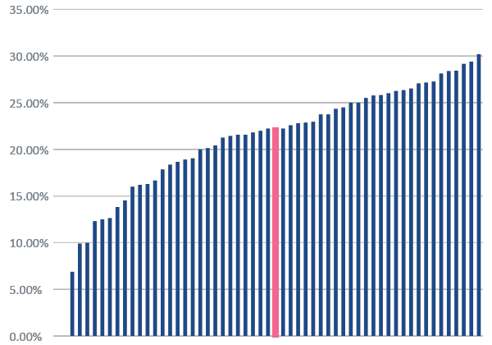
NTSV C-Section Rate by Hospital: Aim >70% hospitals at goal
Q1 2023
35%
Baseline
Goal: < 23.6%
59%
Hospitals are now achieving their NTSV CS goal
All ILPQC Rate: 22.2%
70%
If 7 more hospitals achieve goal
Notes:
If 7 more hospitals achieve <23.6%, we will achieve 70% of Illinois hospitals at goal FIX THE 35% ARROW

Slide 16
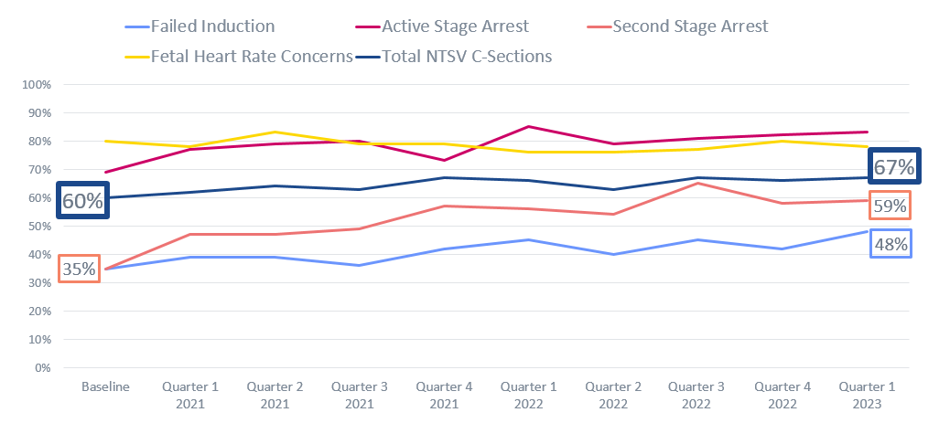
NTSV C-Sections Meeting ACOG/SMFM Criteria
Goal: > 70%
2023 Focus Improving % Second Stage Arrest
&
Failed Induction
meeting criteria

Slide 17
Addressing disparities: NTSV C-Section Rate by Race and Ethnicity
24%
Goal: <23.6%
23%

Slide 18
Addressing disparities: NTSV C-Section Rate by Race and Ethnicity
Goal: <23.6%

Slide 19
Steps to Address NTSV C-Section Disparities
Available in folder

Slide 20
Failed Inductions
Increasing compliance with ACOG/SMFM Criteria

Slide 21
Induction in your PVB Work
The use of induction has increased in the US concurrently with the increase of C-sections*
Variations in the management of labor induction likely affect rates of cesarean delivery including*:
Inconsistency in use of cervical ripening agents for the unfavorable cervix
Not allowing enough time in the latent phase before calling failed induction.
*https://www.acog.org/clinical/clinical-guidance/obstetric-care-consensus/articles/2014/03/safe-prevention-of-the-primary-cesarean-delivery

Slide 23
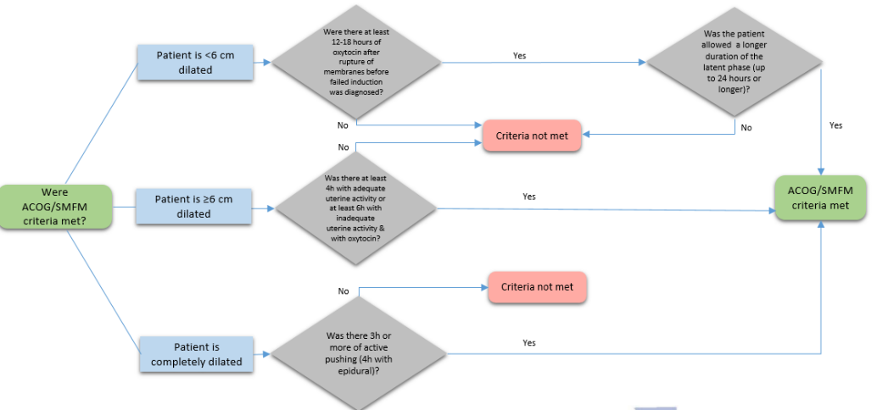
ACOG/SMFM Criteria Induction
Process Flow is located in the ILPQC PVB Toolkit and can be used to review whether ACOG/SMFM Criteria was met

Slide 24
Improving % NTSV C-Sections Meeting ACOG/SMFM Criteria Requires Culture Change
Empower shared decision-making and practice patience to achieve goals
ACOG/SMFM Criteria for Failed Induction (<6cm):
Allow at least 12-18 hours after membrane rupture with oxytocin provided
Allow at least 24 hours of latent phase (from start of induction)

Slide 25
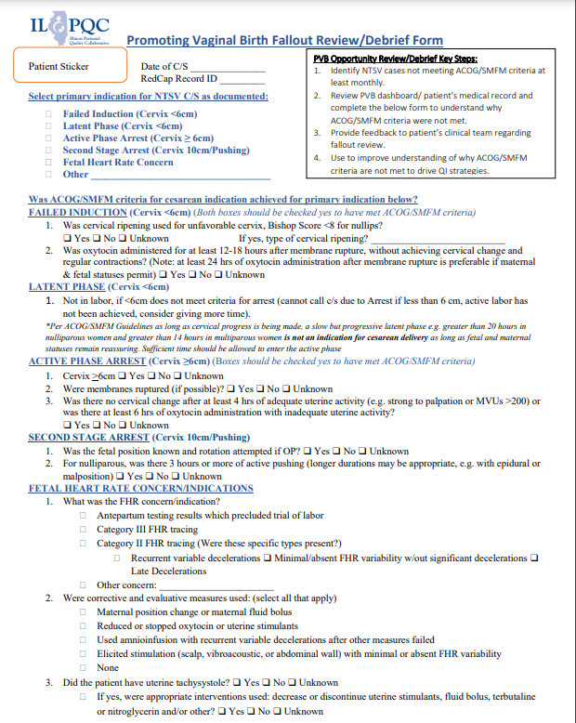
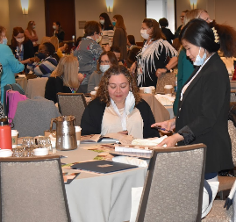
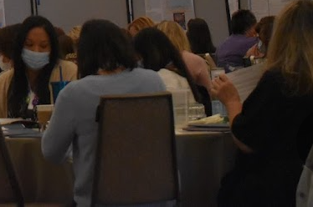
Key ILPQC Resource for Fallout Review NTSV C-Section Cases Not Meeting ACOG/SMFM Criteria
Understand which ACOG/SMFM guidelines not met
Provide feedback to clinical team
Identify patterns and areas to work on

Slide 26
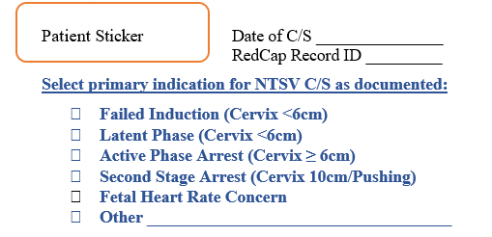
1
Select the primary indication for C/S that is documented
2
Determine whether ACOG/SMFM Criteria for cesarean indication was achieved by answering the questions listed on the indication

Slide 27
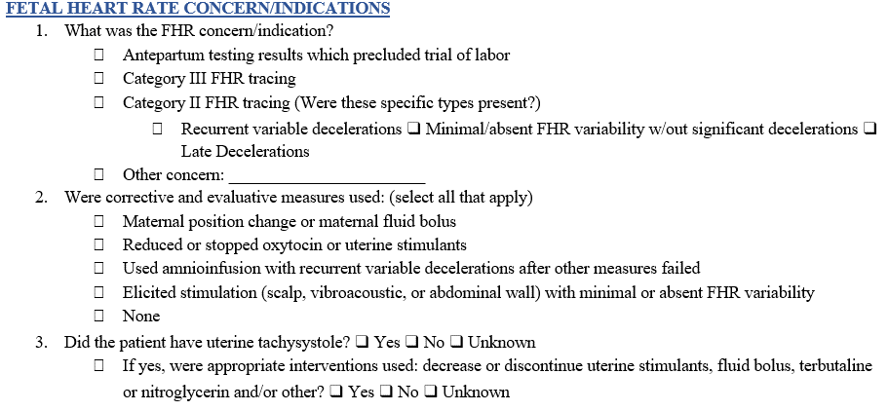
2 Cont…
Determine whether ACOG/SMFM Criteria for cesarean indication was achieved by answering the questions listed on the indication

Slide 28
3
Answer this list of questions to better understand why ACOG/SMFM Criteria were not met

Slide 29
Fallout Review of NTSV C-Section Cases Not Meeting ACOG/SMFM Criteria
Identify cases not compliant with ACOG/SMFM guidelines in the PVB dashboard
Review chart and identify which ACOG/SMFM guidelines were not met
Utilize Fallout Review Form to understand additional details of case
Provide feedback to clinical team that performed C-Section
Identify patterns among C-Sections not meeting criteria and areas to work on
Fallout Review

Slide 30
Key Takeaways from PVB Breakout Session
Strategies for Fallout Review:
Review of all fallouts as well as C/S meeting guidelines at monthly OB meeting
Peer review of all fallouts and corrective actions provided
Fallout review at monthly OB in a case study format
1-1 peer reviews MD to MD to increase awareness of c/s not meeting criteria
Mentoring model pairing OBs with high and low rates
Match providers on same shift with different skill sets
Second opinion prior to elective C/S from OB hospitalists

Slide 31
What about the ARRIVE Trial?
The New England Journal of Medicine, August 8, 2018, Grobman, et al, Labor Induction versus Expectant Management in Low-Risk Nulliparous Women.
RCT compared labor induction at 39 weeks to expectant management up to 42 2/7 weeks among low risk nulliparous women.
Primary outcome was neonatal morbidity. There was no difference.
Secondary outcome: cesarean section rate which was lower in the induction group that in the expectant management group. (18.6% vs 22.2%)
Notes:
Published in 2018 was RCT in community and university hospitals that compared labor induction at 39 weeks to expectant management up to 42 2/7 weeks among low risk nulliparous women.
Primary outcome- Composite Neonatal Outcomes
No difference in groupsSecondary outcome- CD
CD rate 18.5% Induction Group
CD rate 22% Expectant Management Group

Slide 32
What about the ARRIVE Trial?
Rigorous selection process, not simply patient or physician directed request.
High degree of compliance with ACOG/SMFM recommendations for arrest of labor and those utilized in PROVIDE.
Patients undergoing elective induction of labor did experience a 30-40% increase in length of labor compared to patients who were allowed to enter labor spontaneously.
Notes:
A strict definition for failed induction related to cervical ripening, labor duration, and labor management needs to be adopted and practiced to prevent a potential spike in cesarean rates. The increase in labor time indicates that the management of labor is a critical factor for women both induced and expectantly managed.

Slide 33
PVB Toolkit Induction Resources

Slide 34
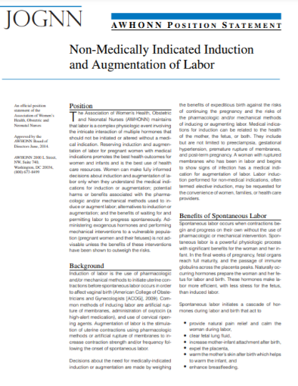
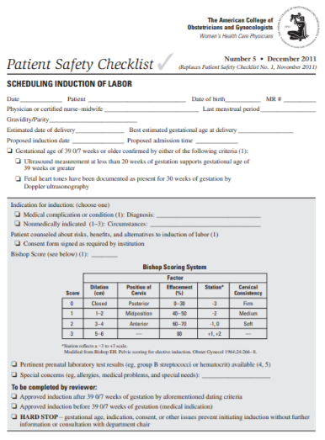
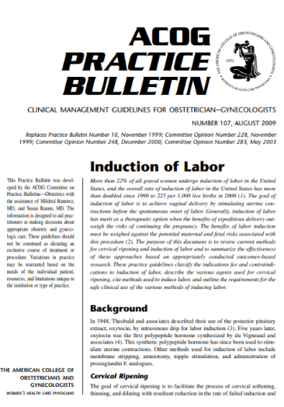
PVB Toolkit: National Induction Resources
AWHONN Position Statement
ACOG Induction Checklist
ACOG Practice Bulletin

Slide 35
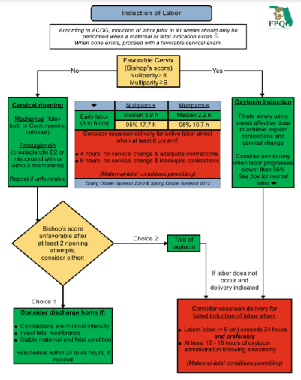
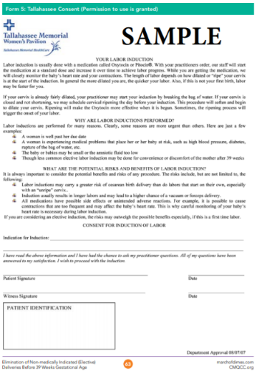
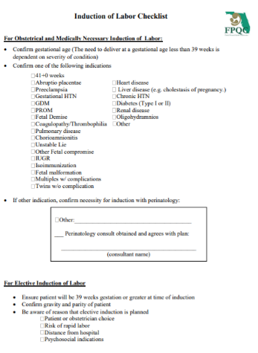
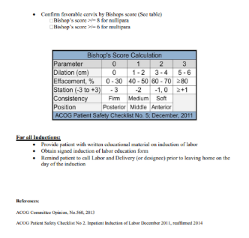
PVB Toolkit Induction Resources
FPQC Induction Algorithm
FPQC Sample Induction Consent
FPQC Sample Induction Checklist

Slide 36
Northwestern Medicine Prentice Women’s Hospital Chicago, IL
Marissa Wernick, MSN, RN, RNC-OB
Manager, Labor and Delivery, Antepartum, OB Triage
mpierce1@nm.org

Slide 37
NMH Promoting Vaginal Birth
Presented by:
Marissa Wernick, MSN, RN, RNC-OB
Manager, Labor and Delivery, Antepartum, OB Triage
mpierce1@nm.org

Slide 38
Northwestern Memorial Hospital Prentice Women’s Hospital Chicago, Illinois
Level 3 Perinatal Designation
CY 2022 - 11,509 deliveries
Beds - 32 LDRs, 5 ORs, 8 PHRs
Induction Volume - Up to 14 scheduled/day; 44% IOL Rate

Slide 39
Our PVB Journey
Achieving RN vs Physician buy in
“Who is the ‘problem?’” vs “We can all help”
Defining the categories
Failed induction < 6cm
Arrest of Dilation/Descent ≥ 6cm
Initial road blocks
Decision checklist/huddle
Successes
Sharing of group & provider level data
Tool development
Labor support
Documentation support

Slide 40
Promoting Vaginal Births NMH NTSV Cesarean Section Rate
23.2% CY21
21.4% CY22
22.8% CY23 YTD
Nulliparous, Term, Singleton, Vertex Deliveries

Slide 41
Promoting Vaginal Births NMH NTSV Cesarean Section Rate
23.2% CY21
21.4% CY22
22.8% CY23 YTD
Nulliparous, Term, Singleton, Vertex Deliveries

Slide 42
Promoting Vaginal Birth Compliance by Cesarean Section Category
Sample 20 charts per month

Slide 43
Promoting Vaginal Birth Compliance by Cesarean Section Category
Sample 20 charts per month

Slide 44
Proactive Management of Induction/Augmentation
“Prentice Pathway”
Induction of labor with an unfavorable cervix
Plan CRIB and adjunct (either misoprostol or oxytocin) within 60 minutes of admission.
Oxytocin is to be administered via standard dosing (increase by 2 mu/min every 15 minutes until contractions q 2-3 minutes or 200 MVU/10 minutes, if IUPC in place).
AROM within 60 minutes of CRIB expulsion
Begin pushing within 30 minutes of complete dilation.
Induction of labor with a favorable cervix.
Oxytocin initiation within 60 minutes of admission, to be increased by standard dosing (2 mu/min every 15 minutes until contractions q 2-3 minutes or 200 MVU/10 minutes, if IUPC in place).
AROM performed within 60 minutes of admission.
Begin pushing within 30 minutes of complete dilation

Slide 45
Proactive Management of Induction/Augmentation
“Prentice Pathway”
Augmentation of labor
Oxytocin initiation within 60 minutes of admission, to be increased by high-dose protocol (6 mu/min every 15 minutes until contractions q 2-3 minutes or 200 MVU/10 minutes, if IUPC in place).
AROM performed within 60 minutes of admission.
Begin pushing within 30 minutes of complete dilation.

Slide 46
NMH Pre-Cesarean Decision Tool

Slide 47
Delivery Summary
C-Section Indications

Slide 48
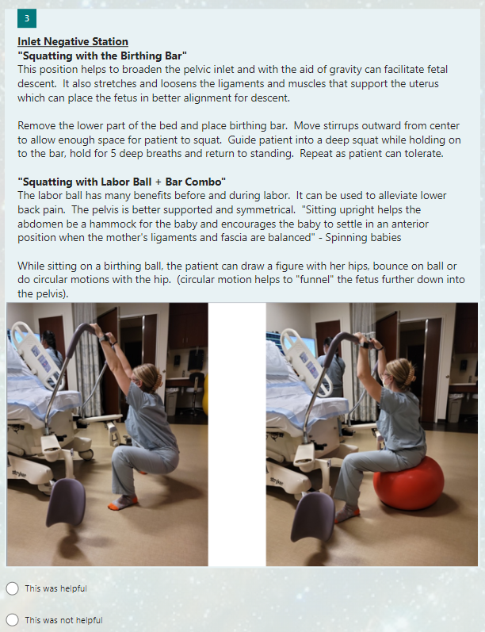
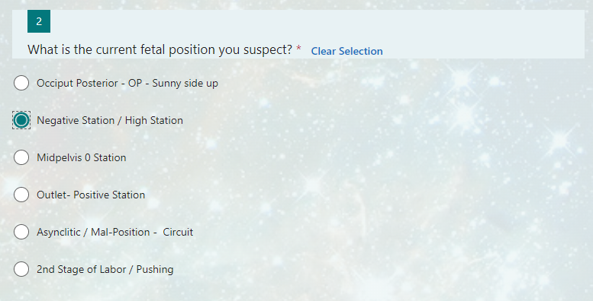
Labor Support Tool

Slide 49
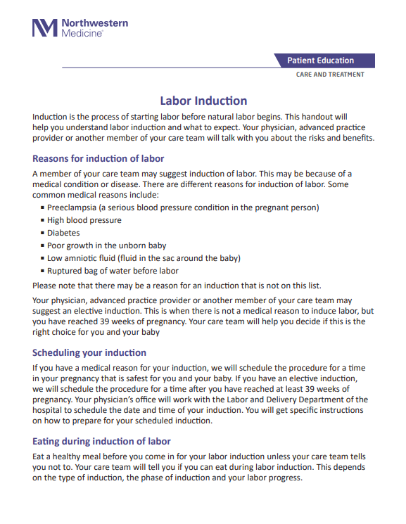
Labor Induction Brochure

Slide 50
Cesarean Section Pre-op Documentation
EPIC Dotphrase

Slide 51
Next Steps
Deeper dive into each of the categories
Chart reviews for failed induction
Pitocin management
Timeline
Decision factors

Slide 52
Polling
Get ready to share!

Slide 53
Question 1: Fallout Reviews
Is your team doing fallout reviews for NTSV C-Sections not meeting ACOG/SMFM Criteria?
Yes, for all C/S not meeting criteria
Yes, for some C/S
No
Are you using the ILPQC Fallout Review form?
Yes
No, but using a different form
No, not doing fallouts
Are you sharing your fallout review with the team that performed the C/S?
Yes
No
How is the fallout review being shared?
During OB meeting
1-1 with provider who performed C/S
Come off mute or put in the chat what your process is for doing fallout reviews!

Slide 54
Question 2: Failed Inductions
Which ACOG/SMFM Criteria is most commonly not being met for failed inductions?
Allow at least 12-18 hours after membrane rupture with oxytocin provided
Allow at least 24 hours of latent phase (from start of induction)
Both
Are your providers and nurses aware of ACOG/SMFM Criteria for failed induction?
Yes
No
Not sure
Come off mute or put in the chat what barriers your team is facing to get 70% of failed inductions to meet ACG/SMFM Criteria

Slide 55
ILPQC is here to help you get across the finish line!
PVB Finish Line Goals:
QI Excellence Award
6 Key Structure Measures in Place
NTSV C-Section Rate ≤23.6%
80% of Providers and Nurses educated on ACOG/SMFM Guidelines
70% of all NTSV C-Sections Meeting ACOG/SMFM Guidelines
We are here to help!
We are here to support!
Schedule a personalized QI Support Call, email info@ilpqc.org to schedule a check-in call
Check-in calls planned with all teams not yet achieving key aims.

Slide 56
Upcoming PVB Calls
Event | Day/Time
PVB Webinar - July | Monday, July 24th at 12:30 pm
PVB Webinar - August | Monday, August 28th at 12:30 pm
PVB Webinar - September | Monday September 21st at 12:30 pm
What Summer PVB Webinar Topics will be helpful for your team to achieve QI Excellence?
Put your ideas in the chat!

Slide 58
Thanks to our Funders
In kind support:

