Slide 1

PVB Monthly Webinar:
Provider and Nurse Buy-In
January 23rd, 2023 at 12:30 PM

Slide 2
Overview:
Upcoming 2023 Face-to-Face Meeting
PVB Data Review
Provider Buy-In Strategies
Team Talk: University of Chicago, Anna Marzano, BSN, RN, CBC, C-EFM
PVB Next Steps

Slide 3
New ILPQC Team Member
Please join is in welcoming our new ILPQC Project Coordinator, Aleena Surenian!

Slide 4
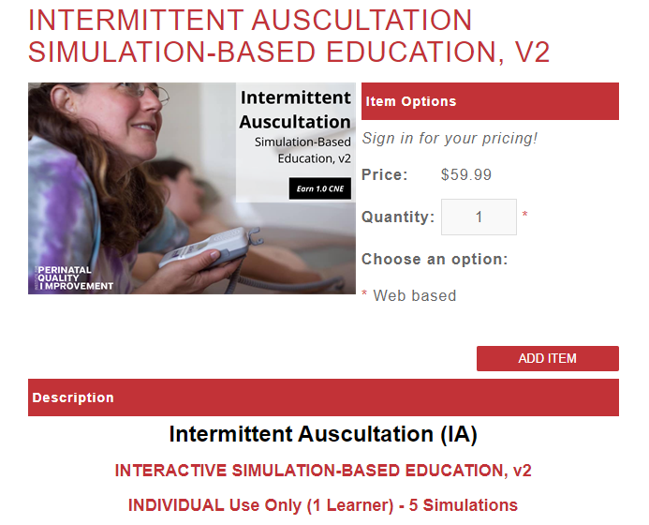
ILPQC Sponsored – FREE
PQI Intermittent Auscultation (IA) Opportunity for Teams
This 45–60-minute online program provides interactive, simulation-based training, and competency assessment designed to improve nurses', midwives', and physicians' IA usage and interpretation skills. This education includes:
evidence related to the use of intermittent auscultation
correct technique to perform IA effectively
IA Practice Guide for interpretation and management of IA findings
simulated IA practice scenarios
Each PVB Team will have access to 1 PQI IA online train the trainer course
Team leads look out for an email with more information!

Slide 5
2023 ILPQC Face-to-Face Meeting

Slide 6

We are back in person in Springfield for Face-to-Face 2023!!!

Slide 7
We want to hear from you!
Ideas for the in-person 2023 Face-to-Face Meeting
What aspects of the in-person annual conference/Face-to-Face meetings do you most enjoy?
What could we improve on?
Email arivera@northshore.org with thoughts and Ideas!

Slide 8


All structure & patient-level data entered for Baseline-August 2022
Key Structure Measures "In Place":
  Provider and Nurse Education
  Standardized Protocol/Processes
  Sharing un-blinded provider level NTSV C-Section rates
  Cesarean Decision Checklist
  Decision Huddles/Debriefs
  Shared Decision-Making

Slide 9
Achievement of PVB aims
  ≥ 80% of Providers and Nurses educated on ACOG/SMFM guidelines
  ≥ 80% of all NTSV C-Sections meeting ACOG/SMFM guidelines
  NTSV C-Section Rate ≤23.6%

Slide 10

Goal is for all PVB teams to achieve a QI Excellence Award by the end of 2023 and receive your wood/glass plaque!
ILPQC is committed to supporting all teams to achieve QI Excellence in PVB
ILPQC has been reaching out to teams to set up 1:1 chats to check in on plans/progress to achieve initiative goals
What elements do you need to achieve to receive a QI excellence award? How can we help?

Slide 11

2023 F2F Volunteers Needed...
Come one! Come ALL!
Join us as we collaborate in-person
at ILPQC Face-to-Face event in Springfield, IL.
The first ILPQC Face-to-Face event since 2019!
We are looking for volunteers to be a part of the:
2023 F2F PLANNING COMMITTEE
2023 F2F BREAKOUT FACILITATORS
Interested? Drop your name in the chat or email info@ilpqc.org

Slide 12
Promoting Vaginal Birth
Moving from systems change to culture change to achieve success

Slide 13
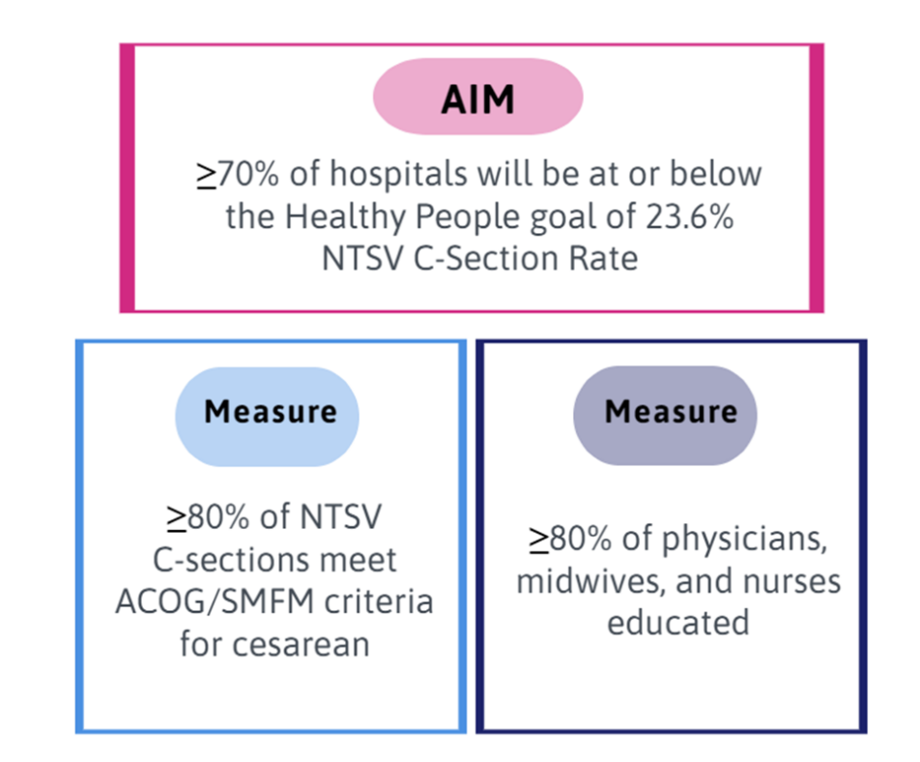

PVB Aims and Measures

Slide 14







PVB Key Strategies for Culture Change
Clinical Team Education and Buy-in
Cesarean Decision Huddles and Checklist
Sharing Unblinded Provider-level NTSV C-Section Rates
Educating patients and shared decision making
Fallout Reviews of cases not meeting ACOG/SMFM Criteria
Labor Management Support

Slide 15
Provider and Nurse Education
Keep it up!

Slide 16
Standard Protocols and Processes
Great work!

Slide 17
Sharing Provider Level Data
Wow! Progress!

Slide 18
Cesarean Decision Checklists and Decision Huddles/Debriefs
Keep it up!

Slide 19
Shared Decision Making and Patient Education
Progress with & for Patients!
Notes:
Focus for today

Slide 20
NTSC C-Section Rate by Hospital
Wow! Progress!
Goal: 23.6%

Slide 21
NTSV C-Section Rate PVB Hospitals baseline to Q3 2022
Goal: 70% of hospitals achieving NTSV C-Section Rate Goal
58% of ILPQC Hospitals achieving NTSV C-Section Rate goal of < 23.6%
Overall ILPQC NTSV C-Section Rate Meeting Goal!!

Slide 22
Addressing disparities:
NTSV C-Section Rate by Race and Ethnicity
71% of teams are tracking NTSV C-section rate by race, ethnicity and insurance status
ILPQC Data System Reports Available!!!
Goal: 23.6%
Notes:
Making progress this year to reduce NTSV C/S disparity gap, but will need to be sustained!

Slide 23
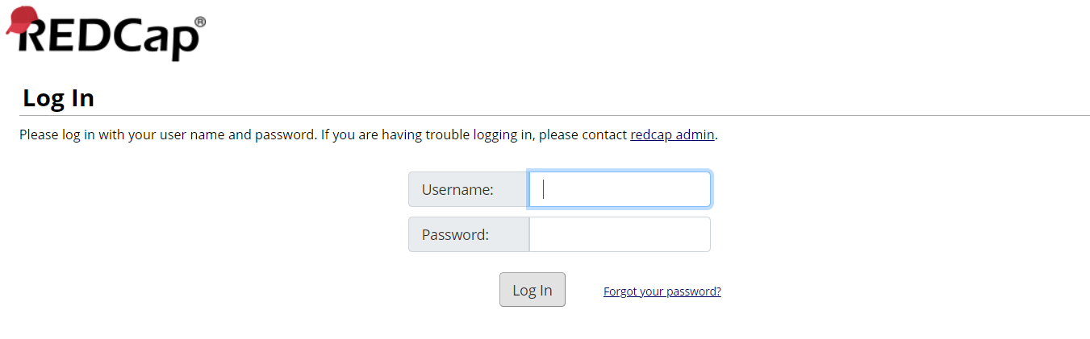
Viewing your NTSV C-Section Rates by race, ethnicity and insurance status in REDCap
https://redcap.healthlnk.org

Slide 24
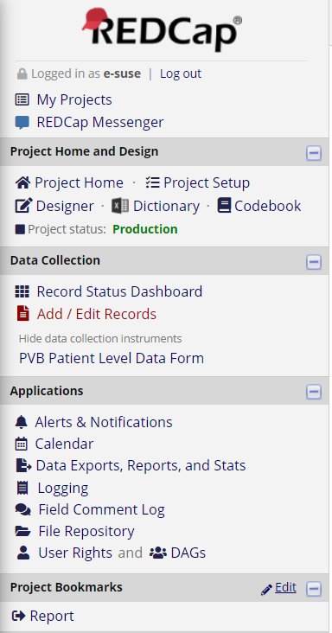
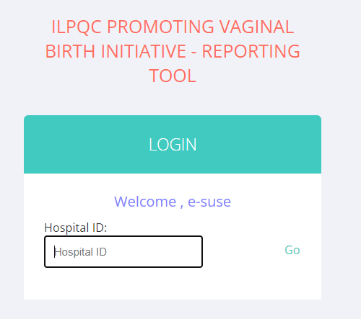
Let’s take a look at our PVB Reports
234

Slide 25
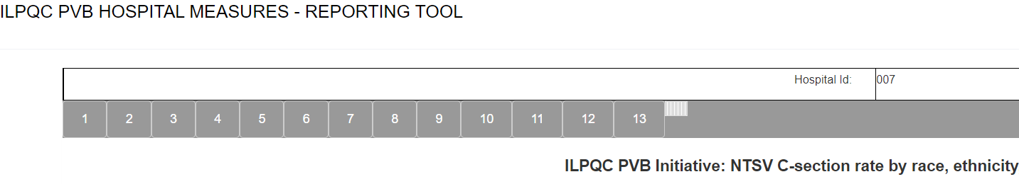
Finding your race and ethnicity report
Go to Report 13

Slide 26
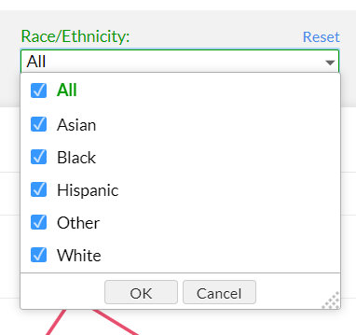
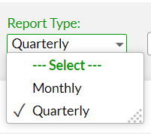
Selecting your report
Select a Quarterly or monthly view
Select which race/ethnicities you would like to compare by checking the boxes

Slide 27
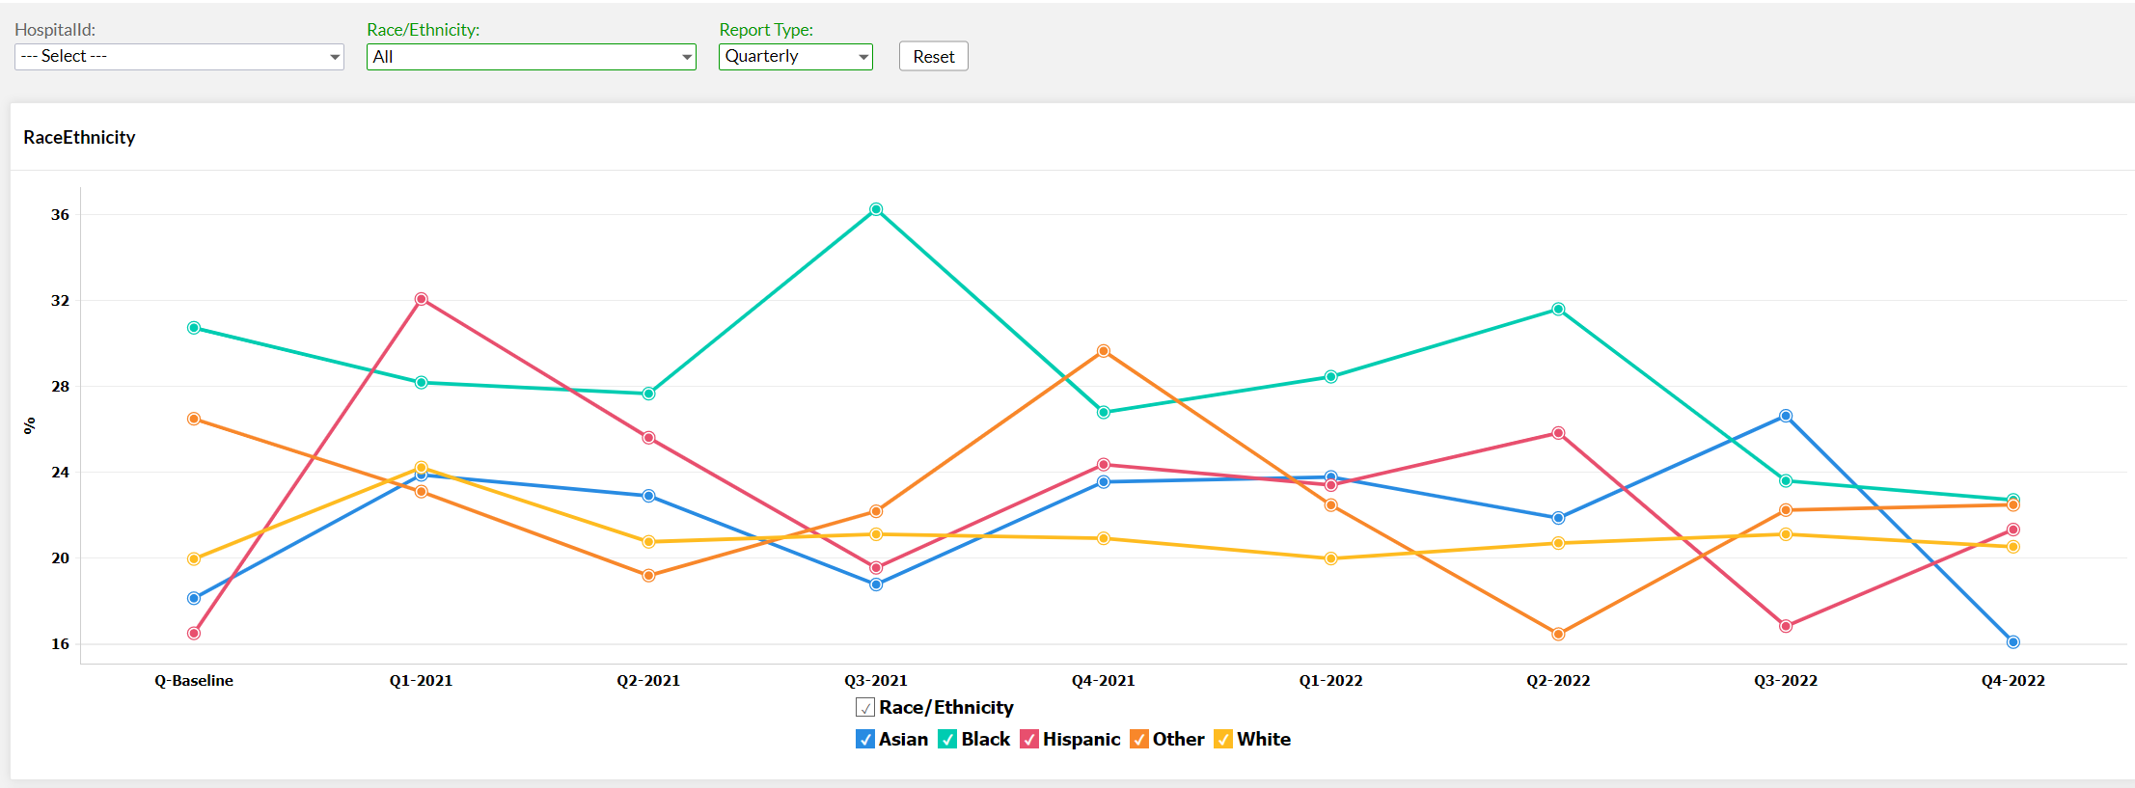
View your report

Slide 28
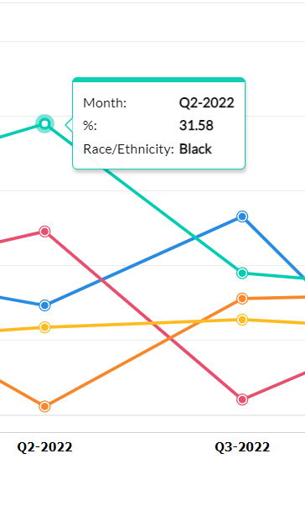
Hover over an individual data point to see the percentage

Slide 29
NTSV C-Sections Meeting
ACOG/SMFM Criteria
64%
of NTSV C-Sections overall are Meeting ACOG/SMFM Criteria

Slide 30
Meeting ACOG/SMFM Criteria by stage of labor
Goal: 80%
Notes:
Add percentages in

Slide 31
Which ACOG/SMFM Criteria does your team need to focus efforts to achieve your > 80% overall goal?
Failed induction
  Oxytocin administered for at least 12-18 hours after membrane rupture, without achieving cervical change and regular contractions
  Longer duration of the latent phase, 24 hours or longer if <6cm and maternal and fetal status permits
Second stage arrest
  At least 3 hours* of pushing in nulliparous patients
*Longer durations (e.g., 4 hrs with epidural) may be appropriate, individualized basis

Slide 32
Provider Buy-In

Slide 33
What you will hear….
It’s not a good time
It’s been done
It’s NEVER been done
It’s not in our policies
It’s not the way we do it here
We don’t have that problem here.
This doesn’t apply to my “high risk” patients
My patient’s won’t like it
You can’t tell me what to do with my patients
My liability will be increased
My productivity will suffer
The doctors won’t like it
I don’t want to get in trouble

Slide 34
Classic reasons to resist change
FEAR and EMOTIONS
  Scared of transition, not idea- Fear of the unknown, confusion
  I feel like I have no say/how do I fit in? Fear of rejection, powerlessness
  What am I going to give up? Fear of loss
  What if my job changes? Fear of failure
  I’m fed up with PHONY change that goes nowhere. Cynicism! Exhaustion!

Slide 35
Key Strategies for Gaining
Provider Buy-In
Engage at the hospital level with the OB Chair
Recruit a strong Provider Champion: Involve them and make them part of the team
Educate Providers on importance of PVB through a PVB Grand Rounds
Un-blind NTSV C-Section rate by individual and Practice Group
Acknowledge high performing providers with low C-section rates and generous with praise and incentives
Center the patient through patient education and shared decision-making
Review Fallouts with providers to better understand decision-making

Slide 36
Changing your culture to value vaginal birth
GET STRONG CHAMPIONS! Change them if you need to or have more than one
Recognize that different types of provider practices will have different concerns/solutions
Have achievable, stated goals
Give everyone tools- algorithms, order sets, new policies, patient education materials, labor support workshops, peer based education on best practices
Engage in patient education,
Practice shared decision making
Notes:
So your task here is to change the culture on your unit to one which values vaginal birth. This is how to begin:

Slide 37
Education
Peer based education
Use ACOG, ACNM, AWHONN best practices
Provide high quality peer-reviewed research and evidence to support change, data from CMQCC
Invest in web-based learning
Leverage education opportunities that exist because of students at institution
Be prepared for new research and how it may affect practice patterns

Slide 38




Key Resources and Strategies for
Provider and Nurse Education + Buy In
  Review fallouts and debrief cases
  Present successful NTSV vaginal deliveries
Provider Education Posters
Missed Opportunity Review
Labor Management E-modules
PVB Grand Rounds
  Hang education posters
  Email pdf versions to providers and nurses
  Send out an email with a different video each week
  Set up labor management skills day
  Schedule a PVB Grand rounds
  Include learners (Residents, fellows, etc.)

Slide 39
Induction of Labor
The goal of induction is
to have a vaginal birth!
Educate patients
Use an Induction Scheduling Checklist
Focus on cervical ripening.
  Outpatient
  Multiple simultaneous induction agents
  Sequential agents
Make admission easier or more timely so less doctor time in the hospital (example: order sets for cytotec dosing)

Slide 40
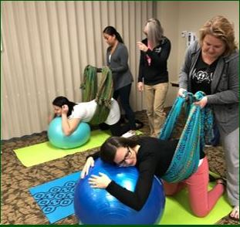

Labor Dystocia
Labor Support workshop
Changes in position
Intermittent auscultation
Resist admission in early labor
Empower nurses to advocate
for patients in early labor
Non-pharmacologic strategies for pain control
Doulas

Slide 41
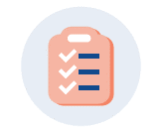

Consistent use of the Cesarean
Decision Checklist and Huddles
Standard process to use the Cesarean Decision Checklist for every potential C-section
Availability of checklist in patient's labor room or in EMR
Standard process to perform Delivery Decision Huddles/Debriefs for every potential C-section
Huddle performed with physician, nurse, any other care team members, and the patient to discuss potential C-section decision
Standardization of who initiates the huddle and use of checklist
Documentation of use of checklist
Use of checklist in huddle initiated by charge or bedside nurse

Slide 42
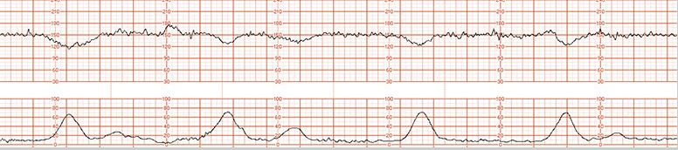
FHR concerns
Nurses and providers mandated to take same courses (online) to standardize discussion
Strip review- at bedside rounds, safety huddle, 5 minutes at department meeting
Recognize that almost every tracing is category 2!

Slide 43
Data Transparency
ASK ME ABOUT MY C-SECTION RATE!
Post NTSV CS rates for MDs or practices
Consider increasing transparency gradually
anonymous rates first, then name top three
Recognize individual success, use positive reinforcement ribbons or buttons “Ask me about my cesarean section rate”
Use Data
  holds us accountable for our own performance,
  creates examples of how our practice can be better
Fully transparent data allows competitive encouragement among team members
Introduce reality: Advise that CS rates will become available to the public soon!

Slide 44
Are you reviewing your ACOG / SMFM criteria fall outs? How can you reach your goal > 80% NTSV C/S meeting criteria?
All team members should understand goal > 80% of NTSV C/S achieve ACOG / SMFM criteria.
Every team should review their data for ACOG / SMFM criteria monthly or quarterly (depending on birth volume) and be sharing the data with QI team as well as providers and nurses.
Review fall outs that do not meet ACOG/SMFM criteria:
  Discuss and provide feedback to clinical team
  Opportunity to provide specific education to providers and/nurses
  Huddles / NTSV c/s checklist process should be used to review/discuss criteria and indications for cesarean
  Check how cesarean decisions are documented and why not meeting criteria? Can documentation be improved?

Slide 45

Fall-Outs: Individual Case Review Steps
Identify cases not compliant with ACOG / SMFM guidelines: data dashboard
Review chart and identify how NTSV Cesarean Indication documented, identify which component was not compliant with ACOG / SMFM guidelines
Understand additional details of case, was there an additional indication for CS that was indicated? Was documentation appropriate?
Take notes and provide feedback to clinical team
Identify patterns and areas to work on

Slide 46
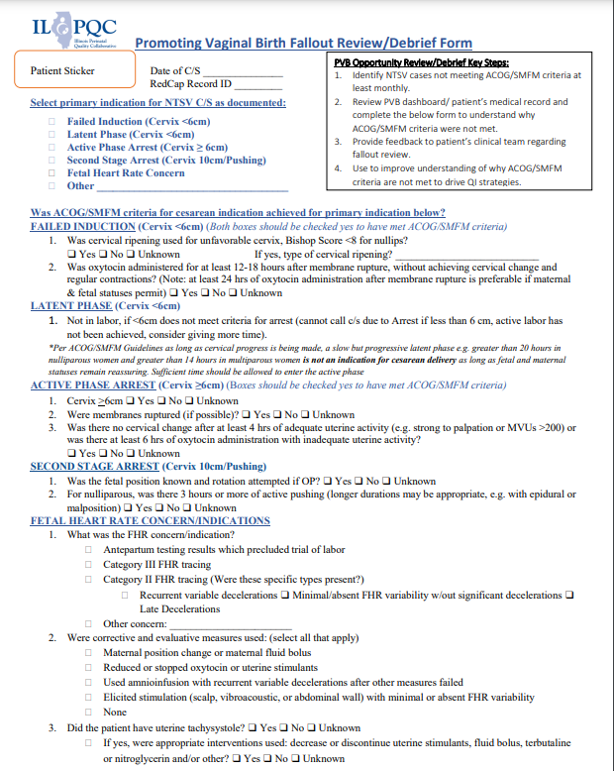

Key ILPQC Resource for Fallout Review NTSV C-Section Cases Not Meeting ACOG/SMFM Criteria
ILPQC has created a Fallout Review form to review NTSV C-Section Cases that do not meet ACOG/SMFM Criteria
Fallout Review

Slide 47
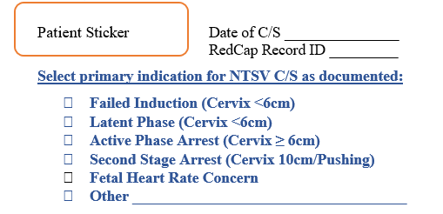
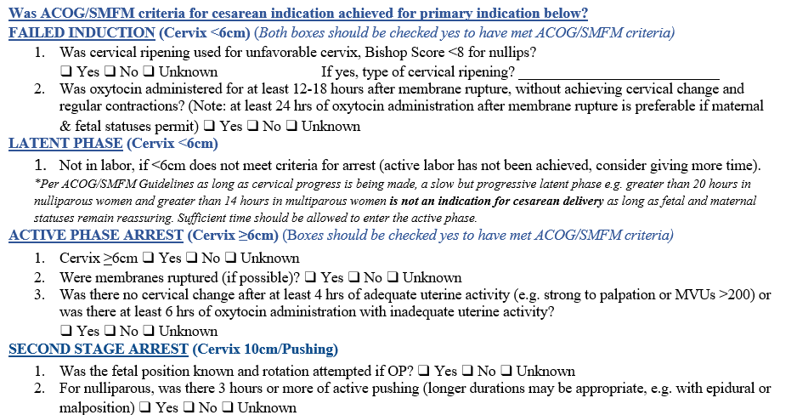
1
Select the primary indication for C/S that is documented
2
Determine whether ACOG/SMFM Criteria for cesarean indication was achieved by answering the questions listed on the indication

Slide 48
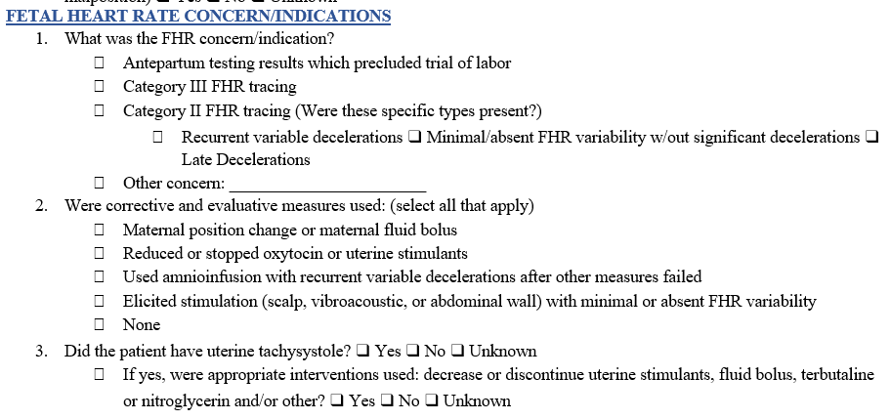
2 Cont…
Determine whether ACOG/SMFM Criteria for cesarean indication was achieved by answering the questions listed on the indication

Slide 49
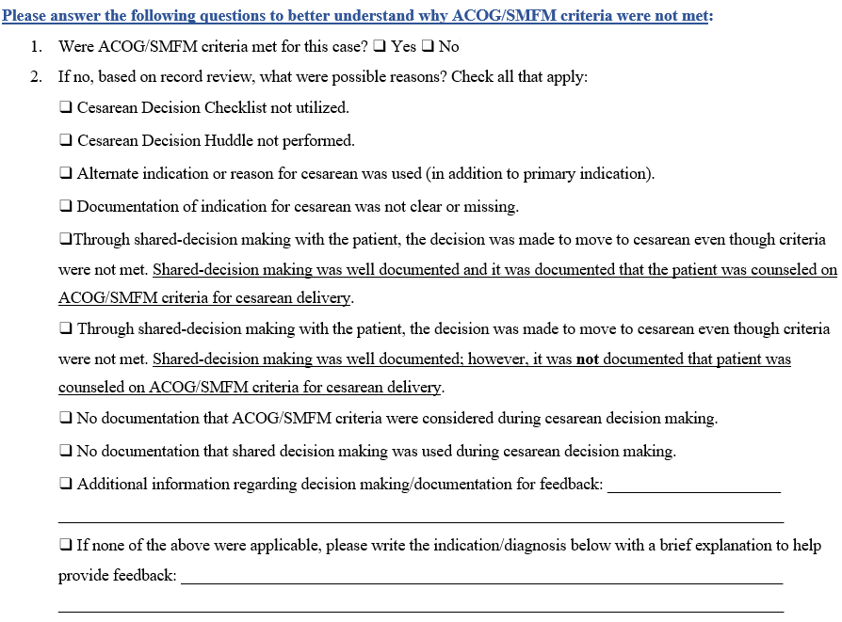
3
Answer this list of questions to better understand why ACOG/SMFM Criteria were not met

Slide 50
PVB Opportunity Review/Debrief Key Steps
Identify NTSV cases not meeting ACOG/SMFM criteria at least monthly.
Review PVB dashboard/ patient’s medical record and use the PVB Fallout Review Form to understand why ACOG/SMFM criteria were not met.
Provide feedback to patient’s clinical team regarding fallout review.
Use to improve understanding of why ACOG/SMFM criteria are not met to drive QI strategies and focus education for L&D clinical teams.

Slide 51
Key Messages from FPQC
Keep patients in the center
Find effective champions (physician, CNM, nurse, administrator)
Educate with reputable sources.
Use checklists in each of the focus areas. Particularly effective is a “pre-cesarean” checklist
Post provider and/or practice level NTSV c/s data
Meet the people where they are
Don’t try to change everything at once

Slide 52
Team Talk: University of Chicago

Slide 53
Promoting Vaginal Birth
Staff Engagement
UChicago Family Birth Center
Anna Marzano, BSN, RN, CBC, C-EFM

Slide 54

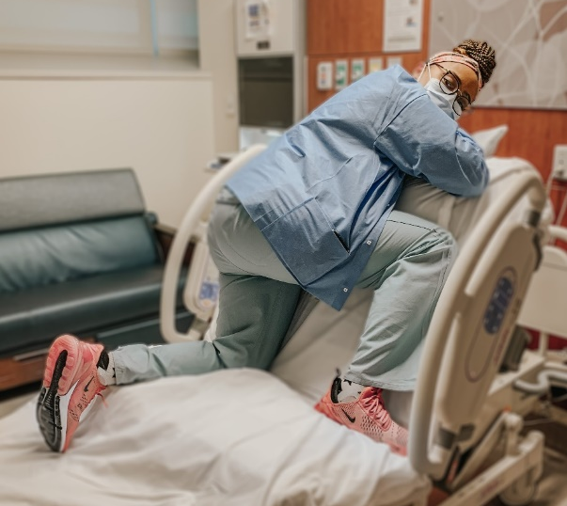
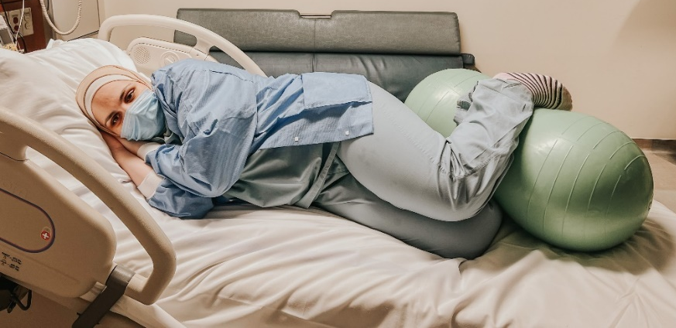
Nursing Engagement
Find nurse champions
  Attend Spinning Babies & ILPQC Workshops
Share “wins” during huddles
Champions help with stalled labors
Unit Based Council Project:
  Create materials featuring our nurses
    Bulletin board refresh
    Share strategies during staff meetings
  QR codes link to “How-to” videos

Slide 55
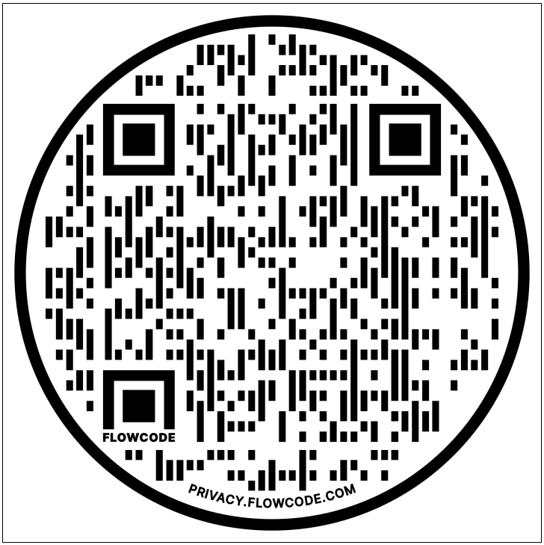
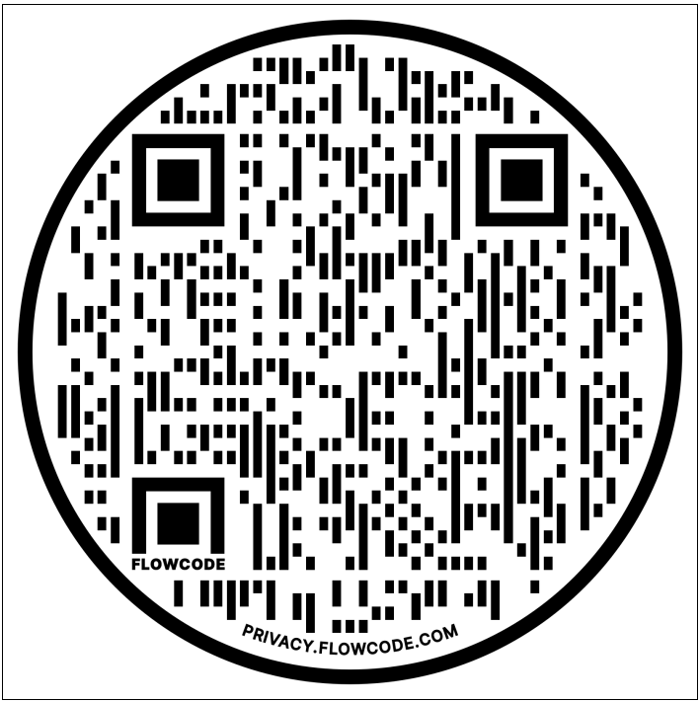
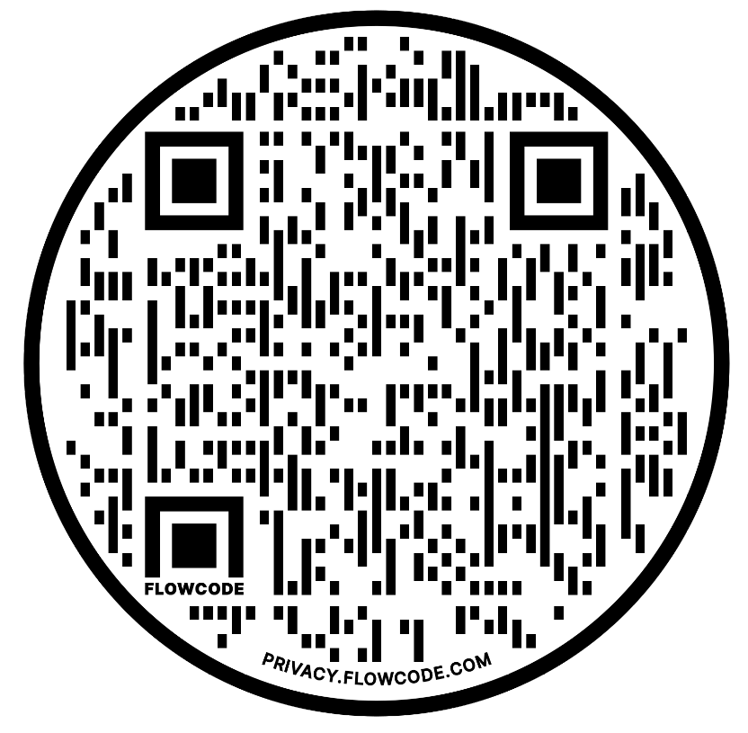
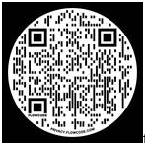
QR Codes for Staff and Patients
Easy Access
Everyone can employ purposeful positioning techniques
QR Code for Side-lying Release Video
QR Code for Squatting Options Video
QR Code for Froggie Walcher’s Video
QR Code for Flying Rider Video

Slide 56
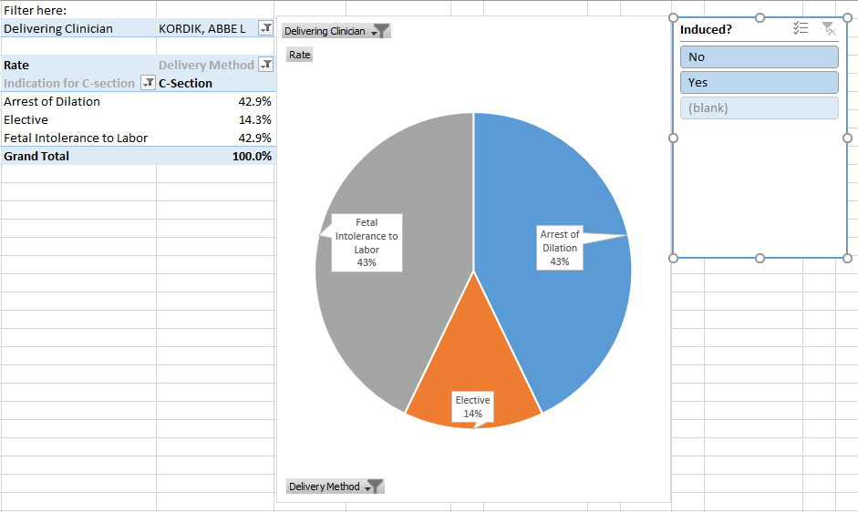
OB Providers
Resident shadowing program
Reviews of unit and personal rates
  Mentorship opportunities

Slide 57
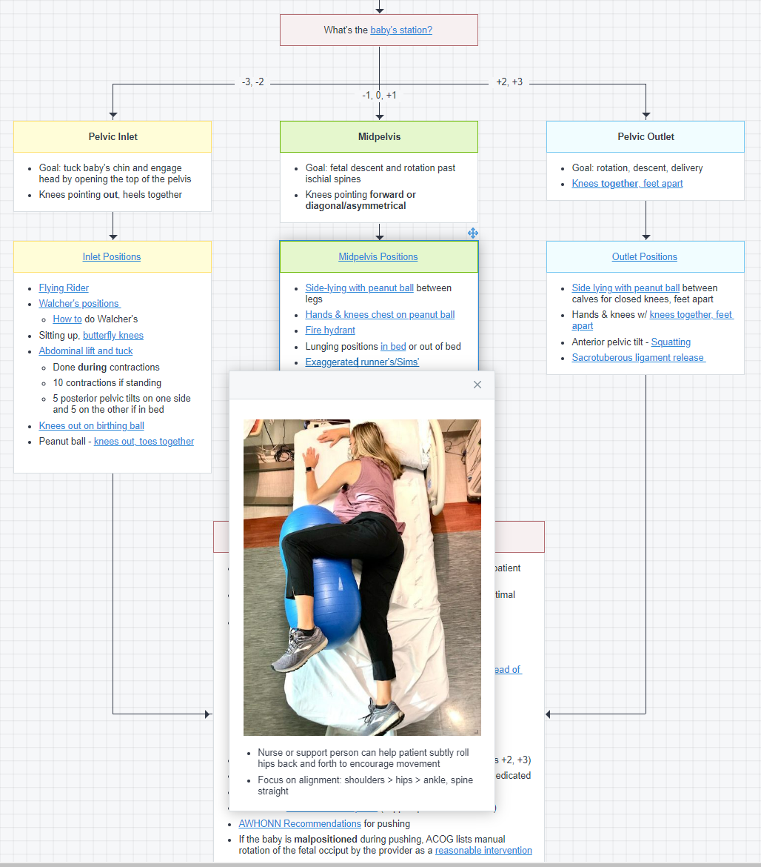
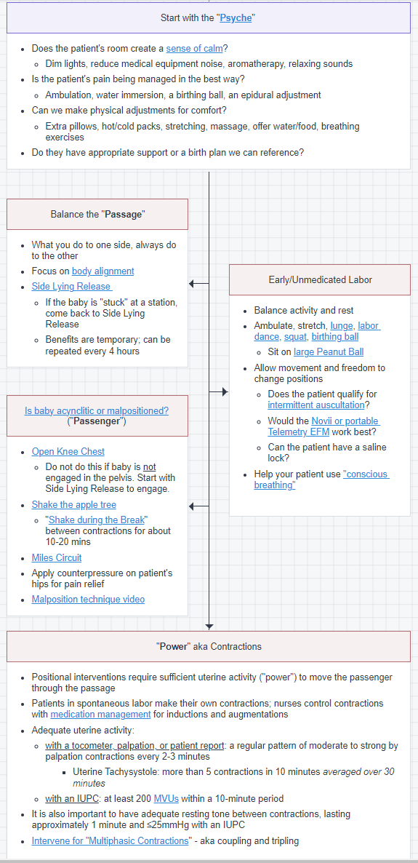
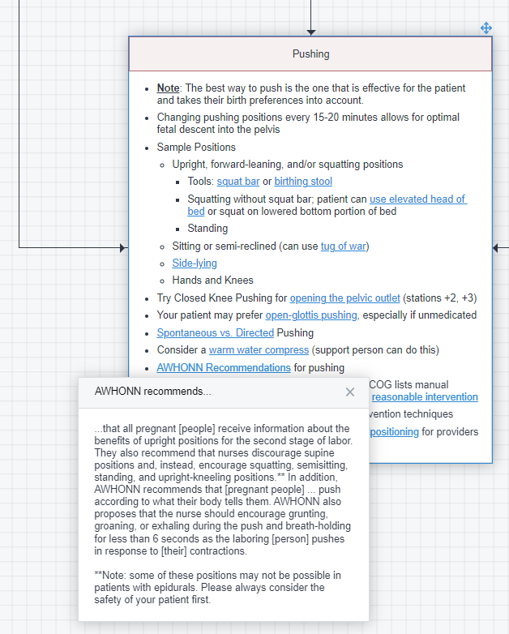
Pathways:
Labor Management Strategies

Slide 58
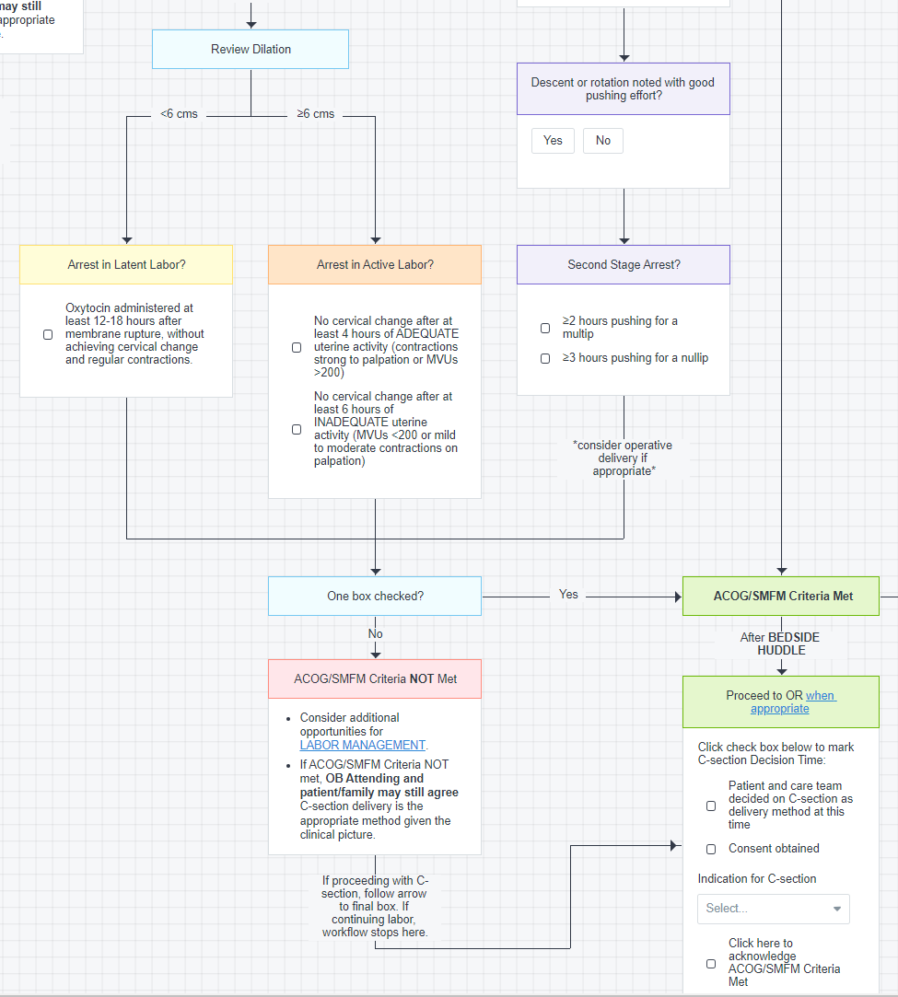
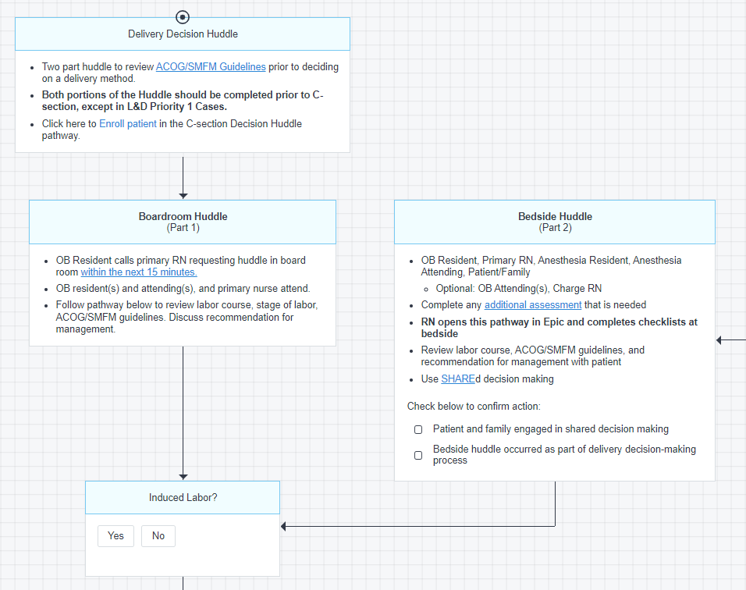
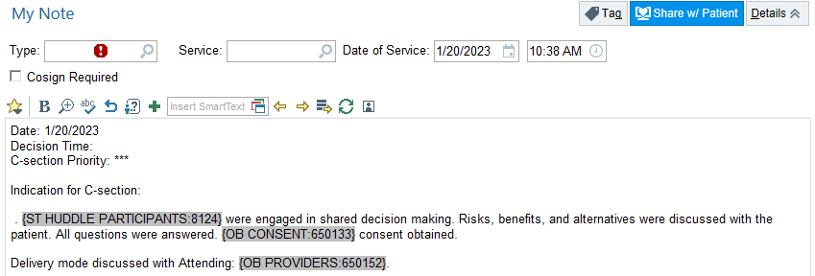
Delivery Decision Huddles
Crucial Conversations Simulations
Streamlines documentation
Links to other initiatives (Birth Equity, Interdisciplinary Communication)

Slide 59
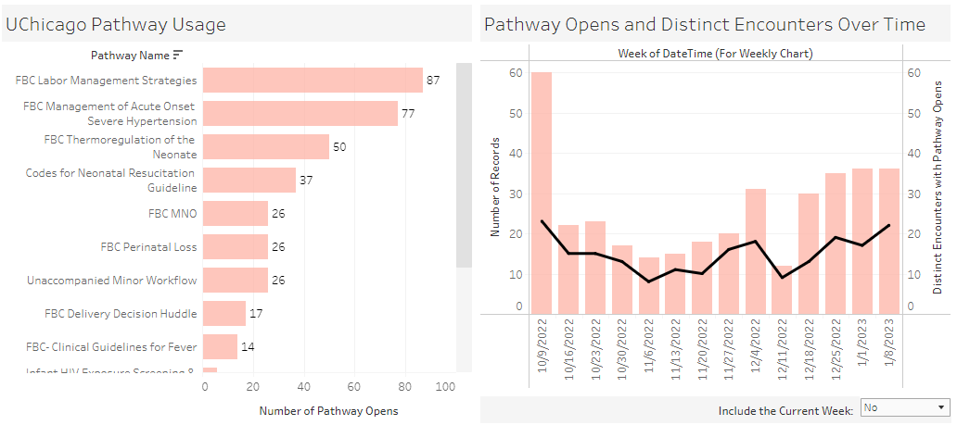
Pathway Usage
Labor Management Strategies most frequently used resource Pathway

Slide 60
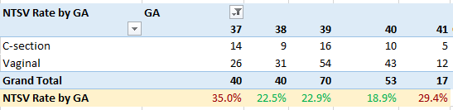
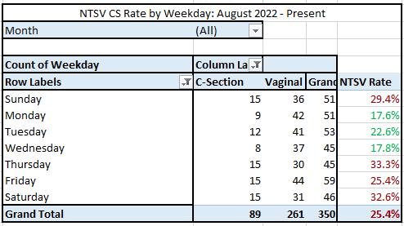
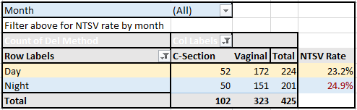
Finally… Constant Data Sharing, Honesty, Revision.
Summary BMI Data: July 2022 - Present
BMI | Total | C-Section | NTSV Rate
≤40 | 375 | 81 | 22%
41-49 | 41 | 17 | 41%
≥50 | 9 | 4 | 44%

Slide 61
PVB Next Steps

Slide 62
February PVB Monthly Webinar
Discussion across hospitals is always the best way to learn new ideas and get motivated to keep working on promoting vaginal birth and reducing C/S delivery.
For our February PVB Monthly Webinar part of the call will be breakout sessions to provide the opportunity for smaller group discussion across hospitals on challenges and strategies to achieve sustainable reductions in NTSV C/S rates
Each small group breakout sessions will be led by PVB coaches/facilitators (providers and nurses) from teams who have achieved QI Excellence Awards and met NTSV c/s goals
Join us on February 23rd at 12:30 pm for this exciting opportunity!

Slide 63
ILPQC Sponsored – FREE
PQI Intermittent Auscultation (IA) Opportunity for Teams
This 45–60-minute online program provides interactive, simulation-based training, and competency assessment designed to improve nurses', midwives', and physicians’ Intermittent Ausculatation (IA) usage and interpretation skills. This education includes:
evidence related to the use of intermittent auscultation
correct technique to perform IA effectively
IA Practice Guide for interpretation and management of IA findings
simulated IA practice scenarios
Each PVB Team will have access to 1 PQI IA online train the trainer course
Team leads look out for an email with more information!

Slide 64
ILPQC is here to help you get across the finish line!
PVB Finish Line Goals:
QI Excellence Award
6 Key Structure Measures in Place
NTSV C-Section Rate ≤23.6%
80% of Providers and Nurses educated on ACOG/SMFM Guidelines
80% of all NTSV C-Sections Meeting ACOG/SMFM Guidelines
We are here to help!
We are here to support!
Schedule a personalized QI Support Call, email info@ilpqc.org to schedule a check-in call
Check-in calls planned with all teams not yet achieving key aims.

Slide 65
Upcoming Calls
Date | Topic
February 27th, 2022, 12:30 PM | Learning from PVB Teams Achieving QI Excellence
March 20th, 2022, 12:30 PM | Reviewing your PVB Data by Race and Ethnicity
April 24th, 2022, 12:30 PM | PVB Monthly Webinar
May 24th, 2022 | Face-to-Face Meeting

Slide 66
Questions?
Please put your questions or comments in the chat

Slide 67










Thanks to our Funders
In kind support:

