Slide 1

PVB Monthly Webinar:
Small group discussions strategies for success
February 27th, 2023, at 12:30 PM

Slide 2
Overview
12:30-12:55:
  ILPQC Announcements for Face-to-Face 2023 Meeting
  Review PVB Data
12:55-1:00:
  Get into Breakout Rooms
1:00-1:30:
  PVB Coaching Breakout Sessions

Slide 3
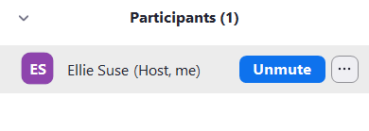
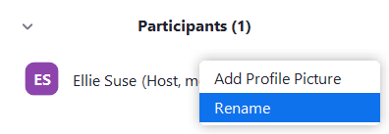
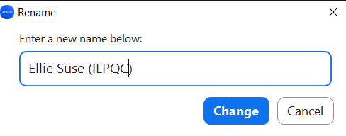
Change your Name to:
First Name Last Name (Hospital)
Hover over your name and click the 3 dots
Click Rename
Rename yourself as: First Name Last Name (Hospital)

Slide 4
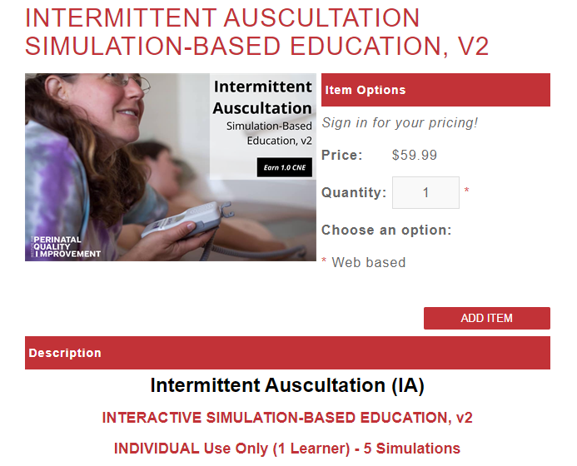
ILPQC Sponsored – FREE
PQI Intermittent Auscultation (IA) Opportunity for Teams
This 45–60-minute online program provides interactive, simulation-based training, and competency assessment designed to improve nurses', midwives', and physicians' IA usage and interpretation skills. This education includes:
evidence related to the use of intermittent auscultation
correct technique to perform IA effectively
IA Practice Guide for interpretation and management of IA findings
simulated IA practice scenarios
Each PVB Team will have access to 1 PQI IA online train the trainer course.
*Emails sent to PVB Team Leads*
Email ellie.suse@northwestern.edu
for more information.

Slide 5
2023 ILPQC Face-to-Face Meeting

Slide 6
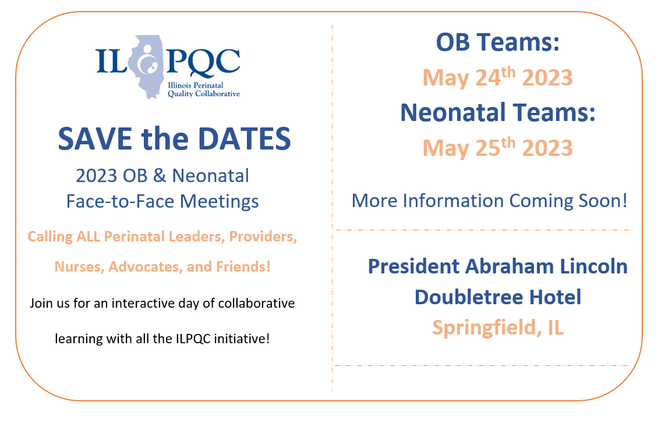
We are back in person in Springfield for Face-to-Face 2023!!!

Slide 7


All structure & patient-level data entered for Baseline-August 2022
Key Structure Measures "In Place":
  Provider and Nurse Education
  Standardized Protocol/Processes
  Sharing un-blinded provider level NTSV C-Section rates
  Cesarean Decision Checklist
  Decision Huddles/Debriefs
  Shared Decision-Making
All Data due
April 21st!

Slide 8
Achievement of PVB aims
  ≥ 80% of Providers and Nurses educated on ACOG/SMFM guidelines
  ≥ 80% of all NTSV C-Sections meeting ACOG/SMFM guidelines
  NTSV C-Section Rate ≤23.6%

Slide 9

2023 F2F Volunteers Needed...
Come one! Come ALL!
Join us as we collaborate in-person
at ILPQC Face-to-Face event in Springfield, IL.
The first ILPQC Face-to-Face event since 2019!
We are looking for volunteers to be a part of the:
2023 F2F PLANNING COMMITTEE
2023 F2F BREAKOUT FACILITATORS
Interested? Drop your name in the chat or email info@ilpqc.org

Slide 10
2023 Face to Face: Let's Get Ready!
Save the Dates!
Submit your Data!
Submit all your 2022 data plus January, February, March 2023
OB- May 24th, Wednesday
Neonatal- May 25th, Thursday
Storyboard Submissions!
Share your successes, opportunities, and specific strategies implemented!
Share your DATA, graphs, PDSA cycles, process flow or 30/60/90 plans
Review the award criteria for PVB, BE, and BASIC to achieve QI Excellence!
Start brainstorming your storyboard ideas!
ILPQC Room Block TBA
President Abraham Lincoln Hotel, Springfield, IL
Share your teams past year QI story
All Data due
April 21st!
Registration opens soon!
Templates coming soon!

Slide 11
Story Board Instructions
At the Face-to-Face Learning Session, use the Storyboard to tell your team’s story descriptively, clearly and creatively – photos, collages and illustrations are welcome.
There is no wrong way to create a Storyboard so don’t be afraid to be creative. Additionally, be sure to keep it simple; the Storyboard is not meant to be an extremely time-consuming project.
Storyboards must fit into a space approximately 28 x 40 inches. It may be created from a collection of 6-8 letter-sized sheets (print outs of your power point slides or word documents) that are convenient for carrying while traveling. Boards for posting and pushpins will be provided at the Face-to-Face Learning Session.
Share your story: about your hospital, about your team, describe your goals for this initiative, include process flow diagram draft, can include any barriers you have identified and opportunities for improvement, describe next steps or action items for your team

Slide 12
Initiative Specific Content
PVB:
  Share your success! (Including Data) what strategies are in place? What has been most successful?
  Barriers you are still facing and plans to overcome them
  Next Steps
BE:
  Share your success! (Including Data)
  Barriers you are still facing and plans to overcome them
  Next Steps

Slide 13
OB Team Story Board Template
Hospital Name
PVB
Birth Equity
PVB Success
Including Data
BE Success
Including Data
Hospital Demographics
PVB Barriers and plans to address
PVB QI Team Members
BE Barriers and plans to address
BE QI Team Members
PVB Next Steps
BE Next Steps

Slide 14
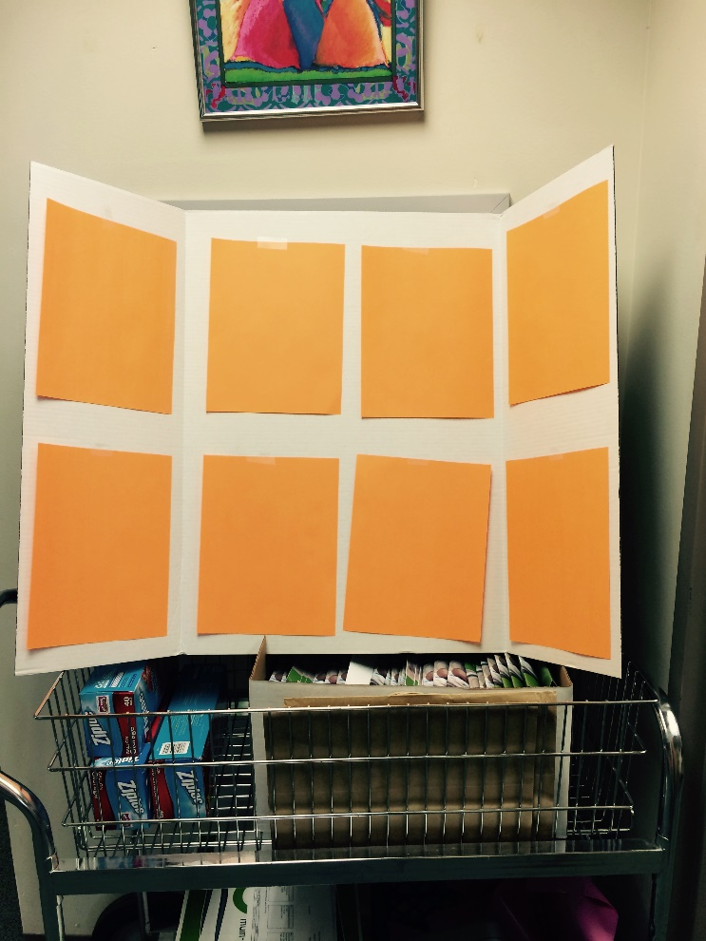
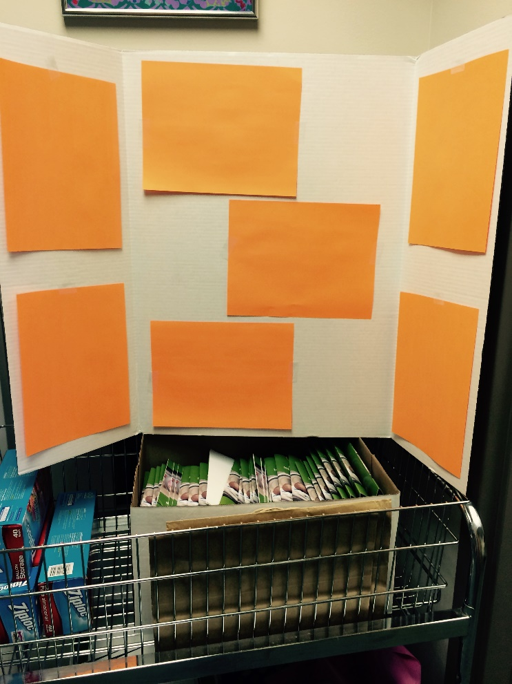
Sample Layout
With 4 portrait oriented sheets in the middle panel
With 3 landscape oriented sheets in the middle panel

Slide 15
Promoting Vaginal Birth
Moving from systems change to culture change to achieve success

Slide 16
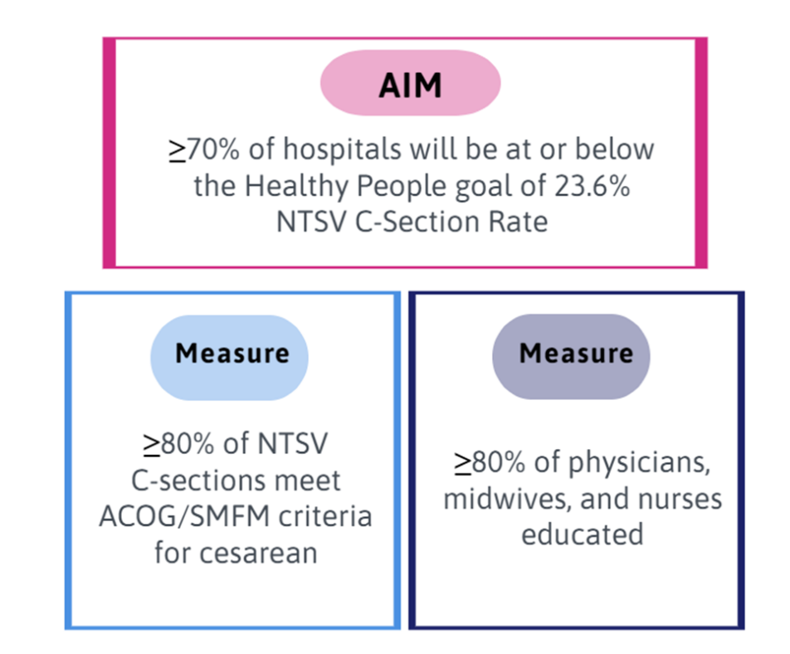
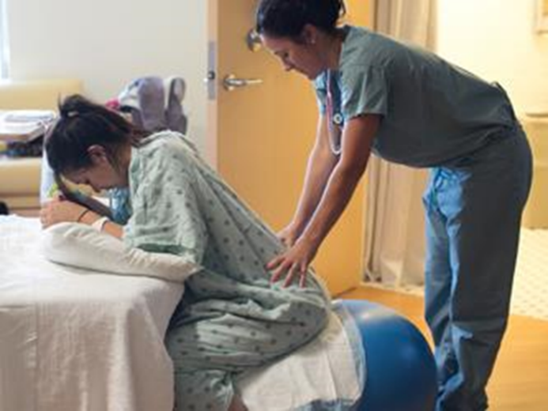
PVB Aims and Measures

Slide 17







PVB Key Strategies for Culture Change
Clinical Team Education and Buy-in
Cesarean Decision Huddles and Checklist
Sharing Unblinded Provider-level NTSV C-Section Rates
Educating patients and shared decision making
Fallout Reviews of cases not meeting ACOG/SMFM Criteria
Labor Management Support

Slide 18
Provider and Nurse Education

Slide 19
Standard Protocols and Processes

Slide 20
Sharing Provider Level Data

Slide 21
Cesarean Decision Checklists and Decision Huddles/Debriefs
Keep it up!

Slide 22
Shared Decision Making and Patient Education
Progress with & for Patients!
Notes:
Focus for today

Slide 23
Teams working on Key PVB SM

Slide 24
NTSC C-Section Rate by Hospital
Wow! Progress!
All ILPQC Rate:
Goal: 23.6%

Slide 25
NTSV C-Section Rate PVB Hospitals baseline to Q3 2022
Goal: 70% of hospitals achieving NTSV C-Section Rate Goal
59% of ILPQC Hospitals achieving NTSV C-Section Rate goal of < 23.6%
Overall ILPQC NTSV C-Section Rate Meeting Goal!!

Slide 26
Addressing disparities:
NTSV C-Section Rate by Race and Ethnicity
ILPQC Data System Reports Available!!!
Goal: 23.6%
Notes:
Making progress this year to reduce NTSV C/S disparity gap, but will need to be sustained!

Slide 27
Meeting ACOG/SMFM Criteria by stage of labor
Goal: 80%
Notes:
Add percentages in

Slide 28
ILPQC is here to help you get across the finish line!
PVB Finish Line Goals:
QI Excellence Award
6 Key Structure Measures in Place
NTSV C-Section Rate ≤23.6%
80% of Providers and Nurses educated on ACOG/SMFM Guidelines
80% of all NTSV C-Sections Meeting ACOG/SMFM Guidelines
We are here to help!
We are here to support!
Schedule a personalized QI Support Call, email info@ilpqc.org to schedule a check-in call
Check-in calls planned with all teams not yet achieving key aims.

Slide 29
Upcoming Calls
Date | Topic
March 20th, 2023, 12:30 PM | Reviewing your PVB Data by Race and Ethnicity
April 24th, 2023, 12:30 PM | PVB Monthly Webinar
May 24th, 2023 | Face-to-Face Meeting

Slide 30
PVB Breakout Sessions

Slide 31
Change your Name to:
First Name Last Name (Hospital)
Hover over your name and click the 3 dots
Click Rename
Rename yourself as: First Name Last Name (Hospital)

Slide 32
Small Group Breakouts: all sharing, all learning, lots of discussion
Your NTSV C-Section Rate (if you are comfortable sharing)
Strategies your PVB has successfully implemented
Challenges you are facing with PVB implementation
Discussion to follow:
best strategies to address challenges and next steps

Slide 33










Thanks to our Funders
In kind support:

