Slide 1
PVB Monthly Webinar: Small Group Breakout Sessions by Network
August 28th, 2023, at 12:30 PM

Slide 2
Overview
Upcoming 2023 Annual Conference
PVB Data overview
Small Group Breakout Sessions by Network
PVB Next Steps

Slide 3
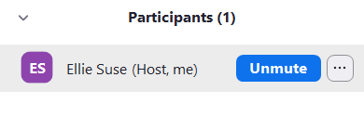
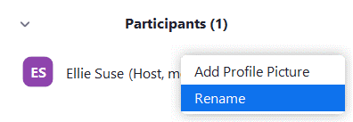
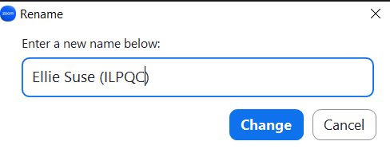
Change your Name to: First Name Last Name (Hospital)
Hover over your name and click the 3 dots
Click Rename
Rename yourself as: First Name Last Name (Hospital)

Slide 4
Thank you to our Discussion Leaders!
A special thank you to our leaders of today’s small group discussions!
These individuals have worked hard their hospitals to implement PVB Key strategies to reduce their NTSV C-Section Rate and achieve QI Excellence!
A special thank you to our leaders of today’s small group discussions!
These individuals have worked hard their hospitals to implement PVB Key strategies to reduce their NTSV C-Section Rate and achieve QI Excellence!
Advocate Condell: Sarah Allen
NorthShore Evanston Hospital: Dina Kapogianis
UIC: Stephanie Mendoza, Olga Marrero
MacNeal: Maria Lotesto, Karen Richardson
NM Kishwaukee: Angela Kennedy, Kelly Densberger
OSF St. Anthony: Courtenai Smith
CarleBroMenn: Keli Sidebottom
UPH Methodist: Mia Doty

Slide 5
Registration Coming Soon!
The Westin Chicago Lombard
Hotel Room Block Coming Soon!

Slide 6
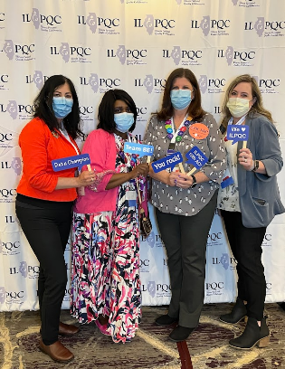
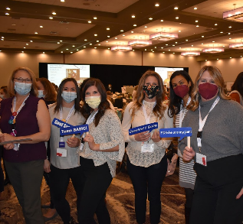
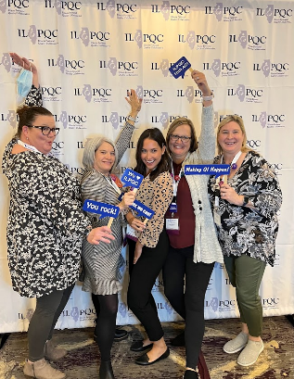
E.N.G.A.G.E. in ILPQC's Annual Conference 2023
Exchange
Network
Gain
Apply
Gather
Energize
Make sure at least one physician champion and one nurse champion are there to represent your hospital.

Slide 7
Upcoming Annual Conference Prep
Submit your Data!
All data baseline-August 2023 will be due on September 22nd, 2023, for award consideration.
Call for Abstracts!
Info coming soon! All hospital teams are asked to submit an abstract on QI work (can be in progress).
ILPQC Annual Conference Survey!
We want to hear from you! Survey opening soon!
This is a great opportunity to share your teams' thoughts & insights reflecting on 2023 and planning for 2024!

Slide 8
PVB AWARD CRITERIA
QI Excellence Award:
All data submitted
6 key structure measures in place
Achieved all 3 process and outcome measures
≥ 80% of Providers and Nurses educated on ACOG/SMFM guidelines
≥ 70% of all NTSV C-Sections meeting ACOG/SMFM guidelines
NTSV C-Section Rate ≤ 23.6%
Your Hospital's Name Here!
Your H
Notes:
QI Excellence Awards signify that you have achieved the initiative aims. Did we change NTSV CS meeting criteria to 70%?

Slide 9
Promoting Vaginal Birth
Moving from systems change to culture change to achieve success

Slide 10
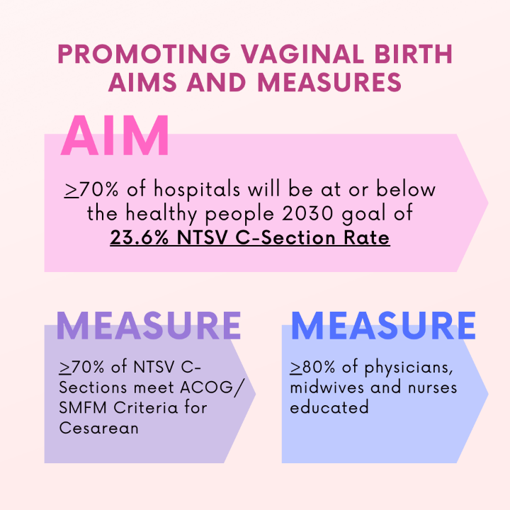
PVB Aims and Measures
Notes:
On ACOG/SMFM critera

Slide 11
2023 PVB Focus
Helping all PVB teams to bring their NTSV C-Section Rates below 23.6%
NTSV C-Section Rate <23.6%
Increasing the % of NTSV C-Sections Meeting ACOG/SMFM Criteria with a focus on Failed Inductions and Second Stage Arrest to >70%
>70% Meeting ACOG/SMFM Criteria
Addressing Disparities
Identifying and addressing disparities in NTSV C-Section rates

Slide 12
PVB Key Strategies for Culture Change
Clinical Team Education and Buy-in
Delivery Decision Huddles and Checklist
Sharing Unblinded Provider-level NTSV C-Section Rates
Educating patients and shared decision making
Fallout Reviews of cases not meeting ACOG/SMFM Criteria
Labor Management Support

Slide 13
NTSV C-Section Rate by Hospital: Aim >70% hospitals at goal
Goal: < 23.6%
All ILPQC Rate: 23.4%
Notes:
If 7 more hospitals achieve <23.6%, we will achieve 70% of Illinois hospitals at goal FIX THE 35% ARROW

Slide 14
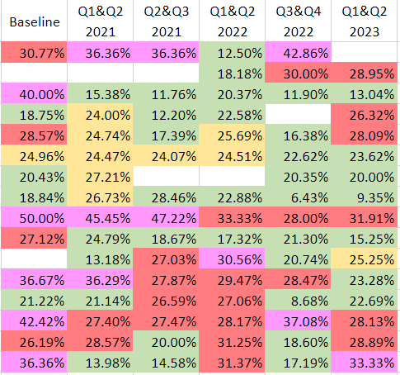
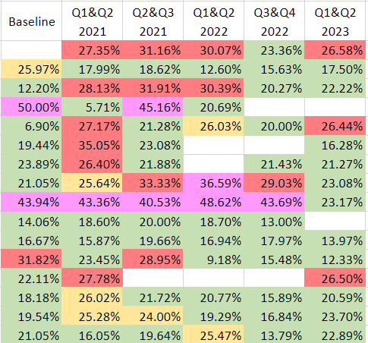
Level I & II Hospitals

Slide 15
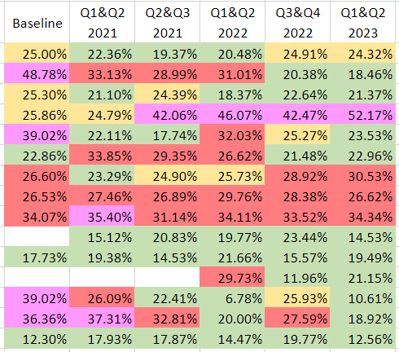
Level II+ Hospitals

Slide 16
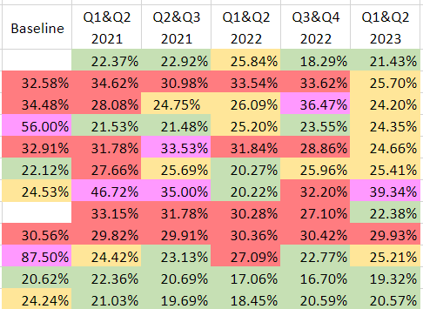
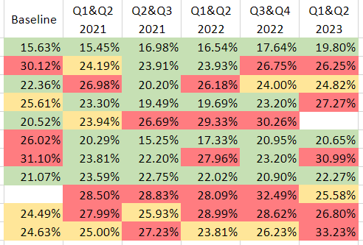
Level III Hospitals

Slide 17
NTSV C-Section Rate by Hospital: Aim >70% hospitals at goal
Goal: 70% of hospitals achieving NTSV C-Section Rate Goal

Slide 18
NTSV C-Sections Meeting ACOG/SMFM Criteria
Work on Fall Out Reviews for Failed Inductions!!
Goal: > 70%
2023 Focus Improving % Second Stage Arrest
&
Failed Induction
meeting criteria

Slide 19
Addressing disparities: NTSV C-Section Rate by Race and Ethnicity
23.7%
23.0%
Goal: <23.6%

Slide 20
Addressing disparities: NTSV C-Section Rate by Race and Ethnicity
Goal: <23.6%

Slide 21
Steps to Address NTSV C-Section Disparities
Available in toolkit

Slide 22
Small Group Breakout Sessions
Get ready to share!

Slide 23
Thank you to our Discussion Leaders!
A special thank you to our leaders of today’s small group discussions!
These individuals have worked hard their hospitals to implement PVB Key strategies to reduce their NTSV C-Section Rate and achieve QI Excellence!
A special thank you to our leaders of today’s small group discussions!
These individuals have worked hard their hospitals to implement PVB Key strategies to reduce their NTSV C-Section Rate and achieve QI Excellence!
Advocate Condell: Sarah Allen
NorthShore Evanston Hospital: Dina Kapogianis
UIC: Stephanie Mendoza, Olga Marrero
MacNeal: Maria Lotesto, Karen Richardson
NM Kishwaukee: Angela Kennedy, Kelly Densberger
OSF St. Anthony: Courtenai Smith
CarleBroMenn: Keli Sidebottom
UPH Methodist: Mia Doty

Slide 24
Change your Name to: First Name Last Name (Hospital)
Hover over your name and click the 3 dots
Click Rename
Rename yourself as: First Name Last Name (Hospital)

Slide 25
Get Ready to Share!!
What key PVB Strategies are you using/could you use to address these challenges? What help do you need?
What challenges are you facing achieving PVB goals?
What Successes have you had with PVB?

Slide 26
Choose the Breakout Session Based on your Perinatal Network
Group 1: University of Chicago + UIC
Group 2: Northwestern + Stroger
Group 3: Loyola + Rush
Group 4: St. Francis+ St. Johns
Group 5: Rockford + Cardinal Glennon

Slide 27
ILPQC is here to help you get across the finish line!
PVB Finish Line Goals:
QI Excellence Award
6 Key Structure Measures in Place
NTSV C-Section Rate ≤23.6%
80% of Providers and Nurses educated on ACOG/SMFM Guidelines
70% of all NTSV C-Sections Meeting ACOG/SMFM Guidelines
We are here to help!
We are here to support!
Schedule a personalized QI Support Call, email info@ilpqc.org to schedule a check-in call
Check-in calls planned with all teams not yet achieving key aims.

Slide 28
Upcoming PVB Calls
Event | Day/Time
PVB Webinar - September | Monday, September 21st at 12:30 pm
Annual Conference 2023 | Thursday, November 2nd Westin Lombard, Illinois
PVB Webinar – November 2023 | Monday September 25th at 12:30 PM
December 2023 | No PVB Webinar

Slide 30
Thanks to our Funders
In kind support:

