Slide 1
BASIC Monthly Teams Call: 2022 Annual Conference Recap
Monday November 21st, 2022 2:00 PM

Slide 2
Call Overview
2022 Annual Conference Recap
ILPQC BASIC Data
Annual Conference Poster Presentations:
Advocate Lutheran General Hospital, Park Ridge IL
HSHS St. John's Hospital
BASIC Next Steps

Slide 3
ABP MOC Part IV (BASIC/MNO)
Complete an attestation form if you are an ABP-certified physician seeking 25 credits under MOC Part IV
Last Chance for MNO
BASIC will be ongoing
Submit the attestation form to your QI project leader for signature and send back to info@ilpqc.org for credit in 2022
Attestation of Meaningful Participation:
Intellectually engaged in planning and executing the project
Participated in implementing the project’s interventions - the changes designed to improve care
Regularly reviewed data in keeping with the project’s measurement plan
Collaborated in the activity by attending team meetings
Claim your credits
TODAY!

Slide 4
Happy 10th Annual Conference!
Thank you to all who continue to contribute to building a successful state collaborative for IL!

Slide 5
2022 AC by the Numbers
Our first in-person event since 2019!!
360 in-person attendees
8 national speakers
48 Quality Improvement Posters
3 breakout sessions
(OB, Neonatal, and Patient & Community)
Over 100 Quality Improvement Recognition Awards for current QI initiatives

Slide 6
Agenda- Recordings Available Soon!
Time | Title and Presenter
8:00a-8:15a | Welcome: Ann Borders, MD, MSc, MPH VIP Welcome: Tamela Milan-Alexander: EverThrive Community Engagement Director
8:15a-9:00a | Decade of Success: Making a Difference for Illinois Mothers and Newborns Ann Borders, MD, MSc, MPH, Leslie Caldarelli, MD and Justin Josephsen, MD
9:00a-9:45a | No Quality without Equity: A Growing Movement to Address Maternal Disparities Zsakeba Henderson, MD, FACOG, Senior Vice President, MCH Impact, Chief Medical & Health Officer, March of Dimes
9:45a-10:00a | Break
10:00a-10:15a | Planting the Seeds for the Next Neonatal Initiative as our BASIC Efforts Now Bloom Leslie Caldarelli, MD and Justin Josephsen, MD
10:15a-10:45a | Accelerating Upstream Together to Eliminate Racial Disparities in Infant Health Outcomes by 2030 Michael D. Warren, MD, MPH, FAAP Associate Administrator, Maternal and Child Health, Health Resources and Services Administration, U.S. Department of Health and Human Services
Time | Title and Presenter
10:45a-11:45a | State Quality Collaborative Leaders Panel: National Perspectives on Improving Perinatal Care Lisa Kane Low, PhD, CNM, FACNM, FAAN (Michigan’s Obstetric Initiative (OBI)) Susan Ford, MSN (Ohio Perinatal Quality Collaborative) Shannon Pursell, MPH (Virginia Perinatal Quality Collaborative)
11:45a-12:00p | ILPQC Award Ceremony
12:00p-1:15p | Networking Lunch and Poster Session
1:15p-1:45p | Lessons Learned from Michigan’s Obstetric Initiative (OBI): Promoting Vaginal Birth and Birth Equity Lisa Kane Low PhD, CNM, FACNM, FAAN Michigan’s Obstetric Initiative (OBI)
1:45-2:30 | A Community Approach to Addressing Inequities in Infant Mortality Meredith Shockley-Smith, PhD Executive Director, Field Service Assistant Professor-AFF, UCMC, Founder, Queens Village James M. Greenberg, MD Co-Director, Perinatal Institute, Professor, Department of Pediatrics, Division of Neonatology
2:30p-2:45p | Break
2:45p-4:15p | We're in the Same Room Again! Harnessing QI Energy through our Togetherness: Breakout sessions
4:15p-4:30p | Wrap-up & Evaluation
Notes:
Alana please add in agenda

Slide 7
All structure & patient-level data entered for Baseline-August 2022
Key Structure Measures "In Place":
Standardized Family Education Process
EOS Risk Assessment Protocols for ≥35 and <35 Newborns
Standardized Dosing Guidelines
Antibiotic Discussions/Time Outs Protocol
Standardized Automatic Stop Order Process

Slide 8
Achievement of process and outcome level measures
≥80% of neonatal/pediatric providers and nurses educated
20% reduction (or absolute rate of ≤4%) in newborns ≥35 who receive antibiotics
20% reduction in newborns with a negative blood culture who receive antibiotics for >48 hours
≥80% of newborns with anticipated duration of antibiotic course discussed by clinical team (antibiotic time out)
≥80% of newborns with an automatic stop order entered into the medical chart

Slide 9
BASIC QI Awards
24 winners
QI Excellence Award:
6 key structure measures in place
Achieved all process and outcome measures
QI Leader Award:
6 key structure measures in place
Achieved at least three process and outcome measures
QI Recognition Award:
Have 4-5 key structure measures in place
Achieved at least two process and outcome measures
Data Champion Award:
Complete data submitted
11 winners
9 winners
5
winners

Slide 10
Didn't receive a QI Excellence Award? Have no fear!
ILPQC is committed to supporting all teams to achieve QI Excellence in BASIC!
ILPQC will be reaching out to teams to set up 1:1 chats to discuss plans to achieve initiative goals
ILPQC will be running QI data for hospital performance during October – December 2022 to assess for QI Awards!

Slide 11
Annual Conference Feedback
What did you like about our 2022 Annual Conference?
What improvements could be made?
Put your comments in the chat!

Slide 12
Annual Conference Team Survey Results
Notes:
Capitals are wrong but I can’t change

Slide 13
Annual Conference Survey
56 Teams reporting!

Slide 14
Top 3 successes teams reported since 2021 launch
2022 Teams Survey
Standardized order sets
Incorporation of antibiotic time outs and automatic stop times
Increased provider buy-in

Slide 15
Implementation of BASIC Key Strategies – the Timeline
Healthcare Team education / buy-in
Early Onset Sepsis Risk Protocol ≥35 Weeks
Antibiotic Dosing Guidelines
EMR Optimization
Family Education
2022 Teams Survey

Slide 16
Top barriers teams overcame since initiative launch
2022 Teams Survey
Gaining provider buy-in
Optimizing EMR for data collection and clinical decision support
Documenting family education

Slide 17
Top barriers teams are still working to overcome
2022 Teams Survey
<35 weeks EOS risk assessment protocols
Buy in for stopping antibiotics by 36 hours with negative blood culture
Continuing education for providers and nurses

Slide 18
Warm Handoffs between Units L&D and Nursery/NICU
2022 Teams Survey
63% reported
better communication

Slide 19
For which babies does your team use NEOSC?
2022 Teams Survey
At initiative start, 57% of teams were using NEOSC
Now, 81% of teams are using the NEOSC in some capacity

Slide 20
Moving to a 36-hour rule out
2022 Teams Survey
81% already have 36 hour rule out
16% will implement in next 6 months
3% will stay at 48 hour rule out

Slide 21
Family education provided
2022 Teams Survey
78% of teams reported the family education materials helpful in educating families on EOS and their newborns treatment plan
75% of teams provide the education materials to most or all families
75% of teams reported the materials were well-received when shared with the family

Slide 23
Top rated components of BASIC Teams Webinars
2022 Teams Survey
Notes:
UPDATE TO TRAFFIC LIGHT COLOR

Slide 24
What BASIC measures in ILPQC Data System teams use to inform QI Work
2022 Teams Survey
Antibiotics stopped by 36 hours with a negative blood culture: 88%
Antibiotic prescribing rate: 63%
Antibiotic Automatic Stop Time: 53%
Antibiotic Time Out: 34%
Family Education: 34%
Notes:
I don’t really understand this slide at all.

Slide 25
Hospital teams using BASIC Dashboard to view measures stratified by race and ethnicity
75% report use the BASIC Dashboard!
Of those, 66% of those who use the dashboard have looked at stratified graphs by race and ethnicity:
Family education
Antibiotic time-outs
Culture-negative sepsis
Reported reasons for lack of use
Don't know how to access the dashboard
Don't know what to do with the information
Unaware of the Dashboard
Notes:
Let’s think about this slide more
The order of the second bullet is wrong and do they look at other things?

Slide 26
Babies Antibiotic Stewardship Improvement Collaborative (BASIC)
Moving to Sustainability
Notes:
BASIC (10 minutes)
Slides
Basic initiative overview
Basic Timeline
Data to support success
Number of blood cultures drawn
AUR
Stopped <36 hours
When is an initiative successful?
What is sustainability
Why it is important
What is systems change
What can cause systems to breakdown
How do you avoid it.
What happens if things breakdown.

Slide 27
BASIC Timeline- Where we have been, where we are going
December 2020
BASIC Launch
January 2021
NEOSC Rollout
April 2021
EMR Integration
July 2021
Parent Education Materials and Antibiotic Timeouts
August 2021
Race and Ethnicity Data Utilization
December 2021
Automatic Stop Times
February 2022
BASIC Data Dashboard and Stratification of Data by Race and Ethnicity
March 2022
Engaging Community Pediatricians
August 2022
Data Narratives and Visualizations

Slide 28
Celebrating BASIC Team Achievements
82
December 2020
Teams participating in BASIC Launch
53
May 2021
Outstanding Launch Award Winners
29
May 2022
QI Excellence, Leader, and Recognition Award Winners
49
October 2022
QI Excellence, Leader, and Recognition Award Winners

Slide 29
What We Sought to Achieve Statewide
Decrease the number of newborns born at ≥35 weeks who receive antibiotics
Decrease number of newborns with a negative blood culture who receive antibiotics for longer than 36 hours
The Right Antibiotic for the Right Baby for the Right Length of Time

Slide 30
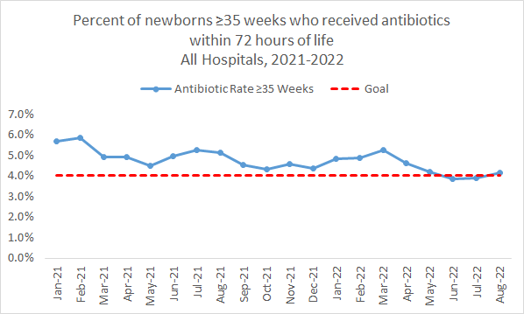
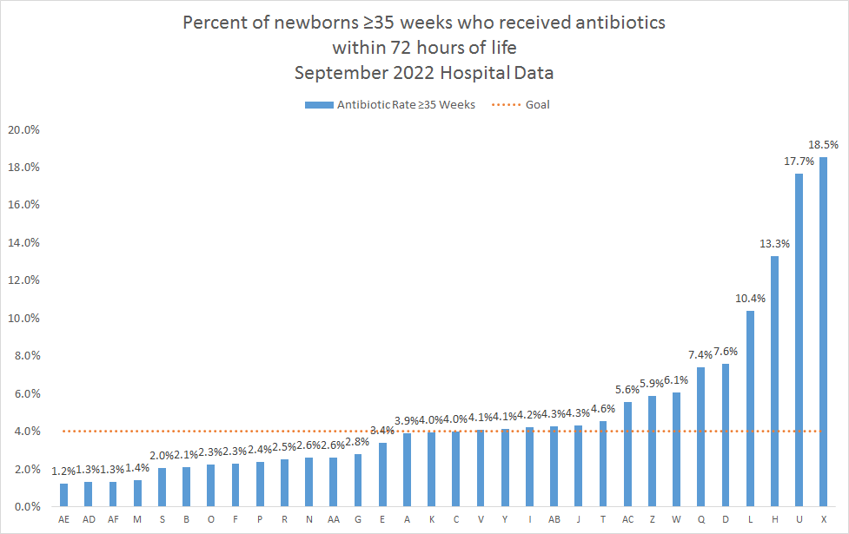
Newborns ≥35 weeks who received antibiotics within 72 hours of life
Notes:
Match morning- do the ol' switcheroo

Slide 31
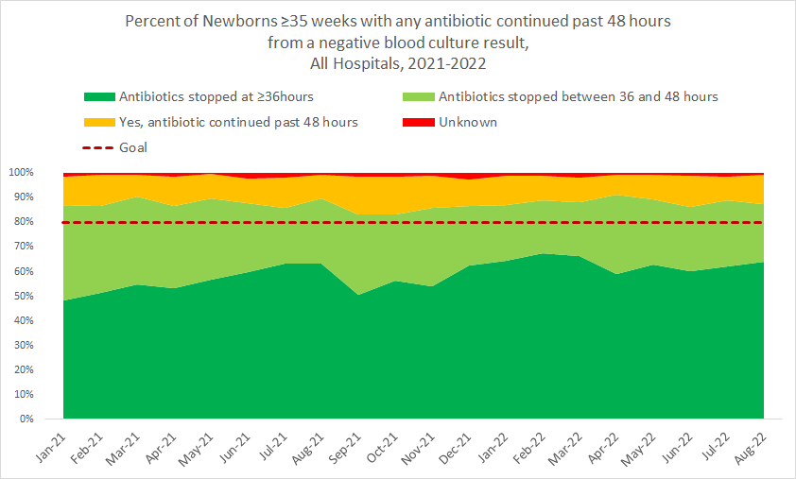
Newborns ≥35 weeks who received antibiotics stopped with negative BC
64%
47%
In Q2 & Q3 2022, 35 of 59 (66%) teams had 80% or more of newborns with a negative BC with abx stopped by 36 hrs
Notes:
Match morning- do the ol' switcheroo

Slide 32
Making Systems Changes Happen: Structure Measures
80% standardized healthcare team education
72% standardized family education
86% ≥35 EOS Risk Assessment
79% <35 EOS Risk Assessment
93% standardized dosing guidelines
89% standardized antibiotic debriefs/
"Time Outs"
89% standardized antibiotic automatic stop orders

Slide 33
Discussion
When is an initiative successful?
What is sustainability?
Why is sustainability important?
What puts sustainability at risk? How do you overcome the risks and realities?
At least 2 risks
2 ways to overcome them
Why do you think we are still having trouble with 36-hour rule outs?
What can ILPQC do to help teams ensure systems & clinical culture change are sustainable?

Slide 34
Preference for Data Collection in Sustainability
2022 Teams Survey

Slide 35
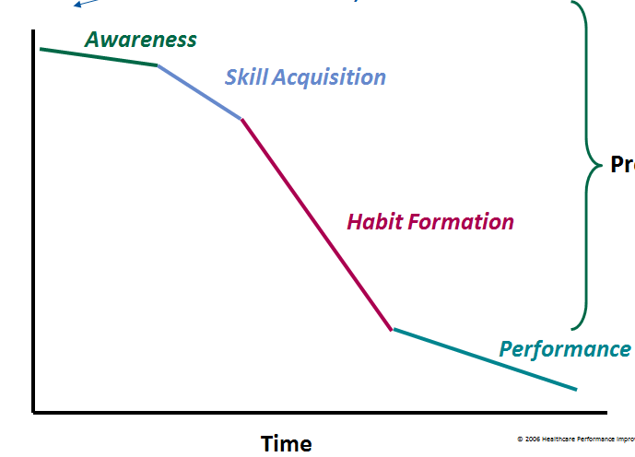
Making it Stick

Slide 36
ILPQC 11th Annual Conference
Thursday, November 2, 2023
AND

Slide 37
We look forward to continuing this great work together in 2023 and thank you for your continued support and dedication to make Illinois the best place to give birth and be born!

Slide 38
BASIC Team Talk: Advocate Lutheran General Hospital, Park Ridge IL Catherine Bennett APRN/CNS
Perinatal Clinical Nurse Specialist
Notes:
-waiting for slides 07.14.22

Slide 39
Advocate Lutheran General Hospital Park Ridge, IL
Level III Perinatal Center
54 bed NICU
3300 deliveries/year.

Slide 40
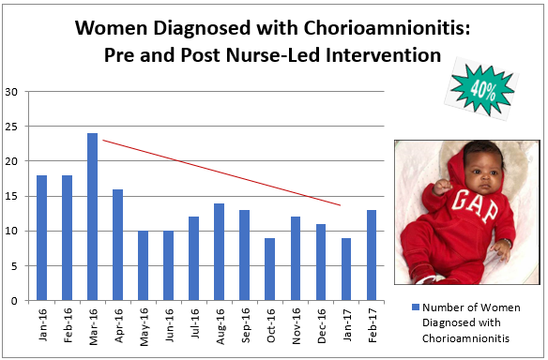
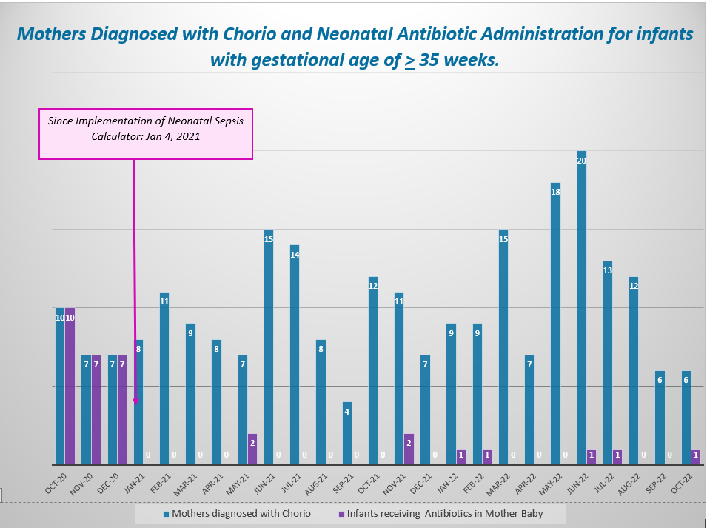
Prophylactic Antibiotics for Neonates, Are We Causing More Harm Than Good?
Laura Lang BSN, RNC-OB, Catherine Bennett APRN/CNS (catherine.bennett@aah.org)
Introduction
Results
Discussion
Early neonatal antibiotic exposure causes disruption of the intestinal microbiome which may lead to lifelong health consequences
Intrapartum and neonatal antibiotic use is prevalent, to battle infection and as a prophylactic intervention.
Standard practice for well appearing neonates born to mothers with chorioamnionitis included a blood culture, complete blood count and 4 doses of antibiotics over 36 hours.
Over a 5-year period, the percentage of well appearing infants with positive blood cultures in our hospital was zero. Unfortunately, each of these infants was treated with prophylactic and unnecessary antibiotics.
Intervention: Decrease the number of vaginal exams and perform perineal care every two hours.
Results: 40% reduction in chorioamnionitis.
A review of the blood cultures of infants exposed to chorioamnionitis demonstrated that 100% were negative and the antibiotics received were unnecessary.
The incidence of chorioamnionitis in term infants is 9.7/1000 births. This translates to approximately 35,000 infants born to mothers diagnosed with chorioamnionitis per year in the United States (US).
Universal implementation of the neonatal sepsis calculator among clinically well appearing neonates ≥ 35 weeks of gestation, born to mothers with chorioamnionitis throughout the US, would significantly reduce the number of newborns receiving antibiotics.
The benefits of reducing antibiotic use in these infants would improve overall lifelong health, one without chronic diseases associated with early antibiotic exposure.
The decrease in antibiotic administration at our institution led to a $1500 savings per infant.
Labor and Delivery nurse-led protocols helped reduce the incidence of chorioamnionitis, but there were limits due existing CDC recommendations.
For infants that are exposed to chorioamnionitis, the need for antibiotics should be evaluated using a neonatal sepsis calculator.
Antibiotic Associated Disruption of Neonatal Microbiome
Asthma
Lung disease
Obesity
Inflammatory bowel disease
Description: Figure 1
A Gap was Identified
Research demonstrated the importance of neonatal gut health.
Improved perineal care and decreased vaginal exams reduced chorioamnionitis by 40%.
However, asymptomatic infants with negative blood cultures were still being treated with antibiotics per CDC recommendations.
The implementation of the neonatal sepsis calculator promoted the necessary practice change that led to a significant reduction in prophylactic antibiotic use.
Figure 1
Methods
April 2016: A nurse led process improvement project was implemented to decrease the incidence of chorioamnionitis. The elements of the project emphasized the need for improved pericare and a decrease in the number of vaginal exams during labor.
December 2020: Education on the usage of the calculator was provided to the Advocate Health System obstetrical and pediatric teams.
January 2021: A validated neonatal sepsis calculator was installed into EPIC and applied to all neonates born at >35 weeks gestation within the first hour of life.
Data points included: Gestational age, length of rupture of membranes, Group B Strep status, maternal antibiotics administered during labor, and highest maternal temperature.
References
CDC https://www.cdc.gov/nchs/data/nvsr/nvsr67/nvsr67_08_tables-508.pdf
Dhudasia, M., Mukhopadhyay, S., Puopolo, K. (2018) Implementation of the sepsis risk calculator at an academic birth hospital. Hospital Pediatrics 8 (5).
Ellington, M., Kasat, K., Williams, K., Reichman, V., Stoffels, G., Leung, T., Degoy, A., Fisk, R., Gonzalez-Ballesteros, L., Peralta-Reich, D., Potash, A. Rao, K. (2021).
Improving antibiotic stewardship among asymptomatic newborns using the early-onset sepsis risk calculator. Pediatric Quality and Safety (5) 6. E459.
Puopolo, K., Benitz, W., Zaoutis, T. (2018). Management of neonates born at > 35 0/7 weeks’ gestation with suspected or proven early-onset bacterial sepsis. Pediatrics 142 (8)
Puopolo, K., Mukhopadhyay, S., Frymoyer, A., Benitz, W. (2021). The term newborn: Early-onset sepsis. Clinics in Perinatology 48(3) 471-484.
Intervention: The use of this calculator was initiated in January 2021.
Results: Antibiotic use for asymptomatic infants has decreased by 96%. protecting the microbiomes of these infants as well as saving thousands of health care dollars.
Description: Figure 2
Advocate Lutheran General Hospital is proud to be Magnet® recognized by the American Nurses Credentialing Center.
Figure 2

Slide 41
BASIC Team Talk: HSHS St. John’s
Notes:
-waiting for slides 07.14.22

Slide 42
Babies Antibiotic Stewardship Improvement Collaborative (BASIC)
Located in Springfield, Illinois
2000 deliveries per year
56 NICU beds
Level III perinatal center
Involved in BASIC
Contact information are:
Kim Lawrence, RN Kimberly.Lawrence@hshs.org
Pele Dina, MD pdina28@siumed.edu

Slide 44
Wrap-up

Slide 45
Upcoming BASIC QI Support for Q3 2022
ILPQC will be doing outreach to teams who have a higher percentage of newborns who receive antibiotics for longer than 36 hours
Teams who have a large portion of newborns who receive antibiotics for longer than 48 hours
Teams who have a large portion of newborns who receive antibiotics for between 36-48 hours
Keep an eye out for an email from ILPQC to schedule your QI Support call on a Thursday or Friday in December!
Notes:
Alana please insert BASIC QI Support Plan

Slide 46
Upcoming Call Schedule
Month | Topic
December 19th, 2022 2-3 PM | BASIC Monthly Webinar
January 23rd , 2022 | MLK Day, No BASIC Call
February 20th, 2022 2-3 PM | BASIC Monthly Webinar
March 20th, 2022 2-3 PM | BASIC Monthly Webinar

Slide 47
Office Hours
Q & A

Slide 48
Thanks to our Funders
In kind support:

