Slide 1

ILPQC: Wrap-up &
Next Steps for 2024
2024 Neonatal Face-to-Face Meeting

Slide 2


How to obtain your continuing education hours
*NOTE* Credits must be claimed by
June 23, 2024 at 9am
Education credits available for providers, nurses, and social workers
Education credits sponsored by:

Slide 3

ESSI ABP MOC Part IV
Complete an attestation form if you are an ABP-certified physician seeking 25 credits under MOC Part IV
Submit the attestation form to your QI project leader for signature and send back to info@ilpqc.org for credit in 2024
You can start submitting the attestation form in October.
Attestation of Meaningful Participation:
  Intellectually engaged in planning and executing the project
  Participated in implementing the project’s interventions - the changes designed to improve care
  Regularly reviewed data in keeping with the project’s measurement plan
  Collaborated in the activity by attending team meetings

Slide 4





UPCOMING OPPORTUNITY
UPCOMING OPPORTUNITY

Slide 5


Slide 6




Coming soon:
ESSI Hospital Level Reports
Want to see how your hospital is performing across ESSI’s structure measures?
Now you can!
More information and guidance on how to access your ESSI Hospital Level Report on REDCap is coming soon.
Join us June 20th at the QI Team Lead Support Call to learn how to access ESSI reports

Slide 7
Upcoming ESSI Calls
Date | Topic
June 17th, 2024 | Equitable and Inclusive Unit Policies
June 20th, 2024 | ESSI RedCap Reports
July 15th, 2024 | Using Qualified Interpreters and Providing Information in Multiple Languages
August 19th, 2024 | Respectful Care Practices and Listening to Families

Slide 8



Thank You to our Amazing Speakers!
Meg Parker, MD, MPH
Bryanne N. Colvin, MD
Christie Lawrence, DNP, RNC-NIC, APN/CNS
Gina S. Lowell, MD, MPH

Slide 9
Thank You Breakout Facilitators and Discussants!
Gretchen Kopec
Shelly Shallat
Gina Lowell
Bryanne Colvin
Daniell Ashford
Meg Parker
Christie Lawrence
Donna Lemmenes
Tina Stupek
Keri Schubert
Keri Benbrook
Jan Southard
Nancy Maruyama
Deb Miller
Danielle Wittig

Slide 10
Thank You Planning Committee!
Deborah Miller
Christina Stupek
Olga I Marrero
Felicitas Cacal
Daniell Ashford
Joanne Sorce
Sherry Jones
C. Susie Swain
Donna Lemmenes
Andrea Cross
Keri Benbrook
Kathryn Patrick
Shawn O'Connor
Myra Sabini

Slide 11
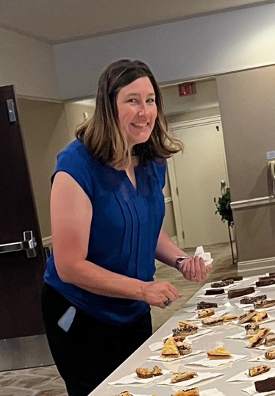
Thank You Jodie!
For helping us create an amazing experience and everything you do!

Slide 12


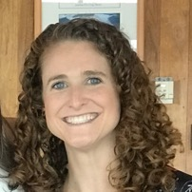
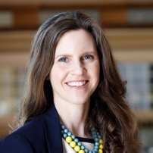

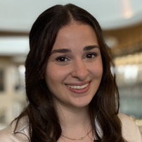
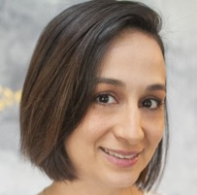
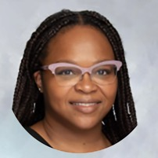
senior
superlatives
Ellie Suse
Patti Lee King
Most likely to bring ILPQC into the future
Most likely to change the world
Kiela Moreno
Aleena Surenian
Most likely to have a great rookie year
Most likely to lead with clarity and purpose
Alana Rivera
Corliss Davis
Most likely to get the job done
Most likely to make a
far-reaching ESSI impact

Slide 13


Slide 14
What Can I Do on the Way Home?
June
August
October
Equitable and Inclusive Unit Policies
Respectful Care Practices and Listening to Families
2024 Annual Conference, 10/30/24
Lombard, IL
Take a minute to reflect on today's general sessions, team storyboards, and breakout sessions.
Write down one thing that you are going to do to work towards ESSI tomorrow or next week.
  What are some next steps to holding a Respectful Care Breakfast?
  How will I learn how SDOH is currently assessed within my hospital system? How can we improve this process?
  How can I improve safe sleep education and implementation at my hospital?
Interpreters and Providing Education in Preferred Language
SDOH Screening and Integrating into EMR
July
September

Slide 15
How to obtain your continuing education hours
*NOTE* Credits must be claimed by
June 23, 2024 at 9am
Education credits available for providers, nurses, and social workers
Education credits sponsored by:

