Slide 1
BASIC Monthly Teams Call: Springing Forward to Sustainability
Monday February 20th 2023 2:00 PM

Slide 2
Call Overview
ILPQC Face-to-Face Meeting 2023
Preparing to move BASIC to sustainability
Sustainability Plan
Data Form
Plan for 2023
BASIC Next Steps

Slide 4
2023 F2F Volunteers Needed...
Come one! Come ALL!
Join us as we collaborate in-person
at the ILPQC Face-to-Face event in Springfield, IL.
The first ILPQC Face-to-Face event since 2019!
We are looking for volunteers:
2023 F2F PLANNING COMMITTEE
2023 F2F BREAKOUT FACILIATORS
Interested? Drop your name in the chat or email info@ilpqc.org

Slide 5
2023 Face to Face: Let's Get Ready!
Save the Dates!
Submit your Data!
Submit all your 2022 data plus January, February, March 2023
OB- May 24th, Wednesday
Neonatal- May 25th, Thursday
Storyboard Submissions!
Share your successes, opportunities, and specific strategies implemented!
Share your DATA, graphs, PDSA cycles, process flow or 30/60/90 plans
Review the award criteria for PVB, BE, and BASIC to achieve QI Excellence!
Start brainstorming your storyboard ideas!
ILPQC Room Block TBA
President Abraham Lincoln Hotel, Springfield, IL
Share your teams past year QI story
All Data due
April 21st!
Registration opens soon!
Templates coming soon!

Slide 6
We want to hear from you! Ideas for the in-person 2023 Face-to-Face Meeting
What aspects of the in-person annual conference/Face-to-Face meetings do you most enjoy?
What can we improve?
Email arivera@northshore.org with thoughts and Ideas!

Slide 7
BASIC QI Excellence Awards
All structure & patient-level data entered for Baseline-March 2023 due May 2nd, 2023, at Midnight
Key Structure Measures "In Place":
Standardized Family Education Process
EOS Risk Assessment Protocols
Standardized Dosing Guidelines
Antibiotic Discussions/Time Outs Protocol
Standardized Automatic Stop Order Process
Achievement of process and outcome level measures (Based on Jan – March 2023 data)
≥80% of neonatal/pediatric providers and nurses educated
20% reduction (or absolute rate of ≤4%) in newborns ≥35 weeks who receive antibiotics
20% reduction in newborns with a negative blood culture who receive antibiotics for >48 hours
≥80% of newborns with the anticipated duration of antibiotic course discussed by clinical team (antibiotic time out)
≥80% of newborns with an automatic stop order entered into the medical chart
F2F Award Criteria:
Data complete
Key Structure measures in place
Process/outcome measures achieved
Notes:
Data complete, structure measures in place, 3 process/outcome measures achieved
Hospital has implemented a process for standardized education for healthcare team on neonatal antibiotic stewardship best practices
Hospital has provided patient standardized education and anticipatory guidance with a focus on equitable care to families on antibiotics, early onset sepsis, and treatment plan for newborn antibiotics and early onset sepsis
Hospital has developed, in coordination with IT department, an electronic reporting system from electronic medical record
Hospital has Implemented Quality Improvement strategies to ensure feedback is provided to the neonatal/pediatric clinical team through one or more of the following components: 1. monitor and share provider-level and/or unit level antibiotics prescribing data; 2. antibiotic debriefs to identify & review neonatal sepsis and antibiotic decisions for consistency with protocols and procedures; 3. report that tracks current inpatient newborns who are receiving antibiotics
Hospital has implemented standardized policies, protocols, and support tools to evaluate risk for early onset sepsis for newborns for ≥ 35 0/7 weeks gestation based on the AAP recommended risk assessment tools.
Hospital has implemented standardized risk assessment algorithm to evaluate risk of early onset sepsis for every neonate < 35 weeks gestation.
Hospital has developed partnerships with obstetric team to standardize communication with the pediatric/neonatal team about maternal risk factors for early onset sepsis.
Hospital has implemented standardized serial assessment of neonates
Hospital has implemented standardized identification of and response to neonates with worsening clinical status.
Hospital has implemented standardized policies, protocols and support tools to assist staff in properly and consistently obtaining blood cultures
Hospital has partnered with inpatient lab to optimize timely processing of blood culture results and communication with care team
Hospital has implemented standardized policies, protocols and support tools to assist staff to stop or de-escalate therapy promptly based on the culture and sensitivity results
Hospital has implemented standardized dosing guidelines and order sets to reduce intra-hospital variation of antibiotic prescribing
Hospital has implemented standardized approach for healthcare team to discuss the anticipated duration of antibiotic course at the initiation of antibiotics (antibiotic time out)
Hospital has implemented standardized automatic stop order process
Hospital has implemented a standardized process to review antibiotic data by race/ethnicity and share with providers and staff.
Hospital has implemented a social determinants of health tool and facilitates coordinated connection to community resources and follow up.

Slide 8
F2F Story Board Instructions
Use a Storyboard to tell your team’s story descriptively, clearly and creatively – photos, collages and illustrations are encouraged.
There is no wrong way to create a Storyboard so be creative. Keep it simple! A Storyboard is not meant to be an extremely time-consuming project.
Storyboards should fit into a space approximately 28 x 40 inches. It can be created from a collection of 6-8 letter-sized sheets (print outs of your power point slides or word documents) that are convenient for carrying while traveling. Boards for posting and pushpins will be provided at the Face-to-Face Learning Session.
Share your story: about your hospital, about your team, describe your goals for this initiative, include process flow diagram draft, can include any barriers you have identified and opportunities for improvement, describe next steps or action items for your team

Slide 9
Initiative Specific Content
BASIC:
Share your success! (Including Data)
Barriers you are still facing and plans to overcome them
Plans for Sustainability
MNO-Neo:
Sustainability Work
Neonatal Equity:
Share any work equity work your hospital is already doing
Connect with your hospital’s Birth Equity team to learn what they have implemented so far!

Slide 10
Neonatal Story Board Template
Hospital Name
BASIC
MNO-Neo
MNO-Neo Sustainability Work
BASIC Success
Including Data
Hospital Demographics
BASIC Barriers and plans to address
BASIC QI Team Members
Neonatal Equity Work
Share any work equity work your hospital is already doing
BASIC Sustainability Plans
MNO QI Team Members

Slide 11
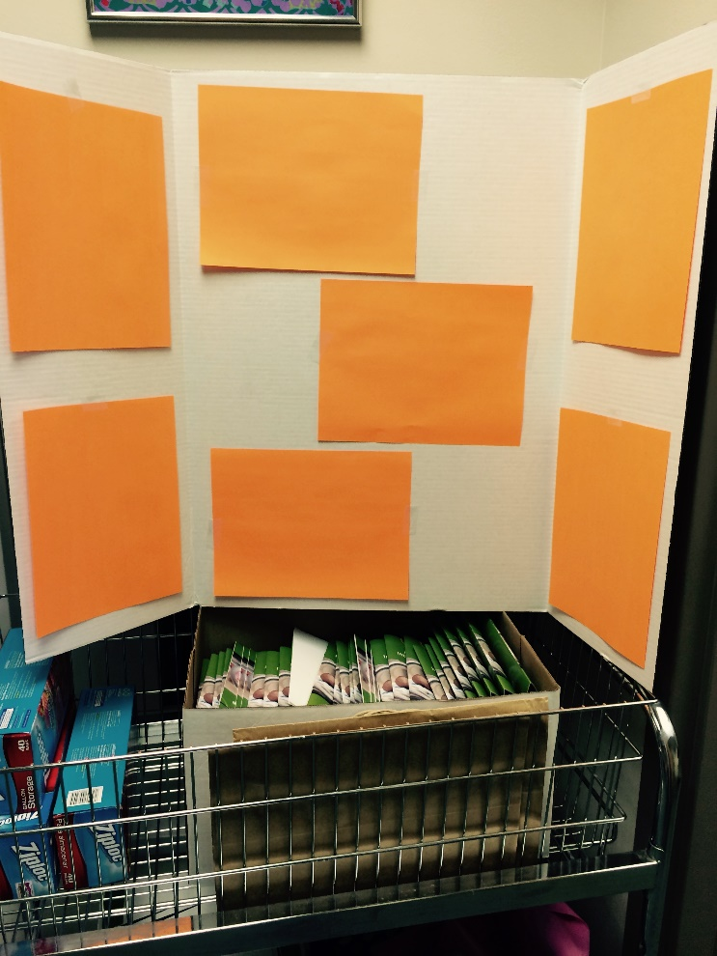
Sample Layout
With 4 portrait oriented sheets in the middle panel
With 3 landscape oriented sheets in the middle panel

Slide 12
BASIC Achievements

Slide 13
What We Sought to Achieve Statewide
Decrease the number of newborns born at ≥35 weeks who receive antibiotics
Decrease number of newborns with a negative blood culture who receive antibiotics for longer than 36 hours
The Right Antibiotic for the Right Baby for the Right Length of Time

Slide 14
BASIC Achievements
38 BASIC Teams have complete patient and hospital level data for October – December 2022
25 / 38 (66%) of those teams have all key structure measures in place:
Family Education; >35 & <35 EOS Risk Assessment Tool protocol; Standardize Dosing; Time Outs; Stop Times
Top SMs still not IN PLACE are <35 EOS and Family Education
16 / 25 (64%) of teams qualified for Excellence Award

Slide 15
BASIC Success: ABX Prescribing ≥35 weeks (Q4 2022)
Notes:
Dan please add graphs

Slide 16
BASIC Success: ≥35 weeks Stopping within 48 hrs (Q4 2022)
Notes:
Dan please add graphs

Slide 17
BASIC Success: ≥35 weeks Antibiotic Time Out (Q4 2022)
Notes:
Dan please add graphs

Slide 18
BASIC Success: ≥35 weeks Antibiotic Stop Order (Q4 2022)
Notes:
Dan please add graphs

Slide 19
PAS Abstract Submission: Figure 1

Slide 20
PAS Abstract Submission: Figure 2

Slide 21
BASIC Data Submission

Slide 22
What we are still working on:
Family Education: 18% of teams still are working on or haven't started
<35 week EOS Risk Assessment: 18% of teams still are working on or haven't started
Antibiotic Time Out: 15% of teams still are working on or haven't started
Automatic Stop Order: 13% of teams still are working on or haven't started
Notes:
Dan can you list the SM or measures that teams are still working on?

Slide 23
Getting to Green: Key BASIC Structure Measures

Slide 24
BASIC Structure Measures for QI Excellence
Right Antibiotics
Standardize Dosing Guidelines
Right Babies
EOS Risk Assessment Protocols for ≥35 and <35 Newborns
Standardized Parent/Family Education
Right Amount of Time
Antibiotic Discussions/Time Outs Protocol
Standardized Automatic Stop Order Process
Notes:
*discuss how structure measures align with our vision
*discuss the concept of:
*Right antibiotics (what structure measures, what we achieved, what we need to focus on in 2022 )
*Right Babies (what structure measures, what we achieved, what we need to focus on in 2022 )
*Right Time (what structure measures, what we achieved, what we need to focus on in 2022 )

Slide 25
Right Antibiotics: Standardized Dosing Guidelines
Stay current with AAP antibiotic dosing recommendations
Educate healthcare team on AAP guidelines to establish best practices
Utilize ILPQC BASIC Toolkit for resources
Communicate updates to clinical teams
(email, daily huddles, boards, etc.)
Notes:
Why: reduces variation in care, expedites ordering process for a common clinical scenario, aligns clinical practice with BASIC AIMS, healthcare team educate together on best practices

Slide 26
Right Babies: Standardized EOS Risk Assessment Protocols
Standardize use of NEOSC as part of workflow
Educate on use of the NEOSC to ensure consistency
Determine best integration method for your hospital
Develop systematic process for documentation of EOS risk
Notes:
Why: Increase percentage of physicians and nurses educated about early-onset sepsis (EOS) risk factors, assessment tools, and guidelines & Increase percentage of newborns with documented use of EOS risk assessment tools at delivery

Slide 27
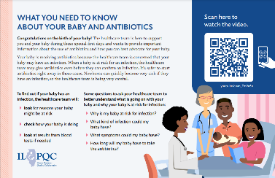
Right Babies: Standardized Parent/Family Education
Standardized workflow providing education to every parent/family every time
Equitable, respectful care practices for neonatal patients and their families

Slide 28
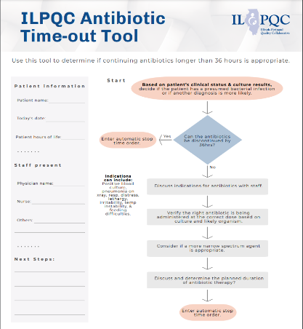
Right Amount of Time: Antibiotic Time Out Process
Process for every baby, every time
Brief antibiotic length/plan discussion
Use ILPQC Time Out tool or similar process
Standardized antibiotic timeout workflow
Notes:
Why: Increase percentage of newborns with care team discussing and documenting plan for length of antibiotic course for standardization
*Paint a workflow for teams to follow
Understand the "process" for teams to follow, not just about the timeout tool (one way to get to green, not the only way)

Slide 29
Preparing for BASIC Sustainability

Slide 30
Steps to Prepare for Sustainability
Submit data through December 2022 by April 14, 2023 in REDCap including:
BASIC Monthly Newborns Data Form
BASIC Monthly Hospital Data Form
Facilitate completion of education with all providers and nurses
Review your hospitals antibiotics prescribing rates and % of newborns with a negative blood culture receiving antibiotics past 36 hrs
Develop sustainability plan with your QI team, submit to your Perinatal Network Administrator & ILPQC
Continue to collect / submit BASIC data for sustained improvement tracking

Slide 31
BASIC Sustainability Plan Sections
Sustained Improvement Tracking:
How will you continue to track measures?
What team member will be responsible for reporting data in REDCap?
What team member will be responsible for monitoring reports?
How often will your QI team meet to review REDCap hospital data reports?
When is your next BASIC sustainability Meeting?
What will be your team’s plan to develop and implement PDSA cycles if progress on measures declines?

Slide 32
BASIC Sustainability Plan Sections
New Hire Education
What education tool(s) will you use for new hires?
Physician-specific (BASIC 1-pager, Assessment Workflow- Entire AAP document >=35 weeks, Key articles re: NEOSC, ILPQC Newborn Nurse to Pediatrician Communication Tool)
Nurse-specific (BASIC 1-pager, ILPQC Newborn Admission Report (LD RN to Newborn RN), Assessment Workflow, ILPQC Newborn Nurse to Pediatrician Communication Tool, ILPQC Antibiotic Time-Out Tool)
Pharmacy-specific (BASIC 1-pager, Empiric Antibiotic Dosing Chart for Neonatal EOS)
Create your own educational materials and share with others!
How will you incorporate BASIC-Neonatal education, clinical care policies, and protocols into hospital new hire education?

Slide 33
BASIC Sustainability Form Key Questions/Updates
Monthly Patient Data Form
Collect data for only newborns ≥35 weeks
Option to continue collecting newborns <35 week
Questions to be removed:
Zip code
Type of delivery
Presence of chorioamnionitis
Maternal GBS status
Date/time BC draw
Type of antibiotics administered
Rationale for continuing antibiotics
How was family education provided
Monthly Structure Measure Data Form
Remove structure measures, continue to track denominators for antibiotic rate

Slide 34
BASIC Next Steps

Slide 35
BASIC QI Support for Q4 2022 Data
ILPQC is doing outreach to teams who have not yet achieved QI Excellence as of Q4 2022
Schedule your QI Support call on a Thursday or Friday in March!
Notes:
Alana please insert BASIC QI Support Plan

Slide 36
BASIC Sustainability Plans for 2023
Month | Topic
February 20th, 2023 2:00 PM | Preparing for BASIC Sustainability
March 20th, 2023 2:00 PM | Moving into BASIC Sustainability
May 25th, 2023 | Neonatal Face-to-Face in Springfield
August 21st, 2023 2:00 PM | BASIC Sustainability Call
November 20th, 2023 2:00 PM | BASIC Sustainability Call

Slide 37
ILPQC 11th Annual Conference
Thursday, November 2, 2023
AND

Slide 38
Thanks to our Funders
In kind support:

