Slide 1
Hospital Name
Insert Hospital Logo

Slide 2
Hospital Demographics
Location
Perinatal Level
Perinatal Network
Birth Volume
*Include map of where your hospital is located: TownMapsUSA.com - Maps of ILLINOIS

Slide 3
PVB QI Team Members
BE QI Team Members
Name, title
Name, title
*Include QI team members in action, during a meeting, updated the initiative board, etc.

Slide 4
PVB Journey: Sustainability teams
Successes?
- what key strategies were used to achieve PVB success
Barriers?
-what are opportunities the team is currently working on, what is the planned follow-up?
Include data and graphs! Reach out if you need help pulling REDCap data

Slide 5
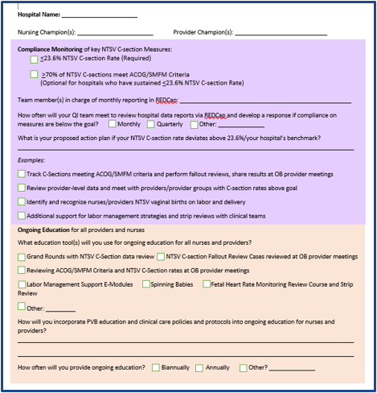
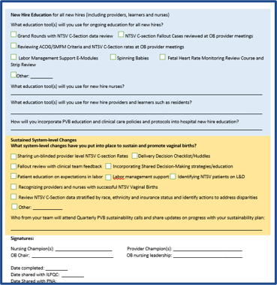
PVB Journey: Sustainability Teams
Highlight PVB resources that your team has found helpful / resources that your team developed to achieve PVB success
Share your PVB Sustainability plans here

Slide 6
PVB Journey: Coaching Teams
Share a new strategy learned in your 1:1 Coaching Session
Highlight your 30-60-90 day plans here
Include your __________
What are your next steps:
What do you plan to implement in the next 3 months

Slide 7
Birth Equity Journey
Successes?
- what key strategies were used to achieve BE success
Barriers?
-what are opportunities the team is working on, what is the planned follow-up?
Highlight BE resources that your team has found helpful / resources that your team developed to achieve BE success

Slide 8
Birth Equity Progress
Share your work on engaging Patient Partners
How did they become involved with your hospital?
How are they engaged with your QI team?
Share one success and one barrier
Share pictures from your hospital's Respectful Care Breakfast
What is sustainability plan for hosting breakfasts, quarterly? Bi-annually?

Slide 9
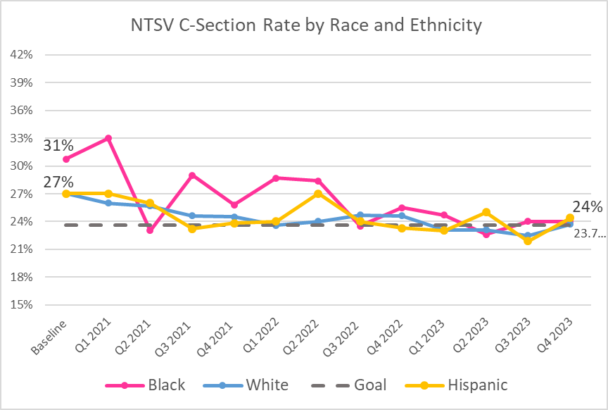
PVB and BE: Reducing Disparities in NTSV C-Section Rates
EXAMPLE
Share your NTSV data by Race and Ethnicity
What has your teams done to actively address these disparities?
Include data and graphs! Reach out if you need help pulling REDCap data

