Slide 1
Equity Redcap Reports
June 20th, 2024 2:00 PM

Slide 7
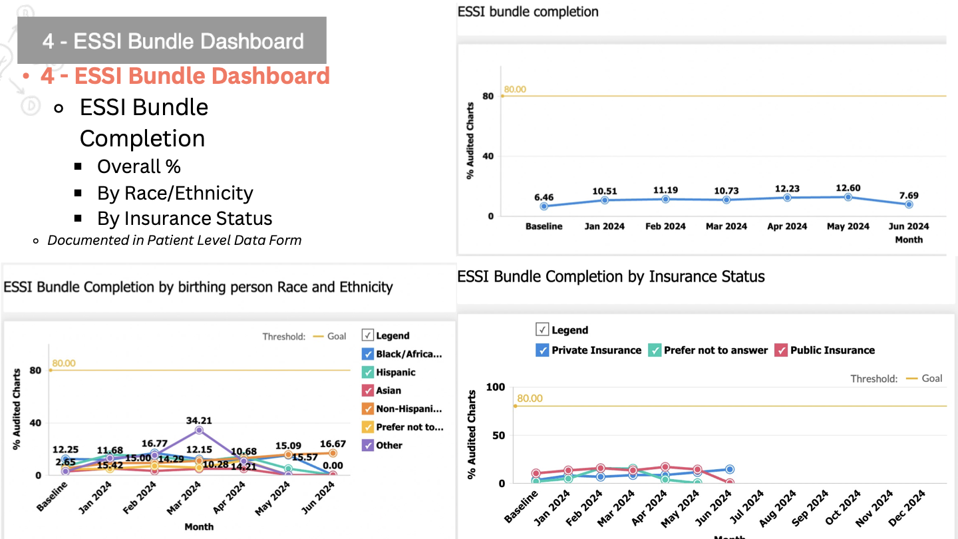

Slide 8
