Slide 1

  Equity and Safe Sleep for Infants
  Safe Sleep Environment Education and Implementation
March 18th, 2024 2:00 PM

Slide 2
Overview
2024 Face-to-Face Meeting
ESSI Aims and Measures
Healthcare Professional Education: Safe Sleep Environment Education and Implementation
Upcoming Opportunities of Interest to ESSI Teams

Slide 3

ABP MOC Part IV (ESSI)
Complete an attestation form if you are an ABP-certified physician seeking 25 credits under MOC Part IV
Submit the attestation form to your QI project leader for signature and send back to info@ilpqc.org for credit in 2024
You can start submitting the attestation form in the fall
Attestation of Meaningful Participation:
  Intellectually engaged in planning and executing the project
  Participated in implementing the project’s interventions - the changes designed to improve care
  Regularly reviewed data in keeping with the project’s measurement plan
  Collaborated in the activity by attending team meetings
Claim your credits!

Slide 4
2024 Face-to-Face Meeting

Slide 5




Register Now!
2024 OB & Neonatal
Face-to-Face Meetings
OB TEAMS:
Calling ALL Perinatal Leaders, Providers, Nurses, Advocates, & Friends!
MAY 22ND, 2024
at the President Abraham Lincoln Doubletree Hotel
in Springfield, IL
NEONATAL
TEAMS:
MAY 23RD, 2024
Join us for two interactive days of collaborative learning with the IL Perinatal Quality Collaborative!

Slide 6
ILPQC F2F Agenda
Time | ILPQC 2024 Neonatal Face-to-Face Meeting
9:00-9:15am | Welcome and Overview of Day Justin Josephsen, MD and Leslie Caldarelli, MD
9:15-9:45am | We’ve Launched! Getting our “Booties” to Work with ESSI Justin Josephsen, MD and Leslie Caldarelli, MD
9:45-10:40am | Steps to Addressing Social Determinants of Health in the Newborn Setting Meg Parker, MD, MPH
10:40-10:55am | Break
10:55 –11:25am | Promoting Safe Sleep in Illinois Hospitals Gina Lowell, MD, MPH Christie Lawrence, DNP, RNC-NIC, APN/CNS Bryanne Colvin, MD
11:55-12:55pm | Team Storyboard Session: An Opportunity to Share and Learn Networking Lunch
12:55-1:40pm | Breakout Session #1: Sharing Strategies for Effective Equity Education
Time | ILPQC 2024 Neonatal Face-to-Face Meeting
1:40-1:50p | Transition to Breakout Sessions
1:50-2:35p | Breakout Session #2: Safe Sleep: Beyond the ABCs
2:35-2:45p | Transition to Breakout Sessions
2:45-3:30p | Breakout Session #3: Parent Partners and Respectful Care Breakfasts: Lessons Learned from Birth Equity Teams
3:00-3:45p | Wrap-up, Next steps for 2024 Justin Josephsen, MD and Leslie Caldarelli, MD

Slide 7



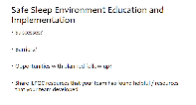


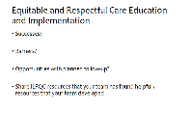
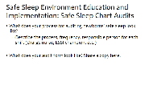

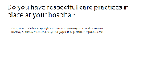
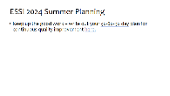
2024 F2F Neonatal Storyboards
Share the great work that your ESSI Team is doing!
See the chat for the Storyboard templates! Also available on F2F Webpage and in newsletter
Introduce your hospital and ESSI QI Team
Kickstarting ESSI at your hospital. Share successes, opportunities of Equitable and Respectful Care Education implementation.
Share successes, opportunities of Safe Sleep Education implementation. Share ESSI 2024 Summer Planning goals.

Slide 8
Upcoming Face-to-Face 2024 Prep
Submit your Data!
  All ESSI data baseline-March 2024 will be due on April 30, 2024, for award consideration.
Call for Storyboards!
  Templates coming soon! All hospital teams are asked to create a storyboard on QI work (can be in progress).
Register for F2F 2024!
Data Due:
Tuesday
April 30th, 2024
  Early Bird Registration: March 11th – April 8th
      $75/day or $145/both days
  Regular Registration: April 9th – April 26th
    $100/day or $200/both days

Slide 9
ESSI Launch Award Criteria
Roster completed
Readiness survey submitted
Data submission Baseline-March 2024
Regular webinar attendance
At least 1 ESSI team member registered and attended PQI Training

Slide 10
ESSI Aims and Measures

Slide 11




ESSI Initiative Aims
1
By December 2025, greater than 70% of Illinois birthing and children’s hospitals will address disparities and promote neonatal equity by actively participating in the ESSI initiative.​
2
By December 2025, greater than 80% of infants will be discharged from ILPQC hospitals with a completed ESSI Bundle.
Parents or caregivers report an understanding of a safe sleep environment.
AWARENESS
READINESS
Family is prepared for a transition to home, including SDoH screening and resource linkage.
TRANSFER OF CARE
Communication to primary care provider completed.

Slide 12








DRIVER 1
Healthcare Professional Commitment
DRIVER 2
Inclusive Clinical Environment
DRIVER 3
Parents and Caregiver Empowerment
DRIVER 4
Community Partnerships
DRIVER 5
Healthcare Data Utilization
Illinois Perinatal Quality Collaborative

Slide 13
Key Driver Diagram
Aims
Primary Drivers
Secondary Drivers
1
By December 2025:
1. Greater than 70% of Illinois birthing and children’s hospitals will address disparities and promote neonatal equity by actively participating in the ESSI initiative.
2. Greater than 80% of infants will be discharged from ILPQC hospitals with a completed ESSI bundle.
Healthcare Professional Commitment
Equitable and Respectful Care Education and Implementation
Safe Sleep Environment Education and Implementation
Inclusive Clinical Environment
Organizational Leadership Commitment
Equitable and Inclusive Unit Policies
Parent and Caregiver Experience Prioritization
Parent and Caregiver Empowerment
Respectful Parent and Caregiver Partnerships
Safe Sleep Awareness
Transition to Home, including SDoH Screening and Resource Linkage
Community Partnerships
Resource Mapping
Building Relationships with Community Organizations
Transfer of Care to Community Providers
Healthcare Data Utilization
Collection of Accurate Race and Ethnicity Data
Dissemination of Stratified Data
Application of Data to Address Inequities
Awareness: Parents or caregivers report an understanding of a safe sleep environment, including navigating challenges to safe sleep at home
Readiness: Family is prepared for a transition to home, including SDoH screening and resource linkage
Transfer of Care: ESSI Newborn Care Plan (Awareness & Readiness) documented in the discharge
ESSI Bundle:

Slide 14
Safe Sleep Environment Education and Implementation

Slide 15







Change Ideas
DRIVER 1:
HEALTHCARE PROFESSIONAL COMMITMENT​
  Educate providers, nurses, and other staff about the importance of a safe sleep environment for every sleep during hospitalization and at home
  Encourage meaningful, culturally appropriate, respectful, nonjudgmental conversations between providers, nurses, and other staff and parents and caregivers about a safe sleep environment
Secondary Driver 2: Safe Sleep Environment Education and Implementation
  Endorse and model a safe sleep environment for every sleep during the hospitalization, including correcting unsafe behaviors

Slide 16






Healthcare Professional Commitment
DRIVER 1
Secondary Driver 2: Safe Sleep Environment Education and Implementation
ESSI Toolkit
Endorse and Model a Safe Sleep Environment
Encourage meaningful, culturally appropriate, respectful, nonjudgmental conversations.
AAP Technical Report
E-Learning Modules
  Cribs for Kids: Hospital-Wide Infant Safe Sleep Training
  Cribs for Kids Safe Sleep Ambassador Education Outreach Program
  NIH Safe to Sleep Provider Training and Materials
  NYSPQC Safe Sleep Crib Cards
  Audit tools
  Cribs for Kids Toolkit & Resources
  Modeling Safe Practices: A Checklist for Infant Sleep & Breastfeeding Images
  AAP Safe Sleep Communication Strategies
  NICHQ Building on Campaigns with Conversation
  Child Safety Forward: a Reflection Guide for Providers
Evidence Base for 2022 Updated Recommendations for a Safe Infant Sleeping Environment to Reduce the Risk of Sleep-Related Infant Deaths

Slide 17



ESSI Safe Sleep Education Plan – Get to Green
Review current safe sleep policy and update policy to reflect 2022 AAP Recommendations.
Disseminate guidelines to hospital staff & educate staff on safe sleep.
Endorse safe sleep practices and incorporate safe sleep education into orientation, annual competencies and ongoing education.
Crib Cards
Crib Audits
Media Toolkits
Sharing Patient Stories
Option 1: E-Module updated with 2022 AAP Recommendations
Option 2: Take Cribs for Kids Safe Sleep Ambassador Training

Slide 18
Step 1: Review current safe sleep policy and update policy to reflect 2022 AAP Recommendations.

Slide 19
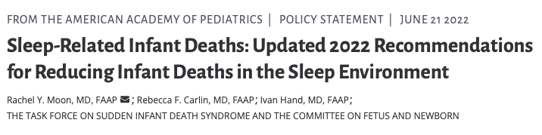

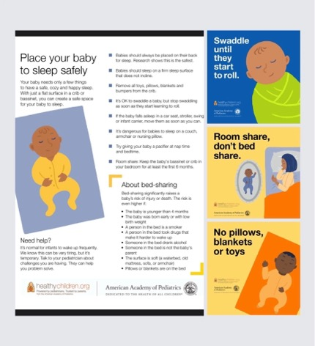
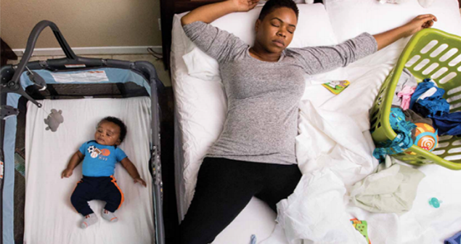
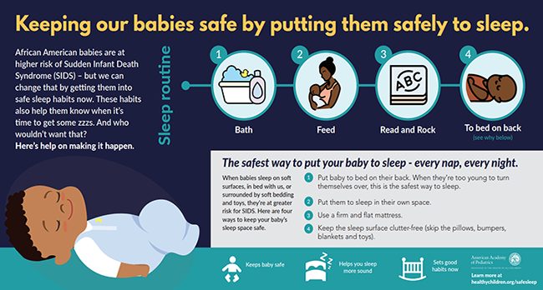

Slide 20
Each year in the United States, ∼3500 infants die of sleep-related infant deaths, including sudden infant death syndrome (SIDS), ill-defined deaths, and accidental suffocation and strangulation in bed. After a substantial decline in sleep-related deaths in the 1990s, the overall death rate attributable to sleep-related infant deaths has remained stagnant since 2000 and disparities persist.
The American Academy of Pediatrics recommends a safe sleep environment to reduce the risk of all sleep-related deaths.
Recommendations for sleep position and the sleep environment, unless otherwise specified, are for the first year after birth.

Slide 21
Definition of Terms
Accidental strangulation or suffocation in bed: An explained sudden and unexpected infant death in a sleep environment (bed, crib, couch, chair, etc) in which the infant’s nose and mouth are obstructed or the neck or chest is compressed from soft or loose bedding, an overlay, or wedging causing asphyxia.
Bed sharing: Parent(s) and infant sleeping together on any surface (bed, couch, chair). Medical examiners prefer the term “surface sharing.”
Cosleeping: This term is commonly used in other publications and is not recommended because it lacks clarity, being variably used for sleeping in close proximity (eg, room sharing) and/or sleep surface/bed sharing.
Room sharing: Parent(s) and infant sleeping in the same room on separate surfaces.
Surface sharing: Parent(s) and infant sleeping together on any surface. Medical examiners prefer surface sharing over bed sharing.

Slide 22
Definition of Terms
SIDS: Cause assigned to infant deaths that cannot be explained after a thorough case investigation, including a death scene investigation, autopsy, and review of the clinical history.
Sleep-related infant death: A sudden, unexpected infant death that occurs during an observed or unobserved sleep period, or in a sleep environment.
Unexplained sudden death in infancy or SIDS: The sudden unexpected death of an apparently healthy infant aged <1 y, in which investigation, autopsy, medical history review, and appropriate laboratory testing fail to identify a specific cause, including cases that meet the definition of SIDS.² The panel of experts representing the National Association of Medical Examiners recommends the use of unexplained sudden death in infancy and not SIDS.³
SUID: A sudden and unexpected death, whether explained or unexplained (including SIDS), occurring during infancy.
Wedging or entrapment: A form of suffocation or mechanical asphyxia in which the nose and mouth or thorax is compressed or obstructed because of the infant being trapped or confined between inanimate objects, preventing respiration.¹⁵⁹ A common wedging scenario is an infant stuck between a mattress and a wall (or a bedframe) in an adult bed.

Slide 23

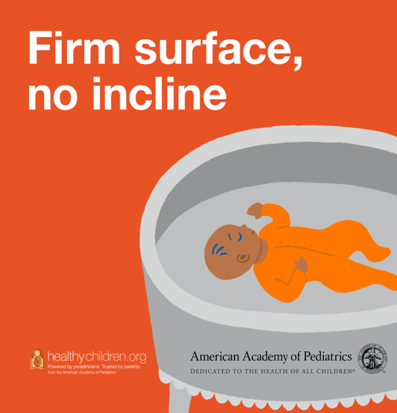
AAP Recommendations to Reduce the Risk of Sleep-Related Infant Deaths

Slide 24
Back to sleep
Back to sleep for every sleep. To reduce the risk of sleep-related death, it is recommended that infants be placed for sleep in a supine (back) position for every sleep by every caregiver until the child reaches 1 year of age.^{14–18} Side sleeping is not safe and is not advised.^{15,17}
  The supine sleep position on a flat, noninclined surface does not increase the risk of choking and aspiration in infants and is recommended for every sleep, even for infants with gastroesophageal reflux (GER).
  Hospitalized preterm infants should be placed supine as soon as clinical status has stabilized and they have achieved positional stability, that is, when therapeutic or nonsupine positioning is no longer medically indicated. This milestone is usually achieved by 32 weeks’ gestational age as the infant’s flexion tone and strength develop.
  During the birth hospitalization, place healthy, newborn infants supine and on a flat, noninclined surface for every sleep when they are not engaged in skin-to-skin care or in the arms of an awake/alert individual.

Slide 25
Sleep surface
Use a firm, flat, noninclined sleep surface to reduce the risk of suffocation or wedging/entrapment.
  Place infants on a firm, flat, noninclined sleep surface (eg, tightly fitting crib mattress in a safety-approved crib) covered by a fitted sheet with no other bedding or soft objects. Sleep surfaces with inclines of more than 10 degrees are unsafe for infant sleep.²⁴
  Infants should not be placed for sleep on adult-sized beds or mattresses because of the risk of entrapment and suffocation.^{40,41} In addition, portable bed rails should not be used with infants because of the risk of entrapment and strangulation.
  Sitting devices, such as car seats, strollers, swings, infant carriers, and infant slings, are not recommended for routine sleep in the hospital or at home, particularly for infants aged <4 months.^{42–47} When infants fall asleep in a sitting device, remove them from the product and move them to a crib or other appropriate flat surface as soon as is safe and practical.
  When infant slings and cloth carriers are used for carrying, it is important to ensure that the infant’s head is up and above the fabric, the face is visible, and the nose and mouth are clear of obstructions.⁵³

Slide 26
Human Milk
Feeding of human milk is recommended, as it is associated with a reduced risk of SIDS.
  Breastfeeding is associated with a reduced risk of SIDS.^{54–56} Unless it is contraindicated or the parent is unable to do so, it is recommended that infants be fed with human milk (ie, not offered any formula or other nonhuman milk-based supplements) exclusively for ∼6 months, with continuation of human milk feeding for 1 year or longer as mutually desired by parent and infant.⁵⁷
  Because preterm and low birth weight infants are at higher risk of dying from SIDS,⁵⁹ it is particularly important to emphasize the benefits of human milk, engage with families to understand the barriers and facilitators to provision of human milk, and provide more intensive assistance during prolonged NICU hospitalization for these groups.

Slide 27
Sleep Location
It is recommended that infants sleep in the parents’ room, close to the parents’ bed, but on a separate surface designed for infants, ideally for at least the first 6 months. There is evidence that sleeping in the parents’ room but on a separate surface decreases the risk of SIDS by as much as 50%.^{16,18,60,61} In addition, this arrangement is most likely to prevent suffocation, strangulation, and entrapment that may occur when the infant is sleeping in the adult bed.
  Return infants who are brought into the adult bed for feeding or comforting to their own crib or bassinet when the parent is ready to return to sleep.^{17,62}
  Couches and armchairs are extremely dangerous places for infants and should never be used for infant sleep. Sleeping on couches and armchairs places infants at extraordinarily high risk (with 22- to 67-fold increased risk) for infant death, including SIDS,^{14,16,17,61,62} suffocation through entrapment or wedging between seat cushions, or overlay if another person is also sharing this surface.⁶³ Therefore, parents and other caregivers need to be especially vigilant as to their wakefulness when feeding infants or lying with infants on these surfaces.

Slide 28

Bed Sharing
The AAP understands and respects that many parents choose to routinely bed share for a variety of reasons, including facilitation of breastfeeding, cultural preferences, and belief that it is better and safer for their infant. However, based on the evidence, the AAP is unable to recommend bed sharing under any circumstances.

Slide 29
Factors that increase the risk when bed sharing
More than 10 times:
Bed sharing with someone who is impaired in their alertness or ability to arouse because of fatigue or use of sedating medications or substanes
Bed sharing with a current smoker (even if the smoker does not smoke in bed) or if the pregnant parent smoked during pregnancy
Bed sharing on a soft surface, such as a waterbed, old mattress, sofa, couch, or armchair
5–10 times:
Term, normal weight infant aged <4 mo, even if neither parent smokes and even if the infant is breastfed. This is a particularly vulnerable time, so parents who choose to feed their infants aged <4 mo in bed need to be especially vigilant to avoid falling asleep.
Bed sharing with anyone who is not the infant’s parent, including nonparental caregivers and other children.
2–5 times:
Preterm or low birth weight infant, even if neither parent smokes.
Bed sharing with soft bedding accessories, such as pillows or blankets.

Slide 30
Additionally
Bed sharing can occur unintentionally if parents fall asleep while feeding their infant, or at times when parents are particularly tired or infants are fussy.

Slide 31

Soft Objects
Keep soft objects, such as pillows, pillow-like toys, quilts, comforters, mattress toppers, fur-like materials, and loose bedding, such as blankets and nonfitted sheets, away from the infant’s sleep area to reduce the risk of SIDS, suffocation, entrapment/wedging, and strangulation.
  Dressing the infant with layers of clothing is preferable to blankets and other coverings to keep the infant warm while reducing the chance of head covering or entrapment that could result from blanket use. Wearable blankets can also be used.

Slide 32
Pacifiers
Offering a pacifier at nap time and bedtime is recommended to reduce the risk of SIDS.
  For breastfed infants, delay pacifier introduction until breastfeeding is firmly established.⁵⁷
  Never attach objects, such as blankets, plush or stuffed toys, and other items that may present a suffocation or choking risk, to pacifiers.

Slide 33
Smoking and Nicotine Use
Avoid smoke and nicotine exposure during pregnancy and after birth. Both smoking by pregnant people and smoke in the infant’s environment after birth are major risk factors for SIDS.
  Encourage families to set strict rules for smoke-free homes and cars and to eliminate secondhand tobacco smoke from all places children and other nonsmokers spend time.¹⁰⁷
  The risk of SIDS is particularly high when the infant bed shares with an adult smoker, even when the adult does not smoke in bed.^{16,17,65,69,70,108}

Slide 34
Prenatal and postnatal exposure to tobacco, alcohol, and other substances
Avoid alcohol, marijuana, opioids, and illicit drug use during pregnancy and after birth. There is an increased risk of SIDS with prenatal and postnatal exposure to alcohol or illicit drug use. Use of alcohol, marijuana, opioids, and illicit drugs periconceptionally and during pregnancy is strongly advised against.^{109–116} The risk of SIDS is also significantly higher with concomitant smoking and alcohol use.¹¹⁷ Parental alcohol, marijuana, opioid, and/or illicit drug use in combination with bed sharing places the infant at particularly high risk for SIDS and suffocation.^{18,67}

Slide 35
Overheating and Head Covering
Although studies have demonstrated an increased risk of SIDS with overheating,^{118–121} the definition of overheating in these studies varies. Therefore, it is difficult to provide specific room temperature guidelines to avoid overheating.
Consider the ambient temperature when dressing or bundling infants. In general, dress infants appropriately for the environment, with no >1 layer more than an adult would wear to be comfortable in that environment.
Avoid overbundling and covering of the face and head.⁷³ Given the questionable benefit of hat use for the prevention of hypothermia¹²² and the risk of overheating, it is advised not to place hats on infants when indoors except in the first hours of life or in the NICU.

Slide 36
Prenatal Care
It is recommended that pregnant people obtain regular prenatal care. There is substantial epidemiologic evidence linking a lower risk of SIDS for infants when there has been regular prenatal care^{103–106} ; however, limited prenatal care often results from social determinants of health that are also associated with increased risk of SIDS.

Slide 37
Immunizations
It is recommended that infants be immunized in accordance with guidelines from the AAP and Centers for Disease Control and Prevention (CDC). There is no evidence that there is a causal relationship between immunizations and SIDS.^{124–127} Instead, vaccination may have a protective effect against SIDS.^{128–131}

Slide 38
Home Monitors
Do not use home cardiorespiratory monitors as a strategy to reduce the risk of SIDS. Use of cardiorespiratory monitors has not been documented to decrease the incidence of SIDS.^{132–135}

Slide 39
Tummy time
Supervised, awake tummy time is recommended to facilitate infant development and to minimize development of positional plagiocephaly. Parents are encouraged to place the infant in tummy time while awake and supervised for short periods of time beginning soon after hospital discharge, increasing incrementally to at least 15 to 30 minutes total daily by 7 weeks of age.^{139–142}

Slide 40
Swaddling
There is no evidence to recommend swaddling as a strategy to reduce the risk of SIDS. Swaddling, or wrapping the infant in a light blanket, is often used as a strategy to calm the infant and encourage use of the supine position. There is a high risk for death if a swaddled infant is placed in or rolls to the prone position.^{120,144,145} If infants are swaddled, always place them on the back. Swaddling should be snug around the chest but allow for ample room at the hips and knees to avoid exacerbation of hip dysplasia.
  There is no evidence with regard to risk of SIDS related to the arms being swaddled in or out. Parents can decide on an individual basis whether to swaddle and whether the arms are swaddled in or out, depending on the behavioral and developmental needs of the infant.
  When an infant exhibits signs of attempting to roll (which usually occurs at age 3 to 4 months but may occur earlier), swaddling is no longer appropriate because it could increase the risk of suffocation if the swaddled infant rolls to the prone position.^{120,144,145}

Slide 41
Endorse and Model
It is essential that physicians, nonphysician clinicians, hospital staff, and child care providers endorse and model safe infant sleep guidelines from the beginning of pregnancy.^{146–148}
  Hospital staff who care for infants who are medically unstable or who may have medical exceptions should model and implement all safe infant sleep recommendations as soon as the infant is medically stable and well before anticipated discharge.
  All physicians, nurses, and other clinicians, especially those who care for pregnant or lactating people and infants, should receive education on safe infant sleep and provide education beginning in the prenatal period. Physicians and nonphysician clinicians should screen for and recommend safe sleep practices at each visit for infants, beginning at prenatal visits and up to age 1 year.
  Provide families who do not have a safe sleep space for their infant with information about low-cost or free cribs or play yards.

Slide 42
Media and Manufacturers
It is advised that media and manufacturers follow safe sleep guidelines in their messaging, advertising, production, and sales to promote safe sleep practices as the social norm.
  Media images, social media posts, and advertising messages contrary to safe sleep recommendations may provide a false sense of security and create misinformation about safe sleep practices.^{152–155}

Slide 43
Education
Continue public education, including strategies for overcoming barriers to behavior change, for all who care for infants, including parents, child care providers, grandparents, foster parents, and babysitters.
Continue to emphasize outreach to subgroups, including Black and American Indian/Alaska Native populations, which have higher incidence of sleep-related deaths or higher prevalence of risk factors.
Culturally appropriate, respectful, and nonjudgmental communication between clinicians and parents is important when discussing safe infant sleep. Language interpreters should be used as needed.

Slide 44

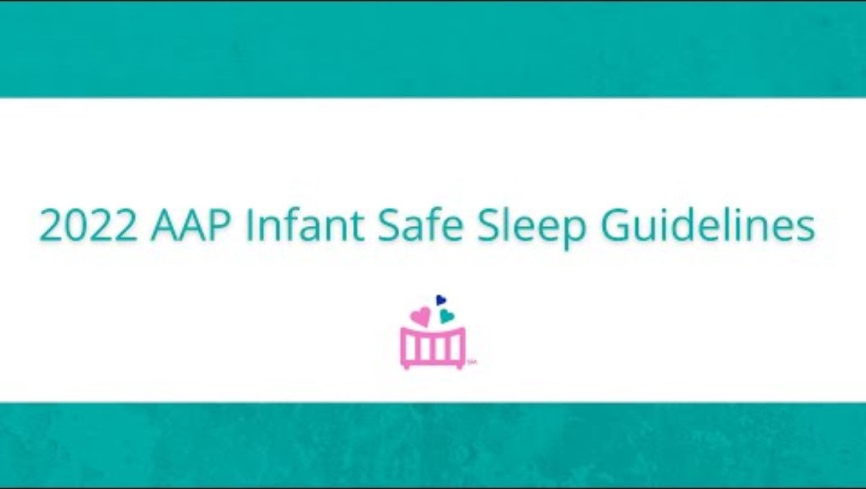

Slide 45
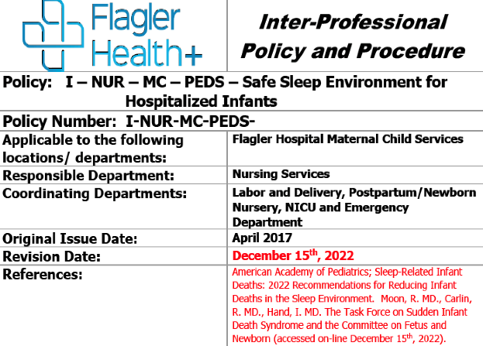
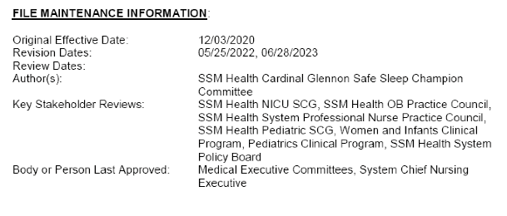
Update Policy to Reflect 2022 AAP Recommendations

Slide 46
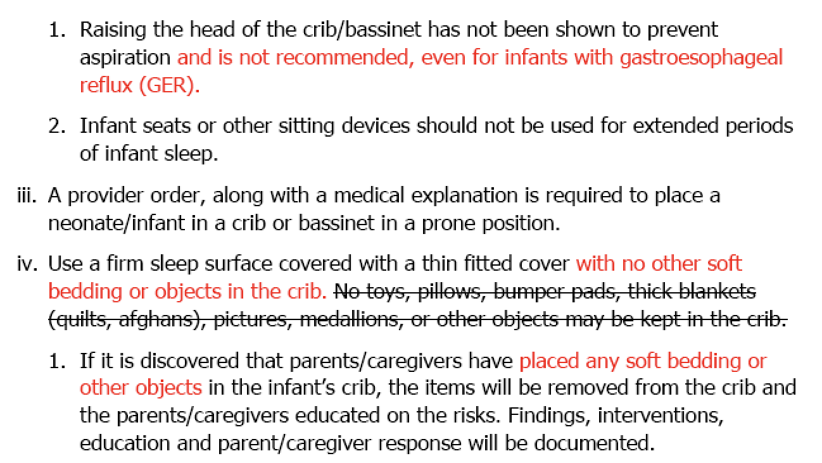

Slide 47
Step 2: Disseminate Guidelines and Educate Staff on Safe Sleep

Slide 48

ESSI Education Additional Toolkit Resources
E-Modules
  Provide comprehensive information describing SUID, SID, AAP Recommendations, and interactive exercises
Patient Stories
  Emphasize the importance of safe sleep practices
Webinar Selections
  Cover a range of supplementary topics (e.g. Safe Sleep for Indigenous Families, Father Engagement, Sleep Safety in the NICU) that could be tailored to hospital's needs
Article Selections
  Studies around quality improvement in safe sleep, integrating cultural humility into safe sleep counseling
Conversation Guides
  Provide scenarios, discussion points, and reflection exercises to ground the provider before engaging in conversations around safe sleep

Slide 49
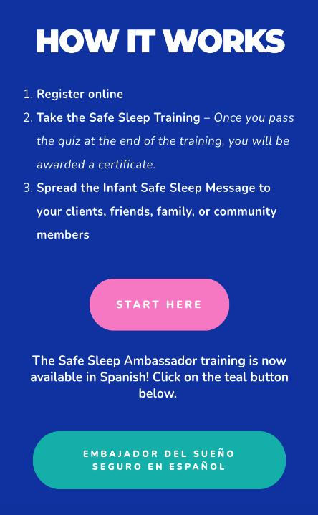
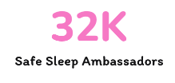
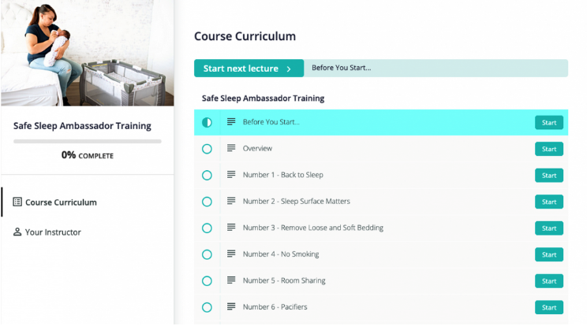
Cribs for Kids – Ambassador Training
ILPQC Recommended
Easily accessible, brief course that goes into depth on 12 steps to safe sleep
Available in English and Spanish

Slide 50

Initiating Conversations around Safe Sleep
Child Safety Forward: A reflection guide to shape provider conversations around infant sleep
What is my stance as a professional on sleep practices? Am I open and receptive to others’ viewpoints?
Can I take a truly nonjudgmental approach when talking about sleep safety?
Do I understand the power I have in this interaction because of who I am?
More to Come at Face-to-Face!

Slide 51
Step 3: Endorse a Safe Sleep Environment

Slide 52


Honoring Patient Stories
Facilitation guide for professionals who provide education on safe sleep to other professionals or parents
Provides guidance on how to use the included digital stories in a variety of settings
Video still from Moments of You
Questions Include:
What does this story teach you about helping families plan for what to do when they are tired?
How does this story help you understand the importance of following the safe sleep guidelines?
Video still from Remember Xavier

Slide 53
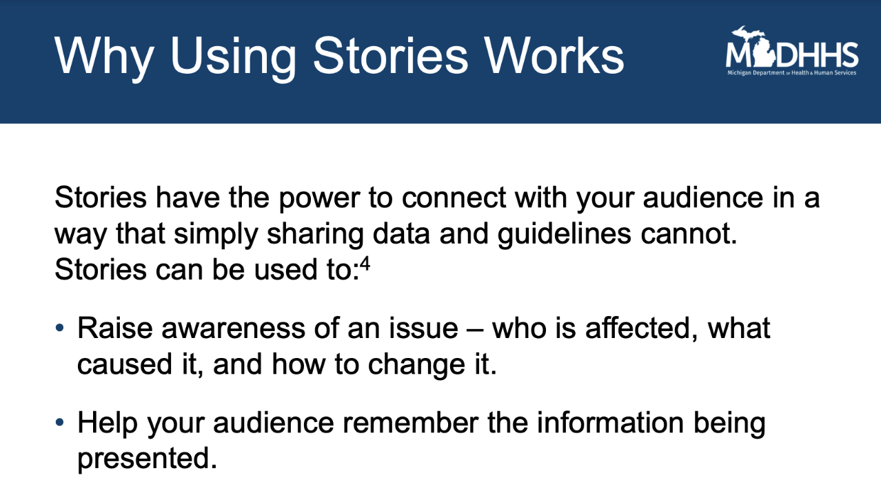

Slide 54
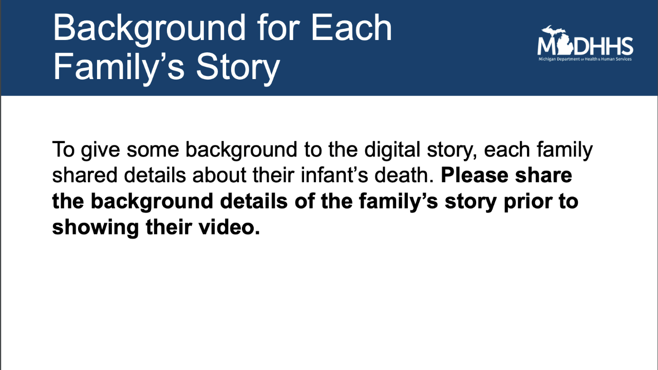

Slide 55
Meet with ESSI QI Team and Review Updated AAP Guidelines
Step 1: Review current safe sleep policy and update policy to reflect 2022 AAP Recommendations.
Step 2: Education on Safe Sleep Guidelines
Disseminate Cribs for Kids Ambassador Training and have staff email completion certificate Or Complete updated safe-sleep E-Module offered by hospital
Step 3: Endorse safe sleep practices and incorporate safe sleep education into orientation, annual competencies and ongoing education.
Email team patient stories Or Share stories during team huddles
Example Education Implementation Plan

Slide 56
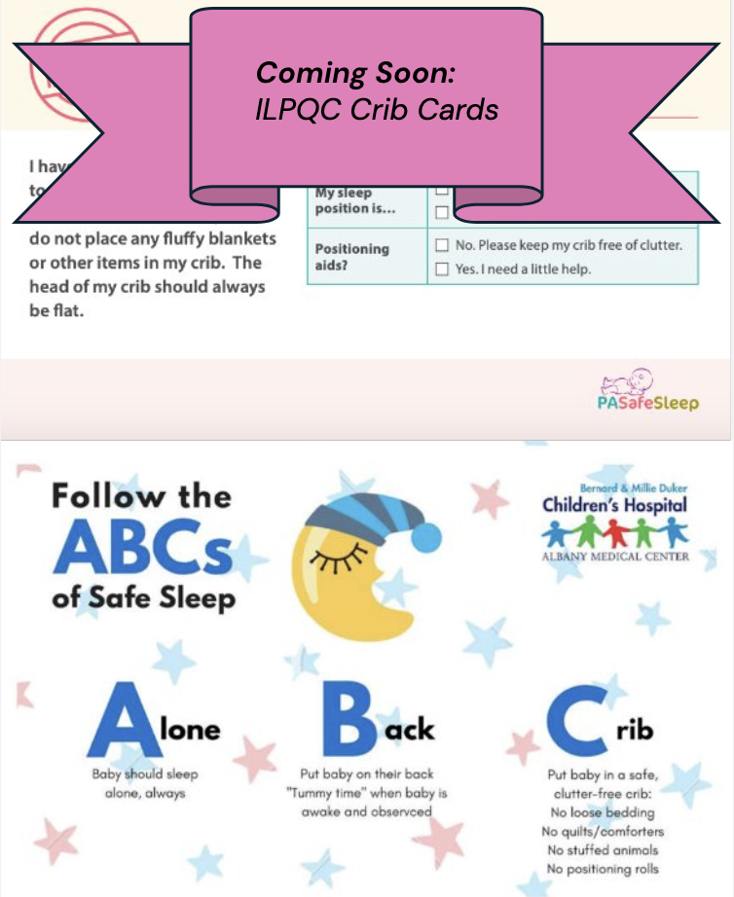
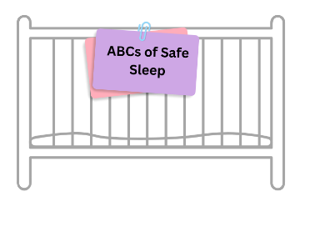
Crib Cards
Educational teaching aid for provider and family
Can include HIPPA information on inside of crib, sleep preferences or accommodations facing outside of crib

Slide 57
Share: Crib Audits
What's your crib auditing process? Type into the chat below

Slide 58
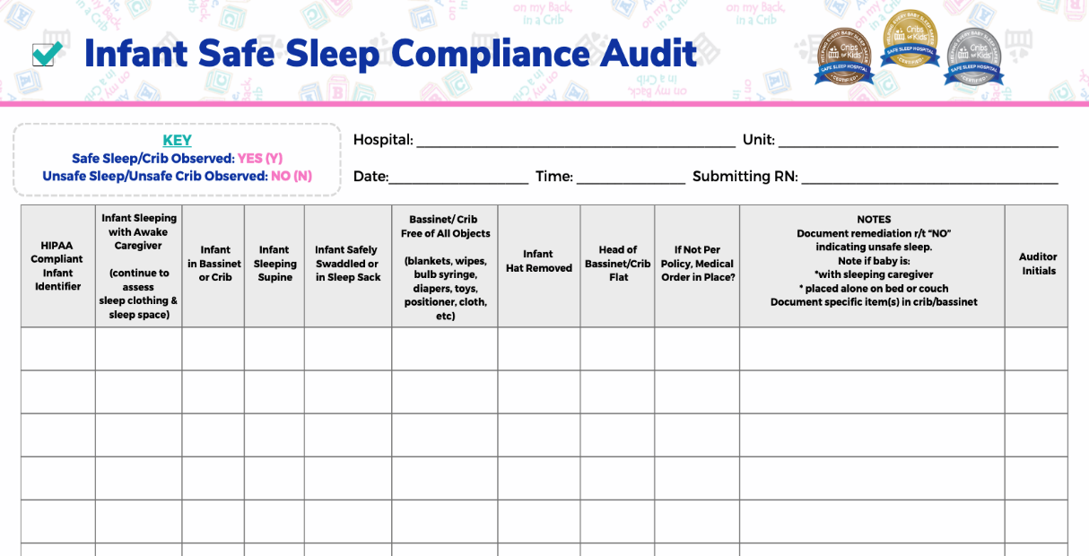
Audit Tool
If you have an effective audit tool your team uses, please email to info@ilpqc.org

Slide 59

ILPQC will be offering one seat to each ESSI hospital team to help build capacity to facilitate live discussions about equity and respectful care with your providers, nurses and staff.
Join the 178 ILPQC hospital-based team members who have already completed this training!​

Slide 60
Upcoming Opportunities of Interest to ESSI Teams

Slide 61


Preventing Sudden Unexpected Infant Death (SUID) Webinar
Felicia Clark D-ABMDI, Prevention Coordinator, CPASS Chicago Gina Lowell MD, MPH, FAAP Associate Professor, Rush University Children's Hospital Kyran Quinlan MD, MPH, FAAP Pediatric Medical Advisor, Illinois Department of Public Health
Learning Objectives:
Describe SUID epidemiology, disparities, risk and the role of risk perception in preventing SUID
Develop communication approaches that value and center families and considers harm reduction.
Recognize the value of partnering with birth hospitals, MCH stakeholders and SUID prevention advocates to promote safe sleep during clinical and community-based encounters with pregnant and parenting families
April 18th - Register here.

Slide 62




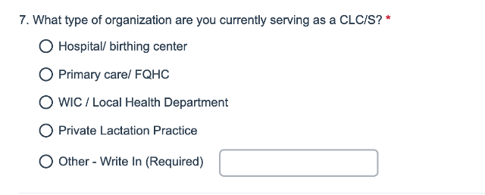

Illinois CLC/S Mapping Project Survey 2024
Surveying Certified Lactation Consultants and Specialists across Illinois
  Learn about service gaps
  Consider opportunities for promoting a diverse lactation support professional network
Only 5 minutes!
Take this survey by May 31st.

Slide 63


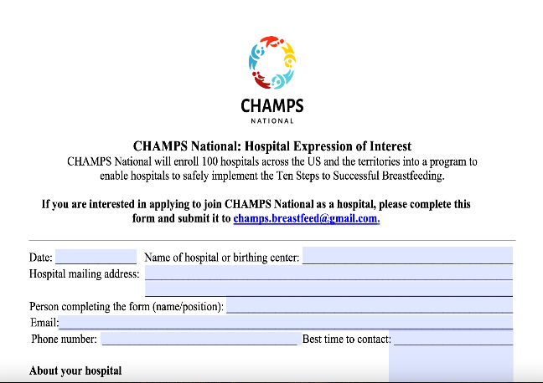

Opportunity: Looking to enroll 100 Hospitals
  Free training and support from a diverse team of interdisciplinary experts to implement the Ten Steps to Successful Breastfeeding
  25 Hospitals already enrolled, 0 in Illinois
  View their informational webinar here.

Slide 64
ESSI Data Collection

Slide 65

Data Collection Timelines
Need clarification about ESSI Data?
Watch the ESSI Data training Webinar recording
Ongoing data, due on the final day of the following month:
  February Data Due March 31st
  March Data Due April 30th
Award Data (Baseline – March 2024): Due April 30th

Slide 66


Two ESSI Data Forms
Hospital Level Data form
Structure Measures
Education Measures
Crib Audits
Patient Level Data form
Random sample of 20 newborns discharged each month​
Newborn and birthing person demographic data​
Safe sleep education​
Transfer of care documentation​

Slide 67
Upcoming ESSI Calls
Date | Topic
April 15th, 2024 2:00 PM | ESSI Webinar
May 22nd, 2024 May 23rd, 2024 | ILPQC Face-to-Face Springfield, IL

Slide 68




ILPQC
2024 Events

