Slide 1
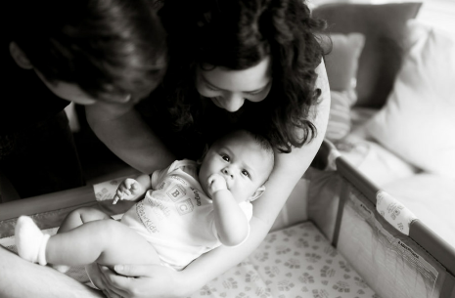
  Equity and Safe Sleep for Infants
  Equitable and Respectful Care Education and Implementation
January 22nd, 2024, 2:00 PM

Slide 2
Overview
ESSI Aims and Measures
Healthcare Professional Education: Equitable and Respectful Care
Toolkit Resources
Education Implementation Plan
ESSI Next Steps

Slide 3


Ice Breaker
Where are you joining us from today?
Add your city to the chat!

Slide 4

Welcome Kiela!
Please welcome our newest ILPQC team member:
Kiela Moreno, MPH
ILPQC Project Coordinator

Slide 5
Healthcare Professional Education

Slide 6




ESSI Initiative Aims
1
By December 2025, greater than 70% of Illinois birthing and children’s hospitals will address disparities and promote neonatal equity by actively participating in the ESSI initiative.​
2
By December 2025, greater than 80% of infants will be discharged from ILPQC hospitals with a completed ESSI Bundle.
Parents or caregivers report an understanding of a safe sleep environment.
AWARENESS
READINESS
Family is prepared for a transition to home, including SDoH screening and resource linkage.
TRANSFER OF CARE
Communication to primary care provider completed.

Slide 7




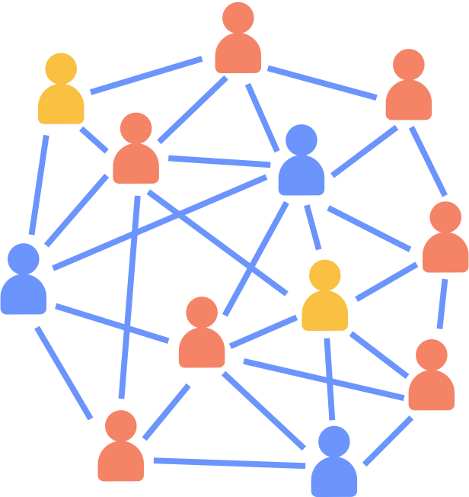


DRIVER 1
Healthcare Professional Commitment
DRIVER 2
Inclusive Clinical Environment
DRIVER 3
Parents and Caregiver Empowerment
DRIVER 4
Community Partnerships
DRIVER 5
Healthcare Data Utilization

Slide 8
Key Driver Diagram
Aims
Primary Drivers
Secondary Drivers
By December 2025:
1. Greater than 70% of Illinois birthing and children’s hospitals will address disparities and promote neonatal equity by actively participating in the ESSI initiative.
2. Greater than 80% of infants will be discharged from ILPQC hospitals with a completed ESSI bundle.
Healthcare Professional Commitment
Equitable and Respectful Care Education and Implementation
Safe Sleep Environment Education and Implementation
Inclusive Clinical Environment
Organizational Leadership Commitment
Equitable and Inclusive Unit Policies
Parent and Caregiver Experience Prioritization
Parent and Caregiver Empowerment
Respectful Parent and Caregiver Partnerships
Safe Sleep Awareness
Transition to Home, including SDoH Screening and Resource Linkage
Community Partnerships
Resource Mapping
Building Relationships with Community Organizations
Transfer of Care to Community Providers
Healthcare Data Utilization
Collection of Accurate Race and Ethnicity Data
Dissemination of Stratified Data
Application of Data to Address Inequities
Awareness: Parents or caregivers report an understanding of a safe sleep environment, including navigating challenges to safe sleep at home
Readiness: Family is prepared for a transition to home, including SDoH screening and resource linkage
Transfer of Care: ESSI Newborn Care Plan (Awareness & Readiness) documented in the discharge
ESSI Bundle:

Slide 9
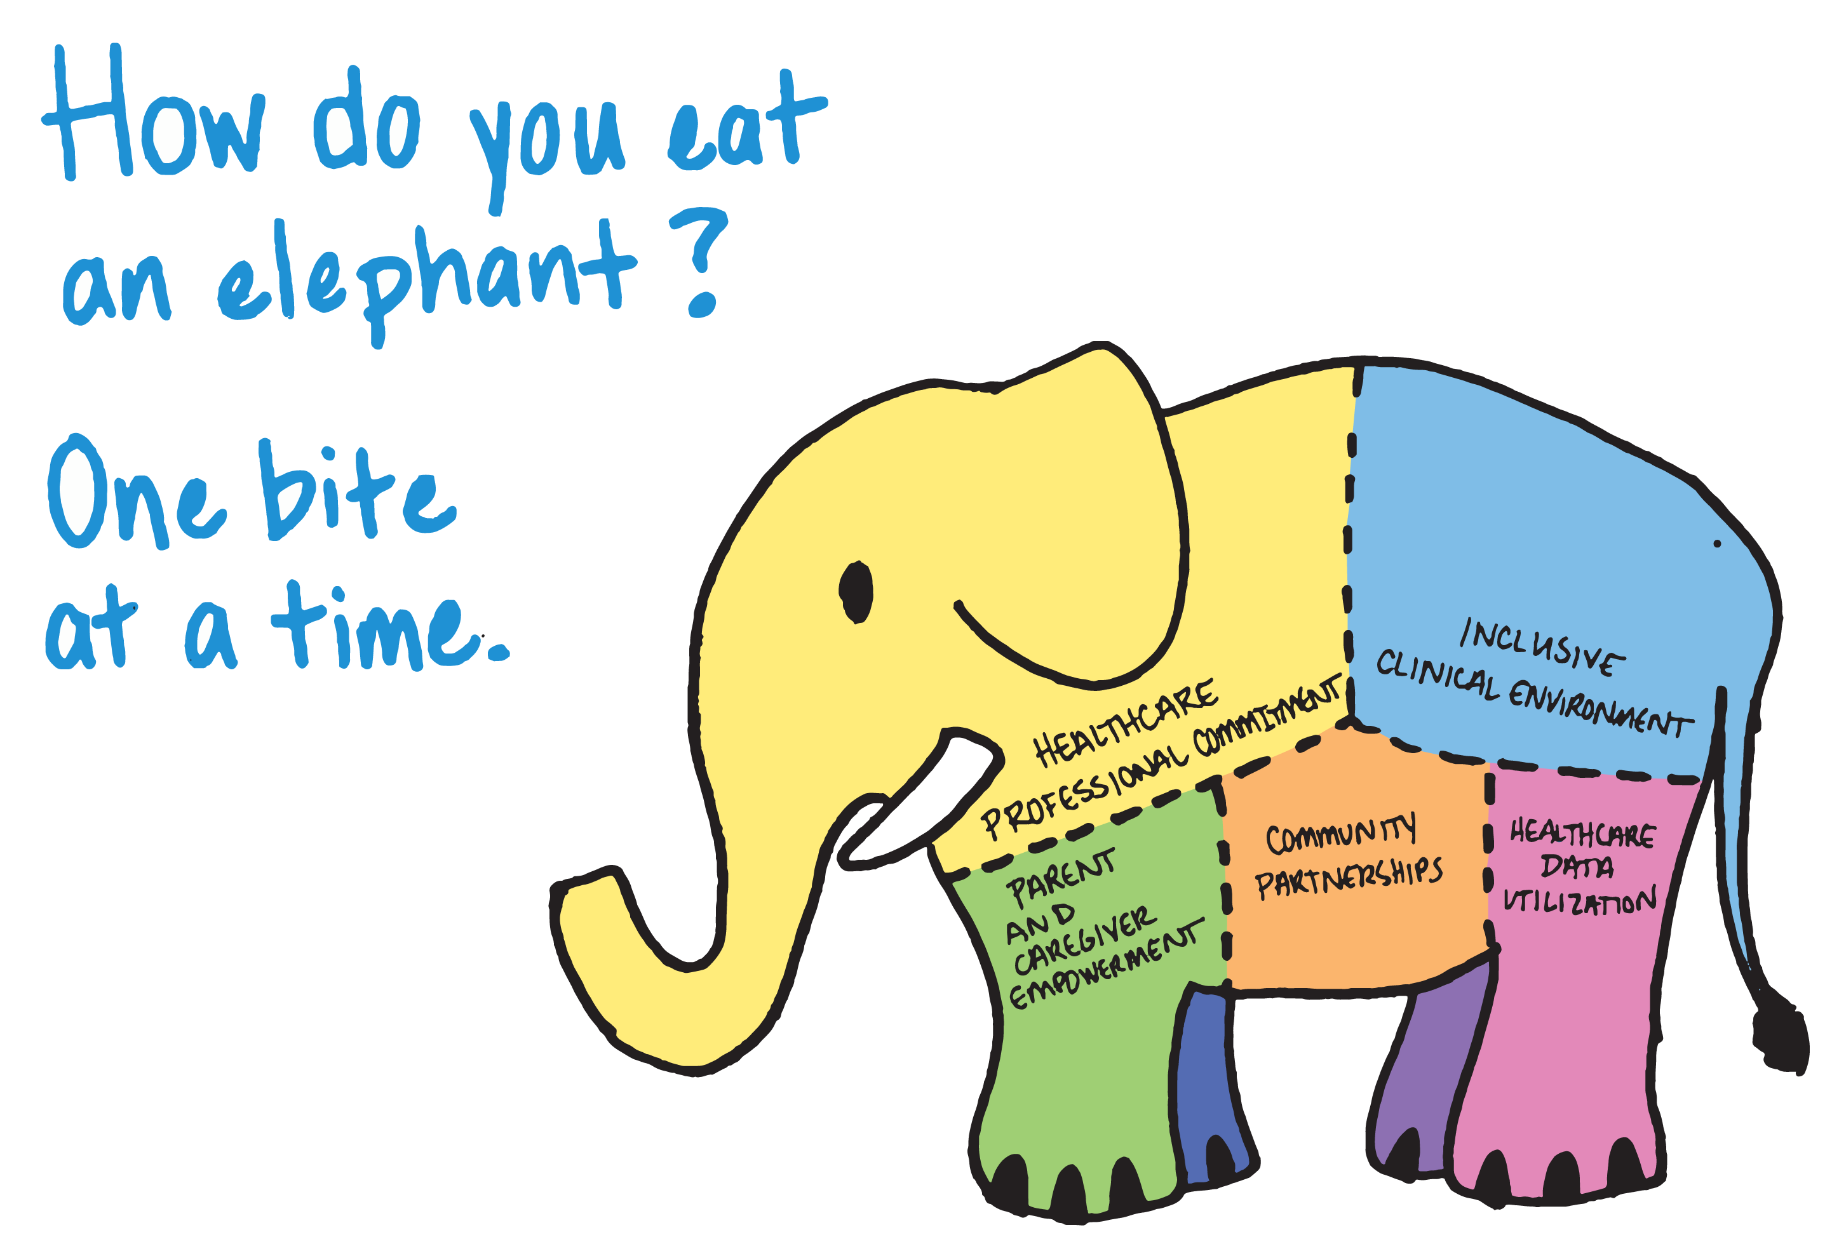
Hold for Justin’s elephant Slide

Slide 10
DRIVER 1
Healthcare Professional Commitment
DRIVER 2
Inclusive Clinical Environment
DRIVER 3
Parents and Caregiver Empowerment
DRIVER 4
Community Partnerships
DRIVER 5
Healthcare Data Utilization

Slide 11
Key Driver Diagram
Aims
Primary Drivers
Secondary Drivers
1
By December 2025:
1. Greater than 70% of Illinois birthing and children’s hospitals will address disparities and promote neonatal equity by actively participating in the ESSI initiative.
2. Greater than 80% of infants will be discharged from ILPQC hospitals with a completed ESSI bundle.
Healthcare Professional Commitment
Equitable and Respectful Care Education and Implementation
Safe Sleep Environment Education and Implementation
Inclusive Clinical Environment
Organizational Leadership Commitment
Equitable and Inclusive Unit Policies
Parent and Caregiver Experience Prioritization
Parent and Caregiver Empowerment
Respectful Parent and Caregiver Partnerships
Safe Sleep Awareness
Transition to Home, including SDoH Screening and Resource Linkage
Community
Partnerships
Resource Mapping
Building Relationships with Community Organizations
Transfer of Care to Community Providers
Healthcare Data Utilization
Collection of Accurate Race and Ethnicity Data
Dissemination of Stratified Data
Application of Data to Address Inequities
Awareness: Parents or caregivers report an understanding of a safe sleep environment, including navigating challenges to safe sleep at home
Readiness: Family is prepared for a transition to home, including SDoH screening and resource linkage
Transfer of Care: ESSI Newborn Care Plan (Awareness & Readiness) documented in the discharge
ESSI Bundle:

Slide 12
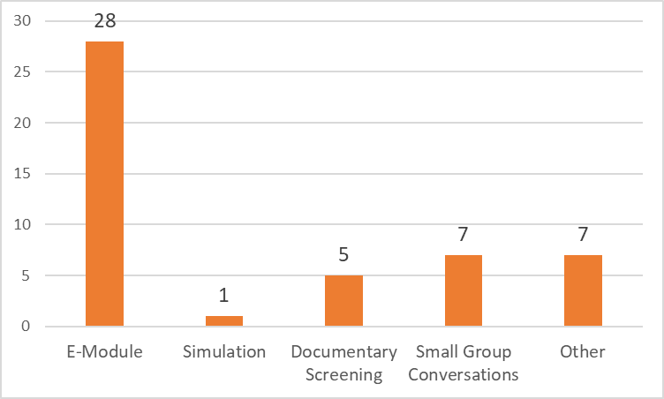
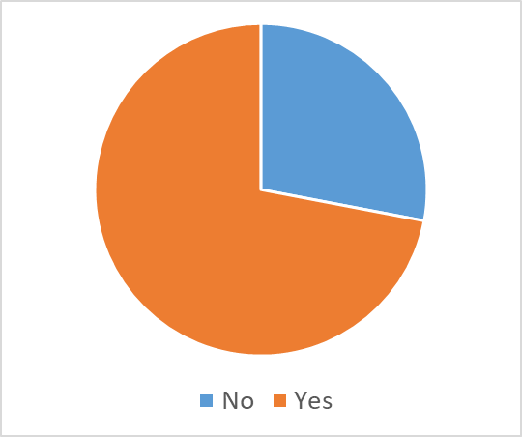
Respectful Care -
Provider, Nurse and Staff Education
Do you currently have any education for providers, nurses, and staff about listening to parents and caregivers, providing respectful care and building trust, and addressing implicit bias and engaging in anti-racism?
If yes, how is it provided?

Slide 13

POLL
If your team has provided any training beyond an e-module, what was it? (Free Text)

Slide 14
Key Driver Diagram
Aims
Primary Drivers
Secondary Drivers
1
By December 2025:
1. Greater than 70% of Illinois birthing and children’s hospitals will address disparities and promote neonatal equity by actively participating in the ESSI initiative.
2. Greater than 80% of infants will be discharged from ILPQC hospitals with a completed ESSI bundle.
Healthcare Professional Commitment
Equitable and Respectful Care Education and Implementation
Safe Sleep Environment Education and Implementation
Inclusive Clinical Environment
Organizational Leadership Commitment
Equitable and Inclusive Unit Policies
Parent and Caregiver Experience Prioritization
Parent and Caregiver Empowerment
Respectful Parent and Caregiver Partnerships
Safe Sleep Awareness
Transition to Home, including SDoH Screening and Resource Linkage
Community Partnerships
Resource Mapping
Building Relationships with Community Organizations
Transfer of Care to Community Providers
Healthcare Data Utilization
Collection of Accurate Race and Ethnicity Data
Dissemination of Stratified Data
Application of Data to Address Inequities
Awareness: Parents or caregivers report an understanding of a safe sleep environment, including navigating challenges to safe sleep at home
Readiness: Family is prepared for a transition to home, including SDoH screening and resource linkage
Transfer of Care: ESSI Newborn Care Plan (Awareness & Readiness) documented in the discharge
ESSI Bundle:

Slide 15






DRIVER 1:
HEALTHCARE PROFESSIONAL COMMITMENT​
Change Ideas
  Educate providers, nurses, and other staff about listening to families, providing respectful care and building trust, and addressing implicit bias and engaging in anti-racism
Secondary Driver 1: Equitable and Respectful Care Education and Implementation
  Encourage open discussions about equitable and respectful care

Slide 16

The ILPQC ESSI Toolkit
The ESSI Toolkit includes the resources you need to successfully launch the ESSI initiative and achieve performance improvement at your hospital.
ESSI Toolkit

Slide 17







Healthcare Professional Commitment
DRIVER 1
ESSI Toolkit
I-PROMOTE Implicit Bias Training Directory
Listening to Parents and Family Voices
Inventory of implicit bias trainings available including the sponsoring organization, title, estimated completion time, and cost
  The Illinois Maternal Health Digital Storytelling Project
  CDC HEAR HER Campaign
E-Learning Modules
Secondary Driver 1:
Tools to Facilitate Discussions
  National Health Start Association
  March of Dimes
  Think Cultural Health
  Diversity Science
Equitable and Respectful Care Education and Implementation
  Toxic – A Black Woman’s Story
  Laboring with Hope Film
  Aftershock Film
  PQI 21-day Anti-Racism Challenge
Resources for Respectful Care Practices
Live Trainings
  ILPQC Actionable Respectful Care Strategies
  AWHONN Respectful Maternity Care Implementation Toolkit-
  The SHARE Approach to shared decision-making
  PQI SpeakUp Training
  March of Dimes

Slide 18
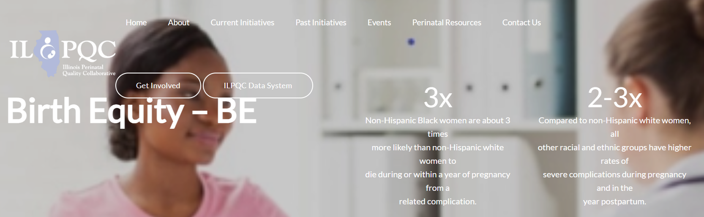
ILPQC Birth Equity hospital teams have been hard at work implementing healthcare professional education on equity and implicit bias
We hope you can work closely with your hospital BE team, if there is one, to build on the foundation they have laid

Slide 19
POLL
Have you connected with your Birth Equity Team?
    Yes
    Yes, I am on the BE team
    No
    Not sure if we have one

Slide 20
QI Team's Role in Getting Started
Review options for each education component
1
Identify what option is best for your hospital with each component
2
Create a 30-60-90 day plan to implement each component
3
Reach out to ILPQC with questions / for assistance
4

Slide 21

Structure Measures
As this point, we expect that most structure measures will be in the HAVEN’T STARTED category
Haven't Started
Working On It
In Place

Slide 22


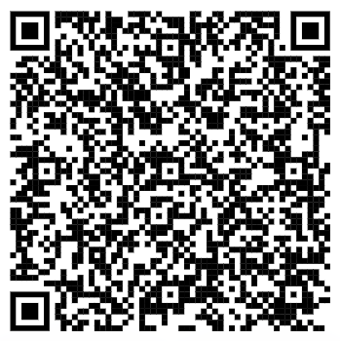


Get to GREEN:
Education Plan Components
All physicians and providers, nurses, ancillary clinicians and hospital staff completing E-Modules
At least 1 ESSI Team Member attends PQI training
Host at least 1 facilitated discussion
System to facilitate feedback from peers, parents and families
QR Code

Slide 23



Step 1: E-Modules
Guidelines for ESSI approved e-modules:
  Perinatal context
  Reflection or application exercise
  Supplemental to your hospital's DEI training
  Separate from your hospital's annual required trainings
Options:
  Free: Think Cultural Health and Diversity Science: Dignity in Pregnancy & Childbirth: Preventing Racial Bias in Perinatal Care
  Paid: March of Dimes: Awareness to Action: Dismantling Bias in Maternal and Infant Healthcare™

Slide 24

Step 2: PQI Speak Up Champion Course
Implicit and Explicit Racial Bias Education
A Black woman is 3 to 4 times more likely to die of pregnancy-related complications than a white woman. Research shows that inequities in outcomes are primarily due to differences in how women are treated within the health care setting based on race (racism).
The SPEAK UP Champion™ Implicit and Explicit Racial Bias Education is a total of eight hours over two days (April 12th & 19th) of live virtual interactive learning that outlines quality improvement strategies to support individuals and groups with dismantling racism, providing quality equitable care, and reducing health disparities.

Slide 25
PQI Speak Up Champion Course
Implicit and Explicit Racial Bias Education
Target Audience
  Illinois Healthcare professionals who support and care for patients before, during and after pregnancy or professionals that care for newborns.
Learning Outcomes
  Describe factors that contribute to perinatal disparities based on a racial equity framework.
  Outline quality improvement strategies and tactics for eliminating implicit and explicit bias in perinatal care.
  Develop a quality improvement action plan for ensuring equity in perinatal outcomes.

Slide 26
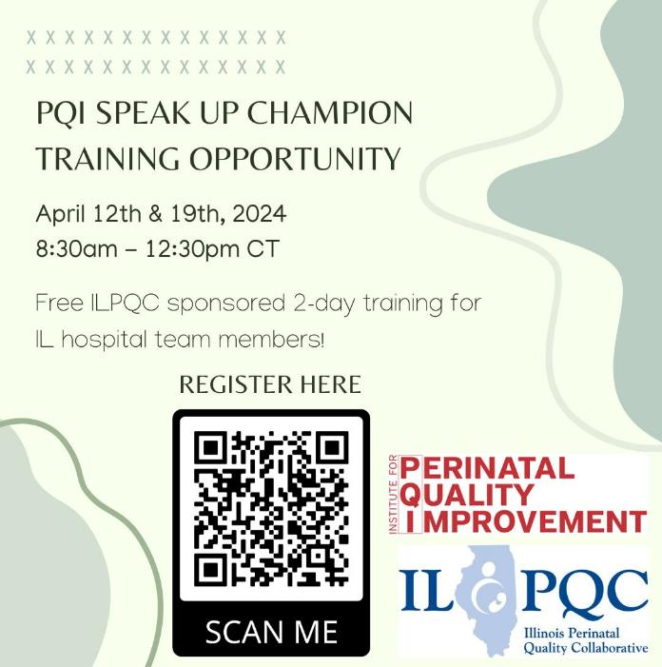
ILPQC will be offering one seat to each ESSI hospital team to help build capacity to facilitate live discussions about equity and respectful care with your providers, nurses and staff
Join the 178 ILPQC hospital-based team members who have already completed this training!​

Slide 27
POLL
Has anyone on your ESSI team attended a previous PQI training?
    Yes
    No
    Not sure

Slide 28

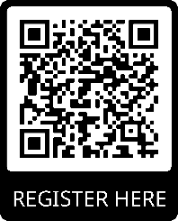

Speak UP 28-Day Challenge
The third year of the Institute for Perinatal Quality Improvement (PQI) 28-Day Anti-Racism Challenge begins February 1, 2024. Each day during the challenge there is a quote meant for reflection (Reflect), a learning activity (Learn), and a recommended action (Act). When you register, you will receive a daily email with links to each day’s challenge activities. EVERYONE is invited to join the challenge!
WHEN: 2/1/2024 - 2/29/2024
29-day challenge for 2024!

Slide 29
Step 3: Facilitated Discussion
Tools for hospitals to facilitate live, in-person discussions
  Health Equity Rounds (Boston Medical Center and CHOP)
  Small Group Role play scenarios to address implicit bias (Cedars Sinai)
View a Patient Story Video(s) and Facilitate a Discussion
  Hear Her
  I-Promote
View a Film / Documentary Capturing Peoples Lived Experience with Discrimination and Bias and Facilitate a Discussion (Discussion Guides Available)

Slide 30
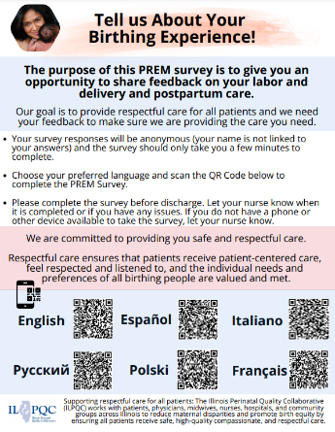
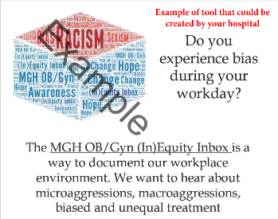
Step 4: Feedback
Parent and Family Feedback
  PREM – implemented by BE teams
  Feedback from NICU families
Hospital peer feedback
  Mass General: (In)equity Inbox

Slide 31
Example Training Plan
Training | Targeted Staff | Brief Description | Date & Time
Step 1: E-Module Selections
Diversity Science | All staff | This three-part course uses the example of real-life, composite stories to illustrate the way racial bias, however unintended, can undermine care. | Launch February 26, 2024
Step 2: 1 ESSI Team Member Attends Live Training
Perinatal Quality Improvement, SPEAK UP Champion Training | At least 1 ESSI Team member | live virtual interactive learning that outlines quality improvement strategies to support individuals and groups with dismantling racism, providing quality equitable care, and reducing health disparities. | April 9 & 12, 2024
Step 3: Tools for hospitals to facilitate live, in-person discussions
Addressing implicit bias and health disparities in a level IV NICU | Nurses | Design and implement small group workshops to provide experiential learning through role-play to highlight examples of implicit bias in the NICU. | May 15th, 2024
Feedback
PREM | All Staff | Patient Reported Experience Measure (PREM) Survey to obtain feedback from patients. | Data Review Monthly

Slide 32
Example Training Plan
Training | Targeted Staff | Brief Description | Date & Time
Step 1: E-Module Selections
Think Cultural Health | All staff | This training is designed to teach healthcare providers skills related to cultural competence and humility with a focus on patient-centered care. Additionally, healthcare providers explore more about their own biases and learn strategies to mitigate the impact of bias within maternal healthcare. | Launch February 26, 2024
Step 2: 1 ESSI Team Member Attends Live Training
Perinatal Quality Improvement, SPEAK UP Champion Training | At least 1 ESSI Team member | live virtual interactive learning that outlines quality improvement strategies to support individuals and groups with dismantling racism, providing quality equitable care, and reducing health disparities. | April 9 & 12, 2024
Step 3: Tools for hospitals to facilitate live, in-person discussions
Aftershock film | All Staff | This documentary film witnesses two families become ardent advocates in the maternal health space after the tragic loss of two women following the deliveries. Screening and discussion | May 15th, 2024
Feedback
Inequity Toolbox | All Staff | Strategy used by Massachusetts General Hospital OB Department to provide anonymous feedback of workplace and patient interactions to improve equity. | Launch February 15th, 2024

Slide 33
To Dos before February Call
Review Provider Education document and select an appropriate E-Module for your providers, nurses and staff
Highlight trainings you think would be most helpful from each category
Register at least 1 ESSI team member for PQI
Create your 30-60-90 plan for implementation of healthcare professional education

Slide 34
Team Talk
MacNeal Hospital

Slide 35
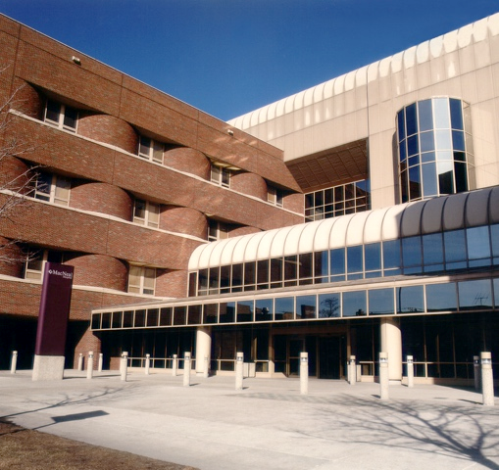
MacNeal Hospital
Part of Loyola Medicine
374 Bed hospital
13,450 Discharges
56,788 ED Visits
9 Bed Labor Unit
5 Special care bed Nursery Level II
25-bed Mother Baby Unit

Slide 36
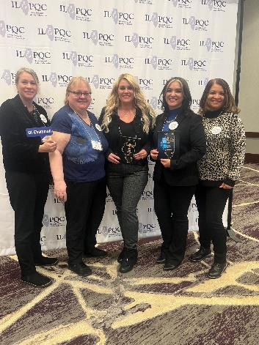
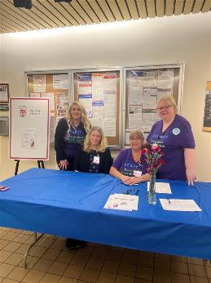
Macneal Hospital
BE Team
Heather Chavez
Karen Richardson
Maria Lotesto
Kari Phillips
Debbie Basa
ESSI Team
Dr. Mohammed
Heather Chavez
Karen Richardson
Amanda Lopez
Maria Lotesto
Carla Gamboa

Slide 37
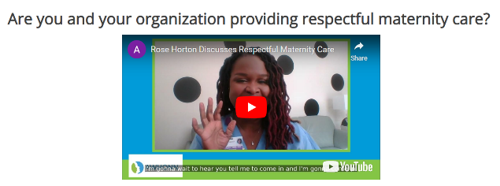

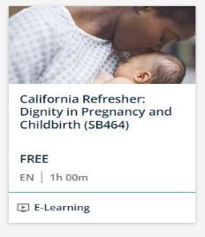
MacNeal Hospital
Timeline
2022
2023
Continuing education refresher course
2024
Annual HealthStream
Bias training

Slide 38
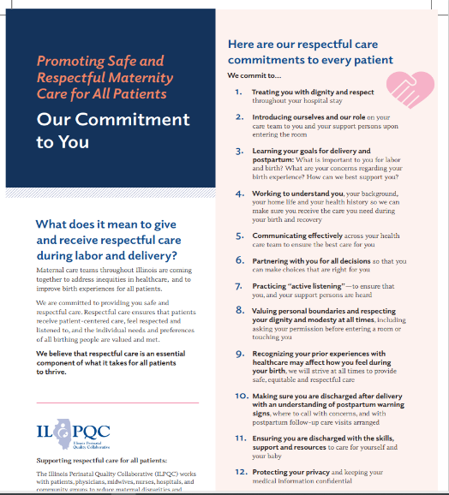
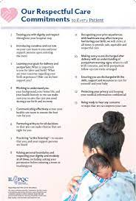
MacNeal Hospital

Slide 39
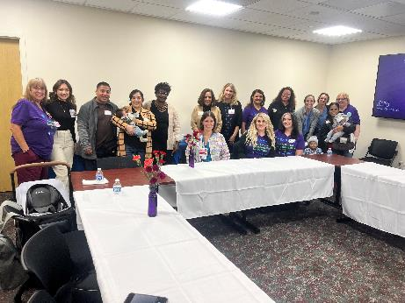
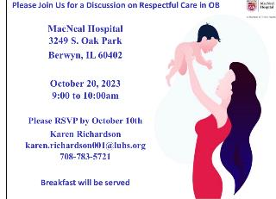
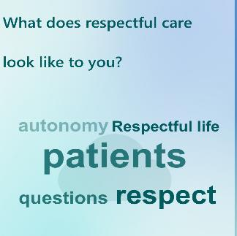
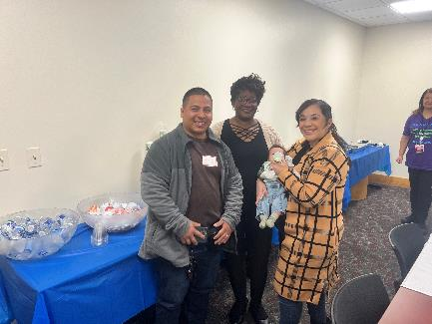
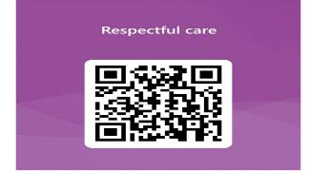
Respectful care breakfast
Patients
Community Partners
Nurses
Doctors
Staff

Slide 40
ESSI Data Collection

Slide 41
Data Collection Timelines
Baseline Data (October-December 2023): Due February 15th
Ongoing data due on the final day of the following month:
  January Data Due February 29th
  February Data due March 31st
  March Data Due April 30th
Award Data: Baseline – March data due April 30th
For more information watch the ESSI Data training Webinar recording

Slide 42


Two ESSI Data Forms
Hospital Level Data form
Structure Measures
Education Measures
Crib Audits
Patient Level Data form
Random sample of 20 newborns discharged each month​
Newborn and birthing person demographic data​
Safe sleep education​
Transfer of care documentation​

Slide 43
2024 Face-to Face Meeting

Slide 44


save the date
2024 OB & Neonatal
Face-to-Face Meetings
OB TEAMS:
MAY 22ND, 2024
at the President Abraham Lincoln Doubletree Hotel
in Springfield, IL
Calling ALL Perinatal Leaders, Providers, Nurses, Advocates, & Friends!
NEONATAL
TEAMS:
MAY 23RD, 2024
Join us for two interactive days of collaborative learning with the IL Perinatal Quality Collaborative!

Slide 45


Interested in Facilitating an ILPQC Face-to-Face
Breakout Session?
Email info@ilpqc.org
Interested in Volunteering on the Face-to-Face Planning Committee?

Slide 46
ESSI Launch Award Criteria
Roster completed
Readiness survey submitted
Data submission Baseline-March
Regular webinar attendance
At least 1 ESSI team member registered and attended PQI Training

Slide 47
ESSI 2024 Plan: Jan-June
January
Equitable and Respectful Care Education and Implementation
February
Equitable and Respectful Care Education and Implementation Part 2
March
Safe Sleep Environment Education and Implementation
April
Policy Review (AAP Safe Sleep Guidelines and reviewing polices with an equity lens)
May
2024 Face-to-Face Meeting in Springfield IL
June
Use qualified interpreters and provide information in multiple languages

Slide 48
Upcoming ESSI Calls
Date | Topic
February 19th, 2024 2:00 PM | Equitable and Respectful Care Education
March 18th, 2024 2:00 PM | Safe Sleep Education
April 15th, 2024 2:00 PM | Policy Review

Slide 49




ILPQC
2024 Events

Slide 50

Thank you for your dedication to making Illinois the best place to give birth and be born!
Q & A Session

