Slide 1
Equity and Safe Sleep for Infants Safe Sleep Environment Education and Implementation
April 15th, 2024 2:00 PM

Slide 2
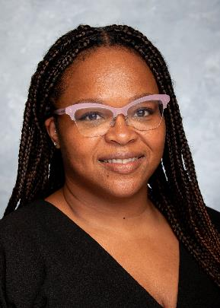
Welcome Corliss!
Please welcome our newest ILPQC team member:
Corliss Davis
ILPQC Community Engagement
Project Coordinator

Slide 3
Overview
2024 Face-to-Face Meeting
ESSI Aims and Measures
Healthcare Professional Education: Safe Sleep Environment Education and Implementation
Upcoming Opportunities of Interest to ESSI Teams

Slide 4
ESSI ABP MOC Part IV
Complete an attestation form if you are an ABP-certified physician seeking 25 credits under MOC Part IV
Submit the attestation form to your QI project leader for signature and send back to info@ilpqc.org for credit in 2024
You can start submitting the attestation form in October
Attestation of Meaningful Participation:
Intellectually engaged in planning and executing the project
Participated in implementing the project’s interventions - the changes designed to improve care
Regularly reviewed data in keeping with the project’s measurement plan
Collaborated in the activity by attending team meetings
Claim your credits!

Slide 5
ATTENDANCE POLL!
Please fill out the poll so that we can track hospital team attendance at ESSI webinars

Slide 6
2024 Face-to-Face Meeting

Slide 7
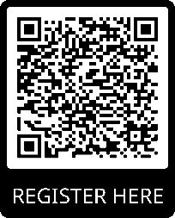
Register Now!
2024 OB & Neonatal
Face-to-Face Meetings
OB TEAMS:
Calling ALL Perinatal Leaders, Providers, Nurses, Advocates, & Friends!
MAY 22ND, 2024
at the President Abraham Lincoln Doubletree Hotel
in Springfield, IL
NEONATAL
TEAMS:
MAY 23RD, 2024
Join us for two interactive days of collaborative learning with the IL Perinatal Quality Collaborative!

Slide 8
We have an exciting opportunity! Please email your Perinatal Network Administrator or email info@ilpqc.org if you are interested in this opportunity!

Slide 9
ILPQC F2F Agenda
Time | ILPQC 2024 Neonatal Face-to-Face Meeting
9:00-9:15am | Welcome and Overview of Day Leslie Caldarelli, MD and Justin Josephsen, MD
9:15-9:45am | We’ve Launched! Getting our “Booties” to Work with ESSI Leslie Caldarelli, MD and Justin Josephsen, MD
9:45-10:40am | Steps to Addressing Social Determinants of Health in the Newborn Setting Meg Parker, MD, MPH
10:40-10:55am | Break
10:55 –11:25am | Promoting Safe Sleep in Illinois Hospitals Bryanne Colvin, MD Christie Lawrence, DNP, RNC-NIC, APN/CNS Gina Lowell, MD, MPH
11:55-12:55pm | Team Storyboard Session: An Opportunity to Share and Learn Networking Lunch
12:55-1:40pm | Breakout Session #1: Sharing Strategies for Effective Equity Education
Time | ILPQC 2024 Neonatal Face-to-Face Meeting
1:40-1:50p | Transition to Breakout Sessions
1:50-2:35p | Breakout Session #2: Safe Sleep: Beyond the ABCs
2:35-2:45p | Transition to Breakout Sessions
2:45-3:30p | Breakout Session #3: Parent Partners and Respectful Care Breakfasts: Lessons Learned from Birth Equity Teams
3:00-3:45p | Wrap-up, Next steps for 2024 Leslie Caldarelli, MD and Justin Josephsen, MD

Slide 10
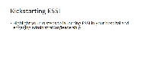
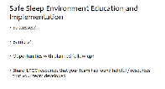
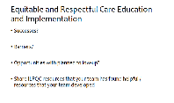
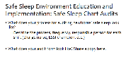
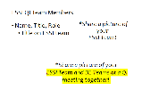
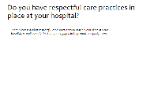
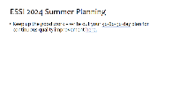
2024 F2F Neonatal Storyboards
Share the great work that your ESSI Team is doing!
See the chat for the Storyboard templates! Also available on F2F Webpage and in newsletter
Introduce your hospital and ESSI QI Team
Kickstarting ESSI at your hospital. Share successes, opportunities of Equitable and Respectful Care Education implementation.
Share successes, opportunities of Safe Sleep Education implementation. Share ESSI 2024 Summer Planning goals.

Slide 11
Upcoming Face-to-Face 2024 Prep
Submit your Data!
All ESSI data baseline-March 2024 will be due on April 30, 2024, for award consideration.
Call for Storyboards!
Templates in the chat and the on F2F page! All hospital teams are asked to create a storyboard on their QI work.
Register for F2F 2024!
Data Due:
Tuesday
April 30th, 2024
Early Bird Registration: March 11th – April 8th
$75/day or $145/both days
Regular Registration: April 9th – April 26th
$100/day or $200/both days

Slide 12
ESSI Launch Award Criteria
Roster completed
Readiness survey submitted
Data submission Baseline-March 2024
Regular webinar attendance
At least 1 ESSI team member registered and attended PQI Training

Slide 13
ESSI Aims and Measures

Slide 14
ESSI Initiative Aims
1
By December 2025, greater than 70% of Illinois birthing and children’s hospitals will address disparities and promote neonatal equity by actively participating in the ESSI initiative.​
2
By December 2025, greater than 80% of infants will be discharged from ILPQC hospitals with a completed ESSI Bundle.
Parents or caregivers report an understanding of a safe sleep environment.
AWARENESS
READINESS
Family is prepared for a transition to home, including SDoH screening and resource linkage.
TRANSFER OF CARE
Communication to primary care provider completed.

Slide 15
DRIVER 1
Healthcare Professional Commitment
DRIVER 2
Inclusive Clinical Environment
DRIVER 3
Parents and Caregiver Empowerment
DRIVER 4
Community Partnerships
DRIVER 5
Healthcare Data Utilization
Illinois Perinatal Quality Collaborative

Slide 16
Key Driver Diagram
Aims
Primary Drivers
Secondary Drivers
1
By December 2025:
1. Greater than 70% of Illinois birthing and children’s hospitals will address disparities and promote neonatal equity by actively participating in the ESSI initiative.
2. Greater than 80% of infants will be discharged from ILPQC hospitals with a completed ESSI bundle.
Healthcare Professional Commitment
Equitable and Respectful Care Education and Implementation
Safe Sleep Environment Education and Implementation
Inclusive Clinical Environment
Organizational Leadership Commitment
Equitable and Inclusive Unit Policies
Parent and Caregiver Experience Prioritization
Parent and Caregiver Empowerment
Respectful Parent and Caregiver Partnerships
Safe Sleep Awareness
Transition to Home, including SDoH Screening and Resource Linkage
Community Partnerships
Resource Mapping
Building Relationships with Community Organizations
Transfer of Care to Community Providers
Healthcare Data Utilization
Collection of Accurate Race and Ethnicity Data
Dissemination of Stratified Data
Application of Data to Address Inequities
Awareness: Parents or caregivers report an understanding of a safe sleep environment, including navigating challenges to safe sleep at home
Readiness: Family is prepared for a transition to home, including SDoH screening and resource linkage
Transfer of Care: ESSI Newborn Care Plan (Awareness & Readiness) documented in the discharge
ESSI Bundle:

Slide 17
Safe Sleep Environment Education and Implementation

Slide 18
SUID
Each year, there are about 3,400 sudden unexpected infant deaths (SUID) in the United States. These deaths occur among infants less than 1 year old and have no immediately obvious cause.
The three commonly reported types of SUID include the following:
Sudden infant death syndrome (SIDS).
Unknown cause.
Accidental suffocation and strangulation in bed.
In 2020, there were about 1,389 deaths due to SIDS, about 1,062 deaths due to unknown causes, and about 905 deaths due to accidental suffocation and strangulation in bed.

Slide 20
Sudden Unexpected Infant Death Case Registry
During the pandemic years of 2020-2021 in Cook County, infants continued to die suddenly and unexpectedly about once a week.
During this time there were 99 SUIDs, 96 of which were sleep-related.
99% of infants were found in an unsafe sleep environment.
22% of infants were found on their stomach.
74% of infants were sleeping with another person.
89% of infants were found in places not approved for safe sleep.
91% percent of infants were sleeping with soft bedding.

Slide 21
We must continue to raise awareness of these tragedies and respectfully promote safe infant sleep practices to reduce risk and to eliminate these preventable deaths.

Slide 22
Change Ideas
DRIVER 1:
HEALTHCARE PROFESSIONAL COMMITMENT​
Educate providers, nurses, and other staff about the importance of a safe sleep environment for every sleep during hospitalization and at home
Encourage meaningful, culturally appropriate, respectful, nonjudgmental conversations between providers, nurses, and other staff and parents and caregivers about a safe sleep environment
Secondary Driver 2: Safe Sleep Environment Education and Implementation
Endorse and model a safe sleep environment for every sleep during the hospitalization, including correcting unsafe behaviors

Slide 23
ESSI Safe Sleep Education Plan – Get to Green
Review current safe sleep policy and update policy to reflect 2022 AAP Recommendations.
Disseminate recommendations and educate about safe sleep
Endorse and model safe sleep practices and incorporate safe sleep education into orientation, annual competencies and ongoing education.
Crib Cards
Crib Audits
Media Toolkits
Sharing Patient Stories
Risk Reduction
Respectful Conversations
Option 1: E-Module updated with 2022 AAP Recommendations
Option 2: Complete Cribs for Kids Safe Sleep Ambassador Training

Slide 24
Step 2: Disseminate Recommendations and Educate about Safe Sleep

Slide 25
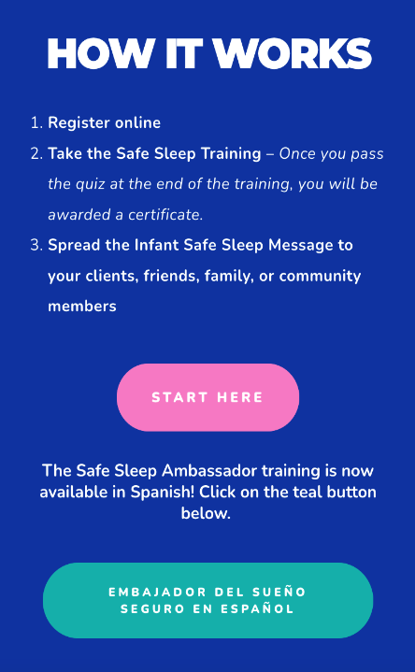
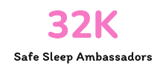
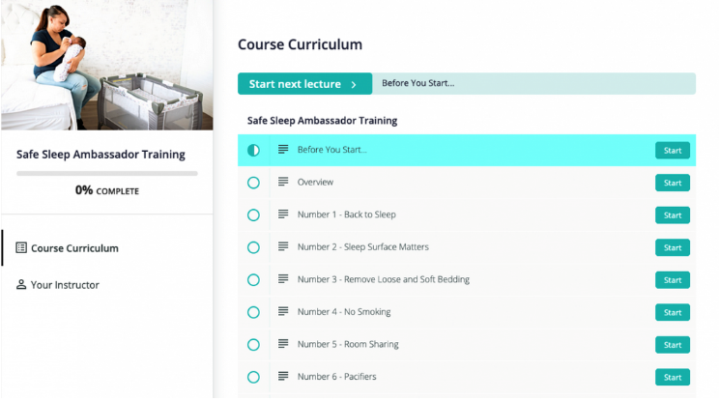
Cribs for Kids – Ambassador Training
ILPQC Recommended
Easily accessible, brief course that goes into depth on 12 steps to safe sleep
Available in English and Spanish

Slide 26
12 Steps from Cribs for Kids
Back to Sleep
Feed Baby Breast Milk
Place Baby in a Bare Crib
Avoid Smoking, Vaping, and Impairment
Keep up with Medical Visits and Vaccines
Practice Tummy Time
Safe Sleep Surface
Room Sharing without Surface Sharing
Sleep with a Pacifier
Dress for Sleep
Caution Use of Commercial Products and Devices
Spread the Safe Sleep Message

Slide 27
Change Ideas
DRIVER 1:
HEALTHCARE PROFESSIONAL COMMITMENT​
Educate providers, nurses, and other staff about the importance of a safe sleep environment for every sleep during hospitalization and at home
Encourage meaningful, culturally appropriate, respectful, nonjudgmental conversations between providers, nurses, and other staff and parents and caregivers about a safe sleep environment
Secondary Driver 2: Safe Sleep Environment Education and Implementation
Endorse and model a safe sleep environment for every sleep during the hospitalization, including correcting unsafe behaviors

Slide 28
What about Safe Sleep in the NICU?
Studies have shown that NICU providers do not consistently support infant sleep safety recommendations (Barsman, 2015)
Endorsing safe sleeping guidelines with parents of infants from the time of admission to the NICU can have a significant influence on safe sleep messaging for parents of NICU babies.
Additional Education for NICU Providers: Read Transition to a Safe Sleep Environment for the NICU Patient and Transition to Safe Sleep at Home Needs a Consistent Approach for NICU Babies and Their Parents

Slide 29
Transitioning from the NICU to Home

Slide 30
Safe Sleep Algorithms
In a 2006 survey of 252 NICU nurses, nurses surveyed were inconsistent regarding how they determined when a preterm infant is ready to sleep supine.
Answers included close to discharge (13%), when maintaining their body temperature in an open crib (25%), PMA of 34 to 36 weeks (15%), PMA ≥37 weeks (13%), and when the infant’s respiratory status was stable (6%). There is a clear need for a standardized process for determining when to practice sleep.
The AAP states the following, "The NICU should use an algorithm for routine and repeated evaluation of each infant for safe home sleep readiness. Some safe sleep practices may be added incrementally."
Safe sleep algorithms have been developed based on literature review, expert opinion, and unit consensus

Slide 31
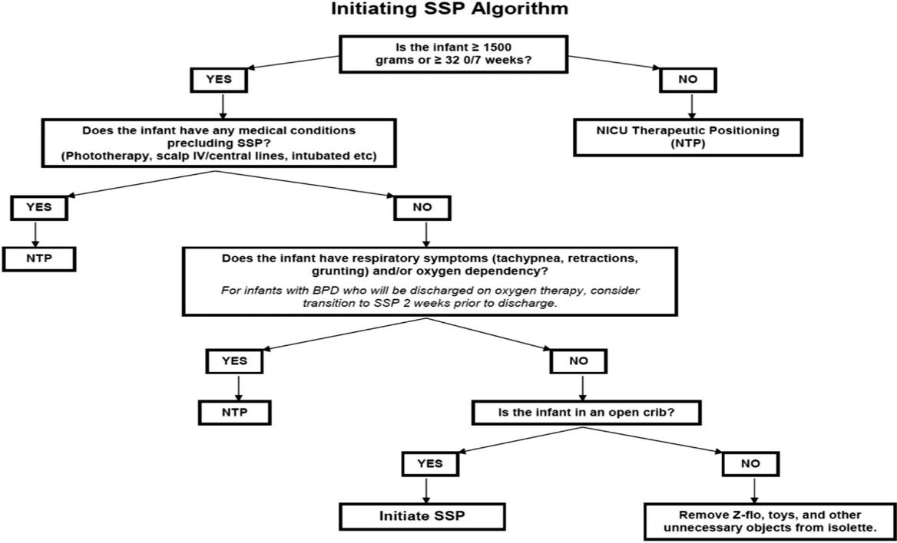
Safe Sleep Algorithm utilized by Hwang et.al
Hwang et.al showed a pre- to post-intervention improvement with overall safe sleep environmental compliance in 2 community NICUs from 25.9% to 79.7%

Slide 32
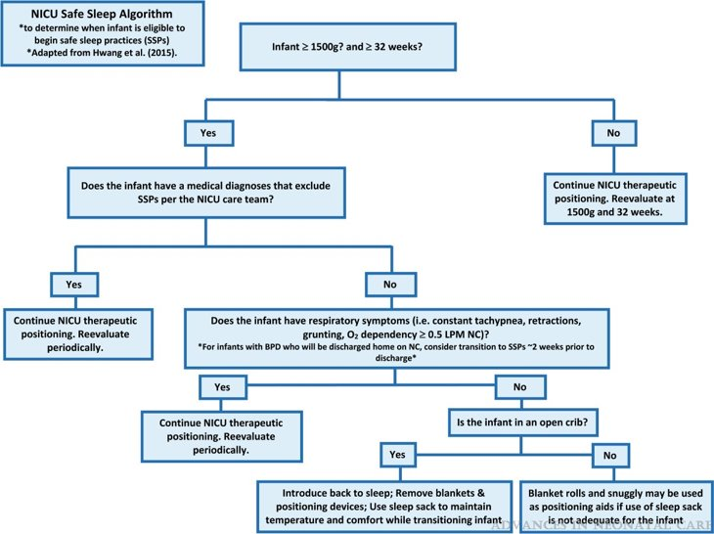
Safe Sleep Algorithm utilized by Treiber-Paul

Slide 33
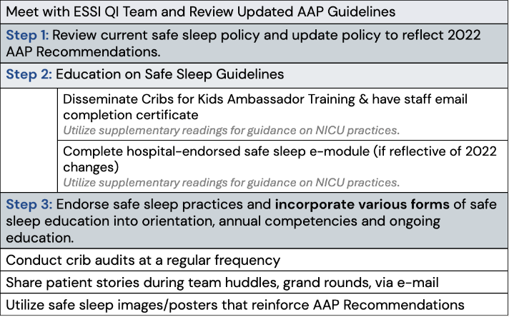
ESSI's Vision for Education
All health care providers and staff caring for infants less than one year old should receive initial and ongoing training on safe sleep practices.
Additional webinars, articles, and supplemental readings on NICU practices are recommended and available on ILPQC's ESSI Education Resources Document.
Crib Cards
Crib Audits
Media Toolkits
Sharing Patient Stories
Risk Reduction
Respectful Conversations

Slide 34
Step 3: Endorse and model safe sleep practices and incorporate safe sleep education into orientation, annual competencies and ongoing education.

Slide 35
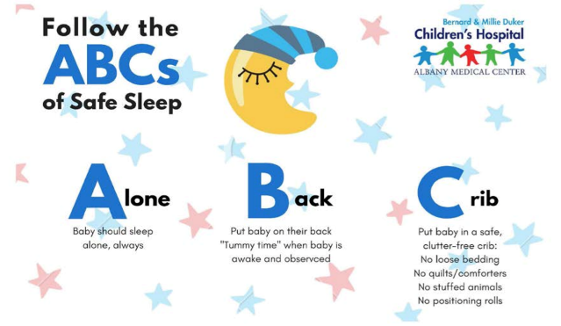
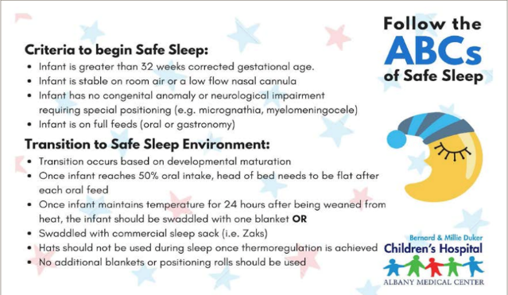

Slide 36
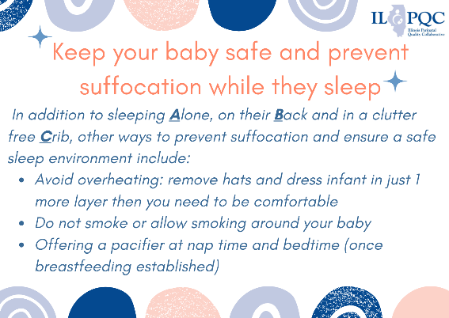
Back
Front
Coming Soon: ILPQC Crib Cards

Slide 37
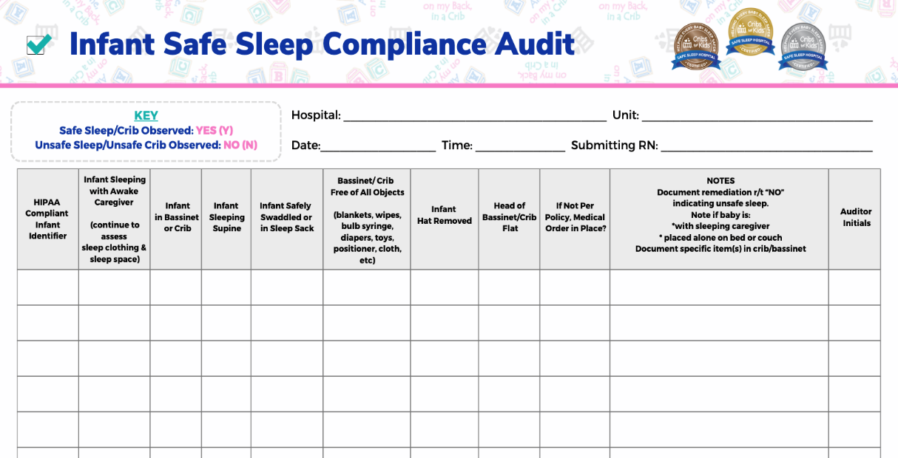
Audit Tool
If you have an effective audit tool your team uses, please email to info@ilpqc.org

Slide 38
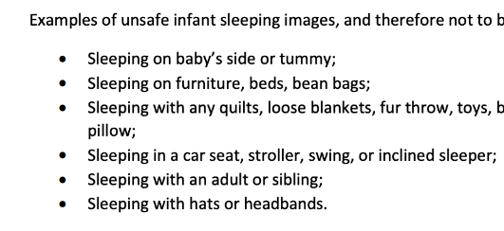
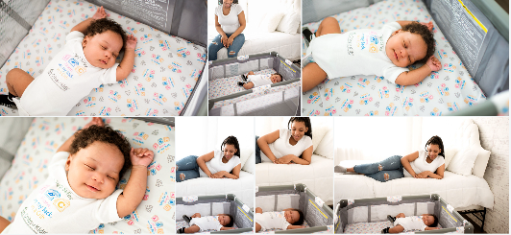
Media and Posters

Slide 39
Modeling

Slide 40
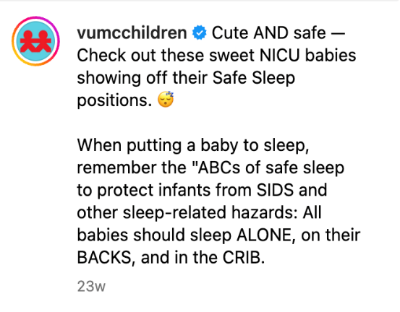
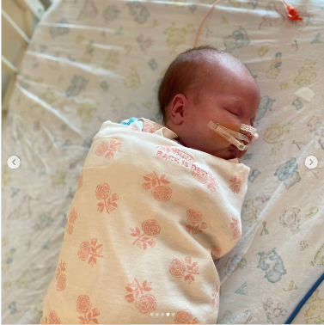
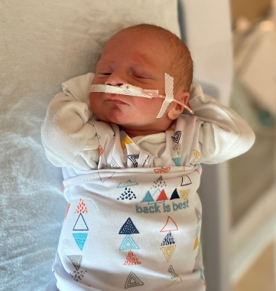
Modeling in the NICU

Slide 41
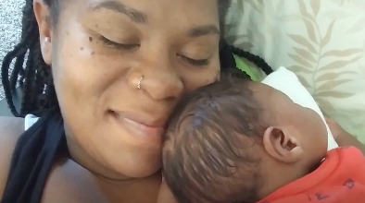
Honoring Patient Stories
Stories have the power to connect in a way that sharing data and guidelines cannot. Stories raise awareness, help people remember, and motivate to action
Charlie’s Kids
Family Stories of Sleep-Related Deaths Michigan.gov
What does this story teach you about helping families plan for what to do when they are tired?
How does this story help you understand the importance of following the safe sleep guidelines?

Slide 42
Meet with ESSI QI Team and Review Updated AAP Guidelines
Step 1: Review current safe sleep policy and update policy to reflect 2022 AAP Recommendations.
Step 2: Education on Safe Sleep Guidelines
 | Disseminate Cribs for Kids Ambassador Training & have staff email completion certificate Utilize supplementary readings for guidance on NICU practices.
 | Complete hospital-endorsed safe sleep e-module (if reflective of 2022 changes) Utilize supplementary readings for guidance on NICU practices.
Step 3: Endorse safe sleep practices and incorporate various forms of safe sleep education into orientation, annual competencies and ongoing education.
Conduct crib audits at a regular frequency
Utilize safe sleep images/posters and crib cards that reinforce AAP recommendations
Share a patient story and debrief, what other things could we do?
Example Education Implementation Plan

Slide 43
Share in the chat! Does your hospital use any creative ways to educate your providers, nurses and staff on Safe Sleep?

Slide 44
Change Ideas
DRIVER 1:
HEALTHCARE PROFESSIONAL COMMITMENT​
Educate providers, nurses, and other staff about the importance of a safe sleep environment for every sleep during hospitalization and at home
Encourage meaningful, culturally appropriate, respectful, nonjudgmental conversations between providers, nurses, and other staff and parents and caregivers about a safe sleep environment
Secondary Driver 2: Safe Sleep Environment Education and Implementation
Endorse and model a safe sleep environment for every sleep during the hospitalization, including correcting unsafe behaviors

Slide 45
Upcoming Opportunities of Interest to ESSI Teams

Slide 46
ILPQC will be offering one seat to each ESSI hospital team to help build capacity to facilitate live discussions about equity and respectful care with your providers, nurses and staff.
Registration for April PQI Training is CLOSED.
To claim a free seat to PQI's June SPEAK UP Champion Training (14th and 21st), please email kmoreno@northshore.org
An additional ILPQC sponsored PQI SPEAK UP Champion Training will be held August 9th and August 16th.

Slide 47
Fetal Infant Mortality Review (FIMR) Implicit Bias Event
The FIMR Community Action Team invites you to our upcoming event focused on continuing our community conversation on Implicit Bias scheduled for April 22nd, 2024.
Over the last 6 months, held 6 community events on the topic of Implicit Bias
This month, emphasis on what we can do as individuals to address implicit bias and what tools/resources we need to help us in this work.
Register in person here.
Register virtually here.

Slide 48
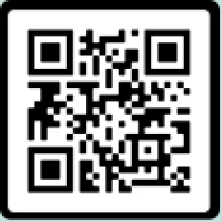
After this webinar, participants will be able to:
Describe SUID epidemiology, disparities, risk and the role of risk perception in preventing SUID
Develop communication approaches that value and center families and consider harm reduction
Recognize the value of partnering with birth hospitals, MCH Stakeholders and SUID Prevention advocates to promote safe sleep during clinical during clinical and community-based encounters with pregnant and parenting families
Register here.

Slide 49
ESSI Safe Sleep Starter Pack
Thanks to IL DHS we are able to provide printed patient education materials for each ESSI Team!

Slide 50
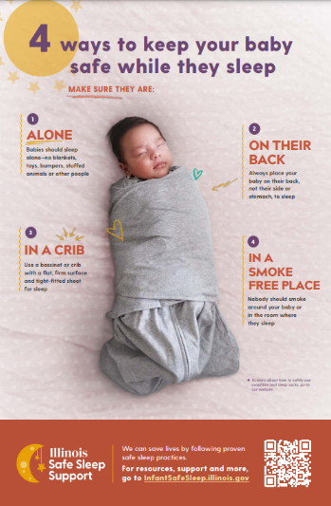
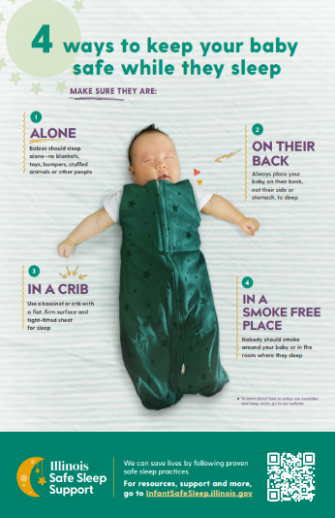
Posters

Slide 51
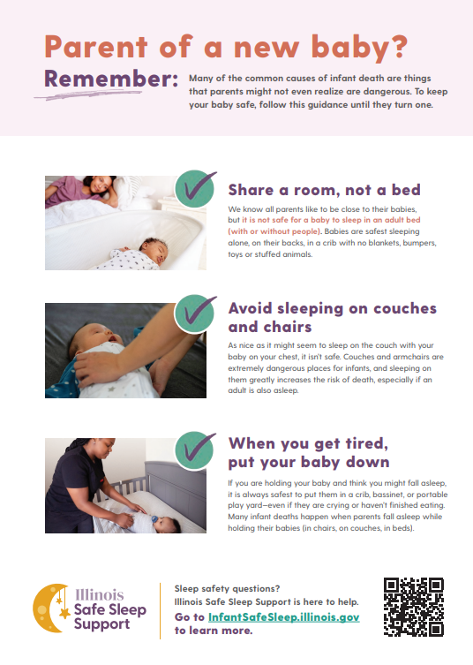
Handouts

Slide 52
What is included:
Each ESSI team has the opportunity to order a Safe Sleep Support Starter Kit.
Based on your birth volume each team will choose:
5 posters + 200 handouts (4 tear pads of 50) in English for hospitals with a birth volume up to 800
10 posters + 400 handouts (8 tear pads of 50) in English for hospitals with a birth volume over 800
Based on your patient demographics you have the opportunity to order additional handouts in the following languages:
Spanish
Chinese
Arabic
Polish
Each additional language packet comes with 50 handouts (1 tear pad of 50).
Each team will also get a pack of 1 poster per language
Click the link in the chat to place your order!

Slide 53
Diversity Science Dignity in Pregnancy & Childbirth: Preventing Racial Bias in Perinatal Care
Diversity Science includes courses that empower clinicians, providers, and healthcare organizations to achieve their mission of providing bias-free, high-quality care to all patients.
ILPQC has been able to work with Diversity Science to allow Hospital teams to integrate the modules in e-learning systems.
We will follow up soon with more information!
COMING SOON!!!

Slide 54
HALO Safer Way to Sleep Program
The HALO In-Hospital Modeling Program replaces the traditional blankets in your Birth Center, NICU or PICU with a FREE* supply of HALO Sleep Sack swaddle wearable blanket.

Slide 55
Other ESSI Information

Slide 56
Data Collection Timelines
Need clarification about ESSI Data?
Watch the ESSI Data training Webinar recording
Active initiative data, due on the final day of the following month:
February Data Due March 31st
March Data Due April 30th
Award Data (Baseline – March 2024): Due April 30th

Slide 57
Two ESSI Data Forms
Hospital Level Data form
Structure Measures
Education Measures
Crib Audits
Patient Level Data form
Random sample of 20 newborns discharged each month​
Newborn and birthing person demographic data
Transfer of care documentation​
Family safe sleep education​

Slide 58
Upcoming ESSI Calls
Date | Topic
May 22nd, 2024 May 23rd, 2024 | ILPQC Face-to-Face Springfield, IL
June 17th, 2024 | Equitable and Inclusive Unit Policies
July 15th, 2024 | Using Qualified Interpreters and Providing Information in Multiple Languages

Slide 59
ILPQC
2024 Events

