Slide 1
BASIC Monthly Teams Call: 36 is the New 48
Monday December 19th, 2022 2:00 PM

Slide 2
Call Overview
36 is the new 48: moving to a 36 hour rule-out
Why a 36 hour rule-out?
AAP Guidelines
36 hour rule-out Scenarios
BASIC Next Steps
BASIC Webinar Ice Breaker: What is your favorite winter holiday activity?
Put your answer in the chat!

Slide 3
ABP MOC Part IV (BASIC/MNO)
Complete an attestation form if you are an ABP-certified physician seeking 25 credits under MOC Part IV
Last Chance for MNO
BASIC will be ongoing
Submit the attestation form to your QI project leader for signature and send back to info@ilpqc.org for credit in 2022
Attestation of Meaningful Participation:
Intellectually engaged in planning and executing the project
Participated in implementing the project’s interventions - the changes designed to improve care
Regularly reviewed data in keeping with the project’s measurement plan
Collaborated in the activity by attending team meetings
Claim your credits
TODAY!

Slide 4
Moving BASIC into 2023
36 hour rule-out and moving to sustainability

Slide 5
BASIC in 2023 Vision
36 is the new 48
Encouraging all teams to move to a 36-hour rule-out
Moving BASIC to Sustainability
Begin work to sustain the gains made during the active BASIC initiative

Slide 6
What We Sought to Achieve Statewide
Decrease the number of newborns born at ≥35 weeks who receive antibiotics
Decrease number of newborns with a negative blood culture who receive antibiotics for longer than 36 hours
The Right Antibiotic for the Right Baby for the Right Length of Time

Slide 7
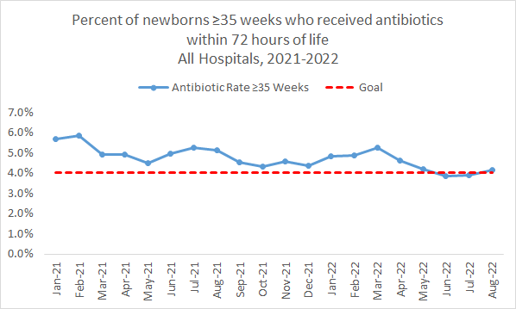
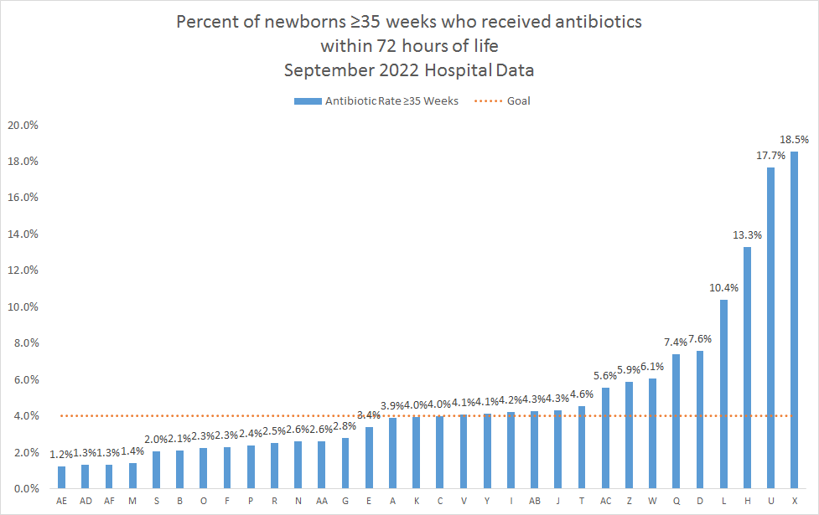
BASIC Success: Newborns ≥35 weeks who received antibiotics within 72 hours of life

Slide 8
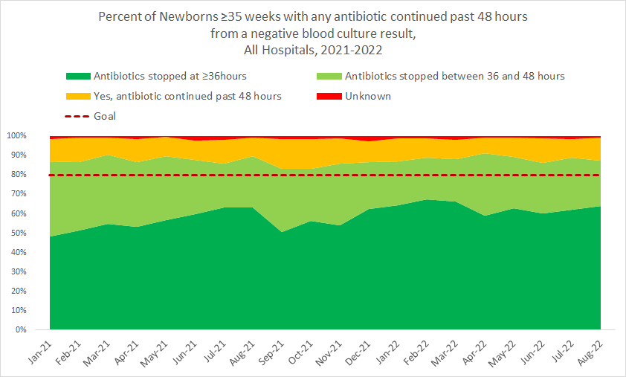
BASIC Work still Needed: Newborns ≥35 weeks who received antibiotics stopped with negative BC
64%
47%
In Q2 & Q3 2022, 35 of 59 (66%) teams had 80% or more of newborns with a negative BC with abx stopped by 36 hrs
Notes:
Add 80% line to right graph

Slide 9
Why a 36 hour rule-out?
The evidence

Slide 10
Antibiotic disruption of the microbiome
Following even a single dose of antibacterial therapy, there is a significant loss of number and diversity of bacteria in the gut
This “dysbiosis” takes weeks to months to recover from
Similar effects seen in the lung and cutaneous microbiome

Slide 11
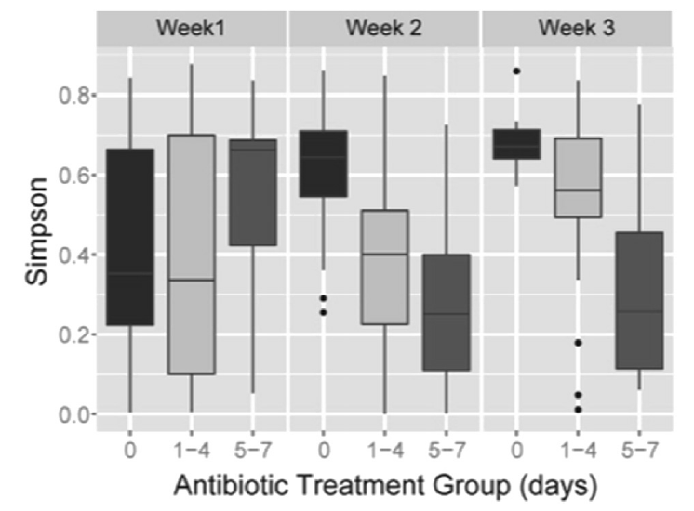
Antibiotic Effects on Gut Microbiome
Greenwood et al, J Pediatr 2014
Stool samples collected from 74 infants ≤32 weeks gestation
Infants stratified by initial antibiotic duration (0, 1-4, ≥5 days)
Higher proportion of Proteobacteria and less microbiome diversity (Simpson index) in infants who received antibiotics

Slide 12
Antibiotic Effects on Gut Microbiome
Rooney et al, Clin Infect Dis 2019
16S rRNA sequencing of stool swabs collected from 72 NICU infants after completing antimicrobial therapy
Most infants received ampicillin and an aminoglycoside
Each additional day of antibiotics reduced richness and diversity of anaerobes (RR 0.84 [95% CI 0.73-0.95])

Slide 13
Adverse Effects on Lung Microbiome
Lohmann et al, Pediatr Res 2014
Serial tracheal samples from infants ≤32 weeks gestation
Reduced diversity (even on day 1) = ↑ risk for BPD
Correlated with maternal and infant antibiotic exposure
Cantey et al, J Pediatr 2017
Retrospective cohort of 1140 VLBW infants receiving initial empiric therapy despite sterile blood cultures; controlled for severity of illness using CRIB-II score
In multivariate analysis, each additional antibiotic DOT was associated with:
Increased risk for BPD (OR 1.13 [95% CI 1.09-1.16]).
Increased severity level of BPD (OR 1.06 [95% CI 1.04-1.08])

Slide 14
Dysbiosis
This loss of diversity is associated with a variety of adverse outcomes even in term newborns
Increased risk for Candida colonization/infection
Saiman et al, PIDJ 2001
Cotten et al, Pediatrics 2006
Lee et al, PIDJ 2012
Increased risk for colonization/infection with multi-drug resistant organisms
de Man et al, Lancet 2000
Carr et al, Arch Dis Child Fetal Neonatal Ed 2017
Ramirez et al, Neoreviews 2019
Atopic disease (asthma, eczema)
Donovan et al, Clin Infect Dis 2019
Ni et al, BMC Pediatr 2019
Ahmadizar et al, Ped All Immunol 2017
Obesity, Metabolic Syndrome, and Diabetes
Block et al, Pediatrics 2018
Bailey et al, JAMA Pediatr 2014
Jess et al, Sci Rep 2019
Singer-Englar et al, Expert Rev Gastro Hepatol, 2019
Primary risk factor in all these studies is duration of therapy – each day increases risk

Slide 15
Mechanism - Dysbiosis

Slide 16
AAP Guidelines
“Most often, however, antibiotic therapy should be discontinued when blood cultures are sterile at 36 to 48 hours of incubation unless there is evidence of site-specific infection. Continuing empirical antibiotic therapy in response to laboratory test abnormalities alone is rarely justified, particularly among well-appearing term infants.”
“A median blood culture time to positivity of <24 hours is reported among term infants when using contemporary blood culture techniques”

Slide 17
Blood Culture Time to Positive
68% positive by 24 hours​
94% positive by 36 hours​
97% positive by 48 hours
Notes:
CHOP slides: graph showing time of positive of culture
Bacteria will start growing in bottle as soon as it enters the bottle,
Regulation: if it turns positive it HAS to be reported
Karen: FAQ slides, end of the GR slides,

Slide 18
36-Hour Rule Out
Prophylactic coverage through the 36-hour window until blood culture results are back
Not actually a treatment
Stop
before
36!
Different scenarios can occur where antibiotics are not started on time, but they can still be stopped by 36 hours

Slide 19
Scenario 1: Standard Dose
Newborn is born at 12:00 PM and NEOSC used
Blood Cultures drawn at 13:10 and antibiotics started with automatic stop time
Ampicillin dose 1 given at 13:35 (1 HOL)
Gentamicin dose 1 given at 13:55 (2 HOL)
Amp Dose 2 given 01:30 (13 HOL)
Amp Dose 3 given 13:30 (25 HOL) → Coverage through 37 hours of life
Gent Dose 2 given 14:00 (26 HOL) → Coverage through 50 hours of life

Slide 20
Scenario 2: ABX order is not written until 12 hours of life
Newborn is born at 19:30
Blood Cultures drawn at 20:15 and no antibiotics ordered
9:00 AM Day time attending determine antibiotics are needed and orders
Ampicillin dose 1 given at 9:45 (14 HOL)
Gentamicin dose 1 given at 10:15 (15 HOL) → Coverage until 39 hours of Life
Amp Dose 2 given 21:45 (26 HOL) → Coverage until 43 hours of Life
At 36 HOL blood culture comes back negative so antibiotics are discontinued and Amp Dose 3 and Gent dose 2 and NOT given

Slide 21
Scenario 3: Pharmacy forgets to send up antibiotic dose
Newborn is born at 12:00 PM
Blood Cultures drawn at 13:10 and antibiotics ordered
19:00 At change of shift, RN realizes dose was never sent from pharmacy and calls to get dose sent STAT
Ampicillin dose 1 given at 19:45 ( 7 HOL)
Gentamicin dose 1 given at 20:15 (8 HOL)
Amp Dose 2 given 07:45 ( 19 HOL)
Amp Dose 3 given at 19:45 (31 HOL) -→ Coverage through 43 hours of life
Gent Dose 3 given at 10:15 (32 HOL) → Coverage through 56 hours of life

Slide 22
Scenario 4: Newborn’s IV falls out
Newborn is born at 10:00
Blood Cultures drawn at 11:10 and antibiotics started with automatic stop time
Ampicillin dose 1 given at 11:35 (1 HOL)
Gentamicin dose 1 given at 11:55 (2 HOL)
Amp Dose 2 given 23:45 ( 19 HOL)
At (25 HOL) RN gets call from MOB that newborns IV has fallen out. RN Checks BC results and sees that blood culture has come back negative so ABX and discontinued and IV does not need to be restarted. Amp dose 3 and Gent dose 2 not given.

Slide 23
Discussion
Are there other reasons that we have not identified that can cause antibiotics to be continued beyond 36 hours?
Poll:
Why are antibiotics being continued past 36 hours at your institution?
Notes:
Provider dependent, our hospital does a 48 hour rule-out, no automatic stop times, no system in place to stop at 36 hours, no time outs, IV falls out and we continue the count, pharmacy doesn’t send abx in a timely manner, abx ordered late, culture results not updated in EMR, other
Prompt for discussion, raise hands

Slide 24
BASIC New Year's Resolution
36 is the New 48!
All babies that are not receiving a full course of antibiotics will have their antibiotics stopped by 36 hours

Slide 25
36 is the new 48
Why are we not stopping all antibiotics rule-outs at 36 hours?
Do we have buy-in of our providers and nurses for a 36 hour rule-out?
Do we have a process in place to stop antibiotics by 36 hours?
Fallout Review of all Cases that go beyond 36 hours
Talking with providers and staff
Reviewing protocols and processes
BASIC New Years Resolution
Notes:
Consultation with process flows specific to your hospital, support from ILPQC clinical leads

Slide 26
Fallout Review: Questions to Consider
How many hours past 36 hours were abx continued?
Who made the decision to continue abx?
Was there a system failure that allowed this to happen (stop time or timeout didn’t occur)
Does there seem to be any pattern in the cases?
What can we do to avoid this for the next time? (talk to provider, fix the system that failed, re-education)

Slide 27
Provider Buy-In for a 36 Hour Rule-out
Strategies
Is it all providers or a subset that lack buy-in?
All/Majority
BASIC Grand Rounds at next provider meeting
Meeting with BASIC Provider Champion, Medical Director and ILPQC Clinical Lead
A small subset or individual provider
1-1 meetings between BASIC Provider champion and resistant physicians
Notes:
Consultation with process flows specific to your hospital, support from ILPQC clinical leads

Slide 28
Provider Buy-In Strategy: Badge Card

Slide 29
Process in place to stop antibiotics by 36 hours: Automatic Stop Times and Antibiotic Time Outs
Brief team antibiotic length/plan discussion
Standardized Automatic Stop Orders
Standardized Antibiotic Timeout Workflow
Team Huddle with every baby, every time
Notes:
Why: Increase percentage of newborns with care team discussing and documenting plan for length of antibiotic course for standardization
*Paint a workflow for teams to follow
Understand the "process" for teams to follow, not just about the timeout tool (one way to get to green, not the only way)

Slide 30
Right Amount of Time: Standardized Automatic Stop Order Process
Plan: Educate team on tools, guidelines
Act: Ensure workflow sustainability
Do:
Implement pilot workflow: every baby, every time
Study: Determine if pilot workflow effective
PDSA Part 1:
Standardized Workflow/Process
Next Steps:
PDSA Part 2:
Implement Process in EMR
QI team, IT, & Pharmacy collaborate
Plan
Act
Do
Study
Notes:
Why: Increase percentage of physicians and nurses educated about early-onset sepsis (EOS) risk factors, assessment tools, and guidelines & Increase percentage of newborns with documented use of EOS risk assessment tools at delivery
*

Slide 31
BASIC Next Steps
Q & A

Slide 32
BASIC QI Support for Q3 2022 Data
ILPQC is doing outreach to teams who have a higher percentage of newborns who receive antibiotics for longer than 36 hours to offer QI Support
Teams who have a large portion of newborns who receive antibiotics for longer than 48 hours
Teams who have a large portion of newborns who receive antibiotics for between 36-48 hours
What can you expect from a QI support call?
You will meet via zoom with Alana and Ellie to have the opportunity to share your current strategies and any barriers you are facing
We will brainstorm potential solutions and strategies to help your team move to a 36 hour rule-out
Notes:
Alana please insert BASIC QI Support Plan

Slide 33
Upcoming Call Schedule
Month | Topic
January 23rd , 2022 | MLK Day, No BASIC Call
February 20th, 2022 2-3 PM | BASIC Monthly Webinar: Preparing for Sustainability
March 20th, 2022 2-3 PM | BASIC Monthly Webinar: Moving to Sustainability

Slide 34
Office Hours
Q & A

Slide 35
ILPQC 11th Annual Conference
Thursday, November 2, 2023
AND

Slide 36
Thanks to our Funders
In kind support:

