Slide 1
BASIC Monthly Teams Call: Moving to Sustainability
Monday August 21st, 2023 2:00 PM
Notes:
Breakout Sessions: getting complete data through March by April 21st, recap the gains we have made, achieving BASIC goals, here is why sustainability is important, why having a plan is important, recap of what sustainability is, here's is what ILPQC sustainability plans, round robin in breakout sessions: Where are you in your sustainability planning? What are your concerns with moving to sustainability? Give one thing you have achieved in the last month/plan to achieve in next 2 weeks to work towards sustainability? Successful strategies from past initiatives.

Slide 2
Call Overview
ILPQC Annual Conference 2023
BASIC Data Overview
BASIC Sustainability
Team Talks
Memorial Hospital Shiloh- Kelsey Dunning, BSN, RNC-LRN
Next Steps

Slide 3
Registration Coming Soon!
The Westin Chicago Lombard
Hotel Room Block Coming Soon!

Slide 4
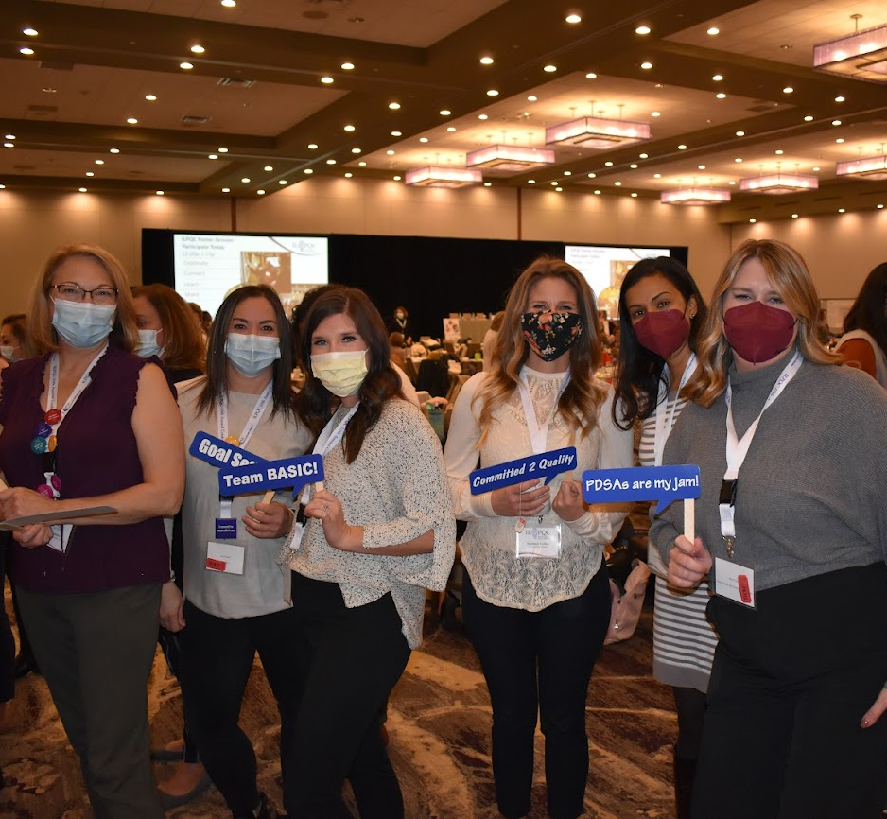
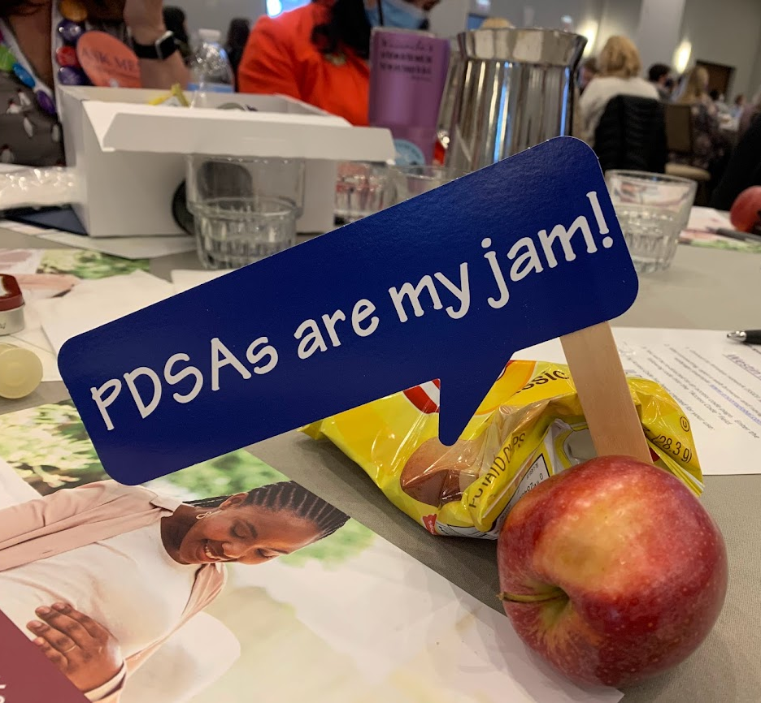
E.N.G.A.G.E. in ILPQC's Annual Conference 2023
Exchange
Network
Gain
Apply
Gather
Energize
Make sure at least one physician champion and one nurse champion are there to represent your hospital.

Slide 5
Upcoming Annual Conference Prep
Submit your Data!
Call for Abstracts!
Info coming soon! All hospital teams are asked to submit an abstract on QI work (can be in progress).
ILPQC Annual Conference Survey!
We want to hear from you! Survey opening soon!
This is a great opportunity to share your teams' thoughts & insights reflecting on 2023 and planning for 2024!
All data baseline-August 2023 will be due on September 22nd, 2023, for award consideration.
Data, Abstracts, & AC Survey due:
Friday September 22nd, 2023

Slide 6
11th Annual Conference Planning Committee Volunteers
Want to join our team to help bring the ILPQC magic to life?
Join the Annual Conference Planning Committee!
Interested? Email info@ilpqc.org

Slide 7
BASIC QI Excellence Awards
All structure & patient-level data entered for Baseline-August 2023 due September 22, 2023, at Midnight
Sustainability Plan Submitted
Key Structure Measures "In Place":
Standardized Family Education Process
EOS Risk Assessment Protocols
Standardized Dosing Guidelines
Antibiotic Discussions/Time Outs Protocol
Standardized Automatic Stop Order Process
Achievement of all process and outcome level measures (Based on June – August 2023 data)
≥80% of neonatal/pediatric providers and nurses educated
20% reduction (or absolute rate of ≤4%) in newborns ≥35 weeks who receive antibiotics
20% reduction in newborns with a negative blood culture who receive antibiotics for >48 hours
≥80% of newborns with the anticipated duration of antibiotic course discussed by clinical team (antibiotic time out)
≥80% of newborns with an automatic stop order entered into the medical chart
Annual Conference Award Criteria:
SUSTAINABILITY PLAN SUBMITTED
Data complete
Key Structure measures in place
Process/outcome measures achieved
Notes:
Hospital has implemented a process for standardized education for healthcare team on neonatal antibiotic stewardship best practices
Hospital has provided patient standardized education and anticipatory guidance with a focus on equitable care to families on antibiotics, early onset sepsis, and treatment plan for newborn antibiotics and early onset sepsis
Hospital has developed, in coordination with IT department, an electronic reporting system from electronic medical record
Hospital has Implemented Quality Improvement strategies to ensure feedback is provided to the neonatal/pediatric clinical team through one or more of the following components: 1. monitor and share provider-level and/or unit level antibiotics prescribing data; 2. antibiotic debriefs to identify & review neonatal sepsis and antibiotic decisions for consistency with protocols and procedures; 3. report that tracks current inpatient newborns who are receiving antibiotics
Hospital has implemented standardized policies, protocols, and support tools to evaluate risk for early onset sepsis for newborns for ≥ 35 0/7 weeks gestation based on the AAP recommended risk assessment tools.
Hospital has implemented standardized risk assessment algorithm to evaluate risk of early onset sepsis for every neonate < 35 weeks gestation.
Hospital has developed partnerships with obstetric team to standardize communication with the pediatric/neonatal team about maternal risk factors for early onset sepsis.
Hospital has implemented standardized serial assessment of neonates
Hospital has implemented standardized identification of and response to neonates with worsening clinical status.
Hospital has implemented standardized policies, protocols and support tools to assist staff in properly and consistently obtaining blood cultures
Hospital has partnered with inpatient lab to optimize timely processing of blood culture results and communication with care team
Hospital has implemented standardized policies, protocols and support tools to assist staff to stop or de-escalate therapy promptly based on the culture and sensitivity results
Hospital has implemented standardized dosing guidelines and order sets to reduce intra-hospital variation of antibiotic prescribing
Hospital has implemented standardized approach for healthcare team to discuss the anticipated duration of antibiotic course at the initiation of antibiotics (antibiotic time out)
Hospital has implemented standardized automatic stop order process
Hospital has implemented a standardized process to review antibiotic data by race/ethnicity and share with providers and staff.
Hospital has implemented a social determinants of health tool and facilitates coordinated connection to community resources and follow up.

Slide 8
BASIC Updates

Slide 9
What We Sought to Achieve Statewide
Decrease the number of newborns born at ≥35 weeks who receive antibiotics
Decrease number of newborns with a negative blood culture who receive antibiotics for longer than 36 hours
The Right Antibiotic for the Right Baby for the Right Length of Time

Slide 10
BASIC Data Submission Status
Sustainability Start

Slide 11
BASIC Data Results: ABX Prescribing ≥35 Weeks

Slide 12
BASIC Data Results: ABX Time Out

Slide 13
BASIC Data Results: ABX Stop Time

Slide 14
BASIC Data Results: ABX with Negative BC Stopped by 36 hours ≥35 Weeks

Slide 15
Ensuring Your BASIC Team is in Sustainability

Slide 16
Steps for Sustainability
Continue Submitting BASIC Data through 2023 in REDCap including:
BASIC Monthly Newborns Data Form
BASIC Monthly Hospital Data Form
Facilitate completion of education with all providers and nurses
Review your hospitals antibiotics prescribing rates and % of newborns with a negative blood culture receiving antibiotics past 36 hrs
Develop sustainability plan with your QI team, submit to your Perinatal Network Administrator & ILPQC (info@ilpqc.org, ellie.suse@northwestern.edu, or dweiss@northshore.org)
Continue to collect / submit BASIC data for sustained improvement tracking

Slide 17
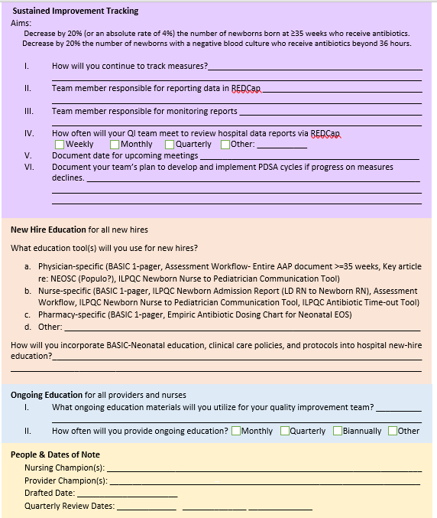
BASIC Sustainability Plan
Why is sustainability planning important?
To sustain the hard work you have put in over the last 2 years of BASIC
To ensure processes are in place to continue antibiotic stewardship best practices for all newborns
To ensure all new hires are educated on the protocols for antibiotic prescribing

Slide 18
BASIC Sustainability Plan

Slide 19
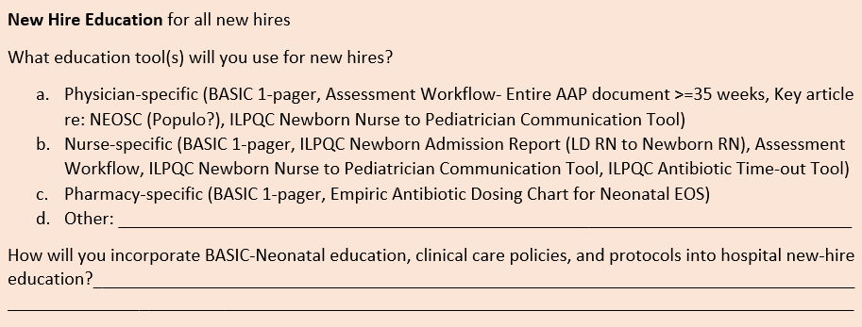
BASIC Sustainability Plan

Slide 20
BASIC Sustainability Plan

Slide 21
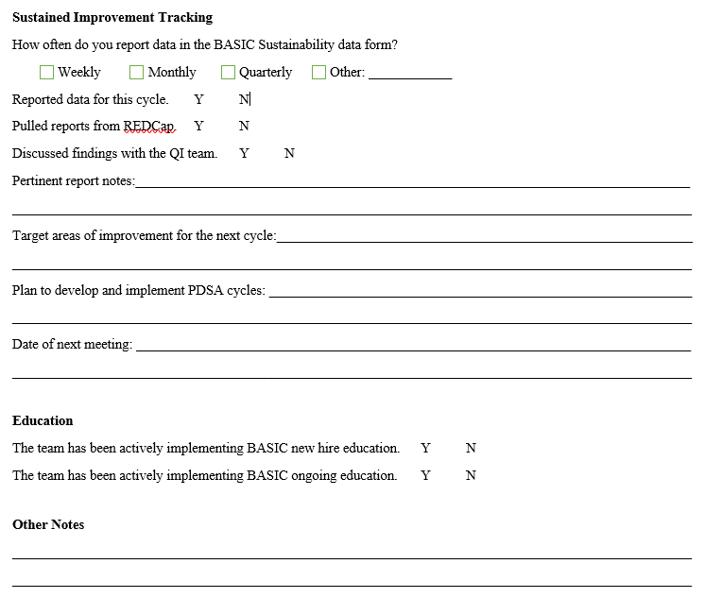
BASIC Sustainability Check-In Worksheet

Slide 22
BASIC Sustainability Form Key Questions/Updates
Monthly Patient Data Form
Collect data for only newborns ≥35 weeks
Option to continue collecting newborns <35 week
Questions to be removed:
Zip code
Type of delivery
Presence of chorioamnionitis
Maternal GBS status
Date/time BC draw
Type of antibiotics administered
Rationale for continuing antibiotics
How was family education provided
Monthly Structure Measure Data Form
Remove structure measures, continue to track denominators for antibiotic rate

Slide 23
BASIC Team Talks
Memorial Hospital Shiloh
Rush University Children’s Hospital

Slide 24
MEMORIAL hOSPital - shiloh
BJC Healthcare
Kelsey Dunning, BSN, RNC-LRN

Slide 25
Special Care Nursery
Shiloh, IL
Level 2E – 12 Bed Unit
16 LDRP Beds
Average 1390 deliveries a year
​
​

Slide 26
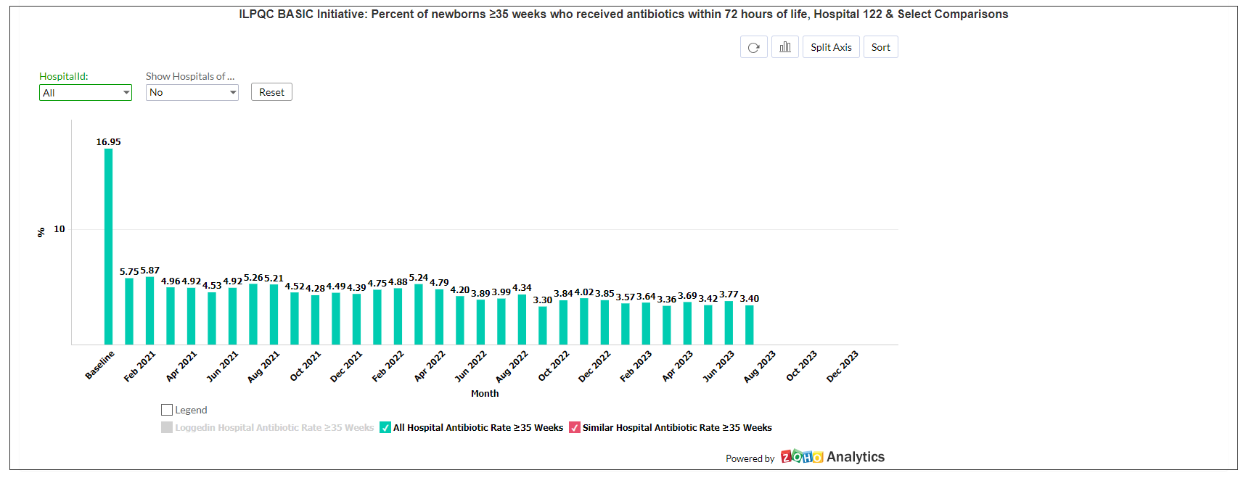
GOALS
Decrease by 20% (or absolute rate of 4%) the number of newborns, born at ≥35 weeks who receive antibiotics

Slide 27
GOALS
Decrease by 20% the number of newborns with a negative blood culture who receive antibiotics for longer than 36 hours

Slide 28
HOW WE ACHIEVED
RN education on obtaining blood culture before antibiotics
Neonatal Early-Onset Sepsis Calculator added into EPIC Flowsheet
Automatic stop time added to physician order set
Review data in pediatrics bi-annual meeting & unit practice committee
Educated staff on changes and updates in staff meetings
Debriefings on fallouts as needed
Physician support from Medical Director & Neonatologist

Slide 29
NEW HIRE EDUCATION
PHYSICIAN
Nurse
Pharmacy
Basic 1-Pager
Newborn Sepsis Policy
Basic 1-Pager in new hire folder
Newborn Sepsis Policy included in orientation checklist to review
Empiric Antibiotic Dosing chart for Neonatal EOS
Newborn Sepsis Policy

Slide 30
Moving forward
Ongoing education
Continue to educate on any policy/protocol changes, current antibiotic rate and fall outs.
Will provide education during staff meetings.

Slide 31
Rush University Children’s Hospital
Keeping an eye on the BASICs
ILPQC BASIC Sustainability Meeting
Adelaide B. Caprio, APRN, CNS and Laura M. Seske, MD, MS
Aug 21, 2023

Slide 32
Hospital Demographics
Location
Chicago, IL
Perinatal Administrative Center (PAC)
Rush University
Perinatal Level
Level 3, Referral Institution for PAC
Birth Volume
Approximately 2400 deliveries/year

Slide 33
It’s was BASICally a success
Implemented Kaiser Neonatal Early –Onset Sepsis (EOS) Calculator
Standardized note template dot phrases to integrate “Risk Assessment” for all infants
Created new EPIC flowsheet for use of calculator data for each patient
Continued use of antibiotic time outs with standardized discussion and documentation of infants who required prolonged duration of antibiotics
Completed mandatory, interprofessional education on antibiotic stewardship
Nursing, Providers, Pharmacists
Updated EPIC order sets with automatic stop times to 36 hours
Standardized vital signs and workflow algorithms to decrease variability of practice and notification to providers
Labor & Delivery, General Newborn Care, NICU
Standardized EOS education in English and Spanish, for parents via text, e-mail and MyChart

Slide 34
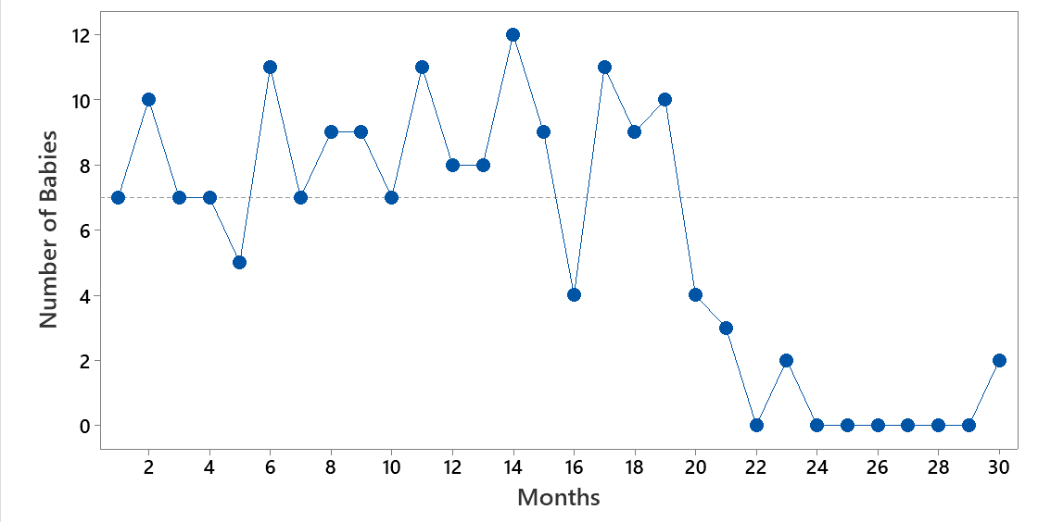
Sepsis Calculator Effect on “well-appearing” babies receiving antibiotics at RUMC
Results
Sepsis Calculator

Slide 35
Opportunities
Evaluation of antibiotics given in the absence of risk factors other than prematurity when delivery occurs purely for maternal indications
Further analysis of Social Determinants of Health and outcomes related to newborn sepsis
Continue to monitor data entry and perform data review at divisional and departmental meetings

Slide 36
Sustainability Plan
Sustained Improvement Tracking
Will continue to measure practice by submitting data via REDCaP
NICU Unit Leadership continues to collaborate with nursing students who assist with data entry
NICU CNS and Director of QI/PS monitor reports and present to NICU QI/PS meetings every other month
Automated EOS calculator and automatic stop times in EPIC aid in sustainability

Slide 37
Sustainability Plan
New Hire & Ongoing Education Plan
EOS, dot phrases, automatic stop time are part of workflow and orientation process for all disciplines
Hospital-based Antibiotic Stewardship Module (annual)
Process flow education during orientation
Review of clinical resources including family education and clinical pathways for providers
EPIC training demonstrating EOS Calculator, flowsheets, order sets, and BPAs
EOS and process flow included in NICU rotation orientation for residents and students

Slide 38
Sustainability Plan
Process to review “missed opportunities” for babies who received antibiotics longer than needed
Infectious Disease Report of antibiotics used and duration
Pharmacy to review patients with extended course
Discussion during NICU QI/PS meetings

Slide 39
Sustainability Plan
Balancing Measures
Review infants with EOS positive cultures at NICU M&M, Infection Control Meetings, and ID antibiotic exposure reports
Review infants transferred to NICU from GCN requiring sepsis evaluation

Slide 40
Our team will keep an eye on the BASICs
Denise Banton, MS, CPPS, CNL, CEFM, RNC-OB: Director 8 Atrium, L&D Units
Andrew Berenz, MD: Associate Medical Director, NICU; Interim General Care Nursery Medical Director
Adelaide Caprio, MSN, APN, ACCNS-N, RNC-NIC: Clinical Nurse Specialist, NICU
Genna Galura, Pharm D: NICU Pharmacist
Raymond Garay, APN: NICU Nurse Practitioner
Andria Hatfield, MBA, BSN, RN, CNML: Interim Unit Director – NICU
Colleen Nash, MD: Pediatric Infectious Disease
Laura Seske, MD, MS: Director of Quality Improvement, NICU
Jill Brak, Bryn Johnson, Amy Rodriguez: Data Entry Nursing Students

Slide 41
BASIC Next Steps

Slide 42
BASIC Sustainability Plans for 2023
Month | Topic
November 2nd, 2023 | ILPQC Annual Conference
November 20th, 2023 2:00 PM | BASIC Sustainability Call

