Slide 1



Addressing Social Determinants of Health in the Newborn Setting
Meg Parker, MD MPH
Professor of Pediatrics
Academic Chief of Neonatology
UMass Chan School of Medicine, UMass Memorial Medical Center
Vanderbilt Neonatology Symposium
November 2023

Slide 2
Disclosures
I have no conflicts of interest.
Meg Parker contact info:
Email: Margaret.parker@umassmemorial.org
Twitter: @Meg_Parker_MD

Slide 3
Topics
Sleep practices among preterm infants
Addressing social determinants of health in the NICU
AAP Discharge Videos- Example safe sleep!

Slide 4

Study of Attitudes and Factors Effecting PREterm infant care Practices
NICHD 1R01HD095060
PIs: Margaret Parker/ Sunah Hwang
2018-2024

Slide 5
Preliminary SAFE PREP Results
Currently in a No Cost Extension Year (end April 2025)
Sites
  29 sites across US
Fall 2023 Prelim results
Currently 1019 consented and completed baseline survey at NICU discharge
883 completed 4-8 week survey (87% Follow Up)
838 completed 4-6 month survey (82% Follow Up)

Slide 6
Preliminary Unweighted Results data pull July 2023
Maternal Characteristics | Overall | <29 wks | 29-33 wks | 34-36 wks
N | 877 | 258 | 292 | 327
US Born | 86% | 81% | 87% | 88%
Race/ethnicity
Non-Hispanic Black | 16% | 22% | 15% | 11%
Non-Hispanic White | 46% | 35% | 51% | 51%
Hispanic Any Race | 24% | 28% | 21% | 24%
High School of GED | 23% | 23% | 25% | 22%
WIC eligible | 46% | 53% | 46% | 41%
Language spoken at home
English | 89% | 86% | 91% | 91%
Spanish | 8% | 9% | 8% | 8%

Slide 7
Preliminary Unweighted Results data pull July 2023
Maternal Characteristics | Overall | <29 wks | 29-33 wks | 34-36 wks
N | 877 | 258 | 292 | 327
US Born | 86% | 81% | 87% | 88%
Race/ethnicity
Non-Hispanic Black | 16% | 22% | 15% | 11%
Non-Hispanic White | 46% | 35% | 51% | 51%
Hispanic Any Race | 24% | 28% | 21% | 24%
High School of GED | 23% | 23% | 25% | 22%
WIC eligible | 46% | 53% | 46% | 41%
Language spoken at home
English | 89% | 86% | 91% | 91%
Spanish | 8% | 9% | 8% | 8%

Slide 12
Preliminary Data on What Mothers Observed in the NICU
What mothers saw in NICU in last week of hospitalization | %
Infant in an exclusively supine position | 35%
Loose objects present in sleep space | 64%

Slide 13
Addressing Social Determinants of Health in the NICU Using a Statewide QI Model
Where did this start?

Slide 14
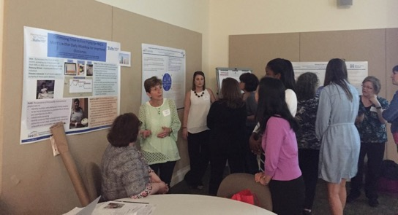
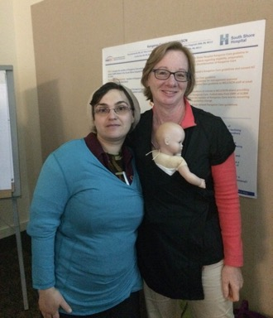
MA Statewide Human Milk Project 2015-2017
Goals: Among VLBW infants in MA:
1) Increase any/exclusive mother’s milk at discharge
2) Reduce racial/ethnic disparities in provision of mother’s milk
Funding: Kellogg Foundation

Slide 15
MA Human Milk Project Results
p = 0.43
p = 0.76
p = 0.08
p = 0.002
p = <0.001
p = <0.001
p = <0.001
Racial/ethnic disparities emerged after day 21
Parker et al, Pediatrics 2019

Slide 16
What did we do next?
Qualitative interviews of Black and Hispanic mothers
Examination of family engagement practices across centers

Slide 17
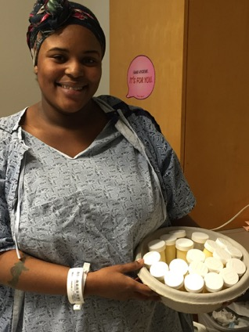
Qualitative Interviews with Black and Hispanic Mothers
Logistical challenges to mother-infant separation are enormous
  Transportation, parking
Hospital providers are an important source of support when:
  Sufficient time is spent
  Interactions perceived as unbiased
  Communication in primary language
Parker et al. Breastfeeding Medicine, 2018

Slide 18
Exemplar Quotes
Financial Challenges:
  “I spent so much of my money on cabs, coming back and forth to the hospital, and I had to space out the times. I didn’t have the money to go back and forth. I think that’s the worst part of them being in the hospital, it’s transportation. That’s it.”
Language
  “sometimes, out of fear or shame, you don’t tell them, okay I need an interpreter”
Bias:
  “The manners were bad from the moment I arrived, because I felt they treated me not like the patient I was supposed to be… they didn’t treat me the way they should have. I wasn’t asking to be treated differently, or to be exclusive, but to be treated like everyone else.”
  “Being there [in the NICU], I didn’t feel like color mattered. It doesn’t matter, being here. I’ve been on other units… and color matters, you know?”

Slide 19
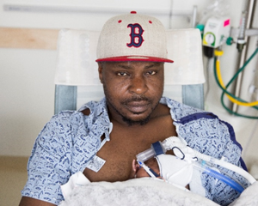

Family Engagement Practice Survey
Major variation in:
  Sibling and non-sibling child visitation
  Presence of family support meetings
    (No hospital offered this routinely in Spanish)
  Meals for breastfeeding or non-breastfeeding mothers
  Parking costs
  Interpreter services

Slide 20

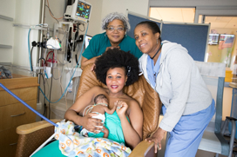
Next Steps
New MA statewide QI project focused on family engagement and social disparities from 2020-2023
  Emphasis:
    Addressing social determinants of health
    Addressing timely, equitable communication
      English and non-English speaking families
    Highlighting the experiences of diverse families
    Develop multi-lingual, multi-cultural discharge videos in family voice
  PNQIN support for anti-bias training in perinatal care settings
Funding: Kellogg Foundation

Slide 21
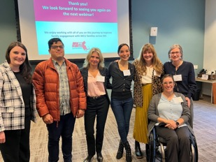
Main Finding Among 8 MA Level 2 and 3 NICUs that Collected Data from 2021-2022
Acknowledgements
Molly Wyllie
Nicole Lomerson
Gaby Cordova Ramos
Aviel Peaceman
Zuzana Kubicka

Slide 22
What are Social Determinants of Health?
Definition from US Department of Health and Human Services, Health People 2030:
SDH are the conditions in the environments where people are born, live, learn, work, play, worship, and age that affect a wide range of health, functioning, and quality of life outcomes and risks
Examples: housing, transportation, education, access to food
https://health.gov/healthypeople/objectives-and-data/social-determinants-health

Slide 23
Why are SDH Important?
SDH impact people’s health, well-being and quality of life
SDH contribute to health inequities
SDH that start in childhood have impact across the lifespan
A note on terms for adverse SDH
-Social risks
-Unmet needs
-Unmet basic needs
-Hardships
-Health related social needs
-Social drivers of health

Slide 24
Adverse Social Risks are Common Among Families with Preterm Children
N=25,675; US Children 0-3 years, 2016-2019
 | Term | Preterm
 | ≥ 37 weeks & >2500 g | 1500 -2500 g | <1500 g | P-value
Weighted % | 93.4% | 5.1% | 1.5%
Race/ethnicity
NHW | 55.5% | 46.8% | 39.0% | 0.04
NHB | 9.8% | 13.2% | 18.9%
Hispanic | 22.2% | 23.6% | 20.5%
Low income (<200% FPL) | 38.6% | 44.1% | 47.1% | 0.04
Social risks in past year
Food insufficiency | 28.5% | 28.3% | 41.5% | 0.03
Financial hardship (covering food/housing) | 18.8% | 19.6% | 40.5% | <0.001
Difficulty paying bills | 14.0% | 17.9% | 47.9% | <0.001
National Survey of Child Health- Maternal Child Health Bureau (CDC)
Cordova-Ramos et al. Academic Pediatrics
Similar findings in Parker et al. Journal of Perinatology, using Children’s HealthWatch Data

Slide 25
Adverse Social Risks are Associated with Worse Outcomes Among Preterm Children
Childrens HealthWatch Data from 5 US Cities; 695 VLBW Children 0-3 years
 | Developmental Risk (≥ 1 Concern) | Child Health Status (Fair/Poor Health;) | Post-neonatal Hospitalizations (≥ 1)
 | Adjusted OR (95% CI)
Housing instability | 1.26 (0.83, 1.92) | 1.24 (0.83, 1.87) | 1.57 (1.09, 2.27)
Energy insecurity | 1.08 (0.68, 1.70) | 1.16 (0.75, 1.81) | 1.19 (0.80, 1.78)
Household food insecurity | 1.13 (0.73, 1.73) | 1.61 (1.07, 2.42) | 1.28 (0.88, 1.85)
Healthcare hardships | 1.91 (1.28, 2.85) | 1.43 (0.97, 2.11) | 1.27 (0.90, 1.79)
# of hardships 0 1 hardships 2+ hardships | Ref 2.00 (1.26, 3.17) 1.85 (1.18, 2.91) | Ref 1.35 (0.85, 2.13) 1.59 (1.02, 2.49) | Ref 1.12 (0.76, 1.66) 1.49 (1.00, 2.20)
Adjusted for site, maternal age, race/ethnicity, education, country of birth, marital status, any breastfeeding
Higher odds of developmental risk, fair/poor health status and post-neonatal hospitalizations among households with 2+ hardships
Parker et al, Journal of Perinatology, 2022

Slide 26
Addressing Social Risks in the Clinical Setting is a Priority
Many professional organizations endorse social risk screening and referral to community resources
  National Academy of Medicine
  Centers for Medicaid and Medicare Services
  American Academy of Pediatrics
AAP Policy Statement 2016, 2021: Poverty and Child Health in the US
Recommendation: Screen and refer for SDH during patient encounters

Slide 27
Summary of regulatory requirements
Joint Commission | Centers for Medicare and Medicaid Services (CMS)
The medical record contains information about the patient’s health-related social needs (HRSNs) At a minimum, this includes: Difficulty paying for prescriptions or medical bills Food insecurity Housing insecurity Interpersonal safety | Screening for Social Drivers of Health: This measure assesses whether a hospital implements screening for all patients who are 18 years or older at time of admission for food insecurity, housing instability, transportation needs, utility difficulties and interpersonal safety. To report on this measure hospitals will provide: The number of patients admitted to the hospital who are 18 years or older at time of admission and who are screened for the five HRSNs; and The total number of patients who are admitted to the hospital who are 18 years or older at time of admission
CMS measures are optional for 2023 and mandatory for 2024

Slide 28
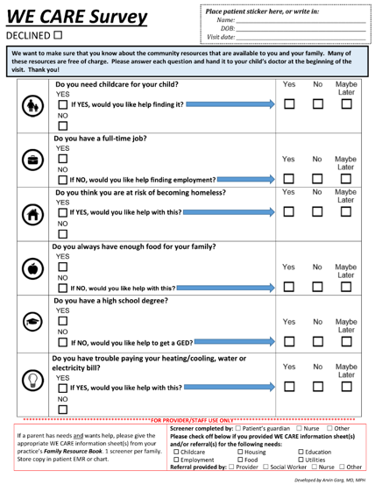
Evidence for Social Risk Screening and Referral in Pediatric Settings
Example of Social Risk Screener
“WE CARE”
Garg, A, et al. Addressing social determinants of health at well child care visits: a cluster RCT; Pediatrics 2015
Increased receipt of resources by 15% in 3 months

Slide 29
Standardized Social Risk Screening in U.S. NICUs
2021 national survey of level 2-4 NICUs across 5 U.S. regions (n=170 respondents)
23% reported standardized processes for social screening and referral
Processes in NICUs with standardized screening & referral
TOOL TYPE: All social screening tools were multi-domain. Most often tools developed by personnel in the unit (35%)
SCREENING PROVIDER: Type of screening provider (all that apply): Social worker (92%), Nurses (26%), Physician or APP (15%).
TIMING OF SCREENING: Within the 1-2 weeks of admission (84%)
REFERRAL PROCEDURES: Social work consultation (94%), referral to community resources (80%)
Cordova-Ramos et al. National Prevalence of Social Determinants of Health Screening Among US NICUs. Hospital Pediatrics 2022

Slide 30

PNQIN Family Engagement Project:
Boston Medical Center Implementation of Social Risk Screening and Referral
Aim: Increase standardized social determinants of health screening of eligible NICU families using the THRIVE tool from 0% to 60% by December 31, 2021.
Eligible families: Predicted or actual NICU stay 7+ days
Setting: Boston Medical Center
  Level 3 NICU, academic, urban, safety net hospital.
  ~2800 annual births, 22 NICU beds
  ~80% public insurance, ~50% non-Hispanic Black, ~25% Hispanic, ~15% non-Hispanic White
  1.0 FTE social work coverage for the NICU, labor and delivery and post-partum area
Cordova Ramos et al. Pediatrics, 2023

Slide 31
Summary of Steps
Chose and adapted a social risk screening tool and embedded into the EMR
Developed and maintained a community resource guide
Implemented a social screening and referral system into NICU work flow using plan-do-study-act cycles

Slide 32
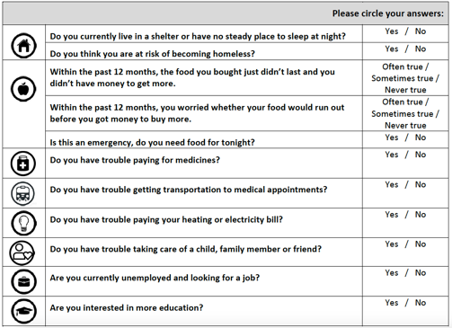
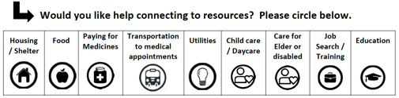
Step 1: THRIVE SDH Screener

Slide 33
Adaptations to THRIVE SDH Screener Examples
Do you have trouble getting transportation for medical appointments? | Yes No
Do you need support getting transportation to or from the NICU? (Examples: paying for parking, getting a taxi ride, shuttle services) | Yes No
Are you interested in more education? | Yes No
Do you need support getting more education for you or anyone in your house? (Examples: obtaining GED, English as second language classes) | Yes No

Slide 34
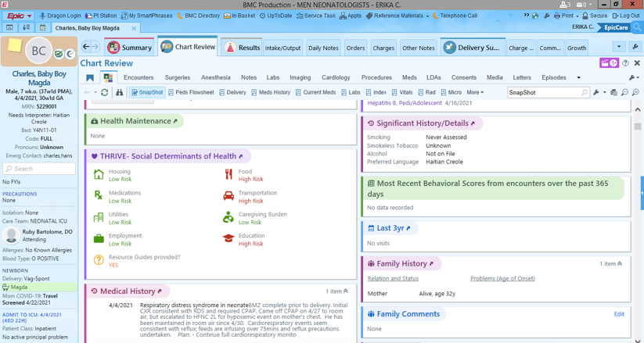
Integration into EMR

Slide 35
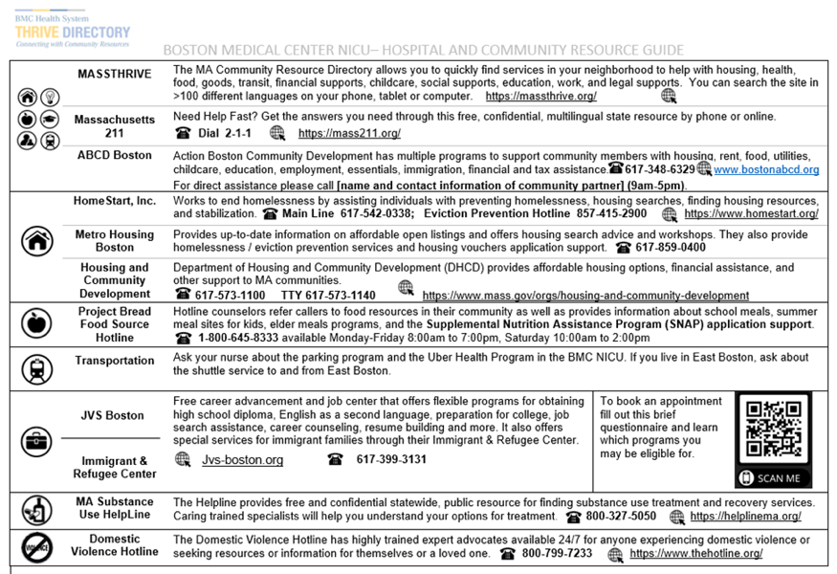
Step 2. Resource Guide
Translated into 5-6 languages

Slide 36
Step 3. Integrate SDH Screening and Referral into NICU Work Flow
Step 1
Parent/caregiver eligibility: expected or actual infant LOS 7+ days
“Appropriate” time to perform screener within 10 days of admission
Step 2
Introduction of screener, explanation of why, assurance of confidentiality, option to decline
Questions are verbally asked in structured conversation format
Screener records answers in EPIC
Step 3
Families who screen positive and request assistance receive resource guide
SW paged for immediate needs
Weekly discussion of screening findings in SW rounds (Tuesdays)
Determination of eligibility and timing
Provide resource guide and discuss with SW
Perform THRIVE screening

Slide 37
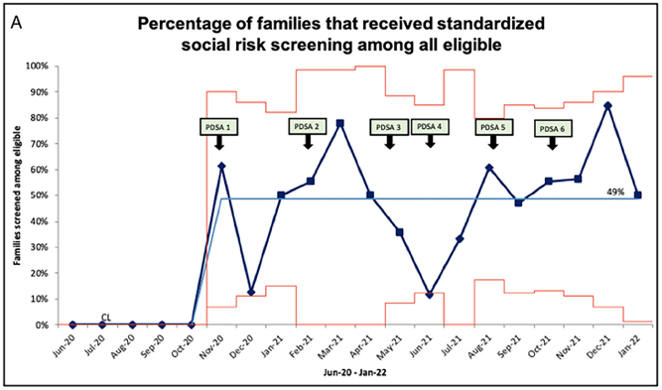
Results: Social Risk Screening Among Eligible NICU Families at BMC
PDSAs focused on increasing nursing staff training to conduct screeners and optimizing resource connection
No difference in screening by parental race/ethnicity or language
No family declined

Slide 38
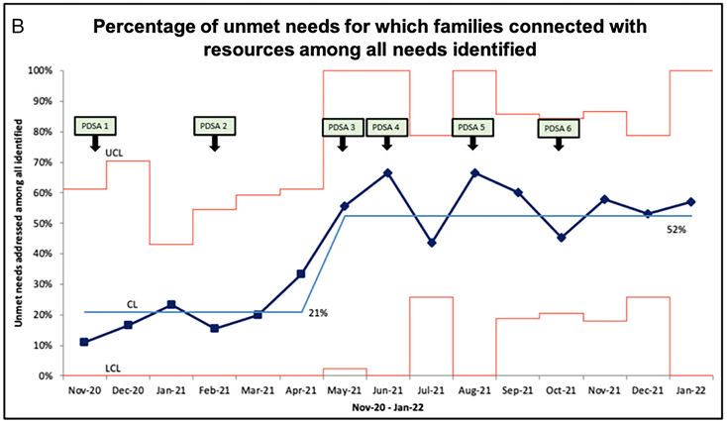
Connection with Resources

Slide 39
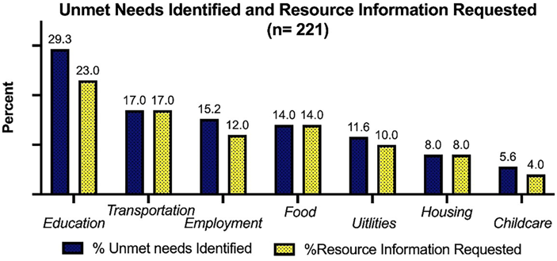
Social Risks Identified and Desired Assistance
84% of families with 1+ need
64% of families with 2+ needs

Slide 40

PNQIN SDOH NICU QI Collaborative
Perinatal Quality Collaborative CDC grant
October 2022-September 2027
Year 1: Oct 2022-Sept 2023
5 Safety-net NICUs in MA
Co-Leads: Meg Parker and Gaby Cordova Ramos
CDC Perinatal Quality Collaborative grant (PI Diop)

Slide 41
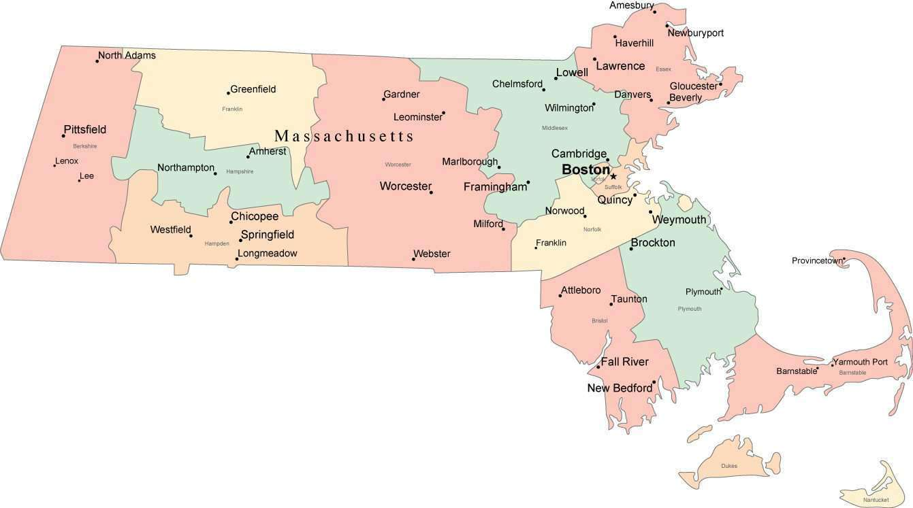
Year 1 Cohort: 9/30/22-9/29/23
Lowell General Hospital
Level 3, Lowell
Baystate Medical Center
Level 3, Springfield
Boston Medical Center
Level 3, Boston
Tufts Medical Center
Level 3, Boston
UMass Medical Center
Level 3, Worcester

Slide 42
Same General Steps
Chose and adapt a social risk screening tool and embed into EMR
Develop and maintain a community resource guide
Implemented a social screening and referral system into NICU work flow using plan-do-study-act cycles
Findings Year 1:
All sites chose to implement using an interview format as part of the routine social work assessment at the beginning of admission
Creating the resource guide “wasn’t too big of a lift”
Integration into EMR really hard for some
Major buy-in
** We were able to give teams some funds to support their efforts for first time in PNQIN history!!!
** ”Smaller cohort” design really worked well

Slide 43
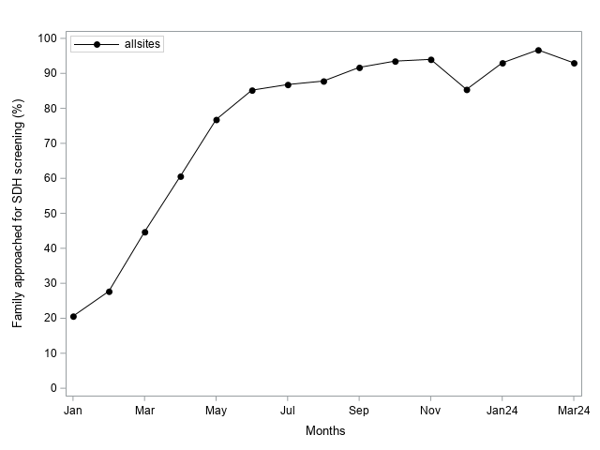
Percent of Eligible Families with SDOH Screening and Referral Among 5 Safety-Net NICUs in MA; 01/2023-03/2024; n = 1369

Slide 44
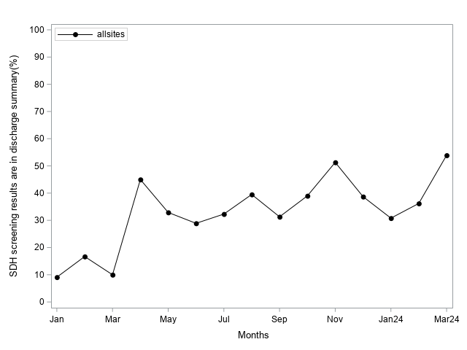
Percent of Eligible Families with SDOH Screening and Referral Documented in the Discharge Summary Among 5 Safety-Net NICUs in MA; 01/23-3/24; n = 1369

Slide 46
What has emerged at the local level?
Huge increase in awareness of social risks, parental desired needs, and community resources at local staff and hospital level
Uber/Lyft programs for families
Expansion of food services
Material goods for infant care
BMC: received grant for dual peer lactation counselor and SDOH navigator

Slide 47


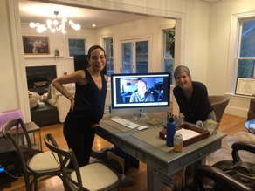
Next steps of the PNQIN SDOH NICU QI collaborative
Currently in the middle of cohort 2
Recruiting for cohort 3
Harmonize with similar efforts on L&D and Postpartum
“How To” guides for NICU Implementation of SDOH Screening
Vermont Oxford Network
https://public.vtoxford.org/health-equity/

Slide 48
But does addressing SDOH actually improve health outcomes for high-risk neonates?
What are the best ways to integrate SDOH Screening and Referral in my NICU?

Slide 49
Hybrid Implementation-Effectiveness SDH NICU Study
NICHD R01 HD104772-01 Parker/Garg/Dranoini
Implementation outcomes: feasibility, acceptability, penetration, equity, sustainability
Effectiveness outcomes:
  Receipt of community resources
  Maternal depression, family coping, preterm infant respiratory, nutrition and developmental health outcomes and healthcare utilization
8 Safety-Net NICUs
  West: Univ of Southern California and Denver Health
  Midwest: Univ of Cincinnati and Wayne State
  South: Univ of Florida Jacksonville and Univ of Mississippi
  Northeast: Temple and Montefiore

Slide 50
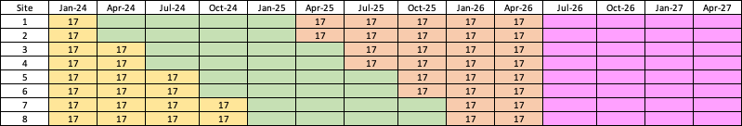
Stepped Wedge Cluster RCT Design
 | "Pre" SDOH Data Collection
 | SDOH Implementation
 | "Post" SDOH Data Collection
 | 12 Month Follow-up

Slide 51
Social Risk Screening and Referral in the NICU Setting Pearls
Social risk screening and referral to community resources is increasingly becoming standardized care
The NICU is the “medical home” for families for weeks to months
Social risk screening and referral is now moving from out-patient to in-patient setting; this requires adaption of past implementation approaches
No screening for sake of screening! It is important to offer thoughtful, vetted community resources and help families
Social risk screening and referral to community resources is NEVER meant to replace the important role that social workers play in our NICU; it is meant to augment their role

Slide 52

The Role of Family Partners

Slide 53
Family Discharge Videos
https://www.aap.org/en/community/aap-sections/sonpm/
https://www.youtube.com/playlist?list=PLKYV5259WcZ1Tf4WQ5f5GUujJOO233qXL

Slide 54
Acknowledgements
MA QI Leadership
Gaby Cordova Ramos
Laura Burnham
Adriana Lopera
Aviel Peaceman
Patrice Melvin
Didem Arytuk
Molly Wyllie
Zuzanna Kubicka
Nicole Lomerson
Fifi Diop
Christin Price
Munish Gupta
100s of team members!
1000s of families!
Funding
NIH R01 HD095060 Parker/Hwang
NIH R01 MD007702 Moon/Parker/Colson
NIH R01 HR011798 Agrawal/Parker/Yu
NIH R01 HD104772 Parker/Garg/Dranoini
NIH R01 HD109293 Parker/McConnell
W.K. Kellogg Foundation
Centers for Disease Control
Research Team- SDH NICU
Mari-Lynn Drainoni
Arvin Garg
Plyce Fuchu
Lindsey Simoncini
Peter Lazar
8 sites and all their teams!

Slide 55
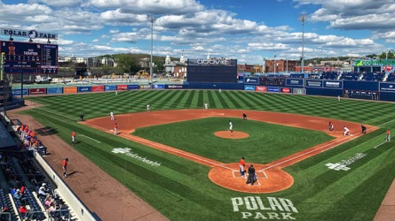


Thank You

Slide 56
How often does social risk screening and referral occur in the NICU?
Mixed Methods Study
Sequential explanatory methods
  - Chart review followed by focus groups to provide context for findings
BMC and UMass Level 3 NICUs in MA
  BMC (Boston) = 22 beds, >80% Medicaid, urban
  UMass (Worcester) = 49 beds, 50% Medicaid, urban/suburban
Parker et al. Journal of Perinatology 2020

Slide 57
Quantitative Component
Collected data on adverse SDH documented in H&Ps, discharge notes, and any social work or family meeting notes
Social risks of interest: childcare, food, housing, transportation, utilities/heat, and employment
Definitions:
  Social risks assessed: social risk mentioned ≥1 time
  Social risks identified: social risk identified ≥1 time when social risk assessed
Parker et al. Journal of Perinatology 2020

Slide 58
 | Social Risk Assessed |  | Social Risk Identified
Social Risks | n assessed/601 | % | n identified/ n assessed | %
Childcare | 17/601 | 3% | 4/17 | 24%
Food/Hunger | 42/601 | 7% | 22/42 | 52%
Housing | 227/601 | 38% | 31/227 | 25%
Transportation difficulties | 17/601 | 3% | 10/17 | 59%
Utilities (e.g., heat) | 1/601 | 0.2% | 0/1 | 0
Employment | 537/601 | 89% | 181/537 | 34%
We hypothesized that assessment of social risks was higher than what was documented; however, without a standardized screening process, assessment of social risks was likely far from universal.
Parker et al. Journal of Perinatology 2020

Slide 59
Qualitative Component
2 focus groups at each site; comprised of social workers, nurses, and physicians
We assessed:
  Current methods of assessment of social risks
  Perceived role of NICU providers to address social risks
  Perceived appropriateness and integration of a standardized screening/referral process
Parker et al. Journal of Perinatology 2020

Slide 60
Theme 1: Current methods of assessing social risks are not standardized, inconsistently performed and documented | “Everyone gets the social work consult. The problem is- what’s contained within that consult is a black box. I don't think that there is a systematic way that it happens each and every time. There’s definitely not a systematic way that it gets documented” (BMC Physician 2)
Theme 2: Addressing social risks of families is a central part of care for preterm infants | “In pediatrics, you don't treat only the patient, you end up treating the family. I think that's true here in the NICU, too, especially for the patients that are here for months and months and months.” (UMass Physician 5)
Parker et al. Journal of Perinatology 2020

Slide 61
Theme 3: Use of a standardized screening tool is feasible and beneficial
Theme 4: Some community resources are increasingly scarce; families do not always recognize the limitations of the NICU team at addressing social risks
Theme 5: Use of a social risk screening and referral system in the NICU needs to be tailored to the emotional needs of families with hospitalized infants
Theme 6: Use of a social risk screening and referral system in the NICU needs to tailored to existing NICU work flow
Parker et al. Journal of Perinatology 2020

