Slide 1
MNO-Neonatal Sustainability Call
Tuesday September 13th, 2022
1:00 pm- 2:00 pm
Notes:
Using Data to tell your Story

Slide 2
Call Overview
Annual Conference 2022 Updates
MNO-Neonatal Data Review
Illimunate Colorado: Jade Woodard and Kathi Wells, MD, FAAP
DCFS Q&A
Notes:
Data Definitions
36/48 hours
NM has a BASIC specific dashboard, going out to all the partners
Picked out specific data to share on
Listing of Reports: so people know what each report is
Highlight Key reports

Slide 3
Annual Conference Updates

Slide 4
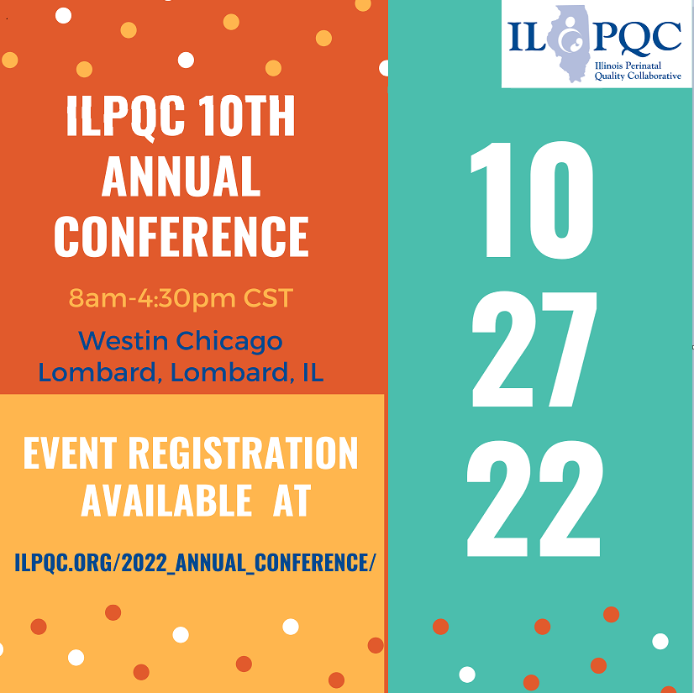
Registration Open!

Slide 5
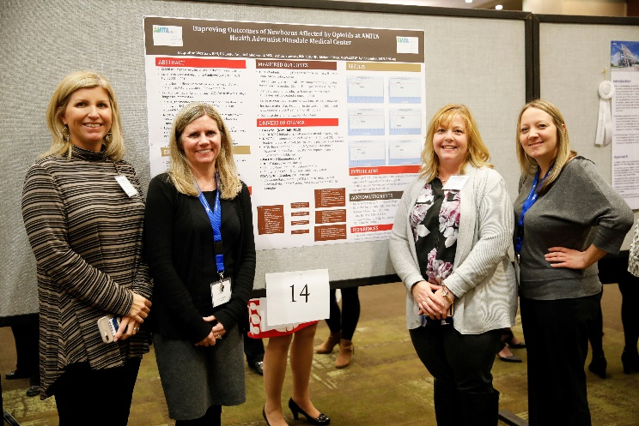
Join us
Collaborative magic.
Remember how great this was?
Make sure at least one provider champion and nursing champion are there.
Don’t miss it.

Slide 6
ILPQC 10th Annual Conference Webpage
Register here // Reserve Hotel Room // AC Teams Survey // Poster Abstract

Slide 7
Book your Stay: ILPQC Westin Room Block
ILPQC Rates available ($144/night): 10/25/2022 to 10/27/2022
Book by 10/06/2022

Slide 8
Call for Data for Award Recognitions
All Data Welcome!
MNO-OB
MNO-Neo
PVB
BASIC
BE
Review and Submit QI initiative data by Friday, September 16th to be considered for Quality Improvement Recognition

Slide 9
Call for Abstracts for AC Poster Session
All hospital teams are encouraged to submit an abstract on complete or in-progress perinatal quality improvement (QI) work.
Abstract briefly describes your QI work and is foundation for your poster you create to display and share at the ILPQC 10th Annual Conference Poster Session.
Abstract format (no more than 300 words overall), submit via RedCap link:
Background
Project Implementation
Results
Conclusions

Slide 10
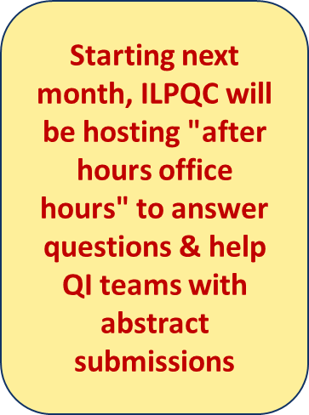
Top abstract(s) in each submission category (OB, Neonatal, and Patient/Family/Community Engagement) will receive Abstract of Excellence Awards.
Two OB and Neo abstracts will receive special recognition, one each for (1) Best Use of Data, (2) Best Project Implementation.
Notes:
Add info about printing

Slide 11
Hospital Team Annual Conference Prep
Register
Data & Awards
Submit your Annual Conference Poster Abstract by October 3rd to be considered for an award.
2022 AC Survey
Abstracts
Make sure all data Baseline-August 2022 is entered in REDCap by Sept 16th 2022
Registration open on ILPQC webpage!
Attend Event
Meet together in-person for ILPQC 10th Annual Conference at the Westin 8:00am-4:30pm
Book your hotel at the Westin in Lombard, IL
Opportunity to share thoughts & insights reflecting on 2022 & 2023 planning
Submit the survey by October 3rd
Print and bring your poster to display!

Slide 12
MNO-Neonatal Data Review
Notes:
Dan to fill in data section
How many teams are submitting data
Structure measures

Slide 13
MNO-Neo Sustainability Data Submission
Sustainability

Slide 14
OENs receiving pharmacologic treatment
Sustainability
Notes:
DAN: Add info about how many hospitals are submitting data
Add arrow for when sustainability started

Slide 15
OENs receiving maternal breastmilk
Sustainability

Slide 16
Coordinated Discharge
Sustainability

Slide 17
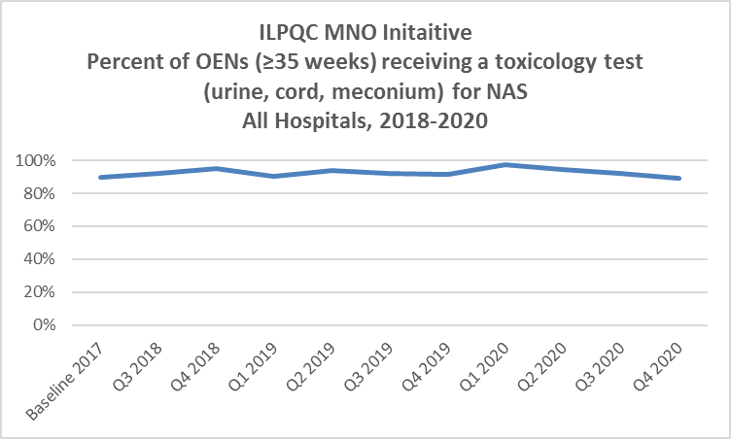
Toxicology screen for newborns by race and ethnicity
Data collection stopped 1/2021
Notes:
Newborn data

Slide 18
Infant Discharged to Mother (2018-2022)
Non-Hispanic Black: 58%
Non-Hispanic White: 66%
Hispanic: 67%
Other: 67%
Notes:
Question 42 on newborn data form by race and ethnicity (To whom was the baby discharged to)
Mother by race and ethnicity

Slide 19
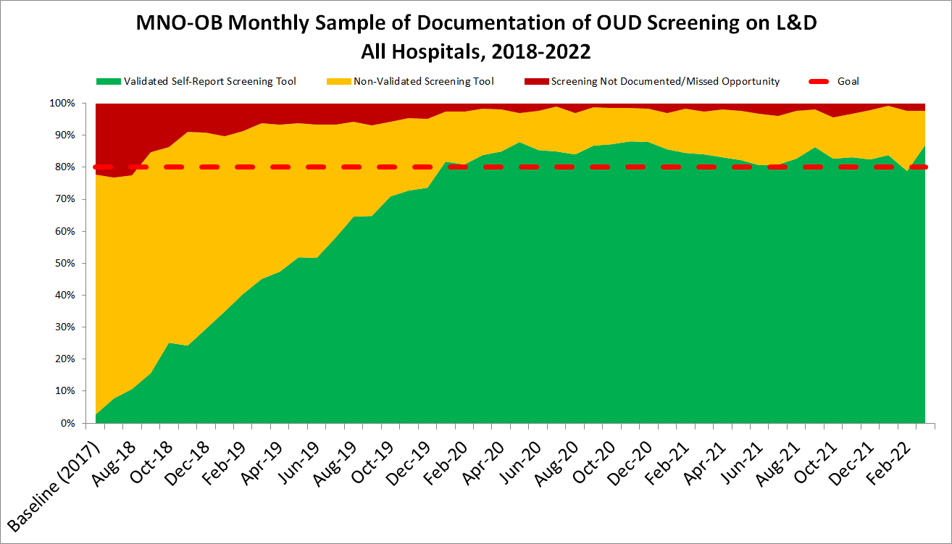
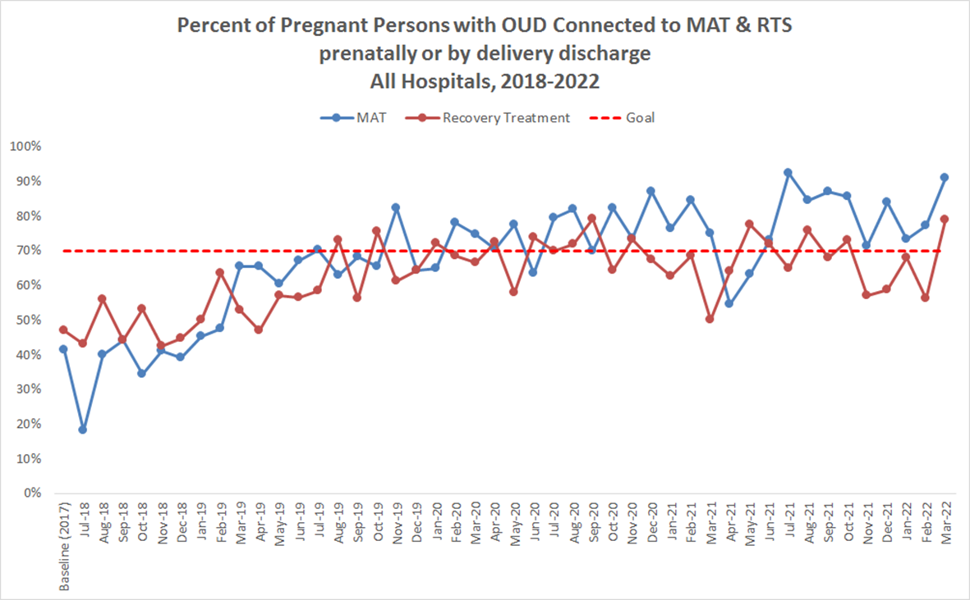
MNO-OB Data Highlights
2,753 dyads between Baseline 2017 – September 2022

Slide 20
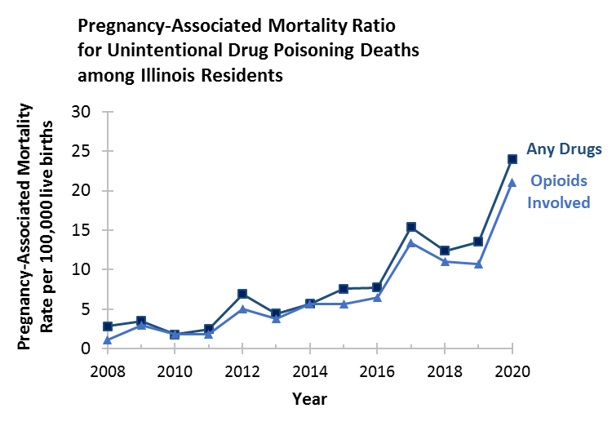
Maternal Deaths due to Opioids in Illinois
2019 – 2020:
Pregnancy-associated mortality ratio increased from 10.7 to 21.0 deaths per 100,000 live births
96% Increase!
IDPH Maternal Morbidity and Mortality report on 2016-2017 deaths, 2021; IDPH Death Certificates, 2021
Notes:
How to show increase in oud cases in 2020
Need an NAS slide or two here after this one.

Slide 21
SuPPoRT Colorado
Jade Woodard and Kathi Wells, MD, FAAP

Slide 22
Child Abuse Prevention & Treatment Act: Overview and Update
CONVENED BY:
IlluminateColorado.org
Notes:
Intros & Kathi

Slide 23
CAPTA: Overview of Current Law
Provides Federal funding and guidance to States in support of prevention, assessment, investigation, prosecution, and treatment activities and also provides grants to public agencies and nonprofit organizations
Creates federal requirements as terms for states to receive federal funds
Comprised of three titles:
Title I: General Program
Title II: Community-Based Grants for the Prevention of Child Abuse and Neglect
Title III: Certain Preventive Services Regarding Children of Homeless Families or Families at Risk ofHomelessness
Notes:
Kathi

Slide 24
CAPTA: Legislative History
More about CAPTA’s legislative history here: https://www.childwelfare.gov/pubPDFs/about.pdf
Originally enacted in 1974
Reauthorized a number of times, most recently in 2010
Due again for reauthorization
Notes:
Kathi

Slide 25
Plans of Safe Care Requirement (2003)
SEC. 114. GRANTS TO STATES FOR CHILD ABUSE AND NEGLECT PREVENTION AND TREATMENT PROGRAMS
(1) IN GENERAL.—Section 106(b) of the Child Abuse Prevention and Treatment Act (42 U.S.C. 5106a(b)) is amended— (A) in paragraph (1)(B)—
(ii) policies and procedures (including appropriate referrals to child protection service systems and for other appropriate services) to address the needs of infants born and identified as being affected by illegal substance abuse or withdrawal symptoms resulting from prenatal drug exposure, including a requirement that health care providers involved in the delivery or care of such infants notify the child protective services system of the occurrence of such condition in such infants, except that such notification shall not be construed to—
‘‘(I) establish a definition under Federal law of what constitutes child abuse; or ‘‘(II) require prosecution for any illegal action;
‘‘(iii) the development of a plan of safe care for the infant born and identified as being affected by illegal substance abuse or withdrawal symptoms;’’
(iii) in clause (iv) (as so redesignated), by inserting ‘‘risk and’’ before ‘‘safety’’(iv) ‘‘(v) triage procedures for the appropriate referral of a child not at risk of imminent harm to a community organization or voluntary preventive service;’’
“(ix) provisions to require a State to disclose confidential information to any Federal, State, or local government entity, or any agent of such entity, that has a need for such information in order to carry out its responsibilities under law to protect children from abuse and neglect;’’
Notes:
Kathi

Slide 26
Plans of Safe Care Requirement (2016)
SEC. 503. INFANT PLAN OF SAFE CARE.
(a) Best Practices for Development of Plans of Safe Care.--Section 103(b) of the Child Abuse Prevention and Treatment Act (42 U.S.C.
5104(b)) is amended-
``(5) maintain and disseminate information about the requirements of section 106(b)(2)(B)(iii) and best practice relating to the
development of plans of safe care as described in such section for infants born and identified as being affected by substance abuse
or withdrawal symptoms, or a Fetal Alcohol Spectrum Disorder;''.
(b) State Plans.--Section 106(b)(2)(B) of the Child Abuse Prevention and Treatment Act (42 U.S.C. 5106a(b)(2)(B)) is amended--
(1) in clause (ii), by striking ``illegal substance abuse''and inserting ``substance abuse''; and
(2) in clause (iii)- (A) by striking ``illegal substance abuse'' and inserting ``substance abuse''; and
(B) ``to ensure the safety and well-being of such infant following release from the care of health care providers, including through--
``(I) addressing the health and substance use disorder treatment needs of the infant and affected family or caregiver; and
``(II) the development and implementation by the State of monitoring systems regarding the implementation of such plans to
Determine whether and in what manner local entities are providing, in accordance with State requirements, referrals to and
delivery of appropriate services for the infant and affected family or caregiver''.
(c) Data Reports.--
(1) In general.--Section 106(d) of the Child Abuse Prevention and Treatment Act (42 U.S.C. 5106a(d)) is amended by adding at the
end of the following:
``(17) The number of infants--
``(A) identified under subsection (b)(2)(B)(ii);
``(B) for whom a plan of safe care was developed under subsection (b)(2)(B)(iii); and
``(C) for whom a referral was made for appropriate services, including services for the affected family or caregiver
Notes:
Kathi

Slide 27
Plans of Safe Care Requirement
2003 CAPTA Reauthorization: Establishes state responsibilities regarding prenatally exposed infants in order to receive federal CAPTA funding.
Comprehensive Addiction and Recovery Act of 2016: Modified the CAPTA State plan requirement for infants born and identified as being affected by substance use or withdrawal symptoms or fetal alcohol spectrum disorders by adding criteria to State plans to ensure the safety and well-being of infants following their release from the care of health-care providers, to address the health and substance use disorder treatment needs of the infant and affected family or caregiver, and to develop the plans of safe care for infants affected by all substance use (not just the use of illegal substances, as was the requirement prior to this change).
Substance Use-Disorder Prevention That Promotes Opioid Recovery and Treatment for Patients and Communities Act of 2018: Authorized grants to States for the purpose of assisting child welfare agencies, social services agencies, substance use disorder treatment agencies, hospitals with labor and delivery units, medical staff, public health and mental health agencies, and maternal and child health agencies to facilitate collaboration in developing, updating, implementing, and monitoring plans of safe care.
Notes:
Kathi

Slide 28
Current Statute: §5106a. (b)(2)
A State plan submitted under paragraph (1) shall contain a description of the activities that the State will carry out using amounts received under the grant to achieve the objectives of this subchapter, including—
(B) an assurance in the form of a certification by the Governor of the State that the State has in effect and is enforcing a State law, or has in effect and is operating a statewide program, relating to child abuse and neglect that includes—
(ii) policies and procedures (including appropriate referrals to child protection service systems and for other appropriate services) to address the needs of infants born with and identified as being affected by substance abuse or withdrawal symptoms resulting from prenatal drug exposure, or a Fetal Alcohol Spectrum Disorder, including a requirement that health care providers involved in the delivery or care of such infants notify the child protective services system of the occurrence of such condition in such infants, except that such notification shall not be construed to—
(I) establish a definition under Federal law of what constitutes child abuse or neglect; or
(II) require prosecution for any illegal action;
Notes:
Kathi

Slide 29
Current Statute: §5106a. (b)(2) Continued
(iii) the development of a plan of safe care for the infant born and identified as being affected by substance abuse or withdrawal symptoms, or a Fetal Alcohol Spectrum Disorder to ensure the safety and well-being of such infant following release from the care of health care providers, including through—
(I) addressing the health and substance use disorder treatment needs of the infant and affected family or caregiver; and
(II) the development and implementation by the State of monitoring systems regarding the implementation of such plans to determine whether and in what manner local entities are providing, in accordance with State requirements, referrals to and delivery of appropriate services for the infant and affected family or caregiver;
Notes:
Kathi

Slide 30
Current Statute: §5106a.
(d) Annual State data reports
Each State to which a grant is made under this section shall annually work with the Secretary to provide, to the maximum extent practicable, a report that includes the following:
(18) The number of infants—
(A) identified under subsection (b)(2)(B)(ii);
(B) for whom a plan of safe care was developed under subsection (b)(2)(B)(iii); and
(C) for whom a referral was made for appropriate services, including services for the affected family or caregiver, under subsection (b)(2)(B)(iii).
Notes:
Kathi

Slide 31
CAPTA Reauthorization
This bill revises and reauthorizes through FY2027 state and community-based child abuse and prevention grants programs, supports for adoption and foster care, and other programs addressing child abuse and neglect
The Senate version includes changes to Plans of Safe Care requirements.
Here is the current Senate version of the CAPTA reauthorization
Notes:
Jade

Slide 32
Summary of Proposed Changes related to Plans of Safe Care
If passed, the Senate version would:
Create a new title in CAPTA (e.g. a new section or "chapter" of the law) that is exclusive about "PUBLIC HEALTH RESPONSE TO INFANTS AFFECTED BY SUBSTANCE USE DISORDER" (Title IV)
Rename "plan of safe care" as a "family care plan"
Update the previous "affected by" language to be "infants born with, and identified as being affected by, substance use disorder, including alcohol use disorder; "
Require policies and procedures that support the development of a family care plan prior to the expected delivery of the infant
Require state policies and procedures for providers involved in the delivery/care of infants to notify the state
Require the development of a family care plan to include:
Family assessment approach
Coordinated service delivery of health and SUD needs of infant and affected caregiver
Development and implementation of state monitoring systems regarding the implementation of such plans to determine whether, and in what manner, local entities are providing referrals to and delivery of appropriate services for the infant and affected family member or caregiver
Require the notification system to be a separate system from child abuse and neglect reporting
Notes:
Jade

Slide 33
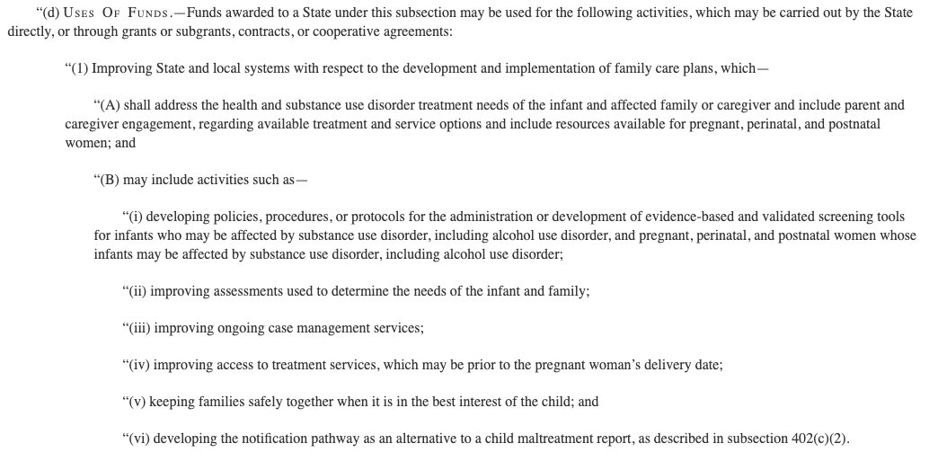
Proposed Grant Program: Allowable Uses of Grant Funding:
Notes:
Jade

Slide 34
Colorado’s Approach
SuPPoRT Colorado Plan of Safe Care Work Group
The group aims to support implementation of Plan of Safe Care at community, hospital, and county child welfare levels.
Identify and clearly communicate best practice recommendations, including how to ensure equitable implementation, how to begin Plans of SafeCare development in the prenatal period, and how to ensure a Plan of Safe Care is a living document.
Colorado Evaluation & Action Lab Policy Brief
Perinatal Navigator Program Pilot
CDHS Division of Child Welfare (DCW) Funding Opportunity
Notes:
Jade

Slide 35
Questions?
Kathryn (Kathi) Wells, MD, FAAP
Kempe Center
kathi.wells@childrenscolorado.org
Jade Woodard, MPA
Illuminate Colorado
jwoodard@illuminatecolorado.org

Slide 36
DCFS Q&A: Karen Birk

Slide 37
New Resources for MNO-Neo Teams
PediaLink Course – Recovery Friendly Care for Families Affected by Opioid Use Disorder
This new online PediaLink course from the AAP educates pediatricians about best practices in caring for and supporting families affected by opioid use and neonatal opioid withdrawal syndrome (NOWS) after discharge from the hospital and through the infants’ third birthday. Learners will identify practical approaches in ensuring children and families have access to continuous, comprehensive primary care designed to support health goals for the dyad. Course units are eligible for AMA PRA Category 1 Credit™ and Maintenance of Certification Part 2 points.
Notes:
Link Chat, newsletter and toolkit

Slide 38
New Resources for MNO-Neo Teams
Pediatrics On Call Podcast – Working to Destigmatize Substance Use Disorder
In this episode Alex R Kemper MD, FAAP, deputy director of Pediatrics, shares a research roundup from the July issue of the journal. Also invited to the discussion was Rachel Alinsky, MD, MPH, FAAP, the lead author of the recently published AAP policy statement titled, Recommended Terminology for Substance Use Disorders in the Care of Children, Adolescents, Young Adults and Families.

Slide 39
Key Resources for MNO-Neo Teams
Policy Statement – Breastfeeding and the Use of Human Milk
The AAP continues to support exclusive breastfeeding for the first 6 months of life and extends the recommended period of time to breastfeed to 2 years and more. In most cases, breastfeeding is desirable in parenting people who use opioids, as a strategy to support parent-infant bonding and mitigate the withdrawal symptoms in infants.

Slide 40
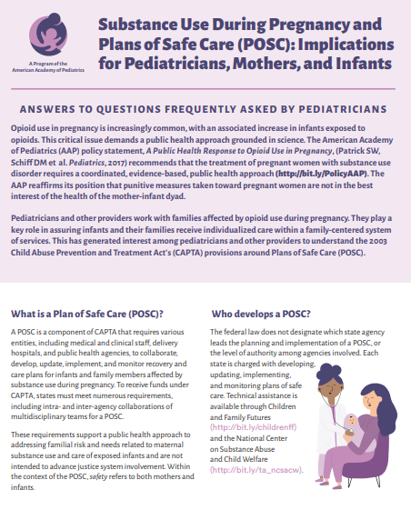
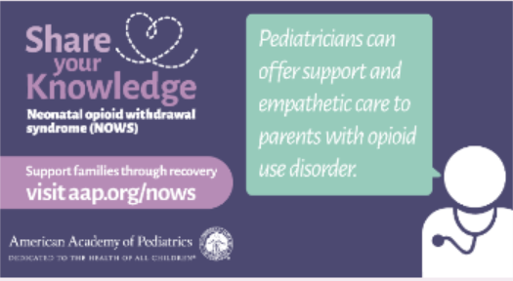
Key Resources for MNO-Neo Teams
Communication Campaign – Share Your Knowledge about Neonatal Opioid Withdrawal Syndrome
Key information for pediatricians
Sharable graphics including ad about treatment and support, family-centered care and plans of safe care

Slide 41
Upcoming Neonatal Call Schedule
Month | Topic
September 19th, 2022 2-3 PM | BASIC Monthly Webinar
October 29th, 2022 | 10th Annual Conference at the Westin Lombard
November 21st, 2022 2-3 PM | BASIC Monthly Webinar
December 19th, 2022 2-3 PM | BASIC Monthly Webinar

Slide 42
ABP MOC Part IV (BASIC & MNO)
Complete attestation forms if you are an ABP-certified physician seeking credit under MOC Part IV for 25 credits
Complete an attestation form and submit it to your project’s local leader or QI project leader for signature and send back to info@ilpqc.org by October 31st.
Attestation of Meaningful Participation in MNO-Neonatal:
Intellectually engaged in planning and executing the project
Participated in implementing the project’s interventions (the changes designed to improve care)
Regularly reviewed data in keeping with the project’s measurement plan
Collaborated in the activity by attending team meetings

Slide 43
Thanks to our Funders
In kind support:

