Slide 1

PVB Monthly Webinar: Patient Education and
Shared Decision Making
Monday, August 22nd 2022 at 12:30 PM

Slide 2
Overview:
2022 Annual Conference Information
PVB Data Review
Patient Education and Shared Decision Making
Sparrow Hospital: Tonyie Andrews-Johnson DNP, BSN, RN, C-EFM, HN-BC Director of Women's Services and Morgan Martin MHA, CPHQ, Performance Improvement Specialist
Team Talk: Deb Miller, Clinical Quality Leader, Northwestern Prentice Women’s Hospital
PVB Next Steps
PVB Office Hours
  Join us after the call to ask any questions you may have

Slide 3

Save the Date:
Calling all perinatal health care providers, nurses, allied health professionals, patient advisors and public health/community partners!

Slide 4

We are so excited for our first in-person ILPQC meeting since 2019 and our 10th Annual Conference!

Slide 5
Steps to Prepare for
2022 Annual Conference
Join the 2022 10th Annual Conference Planning Committee!
Register for conference when registration opens September 5th
Book hotel room Book your group rate for 2022 ILPQC 10th Annual Conference
  Last day to reserve with ILPQC rate: October 6th
PVB QI Excellence Award Criteria: Data submission due date – September 16
Coordinate with your team to submit your Annual Conference Survey between September 1st and October 3rd
Submit your Annual Conference Poster Abstract by October 3rd to be considered for an award (Opens Sept 1st)

Slide 6


All structure & patient-level data entered for Baseline-August 2022
  Including Race, ethnicity, and insurance status NTSV delivery data Baseline-August 2022
Key Structure Measures "In Place":
  Provider and Nurse Education
  Standardized Protocol/Processes
  Sharing un-blinded provider level NTSV C-Section rates
  Cesarean Decision Checklist
  Decision Huddles/Debriefs
  Shared Decision-Making
Due Friday, September 16th

Slide 7
Achievement of PVB aims
  ≥ 80% of Providers and Nurses educated on ACOG/SMFM guidelines
  ≥ 80% of all NTSV C-Sections meeting ACOG/SMFM guidelines
  NTSV C-Section Rate ≤23.6%
Due Friday, September 16th

Slide 8
Call for Abstracts for AC Poster Session
All hospital teams are asked to submit an abstract on QI work (can be in progress)
Abstracts submitted by Oct. 3rd will be reviewed for awards:
  Top abstract(s) in OB, Neonatal, Patient/Family Engagement, First time Level I/II Hospital receive Abstract of Excellence of Wards
  Special recognition for (1) Best Use of Data, (2) Best Project Implementation
Awarded abstracts will be announced at the conference and have a prize designation displayed on their poster
Late breaking abstracts (not eligible for awards) but posters will be shared at the conference are due Oct 10th
All abstracts are accepted- your team should plan to prepare a poster for the AC poster session
Submission link coming soon
Starting next month, ILPQC will be hosting "after hours office hours" to answer questions & help QI teams with abstract submissions

Slide 9
We want to hear from you
ILPQC will be rolling out a 2022 Annual Conference Teams Survey September 1st
This is a great opportunity to share your teams' thoughts & insights reflecting on 2022 and planning for 2023!
Please coordinate with your colleagues working across all ILPQC initiative to have one person from your hospital submit the survey by October 3rd
We typically have almost 100% of teams complete the Annual Survey! Please plan with your team who will complete and submit this important survey to share your important input to make ILPQC the best it can be for every IL birthing hospital

Slide 10
PVB Data Review

Slide 11
NTSV C-Section Rate by Race and
Ethnicity
NTSV C-Section Race and Ethnicity Data Collection:
Goal: Provide data reports to all teams with their NTSV CS rates stratified by race, ethnicity and insurance status
Bridging PVB and BE initiatives to stratify key measures to identify disparities and address them
"There is no quality without equity"

Slide 12
PVB Hospital Data that is needed to provide all teams stratified NTSV C/S data
 | Total | White | Black | Hispanic | Asian | Other
NTSV Deliveries
NTSV Cesarean Deliveries
Legend
Data already submitted
Data that must be submitted Baseline through March 2022
 | Private Insurance | Public Insurance | Uninsured/Self-pay
NTSV Deliveries
NTSV Cesarean Deliveries

Slide 13
NTSV C/S data stratified by race/ethnicity/insurance status: next steps for PVB teams
Who? All PVB Teams
What? # of NTSV Deliveries by Race/ Ethnicity and Insurance status for baseline (Quarter 4 2019) and January 2021 to March 2022
Where? Edit your past submissions for PVB Hospital level data, there is now an entry for # NTSV Deliveries by race/ethnicity and insurance status
When? Due September 16th to receive awards at Annual Conference
26 Teams have submitted all race, ethnicity and insurance data
Notes:
Confirm timeline that NTSV delivery data is needed from

Slide 14
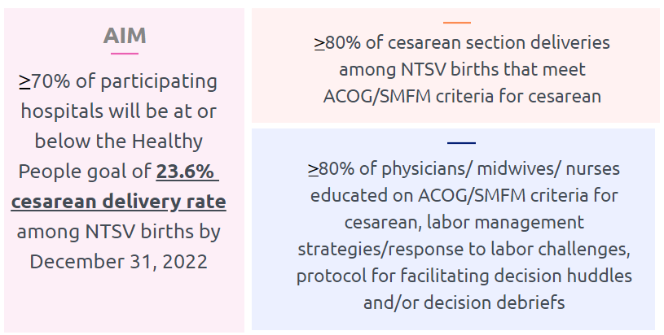
PVB Aims and Measures

Slide 15







PVB Key Strategies for
Creating Clinical Culture Change
Sharing Unblinded Provider-level NTSV C-Section Rates
Review of NTSV C-Section Cases Not Meeting ACOG/SMFM Guidelines

Slide 16
ILPQC Hospital Team Data Submission
(94 Teams Total)
Month | Patient Data | Hospital Data
Baseline | 89 | 85
January 2021 | 86 | 80
February 2021 | 85 | 80
March 2021 | 85 | 79
April 2021 | 81 | 81
May 2021 | 78 | 71
June 2021 | 71 | 71
July 2021 | 76 | 70
August 2021 | 78 | 68
September 2021 | 75 | 67
Month | Patient Data | Hospital Data
October 2021 | 74 | 67
November 2021 | 70 | 65
December 2021 | 70 | 65
January 2022 | 67 | 63
February 2022 | 66 | 63
March 2022 | 69 | 62
April 2022 | 63 | 56
May 2022 | 62 | 57
June 2022 | 53 | 48
July 2022 | 37 | 28

Slide 17
PVB Teams Progress on Key Structure Measures
On track for awards

Slide 18
ILPQC teams NTSV C-Section Rate

Slide 19
NTSV C-Section Rates, by hospital
Goal: < 23.6%
All ILPQC Average: 24%
Notes:
Would probably just share June data for this slide and the slide before as July data really hasn’t all been submitted

Slide 20
NTSV C-Section Rate Exclusion Criteria
After reviewing the NTSV C-Section definition from a variety of institutions, we have determined it is best to stay consistent with the HealthyPeople 2030 and Joint Commission PC-02 definition that many teams will need to continue to use after the PVB initiative:
  Nulliparous
  Term
  Singleton
  Vertex
  With NO exclusions for Medical Indication
Notes:
Ann, should we have teams change their past data if they were entering it incorrectly? Maybe just for the last quarter?

Slide 21
NTSV C-Sections Meeting
ACOG/SMFM Guidelines (goal > 80%)

Slide 22
Are you reviewing your ACOG / SMFM criteria fall outs? How can you reach your goal > 80% NTSV C/S meeting criteria?
Every team should review their data for ACOG / SMFM criteria regularly and be sharing the data regularly with L&D nurses and OB providers
Review fall outs that don’t meet criteria-discuss and provide feedback to clinical team
Huddles / NTSV c/s checklists should be used to review and discuss criteria and indications for cesarean.
Check how cesarean decisions are documented and why not meeting criteria? Can documentation be improved?
All team members should understand goal > 80% of NTSV C/S achieve ACOG / SMFM criteria

Slide 23
NTSV C-Sections Meeting
ACOG/SMFM Guidelines: Failed Induction
ACOG/SMFM Criteria for Failed Induction:
Oxytocin administered for at least 12-18 hours after membrane rupture, without achieving cervical change and regular contractions
Longer duration of the latent phase, 24 hours or longer if <6cm and maternal and fetal status permits

Slide 24
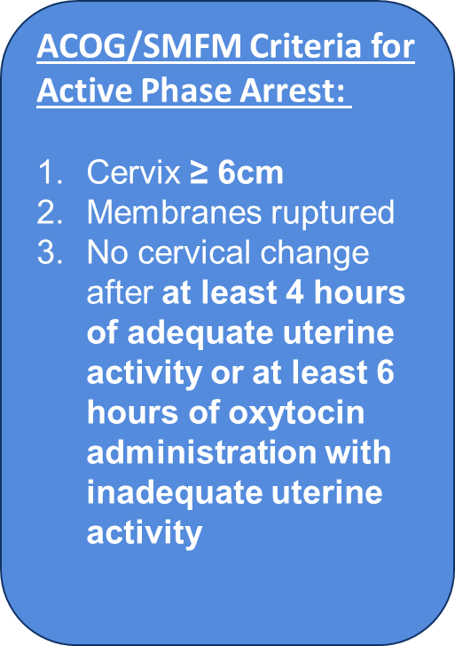
NTSV C-Sections Meeting
ACOG/SMFM Guidelines: Active Phase Arrest

Slide 25
NTSV C-Sections Meeting
ACOG/SMFM Guidelines: Second Stage Arrest
ACOG/SMFM Criteria for Second Stage Arrest:
At least 3 hours* of pushing in nulliparous patients
*Longer durations (e.g. 4 hours with epidural) may be appropriate on an individualized basis

Slide 26
Which ACOG/SMFM Criteria does your team need to focus efforts to achieve your > 80% overall goal?
Failed induction
  Oxytocin administered for at least 12-18 hours after membrane rupture, without achieving cervical change and regular contractions
  Longer duration of the latent phase, 24 hours or longer if <6cm and maternal and fetal status permits
Second stage arrest
At least 3 hours* of pushing in nulliparous patients
*Longer durations (e.g. 4 hours with epidural) may be appropriate on an individualized basis

Slide 27
Provider and Nurse Education
Keep it up!

Slide 28
Standard Protocols and Processes

Slide 29
Sharing Provider Level Data

Slide 30
Cesarean Decision Checklists and Decision Huddles/Debriefs

Slide 31
Shared Decision Making and Patient Education
Notes:
Focus for today

Slide 32
ILPQC is here to help you get across the finish line!
PVB Finish Line Goals:
QI Excellence Award
6 Key Structure Measures in Place
NTSV C-Section Rate ≤23.6%
80% of Providers and Nurses educated on ACOG/SMFM Guidelines
80% of all NTSV C-Sections Meeting ACOG/SMFM Guidelines
We are here to help!
We are here to support!
Schedule a personalized QI Support Call, email info@ilpqc.org to schedule for additional support!

Slide 33
PVB Toolkit Resources:
Patient Education and Shared Decision Making

Slide 34
Shared Decision Making requires that we provide patients with education on expectations for labor and vaginal birth
Do you have a process flow to provide all patients education on expectations in labor, and strategies to promote vaginal birth
Review the PVB Toolkit for patient education materials
Consider process flow to provide to all patients
Encourage shared decision making with patients engaged in provider / nurse / patient discussion of progress and expectations / indications to continue labor vs move to cesarean.

Slide 35
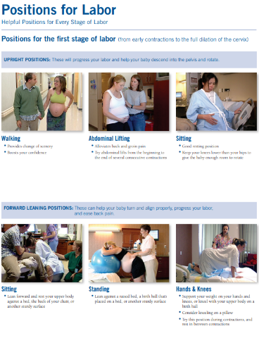
Patient Education Resources
Lamaze Keep Calm and Labor On
Lamaze Positions of Labor
FPQC Positions of Labor

Slide 36


Patient Education Resources
ACNM Am I in Labor?
Penny Simkin- Comfort in Labor
My Birth Matters

Slide 37
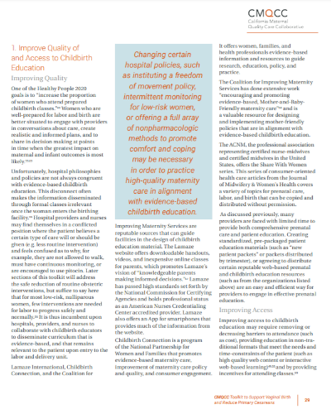
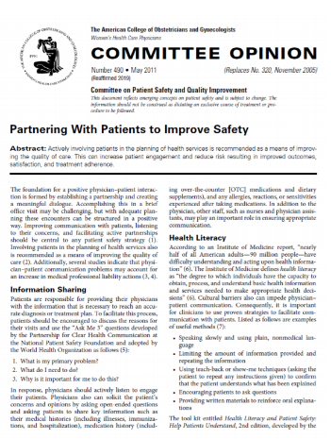
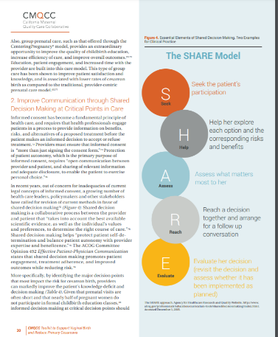
Patient-Centered Decision Making
CMQCC Patient education guidelines: the SHARE Model

Slide 38
Sparrow Hospital
Lansing, Michigan
Tonyie Andrews-Johnson DNP, BSN, RN, C-EFM, HN-BC;
Director of Women's Services
Morgan Martin MHA,CPHQ;
Performance Improvement Specialist II

Slide 39

TeamBirth
Sparrow Hospital
Tonyie Andrews-Johnson DNP, BSN, RN, C-EFM, HN-BC
Morgan Martin MHA, CPHQ
Other Team Members:
Dr. Andria Berry DO, FACOOG
Dr. Desiree Albano DO
Jennifer Thompson-Wood MSN, RNC-OB, C-EFM, ACNS-BC
Miranda Stoneman BSN, RNC-OB, C-EFM
Melissa Hass RN, C-EFM
Morgan Martin MHA, CPHQ
Shannah Ashbay RN, C-EFM
Tonyie Andrews-Johnson DNP, BSN, RN, C-EFM, HN-BC
Veronica Hazen BSN, RN

Slide 40
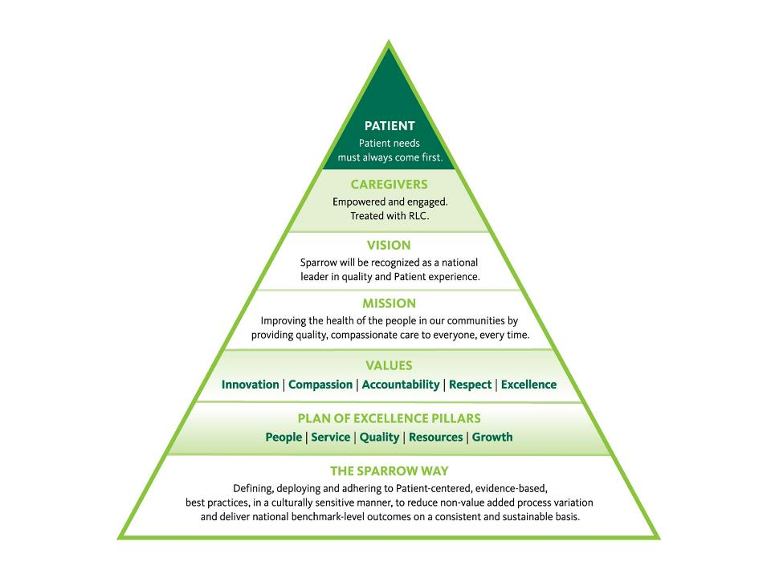
Notes:
Professional Practice Model

Slide 41
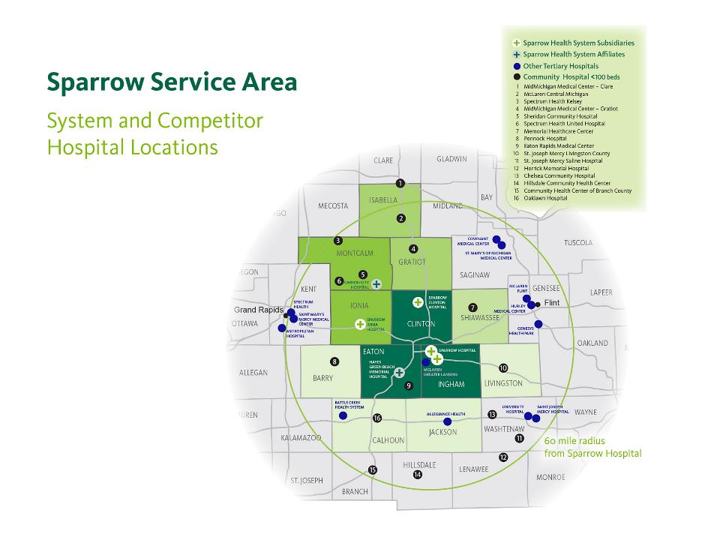
Notes:
The patient population we serve

Slide 42
Sparrow Hospital Demographics
Total annual delivery volume – 4,000
Obstetricians with delivery privileges – 37
Family Practice Physicians with delivery privileges – 8
Midwives (CNMs) – 8
Labor and delivery nurses – 118
Geographical location – Lansing, MI
Hospital size and description – 600 Bed Teaching Hospital
Level III NICU

Slide 43

TeamBirth
A collaborative, inclusive approach to patient rounding
Notes:
Communication provides a safety net

Slide 44


TeamBirth Timeline
February
April
June
March
May
RN
Introduction
Provider Introduction
Multidisciplinary
Training
Go-Live
Required
Documentation
Notes:
Discuss what education looks like
Credentialing requirements
Presented at Nursing staff meeting Feb.
Presented at Dept meeting in March
April Multidisciplinary education -> 150
Discuss what education looks like
Credentialing requirements
Start date: May 3, 2021
Core team collaboration monthly

Slide 45
Staff Education
Spring education:
Poster presentation
TeamBirth video on I-pad for caregivers to watch
Notes:
In addition:
How did we get all these providers trained?
To maintain Physician privileging requirements they come to one education session
We have a collaborative process where providers and nurses are together
TeamBirth videos also placed on the nursing L&D Facebook page
TeamBirth Background video was sent out with OB/Dept minutes

Slide 46


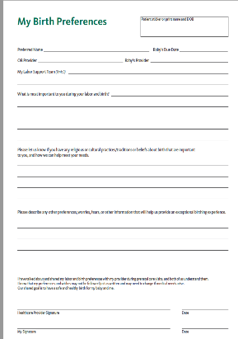

Patient Education & Expectations
Notes:
Patients are given the Labor Partnership booklet and form in all prenatal clinics.
Want patients to learn and expect they are part of the team i.e shared decision making
>90% of postpartum patients are rounded on by leadership team. They are asked if they participated in a teambirth huddle
Gradual increase in affirmative response
Share with physicians in department meetings and office managers at quarterly meetings

Slide 47

TeamBirth Huddles
Who The full direct care team, including
the person in labor and their
support
What Discuss preferences; care plans for mom, baby, and labor progress; and
expectations for next huddle
When At admission, decision points or
changes in the plan of care, or
request of any team member
Why Give all team members the opportunity to participate in shared decision-making
On the John Reminders
This Photo by Unknown Author is licensed under CC BY-NC-ND
Notes:
On the John reminders

Slide 48
Documentation
Nursing Documentation
Notes:
Here is an example of our Epic build
We added this documentation to the “required documentation” list to create an easy daily reminder of what not to miss in charting

Slide 49
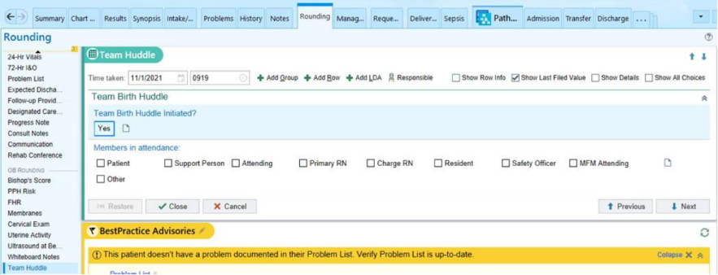
Documentation
Provider Documentation
Notes:
Here is an example of the provider documentation

Slide 50
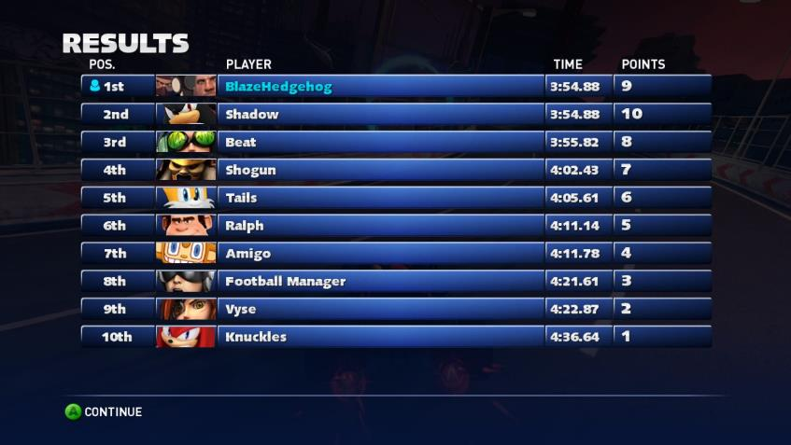
TeamBirth Competition
This Photo by Unknown Author is licensed under CC BY-SA
Notes:
On the John:
Results posted to the back of bathroom doors and
Results also sent out via e-mail in our weekly updates that are titled as “huddles”

Slide 51
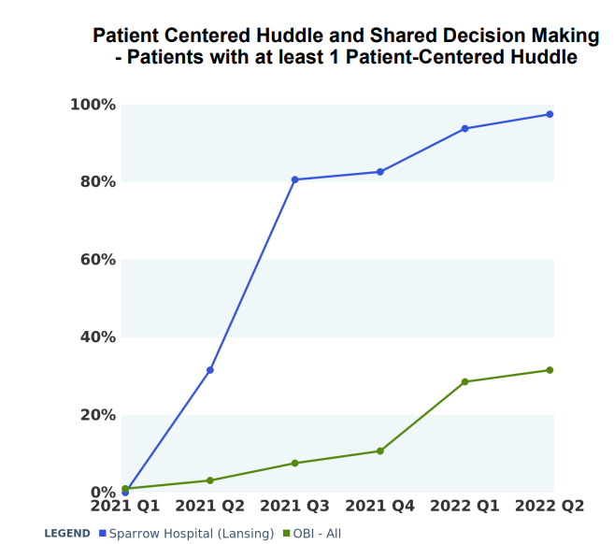
Team Birth Huddle: At Least One Prior to Delivery

Slide 52
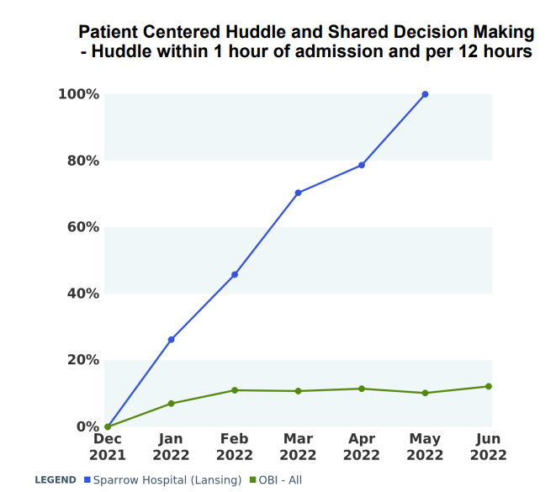
New for 2022: Team Birth Huddle On Admission AND Every Shift

Slide 53
Notes:
We had just purchased new boards prior to the TeamBirth initiative so it was not financially responsible to purchase new. We added to decals.

Slide 54
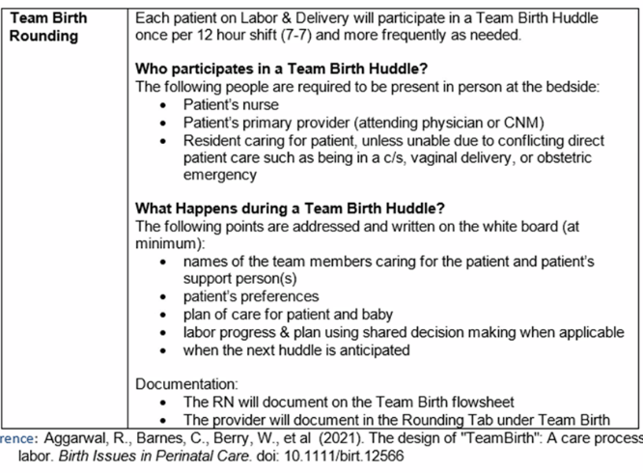
TeamBirth Policy

Slide 55

2022 Plan
Including residents
Including triage providers
Increasing huddles
This Photo by Unknown Author is licensed under CC BY-SA

Slide 56
Team Talk: Northwestern Memorial Prentice Women’s Hospital
Deb Miller, Clinical Quality Leader

Slide 57
Northwestern Memorial Hospital
Promoting Vaginal Birth Initiative
ILPQC Team Talk
August 22, 2022

Slide 58

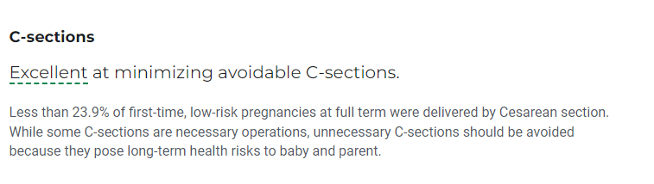
Northwestern Memorial Hospital (Prentice)
Chicago, Illinois
Level III Perinatal Center
CY 2021 Statistics
  Over 12,000 Deliveries
  28.3% Cesarean Section Rate
  23.2% NTSV Cesarean Section Rate
US News & World Report 2022-2023 Rankings

Slide 59
Structure Measure Status Updates
ILPQC Promoting Vaginal Birth Initiative
Decision Checklist
Created decision checklist
Challenges: medical legal issues with form
Huddles/
Debriefs
Huddle workflow process
Indication for Cesarean Section in Delivery Summary
Shared Decision Making
Created dot phrase to document indication and discussion with patient

Slide 60
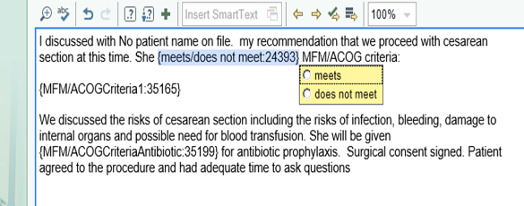
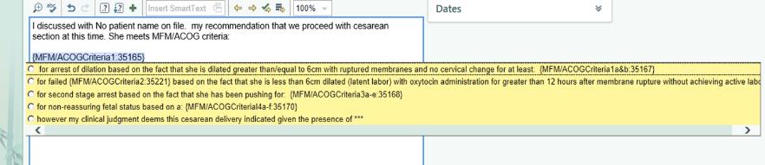
CS Pre-op Documentation
MD documents indication for cesarean in progress notes; optional dot phrase

Slide 61
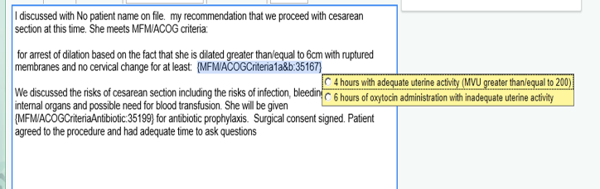
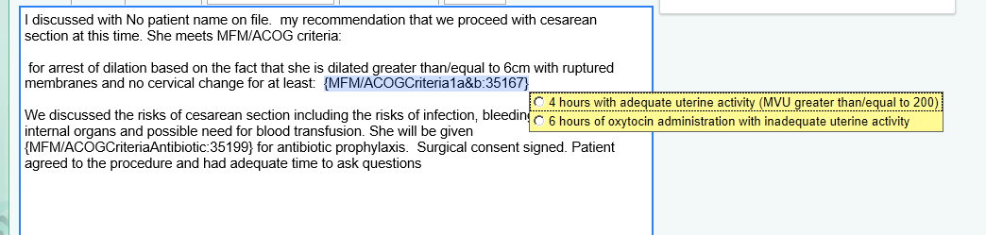
CS Pre-op Documentation
MD documents indication for cesarean in progress notes; optional dot phrase

Slide 62
Structure Measure Status Updates
ILPQC Promoting Vaginal Birth Initiative
MD and Nurse Buy-in
Grand Rounds
Education on Pushing Techniques
Patient Education
NM System Induction Brochure
Share Data
Quarterly Practice Reports (blinded practice data/ unblinded physician data)

Slide 63
NMH NTSV Cesarean Section Rates
ILPQC Promoting Vaginal Birth Initiative

Slide 64
Questions?
Thank you

Slide 65
PVB Next Steps

Slide 66
ILPQC is here to help you get across the finish line!
PVB Finish Line Goals:
QI Excellence Award
6 Key Structure Measures in Place
NTSV C-Section Rate ≤23.6%
80% of Providers and Nurses educated on ACOG/SMFM Guidelines
80% of all NTSV C-Sections Meeting ACOG/SMFM Guidelines
We are here to help!
We are here to support!
Schedule a personalized QI Support Call, email info@ilpqc.org to schedule for additional support!

Slide 67

PVB QI Support
Q1 2022 Outreach with PVB teams in April, June & July:
  We connected with 20 teams with personalized QI Support Calls
Q2 2022 Outreach:
  Letters sent to PVB Teams with NTSV C-Section Rates above 23.6%
  We would like to connect with ALL PVB teams for 1:1 QI support!
  Personalized call with ILPQC PVB team and your QI PVB Team
Email info@ilpqc.org to schedule your QI Support Call for a Thursday or Friday in August!
Notes:
What can you expect from a QI Support call?
Reviewing your data together
Discussing your successes and barriers
Sharing strategies from other teams to overcome barriers and implement key strategies

Slide 68
Upcoming Calls
Date | Topic
September 26th, 2022 12:30 PM | Preparing for Annual Conference
October 27th | ILPQC 10th Annual Conference
November 28th, 2022 12:30 PM | TBD

Slide 69
Questions?
Please put your questions or comments in the chat

Slide 70










Thanks to our Funders
In kind support:

