Slide 1
BASIC Monthly Teams Call: Using your data to tell a story
Monday August 15th, 2022 2:00 PM

Slide 2
Call Overview
BASIC QI Excellence Award Criteria
ILPQC BASIC Data Review
Using your data to tell a story
QI Corner: Data Storytelling
BASIC Team Talk: NM Lake Forest
Anita Gupta, MD
Jacqueline Lowry MSN, RNC, C-EFM
BASIC Next Steps
Notes:
Assessment of where they are
Walk them through how to do that:
Needs Assessment Review award criteria
Connect the dots of what they need to do to see where they are
Logging into redcap and viewing reports to see where they are
Determine how they can think about closing the gaps
We haven’t been able to implement this structure measure…how come?
Get to green slides from F2F
More practical: step by step what to do next
One page word doc with each criteria spelled out and then check boxes with to-do items, what do they need to do specifically to get this in to place
Present data to show where data is in place
ILPQC Collaborative Award:
Team Talk: that started high abx rate and reduced or team already low and how they used ILPQC
Start promoting QI posters for AC
August: Demonstration of well done poster and talk about how the story is being told through that poster, outline in September how to outline that poster (VON poster).

Slide 3
Save the Date:
Calling all perinatal health care providers, nurses, allied health professionals, and public health/community partners!

Slide 5
Steps to prepare for 2022 Annual Conference
Email arivera@northshore.org if interested in joining the 2022 10th Annual Conference Planning Committee!
Register for conference when registration opens September 5th
Book hotel room (room block link to come)
BASIC QI Excellence Award Criteria: Data submission due date – September 16
Coordinate with your team to submit your Annual Conference Survey between September 1st and October 3rd
Submit your Abstract by October 3rd to be considered for an award (Opening September 1st)

Slide 6
All structure & patient-level data entered for Baseline-August 2022
Key Structure Measures "In Place":
Standardized Family Education Process
EOS Risk Assessment Protocols for ≥35 and <35 Newborns
Standardized Dosing Guidelines
Antibiotic Discussions/Time Outs Protocol
Standardized Automatic Stop Order Process
Due Friday, September 16th

Slide 7
Achievement of process and outcome level measures
≥80% of neonatal/pediatric providers and nurses educated
20% reduction (or absolute rate of ≤4%) in newborns ≥35 who receive antibiotics
20% reduction in newborns with a negative blood culture who receive antibiotics for >48 hours
≥80% of newborns with anticipated duration of antibiotic course discussed by clinical team (antibiotic time out)
≥80% of newborns with an automatic stop order entered into the medical chart

Slide 8
Call for Abstracts for AC Poster Session
All hospital teams are asked to submit an abstract on QI work (can be in progress)- Opening September 1st
Abstracts submitted by Oct. 3rd will be reviewed for awards:
Top abstract(s) in OB, Neonatal, Patient/Family Engagement, First time Level I/II Hospital receive Abstract of Excellence of Wards
Two OB and two Neonatal abstracts receive special recognition, one each for (1) Best Use of Data, (2) Best Project Implementation
Awarded abstracts will be announced at the conference and have a prize designation displayed on their poster
Late breaking abstracts (not eligible for awards) but will be shared at the conference are due Oct 10th
All abstracts are accepted- your team should plan to prepare a poster for the AC poster session!
Submission link coming soon!
Starting next month, ILPQC will be hosting "after hours office hours" to answer questions & help QI teams with abstract submissions

Slide 9
We want to hear from you!
ILPQC will be rolling out a 2022 Annual Conference Teams Survey September 1st
This is a great opportunity to share your teams thoughts & insights reflecting on 2022 and planning for 2023!
Please coordinate with your colleagues working across all ILPQC initiative to have one person from your hospital submit the survey by Oct 3rd

Slide 10
Using Data to Tell a Story

Slide 11
What is Data Storytelling?
Data storytelling is the ability to effectively communicate insights from a dataset using narratives and visualizations.
Data stories help you communicate key insights clearly and compellingly—driving change and inspiring action
There are three key components to data storytelling:
Data
Narrative
Visualizations
https://www.lucidchart.com/blog/how-to-tell-a-story-with-data​
https://online.hbs.edu/blog/post/data-storytelling#:~:text=Data%20storytelling%20is%20the%20ability,inspire%20action%20from%20your%20audience
.

Slide 12
Components of Data Storytelling
Data
Thorough analysis of accurate, complete data serves as the foundation of your data story.
Narrative
Also called a storyline, narrative is used to communicate insights from data, the context surrounding it, and actions you recommend and aim to inspire in your audience.
Visualizations
Visualizations of your data and narrative can be useful for communicating its story clearly and memorably
https://www.lucidchart.com/blog/how-to-tell-a-story-with-data​
https://online.hbs.edu/blog/post/data-storytelling#:~:text=Data%20storytelling%20is%20the%20ability,inspire%20action%20from%20your%20audience
.
Notes:
https://www.lucidchart.com/blog/how-to-tell-a-story-with-data
https://online.hbs.edu/blog/post/data-storytelling#:~:text=Data%20storytelling%20is%20the%20ability,inspire%20action%20from%20your%20audience.

Slide 13
Steps to Data Storytelling
Identify your story
Look for correlations: find connections between data points and see what story they tell
Identify new or evolving trends to see how you can adapt and address them
Draw comparisons to help you understand how different data points relate to each other
Look for outliers and pay attention to data that might surprise you
https://www.lucidchart.com/blog/how-to-tell-a-story-with-data​
https://online.hbs.edu/blog/post/data-storytelling#:~:text=Data%20storytelling%20is%20the%20ability,inspire%20action%20from%20your%20audience
.
Notes:
https://www.lucidchart.com/blog/how-to-tell-a-story-with-data
https://online.hbs.edu/blog/post/data-storytelling#:~:text=Data%20storytelling%20is%20the%20ability,inspire%20action%20from%20your%20audience.

Slide 14
Steps to Data Storytelling
2. Be aware of your audience
Customize your story and approach it from different angles depending on the audiences you plan to share it with.
3. Build your narrative​
A narrative isn’t just an explanation of your data. ​
A good data story should take your audience on a journey
https://www.lucidchart.com/blog/how-to-tell-a-story-with-data​
https://online.hbs.edu/blog/post/data-storytelling#:~:text=Data%20storytelling%20is%20the%20ability,inspire%20action%20from%20your%20audience
.
Notes:
https://www.lucidchart.com/blog/how-to-tell-a-story-with-data
https://online.hbs.edu/blog/post/data-storytelling#:~:text=Data%20storytelling%20is%20the%20ability,inspire%20action%20from%20your%20audience.

Slide 15
Steps to Data Storytelling
4. Use visuals to present and clarify your message
Visuals can play an important role in telling a story and communicating key pieces of information.
Data visualizations support and enhance data stories, helping you communicate your findings elegantly and effectively.
Choose visuals that will make it easiest for your audience to understand and engage with the data.
https://www.lucidchart.com/blog/how-to-tell-a-story-with-data​
https://online.hbs.edu/blog/post/data-storytelling#:~:text=Data%20storytelling%20is%20the%20ability,inspire%20action%20from%20your%20audience
.
Notes:
https://www.lucidchart.com/blog/how-to-tell-a-story-with-data
https://online.hbs.edu/blog/post/data-storytelling#:~:text=Data%20storytelling%20is%20the%20ability,inspire%20action%20from%20your%20audience.

Slide 16
BASIC Data: The ILPQC Data Story

Slide 17
The Recipe for Achieving BASIC Aims
Key Ingredients (strategies)
Standardized Dosing Guidelines
Antibiotic debriefs / time outs
Automatic stop times
Family education
Kitchen Utensils (tools & resources)
QI Resources in ILPQC Toolkit
EMR optimization for data and clinical decision support
Heat, the spark (clinical culture change)
Health care team education
Structure measure implementation
A delicious treat (initiative achieved)

Slide 18
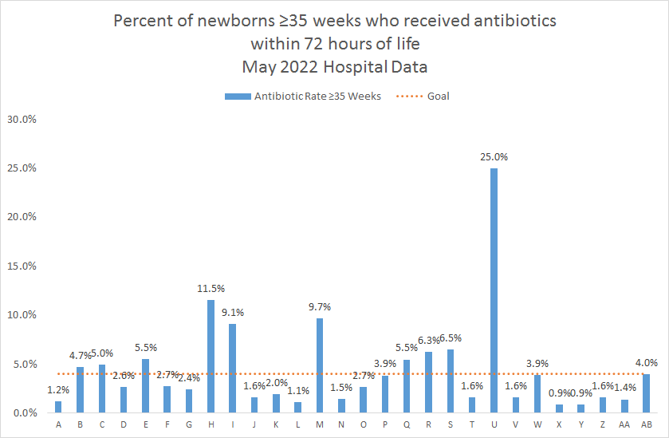
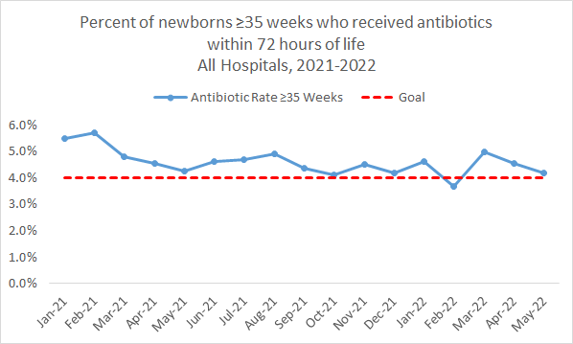
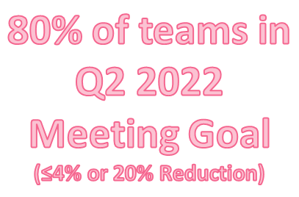
≥35 Weeks Antibiotic Prescribing
Notes:
Add the values for May
what % of hospitals below the goal, fix title
See if more updated data for May or April Data (share teams with highest rates)

Slide 19
Stopping Antibiotics by 36 Hours ≥35 Weeks
At Baseline 2020, 4 of 10 newborns had antibiotics stopped with a negative blood culture by ≤36 hours
By Q2 2022, 7 of 10 newborns had antibiotics stopped with a negative blood culture by ≤36 hours
43% decrease in newborns having antibiotics stopped past 36 hours!
Notes:
Add the values for May
what % of hospitals below the goal, fix title
See if more updated data for May or April Data (share teams with highest rates)

Slide 20
Family Education
80% of teams have the Structure Measure In Place!
20% of teams still are Working on or Not Started
Notes:
What are avergae # of teams entering data? If May is incomplete we should exclude May Data

Slide 21
Antibiotic Time Out
80% of teams have the Structure Measure In Place!
20% of teams still are Working on or Not Started

Slide 22
Automatic Stop Orders
85% of teams have the Structure Measure In Place!
15% of teams still are Working on or Not Started

Slide 23
ILPQC Progress on Key BASIC Aims
ILPQC BASIC Teams have collectively achieved the statewide goals for of all aims, process, and outcome measures for newborns receiving antibiotics including:
Reduction in abx prescribing
Stopping antibiotics at 36/48 hrs with negative culture
EOS risk assessment
Family education
Time outs & Automatic stop times
To ensure these clinical culture changes are standardized, we encourage all teams to ensure their structure measures (system changes) are all “In Green” as we prepare for the Annual Conference!
ILPQC will be following up with hospital teams missing data, structure measures working on/not yet started to help all hospital teams cross the finish line!
Keep up the great work!

Slide 24
QI Corner
Notes:
Alana to fill in

Slide 25
Previously on ILPQC Hospital QI Corner...
This Photo by Unknown author is licensed under CC BY-NC.

Slide 26
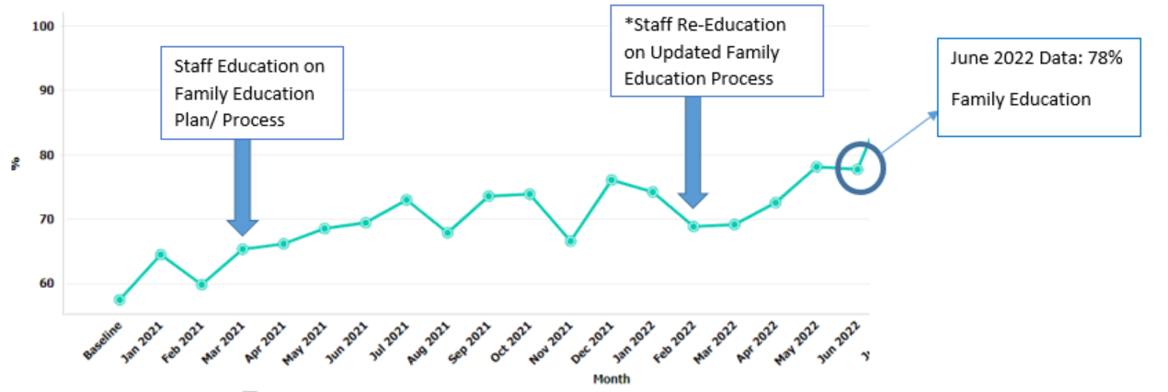
ILPQC Hospital: % of parent/families of all newborns provided education
Notes:
https://www.lucidchart.com/blog/how-to-tell-a-story-with-data
https://online.hbs.edu/blog/post/data-storytelling#:~:text=Data%20storytelling%20is%20the%20ability,inspire%20action%20from%20your%20audience.

Slide 27
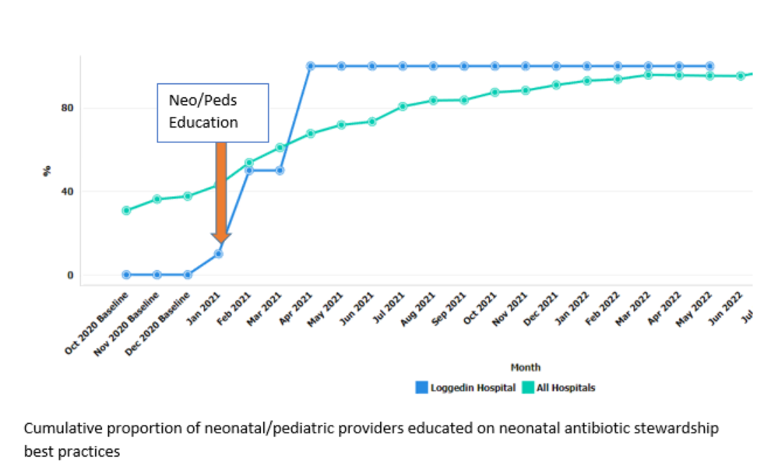
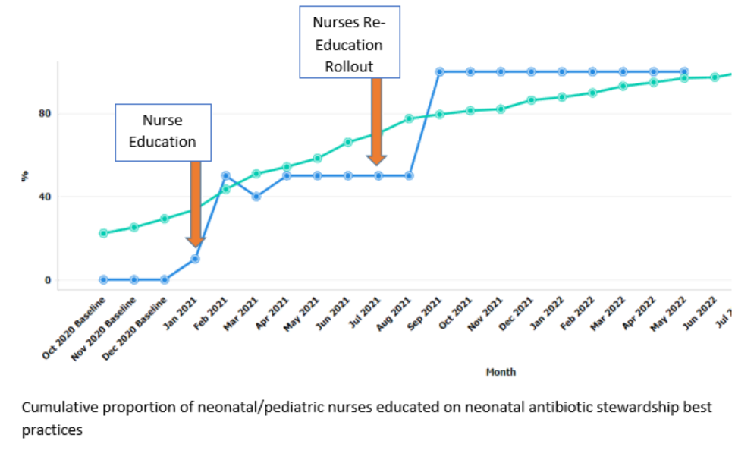
ILPQC Hospital: Provider & Nurse Education

Slide 28
ILPQC Hospital: Stopping Antibiotics by 36 Hours ≥35 Weeks
At Baseline 2020, only 2 of 10 newborns had antibiotics stopped with a negative blood culture by ≤36 hours
Q2 2022, 8 of 10 newborns had antibiotics stopped with a negative blood culture by ≤36 hours
60% increase in newborns having antibiotics stopped with a negative blood culture ≤36 hour
Notes:
Add the values for May
what % of hospitals below the goal, fix title
See if more updated data for May or April Data (share teams with highest rates)

Slide 29
ILPQC Hospital: Our Recipe for Achieving BASIC Aims
Key Ingredients (strategies)
Standardized Dosing Guidelines
Antibiotic debriefs / time outs
Automatic stop times
Family education
Kitchen Utensils (tools & resources)
QI Resources in ILPQC Toolkit
EMR optimization for data and clinical decision support
Heat, the spark (clinical culture change)
Health care team education
Structure measure implementation
A delicious treat (initiative achieved)

Slide 30
BASIC Team Talk: NM Lake Forest
Dr. Anita Gupta – Neonatologist
Jacqueline Lowry MSN, RNC, C-EFM – Clinical Practice Specialist, Maternity Services
Notes:
-waiting for slides 07.14.22

Slide 31
Using BASIC Data to Tell a Story: Lake Forest Hospital BASIC Team
Presented by:
Dr. Anita Gupta - Neonatologist
Jacqueline Lowry MSN, RNC, C-EFM – Clinical Practice Specialist, Maternity Services
Group Members: Pam Chay RN, Dr. Anita Gupta, Melissa Kelley RN, Dr. Hamida Khan, Jacqueline Lowry RN, Dr. Deb Margulis, Dr. Athena Patrianakos-Hoobler, Sogi Skariah RN

Slide 32
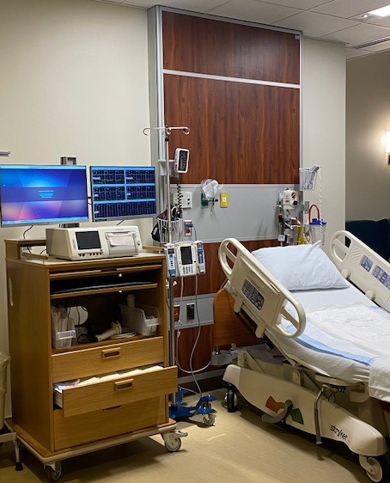
Lake Forest Hospital
~ 1600 deliveries/year
114 Private Patient Beds
72 Outpatient Care Spaces
8 Operating Rooms
Maternity
4 Triage rooms
7 LDR rooms
2 Operating rooms
6 SCN bays
18 Mother Baby rooms
Notes:
JAL
Share the following descriptions of the new hospital:
Teaching community hospital
Family practice medical residents & ED residents
Resource Hospital status with implementation of EMS provider training in 2020
Primary Service Lines include: cardiac services, oncology and ortho/neuro
Hospital design
On stage, off stage
Decentralized nursing care delivery model
Quiet, peaceful, healing environment

Slide 33
Gap Analysis – November 2020
All chorio babies:
Observed for 4 hours in SCN then transferred to postpartum
Received antibiotics for 48 hours – managed by Neonatologist
Inconsistent:
OB definition of chorio / IAI – called hours after delivery
Patient and family education – no handouts or anything standard
Sepsis calculator not utilized

Slide 34
Process Improvements
Implement the Kaiser EOS tool manually, eventually into EPIC
Standardize timing of antibiotics with stop times in the EMR
Decrease the amount of time of antibiotics received from 40 hours to 32 hours
6 doses of ampicillin to 5 doses of ampicillin
2 doses of gentamicin (no change)
Allow family to bond with baby without disruption in LDR
Create a written document for patient education (NM system developed – English/Spanish)
Time of discharge changed from 48 to 36 hours (based on blood culture results)

Slide 35
Challenges
LDR RN not quick to complete delivery summary – not allowing the score to populate
Some staff not recalling the process in real time – more education and mandated in CBL program
Big change in May 2021 when not all chorio babies received antibiotics – took trust in the evidence
Due to the decrease in antibiotic use – less ability for the RNs to place IVs or draw blood cultures (challenges for new hires)

Slide 36
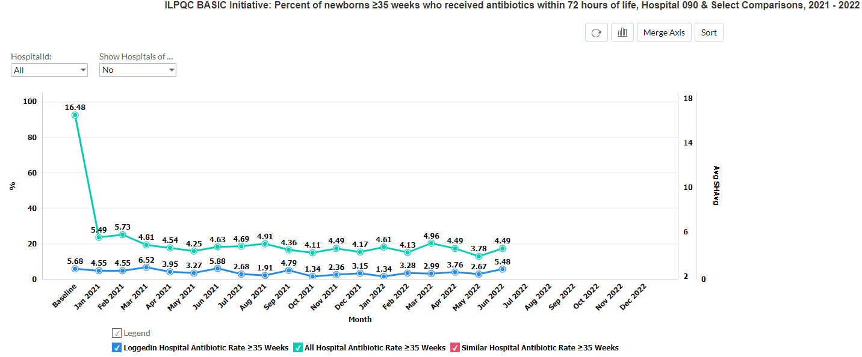
Patient
Education
Flier
EOS Score
For SCN
EOS Score
In EPIC
Automatic Stop
Times in EMR

Slide 37
Basic Antibiotic Stewardship Improvement Collaborative – BASIC
An Illinois Perinatal Quality Collaborative Initiative
Northwestern Medicine - Implementation of the Kaiser Sepsis Screening Tool
“Go-Live” October 25, 2021

Slide 38
Step 2: Current State (10/25/21) Process Map for All Babies
Within 1 hour of birth the Baby RN completes a Kaiser Sepsis screening in the EMR
If baby is noted to be well appearing and antibiotics are not indicated– the baby will remain with parents for routine care under the parent preferred Pediatrician or the EROC if no preference is indicated
4 hours after delivery the postpartum RN will complete a sepsis screening in the EMR, depending upon the findings the attending pediatrician will be contacted for further instruction
If baby is equivocal or antibiotics are indicated – the baby will be admitted under the Pediatric Hospitalist and contacted for further orders
Within 1 hour of birth the Baby RN completes a Kaiser Sepsis screening in the EMR

Slide 39
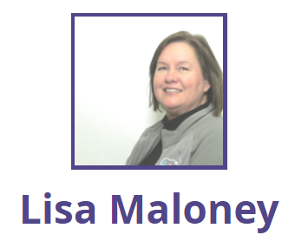
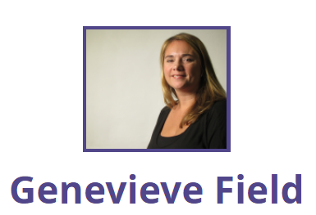
NM BASIC - Patient Education Work Team
CDH
CDH
Delnor
Huntley
Lake Forest Hospital
McHenry
NMH
NMH

Slide 40
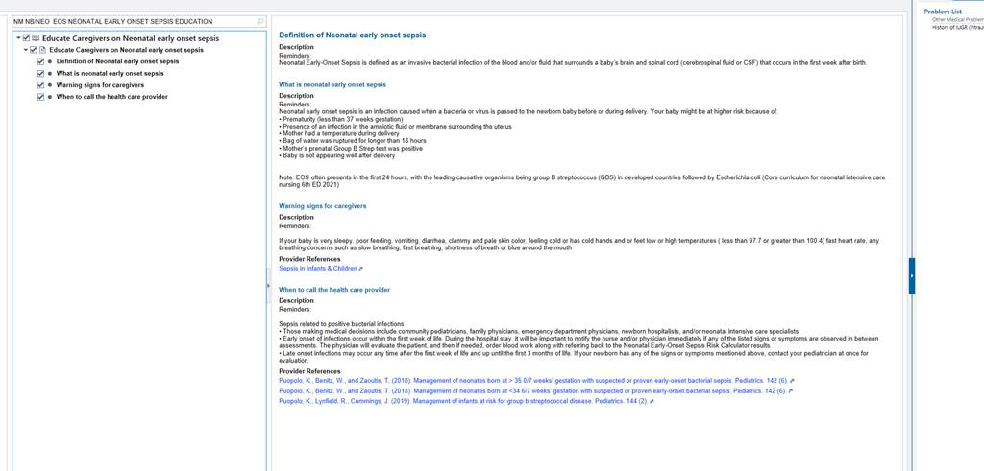
Patient Education Work Group
General education for all babies – Early Onset-Neonatal Sepsis – live in EPIC! Links to articles available

Slide 41
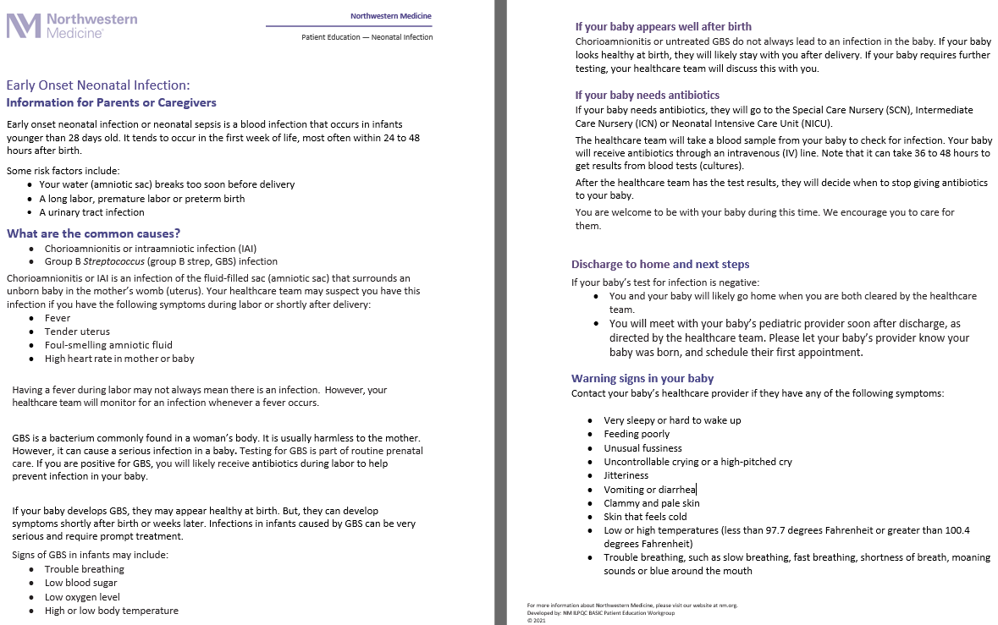
Patient Education Work Group -
Rolled up Early onset-neonatal sepsis (NEOSC NM System Flier) – Flyer approved; translation to Spanish and linked into EPIC.

Slide 42
Questions?

Slide 43
Q&A
Come off mute or submit your questions in the chat!

Slide 44
Wrap-up and Next Steps

Slide 45
Upcoming Call Schedule
Month | Topic
July | Preparing to Accept your Award at Annual Conference
August | Using your BASIC data to tell a story
September | Prepping for Annual Conference: Abstracts
October | 10th Annual Conference
What topics would be helpful to get your BASIC Team across the finish line?

Slide 46
Next Steps for BASIC
Celebrate your QI team if you received a BASIC Data Champion gift card or QI award! Take a photo and submit to info@ilpqc.org
Determine which Structure Measures are still in progress and next steps
Continue with QI Team meetings and data sharing
Review REDCap reports and contact info@ilpqc.org to schedule personalized 1-1 call to review reports, data, progress, etc.

Slide 47
Thanks to our Funders
In kind support:

