Slide 1

Second Stage Arrest & Dystocia Management Strategies
Monday, June 25th 2022 at 12:30 PM

Slide 2
Overview:
PVB Data Review
Second Stage Arrest and Dystocia Management Strategies
Emmet Hirsch, MD Director, Hospitalist Program Department of Obstetrics and Gynecology NorthShore University HealthSystem, Evanston, Illinois
Team Talk: Pat Baker, Team Lead OB, SSM Health Good Samaritan Hospital
PVB Next Steps
PVB Office Hours
  Join us after the call to ask any questions you may have

Slide 3
Opportunity to participate in TeamBirth project late 2023-2024 with free TeamBirth Certification
Reminder: What is TeamBirth?
  A care process innovation involving a series of team huddles between the patient and their care team, designed to empower each team member to contribute information, reliably structure communication, and help the team arrive at shared plans together
Next Steps:
  A letter of support from each possibly interested hospital is needed
  These letters are needed to show hospitals interest in TeamBirth for the grant submission to PCORI (patient centered outcomes research institute)
  Sign and return by July 29th to be eligible to participate
  If funded TeamBirth Project would start in LATE 2023-2024

Slide 4
PVB Data Review

Slide 5
NTSV C-Section Rate by Race and
Ethnicity: 2020 IDPH birth certificate data
NTSV C-Section Race and Ethnicity Data Collection:
Goal: Provide data reports to all teams with their NTSV CS rates stratified by race, ethnicity and insurance status
Bridging PVB and BE initiatives to stratify key measures to identify disparities and address them
"There is no quality without equity"

Slide 6
PVB Hospital Data Form Updates
 | Total | White | Black | Hispanic | Asian | Other
NTSV Deliveries
NTSV Cesarean Deliveries
Legend
Question Already Asked
Proposed New Question
 | Private Insurance | Public Insurance | Uninsured/Self-pay
NTSV Deliveries
NTSV Cesarean Deliveries

Slide 7
NTSV C/S data stratified by race/ethnicity/insurance status: next steps for PVB teams
Prospective Data (April 2022 – end of Initiative) collection ongoing
Retrospective Data (Baseline-March 2022)
Due August 1st 2022
22 Teams have submitted all retrospective data

Slide 8
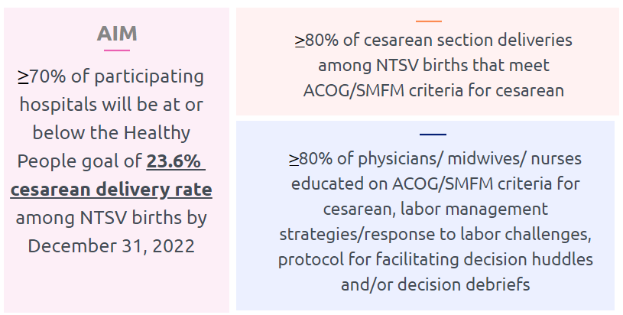
PVB Aims and Measures

Slide 9
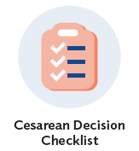






PVB Key Strategies for
Creating Clinical Culture Change
Sharing Unblinded Provider-level NTSV C-Section Rates
Review of NTSV C-Section Cases Not Meeting ACOG/SMFM Guidelines

Slide 10
ILPQC Hospital Team Data Submission
(94 Teams Total)
Month | Patient Data | Hospital Data
Baseline | 89 | 85
January 2021 | 86 | 80
February 2021 | 85 | 80
March 2021 | 85 | 79
April 2021 | 81 | 81
May 2021 | 78 | 71
June 2021 | 71 | 71
July 2021 | 76 | 70
August 2021 | 78 | 68
September 2021 | 75 | 67
Month | Patient Data | Hospital Data
October 2021 | 74 | 64
November 2021 | 70 | 65
December 2021 | 70 | 62
January 2022 | 67 | 62
February 2022 | 66 | 61
March 2022 | 69 | 61
April 2022 | 62 | 54
May 2022 | 58 | 52
June 2022 | 38 | 33

Slide 11
PVB Teams Progress on Key Structure Measures
Notes:
I am leaving this is may because june data looks like we have a lot less teams with all 6 SM in place or working on it because we only have 33 teams

Slide 12
ILPQC teams NTSV C-Section Rate

Slide 13
NTSV C-Section Rates, by hospital
Goal: < 23.6%
All ILPQC Average: 23%

Slide 14
NTSV C-Sections Meeting
ACOG/SMFM Guidelines (goal > 80%)

Slide 15
NTSV C-Sections Meeting
ACOG/SMFM Guidelines: Failed Induction
ACOG/SMFM Criteria for Failed Induction:
Oxytocin administered for at least 12-18 hours after membrane rupture, without achieving cervical change and regular contractions
Longer duration of the latent phase, 24 hours or longer if <6cm and maternal and fetal status permits

Slide 16
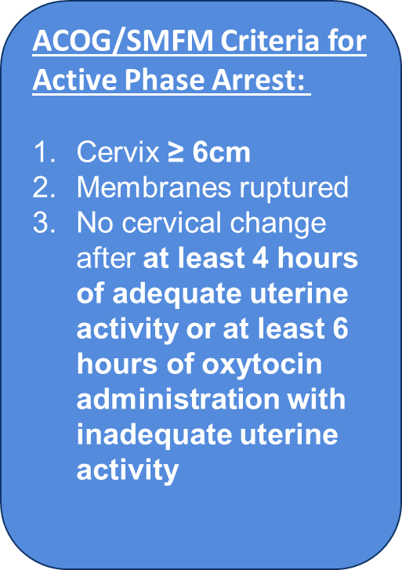
NTSV C-Sections Meeting
ACOG/SMFM Guidelines: Active Phase Arrest

Slide 17
NTSV C-Sections Meeting
ACOG/SMFM Guidelines: Second Stage Arrest
ACOG/SMFM Criteria for Second Stage Arrest:
At least 3 hours* of pushing in nulliparous patients
*Longer durations (e.g. 4 hours with epidural) may be appropriate on an individualized basis

Slide 18
Provider and Nurse Education
Keep it up!

Slide 19
Standard Protocols and Processes

Slide 20
Sharing Provider Level Data

Slide 21
Cesarean Decision Checklists and Decision Huddles/Debriefs

Slide 22
Shared Decision Making and Patient Education
Notes:
Focus for today

Slide 23
Malposition and Dystocia Management Strategies

Slide 24
What is Malposition and why is it important?
Fetal malposition in labor includes occiput posterior and occiput transverse positions.
  (Pilliod & Caughey, 2017) doi: 10.1016/j.ogc.2017.08.003.
“In order to safely prevent cesarean deliveries in the setting of malposition, it is important to assess the fetal position in the second stage of labor, particularly in the setting of abnormal fetal descent”.
Manual rotation of the fetal occiput when fetal malposition is identified is an important strategy to reduce Second Stage Arrest and safely prevent cesarean delivery.
  (ACOG Obstetric Care Consensus: Safe Prevention of the Primary C-Section)

Slide 25
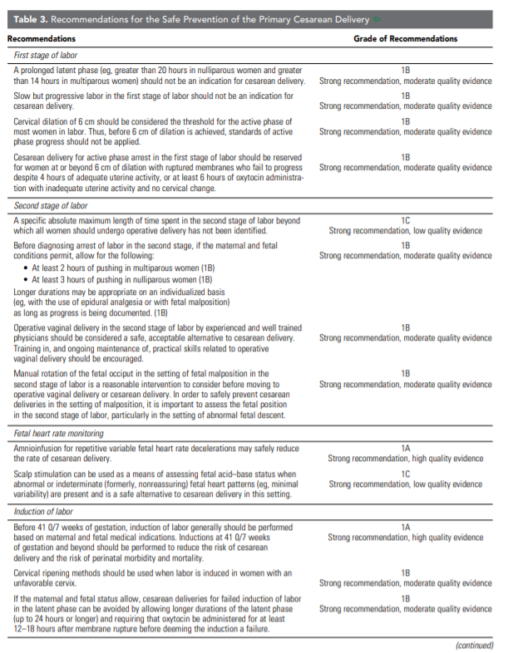




Slide 26
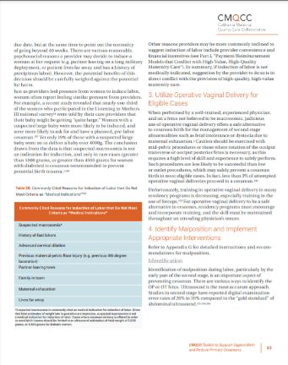
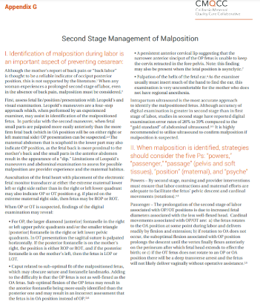
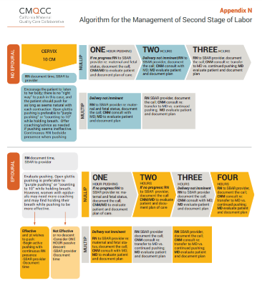
PVB Toolkit Resources: Malposition
CMQCC Second Stage
  Management of Malposition
  Management of Malposition Appendix G
  Algorithm - Appendix N

Slide 27
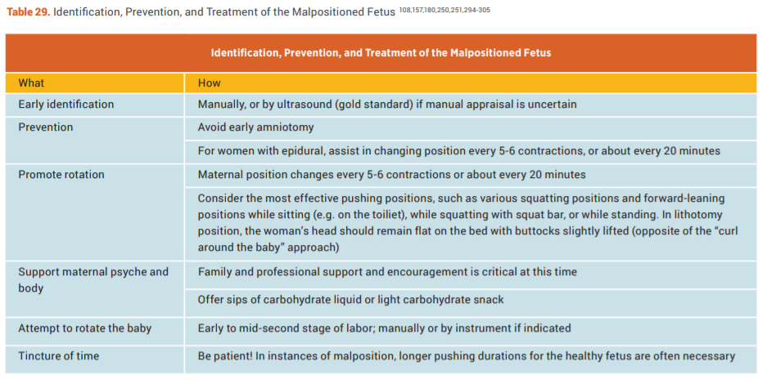
PVB Toolkit Resources: Malposition
CMQCC Management of Malposition

Slide 28
PVB Toolkit Resources: Malposition
CMQCC Second Stage Management of Malposition Appendix G
  Identification of malposition during labor is an important aspect of preventing cesarean
  When malposition is identified, strategies should consider the five Ps:
    “powers”
    “passenger”
    “passage” (pelvis and soft tissues)
    “position” (maternal)
    “psyche“
  Strategies

Slide 29
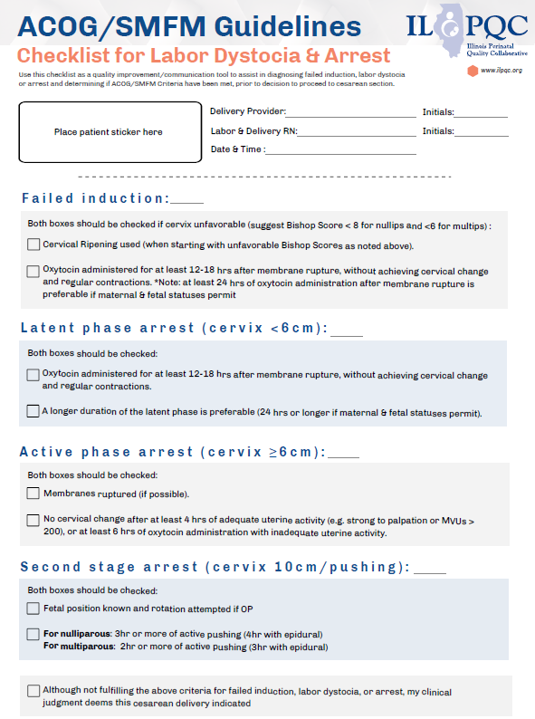
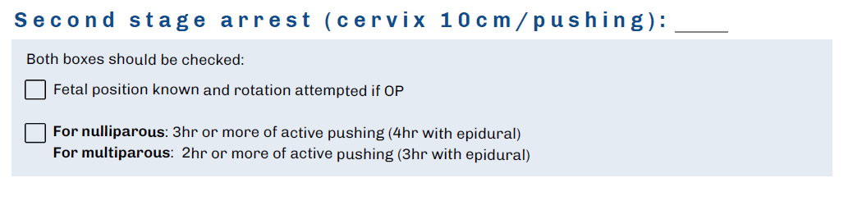
PVB Toolkit Resources:
ILPQC Cesarean Decision Checklist

Slide 30
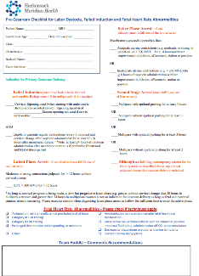

PVB Toolkit Resources:
Cesarean Decision Checklists
FPQC Sample Checklists
  Hackensack Meridian Health Pre-Cesarean Checklist and Team Huddle Form
  Tampa General Pre-cesarean Huddle form
CMQCC: Pre-Cesarean Checklist for Labor Dystocia or Failed Induction

Slide 31
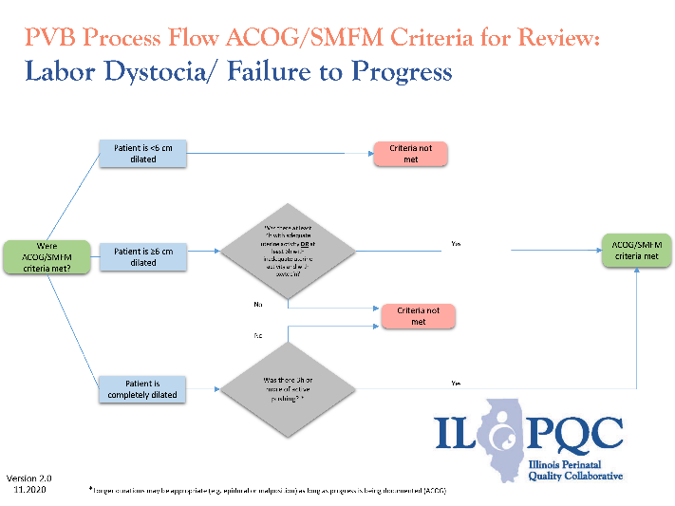
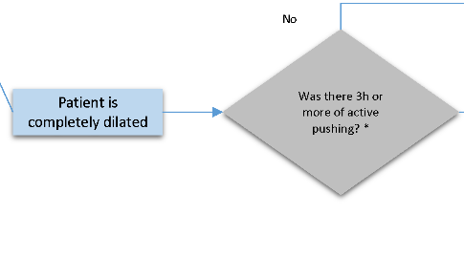
ILPQC Toolkit Items: Process Flow Diagrams for ACOG/SMFM Criteria
*Longer durations may be appropriate (e.g.4 hours with epidural) as long as progress is being documented (ACOG)

Slide 32
The challenge of occiput posterior position
Emmet Hirsch, MD
Director, Hospitalist Program
Department of Obstetrics and Gynecology
NorthShore University HealthSystem, Evanston, Illinois
Notes:
Emmet slides to be sent this week

Slide 33

The challenge of occiput posterior position
Emmet Hirsch, MD
ILPQC Promoting Vaginal Birth session
July 25, 2022
Director, Hospitalist Program
Department of Obstetrics and Gynecology
NorthShore University HealthSystem, Evanston, Illinois
Clinical Professor, Pritzker School of Medicine
University of Chicago, Chicago, Illinois

Slide 34
Objective
Review pathophysiology, consequences and some solutions for occiput posterior positions in labor.

Slide 35

Disclosures
None, except
I make no claims to “truth” *
Interruptions allowed
  Use the Chat
* Mostly
OBSTETRICS

Slide 36
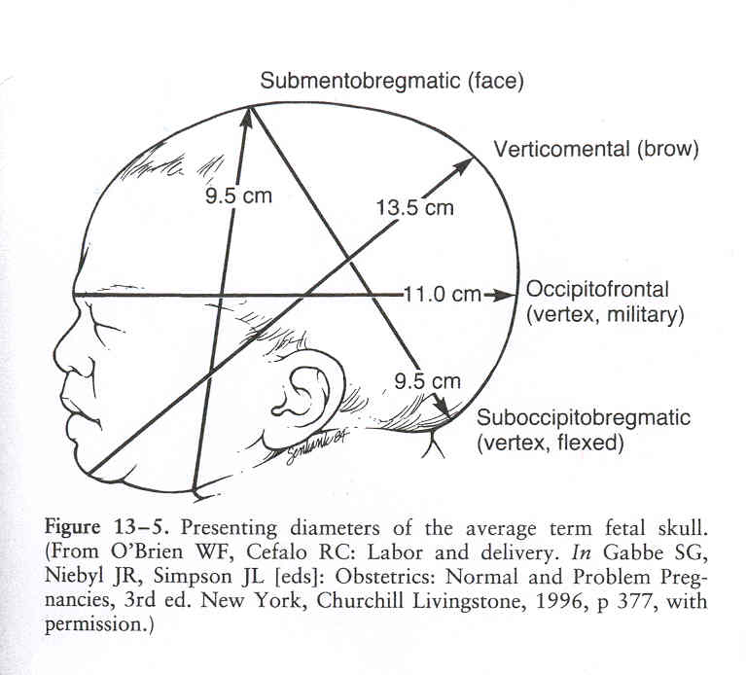
Diameters of the fetal head
Gabbe, Normal and problem pregnancies, 4th ed

Slide 37
Diameter of the presenting part is increased with OP presentation
Occiput anterior
Occiput posterior

Slide 38
Risks of occiput posterior
(all documented in the literature)
Cesarean section
Operative vaginal delivery
Prolonged labor
Oxytocin augmentation
Perineal injury
Anal sphincter injury
Blood loss > 500cc
Postpartum infection
Uterine extensions during C/S
Neonatal 1- and 5-minute Apgars, acidemia, meconium, birth trauma, NICU admission, hospital LOS

Slide 39
How to assess fetal position?
posterior
One finger!!
(really)
If you feel a fontanelle, it is almost always the anterior fontanelle.
Don’t be fooled by the subtle frontal suture!
Feeling ears is both less precise and does not help with device placement.
post. “fontanelle”
lambdoidal
saggital
ant. fontanelle
coronal
frontal
anterior

Slide 40
How to assess fetal position?
(in the real world)

Slide 41
How to assess fetal position?
(in the real world)

Slide 42
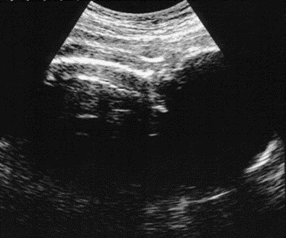
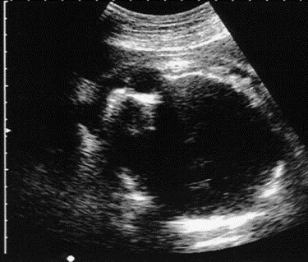
Confirmation of clinical assessment using ultrasound
Occiput anterior
Occiput posterior

Slide 43
When does fetal head rotation occur in spontaneous labor at term?
Hjartardóttir et al, AJOG (2021) 224:514.e1-9
99 nulliparas in spontaneous labor, beginning in active phase (4cm)
Abdominal and transperineal ultrasound

Slide 44
When does fetal head rotation occur in spontaneous labor at term?
Positions at first exam:
  Occiput posterior: 53% (most at 4 or 8 o’clock)
  Occiput transverse: 28%
  Occiput anterior: 19%
77% of initial OP were delivered OA
Rotation to OA most commonly occurred at full dilation and when the head descended below the mid-pelvis
75% (6 of 8) patients with C/S were OP throughout labor

Slide 45
What to do about it?
ILPQC resources
  Module 6: Techniques to Promote Labor Progress - YouTube Run time 17 minutes
  Module 7: Rotating a Suspected Malposition Baby and Labor Positions - YouTube Run time 14 minutes
Techniques mentioned (partial list)
  Movement in labor (rather than in-bed), peanut ball, “Miles circuit”, side-lying release, lunges (“Captain Morgan”), abdominal lift and tuck, circles on a ball, asymmetric pelvic exercises

Slide 46

In God we trust….
…Everyone else needs data

Slide 47
Selected impact of purposeful rotation of occiput posterior
Shaffer, 2006
  Cesarean Rates:
      2% with successful rotation
      34% with unsuccessful rotation
LeRay, 2007
  Cesarean Rates:
    3.8% with successful rotation
    58% with unsuccessful rotation
  Rotation more likely to be successful in prophylactic attempts
Shaffer, 2011
  Decreased rate of high order perineal lacerations
    16% vs 20%
  Increased rate of cervical laceration (2% vs 1%)
These favorable results are not uniform
Examples:
Verhaeghe, Obstet Gynecol (2021) 137:999; Broberg AJOG MFM (2021) 3:100327
Problems: small numbers, variability among studies, success is highly operator dependent

Slide 48
Rotation from OP/OT – digital method
Minimizes loss of station.
Left hand for right-sided positions (clockwise rotation); right hand for left-sided positions (counter-clockwise).
Fingertips on lambdoidal sutures.
Flex the head. Lowenstein and Zevin: fundal pressure.
(Emmet says: while patient is pushing).
Rotate toward shortest route to OA (into the back).
Keep hand in place for head to settle.
Lowenstein and Zevin (1971) Obstet Gynecol 37:790

Slide 49
Rotation from OP/OT – Manual method (Dennen)
Right hand for left-sided positions; left hand for right-sided positions
May involve loss of station (cord or hand prolapse)
Dennen’s Forceps Deliveries, 4th edition

Slide 50
My suggestions
Determine position as early as possible in labor and follow it prospectively.
Only one or two fingers are necessary to determine most fetal positions. The sutures/fontanelles are the key (not the ear)!
Attempt rotation prophylactically (15 minutes into second stage), with the patient pushing.
Repeated attempts – suggested benefit in the literature.
There is no support for the common notion that OP delivery is safer for the mother and/or fetus than rotation with delivery in OA position, even for rotations performed with forceps.

Slide 51


Slide 52
Team Talk: SSM Good Samaritan Hospital
Pat Baker, SSM Health Good Samaritan Hospital, Mt. Vernon, IL

Slide 53
SSM Health
Good Samaritan Hospital
Mt. Vernon, IL
Promoting Vaginal Birth

Slide 54

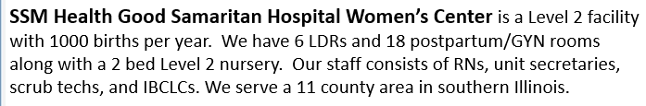

Slide 55
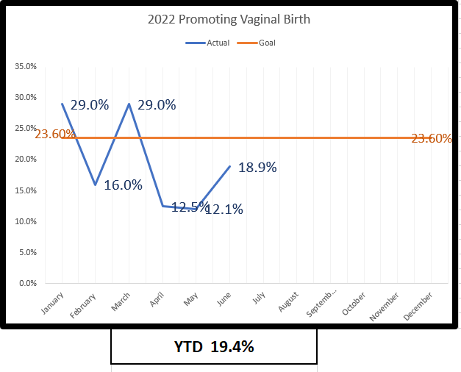

Slide 56
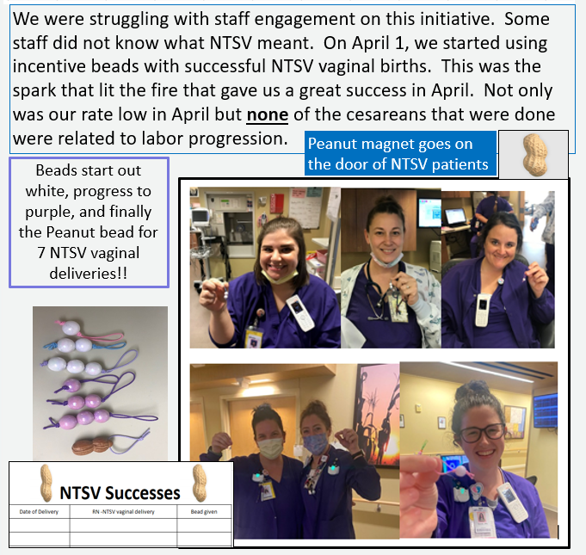

Slide 57
PVB Next Steps

Slide 58
PVB – helping ALL teams cross the finish line!
Monthly Team Webinars
When:
Grand Rounds
OB Provider Meetings
Provider and Nurse Education
What: Personalized and FREE service to available to all participating teams
How: Email Ellie Suse to schedule today info@ilpqc.org
Topic: Patient Education and Shared Decision Making
NEW! ILPQC Virtual Labor Management Support E-Modules
1-1 QI Support Calls
We are providing 1-1 QI support calls for all teams with C-section rates over 23.6%
Live class recorded and created into 10-20 minute e-modules available for free to all hospitals!
Email Ellie Suse and Alana Rivera at info@ilpqc.org to schedule
4th Monday every month at 12:30pm
Next call:
August 22nd 2022
Work to achieve all initiative aims
Complete a sustainability plan
Confirm standardized education
Utilize MNO folders for every OEN
Attend MNO-Neonatal sustainability calls
Notes:
Ellie, can you update this?

Slide 59
ILPQC is here to help you get across the finish line!
PVB Finish Line Goals:
QI Excellence Award
6 Key Structure Measures in Place
NTSV C-Section Rate ≤23.6%
80% of Providers and Nurses educated on ACOG/SMFM Guidelines
80% of all NTSV C-Sections Meeting ACOG/SMFM Guidelines
We are here to help!
We are here to support!
Schedule a personalized QI Support Call, email info@ilpqc.org to schedule for additional support!

Slide 60

PVB QI Support
Q1 2022 Outreach with PVB teams in April, June & July:
  NTSV C-Section rate above the goal of 23.6%
  Missing Data
  Structure Measures
  We have held QI Support Calls with 20 teams
We would like to connect with ALL PVB teams for 1:1 QI support
Next round of PVB QI Outreach–
  Q2 2022 data for PVB Teams above the 23.6% NSTV C-section rates
Email info@ilpqc.org to schedule your QI Support Call for a Thursday or Friday in August!
Notes:
What can you expect from a QI Support call?
Reviewing your data together
Discussing your successes and barriers
Sharing strategies from other teams to overcome barriers and implement key strategies

Slide 61

PVB QI Topic Call Summer Series
*PVB Teams who attend all 3 calls will receive a PVB QI Summer Series education tool to share with your clinical teams!
*Register now!
Look for link in the chat!

Slide 62
TeamBirth Reminder
Submit your Letter of Support to show your interest in participating in the TeamBirth Project starting 2023-2024 by emailing it to info@ilpqc.org. Participating hospitals will receive free TeamBirth training/certification
DUE JULY 29TH!!
See the link to the draft letter of support in the chat or email info@ilpqc.org for more information~

