Slide 1




Preparing to Accept your QI Excellence Award at the 2022 Annual Conference
BASIC Monthly Teams Call
July 18th, 2022

Slide 2
Call Overview
BASIC QI Excellence Award Criteria
ILPQC BASIC Data: where are we now?
Steps to achieve QI Excellence by October
BASIC Team Talk: Tonya Mangiaguerra, MSN, APN, ACCNS-N, RNC-NIC| NICU APN Edward Hospital, Naperville IL
BASIC Next Steps
Notes:
Assessment of where they are
Walk them through how to do that:
Needs Assessment Review award criteria
Connect the dots of what they need to do to see where they are
Logging into redcap and viewing reports to see where they are
Determine how they can think about closing the gaps
We haven’t been able to implement this structure measure…how come?
Get to green slides from F2F
More practical: step by step what to do next
One page word doc with each criteria spelled out and then check boxes with to-do items, what do they need to do specifically to get this in to place
Present data to show where data is in place
ILPQC Collaborative Award:
Team Talk: that started high abx rate and reduced or team already low and how they used ILPQC
Start promoting QI posters for AC
August: Demonstration of well done poster and talk about how the story is being told through that poster, outline in September how to outline that poster (VON poster).

Slide 3

Save the Date:
Calling all perinatal health care providers, nurses, allied health professionals, and public health/community partners!

Slide 4


All structure & patient-level data entered for Baseline-August 2022
Key Structure Measures "In Place":
  Standardized Family Education Process
  EOS Risk Assessment Protocols for ≥35 and <35 Newborns
  Standardized Dosing Guidelines
  Antibiotic Discussions/Time Outs Protocol
  Standardized Automatic Stop Order Process

Slide 5
Achievement of process and outcome level measures
  ≥80% of neonatal/pediatric providers and nurses educated
  20% reduction (or absolute rate of ≤4%) in newborns ≥35 who receive antibiotics
  20% reduction in newborns with a negative blood culture who receive antibiotics for >48 hours
  ≥80% of newborns with anticipated duration of antibiotic course discussed by clinical team (antibiotic time out)
  ≥80% of newborns with an automatic stop order entered into the medical chart

Slide 6
BASIC Data: Where are we now?

Slide 7
Checking In on BASIC Data Submission

Slide 8
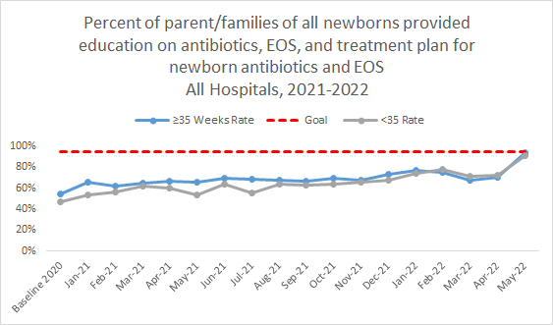
Family Education
80% of teams have the Structure Measure In Place!
20% of teams still are Working on or Not Started

Slide 9
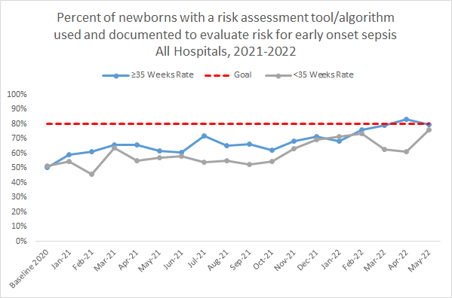
EOS Risk Assessment
94% of teams have the Structure Measure In Place!
6% of teams still are Working on or Not Started

Slide 10
Standardized Dosing Guidelines
94% of teams have standard dosing guidelines in place!

Slide 11
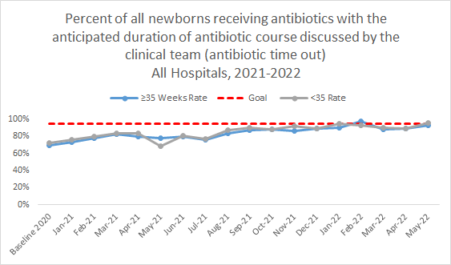
Antibiotic Time Out
80% of teams have the Structure Measure In Place!
20% of teams still are Working on or Not Started

Slide 12
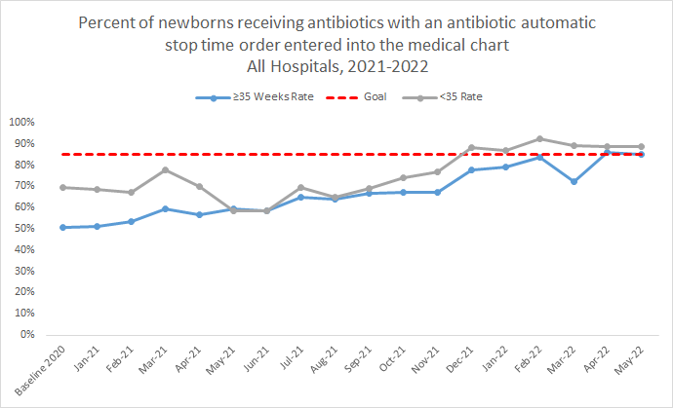
Automatic Stop Orders
85% of teams have the Structure Measure In Place!
15% of teams still are Working on or Not Started

Slide 13
Provider and Nurse Education
96% of providers and nurses have received education on neonatal antibiotic stewardship best practices!

Slide 14
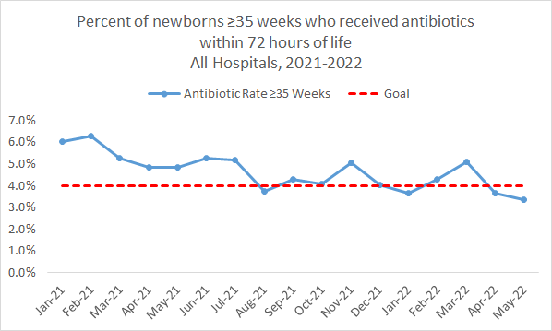
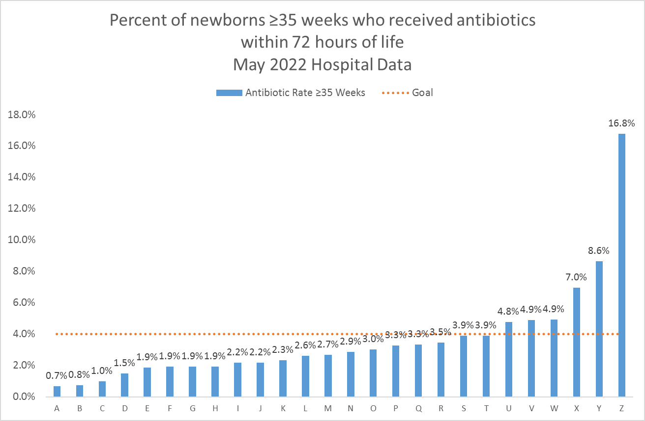
≥35 Weeks Antibiotic Prescribing Rate
Notes:
Graph 1: Add the value for May
Graph 2: Do we have any more teams reporting for May? If not can we do April instead? Also add in what # of teams are below goal and fix spelling of hospital in title

Slide 15
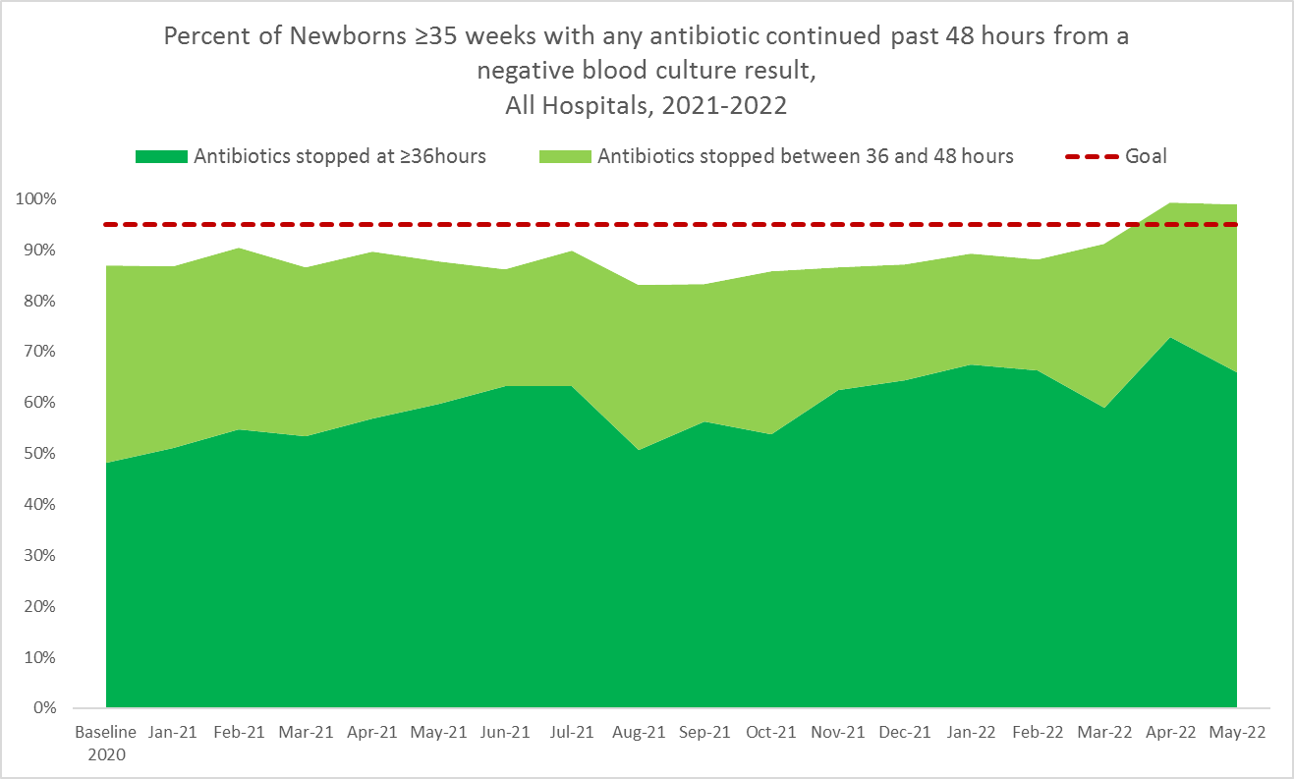
Stopping Antibiotics by 36 Hours
≥35 Weeks
Notes:
update legend:
Antibiotics stopped at ≥36hours
Antibiotics stopped between 36 and 48 hours

Slide 16
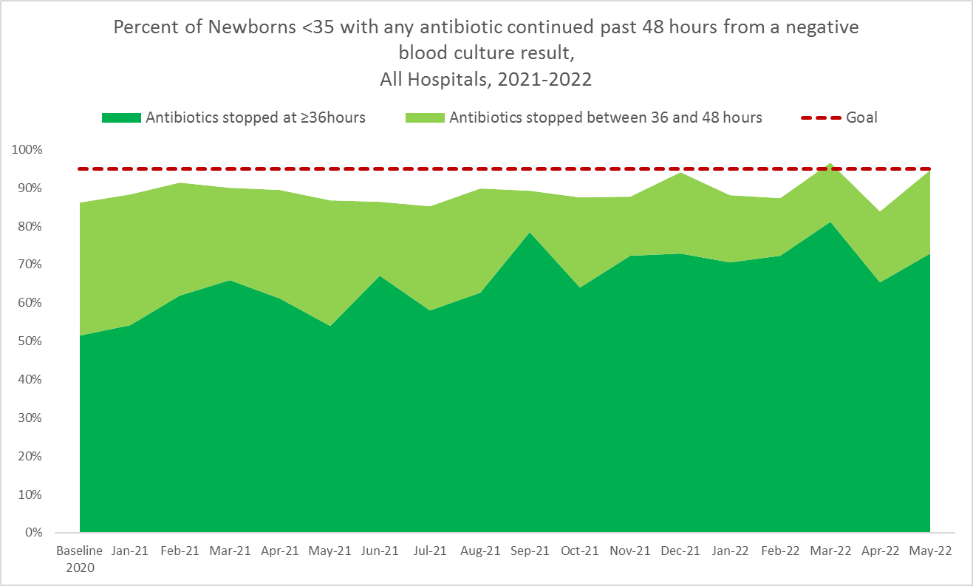
Stopping Antibiotics by 36 Hours
<35 Weeks
Notes:
update legend:
Antibiotics stopped at ≥36hours
Antibiotics stopped between 36 and 48 hours

Slide 17
ILPQC Progress on Key BASIC Aims
ILPQC BASIC Teams have collectively achieved the statewide goals for of all aims, process, and outcome measures for newborns receiving antibiotics including:
  Reduction in abx prescribing
  Stopping antibiotics at 36/48 hrs with negative culture
  EOS risk assessment
  Family education
  Time outs & Automatic stop times
To ensure these clinical culture changes are standardized, we encourage all teams to ensure their structure measures (system changes) are all “In Green” as we prepare for the Annual Conference!
ILPQC will be following up with hospital teams missing data, structure measures working on/not yet started to help all hospital teams cross the finish line!
Keep up the great work!

Slide 18

Steps to Achieve QI Excellence
Notes:
Ellie will fill this in next week!
Notes:
Needs Assessment: Review award criteria and determine which SM are not yet in place and which aims are not being met
Reminder of how to review BASIC data graphs and where to find award status graphs
Determine how they can think about closing the gaps
We haven’t been able to implement this structure measure…how come?
More practical: step by step what to do next
One page word doc with each criteria spelled out and then check boxes with to-do items, what do they need to do specifically to get this in to place

Slide 19

Steps to Achieve BASIC QI Excellence
Review Award Criteria
Review your BASIC Reports in Redcap
Meet with your QI Team
Determine which Structure Measures are not yet “In Place”
  -discuss barriers to implementing SMs and achieving aims
Determine Next Steps for July and August
Accept your BASIC QI Excellence Award at Annual Conference on October 27th

Slide 20

1. Review Award Criteria
All structure & patient-level data entered for Baseline-August 2022
Key Structure Measures "In Place":
  Standardized Family Education Process
  EOS Risk Assessment Protocols for ≥35 and <35 Newborns
  Standardized Dosing Guidelines
  Antibiotic Discussions/Time Outs Protocol
  Standardized Automatic Stop Order Process
Achievement of process and outcome level measures
  ≥80% of neonatal/pediatric providers and nurses educated
  20% reduction (or absolute rate of ≤4%) in newborns ≥35 who receive antibiotics
  20% reduction in newborns with a negative blood culture who receive antibiotics for >48 hours
  ≥80% of newborns with anticipated duration of antibiotic course discussed by clinical team (antibiotic time out)
  ≥80% of newborns with an automatic stop order entered into the medical chart

Slide 21
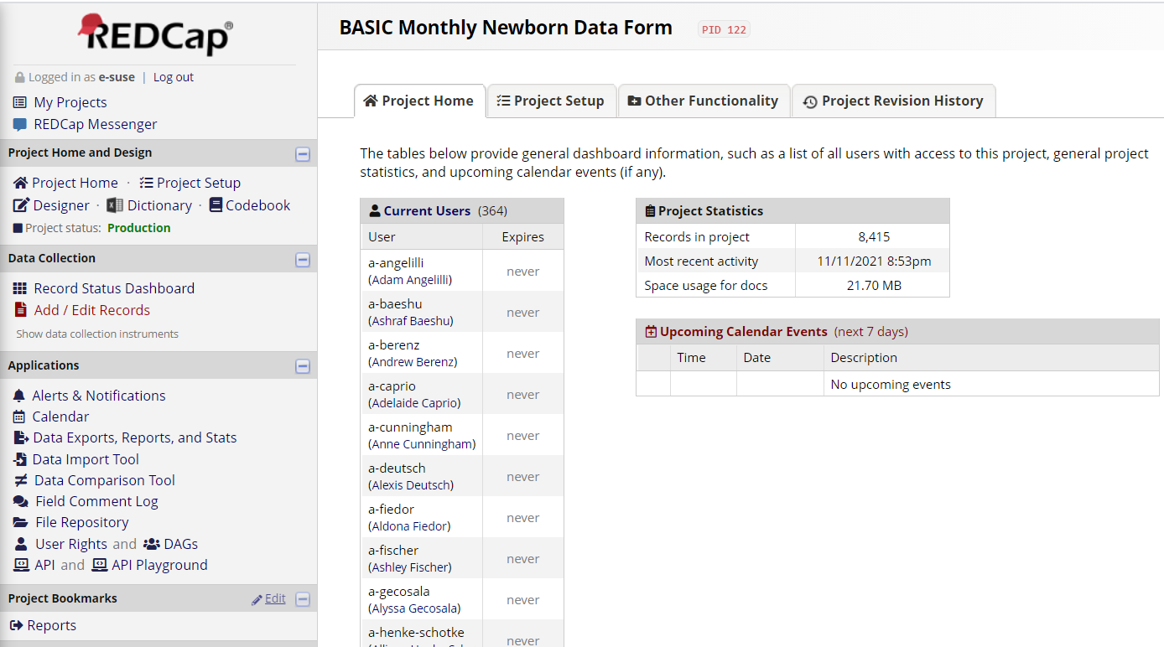
2. Review Your BASIC Reports in REDCap
Log in to REDCap the same way you did to enter data
Click Reports on the left hand side

Slide 22
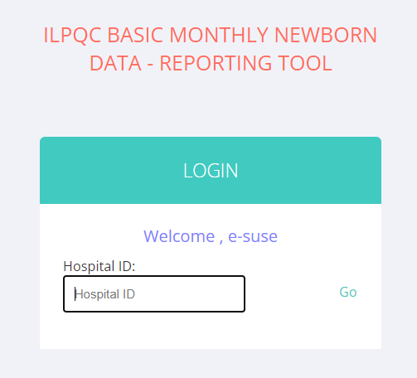
Viewing your Reports
4. A new webpage will open to view your reports
5. Enter your 3-digit Hospital ID (and email us if you do not know it!)
Note: if your ID is single or double digits, place 0’s in front to make 3 digits

Slide 23
REDCap BASIC Reports
6. Review the 11 Patient level and 19 Hospital Level reports.
  Newborn (Patient) Level Reports: For babies receiving antibiotics show progress towards achieving process and outcome measures on data you report on individual
    For the patient level reports you can toggle between gestational weeks as well as compare yourself to the collaborative average for each measure.
  Hospital Level Reports: Show progress on changes that you have made at your hospital
    Stacked bar charts show what percent of the collaborative has not started working on the structure measure (red), is working on getting the structure measure in place (yellow), or has structure measure in place (green).

Slide 24
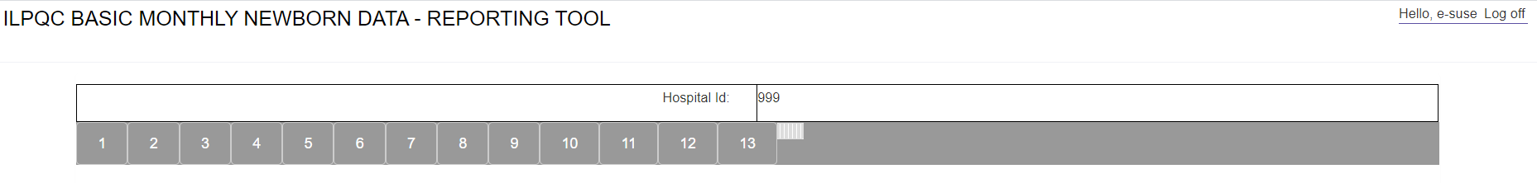
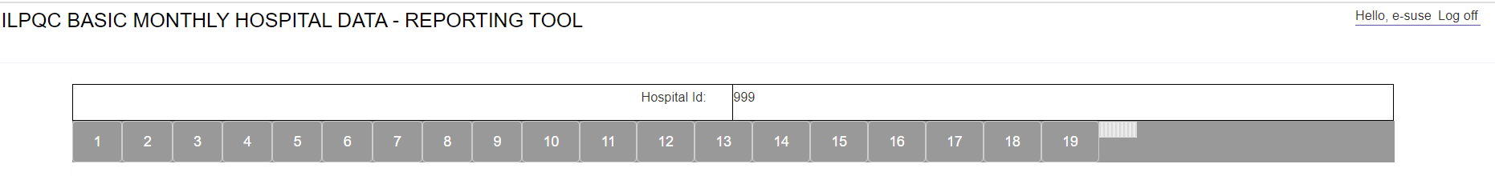
How to Get to Key BASIC Reports
Patient Level Reports
Hospital Level Reports
You can view the different reports by clicking on the different numbers a the top of the screen

Slide 25

3. Meet with your QI Team
Review your BASIC Key Structure, Process and Outcome measures with the full QI team.
Determine which measures still be to be worked on.
Identify barriers to implementation to understand why measures are not yet in place.
Celebrate successes!
Notes:
Insert Tool we create

Slide 26
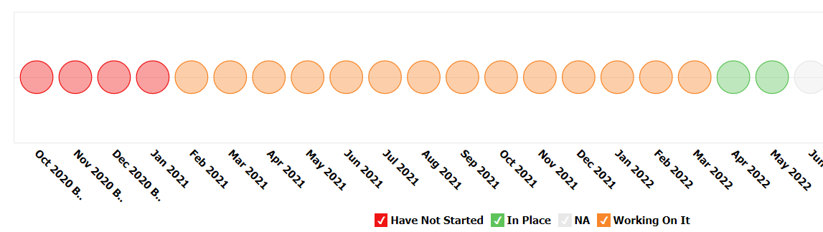
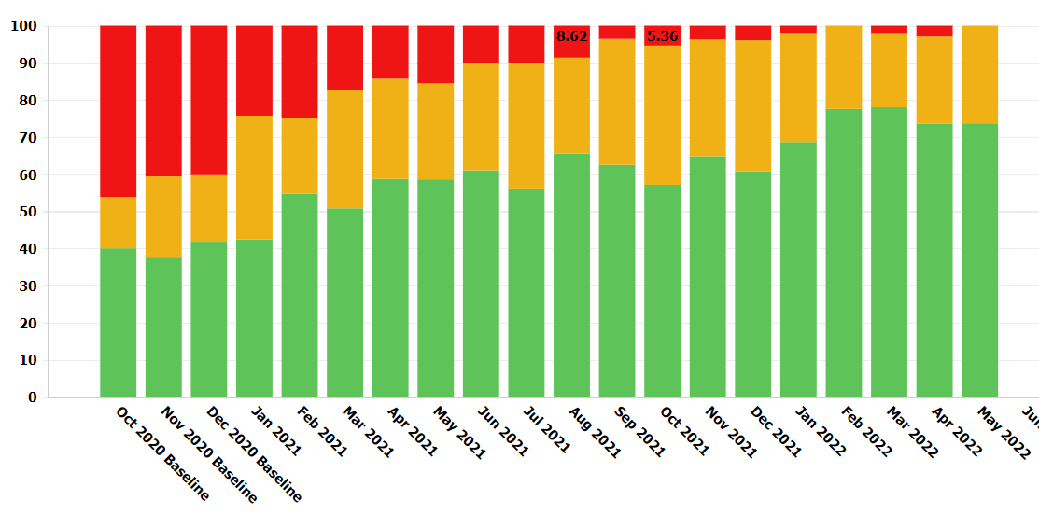
4a. Determine Which Key BASIC Structure Measures are Not Yet In Place
  Standardized Family Education Process
    Report 4
  EOS Risk Assessment Protocols
    Report 7 and Report 9
  Standardized Dosing Guidelines
    Report 16
  Antibiotic Discussions/Time Outs Protocol
    Report 17
  Standardized Automatic Stop Order Process
    Report 18
Notes:
Redo screenshot

Slide 27
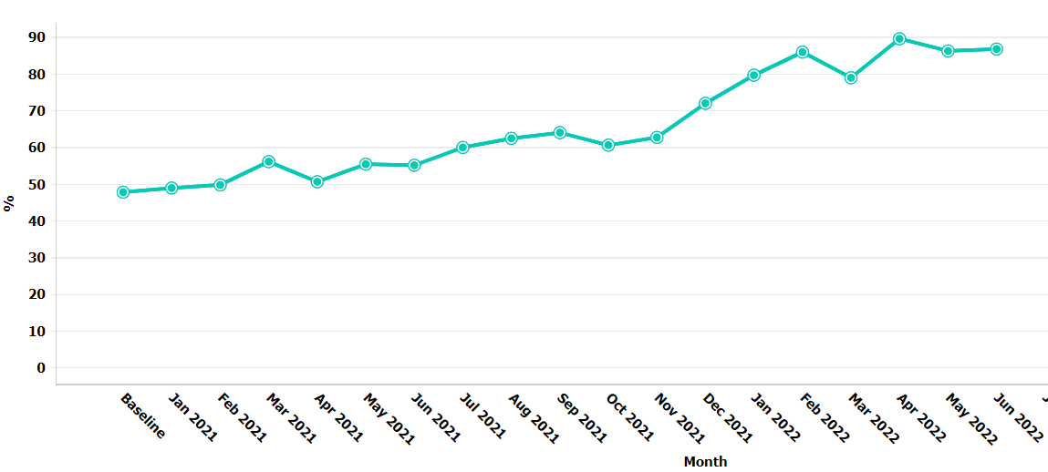
4b. Determine Which BASIC
Aims are Not Yet Achieved
  Antibiotic Prescribing Rate
    Report 2 and Report 3
  Newborns with antibiotic time out
    Report 9
  Newborns with an automatic stop order
    Report 10

Slide 28
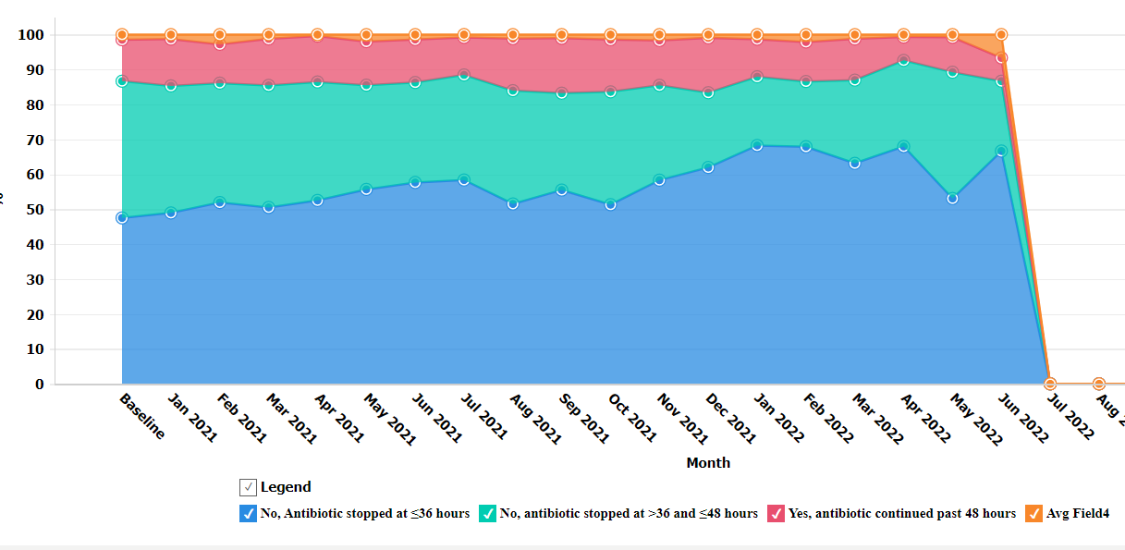
4b. Determine Which BASIC
Aims are Not Yet Achieved
  Newborns with a negative blood culture who receive antibiotics for >48 hours
    Report 11 and Report 12

Slide 29

5. Determine
Next Steps
Create a 30-60-90 Day plan for implementation of key measures before ILPQC Annual Conference
  What are the steps/action items for implementation?
  Who is in charge of each action item?
  Whose buy-in is needed for each action?
  What barriers to implementation are anticipated?
  How can ILPQC Help?
ILPQC Is here to help!
Reach out to Ellie and Alana at info@ilpqc.org to schedule a 1-1 QI Support call to learn strategies for implementation of key BASIC measures!

Slide 30


6. Accept your BASIC QI Excellence Award at Annual Conference on October 27th
2022

Slide 31
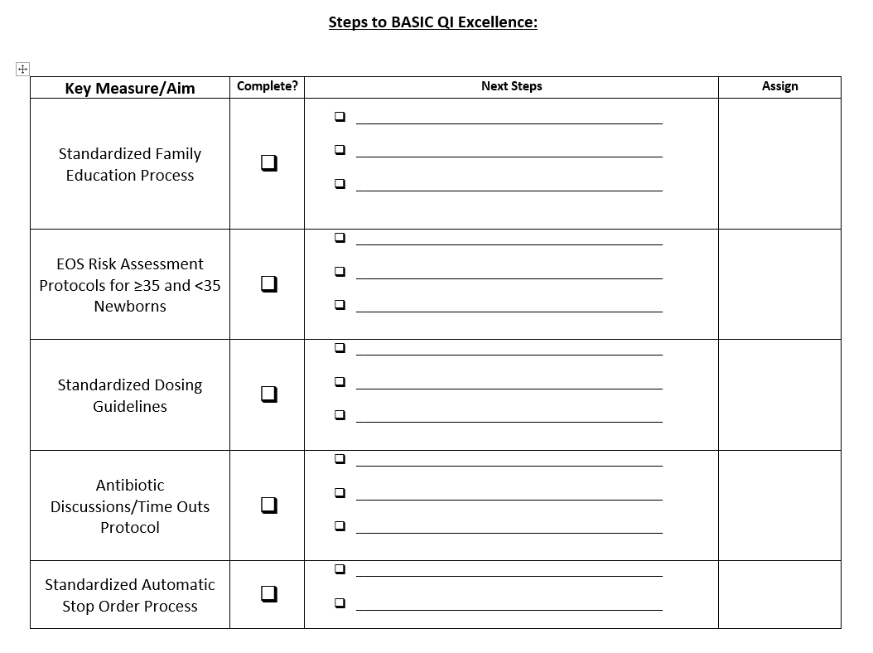
ILPQC Resource for BASIC Success!
Use this tool at monthly QI Team meeting to:
  Determine which Key BASIC Measures your team is still working on
  Determine next steps
  Assign tasks

Slide 32

Getting to Green:
Key BASIC Structure Measures
Notes:
Ellie to Review BASIC F2F slides and see what can be adapted for this call

Slide 33
BASIC Structure Measures for QI Excellence
Right Antibiotics
  Standardize Dosing Guidelines
Right Babies
  EOS Risk Assessment Protocols for ≥35 and <35 Newborns
  Standardized Parent/Family Education
Right Amount of Time
  Antibiotic Discussions/Time Outs Protocol
  Standardized Automatic Stop Order Process
Notes:
*discuss how structure measures align with our vision
*discuss the concept of:
*Right antibiotics (what structure measures, what we achieved, what we need to focus on in 2022 )
*Right Babies (what structure measures, what we achieved, what we need to focus on in 2022 )
*Right Time (what structure measures, what we achieved, what we need to focus on in 2022 )

Slide 34


Right Antibiotics:
Standardized Dosing Guidelines
Stay current with AAP antibiotic dosing recommendations
Educate healthcare team on AAP guidelines to establish best practices
Utilize ILPQC BASIC Toolkit for resources
Communicate updates to clinical teams
(email, daily huddles, boards, etc.)
Notes:
Why: reduces variation in care, expedites ordering process for a common clinical scenario, aligns clinical practice with BASIC AIMS, healthcare team educate together on best practices

Slide 35


Right Babies:
Standardized EOS Risk Assessment Protocols
Standardize use of NEOSC as part of workflow
Educate on use of the NEOSC to ensure consistency
Determine best integration method for your hospital
Develop systematic process for documentation of EOS risk
Notes:
Why: Increase percentage of physicians and nurses educated about early-onset sepsis (EOS) risk factors, assessment tools, and guidelines & Increase percentage of newborns with documented use of EOS risk assessment tools at delivery

Slide 36



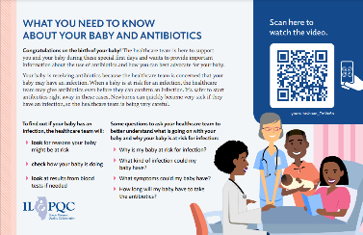

Right Babies:
Standardized Parent/Family Education
Standardized workflow providing education to every parent/family every time
Equitable, Respectful care practices for neonatal patients and their families

Slide 37

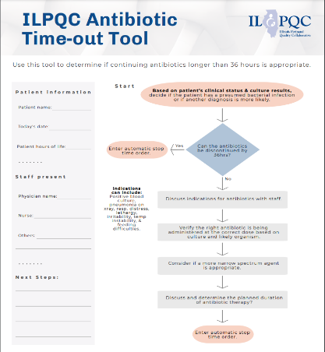
Right Amount of Time:
Antibiotic Time Out Process
Process for every baby, every time
Brief team antibiotic length/plan discussion
Use ILPQC Time out tool or similar process
Standardized antibiotic timeout workflow
Notes:
Why: Increase percentage of newborns with care team discussing and documenting plan for length of antibiotic course for standardization
*Paint a workflow for teams to follow
Understand the "process" for teams to follow, not just about the timeout tool (one way to get to green, not the only way)

Slide 38

Right Amount of Time:
Standardized Automatic Stop Order Process
PDSA Part 1:
Standardized Workflow/Process
Next Steps:
Ensuring every baby, every time
PDSA Part 2:
Implement Process in EMR
QI team, IT, & Pharmacy collaborate
Act: Adopt, adapt, abandon
Plan: Educate team on tools, guidelines
Study: Determine if pilot workflow effective
Act
Plan
Do:
Implement pilot workflow
Study
Do
Notes:
Why: Increase percentage of physicians and nurses educated about early-onset sepsis (EOS) risk factors, assessment tools, and guidelines & Increase percentage of newborns with documented use of EOS risk assessment tools at delivery
*

Slide 39
BASIC Team Talk
Tonya Mangiaguerra, MSN, APN, ACCNS-N, RNC-NIC| NICU APN, CNS
Edward Hospital, Naperville IL
Notes:
-waiting for slides 07.14.22

Slide 40
Q&A
Come off mute or submit your questions in the chat!

Slide 41
Wrap-up and Next Steps

Slide 42
Upcoming Call Schedule
Month | Topic
July | Preparing to Accept your Award at Annual Conference
August | Using your BASIC data to tell a story
September | TBD
October | 10th Annual Conference
What topics would be helpful to get your BASIC Team across the finish line?

Slide 43
Next Steps for BASIC
Celebrate your QI team if you received a BASIC Data Champion gift card or QI award! Take a photo and submit to info@ilpqc.org
Determine which Structure Measures are still in progress and next steps
Continue with QI Team meetings and data sharing
Review REDCap reports and contact info@ilpqc.org to schedule personalized 1-1 call to review reports, data, progress, etc.

Slide 44










Thanks to our Funders
In kind support:

