Slide 1

Getting to Green:
Key PVB Structure Measures
Monday, June 27th 2022 at 12:30 PM

Slide 2
Overview:
2022 Face-to-Face Recap
PVB Data Review
Getting to Green: Key PVB Structure Measures
Team Talk: Elmhurst Hospital, Kate Aliaga MSN, RNC-OB, C-EFM, Clinical Nurse Educator for Labor and Delivery
PVB Next Steps
TeamBirth: Opportunity for hospitals to participate in a TeamBirth extension of PVB/BE Initiatives
PVB Office Hours
  Join us after the call to ask any questions you may have

Slide 3

Response to Friday’s Supreme Court Decision
“Today’s decision is a direct blow to bodily autonomy, reproductive health, patient safety and health equity in the United States. Reversing the constitutional protection for safe, legal abortion established by the Supreme Court nearly fifty years ago exposes pregnant people to arbitrary, state-based restrictions, regulations, and bans that will leave many people unable to access needed medical care.”
“Abortion is a safe, essential part of comprehensive health care, and just like any other safe and effective medical intervention, it must be available equitably to people, no matter their race, socioeconomic status or where they reside. When abortion is legal, it is safe”
“While the Supreme Court’s decision today is a significant and destructive setback, ACOG’s resolve is unwavering: we will continue to support our members, our community partners and all people in the ongoing struggle against laws and regulations that violate and interfere with the patient-physician relationship and block access to essential, evidence-based health care”
Notes:
ACOG Statement: https://www.acog.org/news/news-articles/2022/06/questions-to-help-hospital-systems-prepare-for-the-widespread-and-devastating-impacts-of-a-post-roe-legal-landscape
AWHONN Statement: https://www.awhonn.org/awhonn-responds-to-supreme-court-decision-on-roe-v-wade/
AWHONN Updated: Position Statement: https://i7g4f9j6.stackpathcdn.com/wp-content/uploads/2022/06/24195823/Final-Health-Care-Decision-Making-for-Reproductive-Care-Rev-2022.pdf

Slide 4
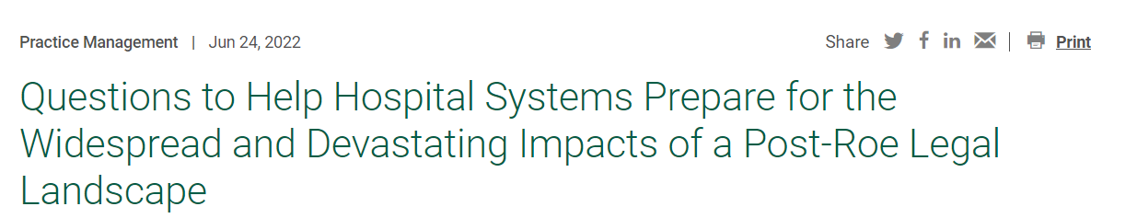
What resources can clinicians use when they are unsure what care they can provide a particular patient under a state’s laws?
Who should be on our hospital’s task force?
For institutions in restrictive states: What is our hospital doing to prepare to potentially transfer and refer patients we are unable to care for at our institution due to state laws or personnel availability?
For institutions in protective states: What is our hospital doing to prepare for a potential surge in patients attempting to access abortion care at our institution?
What is our institution doing to help protect clinicians and their pregnant patients who present for care? Does our institution have a policy and plan to protect healthcare professionals who intervene in life-threatening situations with appropriate medical care from the consequences of abortion bans? What does liability coverage look like in these situations?

Slide 5

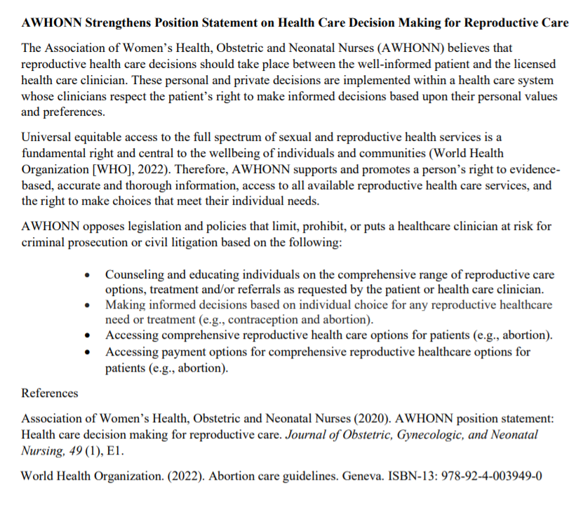
Response to Friday’s Supreme Court Decision
“As we strive for equitable birth outcomes for all that are centered around hearing and valuing the voice of our patients. Legislation that prevents choice and denies basic rights runs counter to these efforts, disproportionately impacting communities of color, those with limited resources, and those who are young. The U.S. Supreme Court is putting the lives and health of pregnant people at risk. ”
“We continue to oppose legislation and policies that limit a health care provider’s ability to counsel patients as to the full range of options and to provide treatment and/or referrals.”
AWHONN updated Position Statement on Health Care Decision Making
Notes:
https://www.awhonn.org/awhonn-responds-to-supreme-court-decision-on-roe-v-wade/
Position Statement https://i7g4f9j6.stackpathcdn.com/wp-content/uploads/2022/06/24195823/Final-Health-Care-Decision-Making-for-Reproductive-Care-Rev-2022.pdf

Slide 6


Face-to-Face Conference Recap
93 hospitals attended
OB Day: 356
Neonatal Day: 272
5 National Speakers
Breakout Sessions:
  15 OB Breakout Sessions
  10 Neonatal Breakout Sessions
Storyboards:
  36 OB Storyboards
  26 Neonatal Storyboards
ILPQC will upload slide presentations & recordings in the upcoming weeks

Slide 7
Congratulations ILPQC Storyboard
Excellence Award Winners!!
Congratulations
Level II
Advocate Trinity Hospital
Level II+
Ascension Resurrection
Level III
Advocate Lutheran General
Elmhurst Memorial Hospital
Advocate Christ
Notes:
to be filled in after PC votes

Slide 8

PVB Awards
3
winners
QI Excellence Award: ​(all PVB aims complete!)
6 key structure measures in place​
Achieved all process and outcome measure goals
​
QI Leader Award: ​
6 key structure measures in place​
Achieved at least one process and outcome measure goal
​
QI Recognition Award:​
Have 4-5 key structure measures in place​
Achieved at least one process and outcome measure goal
16
winners
13
winners

Slide 9
NTSV C-Section Rate by Race and
Ethnicity: 2018-2020 Average
NTSV C-Section Race and Ethnicity Data Collection:
Goal: Provide data reports to all teams with their NTSV CS rates stratified by race, ethnicity and insurance status
Bridging PVB and BE initiatives to stratify key measures to identify disparities and address them
"There is no quality without equity"

Slide 10
PVB Hospital Data Form Updates
 | Total | White | Black | Hispanic | Asian | Other
NTSV Deliveries
NTSV Cesarean Deliveries
Legend
Question Already Asked
Proposed New Question
 | Private Insurance | Public Insurance | Uninsured/Self-pay
NTSV Deliveries
NTSV Cesarean Deliveries

Slide 11



NTSV C/S data stratified by race/ethnicity/insurance status: next steps for PVB teams
Prospective Data (April 2022 – end of Initiative) collection ongoing
Retrospective Data (Baseline-March 2022)
  Due August 1st 2022
  Early Bird Due Date Incentive:
    Teams who submitted Baseline-March 2022 Data by June 17th 2022 will receive a $50 Visa Gift Card to treat your PVB QI team to a “QI Celebration”
16 Teams have submitted so far!

Slide 12
Evaluations
Thank you for sharing your feedback via the evaluation link!
Here are some key takeaways:
“Continuing to provide info from different hospitals. The variety of suggestions is always very helpful”
“I feel that the monthly meetings are very helpful”
“Continue to provide your support”
“More interactive polls to keep everyone engaged in the conversation”
“I can't wait until we are able to meet in person again”
“the ILPQC website has a lot of information that is so valuable”

Slide 13
PVB Data Review

Slide 14
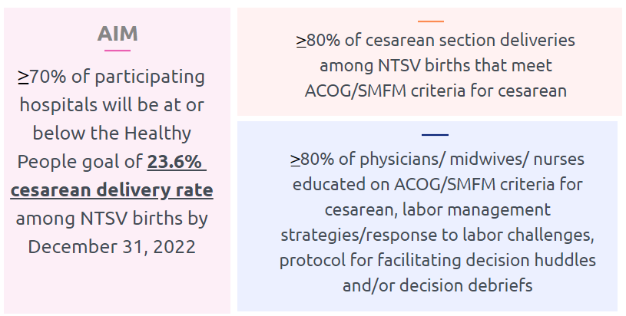
PVB Aims and Measures

Slide 15







PVB Key Strategies for
Creating Clinical Culture Change
Sharing Unblinded Provider-level NTSV C-Section Rates
Review of NTSV C-Section Cases Not Meeting ACOG/SMFM Guidelines

Slide 16
ILPQC Hospital Team Data Submission
(94 Teams Total)
Month | Patient Data | Hospital Data
Baseline | 89 | 85
January 2021 | 86 | 80
February 2021 | 85 | 80
March 2021 | 85 | 79
April 2021 | 81 | 81
May 2021 | 78 | 71
June 2021 | 71 | 71
July 2021 | 76 | 70
August 2021 | 78 | 68
Month | Patient Data | Hospital Data
September 2021 | 75 | 67
October 2021 | 74 | 64
November 2021 | 70 | 64
December 2021 | 70 | 62
January 2022 | 67 | 60
February 2022 | 66 | 61
March 2022 | 69 | 59
April 2022 | 62 | 49
May 2022 | 48 | 40

Slide 17
ILPQC teams NTSV C-Section Rate
23.0
Notes:
Option 1: add lines Show at least 4 in place, 6 in place or working on it
Option 2: 6 SM graphs

Slide 18
NTSV C-Section Rates, by hospital
Goal: < 23.6%
All ILPQC Average: 23%

Slide 19
NTSV C-Sections Meeting
ACOG/SMFM Guidelines (goal > 80%)

Slide 20
NTSV C-Sections Meeting
ACOG/SMFM Guidelines: Failed Induction
ACOG/SMFM Criteria for Failed Induction:
Oxytocin administered for at least 12-18 hours after membrane rupture, without achieving cervical change and regular contractions
Longer duration of the latent phase, 24 hours or longer if <6cm and maternal and fetal status permits

Slide 21
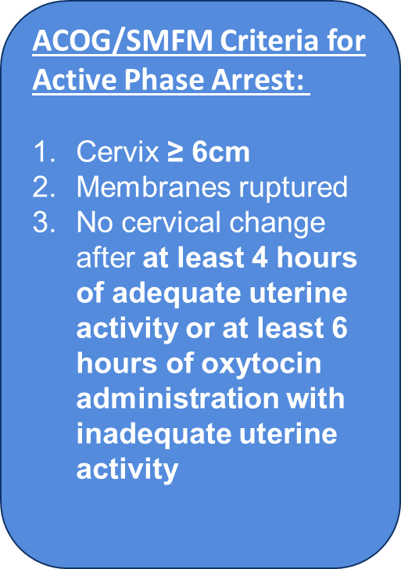
NTSV C-Sections Meeting
ACOG/SMFM Guidelines: Active Phase Arrest

Slide 22
NTSV C-Sections Meeting
ACOG/SMFM Guidelines: Second Stage Arrest
ACOG/SMFM Criteria for Second Stage Arrest:
At least 3 hours* of pushing in nulliparous patients
*Longer durations (e.g. 4 hours with epidural) may be appropriate on an individualized basis

Slide 23
PVB Key Structure Measures:
Helping teams get to GREEN!

Slide 24
PVB Teams Progress on Key Structure Measures

Slide 25
Provider and Nurse Education
Keep it up!

Slide 26

What does it mean to be
GREEN on Provider and Nurse Education?
Do you have a standard process in place to educate providers and nurses on of ACOG/SMFM Guidelines
  Skills days / OB Provider Meeting have leads review guidelines
  Email educational materials
  Education topics during huddles
Have you hosted a PVB Grand Rounds?
Have you displayed Provider Education Posters on your L&D units?
Has your staff attended Labor Management Support training?
  ILPQC Live Virtual Training (August and September 2021)
  Spinning Babies or other in-person courses
  ILPQC Labor Support E-modules (now available!)

Slide 27




Key Resources and Strategies for
Provider and Nurse Education
Provider Education Posters
Missed Opportunity Review
Labor Management E-modules
  Review fallout NTSV C-Sections that did not meet criteria and determine what could have been done differently
  Present successful NTSV vaginal deliveries at OB provider meetings or nursing huddles
  Hang education posters in a place where all providers will see
  Email pdf versions to providers educate on ACOG/SMFM guidelines and key PVB strategies
  Use the comprehension guide to track completion
  Send out an email with a different video each week
  Set up skills days to practice different labor and pushing positions

Slide 28
Standard Protocols and Processes

Slide 29
What does it mean to be GREEN on Standard Protocols and Processes?
Has your hospital implemented updated labor protocols for a unit-standard approach for providing labor support, and freedom of movement?
Has your hospital implemented standard criteria for diagnosis and treatment of labor dystocia, arrest disorders and failed induction based on ACOG/SMFM guidelines?
Has your hospital implemented protocols and support tools for women who present in latent (early) labor to safely encourage early labor at home?
Has your hospital developed a policy to implement intermittent monitoring policies for low-risk women?

Slide 30
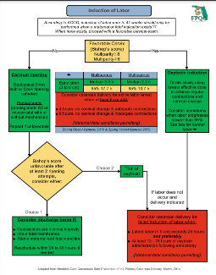
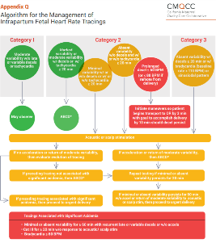
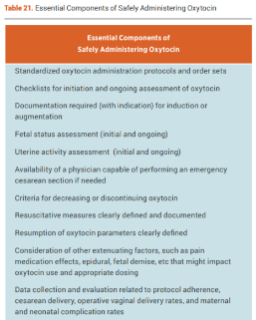
Key Resources and strategies for
Standard Processes and Protocols
FPQC Induction of Labor Algorithm
CMQCC Essential Components of Safe Pitocin administration
CMQCC Algorithm for management of intrapartum FHR tracing

Slide 31
Sharing Provider Level Data

Slide 32
What does it mean to be GREEN on Sharing Provider-Level Data?
Does your hospital have a process to share un-blinded provider-level NTSV C-section rates?
Tips to get started with sharing un-blinded data:
  Involve your PVB Provider Champion
  Explain the “why” to providers and staff
  Create open space to share provider-level data
    via email, department meetings, unit boards, etc.
  Implement a timeline to review provider-level data
    Provide quarterly provider-level data
    Annual un-blinded sharing of provider-level data

Slide 33
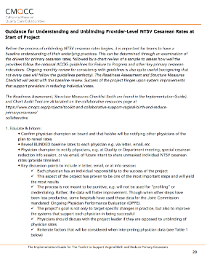
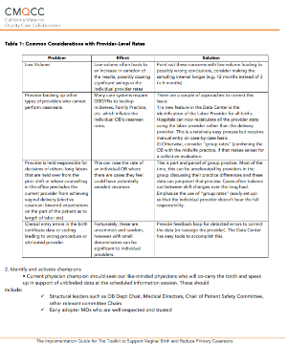
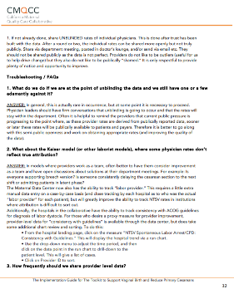
Key Resources and strategies for
Sharing Provider-Level Data
CMQCC Guidance for Understanding and Unblinding Provider-Level NTSV Cesarean Rates
Step by Step Guidance and timeline to
un-blinding data
Common Considerations and barriers to sharing un-blinded data
Troubleshooting and FAQs

Slide 34
Cesarean Decision Checklists and Decision Huddles/Debriefs

Slide 35
What does it mean to be GREEN?
Do you have a standard process to use the Cesarean Decision Checklist for every potential C-Section?
  Availability of checklist in patient's labor room or in EMR
  Who initiates the huddle and use of checklist? Charge nurse / bedside nurse?
  Documentation of use of checklist or review of ACOG/SMFM Guidelines with every C-Section
Do you have a standard process to perform Delivery Decision Huddles/Debriefs?
  Huddle performed with physician, nurse, any other care team members, and the patient to discuss potential C-Section decision, incorporate ACOG / SMFM guidelines / checklist
  Can also incorporate into 2 hour pushing huddle

Slide 36
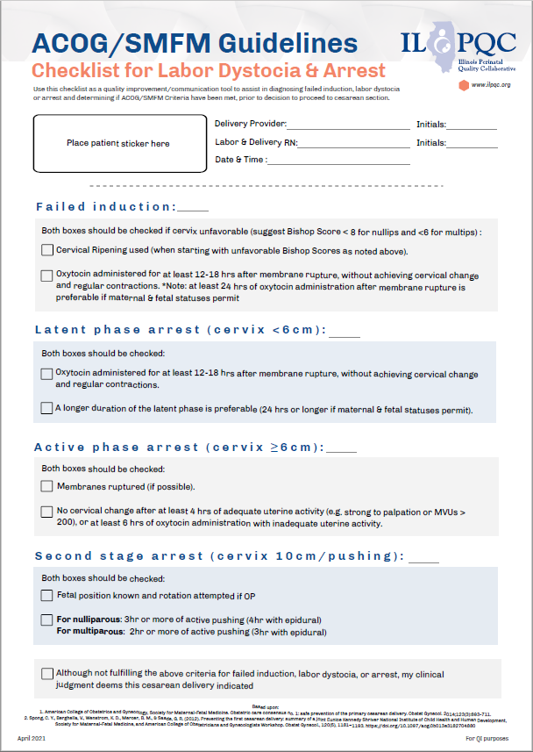
Key Resources and Strategies for
Checklists and Decision Huddles
Integrate the checklist into your EMR for documentation with every NTSV cesarean delivery
Include checklist with admission packet to L&D
Empower nurses to initiate use of checklist and huddles as a communication tool
Require documentation of checklist and/or collect filled out checklists
Meet with providers who are resistant to use of checklist to better understand their concerns

Slide 37
Shared Decision Making and Patient Education
Notes:
Focus for today

Slide 38
What does it mean to be GREEN?
Do you incorporate Shared Decision Making into cesarean decisions?
  Implemented workflow process to incorporate shared decision making with the patient
    Decision huddles = patient involvement
Do you have a standard process for education for all patients?
  Implemented standardized patient education with positive messaging see PVB toolkit for materials
    Collaborate with OB offices to incorporate prenatally
Notes:
Patients have the opportunity to obtain personalized information about their treatment options with the goal of improving their ability to make an autonomous decision.
Inclusion of patient in Decision Huddles

Slide 39
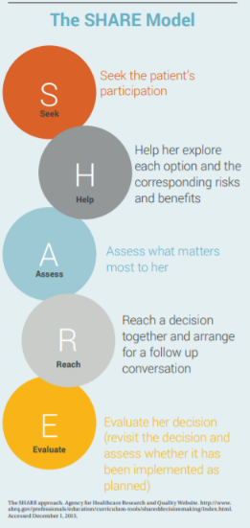


Key Resources and strategies for Shared Decision Making and Patient Education
Know Your Options poster
SHARE model infographic
My Birth Matters from California Health Care Foundation
Notes:
Resources for Standardized Patient Education materials, SHARE Model (for providers/clinical team)

Slide 40

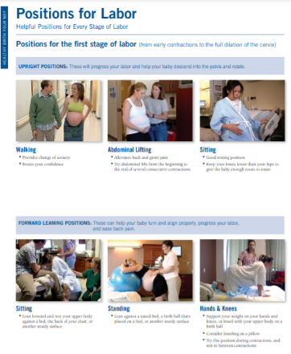
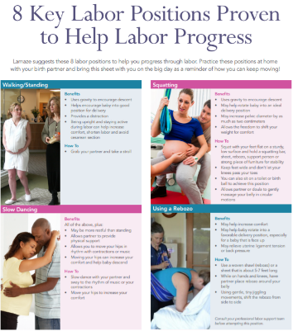
Key Resources and strategies for Shared Decision Making and Patient Education
Keep Calm and Labor On
Positions for Labor
Positions for Labor Progress
Notes:
Standardized Patient Education Materials to support vaginal birth

Slide 41
Team Talk: Elmhurst Hospital
Kate Aliaga MSN, RNC-OB, C-EFM
Clinical Nurse Educator | Labor and Delivery

Slide 42
Elmhurst Hospital
PVB Team Talk

Slide 43


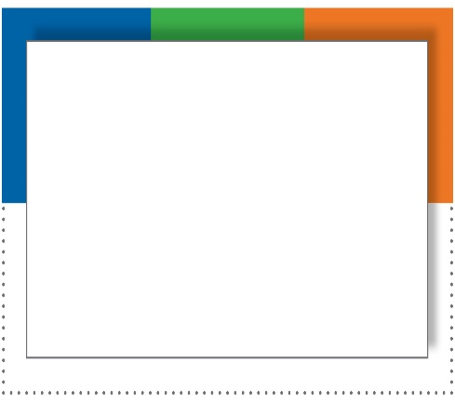
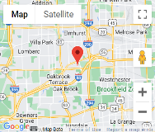


Elmhurst Hospital
Elmhurst is part of Edward-Elmhurst Health and recently merged with NorthShore
Level IIE and part of University of Chicago Perinatal Center
2800+ deliveries per year
Magnet Hospital and Planetree Gold Certified
Straight A every year since Leapfrog began in 2012
Participate in ILPQC quality initiatives and received all QI awards for PVB

Slide 44
PVB QI Team
To launch our PVB initiative, we put together a workgroup consisting of the following fabulous women:
  Kate Aliaga MSN, RNC-OB, C-EFM: L&D Nurse Educator/Project Lead
  Dr. Kinley Berger, Medical Director: OB Physician Leader
  Mary Saracco, CNM: Midwife Champion
  Kelly Beringer, BSN, RN: Clinical Data Registrar
  Leadership:
    Pat Bradley, MSN, RN: System Director Women's Health
    Heather Rodriguez, MSN, RN: Director of Patient Care
    Kathy Lindemulder & Erica Price: Clinical Leaders/Nurse Champions
  Nurse Champions:
    Gianna Giuffre: Nurse Champion – Days
    Jennifer Ketelsen: Nurse Champion – Nights

Slide 45
PVB Structure Measures
What Have We Done?
Unblinding provider data
Patient education in triage
Education and awareness (OB meetings, staff meetings, HealthStream and Friday update emails)
Bulletin board in break room with a friendly competition
Spinning Babies & labor support resource binder
Decision checklist, pre-section huddle, and debriefs
Laminated ACOG/SMFM algorithms

Slide 46
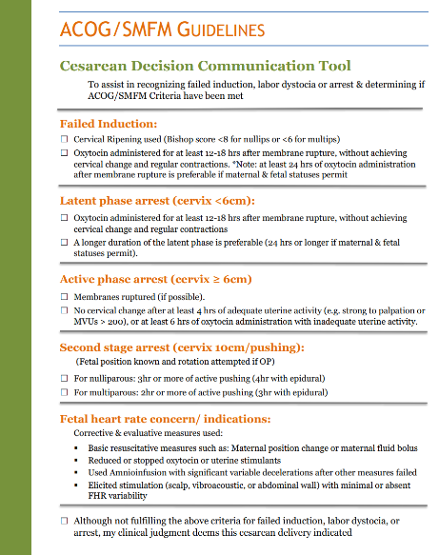
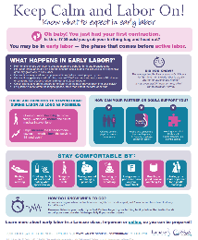
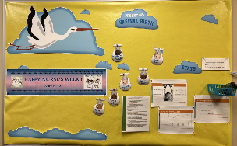

Slide 47

Barriers
Unblinding provider data
Consistent use of checklist and pre-section huddles
Many RNs new to OB specialty

Slide 48
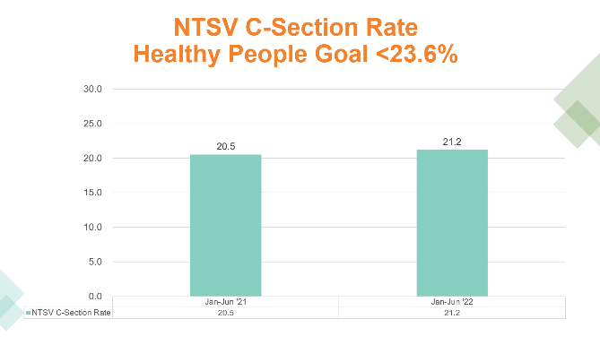
Success Stories

Slide 49


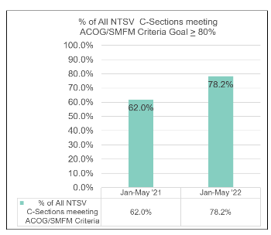
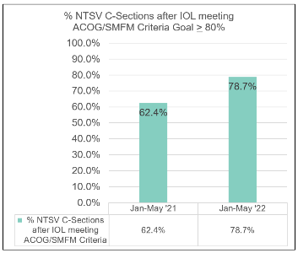
NTSV C-Section ACOG/SMFM Compliance

Slide 50
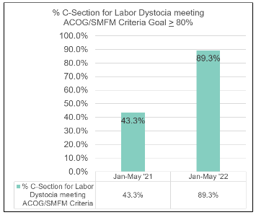
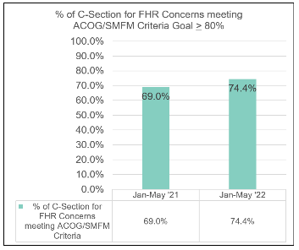
NTSV C-Section ACOG/SMFM Compliance

Slide 51
MANY Success Stories
RNs advocate for patients
Providers asking for Spinning Babies moves
  Primip patient 9 cm for many hours and provider asked if anyone could do any Spinning Babies moves – RN went in to do side lying release and the jiggle and patient progressed to complete in 30 minutes and delivered vaginally
New nurses feeling empowered to initiate pre-section huddles

Slide 52

Questions?

Slide 53
ILPQC is here to help you get across the finish line!
PVB Finish Line Goals:
QI Excellence Award
6 Key Structure Measures in Place
NTSV C-Section Rate ≤23.6%
80% of Providers and Nurses educated on ACOG/SMFM Guidelines
80% of all NTSV C-Sections Meeting ACOG/SMFM Guidelines
We are here to help!
Want a personalized QI Support Call, email info@ilpqc.org to schedule for additional support!

Slide 54
PVB – helping ALL teams cross the finish line!
Monthly Team Webinars
When:
Grand Rounds
OB Provider Meetings
Provider and Nurse Education
What: Personalized and FREE service to available to all participating teams
How: Email Ellie Suse to schedule today info@ilpqc.org
Topic: Dystocia Management Strategies
NEW! ILPQC Virtual Labor Management Support E-Modules
1-1 QI Support Calls
We are providing 1-1 QI support calls for all teams with C-section rates over 23.6%
Live class recorded and created into 10-20 minute e-modules available for free to all hospitals!
Email Ellie Suse and Alana Rivera at info@ilpqc.org to schedule
July 25th 2022
4th Monday every month at 12:30pm
Next call:
Work to achieve all initiative aims
Complete a sustainability plan
Confirm standardized education
Utilize MNO folders for every OEN
Attend MNO-Neonatal sustainability calls
Notes:
Ellie, can you update this?

Slide 55
PVB QI Support
ILPQC is scheduling 1-1 QI Support calls for teams with an NTSV C-Section rate above the goal of 23.6%
  Total of 31 teams with NTSV C-Section Rates above 23.6% for Q1 2022
  We have held QI Support Calls with 5 teams so far, but we would like to connect with ALL teams not meeting the NTSV C-Section Rate Goal
What can you expect from a QI Support call?
  Reviewing your data together
  Discussing your successes and barriers
  Sharing strategies from other teams to overcome barriers and implement key strategies
Email info@ilpqc.org to schedule your QI Support Call for a Thursday or Friday in July!

Slide 56
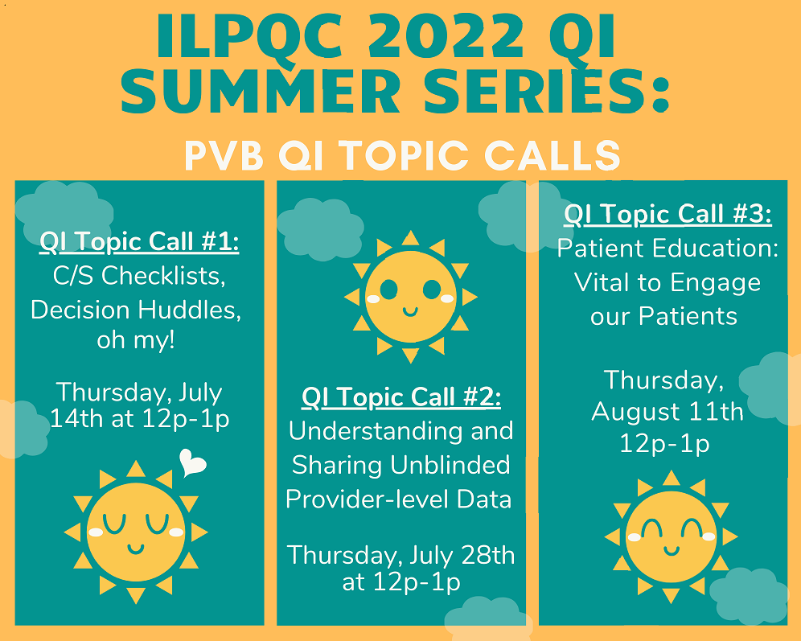
PVB QI Topic Call Summer Series
*PVB Teams who attend all 3 calls will receive a PVB QI Summer Series education tool to share with your clinical teams!
*Register now!
Look for link in the chat!

Slide 57
Opportunity for hospitals to participate in a TeamBirth project as an extension of PVB/BE Initiatives starting late 2023-2024 with free Team Birth Certification
06/27/2022

Slide 58
What is TeamBirth?
A care process innovation involving a series of team huddles between the patient and their care team, designed to empower each team member to contribute information, reliably structure communication, and help the team arrive at shared plans together
Invites patients into conversations about their care and provides a structure that is easy to understand and participate in
Encourages all conversations to be had with the patient to promote effective team communication and alignment across the full team
Patient’s reports feeling engaged in shared decision making, feeling heard and listened to, feel engaged in their care, improved communication across team members

Slide 59
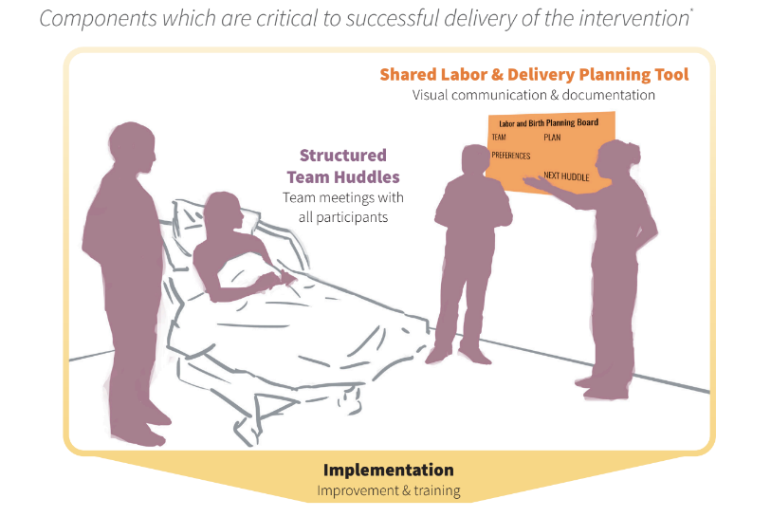
TeamBirth Core Components
Shared Planning Board

Slide 60
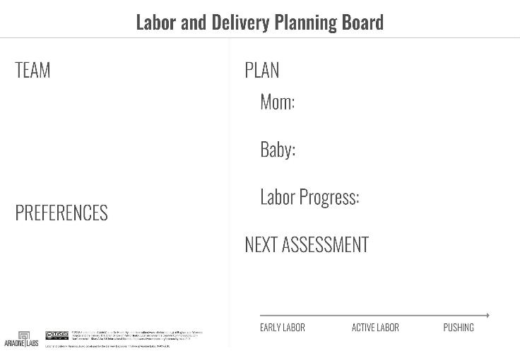
Labor and Delivery Shared Planning Board

Slide 61
What will the initiative look like from the hospital’s perspective?
Train-the-Trainer model – 2 champions from each hospital
Participate in recurring learning and training sessions
  Monthly learning sessions for 4-6 months before launch and 2 months after launch (60- 90 mins each)
  Monthly coaching calls with ILPQC and Ariadne Labs before and after launch (60 mins each and will include an Ariadne clinical implementation specialist)
  Meeting weekly as an implementation team (internal)
  Training your staff (depends on # of employees, ~2 hours/per person)
Board Design
Data collection already in place for ILPQC PVB and BE initiatives

Slide 62
Benefits of Participation
Opportunity to implement Team Birth at your hospital, many hospitals do press release and widely advertise
Project will cover cost of white board and all training costs.
Opportunity to receive otherwise expensive Team Birth training program for your team members, opportunity to be Team Birth trained /certified with costs covered
TeamBirth certification
Improved workplace environment and patient care, improved patient experience scores have been found with Team Birth hospitals

Slide 63
How will hospitals be selected?
Must be participating in both PVB and BE initiatives
If not currently in BE, can still participate if join BE initiative before Team Birth project started
If more hospitals apply then can be covered we will stratify by geography / size and then randomly select

Slide 64
Next Steps: Letter of Support
A letter of support from each interested hospital is requested
These letters will go in with the grant to PCORI (patient centered outcomes research institute) to fund the initiative
Sign and return by July 29th, 2022
If funded project would start in LATE 2023-2024

