Slide 1

Integrating the NEOSC into the EMR
BASIC Monthly Teams Call
April 18th, 2022

Slide 2
Call Overview
Face-to-Face 2022
BASIC Data Review
Patrick Lyons, MD: Integrating the NEOSC into your EMR
Wrap Up

Slide 3

Register now!
Registration link is available at ilpqc.org

Slide 4
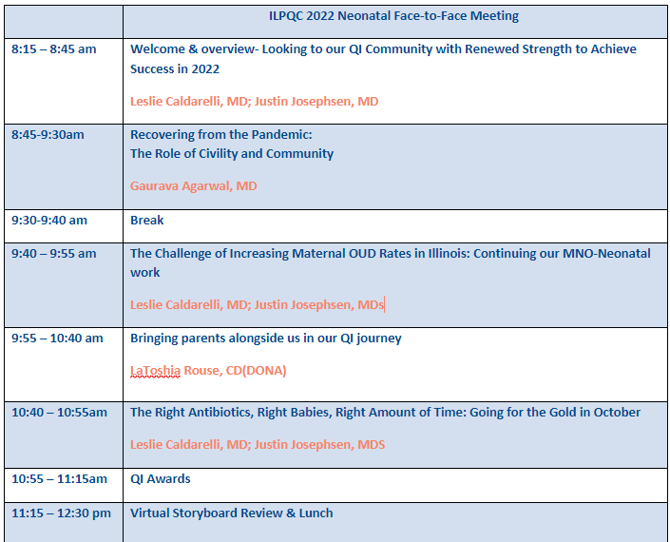
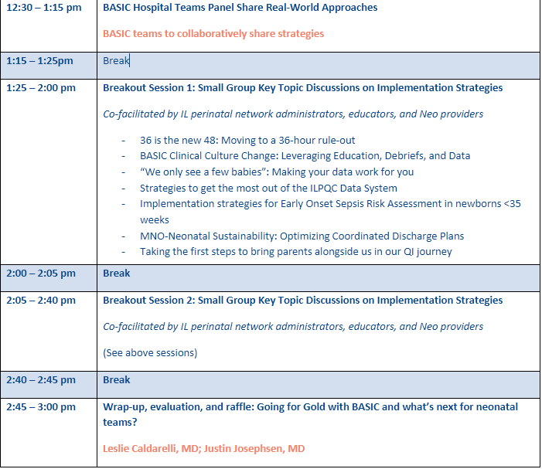
Neonatal Day Face-to-Face Agenda

Slide 5
Neonatal Day Breakout Sessions
36 is the new 48: Moving to a 36-hour rule-out
BASIC Clinical Culture Change: Leveraging Education, Debriefs, and Data
“We only see a few babies”: Making your data work for you
Strategies to get the most out of the ILPQC Data System
Implementation strategies for Early Onset Sepsis Risk Assessment in newborns <35 weeks
MNO-Neonatal Sustainability: Optimizing Coordinated Discharge Plans
Taking the first steps to bring parents alongside us in our QI journey

Slide 6
Face to Face Preparation
Save the Date
Fill out storyboard and send to info@ilpqc.org by May 11th
Data and Awards
Storyboards
Review BASIC award criteria
Make sure all data is entered in REDCap by May 2
Registration is OPEN! Share the registration link with your provider and nursing colleages!
QI Team Photo
Submit a photo of your hospital QI team to info@ilpqc.org by May 11th
Notes:
Dan's notes:
Planning committee recruitment open...first meeting...
Registration Open...
Continuing Education (ONA)…
Submit data for QI Awards...
Storyboard information and submission deadlines...

Slide 7
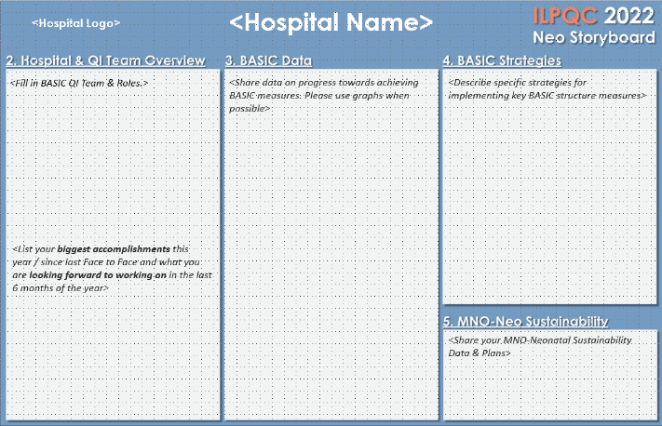
Face-to-Face 2022
Neonatal Storyboard Template
BASIC QI Team and Roles
Biggest accomplishments this year & what are you looking forward to working on in the last 6 months of the year
Data & progress towards achieving BASIC measures
Strategies for implementing key BASIC structure measures
MNO-Sustainability Data & Plans
Instruction sheet available too!

Slide 8

BASIC QI Recognition Awards
All structure & patient-level data entered for Baseline-March 2022 due May 2nd, 2022, at Midnight
Key Structure Measures "In Place":
  Standardized Family Education Process
  EOS Risk Assessment Protocols for ≥35 and <35 Newborns
  Standardized Dosing Guidelines
  Antibiotic Discussions/Time Outs Protocol
  Standardized Automatic Stop Order Process
Achievement of process and outcome level measures (Based on Jan – March 2022 data)
  ≥80% of neonatal/pediatric providers and nurses educated
  20% reduction (or absolute rate of ≤4%) in newborns ≥35 who receive antibiotics
  20% reduction in newborns with a negative blood culture who receive antibiotics for >48 hours
  ≥80% of newborns with anticipated duration of antibiotic course discussed by clinical team (antibiotic time out)
  ≥80% of newborns with an automatic stop order entered into the medical chart
F2F Award Criteria:
Data complete
Structure measures in place
At least 3 process/outcome measures achieved
Teams with complete data for F2F 2022 will received a $50 gift card to treat your QI team to a pizza lunch or coffee and donuts!!
Notes:
Add in incentive
Data complete, structure measures in place, 3 process/outcome measures achieved
Hospital has implemented a process for standardized education for healthcare team on neonatal antibiotic stewardship best practices
Hospital has provided patient standardized education and anticipatory guidance with a focus on equitable care to families on antibiotics, early onset sepsis, and treatment plan for newborn antibiotics and early onset sepsis
Hospital has developed, in coordination with IT department, an electronic reporting system from electronic medical record
Hospital has Implemented Quality Improvement strategies to ensure feedback is provided to the neonatal/pediatric clinical team through one or more of the following components: 1. monitor and share provider-level and/or unit level antibiotics prescribing data; 2. antibiotic debriefs to identify & review neonatal sepsis and antibiotic decisions for consistency with protocols and procedures; 3. report that tracks current inpatient newborns who are receiving antibiotics
Hospital has implemented standardized policies, protocols, and support tools to evaluate risk for early onset sepsis for newborns for ≥ 35 0/7 weeks gestation based on the AAP recommended risk assessment tools.
Hospital has implemented standardized risk assessment algorithm to evaluate risk of early onset sepsis for every neonate < 35 weeks gestation.
Hospital has developed partnerships with obstetric team to standardize communication with the pediatric/neonatal team about maternal risk factors for early onset sepsis.
Hospital has implemented standardized serial assessment of neonates
Hospital has implemented standardized identification of and response to neonates with worsening clinical status.
Hospital has implemented standardized policies, protocols and support tools to assist staff in properly and consistently obtaining blood cultures
Hospital has partnered with inpatient lab to optimize timely processing of blood culture results and communication with care team
Hospital has implemented standardized policies, protocols and support tools to assist staff to stop or de-escalate therapy promptly based on the culture and sensitivity results
Hospital has implemented standardized dosing guidelines and order sets to reduce intra-hospital variation of antibiotic prescribing
Hospital has implemented standardized approach for healthcare team to discuss the anticipated duration of antibiotic course at the initiation of antibiotics (antibiotic time out)
Hospital has implemented standardized automatic stop order process
Hospital has implemented a standardized process to review antibiotic data by race/ethnicity and share with providers and staff.
Hospital has implemented a social determinants of health tool and facilitates coordinated connection to community resources and follow up.

Slide 9
Update on BASIC Progress

Slide 10

BASIC Data Review:
Structure Measures Progress as of March 2022
Keep up the great work:
>35 Risk Assessment Protocol: 89% In Place
<35 Risk Assessment Protocol: 78% In Place
Standardized Dosing Guidelines: 89% In Place
Need to Focus On:
Antibiotic Time Outs: 72% In Place
Automatic Stop Orders: 70% In Place
Family Education: 72% In Place

Slide 11
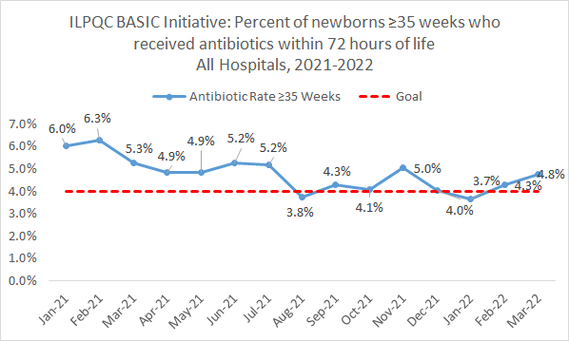
Progress towards achieving BASIC:
≥35 ABX Prescribing

Slide 12
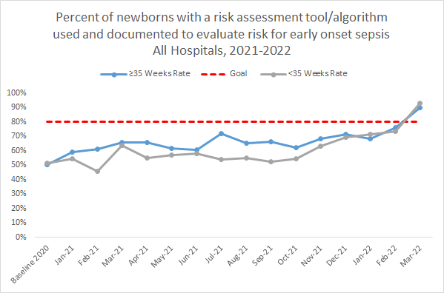
Progress towards achieving BASIC:
EOS Risk Assessment

Slide 13
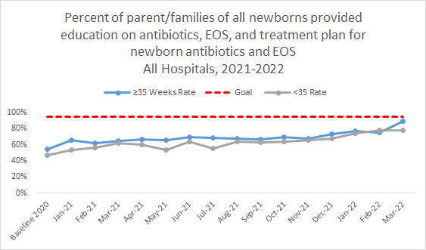
Progress towards achieving BASIC:
Family/Caregiver Education

Slide 14
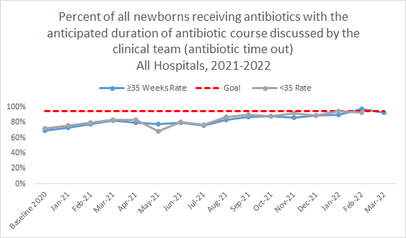
Progress towards achieving BASIC:
ABX Time Out/Discussion

Slide 15
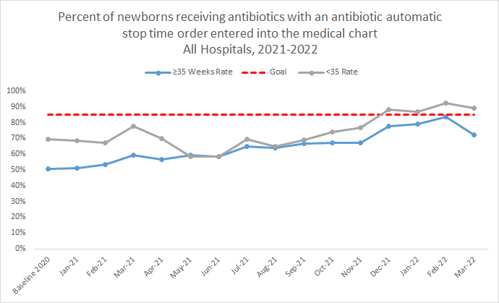
Progress towards achieving BASIC:
Automatic Stop Order

Slide 16
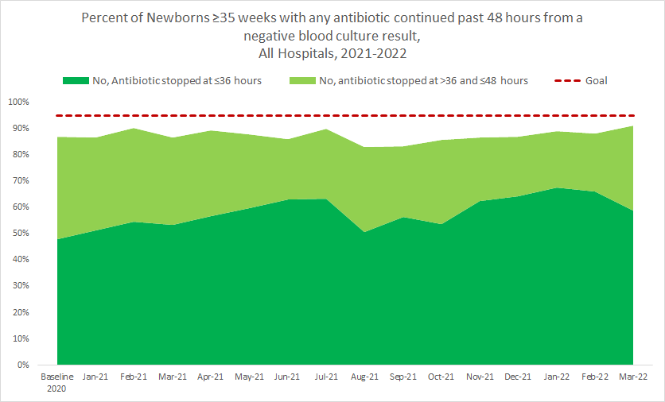
Progress towards achieving BASIC:
≥35 ABX Discontinued

Slide 17
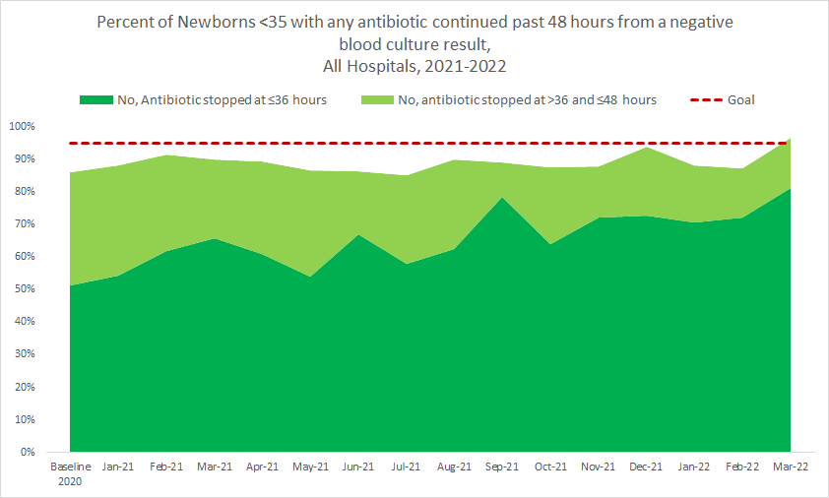
Progress towards achieving BASIC:
<35 ABX Discontinued

Slide 18
Integrating the NEOSC into your EMR

Slide 19
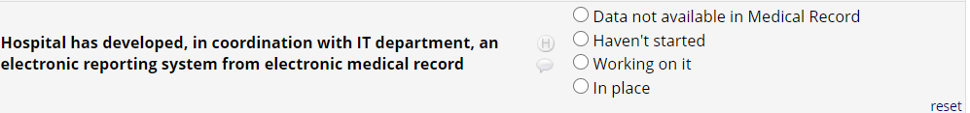
EMR Utilization in ILQPC Data System
Monthly Hospital Data Form Questions:

Slide 20
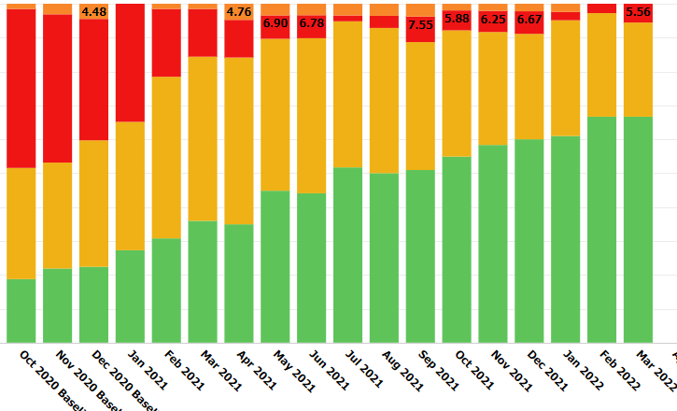
Development of Electronic Reporting
System from EMR
28% Working on It
67% In Place

Slide 21
Get to Green:
Electronic Reporting System in EMR
WHAT DOES IT MEAN TO BE AT GREEN WITH IMPLEMENTING REPORTING SYSTEM IN EMR?
Have reports built into your EMR to support QI work and data entry/reporting
Have EMR systems implemented for clinical decision support (i.e. dot phrases/order-sets)
Notes:
clinical decision support an data entry and reporting

Slide 22
BASIC Monthly Webinar:
Data Reporting & Clinical Decision Support
Patrick Lyons, MD
Lurie Children‘s Hospital

Slide 23
Objectives for Today’s Call
EMR Question on the Hospital Data Form
Data Reporting: Burdensome to Sustainable
Clinical Decision Support: Order Sets and Epic integrated Kaiser Calculator
Future Initiatives

Slide 24

ILPQC BASIC
Vision: ILPQC hospitals, regardless of perinatal level or past experience with implementing newborn antibiotics initiatives, will implement best practices to provide: the right antibiotics for the right babies for the right duration
AIMs:
Decrease by 20% (or absolute rate of 4%) the number of newborns, born at ≥35 weeks who receive antibiotics
Decrease by 20% the number of newborns with a negative blood culture who receive antibiotics for longer than 36 hours

Slide 25
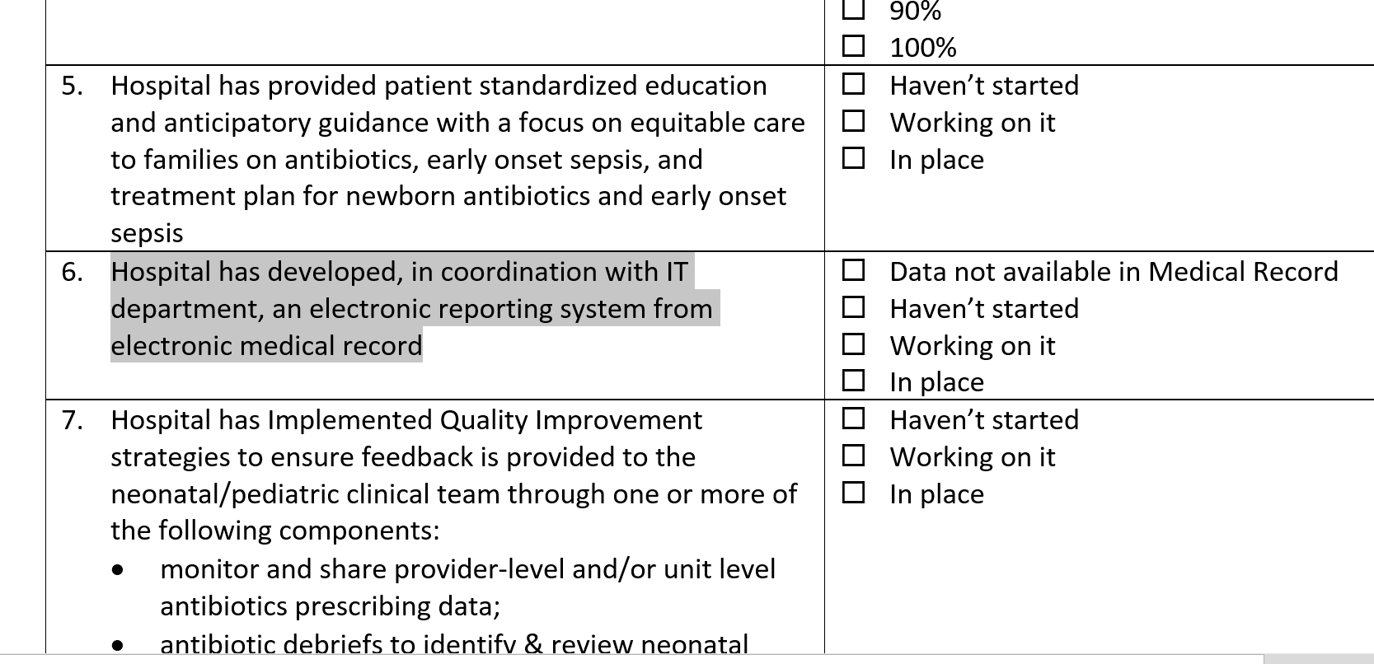
Hospital Data Form

Slide 26

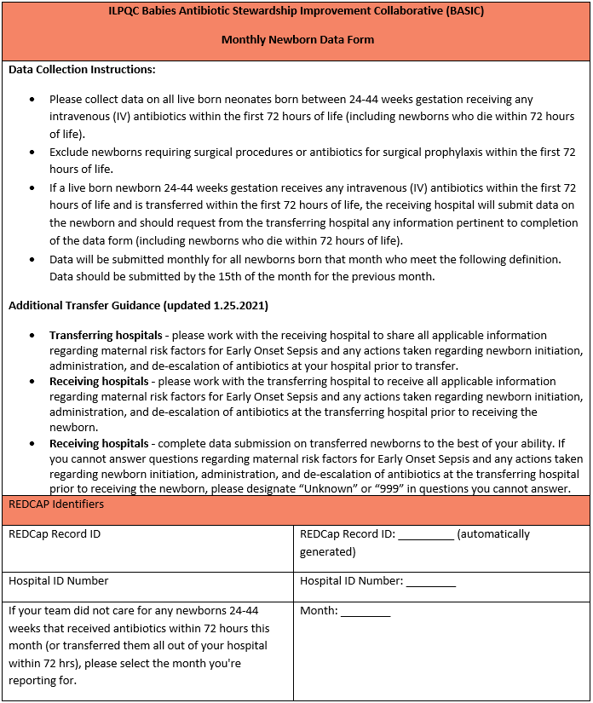




Data Entry & Reporting
EMR Data
Data Form

Slide 27
Example 1: No Reporting
Manual (log sheet, clip board, etc) tracking patients <72h of life who receive IV antibiotics

Slide 28
Example 2: Minimal Reporting
Ideal for institutions with lower patient volumes (especially those with low antibiotic usage)
Scope:
  Create automated process (report) identify all patients <72h of life who received IV antibiotics
  Results in a work intensive manual chart review for data extraction
  Data is then manually entered into REDCap
Next steps:
  Identify other data form questions that are discreetly stored and reportable in your EMR and add those fields to the report
    Prioritize information that is already recorded (no workflow change required)

Slide 29
Example 3: Cadillac of Reporting
Ideal for institutions with high patient volumes (especially those with high antibiotic usage)
Scope:
  Eligible patients are identified and a report is generated that captures the answer for every data form question without any manual chart review
  Data is formatted to match REDCap in such a way that interfacing and uploading does not require manual entry
Is This the Goal?:
  Pro: Once set up there will be minimal data collection and entry efforts going forward – sustainable!
  Cons: Significant upfront investment. Workflows and documentation practices may need to be modified to make data abstraction possible. Future EMR updates and changes need to be taken into account to ensure accuracy of reports.
  As you make progress in decreasing antibiotic usage you will have fewer patients on antibiotics that require review

Slide 30
Clinical Decision Support (CDS)
Software that “[provides] clinicians, patients or individuals with knowledge and person-specific or population information, intelligently filtered or presented at appropriate times, to foster better health processes, better individual patient care, and better population health”
  Karsh B-T. Clinical practice improvement and redesign: how change in workflow can be supported by clinical decision support. Rockville: Agency for Healthcare Research and Quality; 2009.
A substantial body of evidence exists to suggest that clinical decision support systems can be extremely effective.
Evidenced Informed Reduced Variability in Care

Slide 31
Prime Example of CDS: Order Sets
A group of orders that standardizes & expedites the ordering process for a common clinical scenario
Reduce variation in care
Align clinical practice with BASIC AIMS
Educate healthcare team on best practices

Slide 32
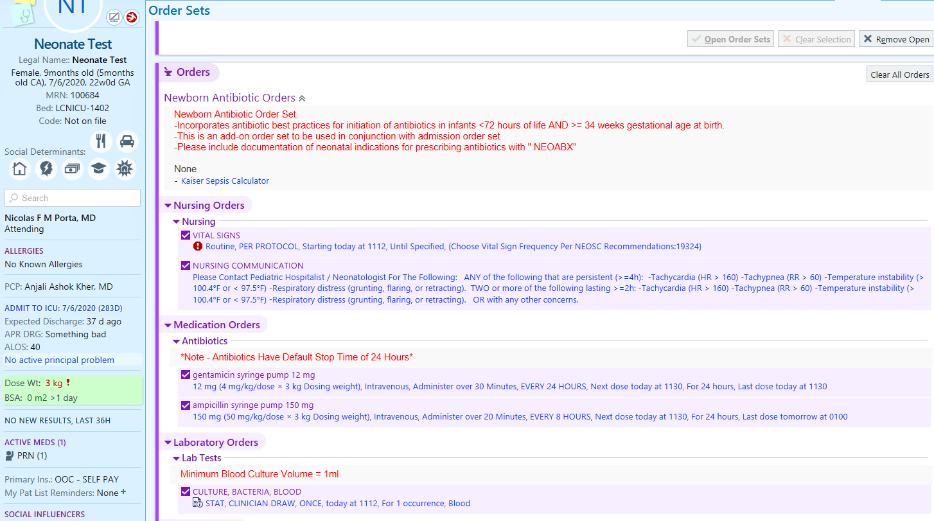

Slide 33
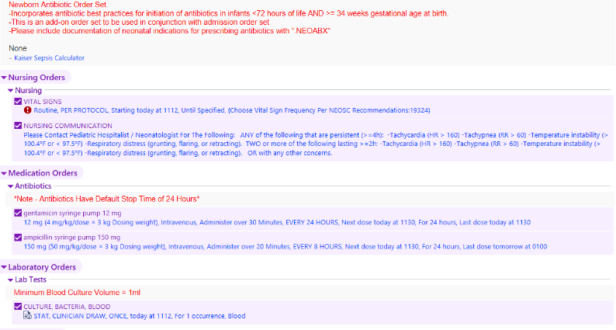
Link to Kaiser calculator

Slide 34
Vital Sign Frequency
Based on Kaiser EOS

Slide 35
Serial Assessment Protocols

Slide 36
Standardized Antibiotic Dosing

Slide 37
Default Stop Times

Slide 38
Blood Culture Best Practices

Slide 39
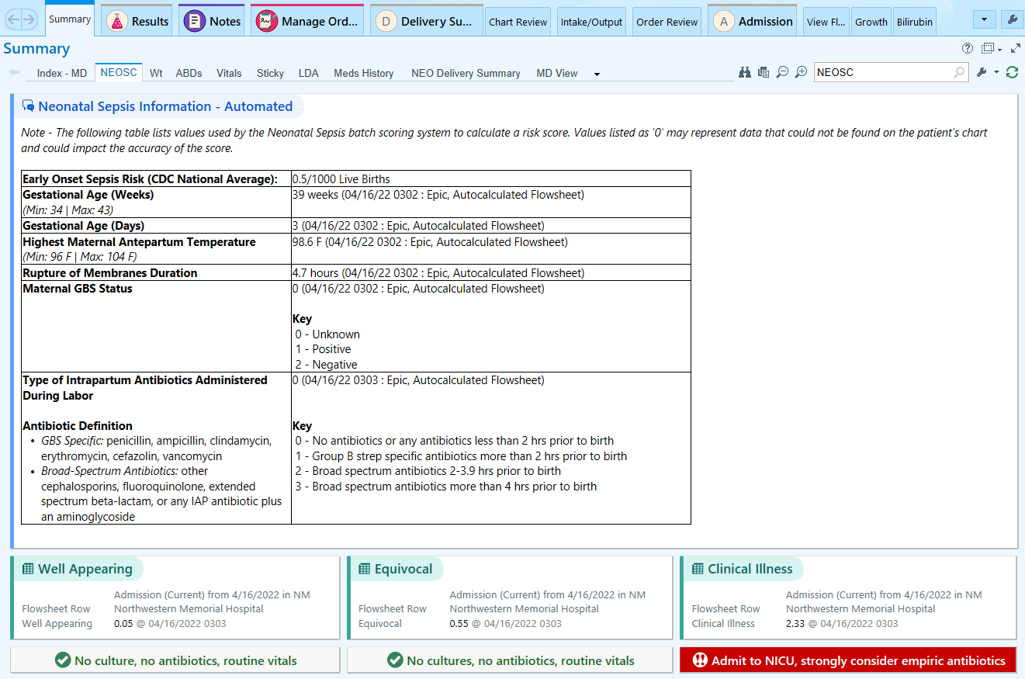
Kaiser Sepsis Calculator

Slide 40
Future Initiatives
The EMR is a powerful tool that has become an integral part of providing patient care
Everyone on this call is involved in some aspect of your hospital’s workflow. An understanding of the EMR capabilities will allow you to fully leverage this tool to support current and future QI efforts
Establishing a working relationship with IT and DAR/EDW will set you up for success

Slide 41
Questions?

Slide 42
Wrap-up and Next Steps

Slide 43
Upcoming Call Schedule
Date | Topic
May 26, 2022 | ILPQC 2022 Face-to-Face Meeting
June 20, 2022 2-3 PM | TBD
July 18, 2022 2-3 PM | TBD
August 15, 2022 2-3 PM | TBD
What topics would be helpful to get your BASIC Team across the finish line?

Slide 44
Next Steps for BASIC
Review Face-to-Face to-dos!
  Register for the meeting now!
  Submit QI Data by May 2nd
  Submit QI Storyboard by May 11th
  Submit team photo by May 11th (to be included in raffle!)
Continue working towards goals to be achieved by Face-to-Face
Review Structure Measures and Face-to-Face Award Criteria
Continue with QI Team meetings and data sharing

Slide 45


UIC Perinatal Network:
Neonatal Equity Virtual Conference
Register at:
https://sites.google.com/uic.edu/apc2022-neonatalequity/home

Slide 46










Thanks to our Funders
In kind support:

