Slide 1

PVB Monthly Webinar:
Shared Decision Making and Patient Education
March 28, 2021 12:30-1:30

Slide 2
Overview:
2022 Face-to-Face Updates
PVB Data Review
Shared Decision Making and Patient Education PVB Resources
TeamBirth: Process Innovation for Clinical Safety, Effective Communication, and Dignity in Childbirth
Team Talk: Loyola University Health System
PVB Next Steps
PVB Office Hours
  Join us after the call to ask any questions you may have

Slide 3


ILPQC Spring 2022 Face-to-Face

Slide 4


2022 OB & Neonatal Face-to-Face Meetings
Obstetric May 25, 2022
Neonatal May 26, 2022
2022 ILPQC 10th Annual Conference
Thursday, October 27, 2022
Registration Opening April 4th, 2022
VIRTUAL
Planning committee recruitment has begun! If you or a colleague are interested please email info@ilpqc.org

Slide 5
PVB QI Excellence Award
All structure & patient-level data entered for Baseline-March 2022 (will provide pass for December and January data given surge) due May 2nd
Key Structure Measures "In Place":
  Implemented provider and nurse education and other strategies to achieve buy-in
  Implemented standardized protocol/processes for induction, labor support management and response to labor and fetal heart rate abnormalities
  Integrated process to review and share data with clinical staff and sharing transparent provider-level data.
  Implemented cesarean decision checklist using ACOG/SMFM labor guidelines
  Implemented decision huddles and/or decision debriefs with appropriate care team to standardize use of ACOG/SMFM guidelines and checklist
  Implemented workflow process to incorporate shared decision making with the patient
Achievement of process and outcome level measures (Based on Jan – March 2022 data)
  80% of Nurses and Providers Educated
  80% of all NTSV C-Sections Meeting ACOG/SMFM Guidelines for January-March 2022
  NTSV C-Section Rate below 23.6% for January-March 2022
Face-to-Face
QI Leader Award Criteria:
Data complete
+
Key structure measures in place
+
1 Process/outcome measure met

Slide 6
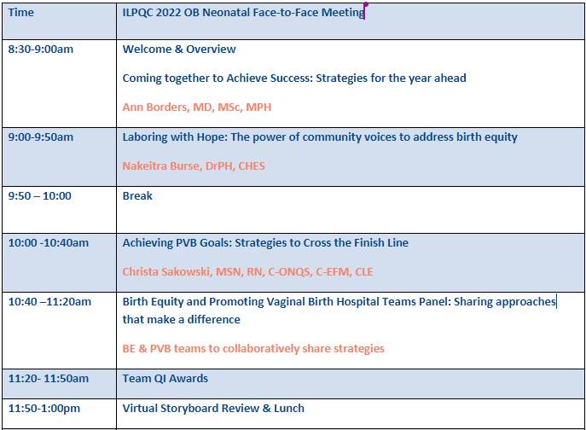

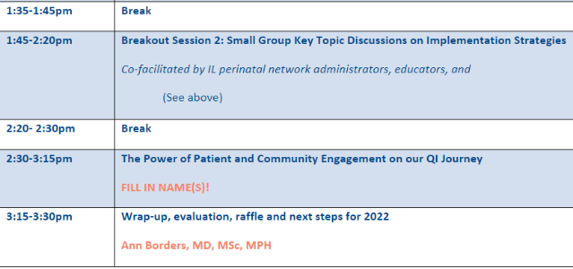
OB Day Face-to-Face Agenda

Slide 7
OB Day Breakout Sessions
PVB: Sharing Provider Data and Using Data to Drive QI
PVB: Checklist and Huddles Strategies
PVB: Patient Education & Shared Decision Making
BE: Social Determinants of Health Screening and Linkage to Resources
BE: Implementation of Respectful Care Practices and the PREM survey
BE: Implementation of Implicit Bias Training and Equity Discussions
MNO-OB: Strategies to Address Maternal Overdose Deaths and Sustain Optimal OUD Care

Slide 8
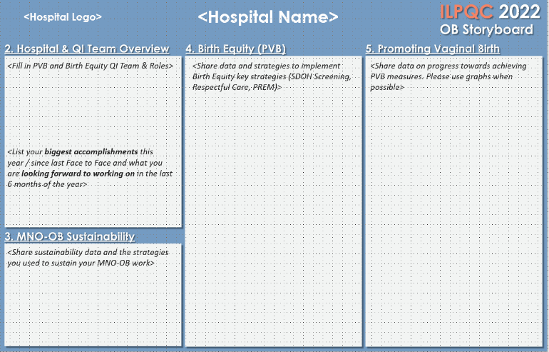

Face-to-Face 2022
OB Storyboard Template

Slide 9
Face to Face Preparation Recap
Save the Date
Get involved
Fill out storyboard and send to info@ilpqc.org by May 11th
Data and Awards
Storyboards
Email info@ilpqc.org to join planning committee or help facilitate breakout session by March 25th
Make sure all data Baseline-March 2022 is entered in REDCap by May 2nd, 2022
Registration opens April 4th, 2022- share save the date with your provider and nursing colleages!
QI Team Photo
Submit a photo of your hospital QI team to info@ilpqc.org by May 11th to be in the running for a raffle!

Slide 10
PVB Data Review

Slide 11
Supporting vaginal birth and reducing primary Cesareans for optimal maternal and neonatal outcomes
Aim: 70% of participating hospitals will be at or below the Healthy People goal of 23.6% cesarean delivery rate among NTSV births by December 31, 2022
Goal: Increase the percent of cesarean section deliveries among NTSV births that meet ACOG/SMFM criteria for cesarean
Goal: Increase the % of physicians/ midwives/ nurses educated on ACOG/SMFM criteria for cesarean, labor management strategies/response to labor challenges, protocol for facilitating decision huddles and/or decision debriefs
UPDATED GOAL based in Health People 2030

Slide 12
Clinical Culture Change
Identifying NTSVs and recognition for clinical team
Education of ACOG/SMFM criteria for providers and nurses
Implementing cesarean decision checklists and huddles
Labor management support
Un-blinding provider data
Standardized Patient Education and Shared Decision Making

Slide 13
ILPQC Hospital Team Data Submission
(94 Teams Total)
Month | Patient Data | Hospital Data
Baseline | 89 | 85
January 2021 | 86 | 80
February 2021 | 85 | 80
March 2021 | 85 | 78
April 2021 | 81 | 78
May 2021 | 78 | 71
June 2021 | 71 | 70
July 2021 | 76 | 68
Month | Patient Data | Hospital Data
August 2021 | 76 | 64
September 2021 | 72 | 62
October 2021 | 71 | 58
November 2021 | 63 | 56
December 2021 | 63 | 52
January 2022 | 54 | 40
February 2022 | 43 | 33

Slide 14
Reducing Data Burden
We have spoken to teams about how best to reduce data burden during this challenging time
Based on teams suggestions, we will pause collection of PVB vaginal birth data for January – June 2022
Please continue to submit hospital level data and patient data for cesarean births

Slide 15
Provider and Nurse Education
Keep it up!

Slide 16
Standard protocols and processes

Slide 17

What does it mean to be green on Standard protocols and processes?
Has your hospital implemented updated labor protocols for a unit-standard approach for providing labor support, and freedom of movement?
Has your hospital implemented standard criteria for diagnosis and treatment of labor dystocia, arrest disorders and failed induction?
Has your hospital implemented protocols and support tools for women who present in latent (early) labor to safely encourage early labor at home?
Has your hospital developed a policy to implement intermittent monitoring policies for low-risk women?

Slide 18
EMR Integration
Notes:
Drop?

Slide 19
Sharing Provider Level Data

Slide 20
Cesarean Decision Checklist

Slide 21
Decision Huddles/Debriefs

Slide 22
Shared Decision Making
Notes:
Focus for today

Slide 23
Standardized Patient Education

Slide 24
ILPQC NTSV C-Section Rates
26%
26%
26%
23%

Slide 25
NTSV C-Section Rates, by hospital
Goal: < 23.6%
All ILPQC Average: 23%

Slide 26
NTSV C-sections meeting
ACOG/SMFM Criteria, across hospitals
Goal: >80%
82%
80%
68%
60%
60%
53%
59%
40%

Slide 27
Where do we need to focus improvements for meeting ACOG/SMFM Guidelines?
ACOG/SMFM Criteria for Failed Induction:
Oxytocin administered for at least 12-18 hours after membrane rupture, without achieving cervical change and regular contractions
Longer duration of the latent phase, 24 hours or longer if <6cm and maternal and fetal status permits
Notes:
?

Slide 28
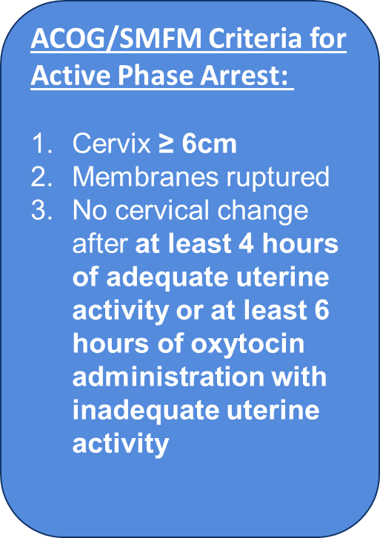
Where do we need to focus improvements for meeting ACOG/SMFM Guidelines?

Slide 29
Where do we need to focus improvements for meeting ACOG/SMFM Guidelines?
ACOG/SMFM Criteria for Second Stage Arrest:
At least 3 hours of pushing in nulliparous patients
Fetal position known and rotated if OP
At least 2 hours of pushing in multiparous patients
Longer durations (e.g. 4 hours with epidural) may be appropriate on an individualized basis

Slide 30
Patient Education and Shared Decision Making

Slide 31
Shared Decision Making
Shared decision making is a patient-centered, individualized approach to the informed consent process that involves discussion of the benefits and risks of available treatment options in the context of a patient's values and priorities.
Allows patients to obtain personalized information about their treatment options with the goal of improving their ability to make an autonomous decision.
Improves patient knowledge around their care, allow for better understanding of risk, and improve patient outcomes and satisfaction
ACOG Committee Opinion: Informed Consent and Shared Decision Making in Obstetrics and Gynecology

Slide 32
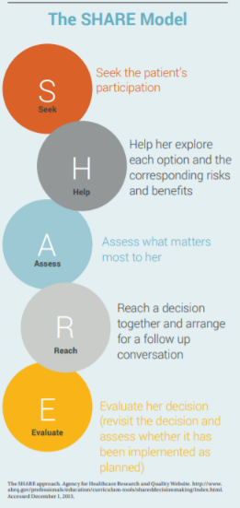


PVB Toolkit Resources:
Know Your Options poster
SHARE model infographic
My Birth Matters from California Health Care Foundation
Notes:
Resources for Standardized Patient Education materials, SHARE Model (for providers/clinical team)

Slide 33

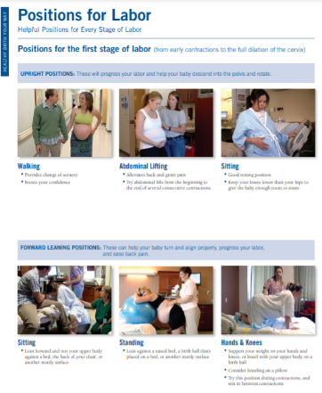
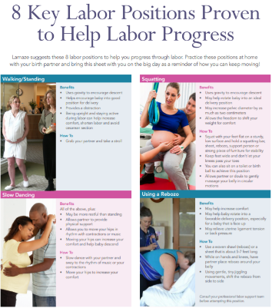
PVB Toolkit Resources
Keep Calm and Labor On
Positions for Labor
Positions for Labor Progress
Notes:
Standardized Patient Education Materials to support vaginal birth

Slide 34
TeamBirth: Process Innovation for Clinical Safety, Effective Communication, and Dignity in Childbirth
Amber Weiseth, DNP, MSN, RNC-OB

Slide 35


TeamBirth: Process Innovation for Clinical Safety, Effective Communication, and Dignity in Childbirth

Slide 36


Our vision is a world in which every person can choose to grow their family with dignity.
Notes:
AW

Slide 37
Over the past generation, giving birth in America has become less safe
American women are 50% more likely to die during childbirth than their own mothers.
These women are also 300% more likely to experience severe maternal morbidity today than a generation ago.
There are 500% more C-sections today.
U.S. women have the highest rate of maternal mortality among high-income countries … and this rate is rising.
Black women experience 3-4x higher mortality.
Two-thirds of pregnancy-related deaths may be preventable.
80-90% of complications are due to
failures of communication and teamwork.
Source: Center for Disease Control
Notes:
AW

Slide 38

AIM: 70% of participating hospitals will be at or below the Healthy People goal of 23.6% cesarean delivery rate among NTSV births by December 31, 2022
Goal: Increase the percent of cesarean section deliveries among NTSV births that meet ACOG/SMFM criteria for cesarean
Goal: Increase the percent of physicians/midwives/nurses educated on ACOG/SMFM criteria for cesarean, labor management strategies/response to labor challenges, protocol for facilitating decision huddles and/or decision debriefs
Notes:
AW

Slide 39
TeamBirth Background and Overview

Slide 40
Different root causes of failure require different types of solutions. Atul adopted a framework from philosophy that divides failures into two primary categories, “ignorance” and “ineptitude,” and focused Ariadne Labs on the latter — solving “know-do” gaps.
Don’t know what to do
(Ignorance)
Know what to do
(Ineptitude)
Intentionally err
Unintentionally err
Educating on new knowledge
Aligning incentives
Addressing cognitive biases
Notes:
AW
Resources:
Atul interview on the sources of failure https://www.vox.com/2016/9/16/12389704/atul-gawande-ezra-klein

Slide 41



TeamBirth is creating the new industry-standard process for a safe and dignified child birth, and provides the essential tools to implement it.
Structured Team Huddles
TeamBirth uses standardized team meetings that occur throughout the care for all laboring patients.
Implementation
Tools
Better Child Birth Outcomes
TeamBirth provides the tools necessary to successfully implement its care process. These include coaching & feedback, data collection & analytics, innovative measurements of patient experience.
TeamBirth leads to improved patient and clinician experience, better healthcare quality, and lower costs of care.
Seamless Communication
TeamBirth uses simple tools (e.g., dry erase board) to reliably share core information. This includes names, the birthing person’s preferences, care plans, and expectations for the next huddle.
Notes:
AW

Slide 42
TeamBirth Purpose
TeamBirth is a care process innovation involving a series of team huddles between the patient and their care team, designed to empower each team member to contribute information, reliably structure communication, and help the team arrive at shared plans together.
For patients, TeamBirth invites them into the conversations and provides a structure that is easy to understand and participate in.
For clinicians, TeamBirth encourages all conversations to be had with the patient to promote effective team communication and alignment across the full team.
Notes:
TS

Slide 43
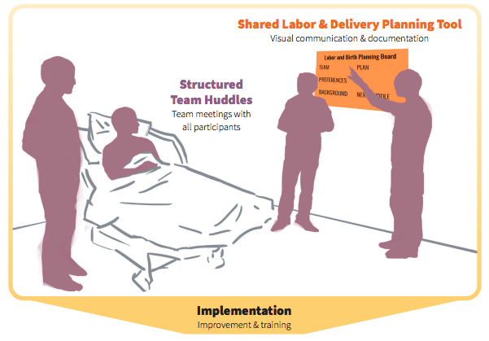
TeamBirth Core Components
Notes:
TS
Core components are Team huddles and Shared planning board
The TeamBirth care process innovation is based around regular team huddles that involve the full care team, including the person in labor and their support person, and give all team members the opportunity to speak and participate in shared decision-making.

Slide 44
TeamBirth Huddles
The full direct care team, including the person in labor and their support
Discuss preferences; care plans for mom, baby, and labor progress; and expectations for the next huddle
At admission, decision points or changes in the plan of care, or request of any team member
Give all team members the opportunity to participate in shared decision-making
WHO
WHAT
WHEN
WHY
Notes:
TS

Slide 45
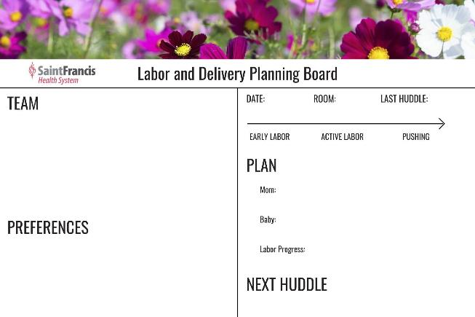
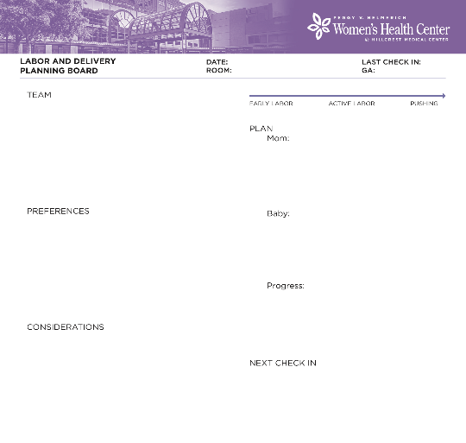
Example of shared planning board
Notes:
TS
The shared planning board is the other core element of TeamBirth–this visual tool provides the structure for TeamBirth huddles. There are 4 required components of the white board: (I might quiz you in a minute, heads up!)
1. Names of team members. 2. Preferences. 3. A designated plan for mom/birthing person, baby, and labor progress. 4. The plan for the next huddle. The key is to ensure you’ve created a safe space for all Team members to participate in the huddles. The provider, the nurse, and the patient/family all bring different knowledge and complementary forms of expertise to each clinical situation, and this format has been shown to provide everyone on the team an opportunity to contribute to the decision.

Slide 46
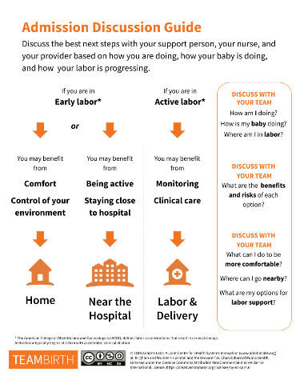
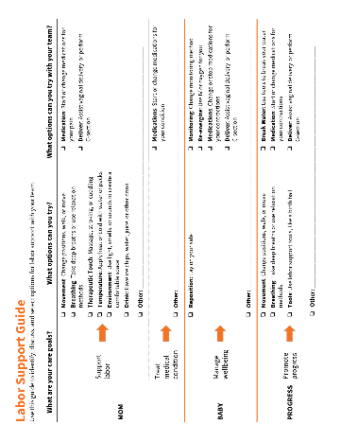
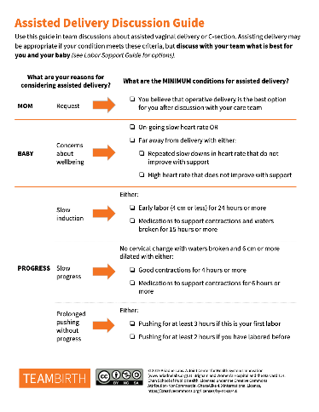
Discussion & Support Guides
Notes:
AW

Slide 47
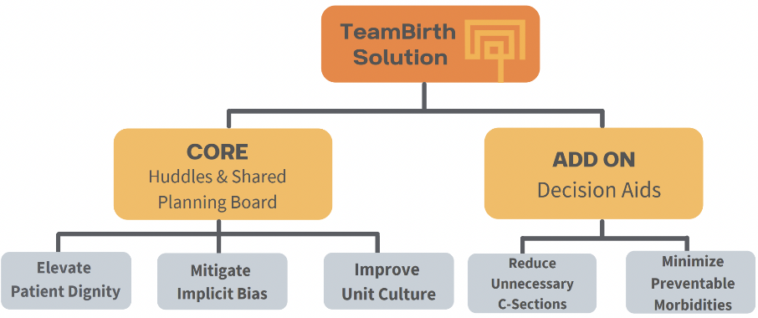
Features and Expected Outcomes
Notes:
AW
Admission and delivery are critical decision points in labor. There is definitive evidence that getting admitted to the hospital too early (in terms of gestation AND in terms of labor progress) leads to one intervention after another, often culminating in an unplanned c-section. These are tools that can be used during huddles to guide the conversation. The advisory board will meet this week, to collaborate on customizing these tools to meet the unique needs in NJ. Also will review the labor support tool.

Slide 48
TeamBirth Research

Slide 49
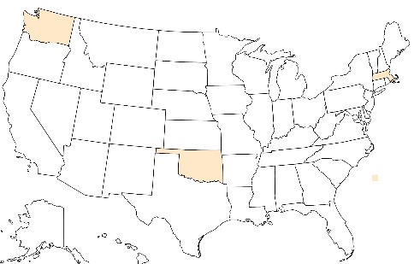
In 2018-2019, we conducted a pilot trial to test the acceptability, feasibility, and safety of TeamBirth in four community hospitals. This test design followed the model of a Phase I clinical trial where we test “tolerance” of TeamBirth before a larger-scale effectiveness trial.
Overlake Medical Center
Bellevue, WA
3,600 deliveries / year
South Shore Hospital
Boston, MA
3,400 deliveries / year
EvergreenHealth Medical Center
Kirkland, WA
4,500 deliveries / year
Saint Francis Hospital
Tulsa, OK
4,000 deliveries / year
Notes:
Need: Opportunity to improve the quality of labor management, as indicated from their low-risk cesarean delivery rates,
Will: Organizational support for the project from executives, unit nursing leadership, and clinicians,
Capacity: Resources to participate in both the research and quality improvement arms of the project
Relationships: Established relationships within their state or network that would position them to be effective partners in scaling this approach if TeamBirth was acceptable, feasible, and safe

Slide 50

TeamBirth was acceptable, feasible, and safe to implement at the pilot trial hospitals for both patients and clinicians. Patients were more likely to report better experiences with more huddles, and clinicians would overwhelmingly recommend TeamBirth to others.
Patients
Clinicians
Had their desired role in the birthing experience
Felt TeamBirth improved care for their patients through better communication, teamwork, and shared decision-making
97%
93%
Reported clear communication with providers and ability to share care preferences
98%
90%
Would recommend TeamBirth to another L&D Unit
90%
Felt their preferences made a difference in their care
84%
Clarified C-section decision-making in non-urgent clinical situation

Slide 51
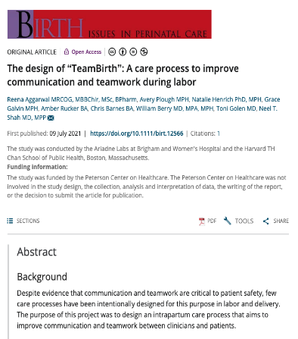
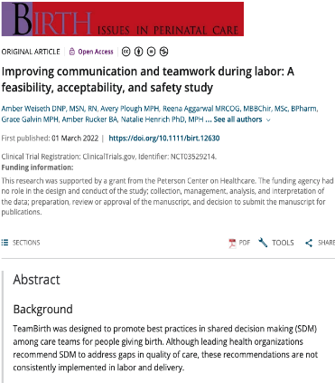
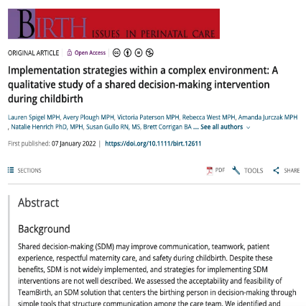
TeamBirth Publications
TeamBirth Design
(July 2021)
2. TeamBirth Primary Outcomes
(March 2022)
3. TeamBirth Implementation
(Jan 2022)
Notes:
AW

Slide 52
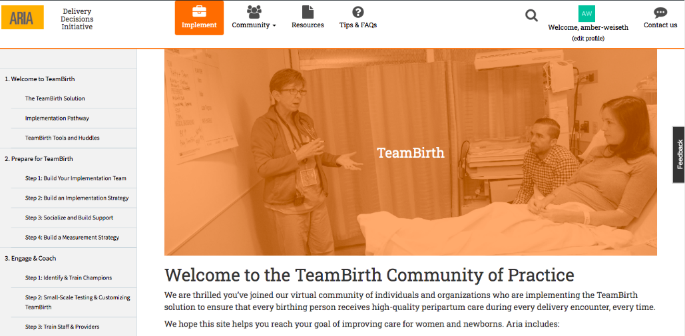
Aria
Preliminary data: Do not share
Notes:
AW

Slide 53
Partnership Opportunities
Notes:
AW
PCORI, Aria

Slide 54
Q&A
Notes:
AW

Slide 55
Team Talk: Loyola University Medical Center
Julie Dervishoski, MSN, C-EFM

Slide 56


ILPQC MEETING IDEAS
Put NTSV rate on Tier 1 Huddle board- Share w/ staff
Determine who qualifies for NTSV in AM and share in report
NTSV added to L&D Chalkboard
Champions to assist w/ POSITION OF THE WEEK/ IMPLEMENTATION/sign-off
Working on: Ordering new portable monitors with grant $$$/Sign-off nurses
Working on: Intermittent monitoring orders (Review Policy)
Train staff of using portable monitors
AUDITS: Champions auditing labor support documentation
Positions added in OBTV under LABOR SUPPORT
Refer to staff who attended Spinning Babies for help
Trying to get all staff to Spinning Babies in 2022
Grant application Phase 1: Support PVB (new portable monitors, send staff to Spinning Babies/Bundle Birth) Due March 7, 2022/Response by July 2022

Slide 57
FEBRUARY 2022 Audit Details
NTSV =27
NTSV Vaginal Deliveries – 22
NTSV Cesarean Deliveries – 5
Our CS Rate 18.5%
HP2020 GOAL: 23.6%

Slide 58
YTD Audit Details
N = 55
NTSV Vaginal Deliveries – 41
NTSV Cesarean Deliveries – 14
HP2020 GOAL: 23.6%
Our CS Rate 25.4%

Slide 59
QI Corner: Using your PVB Data for Case Review

Slide 60
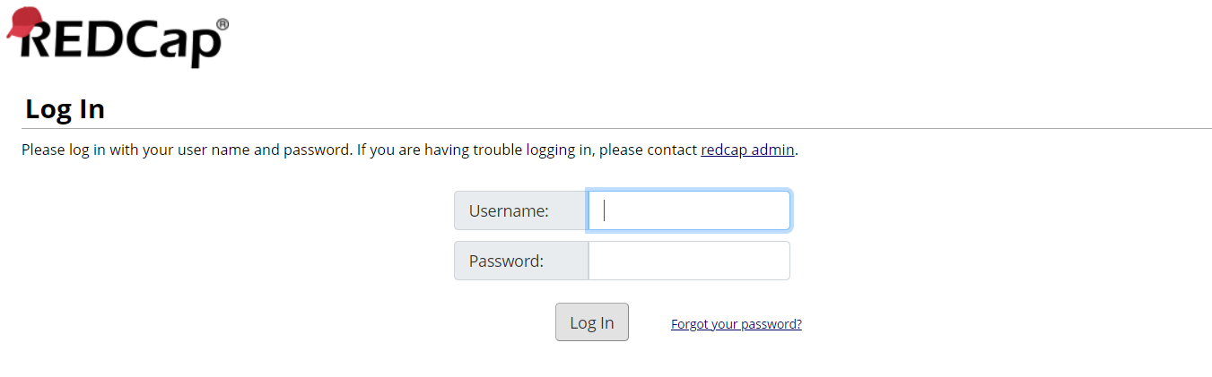
Logging in to RedCap
https://redcap.healthlnk.org

Slide 61
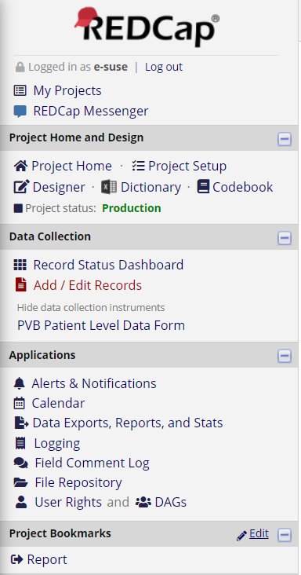
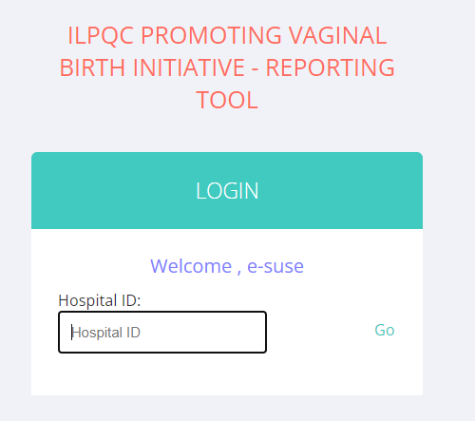
Let’s take a look at our PVB Reports
234

Slide 62
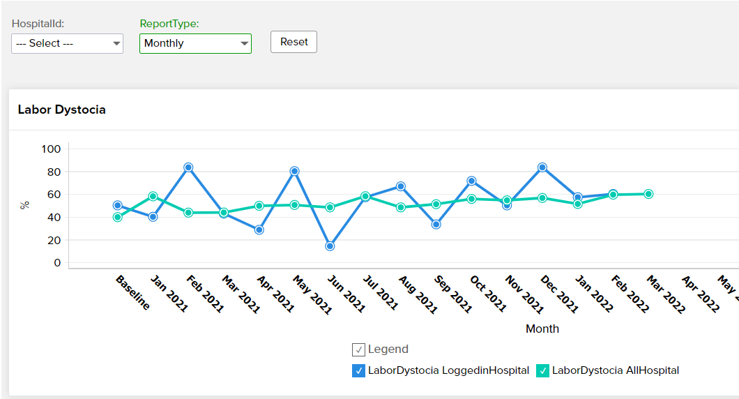
Labor Dystocia Meeting Criteria: Monthly

Slide 63
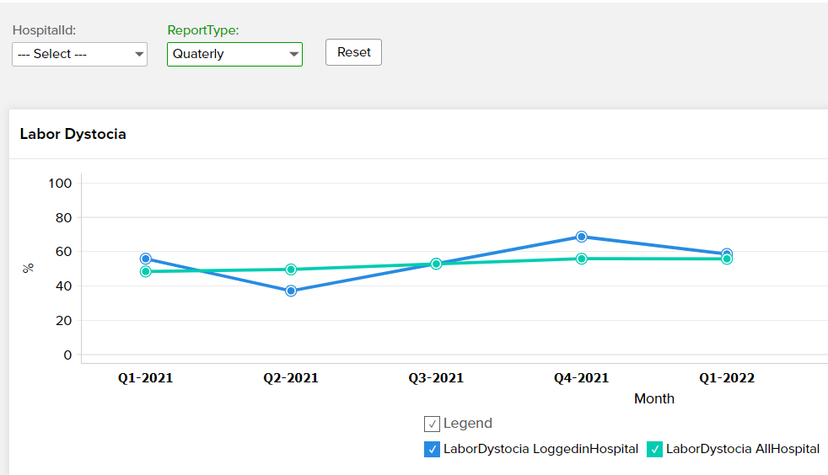
Labor Dystocia Meeting Criteria Quarterly

Slide 64
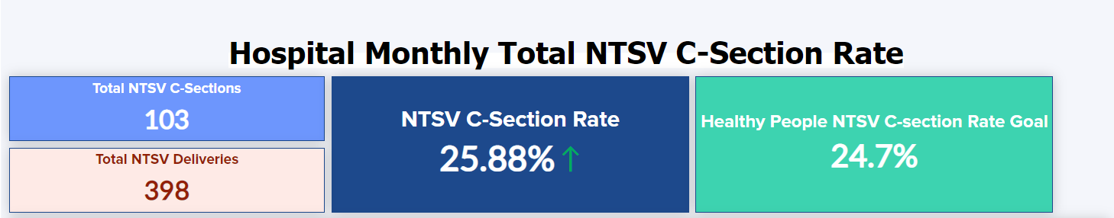
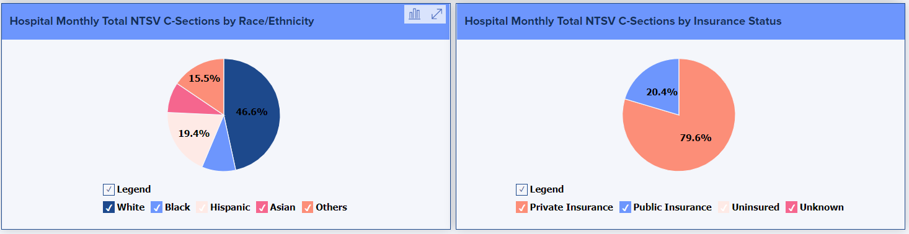
Hospital Level Data Overview
26
23.6%
101

Slide 65
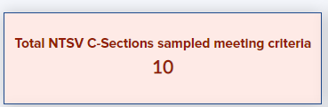
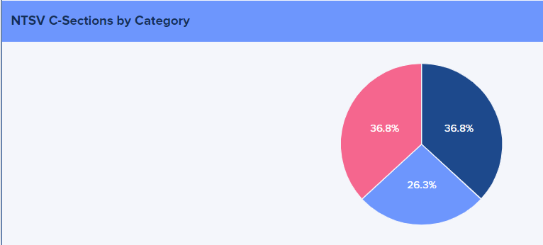
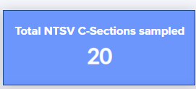
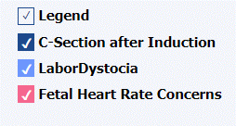
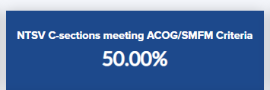
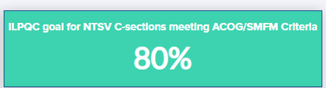
Patient Level PVB Data
13
26

Slide 66
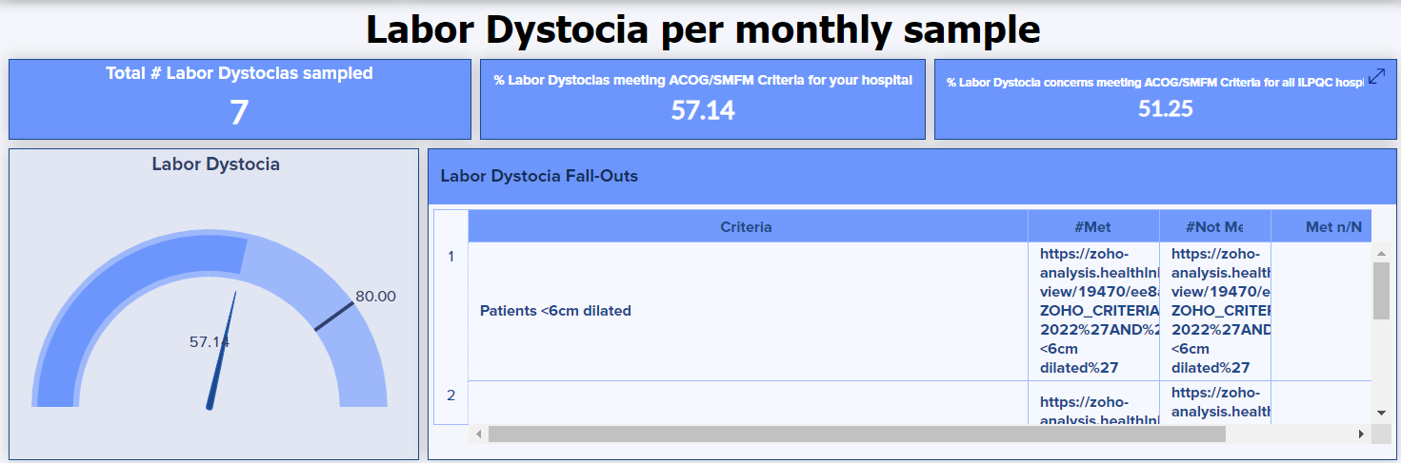
Labor Dystocia

Slide 67
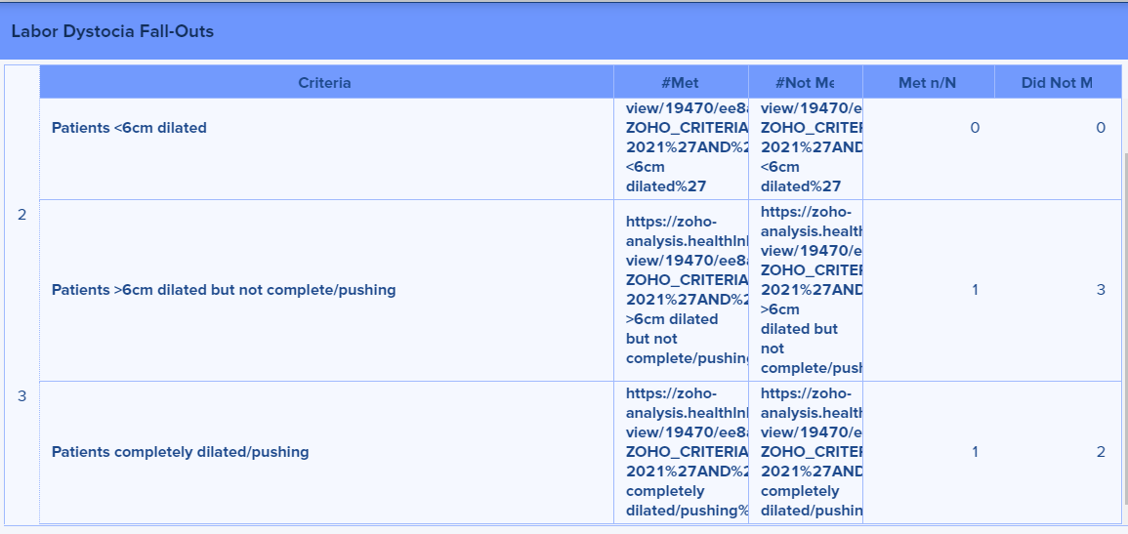
Second Stage Arrest
0
1
2
1
2

Slide 68
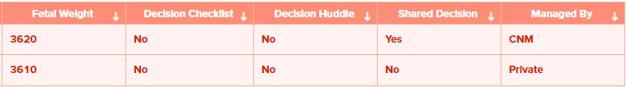
Individual Case Reviews
Record-ID
...
1234-123
…
1234-126
…

Slide 69
Next Steps with PVB

Slide 70

PVB Grand Rounds
PVB Grand Rounds help facilitate buy-in and give your providers the opportunity learn more about the initiative
Hear from an expert on the ILPQC Grand Rounds Speaker’s Bureau
Email ellie.suse@northwestern.edu to schedule your grand rounds or OB provider meeting
14 Grand Rounds already scheduled for PVB

Slide 71

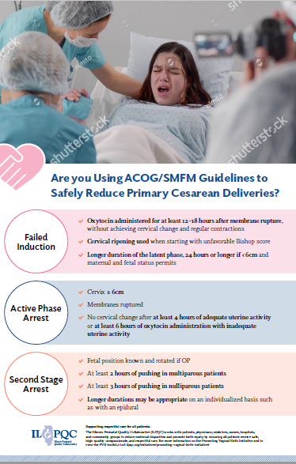
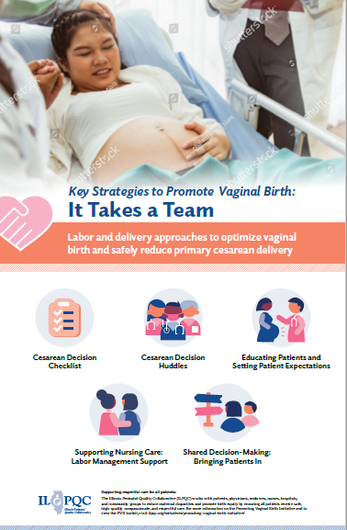
Provider Education Resources:
Look out for posters in the mail in about 2-3 weeks!
Notes:
Ellie

Slide 72
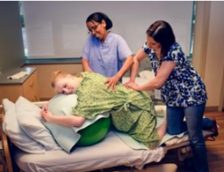
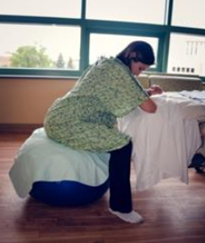
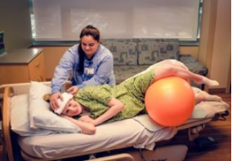
Resources: Labor management support
Additional Resource: Supplemental Comprehension guide
COMING SOON: ILPQC Labor Management Support E-Modules for physician and nurse education adapted from Labor Management Support Workshops

Slide 73
Upcoming Monthly Webinars:
Date | Topic
Monday, March 28th 12:30-1:30 | Shared Decision Making and TeamBirth
Monday, April 25th 12:30-1:30 | Dystocia Management Strategies
Wednesday, May 25th | 2022 ILPQC OB Face-to-Face

Slide 74
Next Steps
Prepare for 2022 Face-to-Face Conference
  Registration Open April 4th
  Submit QI Data by May 2nd
  Submit QI Storyboard by May 11th
  Submit team photo by May 11th (to be included in raffle!)
Be on the lookout for PVB Provider posters in the mail and Labor Management support E-modules on the ILPQC Website
Email ellie.suse@northwestern.edu to set up one-on-one QI Support call
Determine if a PVB Grand Rounds/OB Provider Meeting to help achieve nurse and physician buy-in
Submit monthly data collection for Baseline-February 2022

Slide 75
Questions?
Please put your questions or comments in the chat

Slide 76










Thanks to our Funders
In kind support:

