Slide 1

PVB Monthly Webinar:
Second Stage Arrest Strategies
February 28, 2021 12:30-1:30

Slide 2
Overview:
PVB Data Review
Second Stage Arrest PVB Resources
Dr. Julie DeCesare: Management of the Second Stage of Labor
Beth Hawn: Promoting Vaginal Births:
Cleveland Clinic Tradition Hospital’s Experience
Team Talk: Northwestern Lake Forest Hospital
PVB Next Steps
PVB Office Hours
  Join us after the call to ask any questions you may have

Slide 3
New ILPQC Staff!
Please Welcome our new ILPQC Staff
Su Lee is joining the ILPQC team as a Postdoctoral Scholar!
Alana Rivera is joining the ILPQC team as our new Nurse Quality Manager!

Slide 4



2022 OB & Neonatal Face-to-Face Meetings
Obstetric May 25, 2022
Neonatal May 26, 2022
2022 ILPQC 10th Annual Conference
Thursday, October 27, 2022
More information coming soon!
VIRTUAL

Slide 5
PVB QI Excellence Award
All structure & patient-level data entered for Baseline-March 2022 (will provide pass for December and January data given surge) due May 2nd
Key Structure Measures "In Place":
  Implemented provider and nurse education and other strategies to achieve buy-in
  Implemented standardized protocol/processes for induction, labor support management and response to labor and fetal heart rate abnormalities
  Integrated process to review and share data with clinical staff and sharing transparent provider-level data.
  Implemented cesarean decision checklist using ACOG/SMFM labor guidelines
  Implemented decision huddles and/or decision debriefs with appropriate care team to standardize use of ACOG/SMFM guidelines and checklist
  Implemented workflow process to incorporate shared decision making with the patient
Achievement of process and outcome level measures (Based on Jan – March 2022 data)
  80% of Nurses and Providers Educated
  80% of all NTSV C-Sections Meeting ACOG/SMFM Guidelines for January-March 2022
  NTSV C-Section Rate below 23.6% for January-March 2022
Face-to-Face
QI Leader Award Criteria:
Data complete
+
Key structure measures in place
+
1 Process/outcome measure met
Notes:
**Ann, How many process/outcome measures do we want achieved by Face to Face? QI Excellence Awards have to be reserved for completing the initiative..so if we are giving QI excellence awards out now then it should be for completing the initiative and they would need all 3. If you want to give an inbetween award to motivate folks to go get the QI excellence award before annual conference. Then could add a QI Leader award for completing 1/3 process / outcomes measures.

Slide 6
PVB Data Review

Slide 7
Supporting vaginal birth and reducing primary Cesareans for optimal maternal and neonatal outcomes
Aim: 70% of participating hospitals will be at or below the Healthy People goal of 23.6% cesarean delivery rate among NTSV births by December 31, 2022
Goal: Increase the percent of cesarean section deliveries among NTSV births that meet ACOG/SMFM criteria for cesarean
Goal: Increase the % of physicians/ midwives/ nurses educated on ACOG/SMFM criteria for cesarean, labor management strategies/response to labor challenges, protocol for facilitating decision huddles and/or decision debriefs
UPDATED GOAL based in Health People 2030

Slide 8
Clinical Culture Change
Identifying NTSVs
Education of ACOG/SMFM criteria for providers and nurses
Implementing cesarean decision checklists and huddles
Labor management support
Un-blinding provider data

Slide 9
Month | Patient Data | Hospital Data
Baseline | 89 | 85
January 2021 | 86 | 80
February 2021 | 85 | 80
March 2021 | 85 | 78
April 2021 | 81 | 78
May 2021 | 78 | 71
June 2021 | 71 | 70
July 2021 | 76 | 68
August 2021 | 76 | 64
September 2021 | 72 | 62
October 2021 | 69 | 57
November 2021 | 61 | 54
December 2021 | 59 | 49
January 2022 | 42 | 30
ILPQC Hospital Team Data Submission
(94 Teams Total)
If hospital data is not submitted for a given month you will not have access to your team’s NTSV C-Section rate over time.

Slide 10
Reducing Data Burden
We have spoken to teams about how best to reduce data burden during this challenging time
Based on teams suggestions, we will pause collection of PVB vaginal birth data for January – June 2022
Please continue to submit hospital level data and patient data for cesarean births

Slide 11




2021 Data Completion Raffle Winner
All teams who entered PVB Patient and Hospital data for all of 2021 by February 15th were entered into a raffle to receive a Visa Gift Card!
And the winner is……
Treat your team to a well-earned pizza lunch or coffee and donuts!
AMITA Health Saint Alexius Medical Center!!!

Slide 12
Provider and Nurse Education
Keep it up!

Slide 13
Standard protocols and processes
Notes:
clarify

Slide 14

What does it mean to be green on Standard protocols and processes?
Has your hospital implemented updated labor protocols for a unit-standard approach for providing labor support, and freedom of movement?
Has your hospital implemented standard criteria for diagnosis and treatment of labor dystocia, arrest disorders and failed induction?
Has your hospital implemented protocols and support tools for women who present in latent (early) labor to safely encourage early labor at home?
Has your hospital developed a policy to implement intermittent monitoring policies for low-risk women?

Slide 15
EMR Integration
Notes:
Drop?

Slide 16
Sharing Provider Level Data

Slide 17
Cesarean Decision Checklist

Slide 18
Decision Huddles/Debriefs

Slide 19
Shared Decision Making

Slide 20
Standardized Patient Education

Slide 21
ILPQC NTSV C-Section Rates
26%
24%
25%
24%

Slide 22
NTSV C-Section Rates, by hospital
Goal: < 23.6%
All ILPQC Average: 25%
Notes:
Update to November data

Slide 23
NTSV C-sections meeting
ACOG/SMFM Criteria, across hospitals
Goal: >80%
82%
79%
66%
60%
62%
53%
49%
40%

Slide 24
Where do we need to focus improvements for meeting ACOG/SMFM Guidelines?
ACOG/SMFM Criteria for Failed Induction:
Oxytocin administered for at least 12-18 hours after membrane rupture, without achieving cervical change and regular contractions
Longer duration of the latent phase, 24 hours or longer if <6cm and maternal and fetal status permits
Keep it up!
Notes:
What does Series 1 and Series 2 mean?

Slide 25
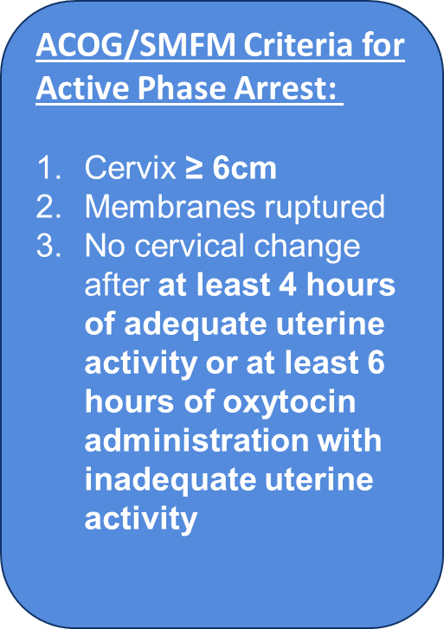
Where do we need to focus improvements for meeting ACOG/SMFM Guidelines?

Slide 26
Where do we need to focus improvements for meeting ACOG/SMFM Guidelines?
ACOG/SMFM Criteria for Second Stage Arrest:
At least 3 hours of pushing in nulliparous patients
Fetal position known and rotated if OP
At least 2 hours of pushing in multiparous patients
Longer durations (e.g. 4 hours with epidural) may be appropriate on an individualized basis

Slide 27
Second Stage Arrest

Slide 28
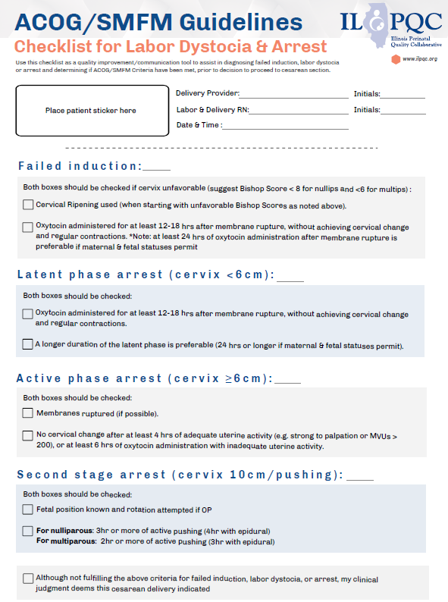
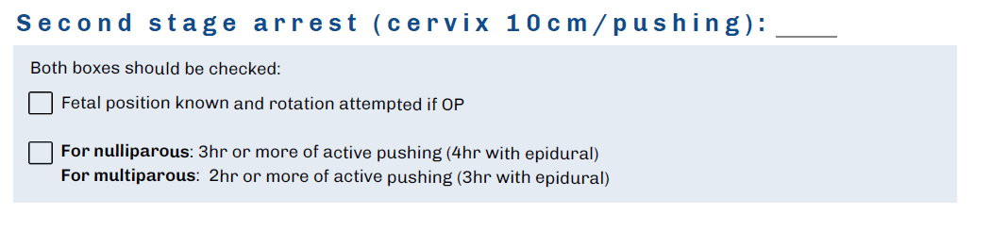
PVB Toolkit Resources:
ILPQC Cesarean Decision Checklist

Slide 29
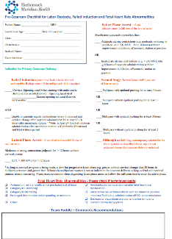

PVB Toolkit Resources:
Cesarean Decision Checklists
FPQC Sample Checklists
  Hackensack Meridian Health Pre-Cesarean Checklist and Team Huddle Form
  Tampa General Pre-cesarean Huddle form
CMQCC: Pre-Cesarean Checklist for Labor Dystocia or Failed Induction

Slide 30
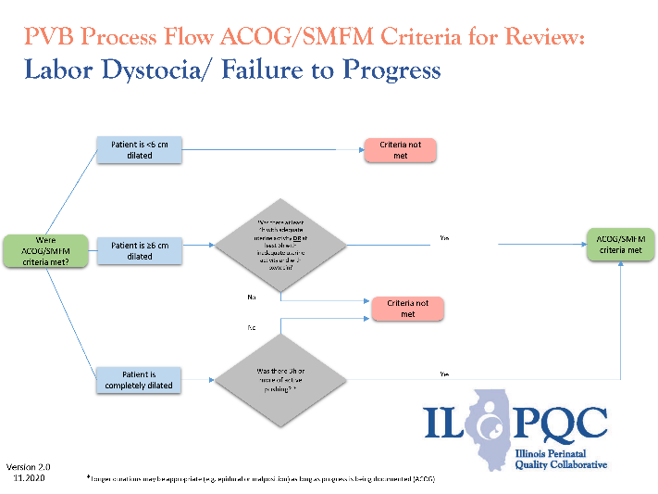
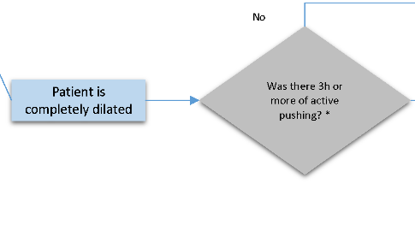
ILPQC Toolkit Items: Process Flow Diagrams for ACOG/SMFM Criteria
*Longer durations may be appropriate (e.g.4 hours with epidural) as long as progress is being documented (ACOG)

Slide 31
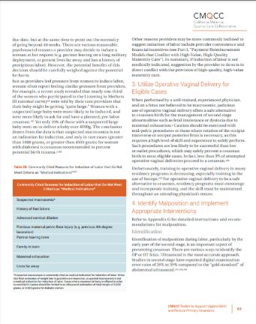
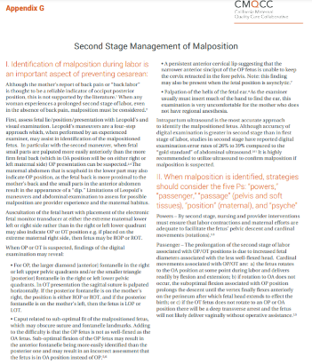
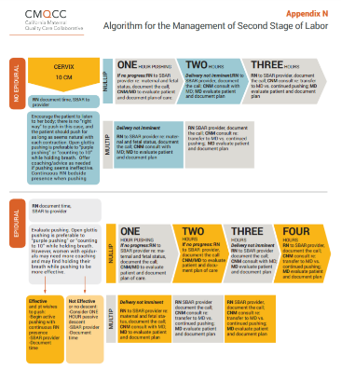
PVB Toolkit Resources
CMQCC Second Stage
  Management of Malposition
  Management of Malposition Appendix G
  Algorithm - Appendix N

Slide 32
Dr. Julie DeCesare
Florida Perinatal Quality Collaborative

Slide 33

Management of the Second stage of Labor
Julie Zemaitis DeCesare, MD
PROVIDE LEAD- FPQC

Slide 34
Session outline
ACOG/SMFM/ACNM/AWHONN Recommendations/data on second stage and demonstrate relationship between fetal position/maternal pelvis and maternal pushing positions
Evidence for second stage management
Appropriate second stage positions for specific clinical presentations and review techniques for rotating a baby in second stage

Slide 35

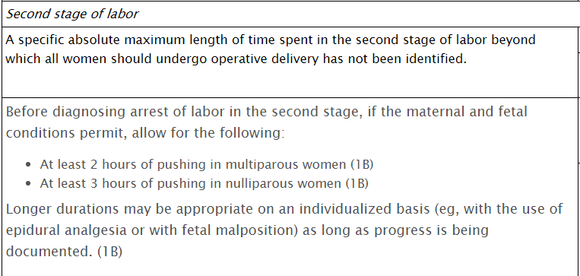

Slide 36
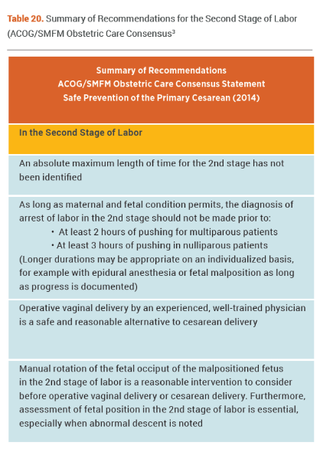


Slide 37


Slide 38
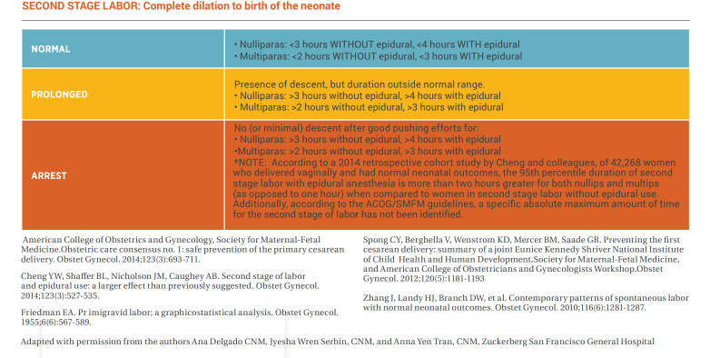
Second Stage Arrest

Slide 39
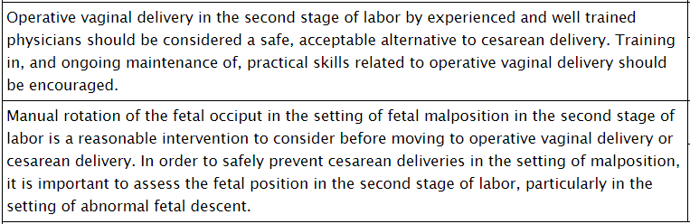

Slide 40

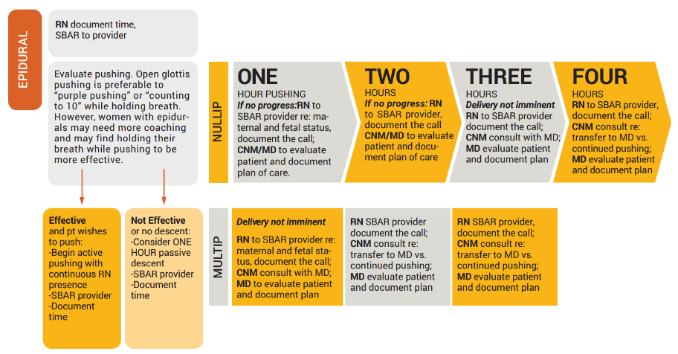
Epidural

Slide 41
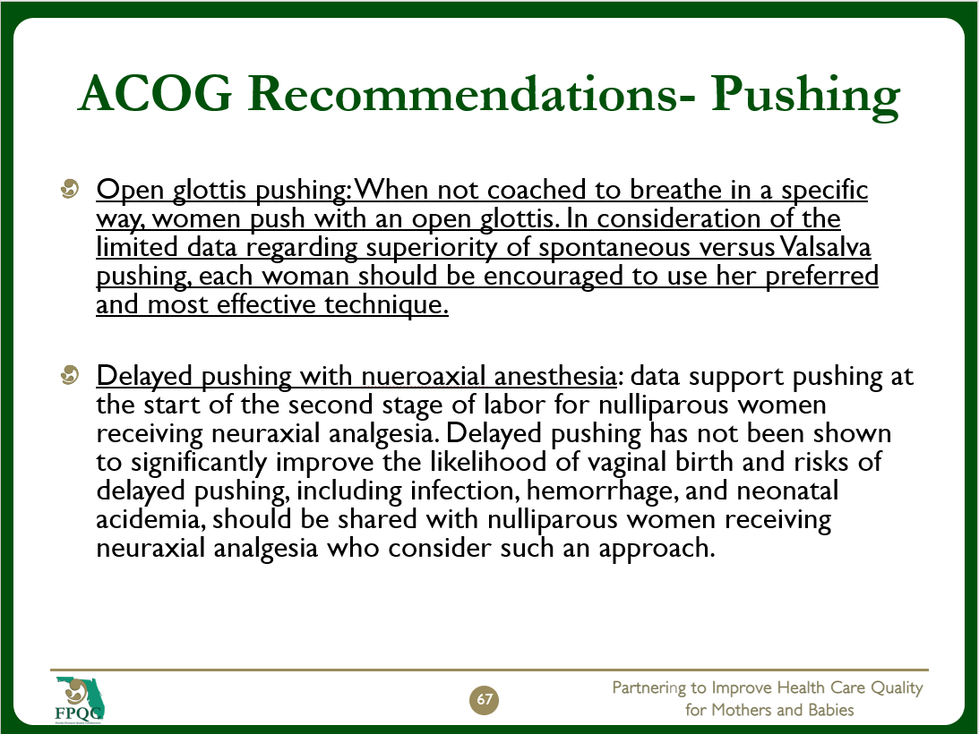

Slide 42
Delayed pushing – nulliparous with an epidural
Often utilized as a strategy in the second stage
Recent high-quality data suggest this technique
  Trends toward in crease in C- section
  Increase in Post partum Transfusion
  Increase in Pot partum Hemorrhage
  Increase in operative vaginal birth
                ACOG Committee Opinion No. 766: Approaches to Limit Intervention During Labor and Birth. Obstet Gynecol. 2019 Feb;133(2):e164-e173. doi: 10.1097/AOG.0000000000003074. PMID: 30575638.

Slide 43
Signs of Malposition:
  Mother might have back labor (but she might not)
  First stage may be prolonged/stalled
  Internal check indicates fetal head position such as swollen cervix especially if more on one side
  Visual inspection of the abdomen may reveal a dip in the front instead of a rounded gravid abdomen.
  Ultrasound if available is the gold standard in diagnosis of Occiput Posterior

Slide 44
Evidence on Birth Balls
Promotes spinal flexion
Increases the utero-spinal angle
Allows for upright movement without exhausting the legs
Reduces pain and pain perception
Increases pelvic inlet and outlet
Facilitates OP rotation
Shorter 1st and 2nd stage duration
(Gizzo et al.2014) (Gau, 2011) (Lawrence et al. 2013) (Makvandi et al. 2015) (Thies et al. 2012)

Slide 45
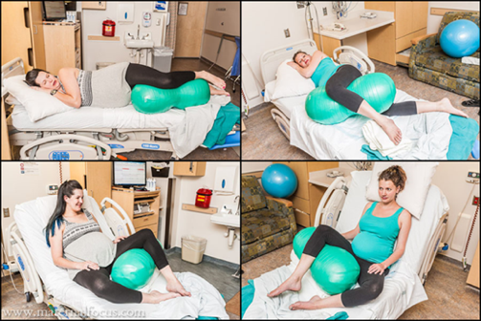
Peanut Ball
Decreased length of labor
Decreased CS rate in patients
with epidurals
Recog/Prevent
Tussey, C. M., Botsios, E., Gerkin, R. D., Kelly, L. A., Gamez, J., & Mensik, J. (2015). Reducing length of labor and cesarean surgery rate using a peanut ball for women laboring with an epidural. The Journal of Perinatal Education, 24(1), 16-24. http://dx.doi.org/10.1891/1058-1243.24.L16
45
Notes:
Peanut Balls are not commonly used in many sites with particular value among women with epidurals to help prevent/treat OP presentations

Slide 46

Rotating a Baby in Second Stage

Slide 47
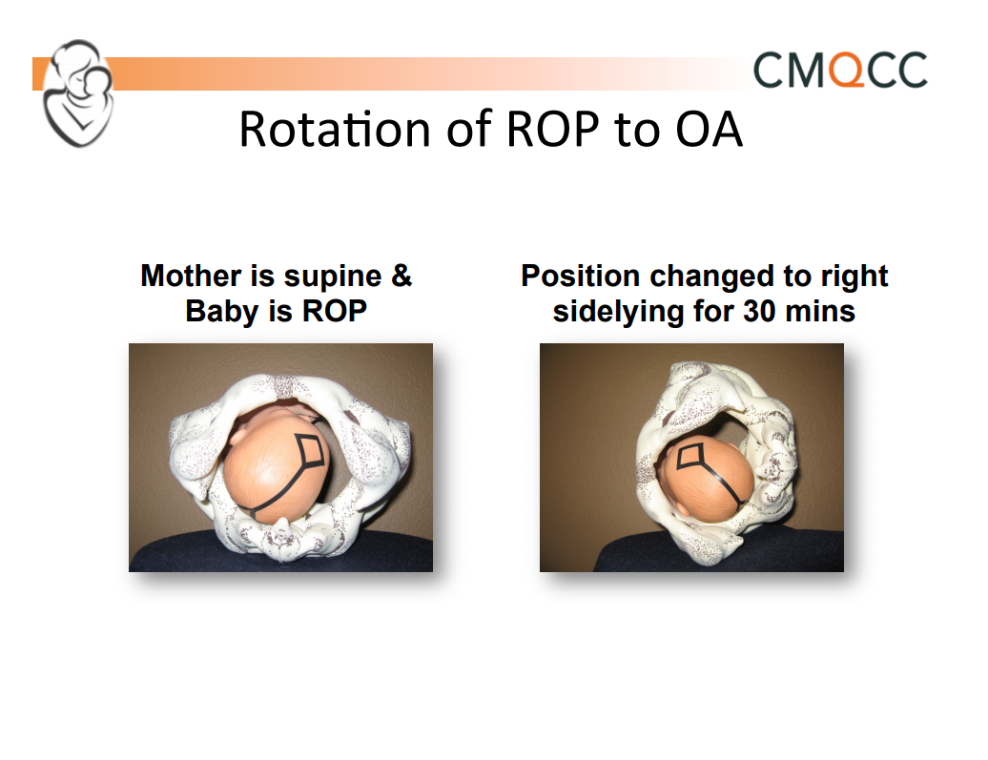

Slide 48
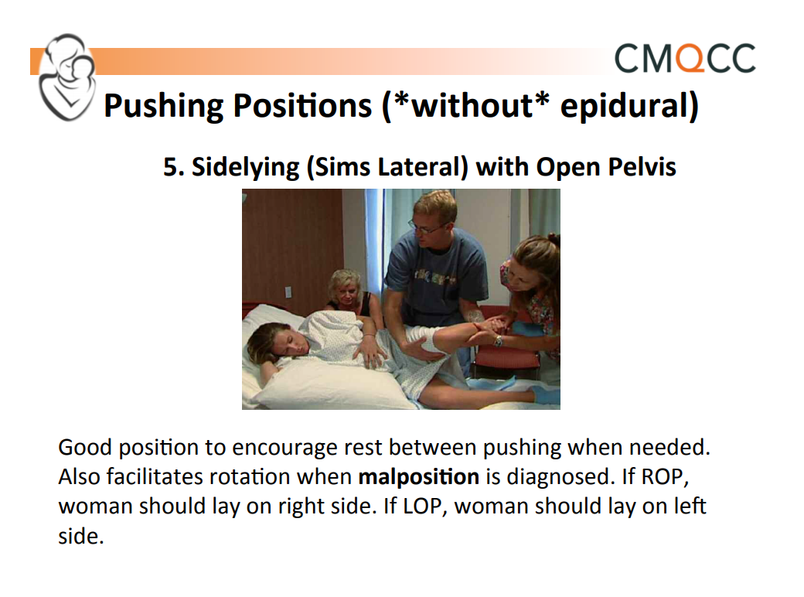

Slide 49
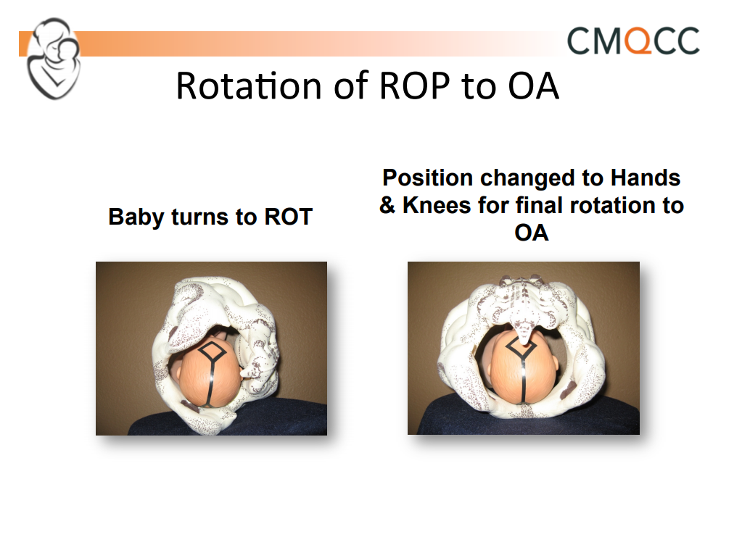

Slide 50
Points to consider…
Successful rotation after the onset of the second stage of labor is more likely to be successful if it is performed before arrest occurs. Manual rotation can convert 90% of OP or transverse arrest situations to OA.
Manual rotation is more successful in multiparous women and young women.
Rotation is important if there is a need for a fast delivery and/or if there is minimal or slow descent after a trial of pushing

Slide 51
What about Operative Vaginal Delivery?
Rotational forceps generally not done
OP Vacuum and Forceps can be performed
Some advocate placement of forceps upside down to facilitate delivery
Traction angle must be straight down with robust perineal support
Increased incidence of higher order lacerations (3rd and 4th)

Slide 52

Questions?

Slide 53
Beth Hawn and Kathy Ergle
Beth Hawn, Director Maternal Child Services
Kathy Ergle, Manager Labor and Delivery and Mother Baby
Cleveland Clinic Martin Health

Slide 54
Promoting Vaginal Births:
Cleveland Clinic Tradition Hospital’s Experience
February 28, 2022
Beth Hawn, Director Maternal Child Services
Kathy Ergle, Manager Labor and Delivery and Mother Baby

Slide 55


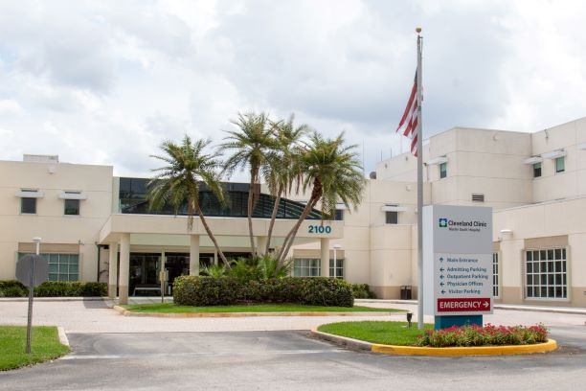
Cleveland Clinic Martin Health
Cleveland Clinic North, Stuart FL
244 Beds
Opened in 1939
Cleveland Clinic Tradition, Port St Lucie, FL
177 beds
Opened in 2013
Cleveland Clinic South, Stuart FL
100 beds
Opened in 1992

Slide 56
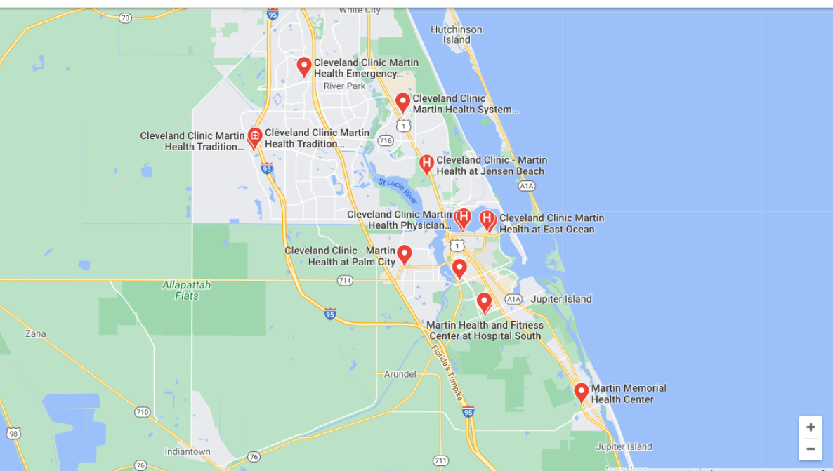


Slide 57
Cleveland Clinic Tradition Hospital
Labor & Delivery 5 LD, 4 Triage 2 ORS, 2 PACUs
Mother Baby Unit 20 beds
Level 2 Neonatal Intensive Care Unit (NICU) 10 bed single family rooms, Neonatal Transport team
Inpatient Pediatric Unit 8 beds
OB Outpatient
Hospitalist Program
On target to do 1300 deliveries in 2021
Joined the PROVIDE initiative in July 2017

Slide 58
CCTH PROVIDE
(Promoting Primary Vaginal Deliveries)
Labor Dystocia/Failure to Progress/Inductions
2016-2021

Slide 59
CCTH PROVIDE
(Promoting Primary Vaginal Deliveries)
Labor Dystocia/Failure to Progress/Inductions
2020-2021

Slide 60
What Worked for Us
Peanut and birth balls for every mom- every room, every time
Education for our nurses on promoting vaginal births
Birth Preference on our website, showing our offerings
PROVIDE Cart
Midwifes
The addition of Laborist in 2020

Slide 61
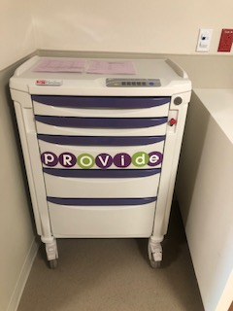
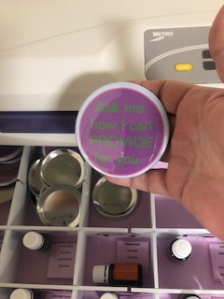
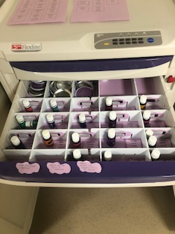
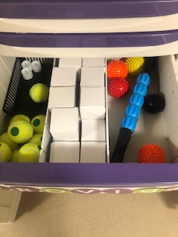
PROVIDE CART

Slide 62
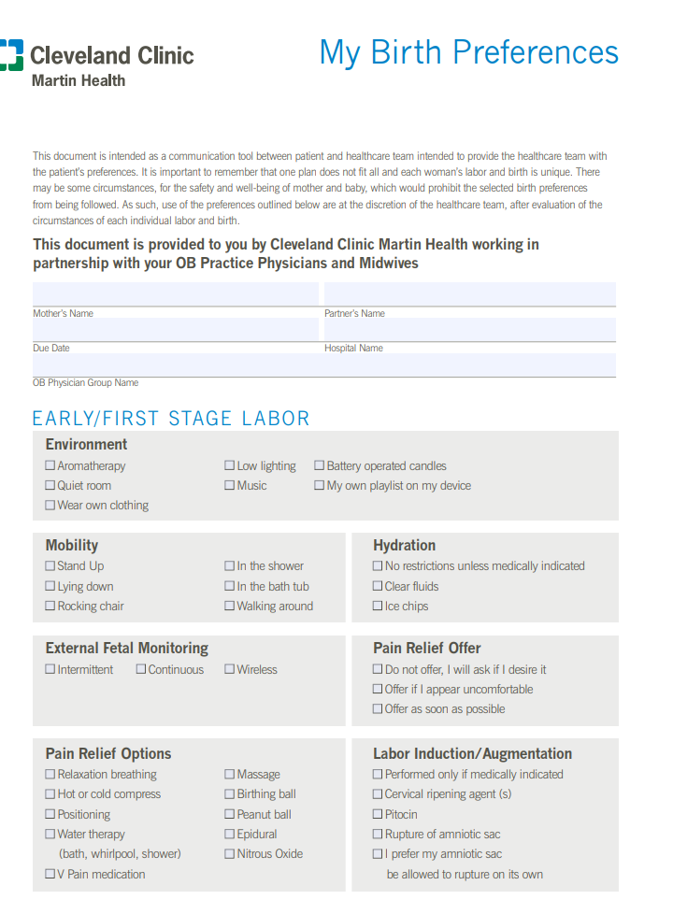
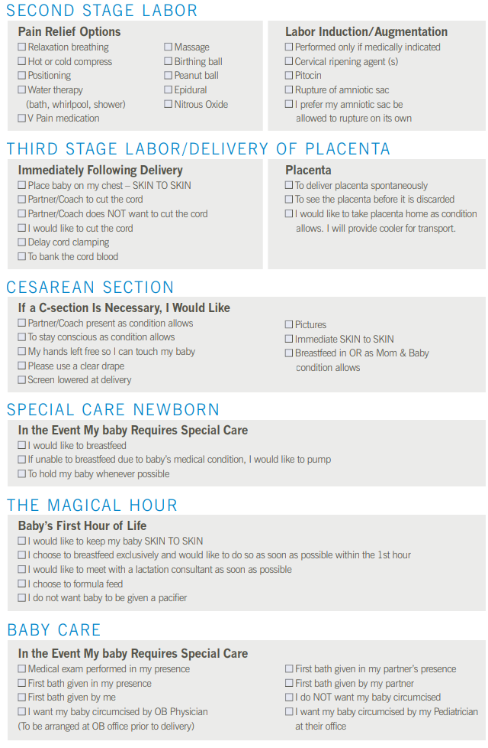
Birth Preferences
]

Slide 63
BUT what really worked….
The way we start our inductions - less pit and more cytotec
Using intermittent monitoring to allow moving
Using the NOVII on the larger moms
Promoting and allowing them to be out of bed
SPINNING babies moves- CLOSED KNEE
Allowing all of the above makes the baby more optimally positioned so that pushing time has been noted to be less
Culture shift of trust by the physicians to trust the midwives/nurses
Mind set of the staff to want a vaginal birth for the mom
Persistence!
Debriefing the cases that went off for a C/S
Posting our numbers every month
Celebrating or numbers every month!

Slide 64
Sharing stories…
My patient was a morning induction with her 3rd baby and her cervix was 2/50/-3. By the end of my shift, she was 4 cm and had gotten her epidural. I told her I’d see her in the morning with a baby in her arms and jokingly said unless she wanted to wait for me. The next morning I was surprised to see that she was undelivered and station was still high -2 and VE 9/90/-2. She had a long night with variables ultimately getting an IUPC and amniofusion. They had her flipping all night, using positions like flying cowgirls, side lying release and others. I was mentally preparing myself for a trip to the OR. I decided to do a modified Walcher positions after getting to ok from the laborist who was very supportive of everything we doing to get her delivered. Immediately, the pt. felt pressure. On her next exam she was an anterior lip 9/90/0 by she was OP. I did a little research and brought my phone into the patient with a picture of the positons I wanted to do with her . It was exaggerated runner’s position. On the next exam she was ROA 30 minutes later she had an 8 lb. baby.
Spinning babies for the win!~

Slide 66
Team Talk: NM Lake Forest Hospital
Sogi Skariah, MPA, BSN-RN, CPHQ – Clinical Quality Leader
Pam Chay, MSN, RN, IBCLC, CCE (ACBE) – Program Manager, Maternity Services
Jacqueline Lowry MSN, RNC, C-EFM – Clinical Practice Specialist, Maternity Services

Slide 67
Next Steps with PVB

Slide 68
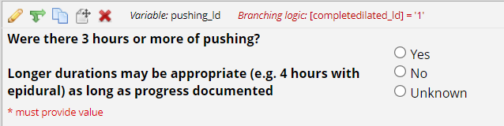
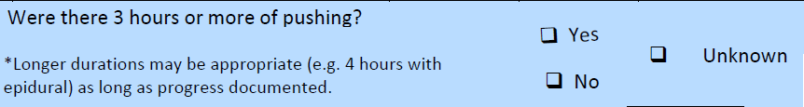
PVB Data Form Update
Were there 3 hours or more of pushing?
  Longer durations may be appropriate (e.g. 4 hours with epidural) as long as progress documented
  Edit made for language to be consistent across forms

Slide 69

PVB Grand Rounds
PVB Grand Rounds help facilitate buy-in and give your providers the opportunity learn more about the initiative
Hear from an expert on the ILPQC Grand Rounds Speaker’s Bureau
Email ellie.suse@northwestern.edu to schedule your grand rounds or OB provider meeting
14 Grand Rounds already scheduled for PVB

Slide 70



Provider Education Resources:
Look out for posters in the mail in about 2-3 weeks!
Notes:
Ellie, add approximate time frame if reference to look for them in the mail.

Slide 71
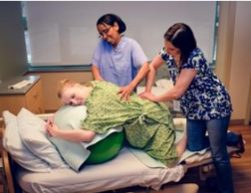

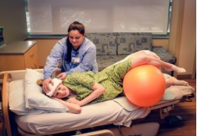
Resources: Labor management support
Additional Resource: Supplemental Comprehension guide
COMING SOON: ILPQC Labor Management Support E-Modules for physician and nurse education adapted from Labor Management Support Workshops

Slide 72
Upcoming Monthly Webinars:
Date | Topic
Monday, March 28th 12:30-1:30 | Shared Decision Making and TeamBirth
Monday, April 25th 12:30-1:30 | Dystocia Management Strategies
Wednesday, May 25th | 2022 ILPQC OB Face-to-Face

Slide 73
Next Steps
Disseminate education on ACOG/SMFM guidelines for Second Stage Arrest
Conduct a PDSA Cycle on use of the checklist with Second Stage Arrest
Be on the lookout for PVB Provider posters in the mail and Labor Management support E-modules on the ILPQC Website
Email ellie.suse@northwestern.edu to set up one-on-one QI Support call
Determine if a PVB Grand Rounds/OB Provider Meeting to help achieve nurse and physician buy-in
Submit monthly data collection for Baseline-February 2022

Slide 74
Questions?
Please put your questions or comments in the chat

Slide 75










Thanks to our Funders
In kind support:

